Slide 1
BB2920: Genetics
Prof. Farny
Lecture 7+
1/26/17
Coming Up:
PLA help hours tonight 7-9pm, Sun 7-9pm
PS2 tomorrow!
Exam 1 MONDAY!
RQ3 Tuesday!

Slide 2

iGEM 2017 info session Tuesday 1/31 and Friday 2/3 4pm in HL116 Applications due Fri Feb 10.
More info and application on course website

Slide 3
Today’s Learning Objectives
In the context of a specific genetic disease (Cystic Fibrosis) , we will:
Examine the process of DNA amplification by PCR
Clone a disease-related gene using standard molecular biology manipulations
Analyze the cloning process using restriction digest, gel electrophoresis and DNA sequencing
Demonstrate how Northern blots, Southern blots and Western blots would be used to perform experiments

Slide 4
Now, Let’s use the tools of molecular genetics to clone the CFTR wildtype and mutant genes
How can you....
isolate a gene of interest from the total genome?
manipulate a gene in order to study its function?
detect a mutation/insertion/deletion in the genome?
induce mutations in a gene of interest?
Cloning – copying DNA for experimental manipulation (we’re not making sheep!)
One bit of vocab: hybridize = anneal = base pair = complementary = hydrogen bonding between nucleotides! You will see all of these terms used interchangeably!

Slide 5
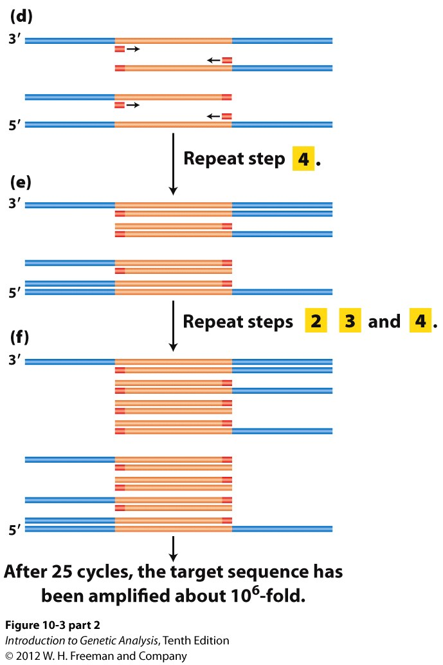
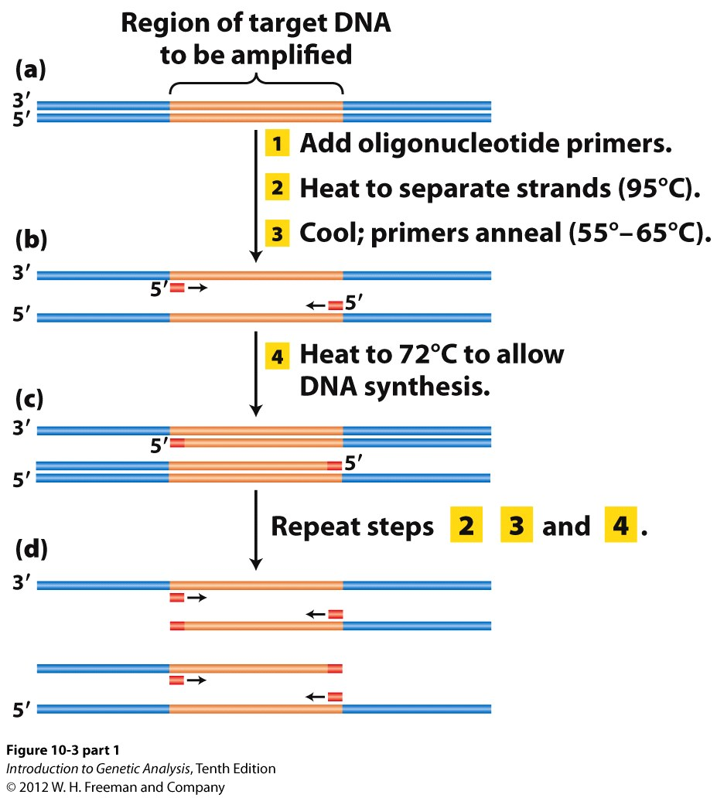
The polymerase chain reaction (PCR) amplifies DNA fragments
Uses: gene cloning and manipulation, making mutations, molecular diagnostic

Slide 6
PCR animation
https://youtu.be/HMC7c2T8fVk

Slide 7
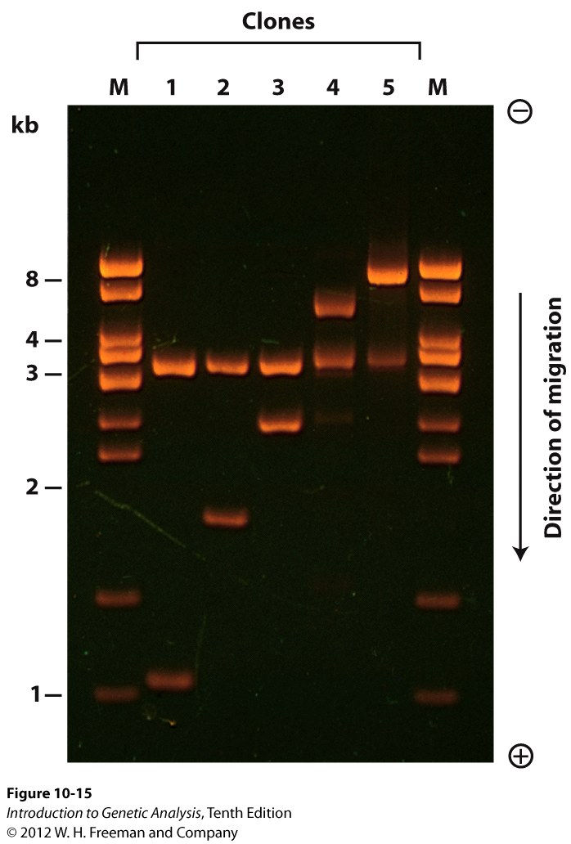
PCR products or restriction digest products can be purified and analyzed by agarose gel electrophoresis
DNA fragment size:
ethidium bromide
intercalating agent
fluorescent under UV light
larger
smaller
size distribution also holds for blots we will examine later

Slide 8
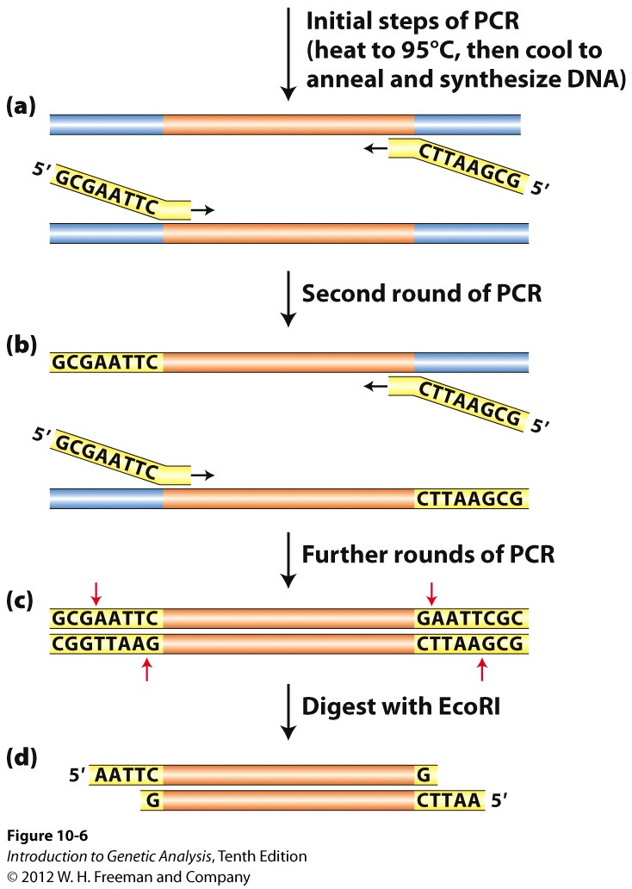
PCR can be used to create DNA inserts with any restriction enzyme site

Slide 9
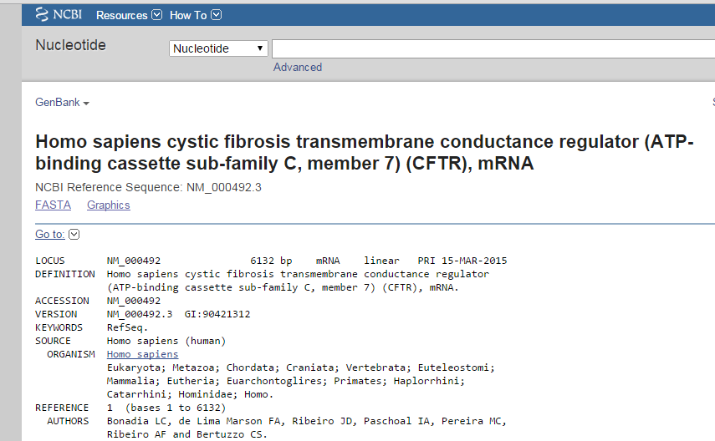
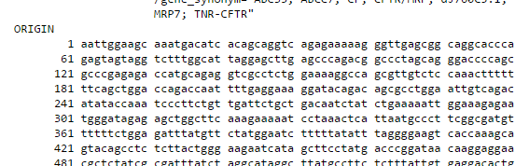

Slide 10
The two sequences below are complimentary strands of the CFTR gene, which you would like to amplify by PCR
Draw in the location of the primers for each strand! You need two primers: one to anneal to the 5’ strand, and one to anneal to the 3’ strand.
Write the first 8 nts.
Label the 5’ and 3’ ends!
Remember your rules!
5’ aattggaagcaaatgacatc…6kb…aaatccatacatttgtgtgaaa 3’
3’ ttaaccttcgtttactgtag…6kb…tttaggtatgtaaacacacttt 5’

Slide 11
Which of the following is the correct primer sequence for annealing to the 3’ strand?
5’-gtgtgaaa-3’
5’-aattggaa-3’
5’-ttaacctt-3’
5’-cacacttt-3’

Slide 12
The two sequences below are complimentary strands of the CFTR gene, which you would like to amplify by PCR
Draw in the location of the primers for each strand! You need two primers: one to anneal to the 5’ strand, and one to anneal to the 3’ strand.
Write the first 8 nts.
Label the 5’ and 3’ ends!
Remember your rules!
5’ aattggaagcaaatgacatc…6kb…aaatccatacatttgtgtgaaa 3’
3’ ttaaccttcgtttactgtag…6kb…tttaggtatgtaaacacacttt 5’

Slide 13
Which of the following is the correct primer sequence for annealing to the 5’ strand?
5’-cacacttt-3’
5’-gtgtgaaa-3’
5’-aaagtgtg-3’
5’-tttcacac-3’

Slide 14
The two sequences below are complimentary strands of the CFTR gene, which you would like to amplify by PCR
Draw in the location of the primers for each strand! You need two primers: one to anneal to the 5’ strand, and one to anneal to the 3’ strand.
Write the first 8 nts.
Label the 5’ and 3’ ends!
Remember your rules!
5’ aattggaagcaaatgacatc…6kb…aaatccatacatttgtgtgaaa 3’
3’ ttaaccttcgtttactgtag…6kb…tttaggtatgtaaacacacttt 5’

Slide 15
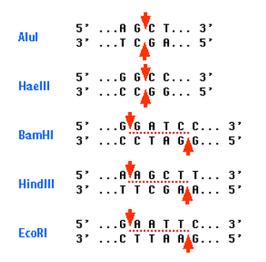
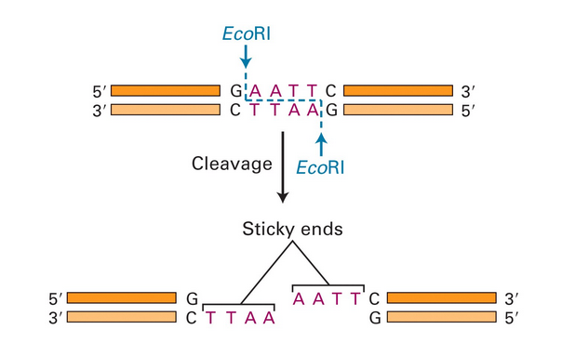
Restriction endonuclease: (or just “restriction enzyme” cut DNA at specific sequences
“restriction digest”
blunt
sticky
sticky or blunt ends
Palindromic – same sequence on both strands
hundreds of enzymes that cut almost any sequence 4-10 nt long (most common is 6nt)

Slide 16
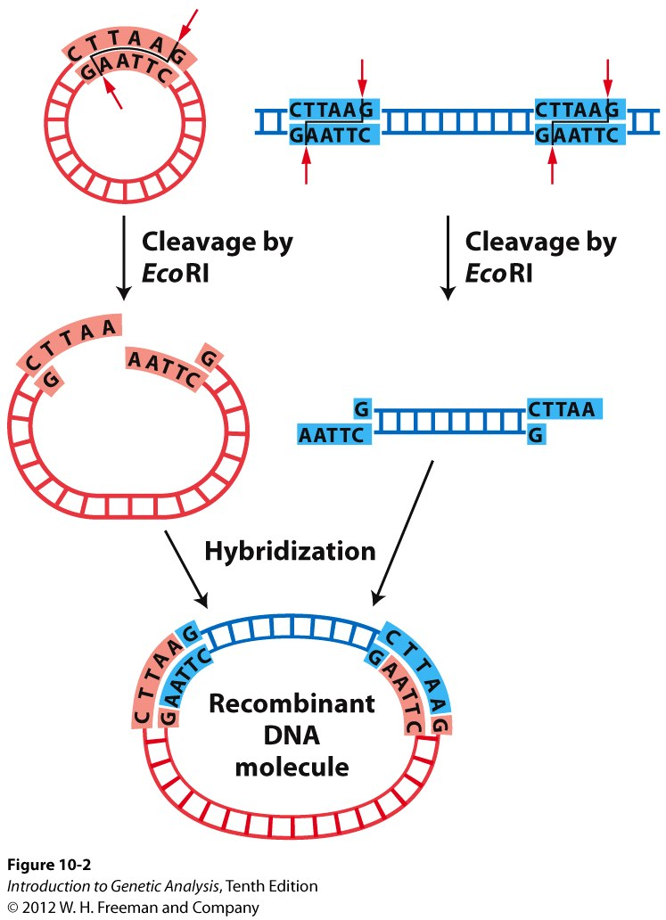
Cloning DNA into a vector
vector DNA
Vector – a circular piece of DNA used to facilitate the manipulation of DNA, many types accommodate different size DNA inserts
insert DNA
Insert – the DNA to be cloned in the vector
Smaller inserts (<15kb): plasmids
Larger inserts: fosmids, cosmids, BAC
ligation, DNA ligase glues the DNA

Slide 17
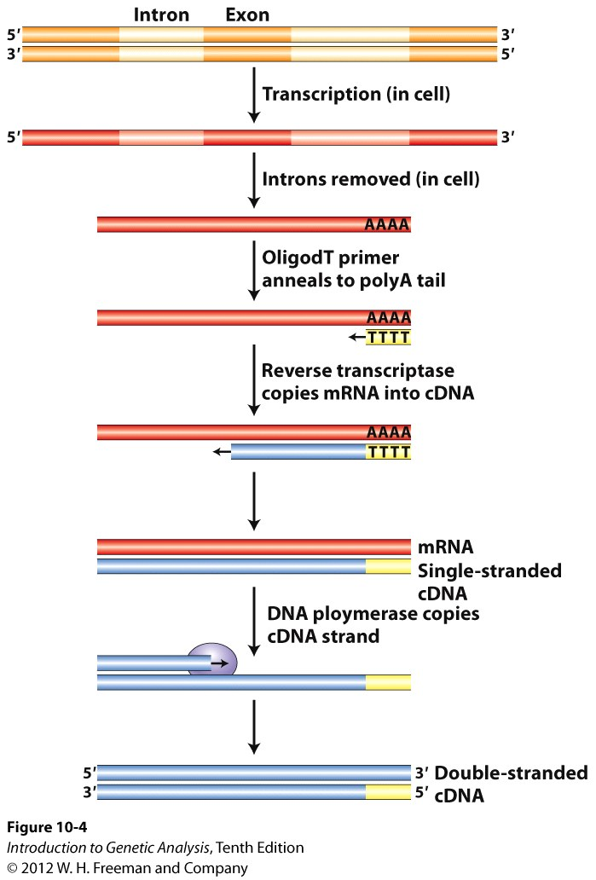
Where do we get the CFTR gene template from?
Reverse Transcription
Making DNA from RNA:
(complementary)cDNA synthesis by reverse transcriptase and PCR
Same sequence as mature mRNA
No introns or regulatory regions
Ease of expression (no processing steps)
Expression of eukaryotic genes in prokaryotes

Slide 18
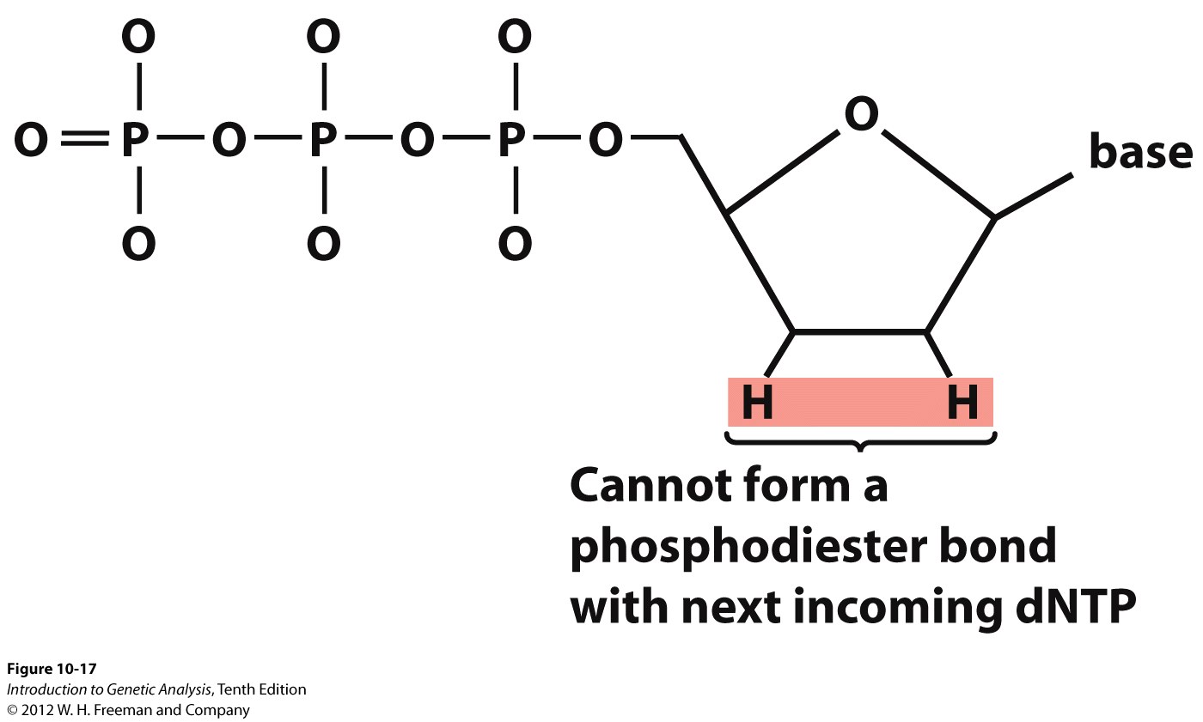
DNA sequencing (classic Sanger)
DNA sequencing is just replication with fancy “chain terminating” nucleotides
You still need a primer and DNA polymerase
Beautifully simple explanation:
http://youtu.be/6ldtdWjDwes

Slide 19
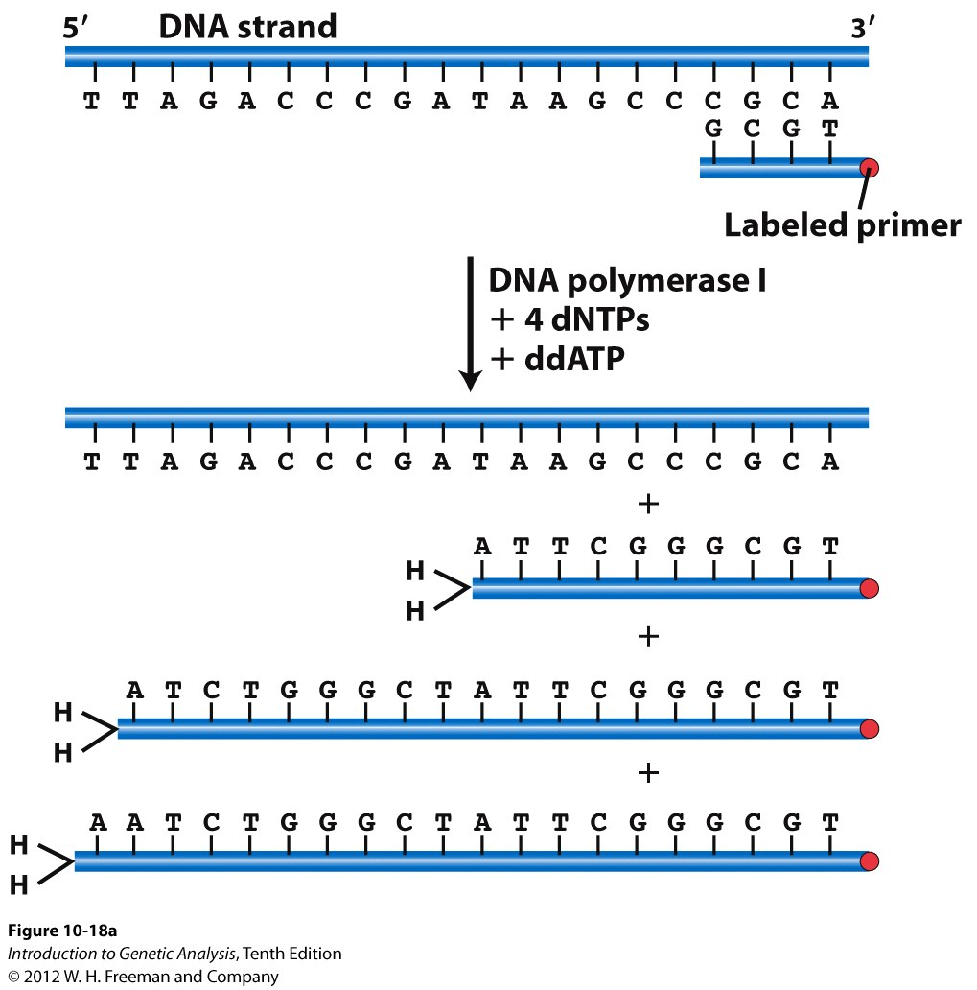
Dideoxy (Sanger) Sequencing of DNA
ddNTP
A labeled ddNTP is mixed with the 4 dNTPs so that incorporation of ddNTP does not happen at every one of a given nucleotide – allows fragments to be different sizes

Slide 20
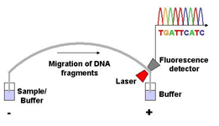
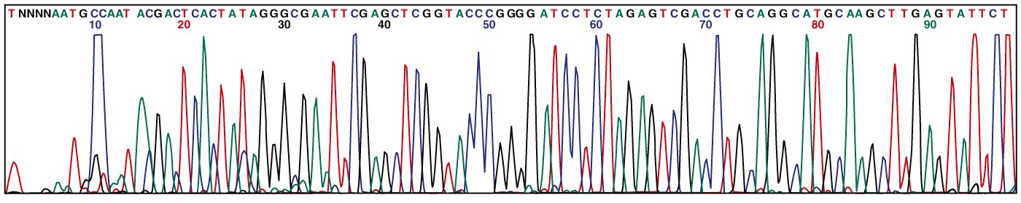
Automated sequencing
as each fragment passes
the laser, the computer
records the fluorescence as
a peak
capillary tube
Sanger reaction
with all four fluorescent
ddNTPs in here
together
electric current applied, fragments move down the capillary tube in order of size (similar to gel electrophoresis)
this is how the human genome was sequenced!

Slide 21
NextGen/Deep/HT Seq
http://youtu.be/v8p4ph2MAvI
This is how genomes today are sequenced
We will revisit this when we talk about genomics at the end of the course.

Slide 22
How do we examine DNA, RNA and Protein? (and, why would we want to?)
DNA: Southern blots, PCR, sequencing
RNA: Northern blots, quantitative PCR
Protein: Western blots, ELISA
Southerns and Northerns depend upon hybridization of nucleotides between sample and probe
Westerns only involve proteins and do not involve nucleotides whatsoever

Slide 23
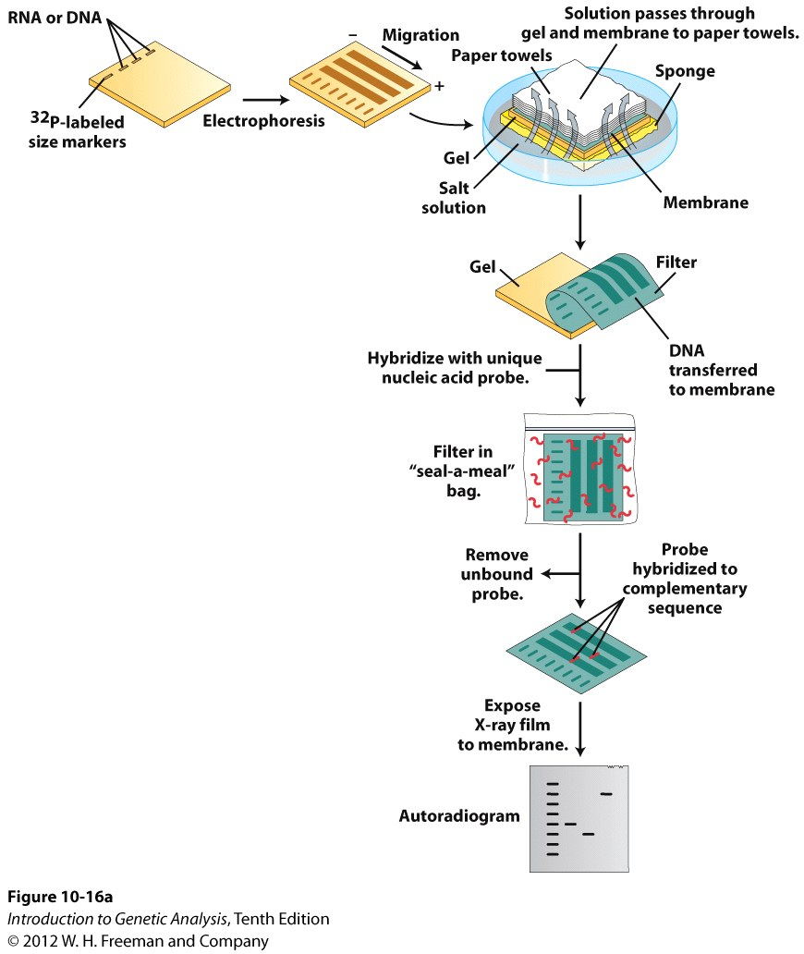
Southern blot
Purify and cut genomic DNA
identify a specific DNA sequence
need a probe (need to know some sequence)
find gene insertions and deletions, transgene integration

Slide 24
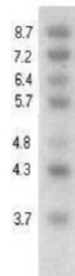

What is wrong with the CFTR gene?
Experiment: Is there an insertion or deletion in the CFTR promoter in this CF patient?
Region of the X chromosome
CF patient
ladder
normal
CFTR Gene
EcoRI sites
About 7.5kb
probe
Adapted from: Reddy KS. BMC Med. Gen. 18 Jan. 2005

Slide 25
Is there a mutation in this CF patient?
Yes, there is an insertion mutation
Yes, there is a deletion mutation
No, there is nothing wrong with the size of the CFTR gene
CF patient
ladder
normal

Slide 26
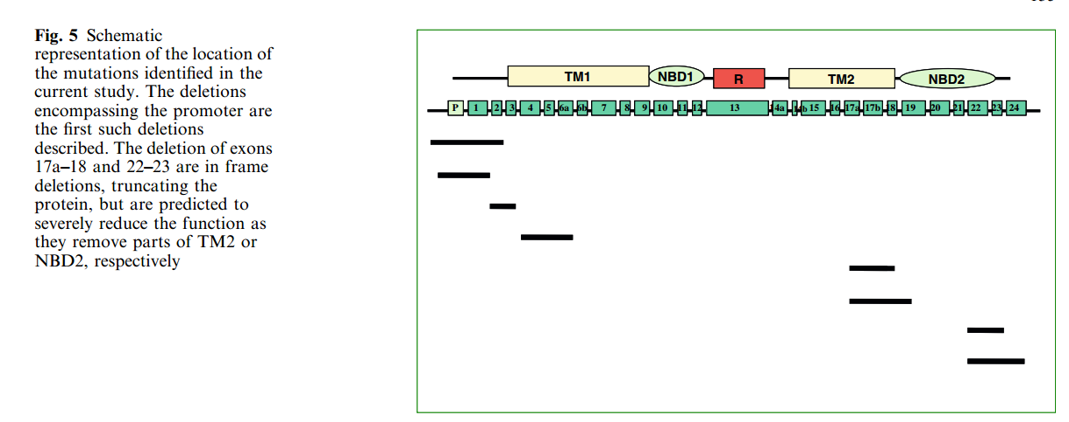
In addition to point mutations, multiple genomic deletions in CFTR have been identified
Hantash et al., Human Genetics March 2006, Volume 119, Issue 1, pp 126-136

Slide 27
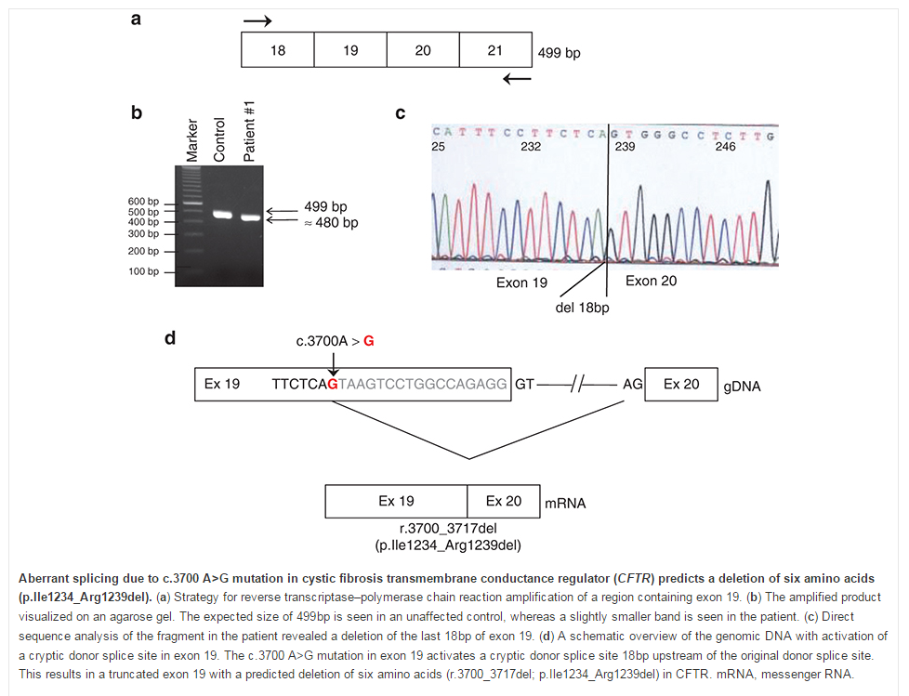
Since the human genome has been sequenced and most genes identified, this experiment would now be done by PCR or genomic sequencing:
Molinski et al., Genetics in Medicine (2014) 16, 625–632

Slide 28
Northern blot
purify RNA from cells or tissues
typically use a radioactive-labeled RNA or DNA probe (created by PCR or a transcription reaction)
compare gene transcription in different types of tissues, different disease states, or under different environmental conditions

Slide 29
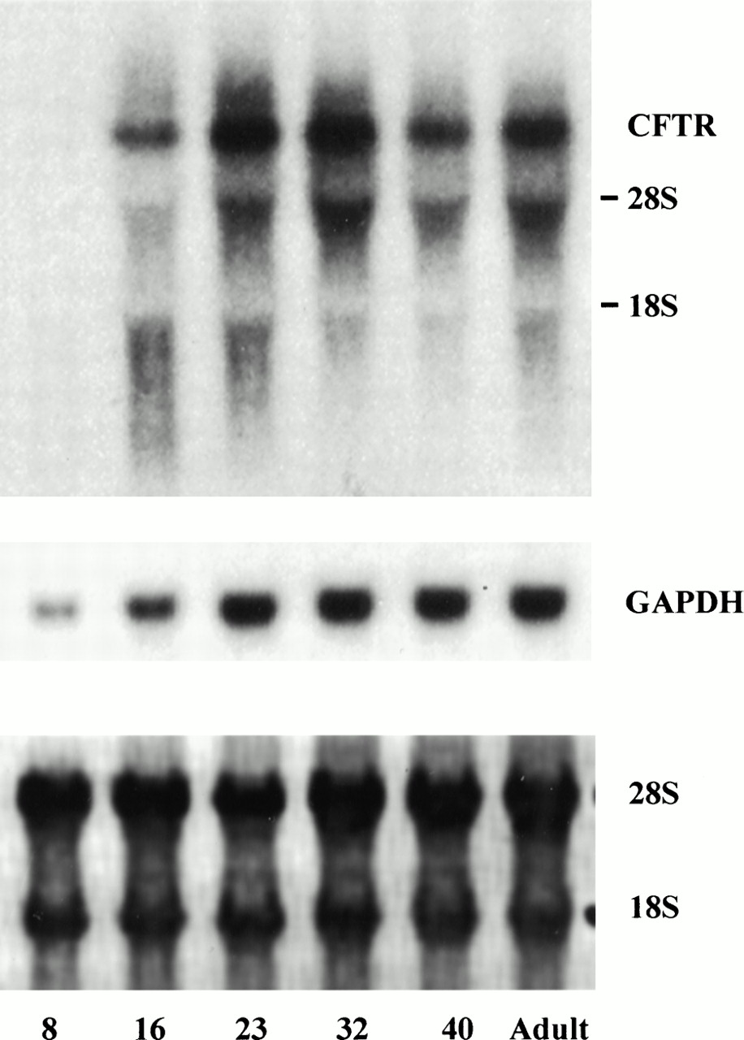

Representative Northern blot of CFTR in normal small intestine during postnatal development.
(mouse intestinal eplithelial samples)
rRNA bands
Post-natal days: 8 16 23 32 40 adult
Robert C. De Lisle et al. Am J Physiol Gastrointest Liver Physiol 1998;275:G219-G227
©1998 by American Physiological Society
Notes:
Representative Northern blot of CFTR and GAPDH mRNA in normal small intestine during postnatal development. CFTR Northern blot of 5 μg total RNA from mice of indicated ages exposed for 24 h; even after a 2-wk exposure no signal was detected atP8. Also shown are blot probed for GAPDH and blot stained with methylene blue before probing to demonstrate equal total RNA loading.

Slide 30
During which time period in postnatal development is CFTR most highly expressed in the intestinal epithelium?
Post-natal days: 8 16 23 32 40 adult
8-16 days
16-23 days
23-32 days
32-40 days
Adults (40+)
It is not possible to say, northern blots are not quantitative

Slide 31
Which is the most important assumption that needs to be made in order to use a blot or gel as a quantitative measure of gene expression?
Post-natal days: 8 16 23 32 40 adult
The samples were all taken from the same animal
The samples were all harvested at the same time
The same amount of total RNA sample was loaded into each lane
The same researcher performed both the sample extractions and the blot protocol

Slide 32
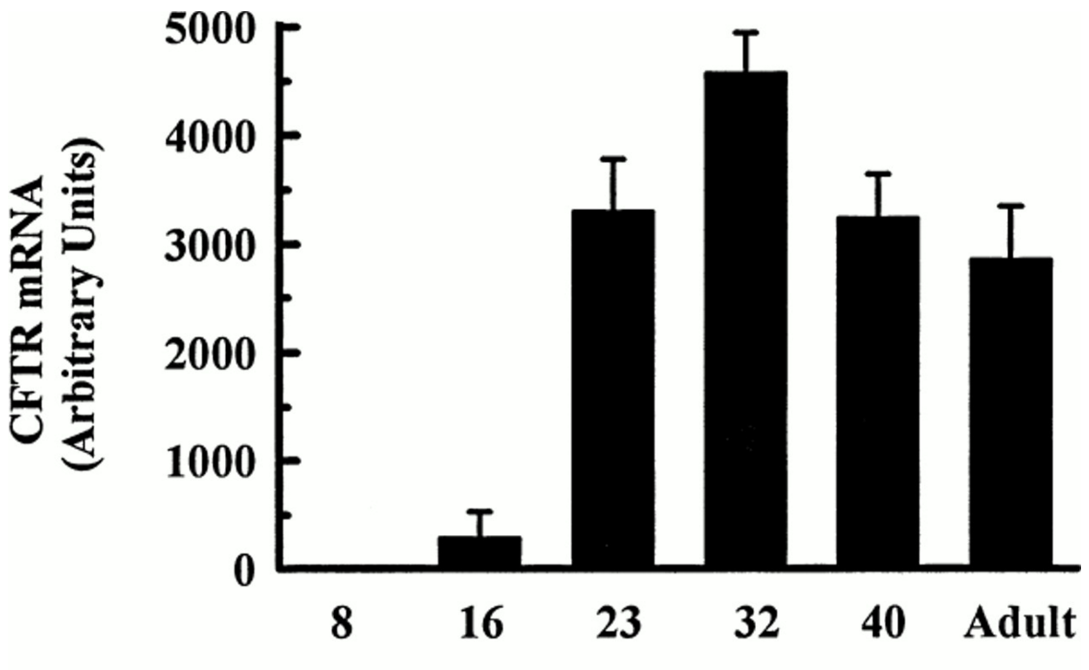
Representative Northern blot of CFTR in normal small intestine during postnatal development.
Robert C. De Lisle et al. Am J Physiol Gastrointest Liver Physiol 1998;275:G219-G227
©1998 by American Physiological Society
Notes:
Representative Northern blot of CFTR and GAPDH mRNA in normal small intestine during postnatal development. CFTR Northern blot of 5 μg total RNA from mice of indicated ages exposed for 24 h; even after a 2-wk exposure no signal was detected atP8. Also shown are blot probed for GAPDH and blot stained with methylene blue before probing to demonstrate equal total RNA loading.

Slide 33
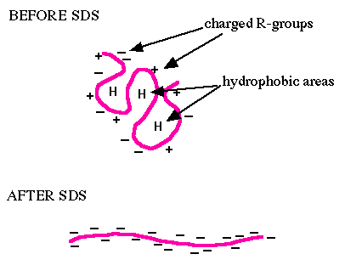
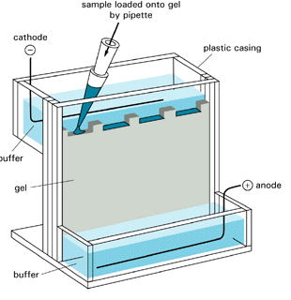
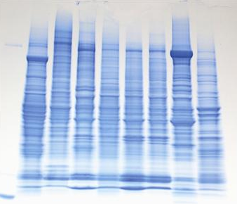
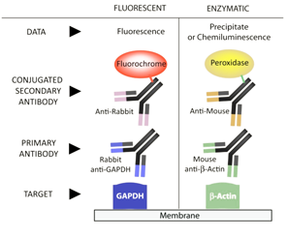
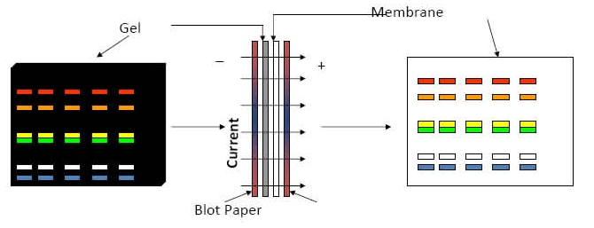
Western blot
make a lysate in SDS
sodium dodecyl sulfate
imparts a net negative charge
so that proteins separate only
by size
run PAGE
polyacrylamide
gel electrophoresis
separated
proteins
transfer to membrane
detection with antibodies

Slide 34
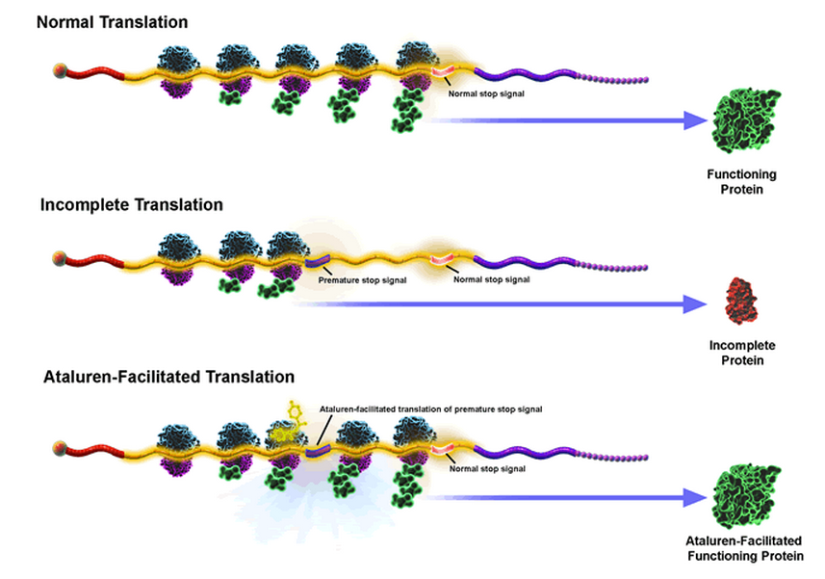
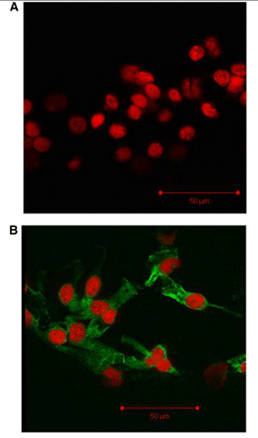
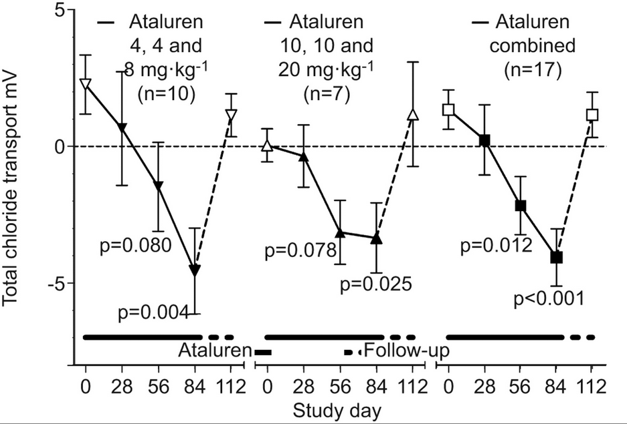
Nonsense mutation read-through: a novel therapeutic strategy
Ataluren: promotes read-through of nonsense, but not normal, stop codons
Cultured nasal epithelial cells from CF patient
ptcbio.com
Improved Cl- transport
No drug
“Translarna” (Ataluren) is approved for nmDMD in the EU and in trials for nmCF in EU and US
Green = CFTR
Red = nucleus
+ Ataluren
Sermet-Gaudelus et al. Am. J. Respir. Crit. Care Med. 182 (10), 15 Nov 2010
Wilschanski et al. Eur Respir J 38, Jul 2011
Notes:
Class question: What could be the extended utility of a drug like Ataluren (A: useful for any nonsense mutation disease)? What are its limitations (not useful for CF due to misssense or DNA deletion mutations)? Hints: Is this drug specific for CFTR?

Slide 35
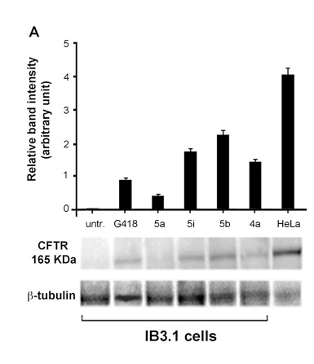
Treatment of nmCF cells with Ataluren derivatives
Results of an experiment where cells from a person with a nmCF were treated with chemical variants of ataluren, or left untreated
CFTR expression is assessed by Western blotting
antibiotic treatment
Control cells (normal CFTR levels)
ataluren compounds
relative amount of CFTR on the blot
Pibiri et al 2015, http://dx.doi.org/10.1016/j.ejmech.2015.06.038

Slide 36
Which ataluren derivative was most effective in causing nonsense readthrough of mutant CFTR?
5a
5i
5b
4a

Slide 37
Treatment of cells from this patient (nonsense mutation) with Ataluren derivatives would most likely result in which of the following functional changes:
Hypomorph to amorph
Hypomorph to hypermorph
Neomorph to antimorph
Amorph to hypomorph
Hypomorph to neomorph

