Slide 1
BB2920: Genetics
Prof. Farny
Lecture 6
1/23/17
Coming Up:
Conference tomorrow
Office Hours Thurs 10-11:30 GH203C
PLA help hours Thurs 7-9pm, Sun 7-9pm
Exam 1 MONDAY!

Slide 2

Exam Prep available on Canvas under Modules

Slide 3
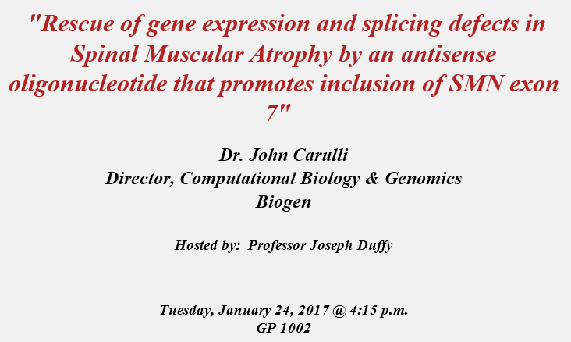
Today! Extra Credit Opportunity
You will attend the seminar and/or read the research article, write a 1 page summary, and answer some questions online.
You will receive up to +3 points on the first exam for your participation and (quality) write-up.
Materials are posted under Modules. Brief write-ups due Monday Jan 30 11:59pm

Slide 4
Today’s Learning Objectives
Complete our discussion of the events of translation
Describe the types of mutations (both physical and functional) that can affect translation of proteins
Predict the functional consequences of a mutation on the activity of a protein, and the effects these mutations can have in human disease

Slide 5
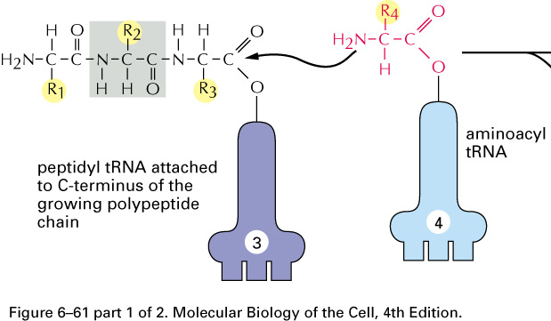
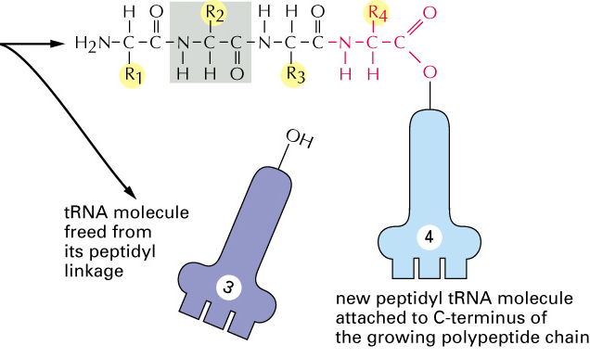
Adjacent amino acids are joined by peptide bonds
The directionality of a protein is N C
Amino end → carboxyl end

Slide 6
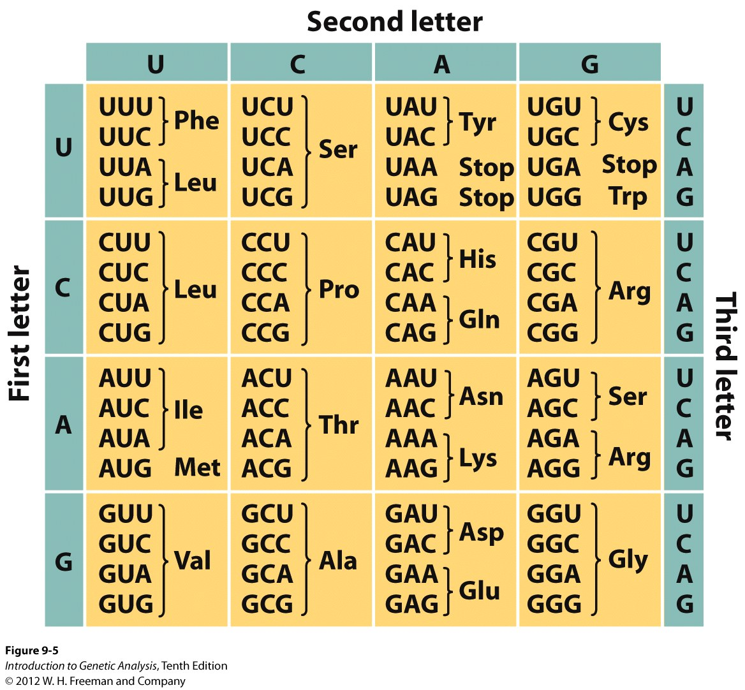
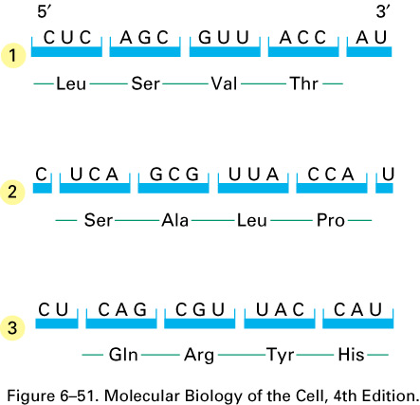
The protein sequence depends on the reading frame
How do you know which is the correct reading frame?

Slide 7
Anatomy of a mature eukaryotic mRNA
AUG (Met) = start codon
stop codon
AAAA....(150-200)
Cap
open reading frame (ORF)
translated into protein
poly-A
tail
3’ UTR
5’ UTR
Translation always begins with AUG (methionine) – there is only one codon for methionine
Ribosome binds to cap, then scans along 5’ UTR until it finds AUG

Slide 8
Mutations
Sources?
Environmental, recombination, replication errors, chromosome instability, DNA repair
Types of DNA mutations:
Substitutions (aka: point mutations)
Transition: purine→ purine or pyrimidine to pyrimidine
Transversion: purine→pyrimidine or pyrimidine to purine
Insertions
Deletions
Not all mutations will fall within a protein coding region; mutations can occur in splice sites, promoters, untranslated regions, as well as non-transcribed places in the genome
Not all mutations will cause a change in phenotype, in fact most do not

Slide 9
Mutations that fall within the ORF are classified into several categories
Normal RNA:
Protein:
AUG CUU UUU AGA AAC UCU GGG CCG
M L F R N S G P
Frameshift (Insertion)
AUG CUU UUU CAG AAA CUC UGG GCC G
M L F Q K L W A
Frameshift
(Deletion)
X
AUG CUU UUUA GAA ACU CUG GGC CG
M L L E T L G
conservative or non-conservative
Missense:
AUG CUU UGU AGA AAC UCU GGG CCG
M L C R N S G P
Nonsense:
AUG CUU UUU UGA AAC UCU GGG CCG
M L F .
Silent:
AUG CUU UUU AGA AAC UCA GGG CCG
M L F R N S G P

Slide 10
Break-out!
Focus on human disease

Slide 11
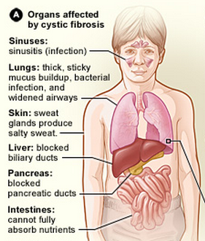
Cystic Fibrosis
30,000 affected in the U.S, 70,000 worldwide
Persistent cough, difficulty breathing, chronic lung infections, digestive problems, very salty skin, pancreatitis
Affects mucosal membranes
Life expectancy = ~40 yrs
http://www.nhlbi.nih.gov/health/health-topics/topics/cf/signs.html

Slide 12
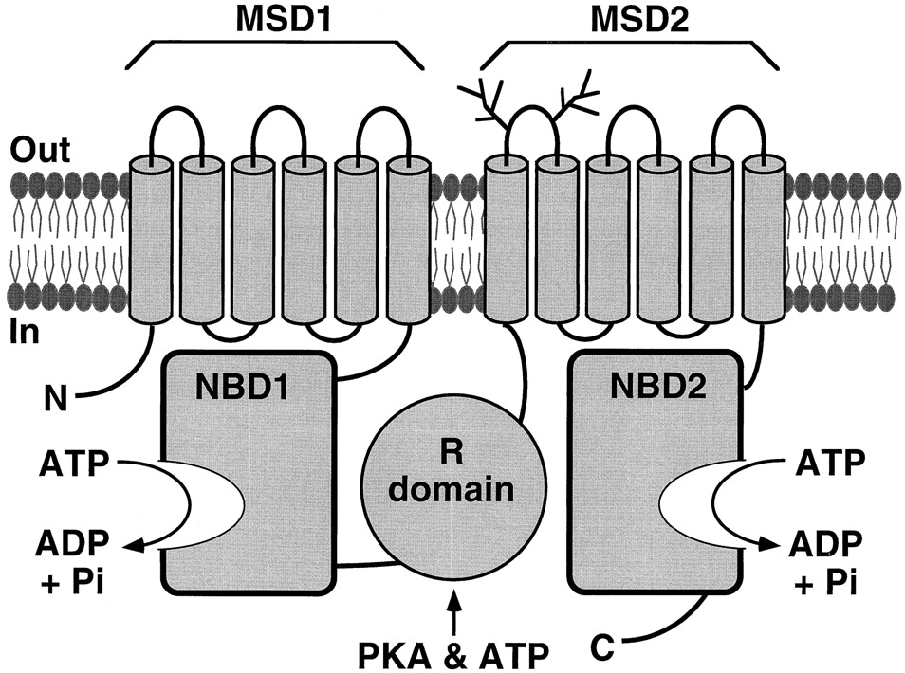
CFTR (cystic fibrosis transmembrane conductance regulator) is a chloride channel
hundreds of mutations have been identified, some of which lead to more severe disease than others
SHEPPARD D N , WELSH M J Physiol Rev 1999;79:S23-S45
An imbalance in Cl- transport results in thickened mucus in the lungs (promotes bacterial growth, inhibits breathing) and the pancreas (inhibits secretion of digestive enzymes)

Slide 13
Below are mRNA sequences from actual CF patients that encode a region NBD2:
unaffected
individual
…uug caa cag ugg agg aaa gcc…
patient 1
…uug caa cag uga agg aaa gcc…
patient 2
…uug caa cag ugg agc aaa gcc…
What type of mutation does patient 1 have?
What type of mutation does patient 2 have?

Slide 14
What type of mutation does patient 1 have?
Frameshift: insertion
Frameshift : deletion
Missense: conservative
Missense: non-conservative
Nonsense
Silent

Slide 15
unaffected
individual
…uug caa cag ugg agg aaa gcc…
leu - gln - gln - trp - arg - lys - ala
patient 1
…uug caa cag uga agg aaa gcc…
leu - gln - gln - STOP
patient 2
…uug caa cag ugg agc aaa gcc…

Slide 16
What type of mutation does patient 2 have?
Frameshift: insertion
Frameshift : deletion
Missense: conservative
Missense: non-conservative
Nonsense
Silent

Slide 17
unaffected
individual
…uug caa cag ugg agg aaa gcc…
leu - gln - gln - trp - arg - lys - ala
patient 1
…uug caa cag uga agg aaa gcc…
leu - gln - gln - STOP
patient 2
…uug caa cag ugg agc aaa gcc…
leu - gln - gln - trp - SER - lys - ala

Slide 18
Below are mRNA sequences from actual CF patients that encode a region NBD2:
unaffected
individual
…uug caa cag ugg agg aaa gcc…
patient 1
…uug caa cag uga agg aaa gcc…
patient 2
…uug caa cag ugg agc aaa gcc…
What type of mutation does patient 1 have?
What type of mutation does patient 2 have?
Which patient, 1 or 2, do you think might have a more severe form of the disease? Why?

Slide 19
Which patient do you think has a more severe form of the disease?
Patient 1
Patient 2
There is not enough information to decide

Slide 20
Think-Pair-Share
This was an exam question. Try to answer it on your own before discussing with your neighbor
Would a nonsense mutation be more deleterious to protein function if it was close to the N terminus or close to the C terminus? Explain your reasoning.

Slide 21
CFTR (cystic fibrosis transmembrane conductance regulator) is a chloride channel
hundreds of mutations have been identified, some of which lead to more severe disease than others
SHEPPARD D N , WELSH M J Physiol Rev 1999;79:S23-S45
An imbalance in Cl- transport results in thickened mucus in the lungs (promotes bacterial growth, inhibits breathing) and the pancreas (inhibits secretion of digestive enzymes)

Slide 22
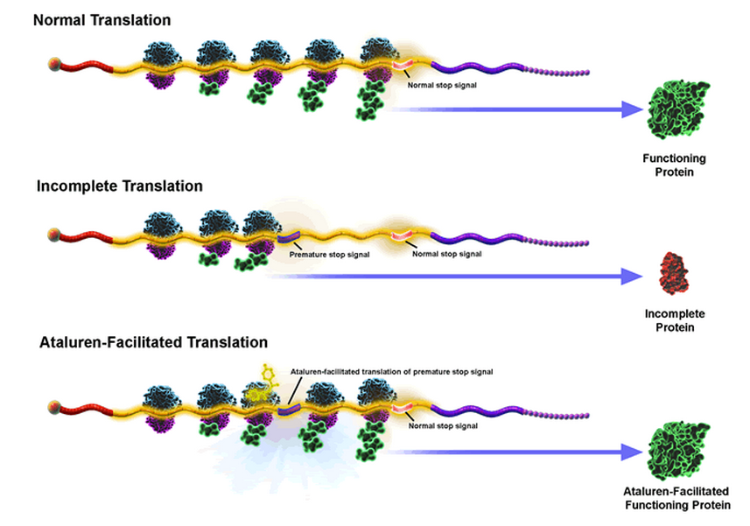
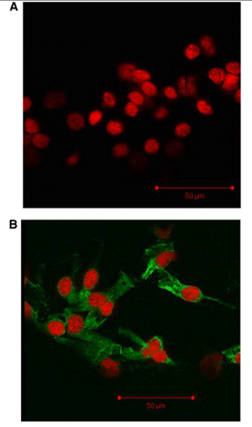
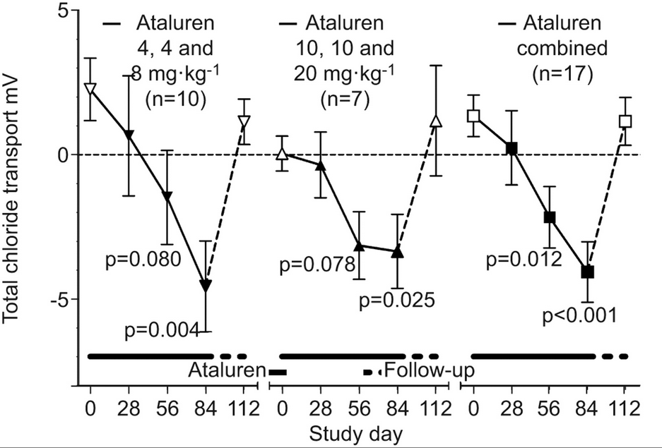
Nonsense mutation read-through: a novel therapeutic strategy
Ataluren: promotes read-through of nonsense, but not normal, stop codons
Cultured nasal epithelial cells from CF patient
ptcbio.com
Improved Cl- transport
No drug
“Translarna” (Ataluren) is approved for nmDMD in the EU and in trials for nmCF in EU and US
Green = CFTR
Red = nucleus
+ Ataluren
Sermet-Gaudelus et al. Am. J. Respir. Crit. Care Med. 182 (10), 15 Nov 2010
Wilschanski et al. Eur Respir J 38, Jul 2011
Notes:
Class question: What could be the extended utility of a drug like Ataluren (A: useful for any nonsense mutation disease)? What are its limitations (not useful for CF due to misssense or DNA deletion mutations)? Hints: Is this drug specific for CFTR?

Slide 23

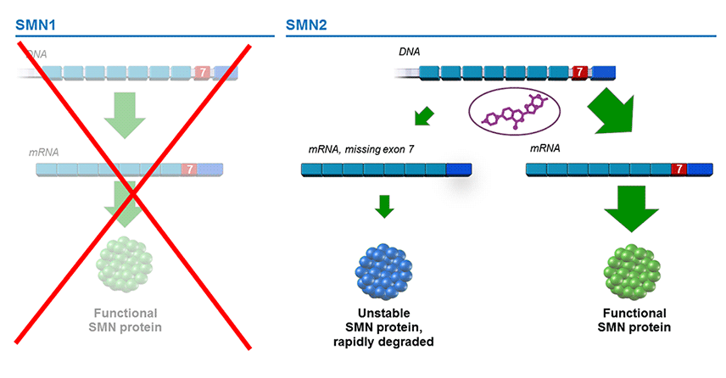
PTC Therapeutics Inc.
Allan Jacobson, PhD
Professor of Microbiology and Physiological Systems
UMass Medical School

Slide 24
Below are mRNA sequences from actual CF patients that encode a region NBD2:
unaffected
individual
…uug caa cag ugg agg aaa gcc…
patient 1
…uug caa cag uga agg aaa gcc…
patient 2
…uug caa cag ugg agc aaa gcc…
What type of mutation does patient 1 have?
What type of mutation does patient 2 have?
Which patient, 1 or 2, do you think might have a more severe form of the disease? Why?
Would Ataluren help patient 1? Patient 2? Both? Neither? Why?

Slide 25
Ataluren would be an effective therapy for:
Patient 1
Patient 2
Both
Neither

Slide 26
Mutations can have different functional affects on proteins:
loss-of-function:
Hypomorph – decreased activity
Amorph (aka “null”) – no activity
gain-of-function:
Hypermorph – increased activity (same function)
Neomorph – new activity
Antimorph – opposite activity
Note the difference between a physical and a functional mutation!!!
Notes:
LOF examples: CF W1282X = null, CF R1283S = hypomorph. Hypothetically, CF mutation hyper=increased cl- transport, neo=transported Na instead of Cl, anti = pumped Cl- back into the cell instead of pumping it out.

Slide 27
Think-Pair-Share: Think of an example of each of the following functional mutations for the CFTR channel
Hypomorph?
Amorph?
Hypermorph?
Neomorph?
Antimorph?

Slide 28
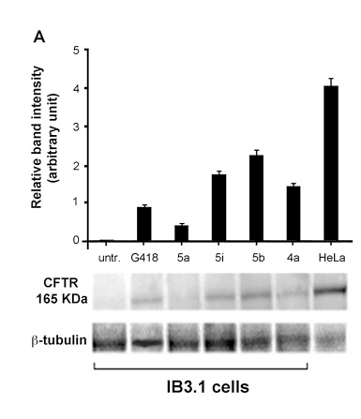
Treatment of nmCF cells with Ataluren derivatives
Results of an experiment where cells from a person with a nmCF were treated with chemical variants of ataluren, or left untreated
CFTR expression is assessed by Western blotting
antibiotic treatment
Control cells (normal CFTR levels)
ataluren compounds
relative amount of CFTR on the blot
Pibiri et al 2015, http://dx.doi.org/10.1016/j.ejmech.2015.06.038

Slide 29
Treatment of cells from this patient (nonsense mutation) with Ataluren derivatives would most likely result in which of the following functional changes:
Hypomorph to amorph
Hypomorph to hypermorph
Neomorph to antimorph
Amorph to hypomorph
Hypomorph to neomorph

