Slide 2
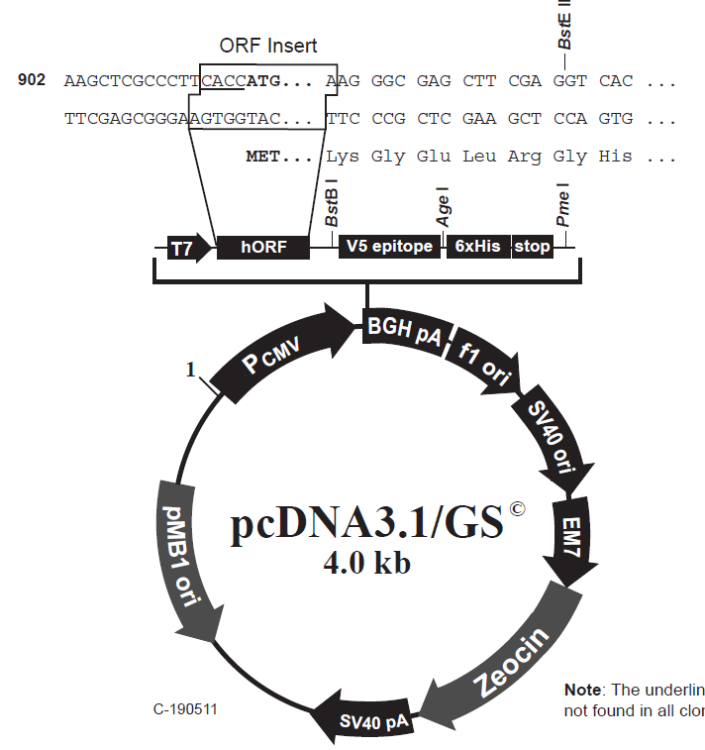
Anatomy of a Plasmid
Draw the vector and insert with overhangs after restriction digest
[Put gene of interest in here]
G/AATTC
EcoRI
TT/CGAA

Slide 3

A cloning conundrum…. (based on a true story!!)
NcoI site in mutant
6kb CFTR gene from PCR, with EcoRI on 5’ end and BstBI on 3’ end
6kb
CFTR gene
EcoRI
BstBI
1.5kb
EcoR1
total size=
10kb
4kb plasmid
+
4kb
NcoI site in mutant
BstBI
You have cloned CFTR from wild type and CF patient samples. The mutation you have cloned is the R347P mutation, which results in the creation of an NcoI restriction site. The affected gene region is here:
C
X
X
P
Oh no! You’ve mixed up the tubes! (Note: Sharpie dissolves in ethanol!) How can you use restriction digest to tell the clones apart?
Digest the wildtype, the mutant, and the original (empty) vector with Nco1, BstBI and EcoR1, then run the pieces on a gel. What do you expect the gel to look like?

Slide 4
Draw it out! Once you cut with the EcoRI, BstB1 and NcoI enzymes, what size are the products? How would these look on a gel?
WT and Mut CFTR plasmids:
Original Plasmid as a control:
NcoI site in mutant only
CFTR total gene size
= 6kb
1.5kb
EcoR1
BstBI
EcoR1
4.5kb
total size=
10kb
4kb
4kb
BstBI

Slide 5
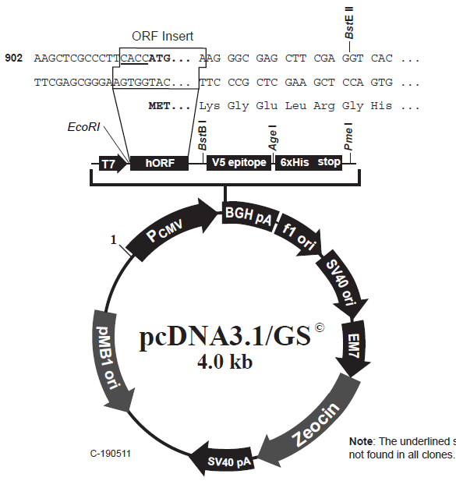
You want to sequence confirm the CFTR sequence in your newly un-mixed-up plasmids. Where on this plasmid would you design the sequencing primer to bind?
NcoI site in mutant
6kb
CFTR gene
1.5kb
EcoR1
total size=
10kb
4kb
BstB1

Slide 6
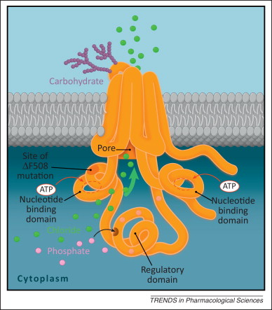
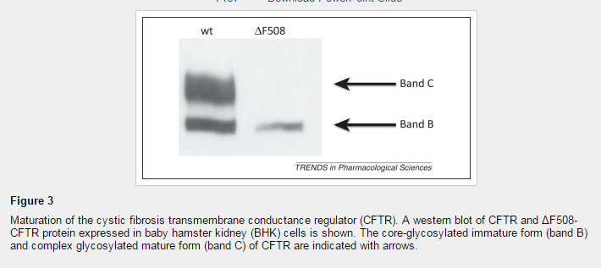
deltaF508 mutation changes the 3-dimensional folding of the protein and prevents glycosylation This lack of glycosylation is detectable by Western blot as a change in band size
Trends in Pharmacological Sciences 2013 34, 119-125DOI: (10.1016/j.tips.2012.11.006)
Recall our two mutations from Monday: nonsense and non-conservative missense. You have cloned these mutations and transfected these into a human cell line, and are looking at the expression of CFTR from these plasmids. Just looking at the pre-processed band, how might these proteins look on a Western blot?
Missense
Nonsense

