Slide 1
The Entity-Relationship Model
Instructor: Rodica Neamtu
rneamtu@wpi.edu

Slide 2



Database Design Stages
Application
Requirements
ER Model
Conceptual
Design
Conceptual Schema
Relational Model
Logical Design
Logical Schema
Creating tables
in a DBMS
Physical Design
Physical Schema

Slide 3
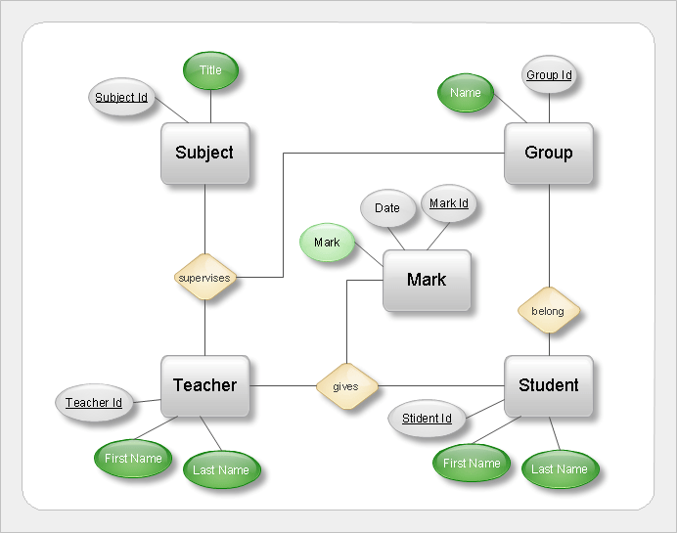
Conceptual Design
Why Conceptual Design ?
  It helps to understand application requirements better
  It helps to communicate our understanding of application
  It helps to come up with a ‘good’ design

Slide 4
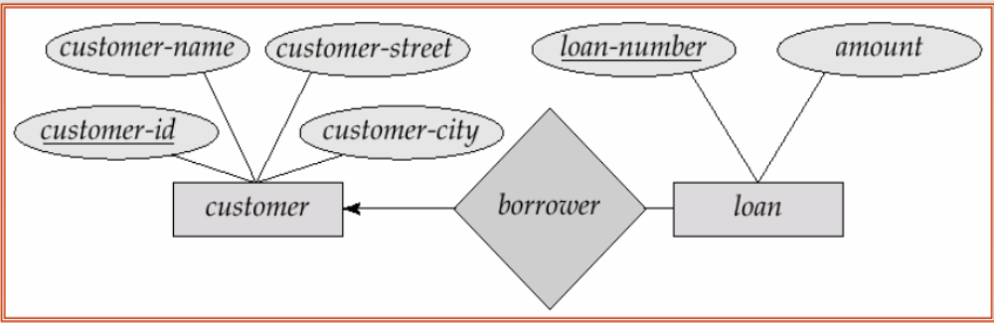
Example: Banking System
There are customers, each customer has some attributes: customer-id, customer-name, customer-street, customer-city.
The bank offers loans to customers, where each loan has a loan-number, and the amount of the loan
A customer can borrow multiple loans from the bank, but each loan can be borrowed by only one customer.
This big story is captured in a better way using an ER model

Slide 5
Conceptual Design (Cont’d)
ER Model
  Structures: Entities and Relationships
  Constraints
An ER schema is represented using Entity-Relationship Diagram (ERD)

Slide 6
Modeling
A database can be modeled as:
  Collection of entities,
  Relationship among entities.
An entity is an object that exists and is distinguishable from other objects.
  Example: a person, company, event, bank account, store, etc.
  Entities have attributes
    Example: a person has name, address, SSN, …
An entity set is a set of entities of the same type that share the same properties.
  Example: set of all persons, companies, trees, holidays

Slide 7
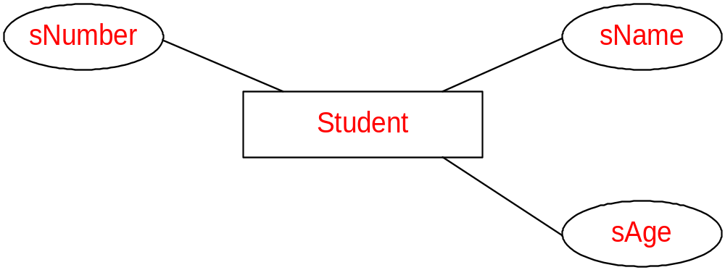
ER: Entity Sets and Attributes
Entity set : Represent a set of “objects”
Attribute: property of an entity, has a domain
In ER diagram
  Entity set → rectangle
  Attribute → Oval.
Entity Set Student
with attributes (sNumber, sName, sAge)

Slide 8
Example: University System
What entity sets come to your mind…
Building
Professor
Employee
Classroom
Student
Course

Slide 9
Attributes Types
Primitive attributes: Attribute stores a single value (Number, String, Boolean, Date, …)
Composite attributes: An attribute can be divided into sub-attributes (each is primitive)
Multi-values attributes: Attribute with many values
Derived attributes: Attributes computed from others
These are primitive attributes
DoB

Slide 10
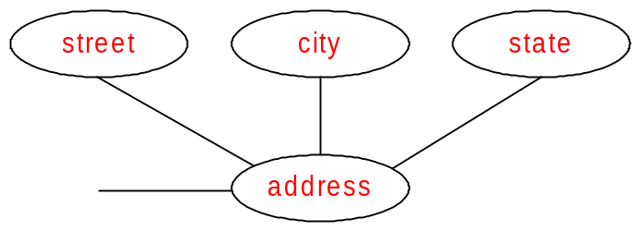

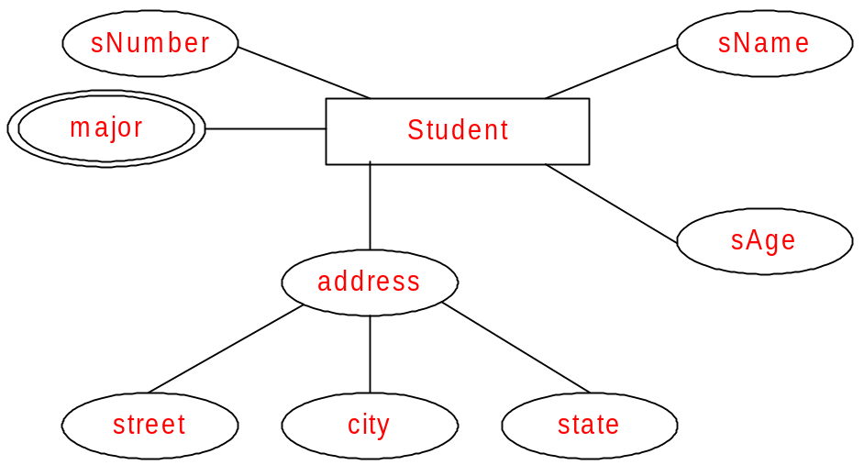
Complex Attributes
Composite Attribute: address
Multivalued Attribute: major
Student entity set
with all its attributes
Derived Attribute: Age
Age
DoB
Age

Slide 11
Expand Your Design: University System
Add attributes for each entity set
Name
Address
Professor
Establishing Year
Building
Classroom
Employee
Student
Course

Slide 12
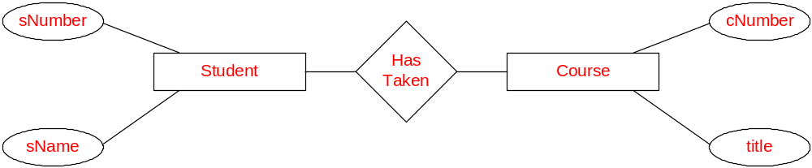
Relationship Types
Relationship: Association (connection) between entities sets
Relationship Type: Class of relationships
Representation: Use a diamond shape
Relationship type HasTaken to represent
Courses taken by Students

Slide 13
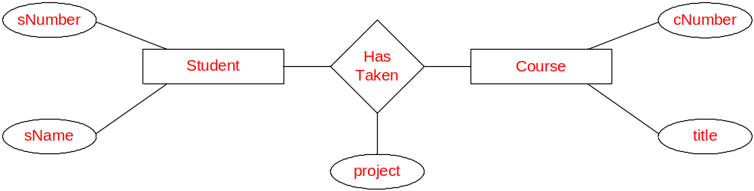
Relationships with Attributes
A relationship may have attributes
These attributes do not belong to any of the connected entities. But they belong the relationship
Relationship HasTaken has an attribute project which is the
project the Student did for the Course

Slide 14
Example I (Simple Application)
Suppliers have a name, and location.
Products have a name, price, and number.
Consumers have a name, and location.
Suppliers supply products on certain dates, while consumers buy products of certain quantity
How would you model this application?
a) What are the entities and attributes?
b) What are the relationships?

Slide 15
Modeling of Example I
pNumber
pName
pPrice
product
date
quantity
supplies
buys
sName
cName
supplier
consumer
sLoc
This ER captures exactly what is written in text
cLoc
>> It is wrong to add “date” or “quantity” to one of the entity sets

Slide 16
Example II (More Complicated)
Suppliers have a name, and location.
Products have a name, and number.
Consumers have a name, and location.
Some Suppliers have established contracts to supply a certain Product to a particular Consumer for specially negotiated price at a given quantity.
How would you model this application?

Slide 17
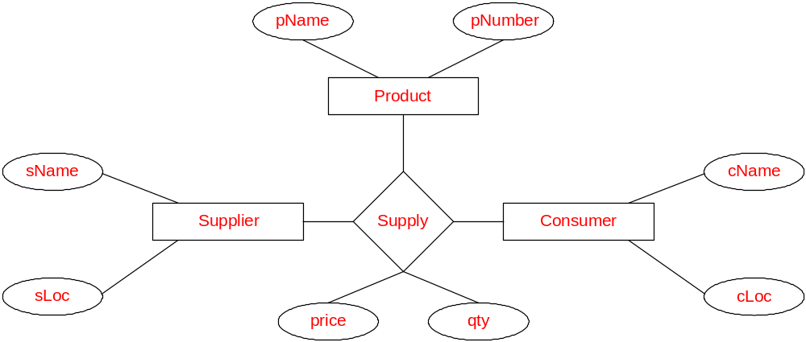
Modeling of Example II
Model the relationship Supplier supplies Products to Consumers
Ternary relationship
(three-way)

Slide 18
Binary vs. Multi-way Relationships
pNumber
sName
product
price
quantity
supplies
buys
sName
cName
supplier
consumer
Binary relationship
sLoc
cLoc

Slide 19
ER Model so far
Entities and entity sets
Relationships
    Binary, ternary, multi-way
Attributes
    For entity sets and relationship types
    Simple, composite, multi-valued, derived

Slide 20
Entities with Different Attribute Types (Recap)
Primitive Attribute: sNumber
Multivalued Attribute: major
sNumber
Composite Attribute: address
Student entity type
with all its attributes
DoB
Derived Attribute: Age
Age
Age

Slide 21
Binary Relationships (Recap)
pNumber
sName
sPrice
product
date
quantity
supplies
buys
sName
cName
supplier
consumer
sLoc
cLoc
Attributes can be attached to Entity Sets or Relationships

Slide 22
Multi-Way Relationships (Recap)
Model the relationship Supplier supplies Products to Consumers
Ternary relationship
(three-way)

Slide 23
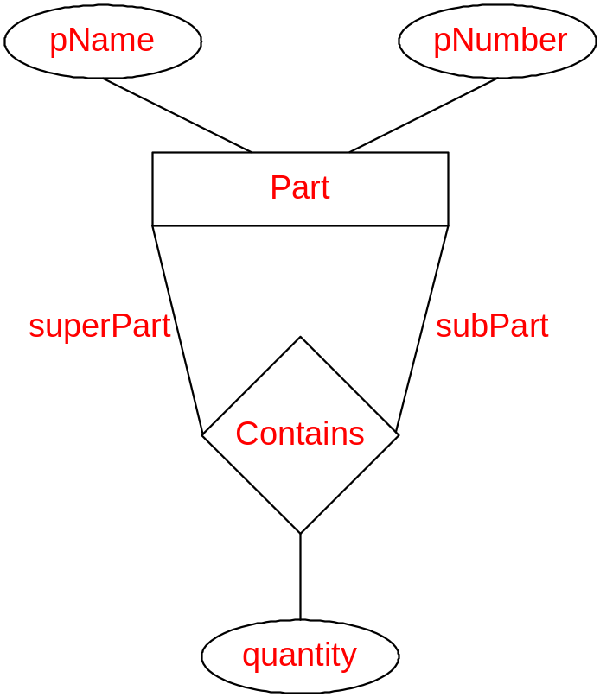
Recursive Relationship Types and Roles
Refer to the same entity set in the relationship
Recursive relationship type : Part-Subpart
Roles:
There are Parts that play the role of superPart
There are Parts that play the role of subPart
If two entities in the same entity set have a relationship ➔ Recursive relationship

Slide 24
Recursive Relationships: Another Example
Employees & Managers
ID
supervisor
Employee
Supervise
Name
supervised

Slide 25

What about an Exercise: University System
Lets enrich this initial design…
Name
Address
Professor
Establishing Year
Building
Classroom
Employee
Student
Course

