Slide 1
The Entity-Relationship Model
Part-2
Rodica Neamtu
rneamtu@wpi.edu

Slide 2
More Elements in ER Model
Key Constraints
Cardinality Constraints
Weak Entities
Subclass Entities (ISA Relationships)
Principles for Good Design
Adding these elements to ERD makes the model more accurate

Slide 3
Keys of Entity Sets
Remember entity set is a group of entities with the same type
Key of Entity Set
  Set of attributes that uniquely identify each entity
Examples:
  “Car” → VIN
  “Person” → SSN
  “WPI Student” → University ID
  “US Student” → (UniversityName + UnivesityID), Or SSN
A key has to be unique within the scope of your application
  Does not have to be globally unique
Customer
Car

Slide 4
Types of Keys
A super key of an entity set is a set of one or more attributes whose values uniquely determine each entity
  “Person” → SSN, SSN + FirstName
  “Account” → AccountNumber + AccountType
A candidate key of an entity set is a minimal super key
  “Person” → SSN
  “Account” → AccountNumber
  “US Student” → SSN, UniversityName + UnivesityID
Each candidate key is a super key but not vice versa
A primary key is one from, possibly several, candidate keys → Pick one and declare it as “primary key”
  “Student” → SSN, StudentID, FirstName + MiddleName + LastName

Slide 5
Keys Summary
Key combination of one or more attributes that uniquely identify an entity
Types:
  Super key (does not have to be minimal)
  Candidate key (minimal super key)
  Primary key (any one from the candidate keys)
Only primary keys are modeled in ERD

Slide 6
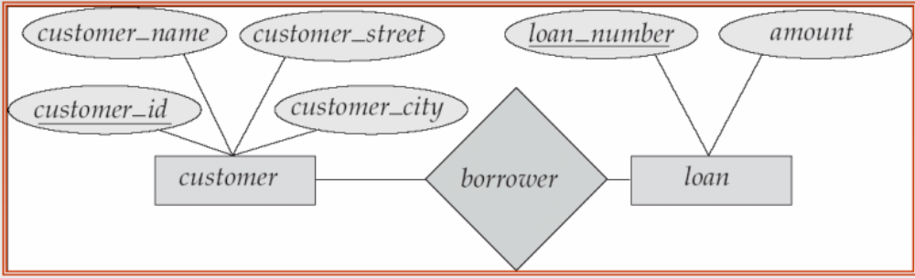
Primary Keys in ERD
Select only one key to be the primary key
Primary key is modeled by “underline” under its set of attributes
Good Practice:
  Select singleton and number attributes whenever possible

Slide 7
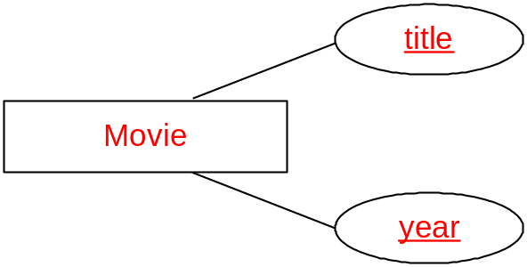
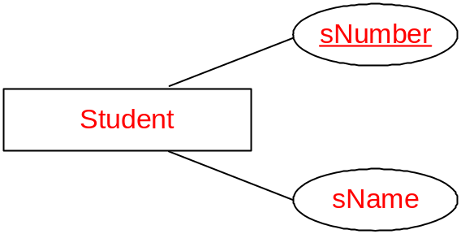
Multi-Attributes Primary Key
Key for Movie is <title, year>
Key for Student is sNumber
We can represent key for entity set consisting of more than one attribute (e.g.: Movie)

Slide 8
Multi-Attributes Primary Key
What does it mean?
Key for Movie is <title, year>
Key for Movie is <title>
year
(title, year) together are unique
Cannot have two movies with the same title in the same year
Can have in the DB movies with the same title but on different years
Movie title is unique
Cannot have two movies in the DB with the same title

Slide 9
Keys of Relationships
Relationship without attributes
  The combination of primary keys of the participating entity sets forms a key of a relationship set
(customer_id, load_number) is the key of borrower

Slide 10
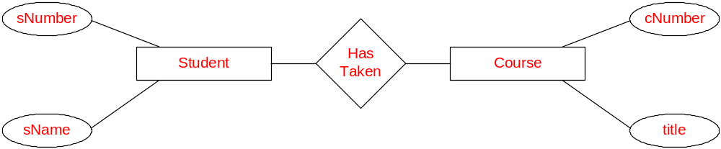
Keys of Relationships (Cont’d)
Relationship with attributes
  Attributes of the relationship may (not always) participate inside the key + the external keys
(sNumber, cNumber) is the key of the relationship
Grade
semester
project

Slide 11
Keys of Relationships (Cont’d)
Relationship with attributes
  Attributes of the relationship may (not always) participate inside the key + the external keys
(sNumber, cNumber, semester) is the key of Taken
Grade
semester
project

Slide 12
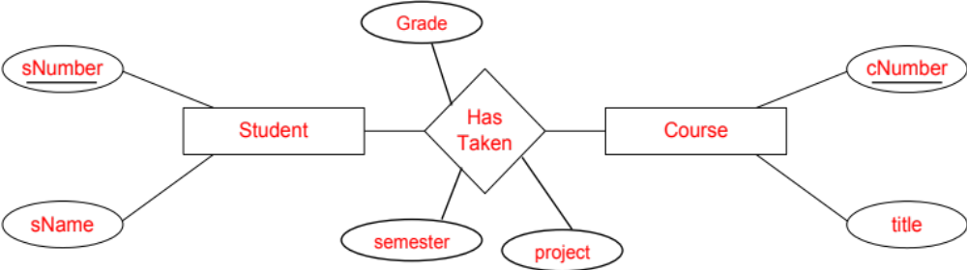
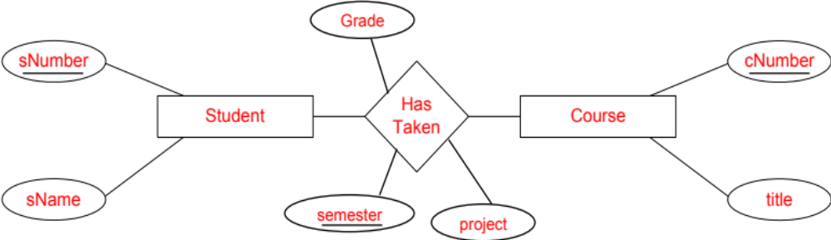
What Does it Mean…?
Which one is more practical and why?
A student can take a course only once over all semesters
A student can take the same course over different semesters
(more flexible assumption)

Slide 13
More Elements in ER Model
Key Constraints
Cardinality Constraints
Weak Entities
Subclass Entities (ISA Relationships)
Principles for Good Design

Slide 14
Cardinality Constraints
Express the number of entities to which another entity can be associated via a relationship set
Most useful in describing binary relationship sets
For a binary relationship set the mapping cardinality must be one of the following types:
  One to one
  One to many
  Many to one
  Many to many

Slide 15
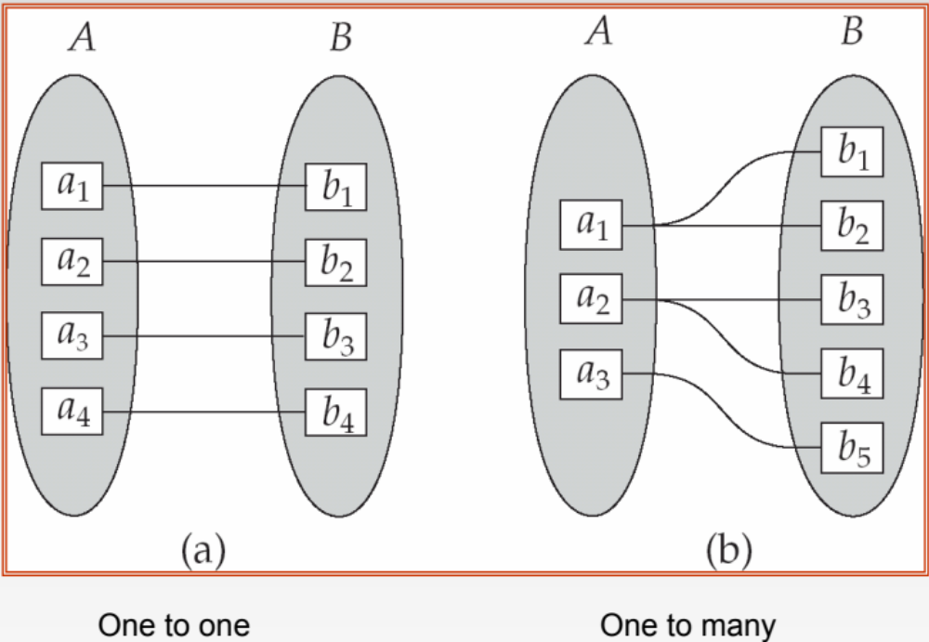
Mapping Cardinalities

Slide 16
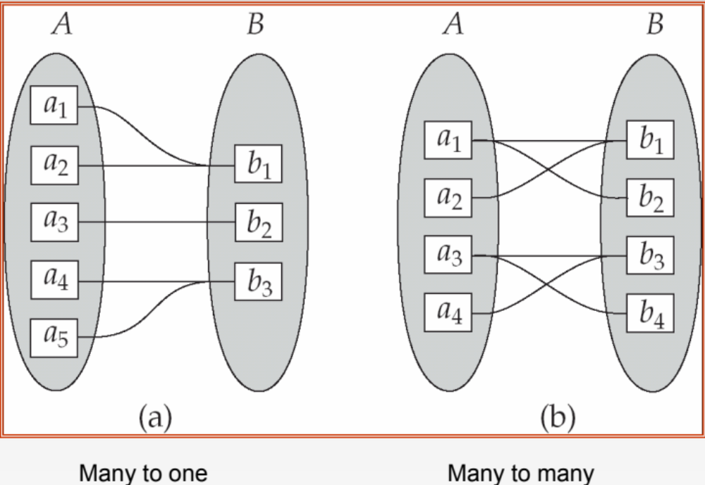
Mapping Cardinalities (Cont’d)

Slide 17
Representing Cardinalities in ERD
In a relationship:
  “ ” : Represent “many” (including 0)
  “ ” : Represent “one” (including 0)
  “ ”: Represent “one” (must be one)
A course can be taken by “many” students.
A student is taking “many” courses.

Slide 18
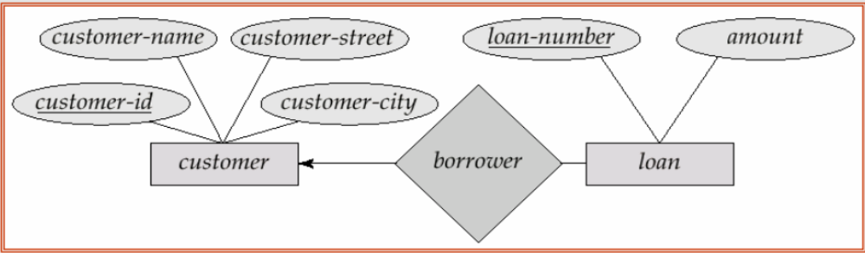
One-To-Many Relationship

Slide 19
One-To-Many Relationship
In the one-to-many relationship a loan is associated with at most one customer via borrower, a customer is associated with many (including 0) loans via borrower
A customer can take many loans
A loan can be taken by one (and at least one) customer

Slide 20
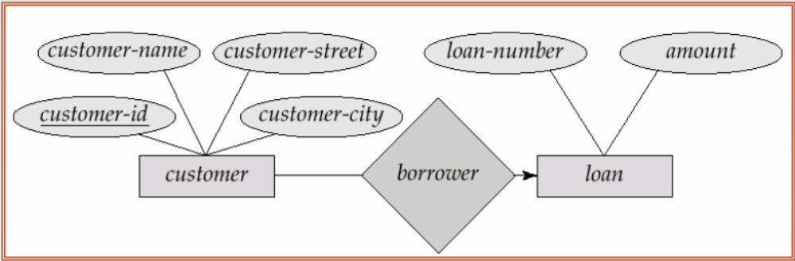
Many-To-One Relationship

Slide 21
Many-To-One Relationship
In a many-to-one relationship a loan is associated with many (including 0) customers via borrower, a customer is associated with at most one loan via borrower
A customer can take at most one loan
A loan can be taken by many customers

Slide 22
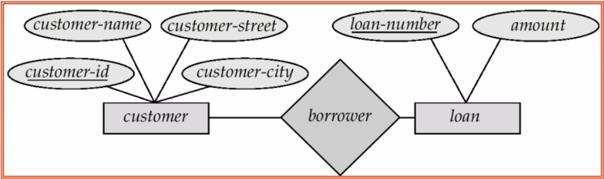
Many-To-Many Relationship
In a many-to-many relationship a loan is associated with many (including 0) customers via borrower, a customer is associated with many loan via borrower

Slide 23
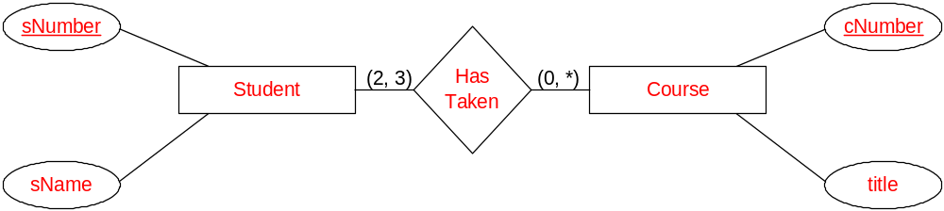
Degree of Cardinalities
How : Expressed using (min, max)
(3, 60)
(0, 5)
Student can take many courses, and a course can be taken by many students
Student can take 0 to 5 courses, and a course can be taken by 3 to 60 students

Slide 24
Cardinality Constraints for Recursive Relationships
pName
pNumber
Part
superPart
subPart
Contains
quantity
A Part may contain many subparts
A Part can be subpart in many superParts

Slide 25
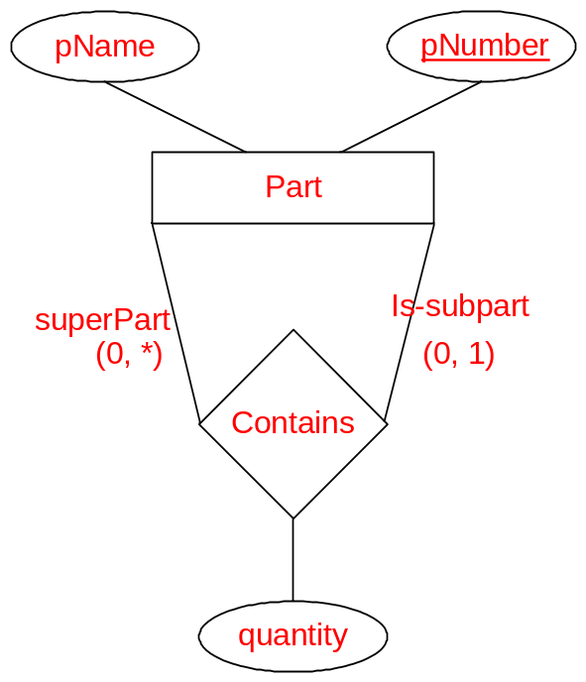
Cardinality Constraints for Recursive Relationships
A Part can have many subParts
A Part can be subpart for at most one superPart

Slide 26
Revisit this example…
Employees & Managers ….. Add cardinalities
ID
supervisor
Employee
Supervise
Name
supervised
Semantics:
Manager can supervise many employees
Employee is supervised by one manager

Slide 27
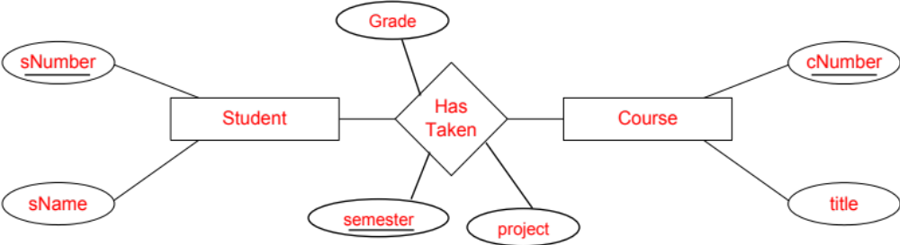
What we covered last time…
Key Constraints
Cardinality Constraints

Slide 28
Cardinality Constraints for
Multi-way Relationships
pName
pNumber
Product
sName
cName
Supplier
Supply
Consumer
sLoc
cLoc
price
qty
Every Supplier supplies some Product to some Consumer
Adding degree constraints over multi-way relationship is complex and not easy to understand…

Slide 29
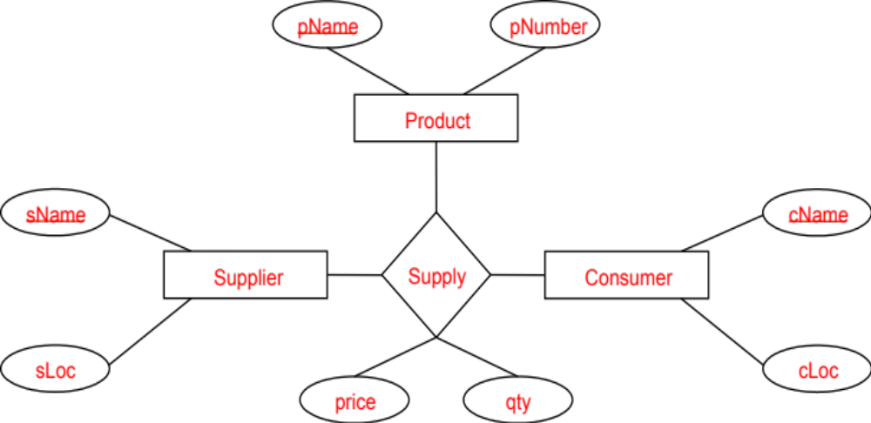
Cardinality Constraints for
Multi-way Relationships
We can always convert a multi-way to binary this way
Every Supplier supplies some Product to some Consumer
To add degree constraints, introduce a new entity set and create multiple binary relationships !!!

Slide 30
Adding Cardinality Constraints to
Multi-way Relationships
pName
pNumber
Product
sName
cName
Supplier
in
Consumer
sLoc
consumes
cLoc
supplies
Contract
What is the key of this entity ???
(Weak Entity)
price
qty

