Slide 1
The Entity-Relationship Model
Part-3
Rodica Neamtu
rneamtu@wpi.edu

Slide 2
More Elements in ER Model
Key Constraints
Cardinality Constraints
Weak Entities
Subclass Entities (ISA Relationships)
Principles for Good Design

Slide 3
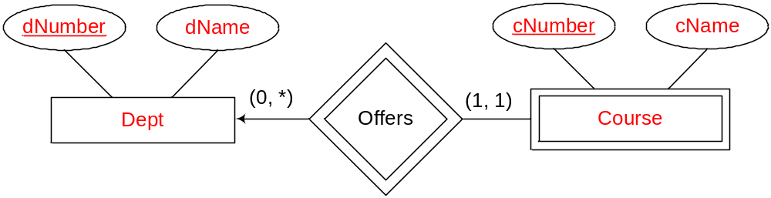
Weak Entity Sets
An entity set that does not have a primary key is referred to as a weak entity set
  Its attributes are not enough to form a key
The existence of a weak entity set depends on the existence of an identifying entity set
  It must relate to the identifying entity set via a total, one-to-many relationship set from the identifying to the weak entity set
Course number is unique only within the department
Weak entity set
Identifying entity set

Slide 4
Weak Entity Sets
Discriminator (or partial key) of a weak entity set
  The set of attributes that uniquely identify a weak entity given its identifying entity
Primary key of a weak entity set
  The composition of the primary key of the identifying entity set + the weak entity set’s discriminator
Identifying entity has to exist for each weak entity
  Cannot have a course without a corresponding department
(dNumber, cNumber) is the primary key for Course
discriminator

Slide 5
Representing a Weak Entity Set
Weak entity set is represented by double rectangles
Weak relationship (supporting relationship) is represented by double diamonds
Weak relationship is one-many from the weak entity to the identifying entity

Slide 6
Again: It Depends on Your Application/Assumptions
If you assume the course number is unique within a department
  “Course” → is a weak entity set
If you assume the course number is unique across all departments
  “Course” → is a strong entity set
offers
Course
Stating your assumptions in text is very important !!!

Slide 7

Revisit Previous Example …
pName
pNumber
Product
sName
cName
Supplier
in
Consumer
sLoc
consumes
cLoc
supplies
Contract
Weak Entity
price
qty
Same supplier cannot make more than one contract with the same consumer for the same product !!!

Slide 8

A Better Design…
pName
pNumber
Product
sName
cName
Supplier
in
Consumer
sLoc
consumes
cLoc
supplies
Contract
Weak Entity
Date
price
qty
Same supplier can now make contract with the same consumer for the same product but on different dates

Slide 9
Another Design …
pName
pNumber
Product
sName
cName
Supplier
in
Consumer
sLoc
consumes
cLoc
supplies
Contract
Contract Id
Strong Entity
price
qty

Slide 10

Exercise 1
Back to the
Book-Publisher
Database

Slide 11
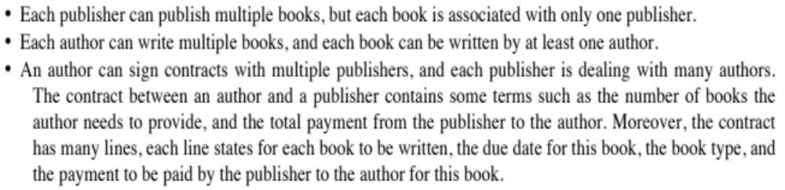
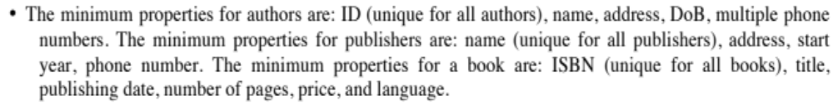
Recall the Scenario

Slide 12
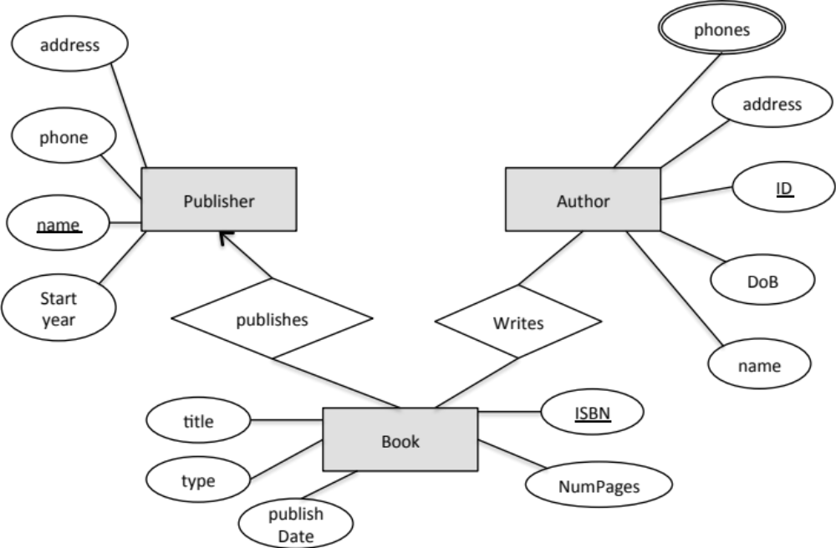
Book-Publisher DB
What remains is the “Contracts” and their details

Slide 13
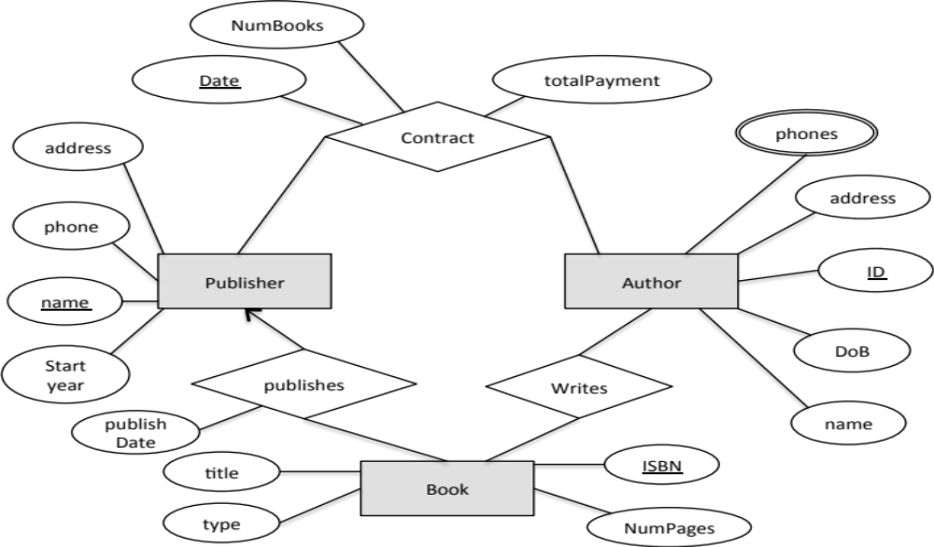


Book-Publisher DB
What about contract lines ???
We modeled the contract between “Authors” & “Publishers”
We made the contract “date” part of the key → now an author can have multiple contracts with the same publisher over time.

Slide 14

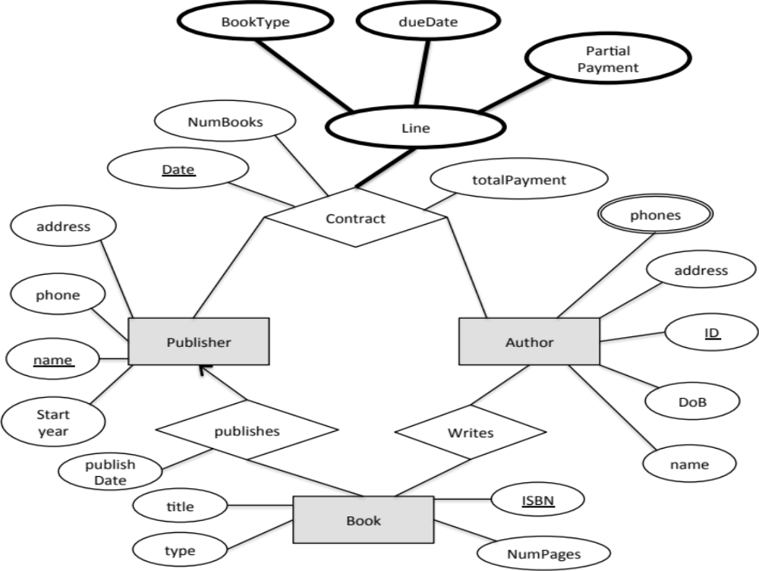
Book-Publisher DB
This means a contract has only one line

Slide 15
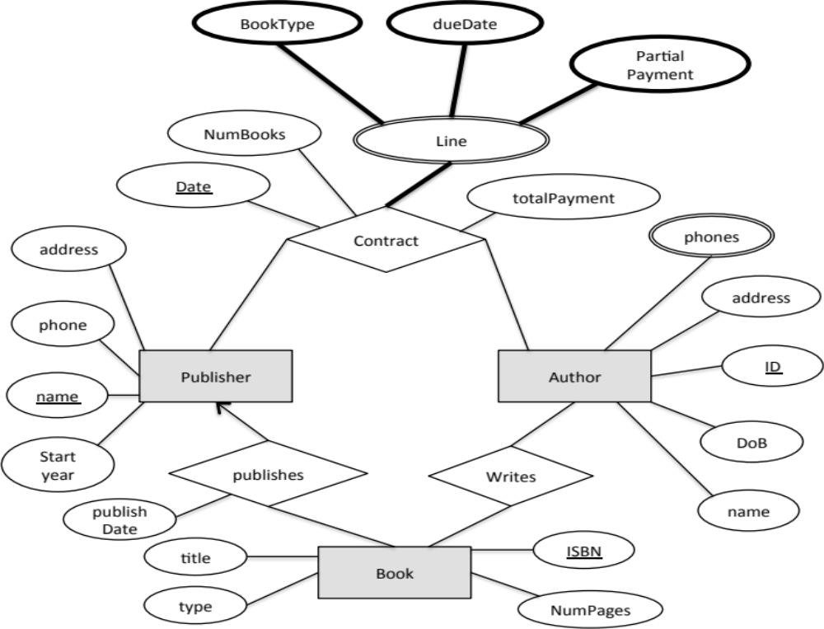
Book-Publisher DB
Not in the ER standards

Slide 16
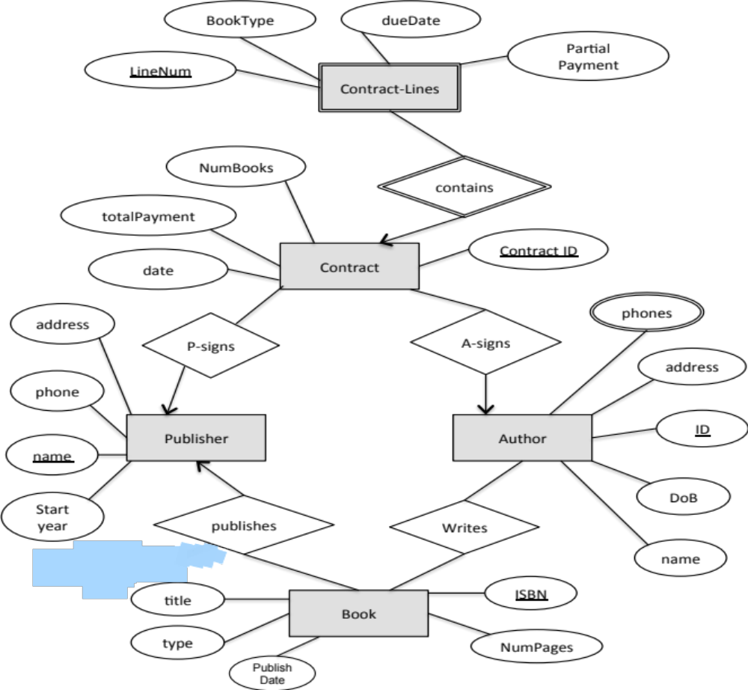

Book-Publisher DB
It is more practical that “LineNum” is unique only within a contact

Slide 17
Exercise 2
Design Hotel database

Slide 18
Example: Hotel Database
A Hotel has many branches
  Hotel → name, logo, address of HQ, Tel., manager, star rating
  Branch → Id, address, Tel., Total capacity
Each branch has many rooms with different types and numbers. A room type defines
  Room size, Number of beds
  Has TV or not, Has Balcony or not
  These attributes of the room depend on its type
Guests can stay in a hotel for a period of time
  Guests have unique ID, name, address, Tel.
  We need to capture, the length of the stay, start date, end date, money paid

Slide 19
Ver. 1
HQ Add.
Name
Manager
Tel.
Rating
Hotel
Num
Num Beds
Capacity
Has TV
Capacity
Room
Has Balcony
Tel.
Branch
Type
Add.
ID
Observations:
Room type is modeled as attribute (causes redundancy)
Room number, is it numeric like 1001? If so, how come to be unique across branches?

Slide 20
Ver. 2
HQ Add.
Name
Manager
Tel.
Rating
Num Beds
Hotel
Capacity
Has TV
Type
Has Balcony
Type
Capacity
Tel.
Branch
Room
Add.
Num
ID
Observations:
Lets add relationships

Slide 21
Ver. 3
HQ Add.
Name
Manager
Tel.
Rating
Num Beds
Hotel
Capacity
Has TV
Type
Has Balcony
has
Type
Capacity
Of type
Tel.
contains
Branch
Room
Add.
Num
ID
Common mistake: Do not add “Branch ID” as an attribute to “Room” entity set. It is already captured by the weak relationship “contains”.
Observation: Not all relationships of “Room” are “supporting” relationships. Only the one that completes my key.

Slide 22
Back to the Requirements
A Hotel has many branches
  Hotel → name, logo, address of HQ, Tel., manager, star rating
  Branch → Id, address, Tel., Total capacity
Each branch has many rooms with different types and numbers. A room type defines
  Room size, Number of beds
  Has TV or not, Has Balcony or not
Guests can stay in a hotel for a period of time
  Guests have unique ID, name, address, Tel.
  We need to capture, the length of the stay, start date, end date, money paid

Slide 23
Ver. 4
HQ Add.
Name
Manager
Tel.
Rating
Num Beds
Hotel
Capacity
Has TV
Type
Has Balcony
has
Type
Capacity
Of type
Tel.
contains
Branch
Room
Add.
Num
Observations:
“Stay” attributes should not be part of “Guest”
ID
Start date
Length of stay
Guest
End date
Money Paid
ID
Name
Add.
Tel.

Slide 24
Ver. 5
HQ Add.
Name
Manager
Tel.
Rating
Num Beds
Hotel
Capacity
Has TV
Type
Has Balcony
has
Type
Capacity
Of type
Tel.
contains
Branch
Room
Add.
Num
ID
Start date
Length of stay
Observations:
Still not quite right..
“Stays-in” 1-M or M-M??
(Guest should be able to stay in diff. rooms)
Stays in
End date
Money Paid
Guest
ID
Name
Add.
Tel.

Slide 25
Ver. 6
HQ Add.
Name
Manager
Tel.
Rating
Num Beds
Hotel
Capacity
Has TV
Type
Has Balcony
has
Type
Capacity
Of type
Tel.
contains
Branch
Room
Add.
Num
ID
Start date
Length of stay
Observations:
Not done yet…
In this model, a guest cannot stay in the same room over diff visits!!!
Stays in
End date
Money Paid
Guest
ID
Name
Add.
Tel.

Slide 26
Ver. 7
HQ Add.
Name
Manager
Tel.
Rating
Num Beds
Hotel
Capacity
Has TV
Type
Has Balcony
has
Type
Capacity
Of type
Tel.
contains
Branch
Room
Add.
Num
ID
Start date
Length of stay
Observations:
Start_date ← part of key
Length of stay ← derived attribute
Stays in
End date
Money Paid
Guest
ID
Name
Add.
Tel.

Slide 27
More Elements in ER Model
Key Constraints
Cardinality Constraints
Weak Entities
Subclass Entities (ISA Relationships)
Principles for Good Design

Slide 28
ISA Relationship Types
Similar to “subclass” concept in Object-Oriented languages
Entity sets share some common attributes but differ in others
Sometimes called “Specialization/Generalization”
Example
  Students can be UGStudents or GradStudents
    UGStudents take undergrad Classes
    GradStudents can be TAs or RAs
    GradStudents are advised by Professors

Slide 29
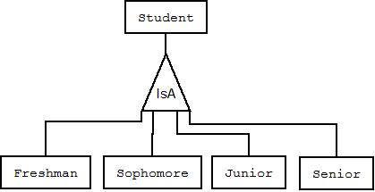
ISA Example
All attributes of “student” are inherited in the other entity sets
Each entity set, e.g., “Freshman”, can have its own additional attributes

Slide 30
ISA Relationship Types (Cont’d)
Top-down design process
  Build entities with the common attributes, then build sub-entities with distinctive attributes from other entities in the set
These sub-entities become lower-level entity sets that have attributes or participate in relationships that do not apply to the general higher-level entity set
In ERD, represented by a triangle component labeled ISA (E.g. customer “is a” person)
Attribute inheritance
  Lower-level entity set inherits all the attributes and relationship participation of the higher-level entity set to which it is linked

Slide 31
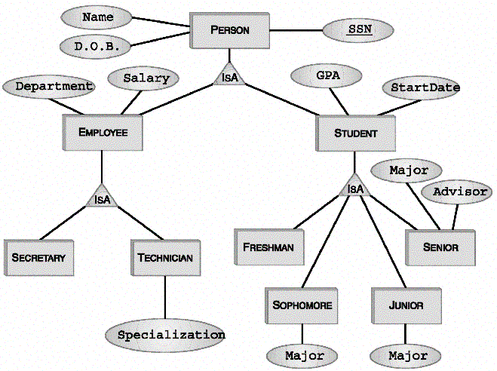
More Complete Example
Attributes of Person:
SSN, Name, DOB
Attributes of Student:
SSN, Name, DOB, GPA, StartDate
Attributes of Technician:
SSN, Name, DOB, Salary, Department, Specialization

Slide 32
Multiple ISA Relationships
Can have multiple specializations of an entity set based on different features
Permanent Emp
ISA
Temporary Emp

Slide 33
ISA Relationship: Constraints
Three types of constraints
  Membership: To which entity set an entity belongs
  Overlapping: can an entity belong to multiple subclasses or not
  Completeness: Does each super entity have to belong to one (or more) subclasses

Slide 34
ISA Relationship: Membership
Constraint on which entities can be members of a given lower-level entity set
    Denoted in ERD on the ISA edge
Year
Year = 1
Year = 4
Year = 2
Year = 3

Slide 35
ISA Relationship: Overlapping
Constraint on whether or not entities may belong to more than one lower-level entity set within a single generalization.
  Disjoint
    An entity can belong to only one lower-level entity set
  Overlapping
    An entity can belong to more than one lower-level entity set
  Denoted in ERD by writing “disjoint” or “overlapping” next to ISA triangle, by default → “disjoint”
disjoint

Slide 36
ISA Relationship: Completeness
Specifies whether or not an entity in the higher-level entity set must belong to at least one of the lower-level entity sets within a generalization
  Total : An entity must belong to one of the lower-level entity sets
  Partial: An entity need not belong to one of the lower-level entity sets
Total

Slide 37
ISA Relationship: Multiplicity
ISA relationship is always 1-1 (even though its notation is arrows without heads)

Slide 38
ISA Relationship: Keys
Key of sub-entities is inherited from the super entities
SSN is the primary key for Person, Student, Employee, Freshman, Technician, and all other sub-entities

Slide 39
More Elements in ER Model
Key Constraints
Cardinality Constraints
Weak Entities
Subclass Entities (ISA Relationships)
Principles for Good Design

Slide 40
Coming up with a good design for your application
No single right design, there can be many…
Put clear, reasonable assumptions and make a design that captures the assumptions
  Without stating the assumptions, others can claim your design is wrong !!!
It is like art, common sense and experience make a difference
The simplest design that captures the requirements is the best

Slide 41
Guidelines Toward a Good Design (I)
Convey “real” application requirements
Utilize meaningful names for
  Entity sets, attributes, relationships
Avoid redundancy, do not store the same data in multiple places
Be as precise as possible (E.g., cardinality constraints)
Don’t over specify (limits input)
Know when to add attributes to entity sets vs. relationships

Slide 42
Examples
Num
Num Beds
Num
SSN
Capacity
take
Has TV
Loan
Customer
Room
Type
offer
lend
X
Bank
- The room “capacity, Num Beds, has TV” attributes they all depend on the type. So why repeat them with each room.
- The “type” should be a separate entity set
ID
The relationship “lend” is redundant and should not be there
The relation between a customer and a bank is already captured by the two other relationships

Slide 43
M-M Relationships vs. An Entity Set
M-M Relationship between E1 and E2 can be always broken to:
  A new entity set E3 (usually weak entity set)
  1-M relationship between E1 and E3
  1-M relationship between E2 and E3
Both are correct use either one
Date
grade
Num
ID
Num
ID
taking
Course
Student
Course
Student
include
Involve
Registration
Date
grade

Slide 44
Do not overuse ISA relationship
  There are always some commonalities between things → this does not mean they should inherit from common ancestor
  Use it only if there is a substantial overlap in attributes (and possibly relationships)
Prof
Student
- No need for an entity set “Person” from which both “Prof” and “Student” inherit

Slide 45
Strong vs. Weak Entity Sets
Avoiding weak entities is better (If no semantics is lost)
You may add unique keys
Name
Hotel
Name
Hotel
has
has
Branch
Branch
ID
ID
- Should always favor the left design over the right one (unless explicitly stated otherwise)

Slide 46
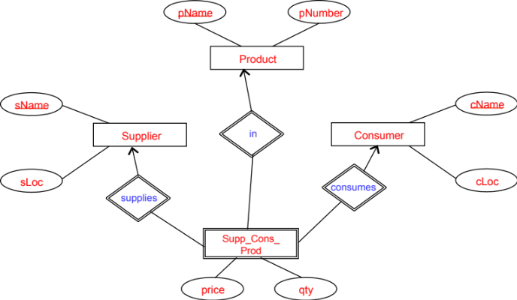
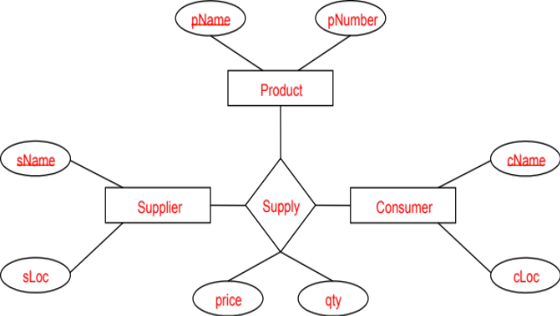
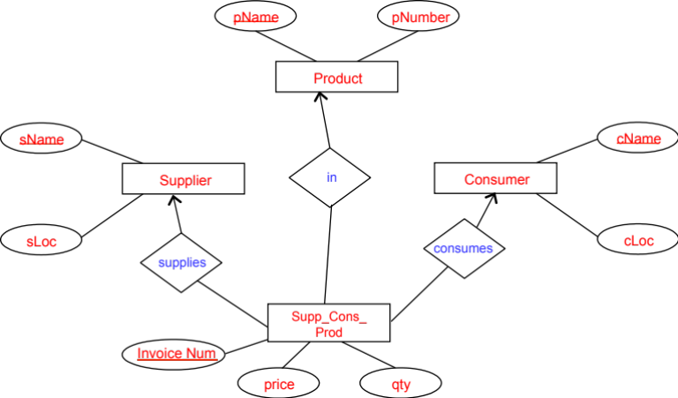
Do not overuse multi-way relationships
They are harder to understand and interpret
Can be broken by introducing new entity set and several 1-M relationships
Avoid multi-way relationship
Avoid weak entity set

Slide 47
ERD Cannot Capture Everything…
Some business constraints will not be captured in the design. For example:
  For a customer to get a load, the sum of the previous loans to him/her must be < MaxLoan
  A student cannot take the same course more than 2 times
  A student cannot re-take a course that (s)he already passed

Slide 48
Find the wrong things ???
Age
Make
Model
VIN
DoB
Name
ID
ColorName
car
colorID
buys
Customer
Date
contains
Price
Date
takes
CarMiles
FeatureName
Car-feature
Loan
= A customer can buy many cars
= A customer may take a loan to buy a specific car
amount
Bank
number
Notes:
ColorId & ColorName
Car has one feature
Car-feature has one attribute
CarMiles should be attached to the car
Age should be a derived attribute
A car can be bought by many customers
Loan and Car are not linked togather

Slide 49
From the Previous Example
ColorId & ColorName (cause redundancy & inconsistency)
Car can have one feature (wrong cardinality)---should be many
Car-feature has one attribute (should not be an entity)---make it attr.
CarMiles should be attached to the car (not to the relationship)
Age should be a derived attribute
A car should be bought by one (or zero) customers (the arrow head should be closed)
Loan and Car are not linked together (buys should be 3-way)
  Or create a new entity set “Contract” and link it to the three entity sets

Slide 50
Summary of ER Model
Concepts
  Entity, Entity Sets, Weak Entity Sets
  Relationships Types
    binary, ternary, multi-way, recursive, weak, ISA
  Attributes
    For entity sets or relationship types
    Simple, composite, derived, multi-valued
Constraints – key, cardinality
Guidelines for Good Design

