Slide 1
Translating ER Schema to Relational Model
Rodica Neamtu
rneamtu@wpi.edu

Slide 2
Translating ER Schema to Relational Schema
Primary keys allow entity sets and relationship sets to be expressed uniformly as relational schemas
Generally, each relational schema will have
  Number of columns corresponding to the number of attributes in ERD
  Column names that correspond to the attribute names
cs3431

Slide 3

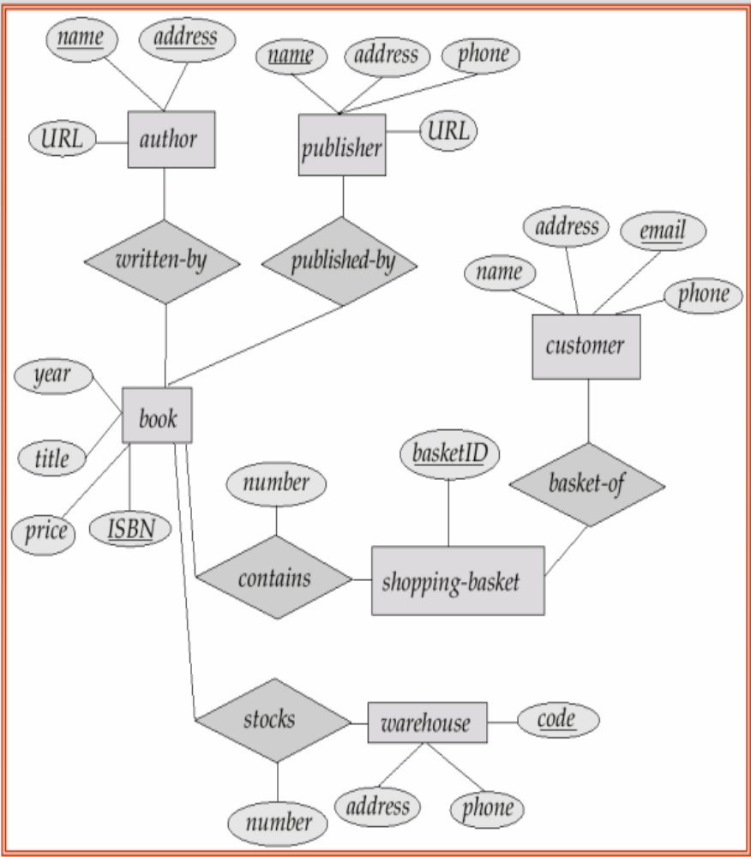
What is the Relational Model ???
cs3431

Slide 4
Basic Rule for Mapping
Each entity set → separate relation
Relationships
  Many-to-Many → always separate relation
  Others (One-to-Many & One-to-One)
    If contributes with a key → map to separate relation
    If not → is not mapped to separate relations
More details will come …
cs3431

Slide 5
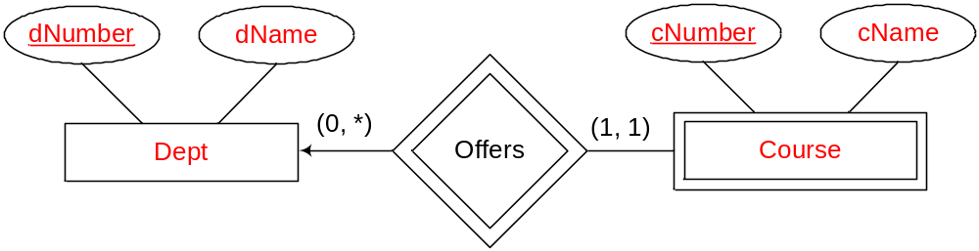
Rule I: One-to-Many & Many-to-One Cardinalities
PK of “One-side” moves to the “many-side”
This transferred primary key becomes a foreign key
The relationship itself is not mapped to a table
  Any attributes on the relationship go to the “Many” side
offers
Course
cs3431

Slide 6
Example 1
offers
Course
Dept (dNumber, dName)
Course (cNumber, dnumber, cName)
FOREIGN KEY Course(dNumber) REFERENCES Dept(dNumber)
cs3431

Slide 7
Example 2
offers
Course
Open head (one and must be one)
Dept (dNumber, dName)
Course (cNumber, dnumber, cName)
FOREIGN KEY Course(dNumber) REFERENCES Dept(dNumber)
Compare this with Example 1
-- In Example 1: Course.dnumber can be null
--In Example 2: Course.dnumber cannot be null
cs3431

Slide 8
Rule I: One-to-Many & Many-to-One With Key: Example 3
term
offer
Course
Relationship maps to separate relation + PK from “many-side”
  If combined with “Course” → Creates redundancy
Do not add dnumber…It’s redundancy
➔ Known from cNumber
Dept (dNumber, dName)
Course (cNumber, dnumber, cName)
Offer(cNumber, term)
FOREIGN KEY Course(dNumber) REFERENCES Dept(dNumber)
Foreign key Offer(cNumber) References Course(cNumber)

Slide 9
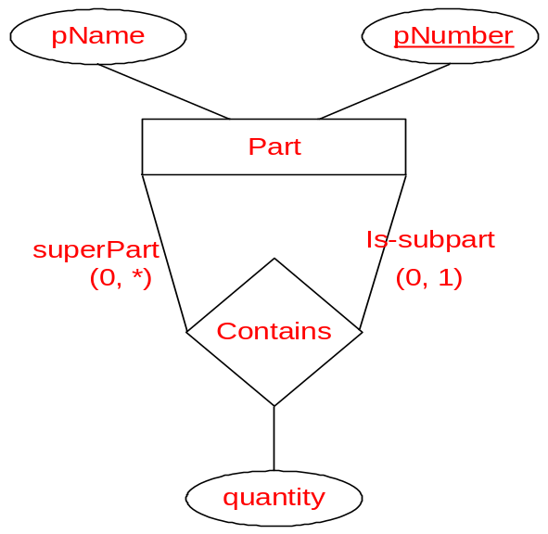
Example 4: Apply one-to-many Rule to recursive relationship
Nothing New….
Part(pNumber, pName, superPartNumber, quantity)
FOREIGN KEY Part(superPartNumber) REFERENCES Part (pNumber)
cs3431

Slide 10
Rule II: One-to-One Cardinalities
PK of either sides go to the other side
This transferred primary key becomes a foreign key
The relationship itself is not mapped to the relational model
  Any attributes on the relationship go to the side receiving the transferred primary key
pName
Number
size
owns
Player
Storage area
pID
StartDate
Location
cs3431

Slide 11
Example 5
pName
Number
size
owns
Player
Storage area
pID
StartDate
Location
Player(pID, pNumber)
StorageArea(Number, pID, startDate, Location, size)
FOREIGN KEY StorageArea(pID) REFERENCES Player(pID)
cs3431

Slide 12
Example 5 (another design)
pName
Number
size
owns
Player
Storage area
pID
StartDate
Location
Player(pID, pName, StorageNumber, StartDate)
StorageArea(Number, Location, size)
FOREIGN KEY Player(StorageNumber) REFERENCES StorageArea(Number)
cs3431

Slide 13
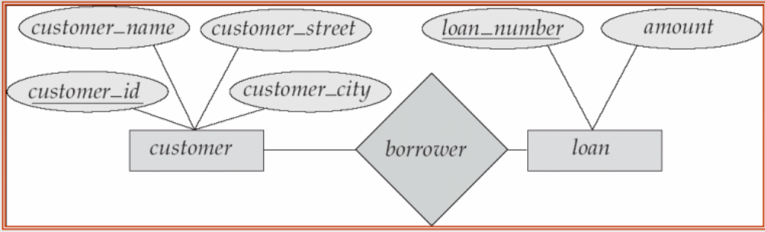
Rule III: Many-to-Many Relationship
Date
Each entity set maps to a relation
The relationship also maps to a relation
  Key of relationship = keys coming from both sides +
    Any key of the relationship itself
Loan (load_number, amount)
Customer (customer_id, customer_name, customer_street, customer_city)
Borrower (customer_id, load_number, Date)

Slide 14
Exercise
cs3431

Slide 15
Exercise
Author(name, address, URL)
Book(ISBN, title, year, price,
publisher_Name)
WrittenBy(name, address, ISBN)
Publisher(name, address, phone, URL)
Warehouse(code, phone, address)
Stocks(ISBN, WH_code, number)
Shopping-Basket(basketID, email)
basketContains(ISBN, basketID, number)
Customer(email, name, address, phone)
cs3431

Slide 16
Rule IV: Weak Entity Sets
Weak entity set does not have its own key
  It must relate to the identifying entity set via a total, one-to-many relationship set from the identifying to the weak entity set
  A weak entity set is mapped to a relation with all its attributes + the key(s) of the identifying entity set(s)
  Primary key of the new relation is the:
    Identifying key(s) from identifying entity set(s), Plus
    Discriminator of the weak entity set
  Supporting relationship is not mapped

Slide 17
Example 6
Dept(dNumber, dName)
Course(dNumber, cNumber, cName)
FOREIGN KEY Course(dNumber) REFERENCES Dept(dNumber)
cs3431

Slide 18
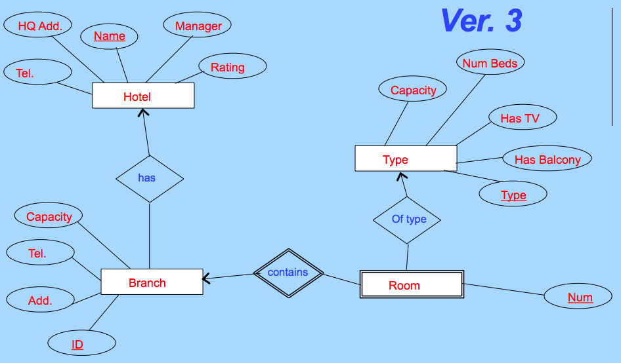
From the Hotel Example…
Room (BranchID, Num, Type)
cs3431

Slide 19
Rule V: Composite & Derived Attributes
sNum
sName
Student
sAge
address
street
city
state
Mapping strategy (Composite): Include only the 2nd level attributes
Mapping strategy (Derived): Mapped as is (enforced later using triggers)
Student(sNum, sName, sAge, street, city, state)
cs3431

Slide 20
Rule VI: Multi-valued Attributes
sNum
sName
major
Student
sAge
address
street
city
state
Mapping strategy:
  Becomes a relation by itself.
  The primary key of that relation = Attribute + the PK of the main entity set
Student(sNum, sName, sAge, street, city, address)
StudentMajor(sNum, major)
FOREIGN KEY StudentMajor (sNum) REFERENCES Student (sNum)
cs3431

Slide 21
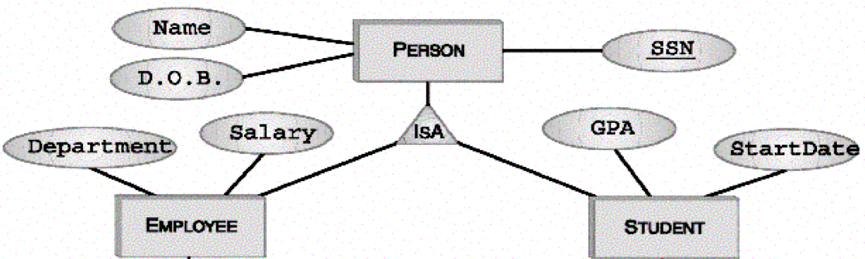
Rule VII: ISA Relationships
ISA is a one-to-one relationship BUT the sub-class entity sets inherit attributes from the super-class entity set
  That is why it does not follow the one-to-one rules
Basically many ways for the mapping depending on whether it is total vs. partial and overlapping vs. disjoint
Super-class key is always the primary key

Slide 22

ISA Relationship : Method 1 (One Relation for All)
Recommended if sub entity sets do not have many attributes or relationships of their own
Person(SSN, Name, DoB, GPA, StartDate, Salary, Department)
In this design:
Any person will have only one record
But, there will be some null values
cs3431

Slide 23
ISA Relationship : Method 2 (Relations only for SubClasses)
Recommended only for
Total & Disjoint type
Student(SSN, Name, DoB, GPA, StartDate)
Employee(SSN, Name, DoB, Department, Salary)
Cannot be used for partial (otherwise some entities will not fit in any relation)
If the relationship is overlapping ➔ there will some redundancy
cs3431

Slide 24
ISA Relationship : Method 3 (Relation for each Entity Set)
Person(SSN, Name, DoB)
Student(SSN, GPA, StartDate)
Employee(SSN, Department, Salary)
FOREIGN KEY Student(SSN) REFERENCES Person(SSN)
FOREIGN KEY Employee(SSN) REFERENCES Person(SSN)
In this design:
Each student has two records (one in Person, and one in Student) ⬅ They complete each other
Each employee has two records (one in Person, and one in Employee) ⬅ They complete each other

Slide 25
Mapping from ER model to Relational model: Summary
Basic algorithm covers the main cases
Rule I : One-to-Many Relationships
Rule II : One-to-One Relationships
Rule III : Many-to-Many Relationships
Rule IV : Weak Entity Sets
Rule V: Composite & Derived Attributes
Rule VI : Multi-Valued Attributes
Rule VII : ISA Relationships
cs3431

