Slide 1
Relational Algebra
Rodica Neamtu
rneamtu@wpi.edu

Slide 2
Algebra Behind the Query Language
Relational Algebra
Set of operators that operate on relations
Operator semantics based on Set or Bag theory
Relational algebra form underlying basis (and optimization rules) for SQL
SELECT pNumber, count(*) AS CNT
FROM Student
WHERE sNumber > 1
GROUP BY pNumber;

Slide 3
Relational Algebra
Basic operators
  Set Operations (Union: ∪, Intersection: ∩ ,difference: – )
  Select: σ
  Project: π
  Cartesian product: x
  rename: ρ
More advanced operators, e.g., grouping and joins
The operators take one or two relations as inputs and produce a new relation as an output
One input → unary operator, two inputs →binary operator

Slide 4
Relational Algebra
Similar in concept to arithmetic operators and expressions
In relational algebra, instead of variables we have relations
  (w + t) / ((x + y) * 3)
w, t, x, y are called variables
+, /, * are called binary operators
  π_{customer_name} (R ⋈ σ_{balance <100} (S) )
R, S are DB relations
Relational operators

Slide 5
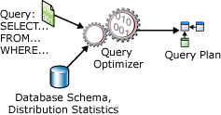
What it is important
Query compilation, optimization, and execution rely on the relational algebra

Slide 6
Set Operators
Union, Intersection, Difference
Defined only for union compatible relations
Relations are union compatible iff
  they have same sets of attributes (schema), and
  the same types (domains) of attributes
Example : Union compatible or not?
  Student (sNumber, sName)
  Course (cNumber, cName)
Not compatible

Slide 7
Union over sets: ∪
Consider two relations R and S that are union-compatible
R
S
R  S
A | B
1 | 2
3 | 4
A | B
1 | 2
3 | 4
5 | 6
A | B
1 | 2
3 | 4
5 | 6

Slide 8
Difference over sets: –
R – S are the tuples that appear in R and not in S
Defined as:
  R – S = {t | t ∈R and t∈ S}
R
S
R – S
A | B
1 | 2
3 | 4
A | B
1 | 2
5 | 6
A | B
3 | 4

Slide 9
Intersection over sets: ∩
Consider two Relations R and S that are union-compatible
R
S
R ∩ S
A | B
1 | 2
3 | 4
A | B
1 | 2
3 | 4
5 | 6
A | B
1 | 2
3 | 4

Slide 10
Selection: σ
Select: σ_{c} (R):
  c is a condition on R’s attributes
  Select subset of tuples from R that satisfy selection condition c
R
σ_{(C ≥ 6)} (R)
A | B | C
1 | 2 | 5
3 | 4 | 6
1 | 2 | 7
A | B | C
3 | 4 | 6
1 | 2 | 7

Slide 11
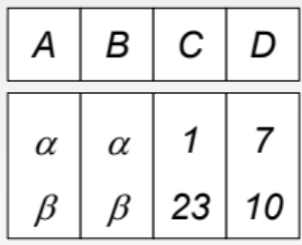
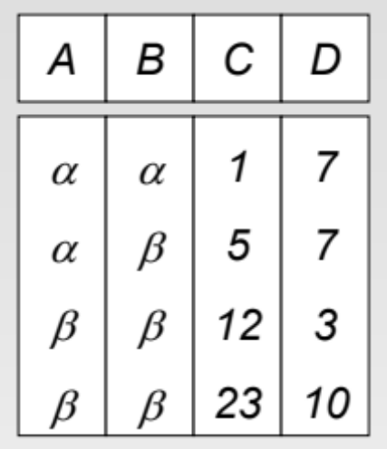
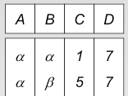
Selection: Example
σ _{((A=B) ^ (D>5))} (R)
R
σ _{(D > C)} (R)

Slide 12
Project: π
π_{A1, A2, …, An} (R), with A1, A2, …, An ∈ attributes A_{R}
  returns all tuples in R, but only columns A1, A2, …, An
A1, A2, …, An are called Projection List
R
π_{A, C} (R)
A | B | C
1 | 2 | 5
3 | 4 | 6
1 | 2 | 7
1 | 2 | 8
A | C
1 | 5
3 | 6
1 | 7
1 | 8

Slide 13
Extended Projection: π_{L} (R)
Example
Compute this expression and call it X
Rename column A to V
π _{C, V←A, X← C*3+B} (R)
R
A | B | C
1 | 2 | 5
3 | 4 | 6
1 | 2 | 7
1 | 2 | 8
C | V | X
5 | 1 | 17
6 | 3 | 22
7 | 1 | 23
8 | 1 | 26

Slide 14
Extended Projection: π_{L} (R)
Example
What If I want to select column B, and add another column called ‘Test’ containing word ‘Ok’
π _{B, ‘Ok’ As Test} (R)
R
A | B | C
1 | 2 | 5
3 | 4 | 6
1 | 2 | 7
1 | 2 | 8
B | Test
2 | Ok
4 | Ok
2 | Ok
2 | Ok

Slide 15
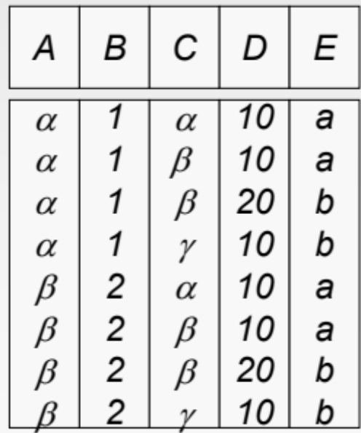
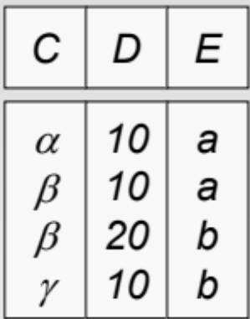
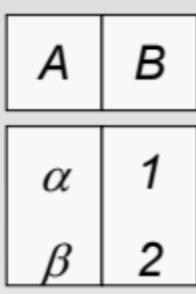
Cross Product (Cartesian Product): X
R X S
S
R

Slide 16
Renaming: ρ
ρ_{S} (R) changes relation name from R to S
ρ_{S(A1, A2, …, An)} (R) renames also attributes of R to A1, A2, …, An
ρ_{S} (R)
ρ_{S(B->X, C, D)} (R)
R
S
S
B | C | D
2 | 3 | 10
2 | 3 | 11
6 | 7 | 12
B | C | D
2 | 3 | 10
2 | 3 | 11
6 | 7 | 12
X | C | D
2 | 3 | 10
2 | 3 | 11
6 | 7 | 12

Slide 17
Composition of Operators
The true power is when you form expressions and put several operators together
We do the same with arithmetic operators
  (w + t) / ((x + y) * 3)

Slide 18
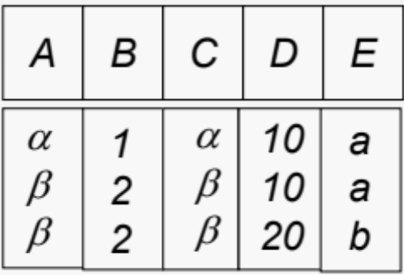
Composition of Operators
Can build expressions using multiple operations
Example: σ_{A=C}(R x S)
R X S
S
R
σ_{A=C}(R x S)

Slide 19
Banking Example
branch (branch_name, branch_city, assets)
customer (customer_name, customer_street, customer_city)
account (account_number, branch_name, balance)
loan (loan_number, branch_name, amount)
depositor (customer_name, account_number)
borrower (customer_name, loan_number)

Slide 20
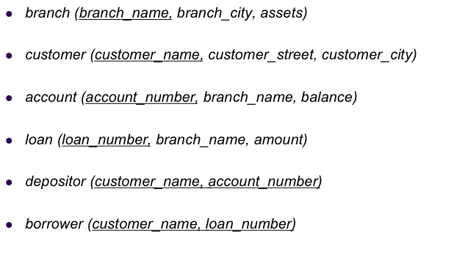

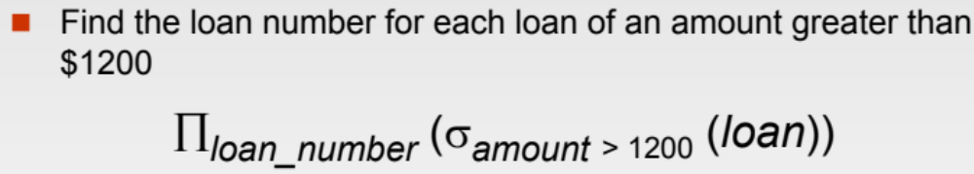
Example Queries

Slide 21

Example Queries (Cont’d)

Slide 22
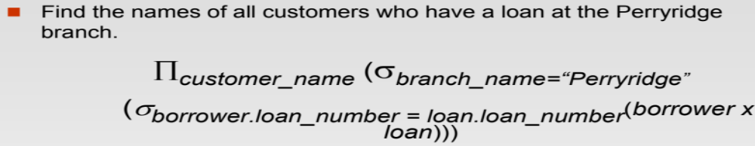
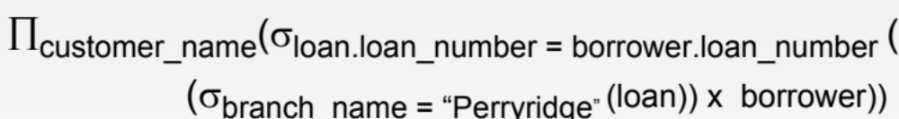
Example Queries (Cont’d)

Slide 23
Example Queries
Find customers’ names who have neither accounts nor loans
  π_{customer_name}(customer) -
  (π_{customer_name}(borrower) U π_{customer_name}(depositer))

