Slide 1
Relational Algebra
Rodica Neamtu
rneamtu@wpi.edu

Slide 2
More Relational Operators

Slide 3
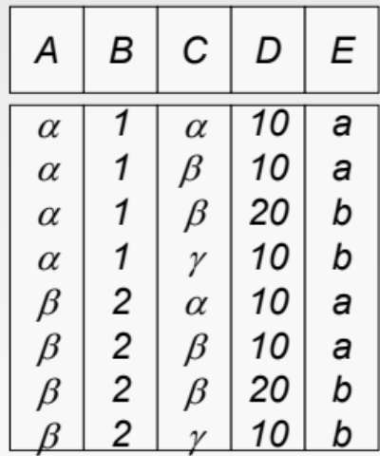
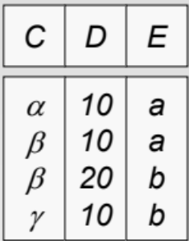
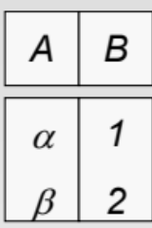
Joins
We mentioned Cartesian Product multiplies two relations
R X S
S
R
What if I want to join R and S based on a certain condition?
  Natural and Theta Joins

Slide 4
Natural Join: R ⋈ S
(Join on the common attributes)
Consider relations
  R with attributes A_{R}, and
  S with attributes A_{S}.
Let A = A_{R} ∩ A_{S} = {A1, A2, …, An} The common attributes
In English
  Natural join R ⋈ S is a Cartesian Product R X S with equality predicates on the common attributes (Set A)

Slide 5
Natural Join: R ⋈ S
R ⋈ S can be defined as :
π_{AR – A, A, AS - A} (σ_{R.A1 = S.A1 AND R.A2 = S.A2}
_{AND … R.An = S.An}
(R X S))
Project the union of all attributes
Equality on common attributes
Cartesian Product
Common attributes appear once in the result

Slide 6
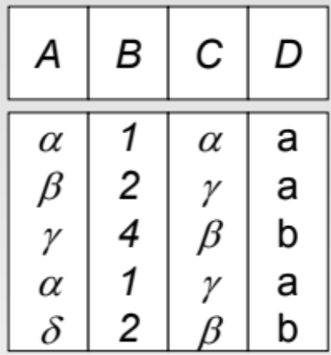
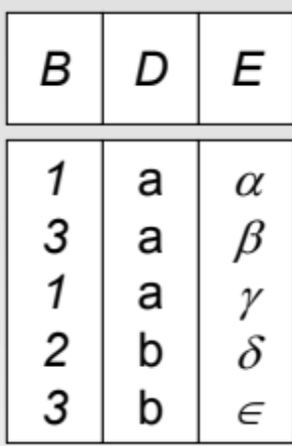
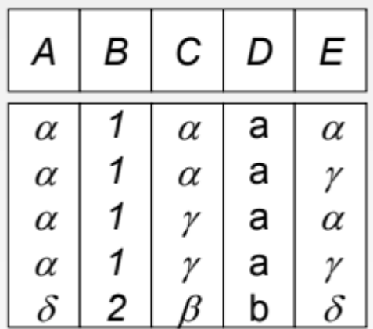
Natural Join: R ⋈ S: Example
Implicit condition
(R.B = S.B and R.D = S.D)
R
S
R ⋈ S

Slide 7
Theta Join: R ⋈_{C} S
Theta Join is cross product, with condition C
It is defined as :
R ⋈_{C} S = (σ_{C} (R X S))
Theta join can express both Cartesian Product & Natural Join
Recommendation:
Always use Theta join
(more explicit and more clear)
R
S
A | B
1 | 2
3 | 2
D | C
2 | 3
4 | 5
4 | 5
R ⋈ _{R.A>=S.C}S
A | B | D | C
3 | 2 | 2 | 3

Slide 8
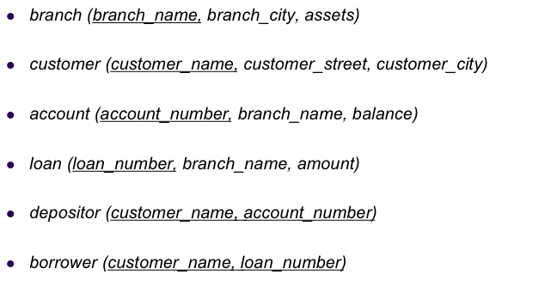
Example Queries
Find customer names having account balance below 100 or above 10,000
  π_{customer_name} (σbalance <100 OR balance > 10,000 (depositor ⋈ account) )

Slide 9
Another equivalent expression
Always good to push selection early
Find customer names having account balance below 100 or above 10,000
  π_{customer_name} (depositor ⋈
  π_{account_number}(σbalance <100 OR balance > 10,000 (account)))
This projection is optional

Slide 10
Assignment Operator: ←
The assignment operation (←) provides a convenient way to express complex queries on multiple line
Write query as a sequence of line consisting of:
  Series of assignments
  Result expression containing the final answer
Example:
  R1 ← (σ _{((A=B) ^ (D>5))} (R – S)) ∩ W
  R2 ← R1 ⋈_{(R.A = T.C)} T
  Result ← R1 U R2

Slide 11
Example Queries
For branches that gave loans > 100,000 or hold accounts with balances >50,000, report the branch name along whether it is reported because of a loan or an account
  R1 ← π_{branch_name, ‘Loan’ As Type} (σ_{amount >100,000} (loan))
  R2 ← π_{branch_name, ‘Account’ As Type}(σ_{balance > 50,000} (account)))
  Result ← R1 U R2

Slide 12
Example Queries
Find customers having account balance below 100 and loans above 10,000
  R1 ← π_{customer_name} (depositor ⋈ π_{account_number}(σ_{balance <100} (account)))
  R2 ← π_{customer_name} (borrower ⋈ π_{loan_number}(σ_{amount >10,000} (loan)))
  Result ← R1 ∩ R2

Slide 13
Duplicate Elimination: δ (R)
Delete all duplicate records
Convert a bag to a set
R
 (R)
A | B
1 | 2
3 | 4
1 | 2
1 | 2
A | B
1 | 2
3 | 4

Slide 14
More Relational Operators

Slide 15
Grouping & Aggregation operator: γ
Aggregation function takes a collection of values and returns a single value as a result
  avg: average value
  min: minimum value
  max: maximum value
  sum: sum of values
  count: number of values
Grouping & Aggregate operation in relational algebra
  γg1,g2, …gm, F1(A1), F2(A2), …Fn(An) (R)
  R is a relation or any relational-algebra expression
  g1, g2, …gm is a list of attributes on which to group (can be empty)
  Each Fi is an aggregate function applied on attribute Ai within each group

Slide 16
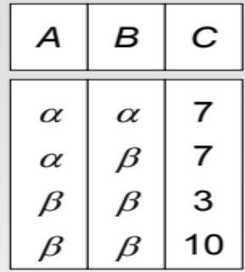
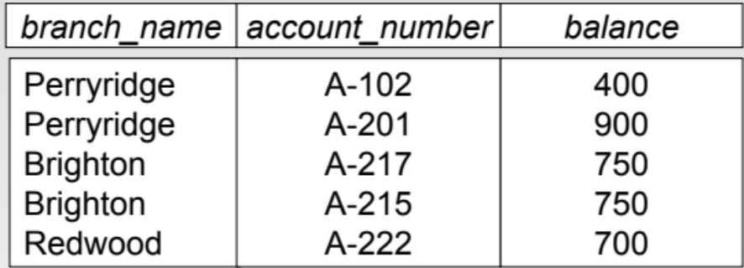
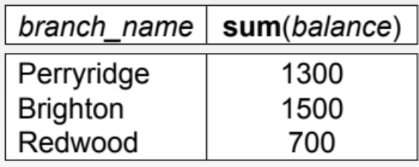
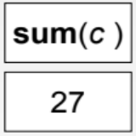
Grouping & Aggregation Operator: Example
R
S
  γ_{branch_name,sum(balance)}(S)
  γ_{sum(c)}(R)

Slide 17
Example Queries
Find customer names having loans with sum > 20,000
  π_{customer_name} (σ_{sum > 20,000} (γcustomer_name, sum ← sum(amount)(loan ⋈ borrower)))

Slide 18
Example Queries
Find the branch name with the largest number of accounts
  R1 ← γbranch_name, countAccounts ← count(account_number)(account)
  R2 ← γ_{Max ← max(countAccounts)}(R1)
  Result ← π_{branch_name}(R1 ⋈_{countAccounts = Max} R2)

Slide 19
Example Queries
Find account numbers and balances for customers having loans > 10,000
  π_{account_number, balance}
  ( (depositor ⋈ account) ⋈
  (π_{customer_name} (borrower ⋈ (σ_{amount >10,000} (loan))))
  )

Slide 20
Reversed Queries (what does it do)?
  π_{customer_name}(customer) - π_{customer_name}(borrower)
Find customers who did not take loans

Slide 21
Reversed Queries (what does it do)?
  R1 ← (γ_{MaxLoan ← max(amount)}(σ_{branch_name= “ABC”} (loan)))
  Result ← π_{customer_name}(borrower ⋈ (R1 ⋈MaxLoan=amount^branch_name= “ABC” loan))
Find customer name with the largest loan from a branch “ABC”

Slide 22
Summary of Relational-Algebra Operators
Set operators
  Union, Intersection, Difference
Selection & Projection & Extended Projection
Joins
  Natural, Theta
Rename & Assignment
Duplicate elimination
Grouping & Aggregation

