Slide 1
Relational Algebra
Rodica Neamtu
rneamtu@wpi.edu

Slide 2
Examples of
Relationships Among Operators

Slide 3
Relationships Among Operators (I)
Intersect as Difference
  R ∩ S = R– (R–S)
Join as Cartesian Product + Select
  R ⋈_{C} S = (σ_{C} (R X S))
Select is commutative
  σ_{C2} (σ_{C1} (R)) = σ_{C1} (σ_{C2} (R)) = σ_{C1^C2} (R)
Order between Select & Project
  σ_{C} (π_{list} (R)) → π_{list} (σ_{C} (R))
  π_{list} (σ_{C} (R)) → σ_{C} (π_{list} (R))
Only if “list” contains all columns needed by conditions C

Slide 4
Relationships Among Operators (II)
Join is commutative
  R ⋈_{C} S = S ⋈_{C} R
Order between Select & Join
  σ_{R.x=“5”} (R ⋈_{R.a = S.b} S ) → ((σ_{R.x=“5”} (R)) ⋈_{R.a = S.b} S)

Slide 5
Some Basic Rules for Algebraic Expressions
(For Better Performance)

Slide 6
1- Joins vs. Cartesian Product
Use Joins instead of Cartesian products (followed by selection)
  R ⋈_{C} S = (σ_{C} (R X S)) -- LHS is better
Intuition: There are efficient ways to do the L.H.S without going through the two-steps R.H.S
CS3431

Slide 7
2- Push Selection Down
Whenever possible, push the selection down
  Selection is executed as early as possible
Intuition: Selection reduces the size of the data
Examples
  σ_{C} (π_{list} (R)) → π_{list} (σ_{C} (R)) -- RHS is better
  σ_{R.x=“5”} (R ⋈_{R.a = S.b} S ) → ((σ_{R.x=“5”} (R)) ⋈_{R.a = S.b} S) -- RHS is better
CS3431

Slide 8
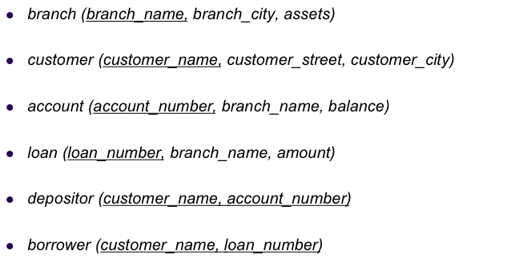
3- Avoid Un-necessary Joins
Intuition: Joins can dramatically increase the size of the data
Find customers having account balance below 100 and loans above 10,000
  R1 ← π_{customer_name} (depositor ⋈ π_{account_number}(σ_{balance <100} (account)))
  R2 ← π_{customer_name} (borrower ⋈ π_{loan_number}(σ_{amount >10,000} (loan)))
  Result ← R1 ∩ R2
Better than joining the 4 relations and then selecting

Slide 9
Operations On Bags

Slide 10
Relations may have duplicates
R(A, B)
π_{B} (R)
R
Under operations, the relation may become a bag
A | B
1 | 2
3 | 4
10 | 2
15 | 3
B
2
4
2
3
The base relation has a primary key, so all records are unique (Set)
This new relation is a bag
CS3431

Slide 11
Operations on Bags
Most DBMSs allow relations to be bags (not limited to sets)
All previous relational algebra operators apply to both sets and bags
  Bags allow duplicates
Duplicate elimination operator converts a bag into a set
Some properties may hold for sets but not bags
  Example: R U R = R (True for sets, False for bags)

Slide 12
Example Operations on Bags: Union: ∪
Consider two relations R and S that are union-compatible
R  S
R
S
A | B
1 | 2
1 | 2
1 | 2
3 | 4
3 | 4
5 | 6
A | B
1 | 2
3 | 4
1 | 2
A | B
1 | 2
3 | 4
5 | 6
Suppose a tuple t appears in R m times, and in S n times.
Then in the union, t appears m + n times.

Slide 13
Example Operations on Bags: Intersection: ∩
Consider two relations R and S that are union-compatible
R
S
R ∩ S
A | B
1 | 2
3 | 4
1 | 2
A | B
1 | 2
3 | 4
5 | 6
A | B
1 | 2
3 | 4
Suppose tuple t appears in R m times, and in S n times.
Then in intersection, t appears min (m, n) times.

Slide 14
Example Operations on Bags: Difference: –
R
S
R – S
A | B
1 | 2
3 | 4
1 | 2
A | B
1 | 2
3 | 4
5 | 6
A | B
1 | 2
Suppose tuple t appears in R m times & in S n times.
Then in R – S, t appears max (0, m - n) times.

