Slide 1
SQL: Structured Query Language
Rodica Neamtu
rneamtu@wpi.edu

Slide 2
SQL Language
Data Definition Language (DDL)
  Create tables, specifying the columns and their types of columns, the primary keys, etc.
  Drop tables, add/drop columns, add/drop constraints – primary key, unique, etc.
Data Manipulation Language (DML)
  Update, Insert, Delete tuples
  Query the data
Our focus today
These are already covered

Slide 3
Reminder About DDL
Create “Students” relation
Create “Courses” relation
CREATE TABLE Students
(sid: CHAR(20) Primary Key,
name: CHAR(20) Not NULL,
login: CHAR(10),
age: INTEGER,
gpa: REAL);
CREATE TABLE Courses
(cid: Varchar(20) Primary Key,
name: string,
maxCredits : integer,
graduateFlag: boolean);
Create “Enrolled” relation
CREATE TABLE Enrolled
(sid: CHAR(20) Foreign Key References (Students.sid),
cid: Varchar(20),
enrollDate: date,
grade: CHAR(2),
Constraints fk_cid Foreign Key cid References (Courses.cid));
Alter Table Enrolled Add Constraints fk_cid Foreign Key cid References Courses(cid));

Slide 4
Reminder About:
Insert, Update, Delete
This is performed using Data Manipulation Language of SQL (DML)
Insertion
  Insert into Students values (‘1111’, …);
Deletion
  Delete from Students;
  Delete from Students Where sid = ‘1111’;
Update
  Update Students Set GPA = GPA + 0.4;
  Update Students Set GPA = GPA + 0.4 Where sid = ‘1111’;

Slide 5
SQL Query Language
SELECT Statement

Slide 6
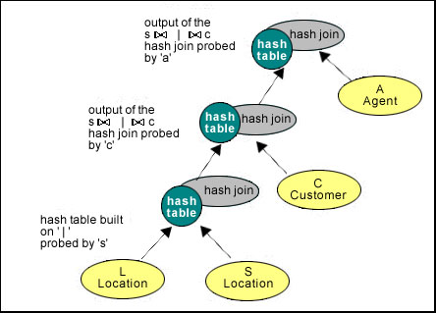
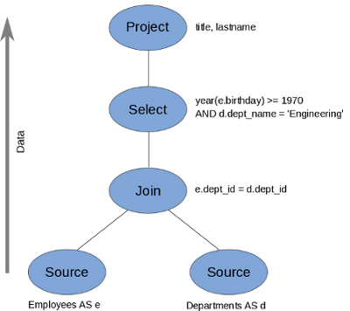
Relation between Algebra and SQL-Select
Will be mapped to the algebraic operators that we learned
SELECT <projection list>
FROM <relation names>
WHERE <conditions>
GROUP BY <grouping columns>
HAVING <grouping conditions>
ORDER BY <order columns>;
Query Plans

Slide 7
SELECT-FROM-WHERE
π
SELECT <list of columns>
FROM <relation name>
WHERE <conditions>;
relation name
σ

Slide 8
SELECT-FROM-WHERE
* Means “project all attributes”
SELECT *
FROM Student
WHERE sName= ‘Greg’ AND address=‘320FL’;
Must terminate with ; to execute
Student
sNumber | sName | address | professor
1 | Dave | 311FL | MM
2 | Greg | 320FL | MM
3 | Matt | 320FL | ER
sNumber | sName | address | professor
2 | Greg | 320FL | MM
σ (sName=‘Greg’ AND address=‘320FL’) (Student)

Slide 9
SELECT-FROM-WHERE
SELECT sNumber
FROM Student
WHERE sName=‘Greg’ AND address=‘320FL’;
Student
sNumber | sName | address | professor
1 | Dave | 311FL | MM
2 | Greg | 320FL | MM
3 | Matt | 320FL | ER
sNumber | sName | address | professor
2 | Greg | 320FL | MM
π_{sNumber}(σ(sName=‘Greg’ AND address=‘320FL’) (Student))

Slide 10
Select-From Query
The WHERE clause is optional
SELECT sNumber, sName
FROM Student;
Student
sNumber | sName | address | professor
1 | Dave | 320FL | MM
2 | Greg | 320FL | MM
3 | Matt | 320FL | ER
sNumber | sName
1 | Dave
2 | Greg
3 | Matt

Slide 11
Extended Projection
The select clause can have expressions and constants
SELECT <list of columns or expressions>
FROM <relation name>
WHERE <conditions>;
Can also rename the fields or expressions using “AS” keyword

Slide 12
Extended Projection
SELECT ‘Name:’ || sName AS info, 0 AS gpa
FROM Student
WHERE address=‘320FL’;
Student
sNumber | sName | address | professor
1 | Dave | 320FL | MM
2 | Greg | 320FL | MM
3 | Matt | 320FL | ER
info | gpa
Name:Dave | 0
Name:Greg | 0
Name:Matt | 0

Slide 13
Renaming Relations and Tuple Variables
SELECT S1.sNumber AS num
FROM Student S1
WHERE S1.sNumber >= 1;
Tuple variable
Student
sNumber | sName | address | professor
1 | Dave | 320FL | MM
2 | Greg | 320FL | MM
3 | Matt | 320FL | ER
num
1
2
3

Slide 14
Where Clause
The comparison operator depends on the data type
For Numbers:
  <, >, <=, >=, =, <>
What about Strings??
SELECT S1.sNumber AS num
FROM Student S1
WHERE S1.sNumber >= 1;

Slide 15
String Operators
Comparison Operators based on lexicographic ordering: =, <, >, <>, >=, <=
Concatenation operator: ||
Pattern match: s LIKE p
  p denotes a pattern
  Can use wild characters in p such as _, %
  _ ➔ matches exactly any single character
  % ➔ matches zero or more characters
SELECT ‘Name:’ || sName
FROM Student
WHERE address=‘320FL’;

Slide 16
String Matching Example
SELECT s1.sNumber AS num
FROM Student S1
WHERE s1.sName LIKE ‘Da%’
Or S1.professor LIKE ‘M_’ ;
sNumber | sName | address | professor
1 | Dave | 320FL | MM
2 | Greg | 320FL | MM
3 | Matt | 320FL | ER
num
1
2

Slide 17
Set Operators in SQL
Set Semantics
  Union, Intersect, Except
The two relations R and S must have the same number of columns and data types (Union Compatible)
  Oracle allows columns to have different names
They eliminate duplicates

Slide 18
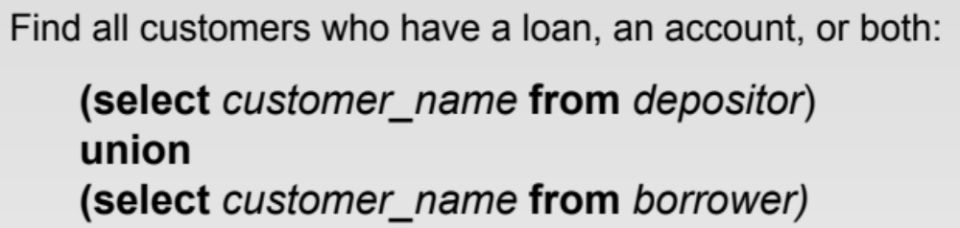
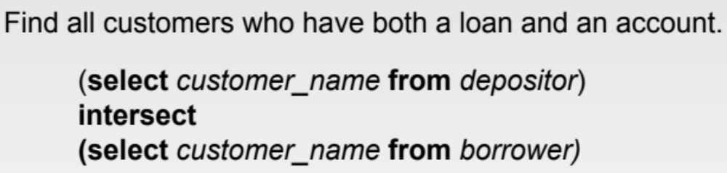
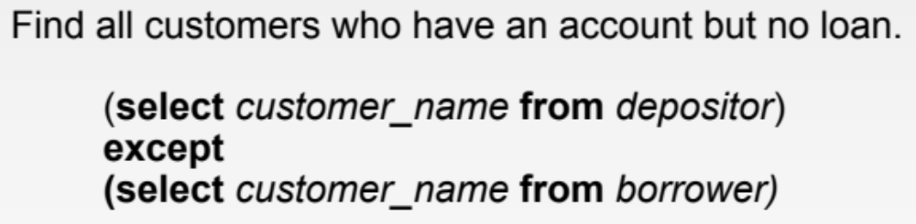
Set Operations in SQL: Example
;
;
;

Slide 19
Bag Operators in SQL
Bag Semantics
  Union ALL, Intersect ALL, Except ALL
Under bag semantics duplication is allowed

Slide 20
Example: Union ALL
Select * From R Union All Select * From S;
R
S
A | B
1 | 2
1 | 2
1 | 2
3 | 4
3 | 4
5 | 6
A | B
1 | 2
3 | 4
1 | 2
A | B
1 | 2
3 | 4
5 | 6
Suppose a tuple t appears in R m times, and in S n times.
Then in the union, t appears m + n times.

Slide 21
Example: Intersect ALL
Select * From R Intersect All Select * From S;
R
S
A | B
1 | 2
3 | 4
1 | 2
1 | 2
A | B
1 | 2
3 | 4
5 | 6
1 | 2
A | B
1 | 2
3 | 4
1 | 2
Suppose tuple t appears in R m times, and in S n times.
Then in intersection, t appears min (m, n) times.

Slide 22
Example: Except ALL
Select * From R Except All Select * From S;
R
S
A | B
1 | 2
3 | 4
1 | 2
A | B
1 | 2
3 | 4
5 | 6
A | B
1 | 2
Suppose tuple t appears in R m times & in S n times.
Then in R – S, t appears max (0, m - n) times.

Slide 23
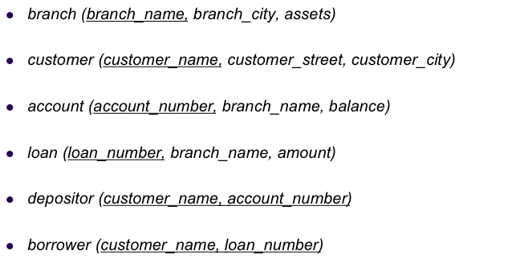

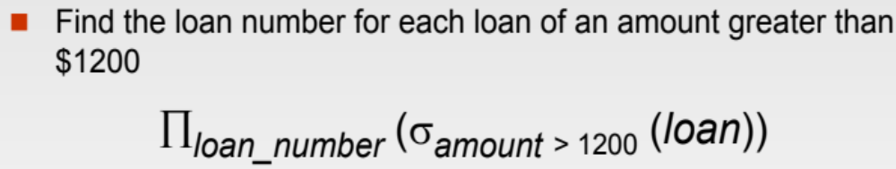
Example Queries
SELECT *
FROM loan
WHERE amount > 1200 ;
SELECT L.loan_number
FROM loan L
WHERE L.amount > 1200 ;

Slide 24
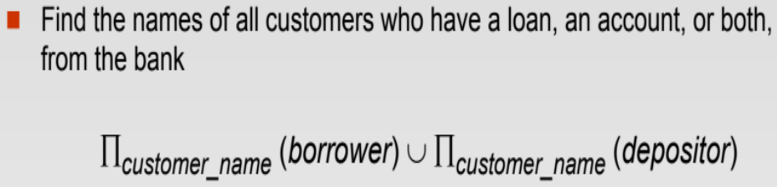
Example Queries
SELECT customer_name
FROM depositor
Union
SELECT customer_name
FROM borrower;

Slide 25
More on SQL SELECT

Slide 26
Cartesian Product in SQL
In Relation Algebra: R x S
In SQL, add R and S to FROM clause
  No WHERE condition that links R and S
SELECT *
FROM Student, Professor;
SELECT sName, pNumber
FROM Student, Professor;

Slide 27
Cross Product - Example
Student
Professor
sNumber | sName | address | professor
1 | Dave | 320FL | 1
2 | Greg | 320FL | 1
3 | Matt | 320FL | 2
pNumber | pName | addr
1 | MM | 141FL
2 | ER | 201FL
SELECT *
FROM Student, Professor;
sNumber | sName | address | professor | pNumber | pName | addr
1 | Dave | 320FL | 1 | 1 | MM | 141FL
1 | Dave | 320FL | 1 | 2 | ER | 201FL
2 | Greg | 320FL | 1 | 1 | MM | 141FL
2 | Greg | 320FL | 1 | 2 | ER | 201FL
3 | Matt | 320FL | 2 | 1 | MM | 141FL
3 | Matt | 320FL | 2 | 2 | ER | 201FL

Slide 28
Theta Join in SQL
In Relation Algebra: R ⋈_{C} S
In SQL, add R and S to FROM clause
  WHERE condition that links R and S with the join condition C
SELECT *
FROM Student, Professor
WHERE Student.pNum = Professor.Number;
Join condition

Slide 29
Theta Join Example
Student
Professor
sNumber | sName | address | profNum
1 | Dave | 320FL | 1
2 | Greg | 320FL | 1
3 | Matt | 320FL | 2
pNumber | pName | address
1 | MM | 141FL
2 | ER | 201FL
SELECT sNumber, sName, pName
FROM Student, Professor
WHERE profNum = pNumber;
sNumber | sName | pName
1 | Dave | MM
2 | Greg | MM
3 | Matt | ER
π _{sNumber,sName,pName}(Student ⋈_{(profNum=pNumber)} Professor)

Slide 30
Theta Join Example
Student
Professor
sNumber | sName | address | profNum
1 | Dave | 320FL | 1
2 | Greg | 320FL | 1
3 | Matt | 320FL | 2
pNumber | pName | address
1 | MM | 141FL
2 | ER | 201FL
If column names are the same ➔ use relationName.attrName
SELECT sName, pName, S.address
FROM Student S, Professor P
WHERE S.address = P.address;
π _{sName,pName,S.address}(ρ_{S}(Student) ⋈_{(S.address=P.address)} ρ_{P}(Professor))

Slide 31
Natural Join
Reminder: Join columns must have same names in both relations (R ⋈ S)
Student ⋈ Professor
SELECT *
FROM Student NATURAL JOIN Professor;
SELECT *
FROM Student , Professor
WHERE Student.pnumber = Professor.pnumber ;
Explicitly add the equality join condition

Slide 32
Difference between the two Queries below
Student ⋈ Professor
Common columns will appear once
SELECT *
FROM Student NATURAL JOIN Professor;
Common columns will appear twice
SELECT *
FROM Student , Professor
WHERE Student.pnumber = Professor.pnumber ;
Explicitly add the equality join condition

Slide 33
Natural Join - Example
Student ⋈ Professor
Must be the same name
Student
Professor
sNumber | sName | address | pNumber
1 | Dave | 320FL | 1
2 | Greg | 320FL | 1
3 | Matt | 320FL | 2
pNumber | pName | addr
1 | MM | 141FL
2 | ER | 201FL
SELECT *
FROM Student natural join Professor;
Common cols appear once
sNumber | sName | address | pNumber | pName | addr
1 | Dave | 320FL | 1 | MM | 141FL
2 | Greg | 320FL | 1 | MM | 141FL
3 | Matt | 320FL | 2 | ER | 201FL

Slide 34
Theta Join - Example
Student ⋈Student.pNumber = Professor.pNumber Professor
Student
Professor
sNumber | sName | address | pNumber
1 | Dave | 320FL | 1
2 | Greg | 320FL | 1
3 | Matt | 320FL | 2
pNumber | pName | addr
1 | MM | 141FL
2 | ER | 201FL
SELECT *
FROM Student S, Professor P
Where S.pNumber = P.pNumber;
All columns will appear
sNumber | sName | address | S.pNumber | P.pNumber | pName | addr
1 | Dave | 320FL | 1 | 1 | MM | 141FL
2 | Greg | 320FL | 1 | 1 | MM | 141FL
3 | Matt | 320FL | 2 | 2 | ER | 201FL

Slide 35
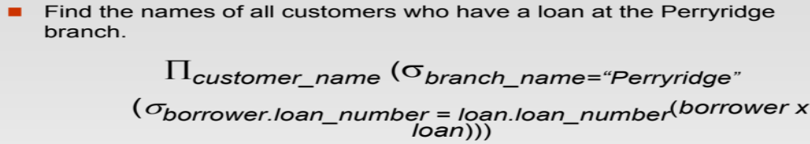
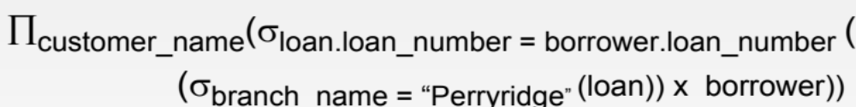
Example Queries
DBMS is smart enough !!!
(Select first, then joins)
SELECT customer_name
FROM borrower B, loan L
WHERE B.loan_number = L.loan_number
AND L.branch_name = “Perryridge”;
Tested second
Tested first

Slide 36
Example Queries
Find customer names having account balance below 100 or above 10,000
SELECT customer_name
FROM account A, depositor D
WHERE A.account_number = D.account_number
AND (balance < 100
OR balance >10,000);
It is better to write the condition than using Natural Join
These two conditions will execute first before the join.

Slide 37
Example Queries
For branches that gave loans > 100,000 or hold accounts with balances >50,000, report the branch name along whether it is reported because of a loan or an account
SELECT branch_name, ‘Loan’ As Type
FROM Loan
WHERE amount > 100,000
Union
SELECT branch_name, ‘Account’ As Type
FROM account
WHERE balance > 50,000;

Slide 38
Sorting: ORDER BY clause
New optional clause that you can add to the SELECT statement called “ORDER BY”
Allows sorting the returned records according to one or more fields
SELECT *
FROM Student
WHERE sNumber >= 1
ORDER BY pNumber, sName;
Default is ascending order
SELECT *
FROM Student
WHERE sNumber >= 1
ORDER BY pNumber ASC, sName DESC;
-Order first based on the pNumber (ascending)
-If many records exist with the same pNumber
- order them based on sName (descending)

Slide 39
Sorting: ORDER BY clause
SELECT *
FROM Student
WHERE sNumber >= 1
ORDER BY pNumber, sName;
Order By does not change the content of the output relation. It only change the order of tuples
Must be the last clause in the SELECT statement.

Slide 40
Sorting: ORDER BY clause
Student
sNumber | sName | address | pNumber
1 | Dave | 320FL | 1
2 | Greg | 320FL | 1
3 | Matt | 320FL | 2
SELECT *
FROM Student
WHERE sNumber >= 1
ORDER BY pNumber,
sName DESC;
sNumber | sName | address | pNumber
2 | Greg | 320FL | 1
1 | Dave | 320FL | 1
3 | Matt | 320FL | 2
τ _{(pNumber, sName DESC)} (σ _{(sNumber >= 1)} (Student))

Slide 41
Duplicate Elimination in SQL
New optional keyword “DISTINCT”
Added in the SELECT clause
SELECT DISTINCT …
FROM …
…
Eliminate any duplicates from the answer

Slide 42
Duplicate Elimination: Example
Student
sNumber | sName | address | professor
1 | Dave | 320FL | MM
2 | Greg | 320FL | MM
3 | Matt | 320FL | ER
(π_{sName,address}(Student))
(π _{(address)} (σ _{(sNumber > 1)} (Student)))
SELECT DISTINCT sName, address
FROM Student;
SELECT DISTINCT address
FROM Student
WHERE sNumber > 1;
sName | address
Dave | 320FL
Greg | 320FL
Matt | 320FL
address
320FL

Slide 43

Always Remember….
Only SELECT and FROM clauses are mandatory
All the others are optional
You can mix and match the optional ones
  But if you add a clause, then keep it in its order
SELECT DISTINCT address
FROM Student
WHERE sNumber > 1;
SELECT address
FROM Student
ORDER BY sNumber;
SELECT address
FROM Student
WHERE sNumber > 1
ORDER BY sNumber;
SELECT address
FROM Student
ORDER BY sNumber
WHERE sNumber > 1;
X

Slide 44
Aggregation + GroupBy

Slide 45
Possible Aggregations in SQL
SELECT COUNT (*) FROM Student;
SELECT COUNT (sNumber) FROM Student;
SELECT MIN (sNumber) FROM Student;
SELECT MAX (sNumber) FROM Student;
SELECT SUM (sNumber) FROM Student;
SELECT AVG (sNumber) FROM Student;

Slide 46
Grouping & Aggregation in SQL
New optional clause called “GROUP BY”
If the SELECT statement has “WHERE”
  Then WHERE conditions are evaluated first, then records are grouped
Then count the records in each group
And get the minimum gpa for each group
SELECT pNumber, COUNT (sName), Min(gpa)
FROM Student
GROUP BY pNumber;
First form groups for each pNumber

Slide 47
GROUP BY: Example I
Student
sNumber | sName | address | pNumber
1 | Dave | 320FL | 1
2 | Greg | 320FL | 1
3 | Matt | 320FL | 2
4 | Jan | 500MA | 2
γ_{cnt ← count(*)} (Student)
γ_{pNumber,cnt ←count(*)} (σ _{(sNumber > 1)} (Student))
SELECT count(*) AS CNT
FROM Student;
SELECT pNumber, count(*) AS CNT
FROM Student
WHERE sNumber > 1
GROUP BY pNumber;
CNT
4
pNumber | CNT
1 | 1
2 | 2

Slide 48
GROUP BY: Example II
Student
sNumber | sName | address | pNumber
1 | Dave | 320FL | 1
2 | Greg | 320FL | 1
3 | Matt | 320FL | 2
4 | Jan | 500MA | 2
γpNumber,address, CNT ← count(sName), SUM ← sum(sNumber) (σ _{(sNumber > 1)} (Student))
SELECT pNumber,address, count(sName) AS CNT, sum(sNumber) AS SUM
FROM Student
WHERE sNumber >= 1
GROUP BY pNumber, address;
pNumber | address | CNT | SUM
1 | 320FL | 2 | 3
2 | 320FL | 1 | 3
2 | 500MA | 1 | 4

