Slide 1
SQL: Structured Query Language
Part -2
Instructor: Rodica Neamtu
rneamtu@wpi.edu

Slide 2
Aggregation + GroupBy

Slide 3

Restrictions of GROUP BY
If you group by A1, A2, …An, then any other column projected in SELECT clause must be inside an aggregation function
SELECT pNumber, address, count(sName) AS CNT, sum(sNumber) AS SUM
FROM Student
WHERE sNumber > 1
GROUP BY pNumber, address;
SELECT pNumber, address, sName, sum(sNumber) AS SUM
FROM Student
WHERE sNumber > 1
GROUP BY pNumber, address;
X
SELECT pNumber, count(sName) AS CNT, sum(sNumber) AS SUM
FROM Student
WHERE sNumber > 1
GROUP BY pNumber, address;

Slide 4
Oracle Non-Standard Aggregate Functions
(URL)
Lets do: ListAgg()

Slide 5
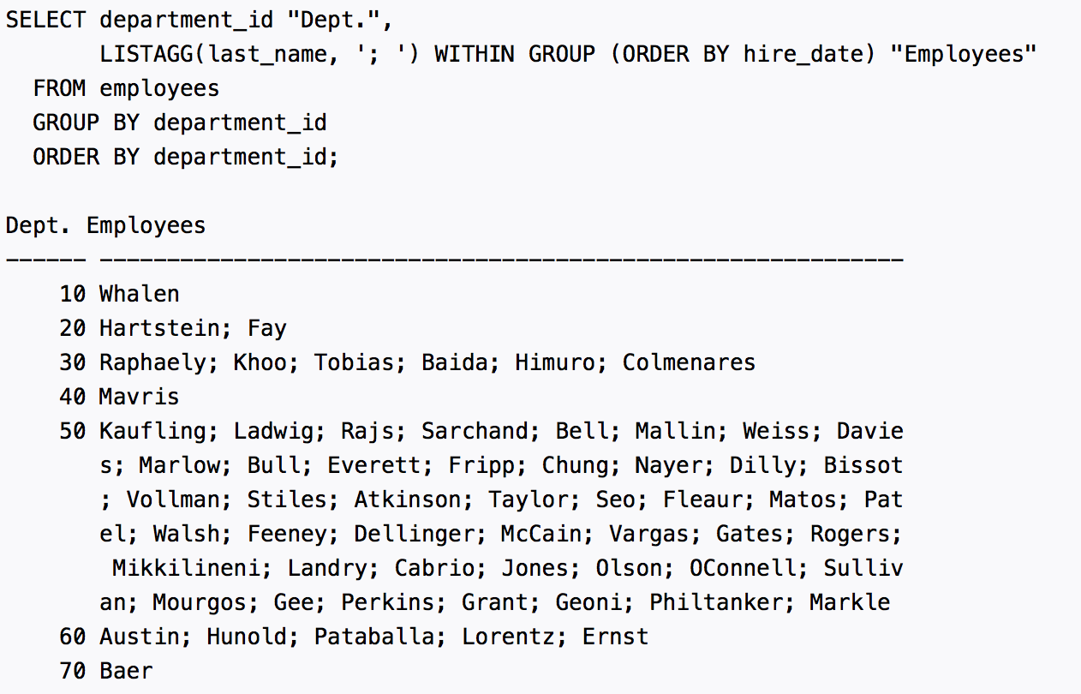

Slide 6
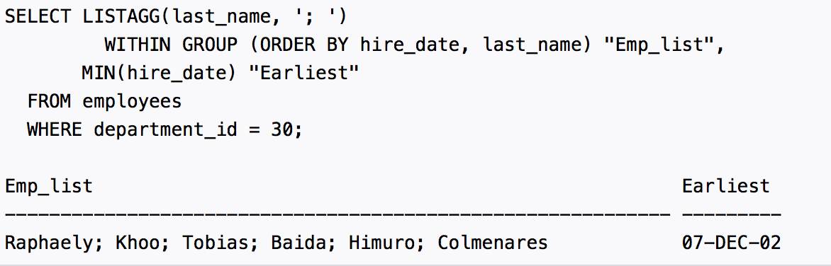

Slide 7
HAVING Clause: Putting Condition on Groups
How to add conditions on each group?
  Select only the groups where the COUNT > 5
These conditions are after you build the groups (not before)
  Remember: WHERE conditions are executed before the groups are formed
New optional clause called “HAVING”, added after the GROUP BY clause
SELECT pNumber, COUNT (sName)
FROM Student
GROUP BY pNumber
HAVING SUM(sNumber) > 2;
Can reference aggregation inside HAVING

Slide 8
HAVING Clause: Example
Student
sNumber | sName | address | pNumber
1 | Dave | 320FL | 1
2 | Greg | 320FL | 1
3 | Matt | 320FL | 2
4 | Jan | 500MA | 2
σ _{(SUM> 3)} (γpNumber,address, CNT ← count(sName), SUM ← sum(sNumber) (σ _{(sNumber > 1)} (Student)))
SELECT pNumber,address, count(sName) AS CNT, sum(sNumber) AS SUM
FROM Student
WHERE sNumber > 1
GROUP BY pNumber, address
HAVING sum(sNumber) > 3;
Applied before the grouping
Applied after the grouping on each group
pNumber | address | CNT | SUM
2 | 500MA | 1 | 4

Slide 9
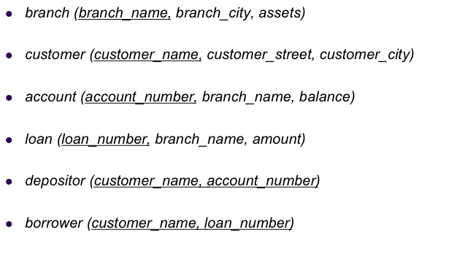
Example Queries
Find customers having loans with sum > 20,000. Report the customer names and the total loans amount
SELECT customer_name, sum(amount) AS SUM
FROM Loan L, Borrower B
WHERE L.loan_number = B. loan_number
GROUP BY customer_name
HAVING sum(amount) > 20,000;

Slide 10
Example Queries
Find the cities with more than 3 branches
SELECT branch_city
FROM Branch
GROUP BY branch_city
HAVING count(branch_name) > 3;

Slide 11
Example Queries
Find the customer names who have accounts with balance > 100,000 in more than two branches. Report the customer names & number of branches
SELECT customer_name, count(branch_name) As CNT
FROM Account A, Depositor D
WHERE A.account_number = D.account_number
AND A.balance > 100,000
GROUP BY customer_name
HAVING count(branch_name) > 2;

Slide 12
Example Queries
Report the largest and smallest loans given by each branch in NY city along with the branch name.
SELECT branch_name, Max(amount) As MaxLoan, Min(amount) As MinLoan
FROM Loan L, Branch B
Where L.branch_name = B.branch_name
AND branch_city = ‘NY’
GROUP BY branch_name;

Slide 13
SELECT Statement Clauses
SELECT <projection list>
FROM <relation names>
WHERE <conditions>
GROUP BY <grouping columns>
HAVING <grouping conditions>
ORDER BY <order columns>;
optional
Optional clauses if added must be in the order above
Order of execution
  FROM ⬅ Check which relations are used
  WHERE ⬅ Filter records based on conditions
  GROUP BY ⬅ Form groups
  HAVING ⬅ Filter groups based on conditions
  ORDER BY ⬅ Sort the data
  SELECT ⬅ Form the projection list (output columns)

Slide 14
Example: Order of Execution
Student
sNumber | sName | address | pNumber
1 | Dave | 320FL | 1
2 | Greg | 320FL | 1
3 | Matt | 320FL | 2
4 | Jan | 500MA | 2
5
SELECT pNumber,address, count(sName) AS CNT, sum(sNumber) AS SUM
FROM Student
WHERE sNumber > 1
GROUP BY pNumber, address
HAVING sum(sNumber) > 3;
1
2
3
4
pNumber | address | CNT | SUM
2 | 500MA | 1 | 4

Slide 15


Questions
SELECT <projection list>
FROM <relation names>
WHERE <conditions>
GROUP BY <grouping columns>
HAVING <grouping conditions>
ORDER BY <order columns>;
optional

Slide 16
More on SELECT Statement
Queries inside Insert/Update/Delete
Special handling for NULL values
Temp Tables
Nested subqueries

Slide 17
Reminder About:
Insert, Update, Delete
This is performed using Data Manipulation Language of SQL (DML)
Insertion
  Insert into Students values (‘1111’, …);
Deletion
  Delete from Students;
  Delete from Students Where sid = ‘1111’;
Update
  Update Students Set GPA = GPA + 0.4;
  Update Students Set GPA = GPA + 0.4 Where sid = ‘1111’;

Slide 18
Use of Select Inside Insert
All records returned from the Select will be inserted
Notice that there is no keyword “values” in this case
INSERT INTO suppliers (supplier_id, supplier_name)
  SELECT account_no, name
  FROM externals
  Where code = 1;
Number of columns and data types should match

Slide 19
Use of Select Inside Delete
Student
Registration
sNumber | sName | address
1 | Dave | 320FL
2 | Greg | null
3 | Matt | null
4 | Jan | 500MA
sNumber | courseID | grade
4 | DB1 | A
2 | DB1 | F
3 | DB2 | A
4 | DB2 | F
Delete from Student all those who have grade ‘F’
Delete
From Student
Where sNumber in (Select sNumber from Registration Where grade = ‘F’);
Students number 2 & 4 will be deleted…

Slide 20
Use of Select Inside Delete
Student
Registration
sNumber | sName | address
1 | Dave | 320FL
2 | Greg | null
3 | Matt | null
4 | Jan | 500MA
sNumber | courseID | grade
4 | DB1 | A
2 | DB1 | F
3 | DB2 | A
4 | DB2 | F
Delete from Student all those who do not have registration
Delete
From Student
Where sNumber not in (Select sNumber from Registration);
Student number 1 will be deleted…

Slide 21
Use of Select Inside Update
Student
Registration
sNumber | sName | address
1 | Dave | 320FL
2 | Greg | null
3 | Matt | null
4 | Jan | 500MA
sNumber | courseID | grade
4 | DB1 | A
2 | DB1 | F
3 | DB2 | A
4 | DB2 | F
Update the grades of student ‘Matt’ to B
Update Registration
Set grade = ‘B’
Where sNumber in (Select sNumber from Student Where sName =‘Matt’);

Slide 22
Remember…
Delete
From Student
Where sNumber not in (Select sNumber from Registration);
Update Registration
Set grade = ‘B’
Where sNumber in (Select sNumber from Student Where sName =‘Matt’);
In Delete and Update
- The ‘From’ clause always has one table
- The subquery can be only added in the ‘Where’ clause

Slide 23
Example Queries
Report the branch-cities having more than 5 branches, and order them by the number branches
Select the distinct branch names that offer loans > 100,000
Report the output relation O(CustomerName, Num_Loans, Num_Accounts) only for customers who have loans and accounts

Slide 24
Example Queries
Report the branch-cities having more than 5 branches, and order them by the number branches
SELECT branch_city, count(branch_name)
FROM Branch
GROUP BY branch_city
Having count(branch_name) > 5
Order By count(branch_name);

Slide 25
Example Queries
Select the distinct branch names that offer loans > 100,000
SELECT Distinct branch_name
FROM Loan
Where amount > 100,000;

Slide 26
Example Queries
Report the output relation O(CustomerName, Num_Loans, Num_Accounts) only for customers who have loans and accounts
SELECT customer_name, count(loan_number), count(account_number)
FROM Depositor D, Borrower B
WHERE D.customer_name = B.customer_name
GROUP BY customer_name;
X
Join will cause values to replicate

Slide 27
Fixing Previous Example
The join keeps only customers
Who appear in both sides
Report the output relation O(CustomerName, Num_Loans, Num_Accounts) only for customers who have loans and accounts
SELECT customer_name, count(Distinct loan_number), count(Distinct account_number)
FROM Depositor D, Borrower B
WHERE D.customer_name = B.customer_name
GROUP BY customer_name;
➔ Applies the aggregation over the distinct values
➔ Can be used with others, e.g., Min, Max, Avg, …

