Slide 1
Advanced SQL
Rodica Neamtu
rneamtu@wpi.edu

Slide 2
Roadmap
Views
Triggers
Cursors
Stored Procedures

Slide 3
What is a View
An SQL query that we register (store) inside the database
Any query can be a view
CREATE VIEW <name> AS <select statement>;
DROP VIEW <name>;
ProfNumStudents is a view with schema (pNumber, CNT)
CREATE VIEW ProfNumStudents AS
  SELECT pNumber, count(*) AS CNT
  FROM Student
  GROUP BY pNumber;

Slide 4
Why Need a View: I
Frequent queries: query is used again and again
Complex queries: query written once and stored in the database
CREATE VIEW StudentInfo AS
  SELECT sNumber, sName
  FROM Student S, Registration R, Professor P
  Where <many conditions>
  Group By ….
  Having …;
Write this complex query once
And store it in the DB

Slide 5
Why Need a View: II
Logical data independence: the base table may change but the the view is still the same
Student (sNumber, sName, sAddress, sMajor)
CREATE VIEW StudentBasicInfo AS
  SELECT sNumber, sName
  FROM Student;
We need only sNumber and sName
Code that queries table Student may need to change because the output schema has changed.
Alter table Student drop column sMajor;
Any code that queries the view will not change because the view output is still the same.

Slide 6
Why Need a View: III
Hide information (Security): allow users to see the view but not the original tables
Student (sNumber, sName, sAddress, sMajor, SSN)
CREATE VIEW StudentNo_SSN AS
  SELECT sNumber, sName, sAddress, sMajor
  FROM Student;
This view hides the SSN column

Slide 7
View Schema
Think of a view as a table, but it gets its data during runtime
  Only the definition is stored without data
View Schema
  Consists of the columns produced from the select statement
CREATE VIEW ProfNumStudents AS
  SELECT pNumber, count(*) AS CNT
  FROM Student
  GROUP BY pNumber;
ProfNumStudents(pNumber, CNT)
CREATE VIEW StudentBasicInfo AS
  SELECT sNumber, sName
  FROM Student;
StudentBasicInfo(sNumber, sName)

Slide 8
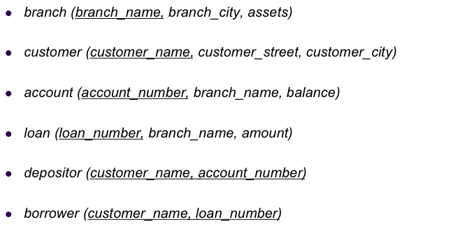
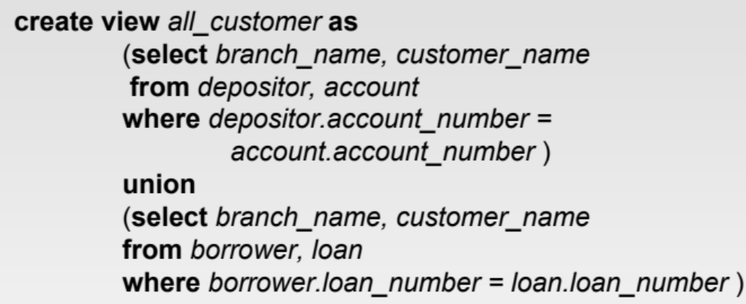
Example
Customers who have accounts
Customers who have loans

Slide 9

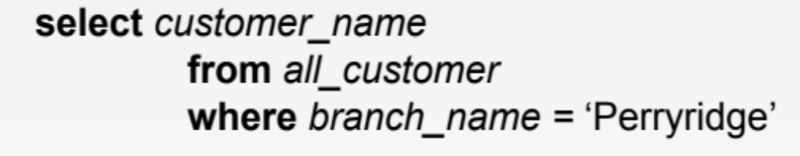
Querying a View
Exactly as querying a table
all_customer(branch_name, customer_name)
Query the view

Slide 10
View Execution: Naïve way
1
Execute the view and store the output in temporary table
Temp table:
all_customer(branch_name, customer_name)
Not the way the DB does it….
2
Execute the user’s query
Produce output
3
Delete the temporary table

Slide 11
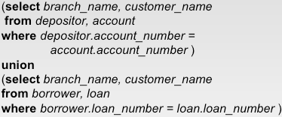
View Execution: Actual Way
1
Replace the view name with its definition
Select customer_name
From
Where branch_name = ‘Perryridge’;
all_customer
2
Optimize the query
This condition can move inside the two select statements

Slide 12


View Execution: Actual Way
3
Re-write the query and execute
Select customer_name
From
Conditions will even execute before the joins
And branch_name = ‘Perryridge’)
And branch_name = ‘Perryridge’) all_customer;

Slide 13
Summarizing Views
1- Register query and store it in DB
2- Only query definition is stored (not data)
CREATE VIEW StudentInfo AS
  SELECT sNumber, sName
  FROM Student S, Registration R, Professor P
  Where <many conditions>
  Group By ….
  Having …;
4- Why need it:
- Storing complex queries
- Security (hide information)
- Logical Independence
3- Referenced in other queries like any other table in the DB

Slide 14
Roadmap
Views
Triggers
Cursors
Stored Procedures

Slide 15
Triggers: Introduction
The application constraints need to be captured inside the database
Some constraints can be captured by:
  Primary Keys, Foreign Keys, Unique, Not NULL, and domain constraints
CREATE TABLE Students
(sid: CHAR(20),
name: CHAR(20) NOT NULL,
login: CHAR(10),
age: INTEGER,
gpa: REAL Default 0,
Constraint pk Primary Key (sid),
Constraint u1 Unique (login),
Constraint gpaMax check (gpa <= 4.0) );
These constraints are defined in CREATE TABLE or ALTER TABLE

Slide 16



Triggers: Introduction
Some application constraints are complex
  Sum of loans taken by a customer does not exceed 100,000
  Student cannot take the same course after getting a passing grade in it
  Age field is derived automatically from the Date-of-Birth field
  Admission date should automatically be filled in
  A student cannot take IQP and MQP in overlapping terms

Slide 17
Triggers
A procedure that runs automatically when a certain event occurs in the DBMS
The procedure performs some actions, e.g.,
  Check certain values
  Fill in some values
  Inserts/deletes/updates other records
  Check that some business constraints are satisfied
  Commit (approve the transaction) or roll back (cancel the transaction)

Slide 18
Trigger Components
Three components
  Event: When this event happens, the trigger is activated
  Condition (optional): If the condition is true, the trigger executes, otherwise skipped
  Action: The actions performed by the trigger
Semantics
  When the Event occurs and Condition is true, execute the Action
Lets see how to define these components

Slide 19
Trigger: Events
Three event types
  Insert
  Update
  Delete
Two triggering times
  Before the event
  After the event
Two granularities
  Execute for each row
  Execute for each statement

Slide 20
1) Trigger: Event
Trigger name
Create Trigger <name>
Before|After Insert|Update|Delete ON <tablename>
….
That is the event
Example
Create Trigger ABC
Before Insert On Students
….
Create Trigger XYZ
After Update On Students
….
This trigger is activated when an insert statement is issued, but before the new record is inserted
This trigger is activated when an update statement is issued and after the update is executed

Slide 21
Granularity of Event
A single SQL statement may update, delete, or insert many records at the same time
  E.g., Update student set gpa = gpa x 0.8;
Does the trigger execute for each updated or deleted record, or once for the entire statement ?
  We define such granularity
Create Trigger <name>
Before| After Insert| Update| Delete
For Each Row | For Each Statement
….
This is the event
This is the granularity

Slide 22
Example: Granularity of Event
Create Trigger XYZ
After Update ON <tablename>
For each statement
….
Create Trigger XYZ
Before Delete ON <tablename>
For each row
….
This trigger is activated once (per UPDATE statement) after all records are updated
This trigger is activated before deleting each record
In Oracle ➔ The Default is “For each Statement”
  You do not need to write it

Slide 23
2) Trigger: Condition
This component is optional
Trigger executes only if the condition is true
Create Trigger <name>
Before| After Insert| Update| Delete On <tableName>
For Each Row | For Each Statement
When <condition>
…
That is the condition
If the employee salary > 150,000 then some actions will be taken
Create Trigger EmpSal
After Insert or Update On Employee
For Each Row
When (new.salary >150,000)
…

Slide 24
3) Trigger: Action
In the action, you may want to reference:
  The new values of inserted or updated records (:new)
  The old values of deleted or updated records (:old)

Slide 25
Trigger: Referencing Values
In the action, you may want to reference:
  The new values of inserted or updated records (:new)
  The old values of deleted or updated records (:old)
Create Trigger EmpSal
After Insert or Update On Employee
For Each Row
When (new.salary > 50,000)
Begin
if (:new.salary < 100,000) …
End;
Inside “When”, the “new” and “old” should not have “:”
Trigger body
Inside the trigger body, they should have “:”

Slide 26
:New and :Old Variables
R
Insert into R values (5, 10);
A | B
1 | 2
3 | 4
1 | 7
Create Trigger Test
Before Insert On R
For Each Row
Begin
End;
/
Rule 1: Do not use :Old variable (it does not exist)
Rule 2: :New variable gives you the new values to be inserted.
:New.A ➔ 5
:New.B ➔ 10

Slide 27
:New and :Old Variables (cont’d)
R
Delete From R Where A = 1;
A | B
1 | 2
3 | 4
1 | 7
Create Trigger Test
Before Delete On R
For Each Row
Begin
End;
/
Rule 1: Do not use :New variable (it does not exist)
Rule 2: :Old variable gives you the old values to be deleted.
A | B
1 | 2
3 | 4
1 | 7
1st execution
:Old.A➔ 1
:Old.B ➔ 2
2nd execution
:Old.A➔ 1
:Old.B ➔ 7

Slide 28
:New and :Old Variables (cont’d)
R
Update R Set B = B * 2 Where A= 3;
A | B
1 | 2
3 | 4
1 | 7
Create Trigger Test
Before Update On R
For Each Row
Begin
End;
/
Rule 1: :Old gives you the old values before the update. :New gives you the new values after the update
:Old.A➔ 3
:New.A➔ 3
:Old.B ➔ 4
:New.B ➔ 8

Slide 29
:New and :Old Variables (cont’d)
Statement-Level Trigger
R
Delete From R Where A = 1;
A | B
1 | 2
3 | 4
1 | 7
Create Trigger Test
Before Insert/Update/Delete On R
For Each Statement
Begin
End;
/
Remember: In Oracle, it is not written
Rule 1: Statement-level triggers have no access to :Old or :New

Slide 30
Trigger: Referencing Values (Cont’d)
Insert Event
  Has only :new defined
Delete Event
  Has only :old defined
Update Event
  Has both :new and :old defined
Before triggering (for insert/update)
  Can update the values in :new
  Changing :old values does not make sense
After triggering
  Should not change :new because the event is already done

