Slide 1
Examples on Triggers
Rodica Neamtu
rneamtu@wpi.edu

Slide 2
Example 1
If the employee salary increased by more than 10%, make sure the ‘rank’ field is not null and its value has changed, otherwise reject the update
If the trigger exists, then drop it first
Create or Replace Trigger EmpSal
Before Update On Employee
For Each Row
Begin
IF (:new.salary > (:old.salary * 1.1)) Then
IF (:new.rank is null or :new.rank = :old.rank) Then
RAISE_APPLICATION_ERROR(-20004, 'rank field not correct');
End IF;
End IF;
End;
/
Compare the old and new salaries
Make sure to have the “/” to run the command

Slide 3
Example 2
If the employee salary increased by more than 10%, then increment the rank field by 1.
In the case of Update event only, we can specify which columns
Create or Replace Trigger EmpSal
Before Update Of salary On Employee
For Each Row
Begin
IF (:new.salary > (:old.salary * 1.1)) Then
:new.rank := :old.rank + 1;
End IF;
End;
/
We changed the new value of rank field
Changing the :new vector has to be in the “Before” event

Slide 4
Example 3: Using Temp Variable
If the newly inserted record in employee has null hireDate field, fill it in with the current date
Create Trigger EmpDate
Before Insert On Employee
For Each Row
Declare
temp date;
Begin
Select sysdate into temp from dual;
IF (:new.hireDate is null) Then
:new.hireDate := temp;
End IF;
End;
/
Since we need to change values, then it must be “Before” event
Declare section to define variables
Oracle way to select the current date
Updating the new value of hireDate before inserting it

Slide 5
Example 4: Maintenance of Derived Attributes
Keep the bonus attribute in Employee table always 3% of the salary attribute
Create Trigger EmpBonus
Before Insert Or Update On Employee
For Each Row
Begin
:new.bonus := :new.salary * 0.03;
End;
/
Indicate two events at the same time
The bonus value is always computed automatically

Slide 6
Combining Multiple Events in One Trigger
If you combine multiple operations
  Sometimes you need to know what is the current operation
Create Trigger EmpBonus
Before Insert Or Update On Employee
For Each Row
Begin
IF (inserting) Then … End IF;
IF (updating) Then … End IF;
End;
/
Combine Insert and Update
Can do something different under each operation

Slide 7
Order Of Trigger Firing
Loop over each affected record
Before Trigger
(statement-level)
Before Trigger
(row-level)
Event
(row-level)
After Trigger
(row-level)
After Trigger
(statement-level)
Important: (Transaction is one unit)
At any moment, if you cancel the transaction “RAISE_APPLICATION_ERROR”
➔The entire transaction is cancelled

Slide 8
Before vs. After
Before Event
  When checking certain conditions that may cause the operation to be cancelled
    E.g., if the name is null, do not insert
  When modifying values before the operation
    E.g., if the date is null, put the current date
After Event
  When taking other actions that will not affect the current operations
    The insert in table X will cause an update in table Y
Before Insert Trigger:
:new.x := …. //Changing value x that will be inserted
After Insert Trigger:
:new.x := … //meaningless because the value is already inserted

Slide 9
Row-Level vs. Statement-Level Triggers
Example: Update emp set salary = 1.1 * salary;
  Changes many rows (records)
Row-level triggers
  Check individual values and can update them
  Have access to :new and :old vectors
Statement-level triggers
  Do not have access to :new or :old vectors (only for row-level)
  Execute once for the entire statement regardless how many records are affected
  Used for verification before or after the statement

Slide 10
Example 5: Statement-level Trigger
Store the count of employees having salary > 100,000 in table R
Indicate three events at the same time
Create Trigger EmpBonus
After Insert Or Update of salary Or Delete On Employee
For Each Statement
Begin
delete from R;
insert into R(cnt) Select count(*) from employee where salary > 100,000;
End;
/
Remember: In Oracle, it is not written
Delete the existing record in R, and then insert the new count.

Slide 11
Some Other Operations
Dropping Trigger
If creating trigger with errors
SQL> Drop Trigger <trigger name>;
SQL > Show errors;
It displays the compilation errors

Slide 12
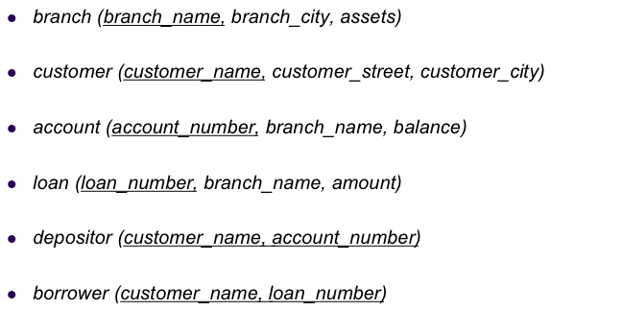
Example on Triggers
Sum of loans taken by a customer does not exceed 100,000…Assume primary keys cannot be updated
Which table ?
Which event ?
Which Timing ?
Which Granularity ?
➔ Borrower & Loan
➔ Borrower (Insert) & Loan (update)
➔ ??? Lets see
➔ row-level

Slide 13
Part 1
Sum of loans taken by a customer does not exceed 100,000
Create Trigger CustMaxLoan1
After Insert On Borrower
For Each Row
Declare
sumLoan int;
Begin
Select sum(amount) into sumLoan
From loan L, Borrower B
where L.loan_number = B.loan_number
And B.customer_name = :new.customer_name;
IF sumLoan > 100,000 Then
RAISE_APPLICATION_ERROR(-20004, ’Cannot insert record.');
End IF;
End;
/
Takes into account the new loan assigned to the customer (because it is “After Insert”

Slide 14
Part 2
Sum of loans taken by a customer does not exceed 100,000
Create Trigger CustMaxLoan2
After Update of amount On Loan
For Each Row
Declare
sumLoan int; custName varchar2(100);
Begin
Select customer_name into custName From Borrower
Where loan_number = :new.loan_number;
Select sum(amount) into sumLoan
From loan L, Borrower B
where L.loan_number = B.loan_number
And B.customer_name = custName;
IF sumLoan > 100,000 Then
RAISE_APPLICATION_ERROR(-20004, ’Cannot insert record.');
End IF;
End;
/
Get the customer to whom the updated loan belongs
Get the sum of loans for this customer

Slide 15
Example 2
What if you are requested to enforce this part ???
Sum of loans taken by a customer does not exceed 100,000…Assume primary keys cannot be updated
For each table, create “Before Update” trigger preventing a change on PK columns
Create Trigger PK-No-Update
Before Update of loan_number On Loan
For Each Row
Begin
RAISE_APPLICATION_ERROR(-20004, 'Cannot Update PK…');
End;
/

