Slide 1
Advanced SQL: Cursors & Stored Procedures
Rodica Neamtu
rneamtu@wpi.edu

Slide 2
Today’s Roadmap
Views
Triggers
Cursors
Stored Procedures

Slide 3
Using Select Inside Triggers
Create Trigger EmpDate
Before Insert On Employee
For Each Row
Declare
temp date;
Begin
Select sysdate into temp from dual;
IF (:new.hireDate is null) Then
:new.hireDate := temp;
End IF;
End;
/
- Execute Select inside trigger
- Store the result in temp variables
Works fine if the Select returns one tuple…
Create Trigger EmpDate
Before Insert On Employee
For Each Row
Declare
tempAge number;
tempName varchar2(100);
Begin
Select age, name into tempAge, tempName from R where ID = 5;
….
End;
/
- Select two columns into two variables

Slide 4
Cursors: Introduction
Select statement may return many records
Select empID, name, salary
From Employee
Where salary > 120,000;
Get 0 or more records
What if inside a trigger:
  Want to execute a select statement
  Get one record at a time
  Do something with each record
This’s what a cursor does for you…

Slide 5
What is a Cursor
A mechanism to navigate tuple-by-tuple over a relation
Typically used inside triggers, stored procedures, or stored functions
Main Idea
  When we execute a query, a relation is returned
  It is stored in private work area for the query
  Cursor is a pointer to this area
  Move the cursor to navigate over the tuples

Slide 6
Creating a Cursor
Cursor name
Any query can go here
Cursor <name> IS <SQL query>;
Cursor HighSalEmp IS
Select empID, name, salary
From Employee
Where salary > 120,000;

Slide 7
Cursor Operations
Cursor HighSalEmp IS
Select empID, name, salary
From Employee
Where salary > 120,000;
Define cursor
Open cursor
  Execute the query and put the pointer at the first tuple
Fetch next tuple
  Pointer moves automatically when a tuple is fetched
Close cursor
Open HighSalEmp;
Fetch HighSalEmp into <variable>;
Close HighSalEmp;

Slide 8
Example 1
Have two tables: Customer & Product
When insert a new customer
  Put in Marketing table, the customer ID along with the products labeled ‘OnSale’
Create Trigger NewCust
After Insert On Customer
For Each Row
Declare
pid number;
cursor C1 is Select product_id From Product Where label = 'OnSale';
Begin
open C1;
Loop
Fetch C1 Into pid;
IF (C1%Found) Then
Insert into Marketing(Cust_id, Product_id) values (:new.Id, pid);
END IF;
Exit When C1%NotFound;
END Loop;
close C1;
End; /
Define the cursor in ‘Declare’ section
Open the cursor
Loop over each record at a time
If the fetch returned a record
Customer ID
Close the cursor

Slide 9
Example 2: Another way
Use of the FOR loop with cursors
Create Trigger NewCust
After Insert On Customer
For Each Row
Declare
cursor C1 is Select product_id From Product Where label = 'OnSale';
Begin
For rec In C1 Loop
Insert into Marketing(Cust_id, Product_id) values (:new.Id, rec.product_id);
End Loop;
End; /
Automatically opens the cursor and fetches a record in each iteration
Automatically closes the cursor
That is how to read the rec variable

Slide 10
Cursor Attributes
These are attributes maintained by the system
Assume C1 is the cursor name
Attributes include:
  C1%ROWCOUNT: The number of tuples in C1
  C1%FOUND: TRUE if the last fetch was successful
  C1%NOTFOUND: TRUE if the last fetch was not successful
  C1%ISOPEN: TRUE if C1 is open

Slide 11
Parameterized Cursor
Cursors can take parameters while opening them
Very powerful to customize their execution each time
Example: Like the previous example, but select products with price < customer’s budget
Create Trigger NewCust
After Insert On Customer
For Each Row
Declare
cursor C1 (budget number) is Select product_id From Product p
Where p.label = 'OnSale' and p.price < budget;
Begin
For rec In C1(:new.budget) Loop
Insert into Marketing(Cust_id, Product_id) values (:new.Id, rec.product_id);
End Loop;
End; /
Define the cursor with a parameter
Pass the value at open time

Slide 12
Summary of Cursors
Efficient mechanism to iterate over a relation tuple-by-tuple
Main operations
  Open, fetch, close
  Usually used inside loops
Cursors can be parameterized
  What they return depends on the passed parameters

Slide 13
Today’s Roadmap
Views
Triggers
Cursors
Stored Procedures

Slide 14
Stored Procedures & Functions
Views
Way to register queries inside DBMS
Stored Procedures & Functions
Way to register code inside DBMS

Slide 15
Stored Procedures in Oracle
Stored procedures in Oracle follow a language called PL/SQL
PL/SQL: Procedural Language SQL
Same language used inside DB triggers

Slide 16
Creating A Stored Procedure
If exists, then drop it and create it again
‘IS’ or ‘AS’ both are valid
CREATE [OR REPLACE] PROCEDURE <procedureName> (<paramList>) [IS| AS]
<localDeclarations>
Begin
<procedureBody>;
End;
/
A parameter in the paramList is specified as:
<name> <mode> <type>
Mode:
IN ➔ input parameter (default)
OUT ➔ output parameter
INOUT ➔ input and output parameter

Slide 17
General Structure
CREATE [OR REPLACE] PROCEDURE procedure_name
[ (parameter [,parameter]) ]
[IS | AS]
[declaration_section]
BEGIN
executable_section
[EXCEPTION
exception_section]
END [procedure_name];
Optional section for exception handling

Slide 18
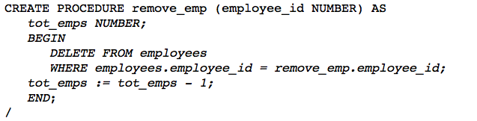
Example I
Define a variable
By default, it is IN
You can use the procedure name before the parameter name

Slide 19
Calling a Stored Procedure
SQL> exec <procedureName> [(<paramList>)];
SQL > exec remove_emp (10);

Slide 20
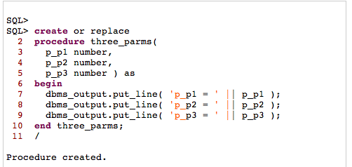
Printing From Stored Procedures
Taking three parameters
Printing lines to output screen
For the output to appear on screen. Make sure to run:
Sql > set serveroutput on;

Slide 21
Features in Stored Procedures
IN parameters
Create Procedure profiler_control(start_stop IN VARCHAR2,
run_comm IN VARCHAR2,
ret OUT number) AS
ret_code INTEGER;
BEGIN
  ret_code := 10;
  IF start_stop NOT IN ('START','STOP') THEN
  ret:= 0;
  ELSIF start_stop = 'START' THEN
  ret:= 1;
  ELSE
  ret:= ret_code;
  END IF;
END profiler_control;
/
OUT parameters
Variable declaration
Variable assignment
IF statement

Slide 22
More Features: CURSOR & FOR Statement
Create Procedure OpeningBal (p_type IN string) AS
cursor C1 Is
Select productId, name, price
From products
where type = p_type;
Begin
For rec in C1 Loop
Insert into Temp values (rec.productId, rec.name, rec.price);
End Loop;
End;
/

Slide 23
Return Value
Stored procedures can set output variables
Stored procedures do not return values
Stored functions differ from procedure in that they return values

Slide 24
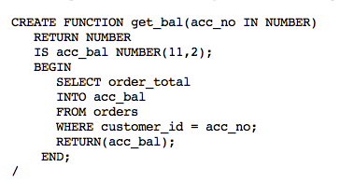
Stored Functions
Similar to stored procedures except that they return value
CREATE [OR REPLACE] FUNCTION <functionName>
RETURN <type> [(<paramList>)] AS
<localDeclarations>
<functionBody>;
The function return a number
Select into a variable
Return to the called

Slide 25
Stored Functions
All features in stored procedures are valid in stored functions
Functions have an extra ‘Return’ statement

Slide 26
Using Stored Procedures or Functions
Stored Procedures
  Called from other procedures, functions, triggers, or standalone
Stored Functions
  In addition to above, can be used inside SELECT statement
    In WHERE, HAVING, or projection list

Slide 27
Example I
CREATE FUNCTION MaxNum() RETURN number AS
num1 number;
BEGIN
SELECT MAX (sNumber) INTO num1 FROM Student;
RETURN num1;
END;
/
SQL> Select * from Student where sNumber = MaxNum();
Calling the function in the Where clause
(function will be executed once)

Slide 28
Example II
Adding a parameter
CREATE FUNCTION MaxNum(lastName_in varchar2)
RETURN number AS
num1 number;
BEGIN
SELECT MAX (sNumber) INTO num1 FROM Student Where lastName = lastName_in;
RETURN num1;
END;
/
SQL> Select * from Student S where S.sNumber = MaxNum(S.lastName);
Calling the function in the Where clause
(function will execute with each record in Student)

Slide 29
Example III
CREATE FUNCTION MaxNum(lastName_in varchar2)
RETURN number AS
num1 number;
BEGIN
SELECT MAX (sNumber) INTO num1 FROM Student Where lastName = lastName_in;
RETURN num1;
END;
/
SQL> Select MaxNum(S.lastName) from Student S;
Calling the function in the projection list

Slide 30
Some Other Operations
If creating trigger, Procedure, Function with errors
SQL > Show errors;
It displays the compilation errors

Slide 31

End of Advanced SQL
Views
Triggers
Cursors
Stored Procedures/Functions

