Slide 1
Introduction to JDBC
Rodica Neamtu
rneamtu@wpi.edu

Slide 2
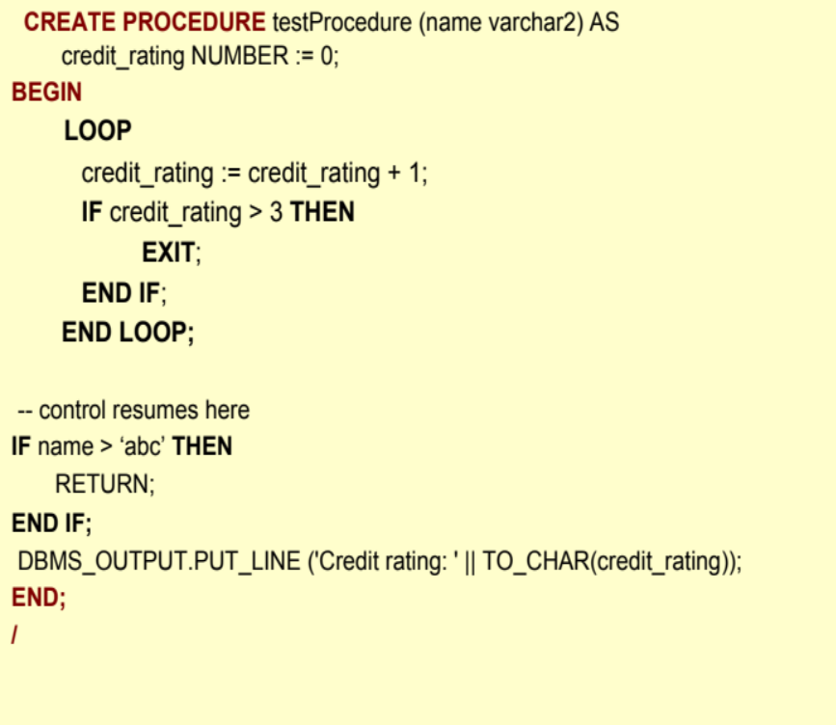
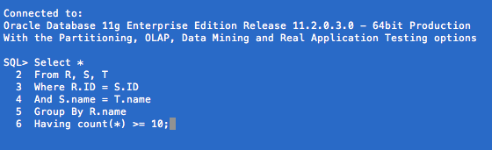
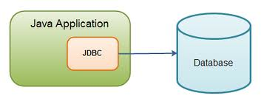
Ways to Access DB
PL/SQL
Direct SQL
External language connected to DB

Slide 3
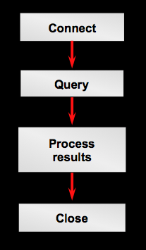
Overview of Querying a Database With JDBC
JDBC: Java Database Connectivity

Slide 4
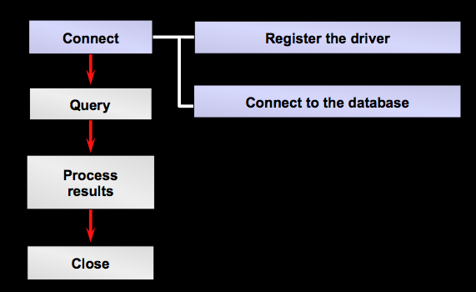
Stage 1: Connect

Slide 5
How to Make the Connection
1. Register the driver.
Class.forName(“oracle.jdbc.driver.OracleDriver”);
Or
DriverManager.registerDriver (new
oracle.jdbc.driver.OracleDriver());

Slide 6
How to Make the Connection
2. Connect to the DB
Connection conn = DriverManager.getConnection
(URL, userid, password);
In our Oracle DB
Connection conn = DriverManager.getConnection
("jdbc:oracle:thin:@oracle.wpi.edu:1521:orcl",
"userid", "password");
Your Oracle username and pw

Slide 7
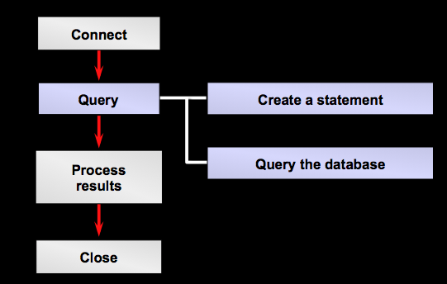
Stage 2: Query the DB

Slide 8
JDBC Statement Object
A Statement object sends your SQL command to the database
You need an active connection to create a JDBC statement
Statement has methods to execute a SQL statement:
  executeQuery() for QUERY statements
  executeUpdate() for INSERT, UPDATE, DELETE

Slide 9
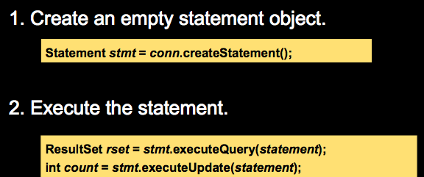
How to Query the Database
The query string
Output relation
Number of affected tuples

Slide 10
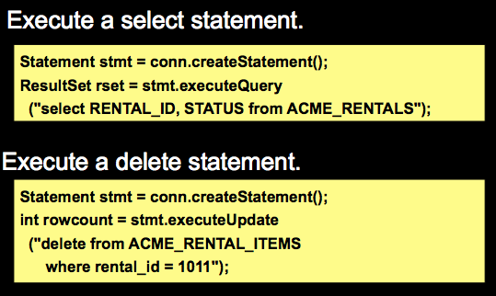
Querying the Database: Example I

Slide 11
Querying the Database: Example II
Execute a select statement
Statement stmt = conn.createStatement();
String str = "SELECT * FROM users”;
Resultset rset = stmt.executeQuery(str);
Build your SQL command in a separate string and then pass it for execution

Slide 12
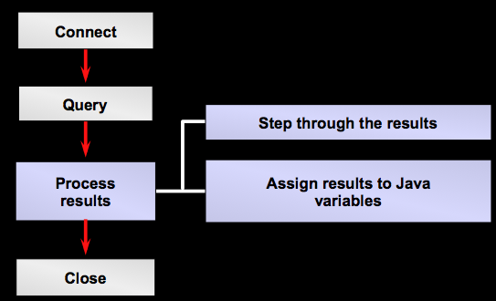
Stage 3: Process Results

Slide 13
Resultset Object
JDBC returns the results of a query in a ResultSet object.
A ResultSet maintains a cursor pointing to its current row of data.
Use next() to step through the result set row by row.
getString(), getInt(), and so on assign each value to a Java variable.

Slide 14
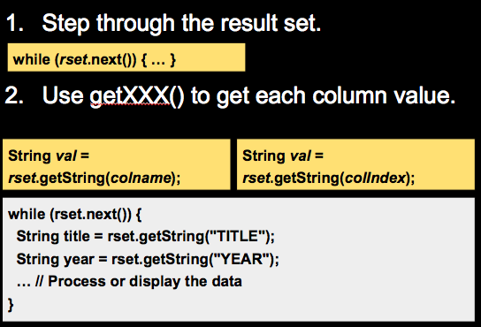
How to Process Results

Slide 15
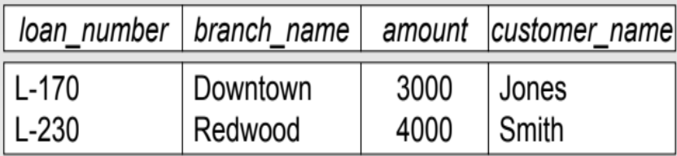
Example
Statement stmt = conn.createStatement();
String str = "SELECT branch_name, amount FROM R”;
Resultset rset = stmt.executeQuery(str);
While ( rset.next()) {
String bName = rset.getString(“branch_name”);
int amt = rset.getInt(“amount”);
…
System.out.println(”Name:” + bName + ” Amount: ” +
amt);
}

Slide 16
Get---- Function over Resultset
And many more:
http://docs.oracle.com/javase/7/docs/api/java/sql/ResultSet.html

Slide 17
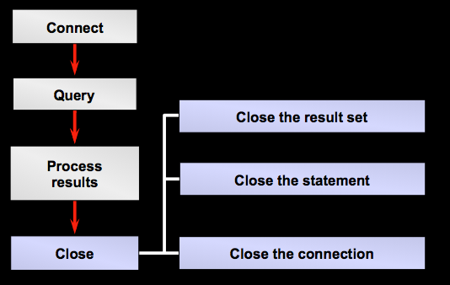
Stage 4: Closing

Slide 18
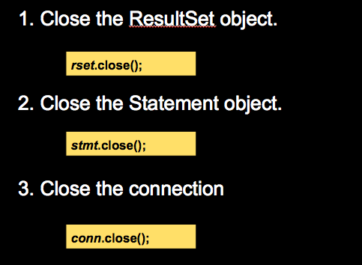
How to Close

Slide 19
JDBC PrepareStatement
If execute the statement multiple times
  Use a PrepareStatement object
  It is compiled once and used multiple times
PrepareStatement may contain variables
  Placeholder for actual values supplied at execution time

Slide 20
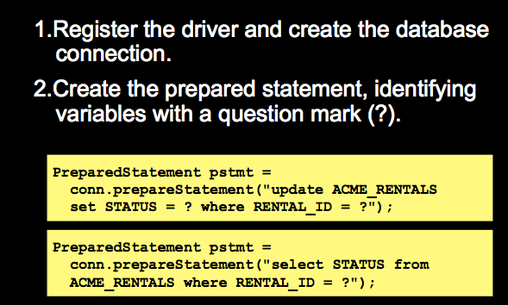
How to create PrepareStatement
“?” Is the placeholder for variables

Slide 21
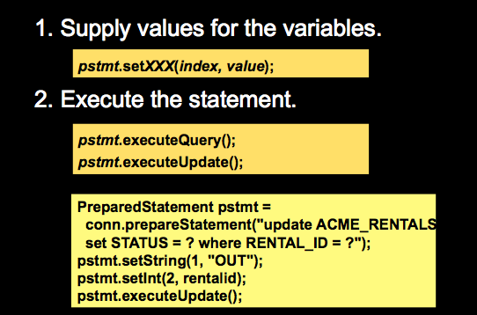
How to Execute
For SQL queries
For Insert/Update/ Delete
With each execution set the values and then execute…

Slide 22
How to Connect to WPI Oracle
1- Log in to CCC machine
2- Set environment variables
> source /cs/bin/oracle-setup
3- Set CLASSPATH for java
> export CLASSPATH=./:/usr/local/oracle11gr203/product/11.2.0/ db_1/jdbc/lib/ojdbc6.jar
4- Write your java code (say file name is OracleTest.java) and then compile it
> /usr/local/bin/javac OracleTest.java
5- Run it
> /usr/local/bin/java OracleTest

Slide 23
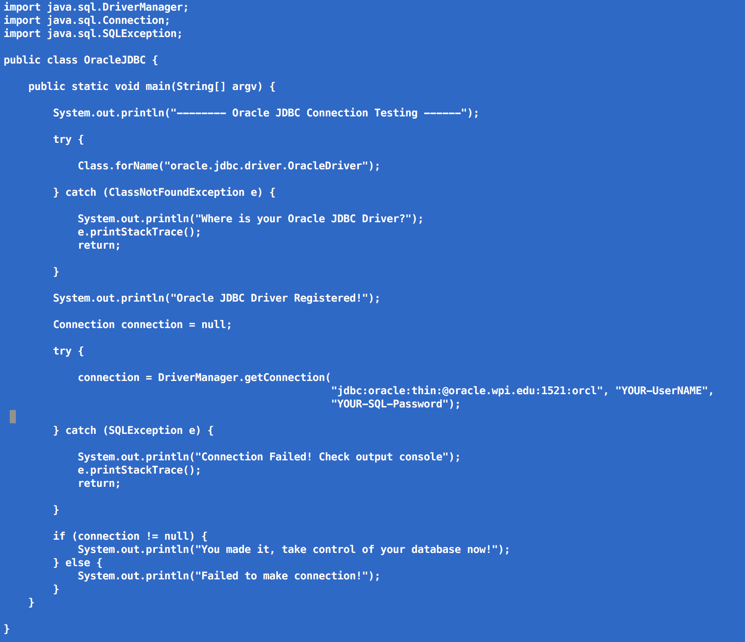
Example Code (Posted in Blackboard System)
Replace here with your username & DB Password

Slide 24
Sources
Some links with examples
http://www.cs.ubc.ca/~ramesh/cpsc304/tutorial/JDBC/jdbc1.html
http://infolab.stanford.edu/~ullman/fcdb/oracle/or-jdbc.html

