Slide 1
Functional Dependencies and Normalization
Rodica Neamtu
rneamtu@wpi.edu

Slide 2
Goal…
Given a database schema, how do you judge whether or not the design is good?
How do you ensure it does not have redundancy or anomaly problems?
Num
Num Beds
Capacity
Has TV
Room
Has Balcony
Type

Slide 3
What is Normalization
Normalization is a set of rules to systematically achieve a good design
If these rules are followed, then the DB design is guarantee to avoid several problems:
  Inconsistent data
  Anomalies: insert, delete and update
  Redundancy: which wastes storage, and often slows down query processing

Slide 4
Problem I: Insert Anomaly
Student
sNumber | sName | pNumber | pName
s1 | Dave | p1 | MM
s2 | Greg | p2 | ER
Student Info
Professor Info
Question: Could we insert a professor without student?
Note: We cannot insert a professor who has no students.
Insert Anomaly: We are not able to insert “valid” value/(s)

Slide 5
Problem II: Delete Anomaly
Student
sNumber | sName | pNumber | pName
s1 | Dave | p1 | MM
s2 | Greg | p2 | ER
Student Info
Professor Info
Question: Can we delete a student and keep a professor info ?
Note: We cannot delete a student that is the only student of a professor.
Delete Anomaly: We are not able to perform a delete without losing some “valid” information.

Slide 6
Problem III: Update Anomaly
Student
sNumber | sName | pNumber | pName
s1 | Dave | p1 | MM
s2 | Greg | p1 | MM
VV
VV
Student Info
Professor Info
Question: Can we simply update a professor’s name ?
Note: To update the name of a professor, we have to update in multiple tuples.
Update Anomaly: To update a value, we have to update multiple rows. Update anomalies are due to redundancy.

Slide 7
Problem IV: Inconsistency
Student
sNumber | sName | pNumber | pName
s1 | Dave | p1 | MM
s2 | Greg | p1 | MM
VV
Student Info
Professor Info
What if the name of professor p1 is updated in one place and not the other!!!
Inconsistent Data: The same object has multiple values. Inconsistency is due to redundancy.

Slide 8
Schema Normalization
Following the normalization rules, we avoid
  Insert anomaly
  Delete anomaly
  Update anomaly
  Inconsistency

Slide 9
What to Cover
Functional Dependencies (FDs)
Closure of Functional Dependencies
Lossy & Lossless Decomposition
Normalization

Slide 10
Usage of Functional Dependencies
Discover all dependencies between attributes
Identify the keys of relations
Enable good (Lossless) decomposition of a given relation

Slide 11
Functional Dependencies (FDs)
Student
sNumber | sName | address
1 | Dave | 144FL
2 | Greg | 320FL
Suppose we have the FD: sNumber → address
That is, there is a functional dependency from sNumber to address
Meaning: A student number determines the student address
Or: For any two rows in the Student relation with the same value for sNumber, the value for address must be same.

Slide 12
Functional Dependencies (FDs)
Require that the value for a certain set of attributes determines uniquely the value for another set of attributes
A functional dependency is a generalization of the notion of a key
FD: A1,A2,…An → B1, B2,…Bm
L.H.S
R.H.S

Slide 13
Functional Dependencies (FDs)
The basic form of a FDs
A1,A2,…An → B1, B2,…Bm
L.H.S
R.H.S
>> The values in the L.H.S uniquely determine the values in the R.H.S attributes
(when you lookup the DB)
>> It does not mean that L.H.S values compute the R.H.S values
Examples:
SSN → personName, personDoB, personAddress
DepartmentID, CourseNum → CourseTitle, NumCredits
personName personAddress
X

Slide 14
FD and Keys
Student
sNumber | sName | address
1 | Dave | 144FL
2 | Greg | 320FL
Primary Key : <sNumber>
Questions :
Does a primary key implies functional dependencies? Which ones ?
Does unique keys imply functional dependencies? Which ones ?
Does a functional dependency imply keys ? Which ones ?
Observation :
Any key (primary or candidate) or superkey of a relation R functionally determines all attributes of R.
Notes:
We assume NO NULL values here.

Slide 15
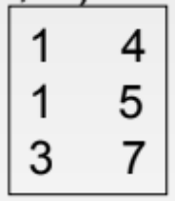
Functional Dependencies (FDs)
Let R be a relation schema where
  α⊆R and β⊆R -- α and β are subsets of R’s attributes
The functional dependency α→β holds on R if and only if:
  For any legal instance of R, whenever any two tuples t1 and t2 agree on the attributes α, they also agree on the attributes β. That is,
  t1[α]=t2[α] ⇒ t1[β] =t2[β]
A
B
A → B (Does not hold)
B → A (holds)

Slide 16
Functional Dependencies & Keys
K is a superkey for relation schema R if and only if
  K → R -- K determines all attributes of R
K is a candidate key for R if and only if
  K→R, and
  No α⊂K, α→R
Keys imply FDs, and FDs imply keys

Slide 17
Example I
Student(SSN, Fname, Mname, Lname, DoB, address, age, admissionDate)
If you know that SSN is a key, Then
  SSN → Fname, Mname, Lname, DoB, address, age, admissionDate
If you know that (Fname, Mname, Lname) is a key, Then
  Fname, Mname, Lname → SSN, DoB, address, age, admissionDate
Need to know all of L.H.S to determine any of the R.H.S

Slide 18
Example II
Student(SSN, Fname, Mname, Lname, DoB, address, age, admissionDate)
If you know that SSN → Fname, Mname, Lname, DoB, address, age, admissionDate
  Then, we infer that SSN is a candidate key
  If you know that Fname, Mname, Lname → SSN, DoB, address, age, admissionDate
  Then, we infer that (Fname, Mname, Lname) is a key. Is it Candidate or super key???
  Does any pair of attributes together form a key??
    If no → (Fname, Mname, Lname) is a candidate key (minimal)
    If yes → (Fname, Mname, Lname) is a super key

Slide 19
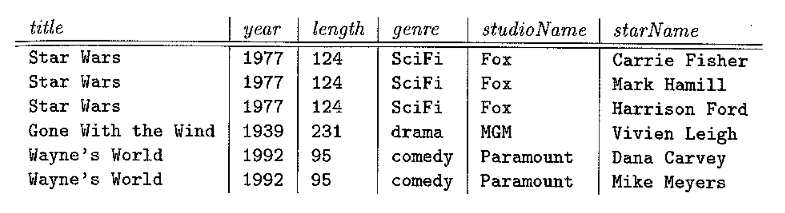

Example III
Does this FD hold?
  Title, year → length, genre, studioName
Does this FD hold?
  Title, year → starName
What is a key of this relation instance?
  {title, year, starName}
  Is it candidate key?
YES
NO
>> For this instance → not a candidate key
(title, starName) can be a key

Slide 20
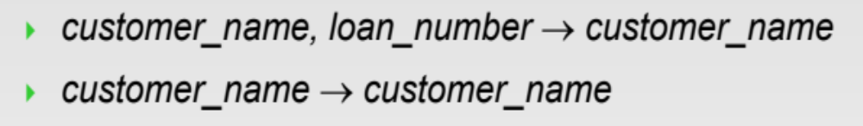
Properties of FDs
Consider A, B, C, Z are sets of attributes
Reflexive (trivial):
  A → B is trivial if B ⊇ A

Slide 21
Properties of FDs (Cont’d)
Consider A, B, C, Z are sets of attributes
Transitive:
  if A → B, and B → C, then A → C
Augmentation:
  if A → B, then AZ → BZ
Union:
  if A → B, A → C, then A → BC
Decomposition:
  if A → BC, then A → B, A → C
Use these properties to derive more FDs

Slide 22
Example
Use the FD properties to derive more FDs
Given R( A, B, C, D, E)
  F = {A → BC, DE → C, B → D}
Is A a key for R or not? Does A determine all other attributes?
  A → A B C D
Is BE a key for R?
  BE → B E D C
Is ABE a candidate or super key for R?
  ABE → A B E D C
  AE → A E B C D
NO
NO
>> ABE is a super key
>> AE is a candidate key

Slide 23
What to Cover
Functional Dependencies (FDs)
Closure of Functional Dependencies
Lossy & Lossless Decomposition
Normalization

Slide 24
Closure of a Set of Functional
Dependencies
Given a set F set of functional dependencies, there are other FDs that can be inferred based on F
  For example: If A → B and B → C, then we can infer that A → C
Closure set F ➔ F⁺
  The set of all FDs that can be inferred from F
  We denote the closure of F by F⁺
  F⁺ is a superset of F
Computing the closure F⁺ of a set of FDs can be expensive

Slide 25
Inferring FDs
Suppose we have:
  a relation R (A, B, C, D) and
  functional dependencies A → B, C → D, A → C
Question:
  What is a key for R?
We can infer A → ABC, and since C → D, then
  A → ABCD
Hence A is a key in R
Is it is the only candidate key ???

Slide 26
Attribute Closure
Attribute Closure of A
  Given a set of FDs, compute all attributes X that A determines
    A → X
Attribute closure is easy to compute
  Just recursively apply the transitive property
A can be a single attribute or set of attributes
Notes:
21

Slide 27
Algorithm for Computing Attribute Closures
Computing the closure of set of attributes {A1, A2, …, An}:
  Let X = {A1, A2, …, An}
  If there exists a FD: B1, B2, …, Bm → C, such that every Bi ∈ X, then X = X ∪ C
  Repeat step 2 until no more attributes can be added.
X is the closure of the {A1, A2, …, An} attributes
  X = {A1, A2, …, An} ⁺

Slide 28
Example 1: Inferring FDs
Assume relation R (A, B, C)
Given FDs : A → B, B → C, C → A
What are the possible keys for R ?
  Compute the closure of each attribute X, i.e., X⁺
  X⁺ contains all attributes, then X is a key
For example:
  {A}⁺ = {A, B, C}
  {B}⁺ = {A, B, C}
  {C}⁺ = {A, B, C}
So keys for R are <A>, <B>, <C>

Slide 29
Example 2: Attribute Closure
Given R( A, B, C, D, E)
  F = {A → BC, DE → C, B → D}
What is the attribute closure {AB}⁺ ?
  {AB}⁺ = {A B}
  {AB}⁺ = {A B C}
  {AB}⁺ = {A B C D}
What is the attribute closure {BE}⁺ ?
  {BE}⁺ = {B E}
  {BE}⁺ = {B E D}
  {BE}⁺ = {B E D C}
Set of attributes α is a key if α⁺ contains all attributes

Slide 30
Example 3: Inferring FDs
Assume relation R (A, B, C, D, E)
Given F = {A → B, B → C, C D → E }
  Does A → E?
The above question is the same as
  Is E in the attribute closure of A (A⁺)?
  Is A → E in the function closure F⁺ ?
A → E does not hold
A D → ABCDE does hold
A D is a key for R
Notes:
21

Slide 31
Summary of FDs
They capture the dependencies between attributes
How to infer more FDs using properties such as transitivity, augmentation, and union
Functional closure F⁺
Attribute closure A⁺
Relationship between FDs and keys

Slide 32
What to Cover
Functional Dependencies (FDs)
Closure of Functional Dependencies
Lossy & Lossless Decomposition
Normalization

Slide 33
Decomposing Relations
StudentProf
sNumber
sName
pNumber
pName
s1
Dave
p1
MM
s2
Greg
p2
MM
FDs: pNumber → pName
Num
Num Beds
Capacity
Has TV
Room
Has Balcony
Type

Slide 34
Decomposing Relations
StudentProf
sNumber
sName
pNumber
pName
s1
Dave
p1
MM
s2
Greg
p2
MM
FDs: pNumber → pName
Student
Lossless
Professor
sNumber
sName
pNumber
pNumber
pName
s1
Dave
p1
p1
MM
s2
Greg
p2
p2
MM
Student
Lossy
Professor
sNumber
sName
pName
pNumber
pName
S1
Dave
MM
p1
MM
S2
Greg
MM
p2
MM

Slide 35
Lossless vs. Lossy Decomposition
Assume R is divided into R1 and R2
Lossless Decomposition
  R1 natural join R2 should create exactly R
Lossy Decomposition
  R1 natural join R2 adds more records (or deletes records) from R

Slide 36
Lossless Decomposition
StudentProf
sNumber
sName
pNumber
pName
s1
Dave
p1
MM
s2
Greg
p2
MM
FDs: pNumber → pName
Student
Lossless
Professor
sNumber
sName
pNumber
pNumber
pName
s1
Dave
p1
p1
MM
s2
Greg
p2
p2
MM
Student & Professor are lossless decomposition of StudentProf
(Student ⋈ Professor = StudentProf)

Slide 37
Lossy Decomposition
StudentProf
sNumber
sName
pNumber
pName
s1
Dave
p1
MM
s2
Greg
p2
MM
FDs: pNumber → pName
Student
Lossy
Professor
sNumber
sName
pName
pNumber
pName
S1
Dave
MM
p1
MM
S2
Greg
MM
p2
MM
Student & Professor are lossy decomposition of StudentProf
(Student ⋈ Professor != StudentProf)

Slide 38
Goal: Ensure Lossless Decomposition
How to ensure lossless decomposition?
Answer:
  The common columns must be candidate key in one of the two relations

Slide 39
Back to our example
StudentProf
sNumber
sName
pNumber
pName
s1
Dave
p1
MM
s2
Greg
p2
MM
pNumber is candidate key
FDs: pNumber → pName
Student
Lossless
Professor
sNumber
sName
pNumber
pNumber
pName
s1
Dave
p1
p1
MM
s2
Greg
p2
p2
MM
pName is not candidate key
Student
Lossy
Professor
sNumber
sName
pName
pNumber
pName
S1
Dave
MM
p1
MM
S2
Greg
MM
p2
MM

Slide 40
What to Cover
Functional Dependencies (FDs)
Closure of Functional Dependencies
Lossy & Lossless Decomposition
Normalization

