Slide 1
Functional Dependencies and Normalization
Rodica Neamtu
rneamtu@wpi.edu

Slide 2
What to Cover
Functional Dependencies (FDs)
Closure of Functional Dependencies
Lossy & Lossless Decomposition
Normalization

Slide 3
Normalization
First Normal Form (1NF)
Boyce-Codd Normal Form (BCNF)
3rd Normal Form (3NF)

Slide 4
Normalization
Set of rules to avoid “bad” schema design
Decide whether a particular relation R is in “good” form
  If not, decompose R to be in a “good” form
If a relation is in a certain normal form, then it is known that certain kinds of problems are avoided or minimized

Slide 5
First Normal Form (1NF)
Attribute domain is atomic if its elements are considered to be indivisible units (primitive attributes)
Examples of non-atomic domains are multi-valued and composite attributes
A relational schema R is in first normal form (1NF) if the domains of all attributes of R are atomic
We assume all relations are in 1NF

Slide 6
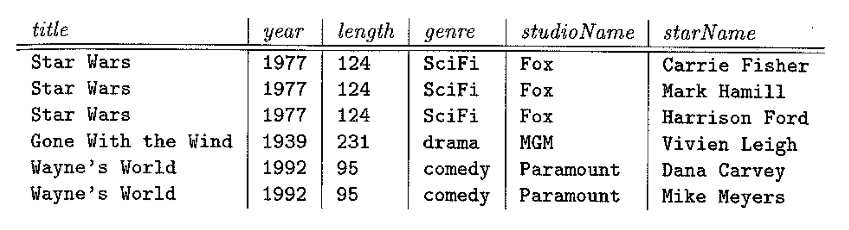
First Normal Form (1NF): Example
Since all attributes are primitive ➔ It is in 1NF

Slide 7
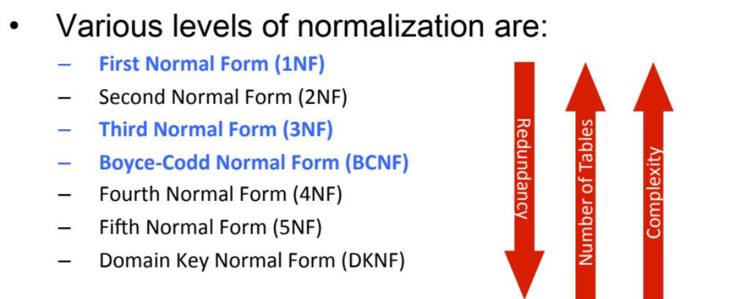
Levels of Normalization
> 3NF & BCNF are the most used ones

Slide 8
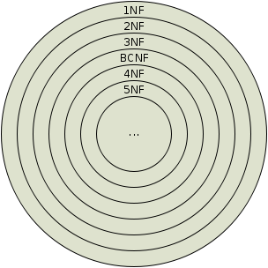
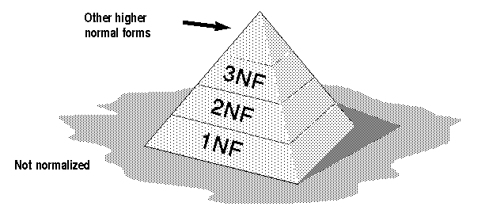
Levels of Normalization

Slide 9

First Normal Form (1NF)
A table is considered to be in 1NF if all the fields contain
only scalar values.
Example (Not 1NF)
1-M attribute.
(PK, AuName) should be a separate table
Same for this one
Author and AuPhone columns are not scalar

Slide 10
Boyce-Codd Normal Form (BCNF): Definition
A relation schema R is in BCNF with respect to a set F of functional dependencies if for all functional dependencies in F⁺ of the form
  α → β
  where α ⊆ R and β ⊆ R, then at least one of the following holds:
        α → β is trivial (i.e.,β⊆α)
        α is a superkey for R
Remember:
Candidate keys are also superkeys

Slide 11

BCNF: Example
Student
sNumber | sName | pNumber | pName
s1 | Dave | p1 | MM
s2 | Greg | p2 | ER
s3 | Mike | p1 | MM
Student Info
Professor Info
Is relation Student in BCNF given pNumber → pName
  It is not trivial FD
  pNumber is not a key in Student relation
  How to fix it and make it in BCNF???
NO

Slide 12
Decomposing a Schema into BCNF
If R is not in BCNF because of non-trivial dependency α → β, then decompose R
R is decomposed into two relations
  R1 = (α U β ) -- α is super key in R1
  R2 = (R- (β - α)) -- R2.α is foreign keys to R1.α

Slide 13
Example of BCNF Decomposition
StudentProf
sNumber | sName | pNumber | pName
s1 | Dave | p1 | MM
s2 | Greg | p2 | MM
FDs: pNumber → pName
Student
Professor
sNumber | sName | pNumber
s1 | Dave | p1
s2 | Greg | p2
pNumber | pName
p1 | MM
p2 | MM
  FOREIGN KEY: Student (PNum) references Professor (PNum)

Slide 14
What is Nice about this Decomposing ???
R is decomposed into two relations
  R1 = (α U β ) -- α is super key in R1
  R2 = (R- (β - α)) -- R2.α is foreign keys to R1.α
This decomposition is lossless
(Because R1 and R2 can be joined based on α, and α is unique in R1)
When you join R1 and R2 on α, you get R back without lose of information

Slide 15
StudentProf = Student ⋈ Professor
StudentProf
sNumber | sName | pNumber | pName
s1 | Dave | p1 | MM
s2 | Greg | p2 | MM
FDs: pNumber → pName
Student
Professor
sNumber | sName | pNumber
s1 | Dave | p1
s2 | Greg | p2
pNumber | pName
p1 | MM
p2 | MM
  BCNF decomposition rule create lossless decomposition

Slide 16
Multi-Step Decomposition
Relation R and functional dependency F
  R = (customer_name, loan_number, branch_name, branch_city, assets, amount )
  F = {branch_name → assets branch_city,
    loan_number → amount branch_name}
Is R in BCNF ??
Based on branch_name → assets branch_city
  R1 = (branch_name, assets, branch_city)
  R2 = (customer_name, loan_number, branch_name, amount)
Are R1 and R2 in BCNF ?
Divide R2 based on loan_number → amount branch_name
  R3 = (loan_number, amount, branch_name)
  R4 = (customer_name, loan_number)
NO
R2 is not
Final Schema has R1, R3, R4

Slide 17
What is NOT Nice about BCNF
Before decomposition, we had set of functional dependencies FDs (Say F)
After decomposition, do we still have the same set of FDs or we lost something ??

Slide 18
What is NOT Nice about BCNF
Dependency Preservation
  After the decomposition, all FDs in F⁺ should be preserved
BCNF does not guarantee dependency preservation
Can we always find a decomposition that is both BCNF and preserving dependencies?
  No…This decomposition may not exist
  That is why we study a weaker normal form called (third normal form –3NF)

Slide 19
Dependency Preserving
Assume R is decomposed to R1 and R2
Dependencies of R1 and R2 include:
Local dependencies α → β
  All columns of α and β must be in a single relation
Global Dependencies
  Use transitivity property to form more FDs across R1 and R2 relations
Yes ➔ Dependency preserving
Do these dependencies match the ones in R ?
No ➔ Not dependency preserving
Notes:
3

Slide 20
Dependency Preservation Test
Assume R is decomposed into R1 and R2
The closure of FDs in R is F⁺
The FDs in R1 and R2 are F_{R1} and F_{R2}, respectively
Then dependencies are preserved if:
  F⁺ = (F_{R1} union F_{R2})⁺
local dependencies in R1
local dependencies in R2
Notes:
4

Slide 21
Back to Our Example
Assume relation R(C, S, J, D, T, Q, V)
C is key, JT → C and SD → T
  C → CSJDTQV (C is key) -- Good for BCNF
  JT → CSJDTQV (JT is key) -- Good for BCNF
  SD → T (SD is not a key) –Bad for BCNF
Decomposition:
  R1(C, S, J, D, Q, V) and R2(S, D, T)
F⁺ = {C → CSJDTQV, JT→ CSJDTQV, SD →T}
F_{R1} = {C → CSJDQV} ⬅ local for R1
F_{R2} = {SD → T} ⬅ local for R2
F_{R1} U F_{R2} = {C → CSJDQV, SD → T}
(F_{R1} U F_{R2})⁺ = {C → CSJDQV, SD → T, C→ T}
Lossless & in BCNF
JT → C is still missing
Notes:
3

Slide 22
Third Normal Form: Motivation
BCNF is not always dependency preserving
Solution: Define a weaker normal form (3NF)
  Allows some redundancy (we will see examples later)
  But all FDs are preserved
  There is always a lossless, dependency-preserving decomposition in 3NF

Slide 23
Normal Form : 3NF
Relation R is in 3NF if, for every FD
  α → β,
  where α ⊆ R and β ⊆ R, at least one of the following holds:
        α → β is trivial (i.e.,β⊆α)
        α is a superkey for R
        Each attribute in β-α is part of a candidate key (prime attribute)
L.H.S is superkey OR
R.H.S consists of prime attributes

Slide 24
Back to Our Example
Assume relation R(C, S, J, D, T, Q, V)
C is key, JT → C and SD → T
  C → CSJDTQV (C is key) -- Good for 3NF
  JT → CSJDTQV (JT is key) -- Good for 3NF
  SD → T (SD is not a key) (T is prime attr.) –Good for 3NF
No decomposition is needed w.r.t 3NF
Notes:
3

Slide 25
Example
Relation R= (J,K,L)
  F = {JK → L, L → K }
  Two candidate keys: JK and JL
Is R in BCNF ?
Is R in 3NF ?
  JK → L (JK is a superkey)
  L → K (K is contained in a candidate key)
NO
YES

Slide 26
3NF: Example
Lot (ID, county, lotNum, area, price, taxRate)
Primary key: ID
Candidate key: <county, lotNum>
FDs:
county → taxRate
area → price
Is relation Lot in 3NF ?
NO
Decomposition based on county → taxRate
Lot (ID, county, lotNum, area, price)
County (county, taxRate)
Are relations Lot and County in 3NF ?
Lot is not

Slide 27
3NF: Example (Cont’d)
Lot (ID, county, lotNum, area, price)
County (county, taxRate)
Candidate key for Lot: <county, lotNum>
FDs:
county → taxRate
area → price
Decompose Lot based on area → price
Lot (ID, county, lotNum, area)
County (county, taxRate)
Area (area, price)
Is every relation in 3NF ?
YES

Slide 28
Comparison between 3NF & BCNF ?
If R is in BCNF, obviously R is in 3NF
If R is in 3NF, R may not be in BCNF
3NF allows some redundancy and is weaker than BCNF
3NF is a compromise to use when BCNF with good constraint enforcement is not achievable
Important: Lossless, dependency-preserving decomposition of R into a collection of 3NF relations always possible !
Notes:
24

Slide 29

Questions ?

