Slide 1
Lecture 5
Morphology

Slide 2
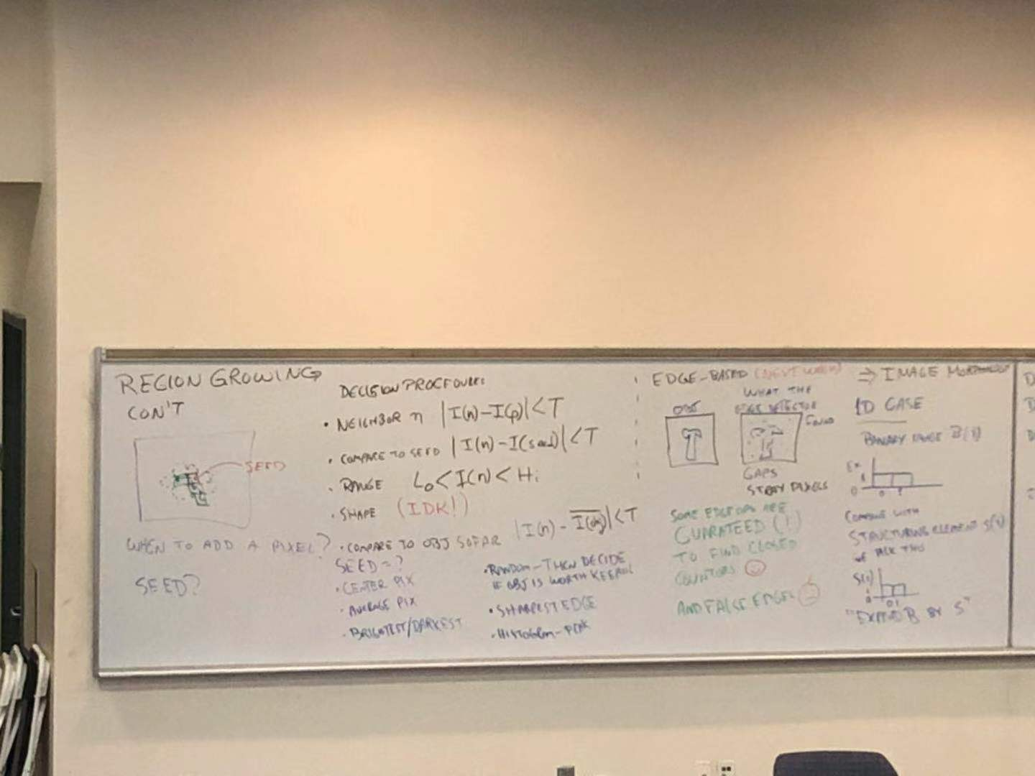

Slide 3
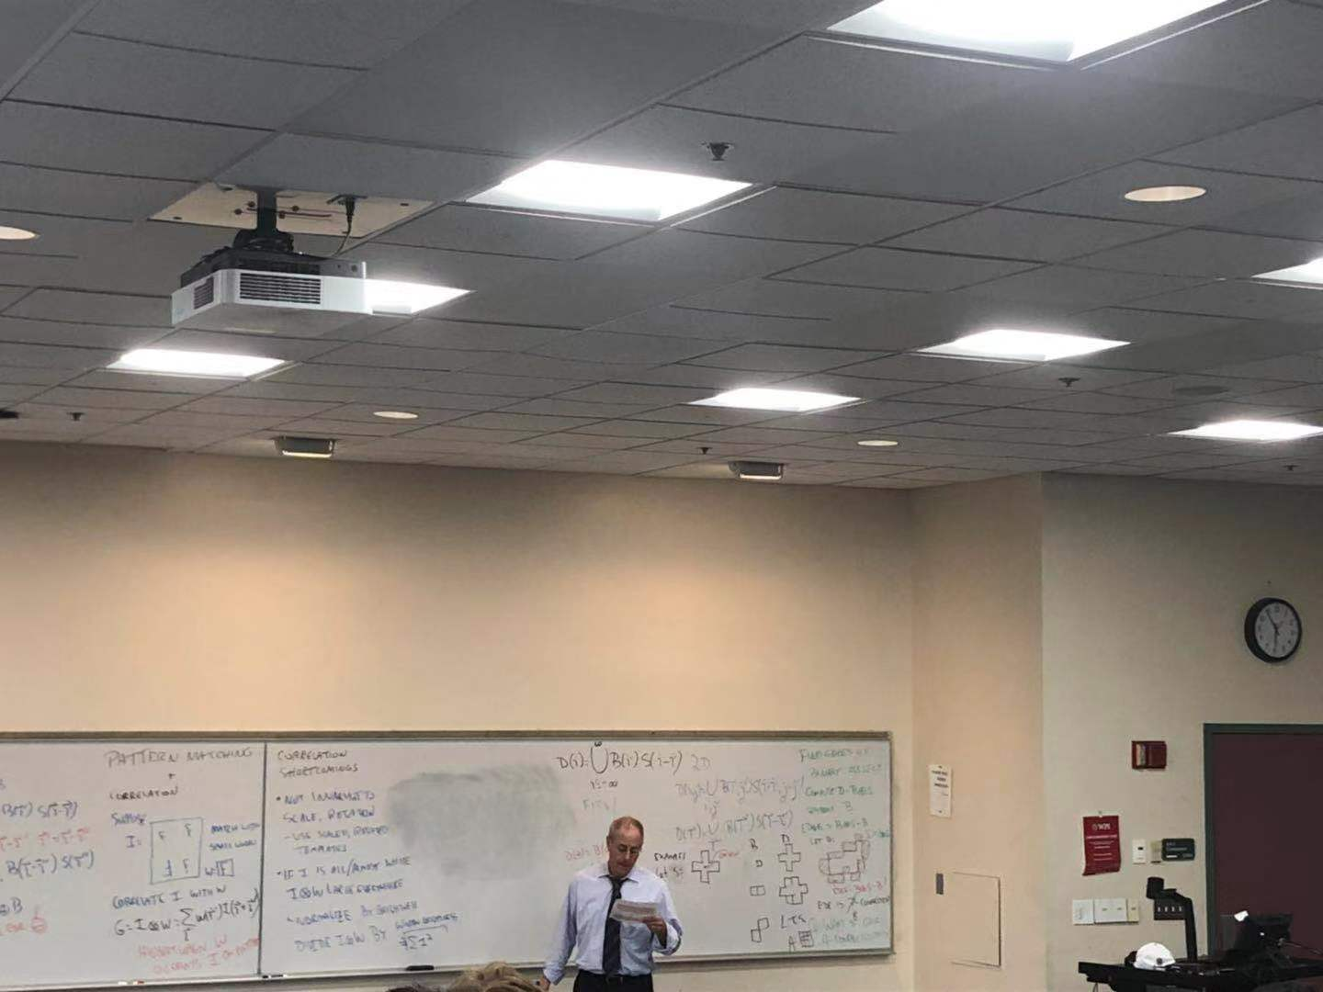

Slide 4
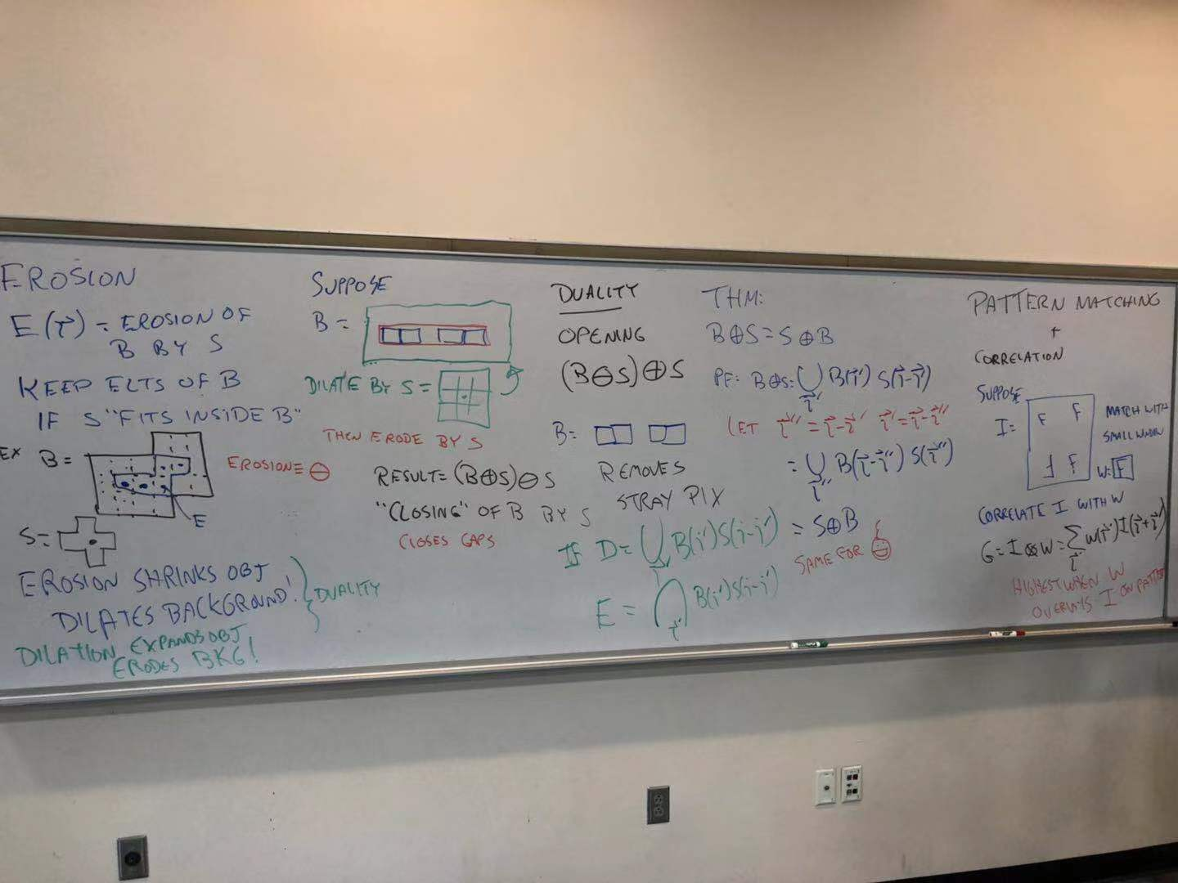

Slide 5
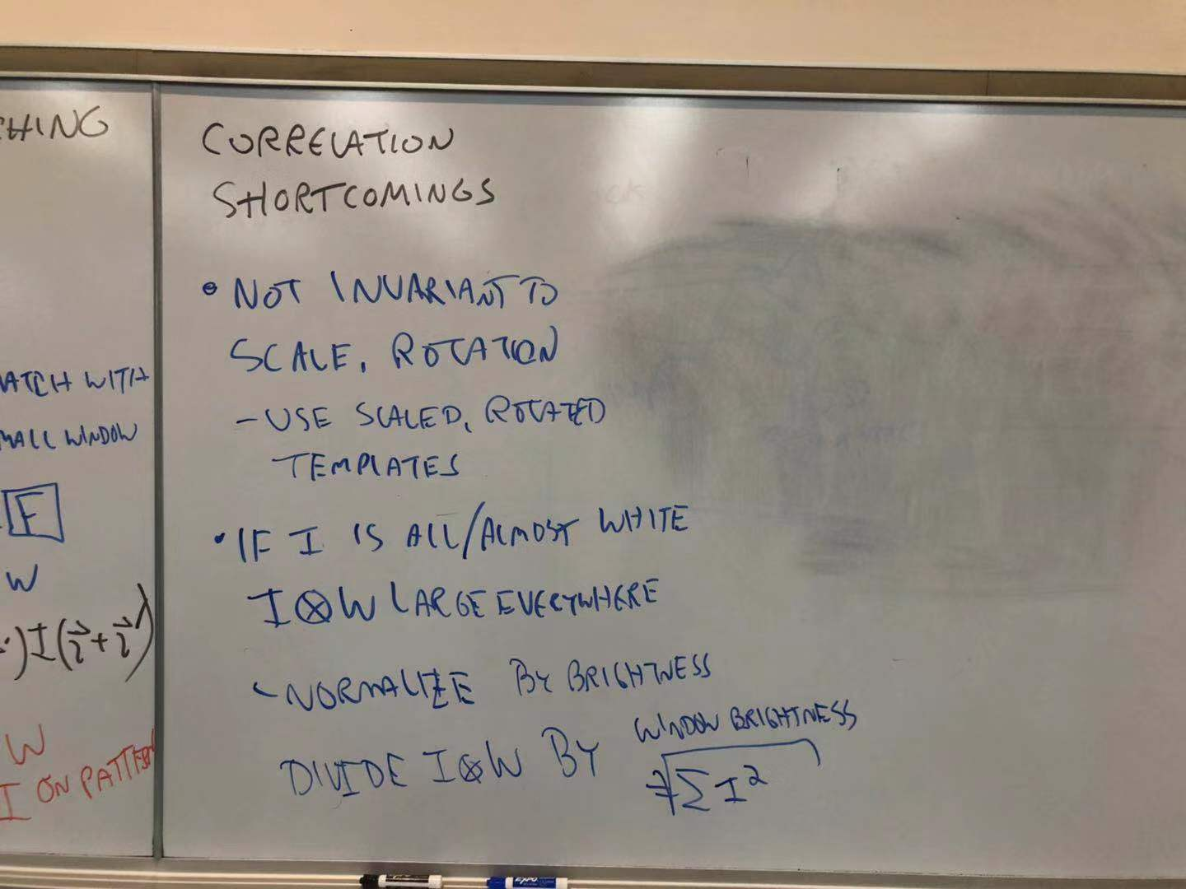

Slide 6

If you can not see picture2 clearly, I provide some supplement pictures about that part:

Slide 7
