Slide 1
Lecture 7 Frequency, Fourier Transform and Edges

Slide 2
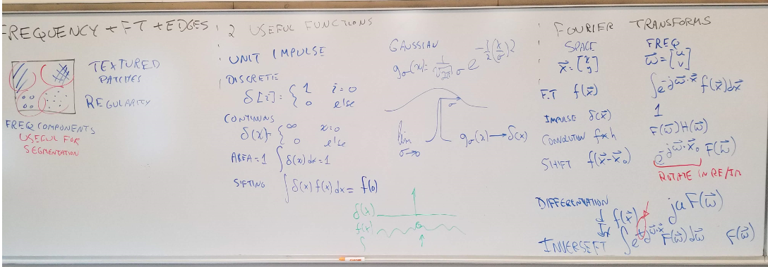

Slide 3


Slide 4


Slide 5


Slide 6
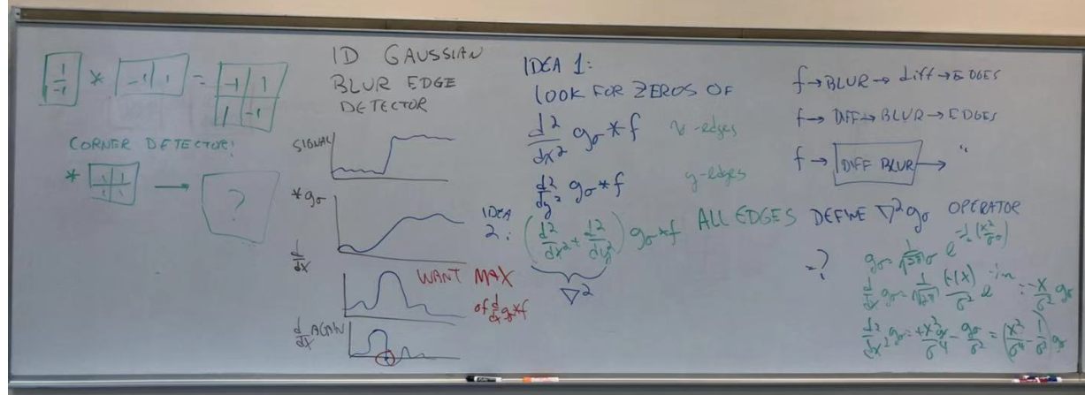

Slide 7
