Slide 1
Lecture 11 Segmentation

Slide 2
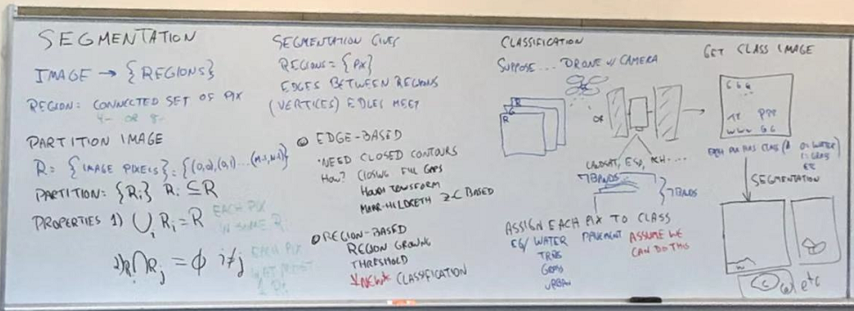

Slide 3
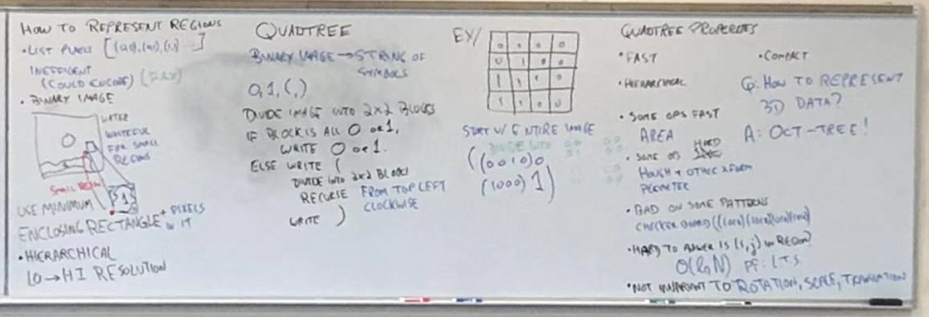

Slide 4
