Slide 1
CS/RBE 549 COMPUTER VISION
LECTURE 2 – IMAGE FORMATION & COORDINATES

Slide 2
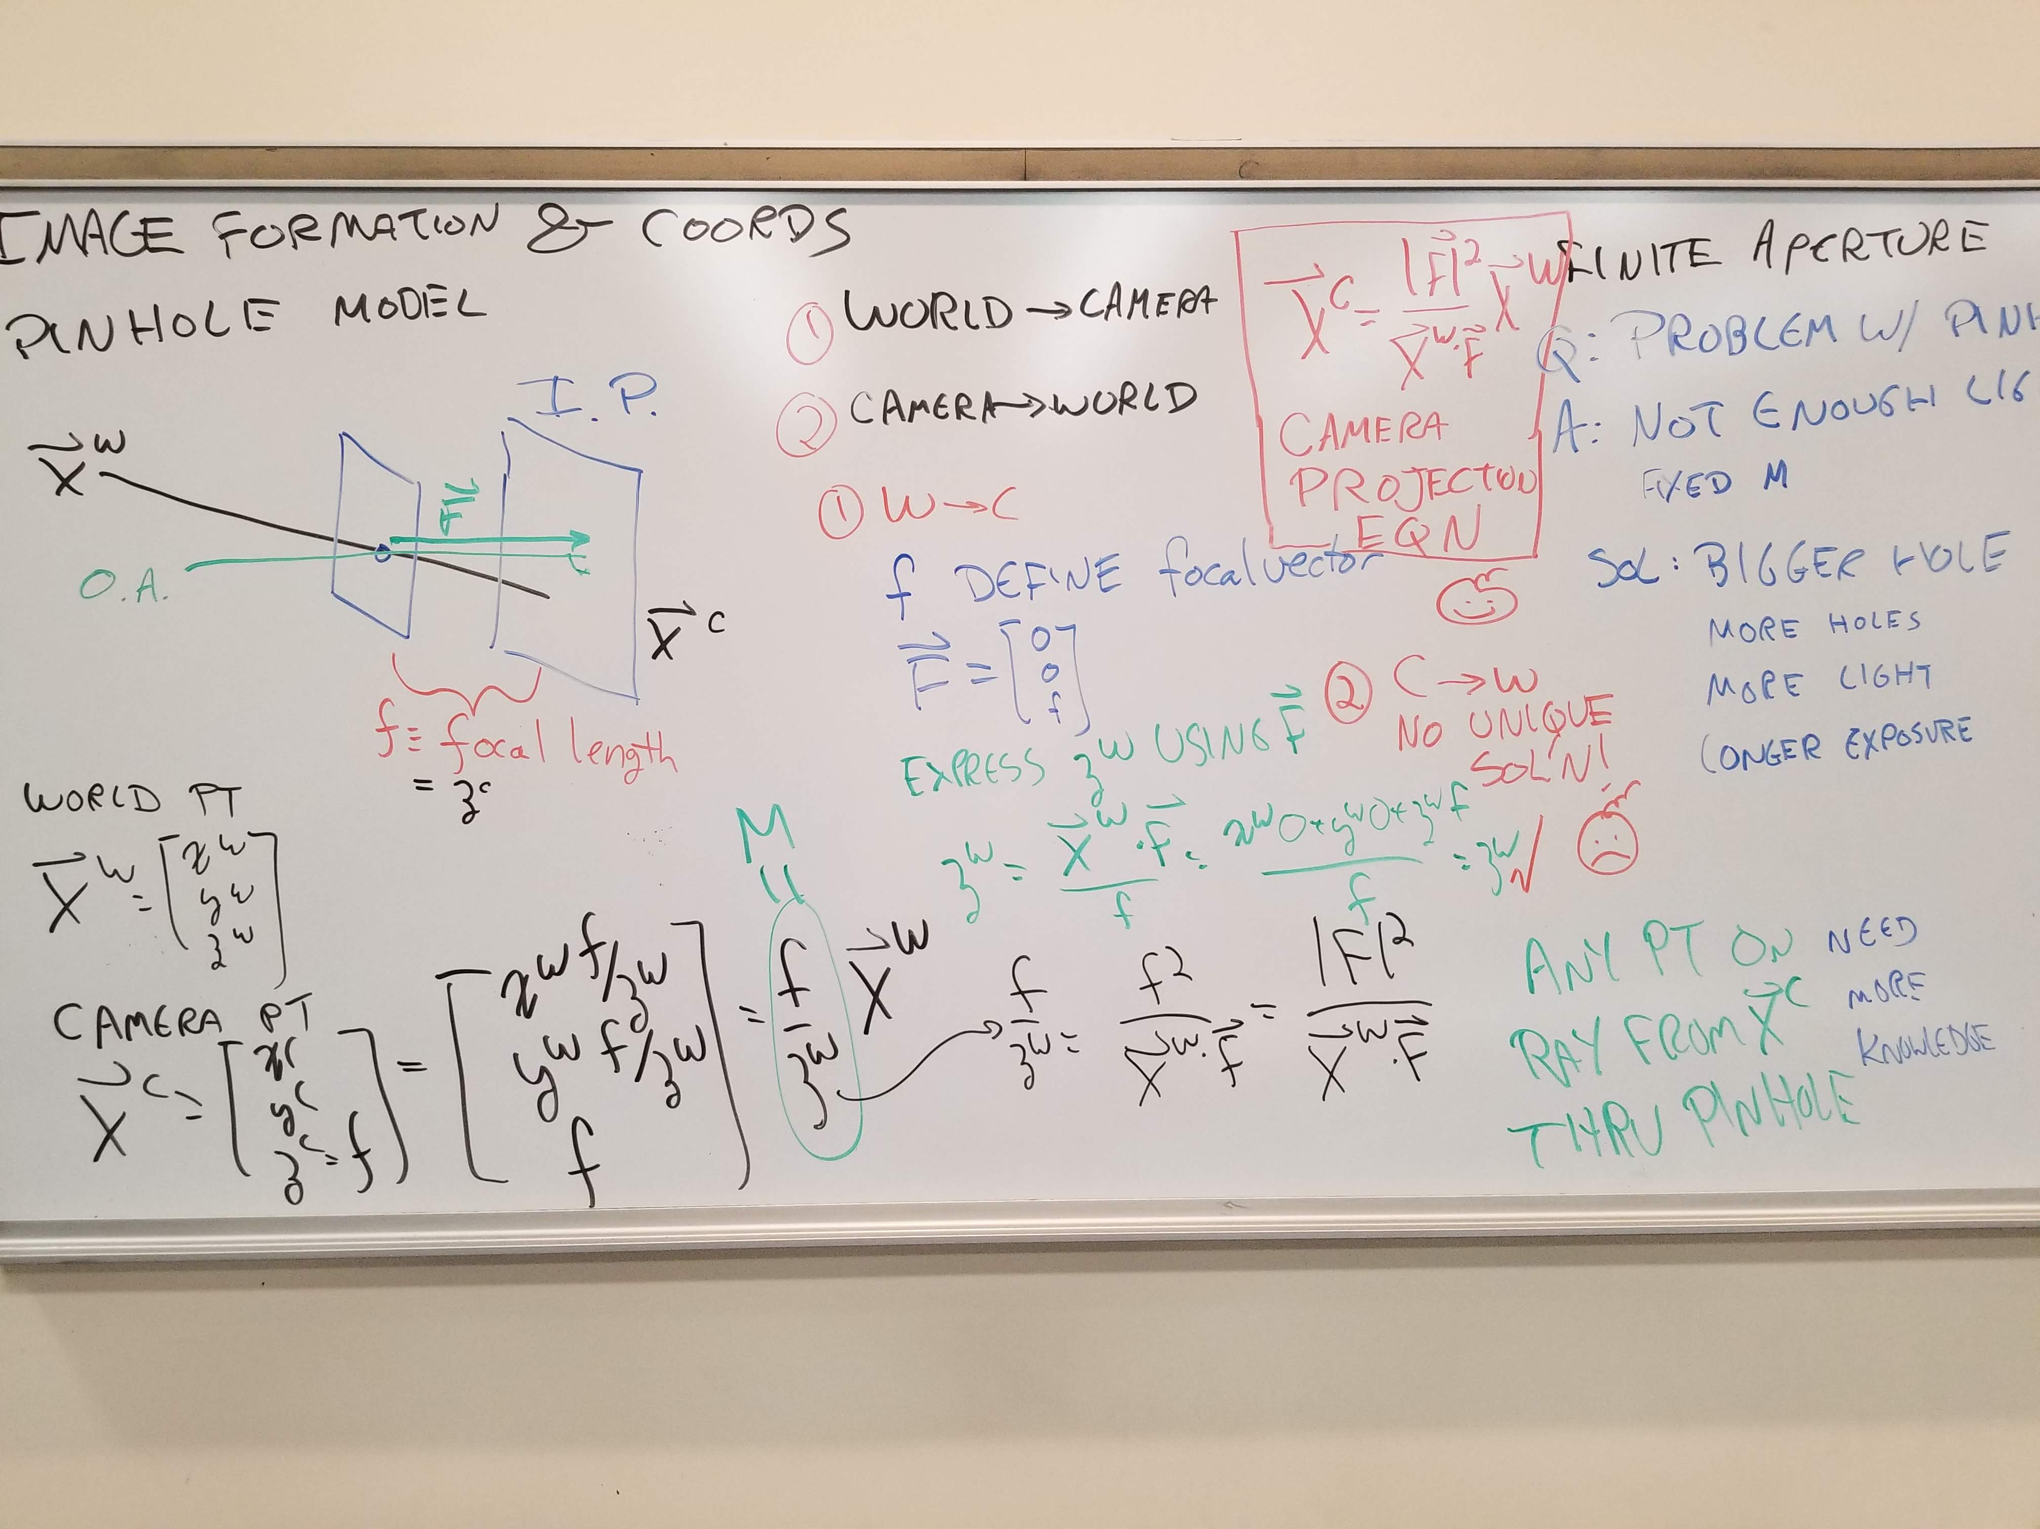

Slide 3
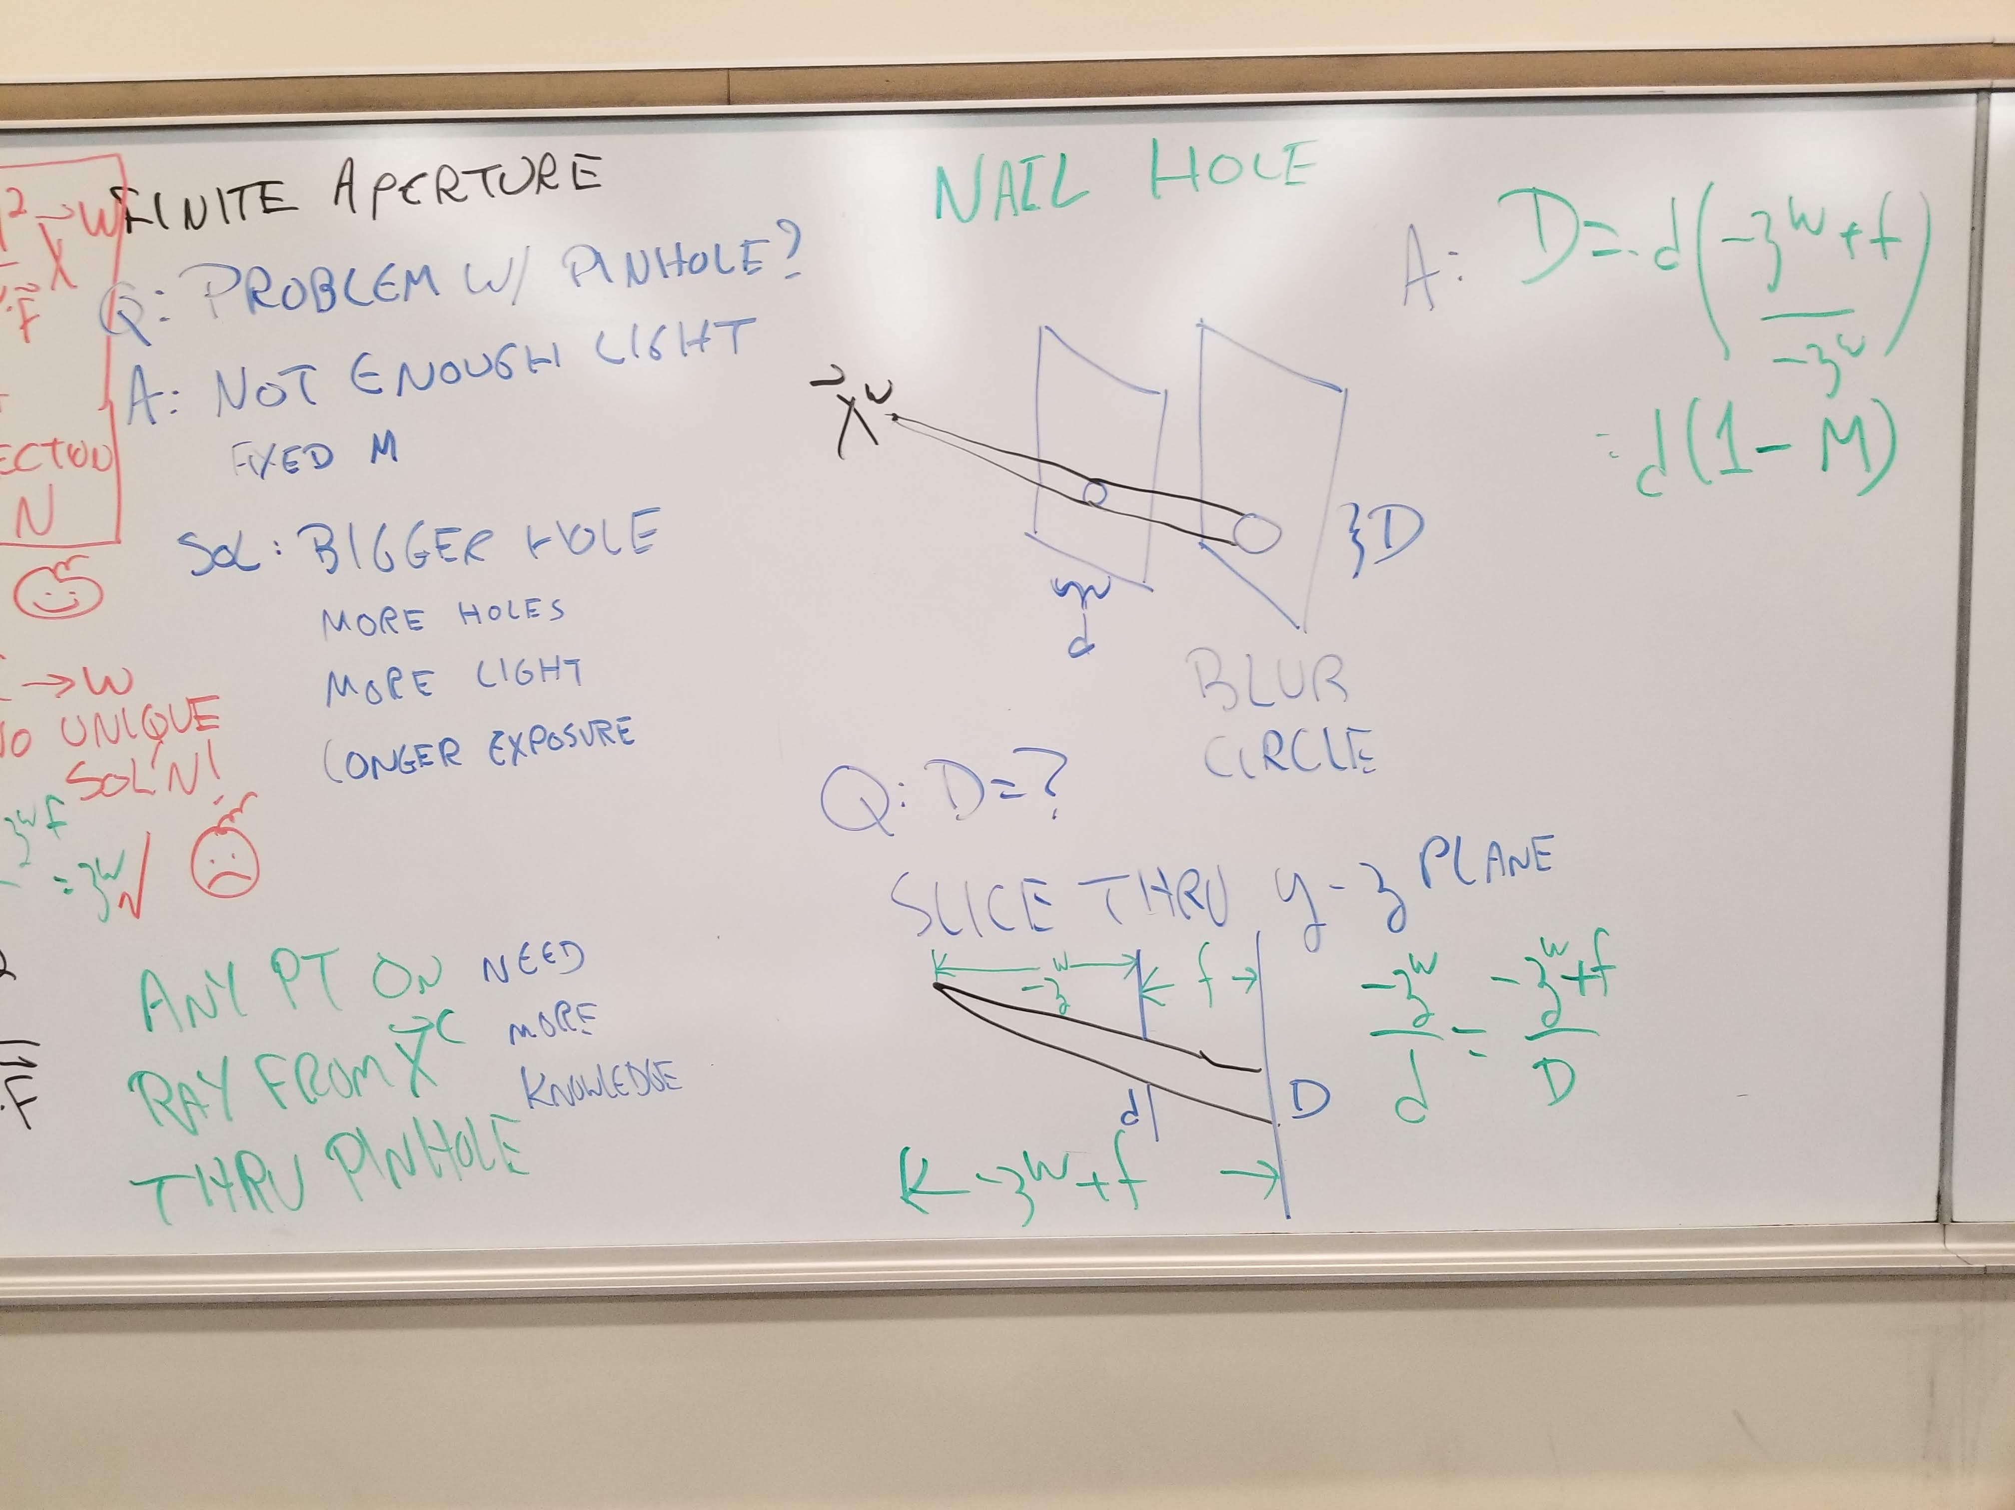

Slide 4
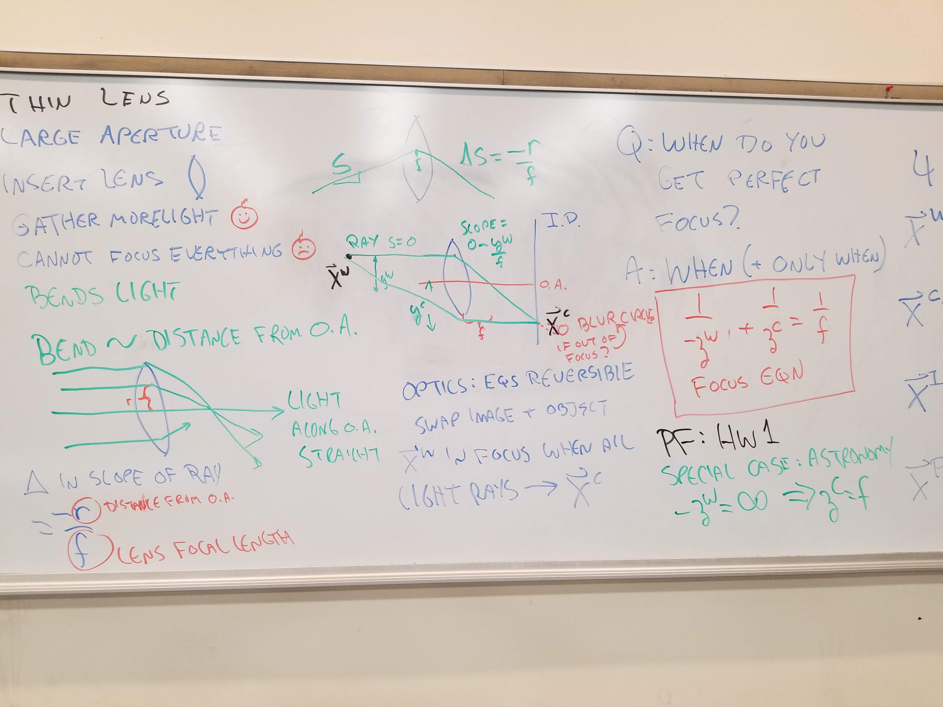

Slide 5
