Slide 1
The single entity
I want to be alone
Greta Garbo

Slide 2
Modeling reality
A database must mirror the real world if it is to answer questions about the real world
Data modeling is a design technique for capturing reality
Reality matters

Slide 3

An entity
Some thing in the environment
Represented by a rectangle
An instance is a particular occurrence of an entity

Slide 4
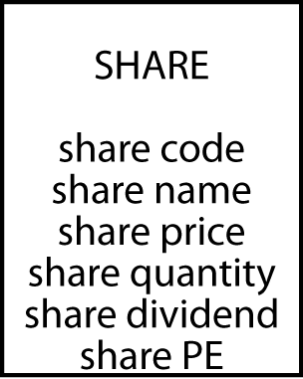
Attributes
An attribute is a discrete data element that describes an entity
Attribute names must be unique within a data model
Attribute names must be meaningful

Slide 5
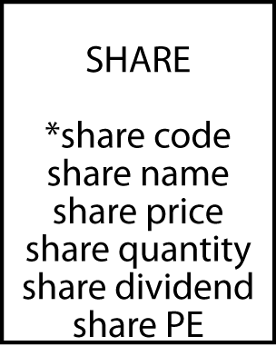
Identifiers
Every instance of an entity must be uniquely identified
An identifier can be an attribute or collection of attributes
An identifier can be created if there is no obvious attribute
A leading asterisk denotes an identifier

Slide 6
Exercise
Visit www.marinetraffic.com/en/
Select a port of interest to view the ships currently within its vicinity
What technology is necessary to provide this information?
Notes:
Maritime Mobile Service Identities (MMSIs) are nine digit numbers used by maritime digital selective calling (DSC), automatic identification systems (AIS) and certain other equipment to uniquely identify a ship or a coast radio station
A ship number consists of the three letters “IMO” (International Maritime Organization) followed by a unique seven-digit number assigned to sea-going merchant ships

Slide 7
Global legal entity identifier(LEI)
No global standard for identifying legal entities
Lehman Brothers collapse in 2008
209 registered subsidiaries, legal entities, in 21 countries
Party to more than 900,000 derivatives contracts
Creditors were unable to assess their exposure
Transitive nature of many investments (i.e., A owes B, B owes C, and C owes D)
LEI is in the process of global adoption

Slide 8
Exercise
Design a data model for recording details of Olympic cities
See http://en.wikipedia.org/wiki/List_of_Olympic_Games_host_cities

Slide 9
Rules for creating a table
Each entity becomes a table
The entity name becomes the table name
Each attribute becomes a column
The identifier becomes the primary key

Slide 10
Defining a table
CREATE TABLE share (
shrcode CHAR(3),
shrfirm VARCHAR(20)NOT NULL,
shrprice DECIMAL(6,2),
shrqty DECIMAL(8),
shrdiv DECIMAL(5,2),
shrpe DECIMAL(2),
PRIMARY KEY(shrcode));
Are the data types selected a good choice?

Slide 11
Exercise
Install MySQL Workbench & Community Server
OS X
MySQL workbench
MySQL Community Server
Instructions
Default username is root with password generated at install
Windows
MySQL Installer
Instructions
The install wizard will ask you to create a username and password for the MySQL server. You will need this when you create a connection to the server

Slide 12
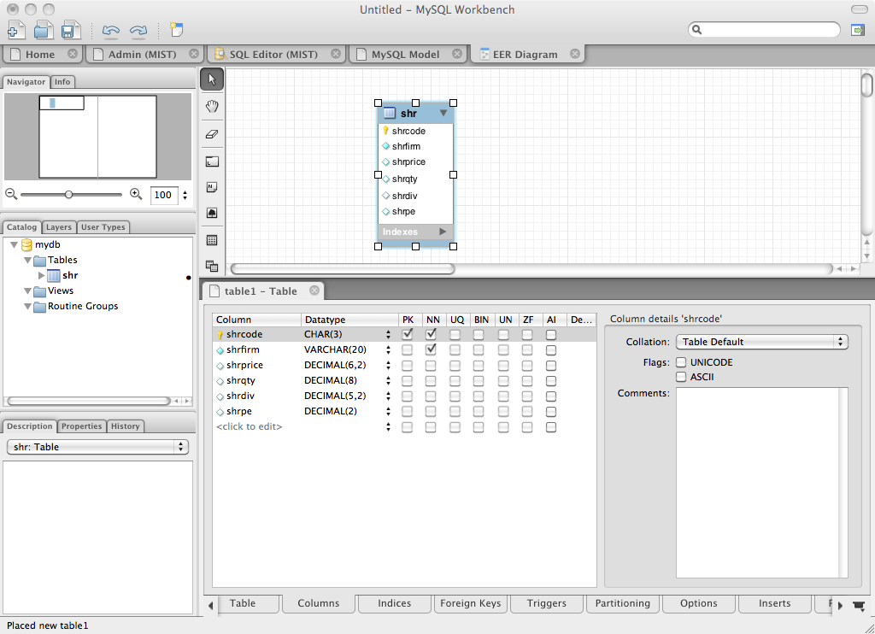
Defining a table with MySQL workbench

Slide 13
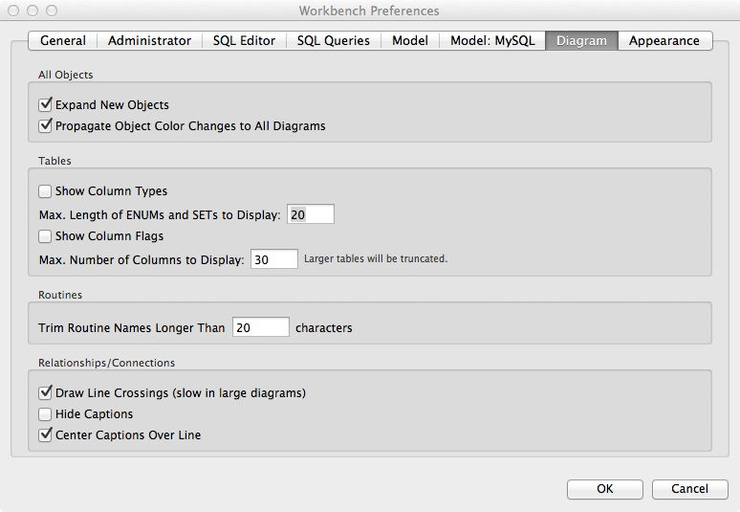
MySQL Workbench preferences
Hide column type
Hide column flag

Slide 14

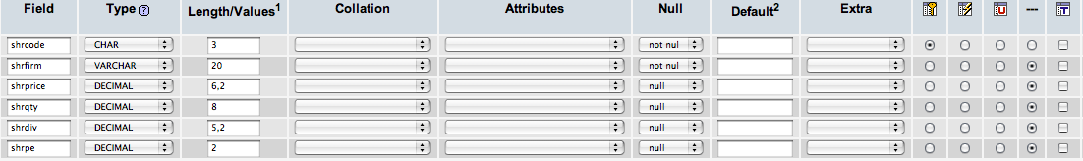
Defining a table with phpMyAdmin

Slide 15
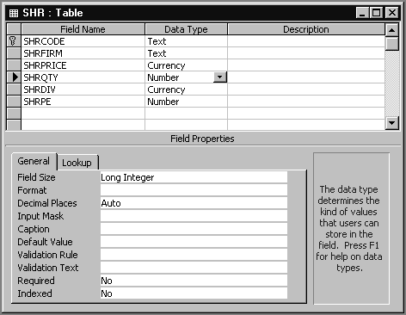
Defining a table with MS Access

Slide 16
Allowable data types
SQL standard
Numeric | integer | A 31-bit signed binary value
 | smallint | A 15-bit signed binary value
 | float(p) | A scientific format number of p binary digits precision
 | decimal(p,q) | A packed decimal number of p digits total length; q decimal places to the right of the decimal point may be specified
String | char(n) | A fixed length character string of n characters
 | varchar(n) | A variable length character string up to n characters
 | text | A variable-length character string of up to 65,535 characters
Date/time | date | Date in the form yyyymmdd
 | time | Time in the form hhmmss
 | timestamp | A combination of date and time to the nearest microsecond
 | time with time zone | Same as time, with the addition of an offset from UTC of the specified time
 | timestamp with time zone | Same as timestamp, with the addition of an offset from UTC of the specified time

Slide 17
Allowable data types
MS Access
Text |  | A variable length character string of up to 255 characters
Memo |  | A variable length character string of up to 64,000 characters
Number | Byte | A 8-bit unsigned binary value
 | Integer | A 15-bit signed binary value
 | Long Integer | A 31-bit signed binary value
 | Single | A signed number with an exponent in the range -45 to +38
 | Double | A signed number with an exponent in the range -324 to +308
Date/time |  | A formatted date or time for the years 100 through 9999
Currency |  | A monetary value
AutoNumber |  | A unique sequential number or random number assigned by Access whenever a new record is added to a table
Yes/No |  | A binary field that contains one of two values (Yes/No, True/False, or On/Off)
OLE Object |  | An object, such as a spreadsheet, document, graphic, sound, or other binary data.
Hyperlink |  | A hyperlink address (e.g., a URL)

Slide 18
The share table
share
shrcode | shrfirm | shrprice | shrqty | shrdiv | shrpe
FC | Freedonia Copper | 27.50 | 10529 | 1.84 | 16
PT | Patagonian Tea | 55.25 | 12635 | 2.50 | 10
AR | Abyssinian Ruby | 31.82 | 22010 | 1.32 | 13
SLG | Sri Lankan Gold | 50.37 | 32868 | 2.68 | 16
ILZ | Indian Lead & Zinc | 37.75 | 6390 | 3.00 | 12
BE | Burmese Elephant | 0.07 | 154713 | 0.01 | 3
BS | Bolivian Sheep | 12.75 | 231678 | 1.78 | 11
NG | Nigerian Geese | 35.00 | 12323 | 1.68 | 10
CS | Canadian Sugar | 52.78 | 4716 | 2.50 | 15
ROF | Royal Ostrich Farms | 33.75 | 1234923 | 3.00 | 6

Slide 19
Inserting rows
INSERT INTO share
(shrcode,shrfirm,shrprice,shrqty,shrdiv,shrpe)
VALUES ('FC','Freedonia Copper',27.5,10529,1.84,16);
Or
INSERT INTO share
VALUES ('FC','Freedonia Copper',27.5,10529,1.84,16);

Slide 20
Importing from a text file
Use MySQL Workbench’s import facility

Slide 21
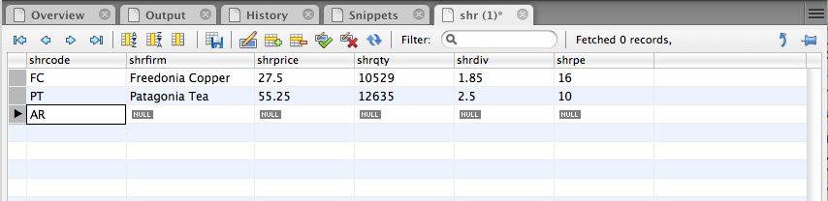
Inserting rows with MySQL Workbench

Slide 22
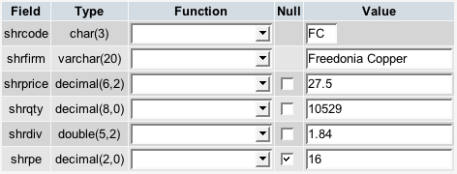
Inserting rows with phpMyAdmin

Slide 23
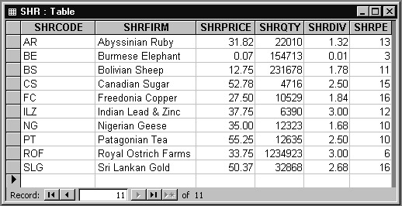
Inserting rows with MS Access

Slide 24
Exercise
Use MySQL Workbench to design your data model for recording details of Olympic cities
Create a table and add rows for the first three Olympics

Slide 25
Querying a table
List all data in the share table.
SELECT * FROM share;
shrcode | shrfirm | shrprice | shrqty | shrdiv | shrpe
FC | Freedonia Copper | 27.50 | 10529 | 1.84 | 16
PT | Patagonian Tea | 55.25 | 12635 | 2.50 | 10
AR | Abyssinian Ruby | 31.82 | 22010 | 1.32 | 13
SLG | Sri Lankan Gold | 50.37 | 32868 | 2.68 | 16
ILZ | Indian Lead & Zinc | 37.75 | 6390 | 3.00 | 12
BE | Burmese Elephant | 0.07 | 154713 | 0.01 | 3
BS | Bolivian Sheep | 12.75 | 231678 | 1.78 | 11
NG | Nigerian Geese | 35.00 | 12323 | 1.68 | 10
CS | Canadian Sugar | 52.78 | 4716 | 2.50 | 15
ROF | Royal Ostrich Farms | 33.75 | 1234923 | 3.00 | 6

Slide 26
Project
Choosing columns
A vertical slice
share
shrcode | shrfirm | shrprice | shrqty | shrdiv | shrpe
FC | Freedonia Copper | 27.50 | 10529 | 1.84 | 16
PT | Patagonian Tea | 55.25 | 12635 | 2.50 | 10
AR | Abyssinian Ruby | 31.82 | 22010 | 1.32 | 13
SLG | Sri Lankan Gold | 50.37 | 32868 | 2.68 | 16
ILZ | Indian Lead & Zinc | 37.75 | 6390 | 3.00 | 12
BE | Burmese Elephant | 0.07 | 154713 | 0.01 | 3
BS | Bolivian Sheep | 12.75 | 231678 | 1.78 | 11
NG | Nigerian Geese | 35.00 | 12323 | 1.68 | 10
CS | Canadian Sugar | 52.78 | 4716 | 2.50 | 15
ROF | Royal Ostrich Farms | 33.75 | 1234923 | 3.00 | 6

Slide 27
Project
Report a firm’s name and price-earnings ratio.
SELECT shrfirm, shrpe FROM share;
shrfirm | shrpe
Freedonia Copper | 16
Patagonian Tea | 10
Abyssinian Ruby | 13
Sri Lankan Gold | 16
Indian Lead & Zinc | 12
Burmese Elephant | 3
Bolivian Sheep | 11
Nigerian Geese | 10
Canadian Sugar | 15
Royal Ostrich Farms | 6

Slide 28
Restrict
Choosing rows
A horizontal slice
share
shrcode | shrfirm | shrprice | shrqty | shrdiv | shrpe
FC | Freedonia Copper | 27.50 | 10529 | 1.84 | 16
PT | Patagonian Tea | 55.25 | 12635 | 2.50 | 10
AR | Abyssinian Ruby | 31.82 | 22010 | 1.32 | 13
SLG | Sri Lankan Gold | 50.37 | 32868 | 2.68 | 16
ILZ | Indian Lead & Zinc | 37.75 | 6390 | 3.00 | 12
BE | Burmese Elephant | 0.07 | 154713 | 0.01 | 3
BS | Bolivian Sheep | 12.75 | 231678 | 1.78 | 11
NG | Nigerian Geese | 35.00 | 12323 | 1.68 | 10
CS | Canadian Sugar | 52.78 | 4716 | 2.50 | 15
ROF | Royal Ostrich Farms | 33.75 | 1234923 | 3.00 | 6

Slide 29
Restrict
Get all firms with a price-earnings ratio less than 12.
SELECT * FROM share WHERE shrpe < 12;
shrcode | shrfirm | shrprice | shrqty | shrdiv | shrpe
PT | Patagonian Tea | 55.25 | 12635 | 2.50 | 10
BE | Burmese Elephant | 0.07 | 154713 | 0.01 | 3
BS | Bolivian Sheep | 12.75 | 231678 | 1.78 | 11
NG | Nigerian Geese | 35.00 | 12323 | 1.68 | 10
ROF | Royal Ostrich Farms | 33.75 | 1234923 | 3.00 | 6

Slide 30
Project and restrict combo
Choosing rows and columns
List the firm’s name, price, quantity, and dividend where share holding is at least 100,000.
SELECT shrfirm, shrprice, shrqty, shrdiv
FROM share WHERE shrqty >= 100000;
shrfirm | shrprice | shrqty | shrdiv
Burmese Elephant | 0.07 | 154713 | 0.01
Bolivian Sheep | 12.75 | 231678 | 1.78
Royal Ostrich Farms | 33.75 | 1234923 | 3.00

Slide 31
Exercise
Report the name and price of those shares where the share price is greater than 10

Slide 32
Primary key retrieval
A query using the primary key returns at most one row
Report firms whose code is AR.
SELECT * FROM share WHERE shrcode = 'AR';
shrcode | shrfirm | shrprice | shrqty | shrdiv | shrpe
AR | Abyssinian Ruby | 31.82 | 22010 | 1.32 | 13

Slide 33
Primary key retrieval
A query not using the primary key can return more than one row
Report firms with a dividend of 2.50.
SELECT * FROM share WHERE shrdiv = 2.5;
shrcode | shrfirm | shrprice | shrqty | shrdiv | shrpe
PT | Patagonian Tea | 55.25 | 12635 | 2.50 | 10
CS | Canadian Sugar | 52.78 | 4716 | 2.50 | 15

Slide 34
IN
Used with a list of values
Report data on firms with codes of FC, AR, or SLG.
SELECT * FROM share WHERE shrcode IN ('FC','AR','SLG');
or
SELECT * FROM share WHERE shrcode = 'FC' OR
shrcode = 'AR' OR shrcode = 'SLG';
shrcode | shrfirm | shrprice | shrqty | shrdiv | shrpe
FC | Freedonia Copper | 27.50 | 10529 | 1.84 | 16
AR | Abyssinian Ruby | 31.82 | 22010 | 1.32 | 13
SLG | Sri Lankan Gold | 50.37 | 32868 | 2.68 | 16

Slide 35
NOT IN
Not in a list of values
Report all firms other than those with the code CS or PT.
SELECT * FROM share WHERE shrcode NOT IN ('CS', 'PT');
is equivalent to:
SELECT * FROM share WHERE shrcode <> 'CS' AND shrcode <> 'PT';
shrcode | shrfirm | shrprice | shrqty | shrdiv | shrpe
AR | Abyssinian Ruby | 31.82 | 22010 | 1.32 | 13
SLG | Sri Lankan Gold | 50.37 | 32868 | 2.68 | 16
ILZ | Indian Lead & Zinc | 37.75 | 6390 | 3.00 | 12
BE | Burmese Elephant | 0.07 | 154713 | 0.01 | 3
BS | Bolivian Sheep | 12.75 | 231678 | 1.78 | 11
NG | Nigerian Geese | 35.00 | 12323 | 1.68 | 10
ROF | Royal Ostrich Farms | 33.75 | 1234923 | 3.00 | 6

Slide 36
Ordering output
Ordering columns
Columns are reported in the order specified in the SQL command
Ordering rows
Rows are ordered using the ORDER BY clause

Slide 37
Ordering columns
SELECT shrcode, shrfirm FROM share WHERE shrpe = 10;
SELECT shrfirm, shrcode FROM share WHERE shrpe = 10;
shrcode | shrfirm
PT | Patagonian Tea
NG | Nigerian Geese
shrfirm | shrcode
Patagonian Tea | PT
Nigerian Geese | NG

Slide 38
Ordering rows
List all firms where PE is at least 12, and order the report in descending PE. Where PE ratios are identical, list firms in alphabetical order.
SELECT * FROM share WHERE shrpe >= 12
ORDER BY shrpe DESC, shrfirm;
shrcode | shrfirm | shrprice | shrqty | shrdiv | shrpe
FC | Freedonia Copper | 27.50 | 10529 | 1.84 | 16
SLG | Sri Lankan Gold | 50.37 | 32868 | 2.68 | 16
CS | Canadian Sugar | 52.78 | 4716 | 2.50 | 15
AR | Abyssinian Ruby | 31.82 | 22010 | 1.32 | 13
ILZ | Indian Lead & Zinc | 37.75 | 6390 | 3.00 | 12

Slide 39
Calculating
Get firm name, price, quantity, and firm yield.
SELECT shrfirm, shrprice, shrqty,
shrdiv/shrprice*100 AS yield FROM share;
shrfirm | shrprice | shrqty | yield
Freedonia Copper | 27.50 | 10,529 | 6.69
Patagonian Tea | 55.25 | 12,635 | 4.52
Abyssinian Ruby | 31.82 | 22,010 | 4.15
Sri Lankan Gold | 50.37 | 32,868 | 5.32
Indian Lead & Zinc | 37.75 | 6,390 | 7.95
Burmese Elephant | 0.07 | 154,713 | 14.29
Bolivian Sheep | 12.75 | 231,678 | 13.96
Nigerian Geese | 35.00 | 12,323 | 4.80
Canadian Sugar | 52.78 | 4,716 | 4.74
Royal Ostrich Farms | 33.75 | 1,234,923 | 8.89

Slide 40
Exercise
Calculate the total dividends earned by each share. Report the name of the firm and the payment sorted from highest to lowest payment.

Slide 41
Built-in functions
COUNT, AVG, SUM, MIN, and MAX
Find the average dividend.
SELECT AVG(shrdiv) AS avgdiv FROM share;
What is the average yield for the portfolio?
SELECT AVG(shrdiv/shrprice*100) AS avgyield FROM share;
avgdiv
2.03
avgyield
7.53

Slide 42
COUNT
COUNT(*) counts all rows
COUNT(columname) counts rows with non null values for columname

Slide 43
Subqueries
A query within a query
Report all firms with a PE ratio greater than the average for the portfolio.
SELECT shrfirm, shrpe FROM share WHERE shrpe >(SELECT AVG(shrpe)FROM share);
shrfirm | shrpe
Freedonia Copper | 16
Abyssinian Ruby | 13
Sri Lankan Gold | 16
Indian Lead & Zinc | 12
Canadian Sugar | 15

Slide 44
Regular expression
A concise and flexible method for string searching
Commands are handled by a regular expression processor
Supported by many programming languages

Slide 45
Regular expression
Search for a string
List all firms containing ‘Ruby’ in their name.
SELECT shrfirm FROM share
WHERE shrfirm REGEXP 'Ruby';
shrfirm
Abyssinian Ruby

Slide 46
Regular expression
Search for alternative strings
[a|b] finds 'a' or 'b'
| is the alternation symbol
List the firms containing gold or zinc in their name.
SELECT * FROM share
WHERE shrfirm
REGEXP 'gold|zinc|Gold|Zinc';

Slide 47
Regular expression
Search for a beginning string
^ means at the start of the string
List the firms whose name begins with Sri.
SELECT * FROM share
WHERE shrfirm REGEXP '^Sri';

Slide 48
Regular expression
Search for a ending string
$ means at the end of the string
List the firms whose name ends in Geese.
SELECT shrfirm
FROM share
WHERE shrfirm REGEXP 'Geese$';

Slide 49
Exercise
List names of shares whose name contains sheep or geese

Slide 50
DISTINCT
Eliminating duplicate rows
Find the number of different PE ratios.
SELECT COUNT(DISTINCT shrpe)AS 'Different PEs' FROM share;
Different PEs
8
DISTINCT column-name is not implemented by all relational systems

Slide 51
DISTINCT
Eliminating duplicate rows when reporting
Report the different values of the PE ratio.
SELECT DISTINCT shrpe FROM share;
shrpe
3
6
10
11
12
13
15
16

Slide 52
DELETE - deleting rows
Erase the data for Burmese Elephant. All the shares have been sold.
DELETE FROM share
WHERE shrfirm = 'Burmese Elephant';

Slide 53
UPDATE - changing rows
Change the share price of FC to 31.50.
UPDATE share
SET shrprice = 31.50
WHERE shrcode = 'FC';

Slide 54
UPDATE - changing rows
Increase the total number of shares for Nigerian Geese by 10% because of the recent bonus issue.
UPDATE share
SET shrqty = shrqty*1.1
WHERE shrfirm = 'Nigerian Geese';

Slide 55
Quotes
Three kinds of quotes
Single ' (must be straight not curly)
Double " (must be straight not curly)
Back ` ( left of 1 key)
In MySQL, the first two are equivalent and can be used interchangeably
SELECT `person first` FROM person WHERE `person last` = "O'Hara";

Slide 56
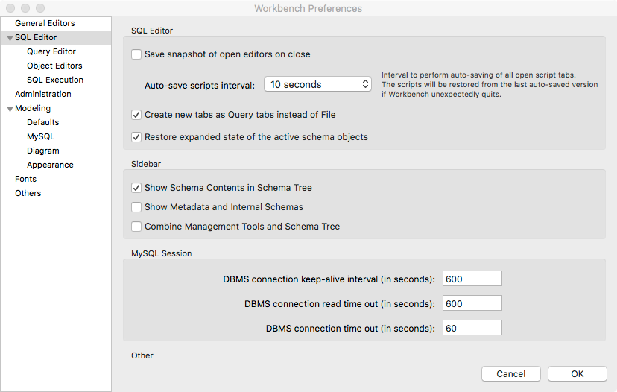
Workbench bug
Some releases of Workbench hang when you try to close a tab or connection
Switch off some features if you have a problem

Slide 57
Summary
Introduced
Entity
Attribute
Identifier
SQL
CREATE
INSERT
SELECT
DELETE
UPDATE

