Slide 1
Data Modeling
Man is a knot, a web, a mesh into which relationships are tied. Only those relationships matter
Saint-Exupéry

Slide 2
Data modeling
A technique for modeling data
A graphical representation of a database
The goal is to identify the facts to be stored in a database
Data modeling is a partnership between the client and analyst

Slide 3
Modeling
5W + H model of journalism
 |  | Scope | Model | Technology
Motivation | why | Goals | Business model canvas | Groupware
People | who | Business units | Organization chart | Systems interface
Time | when | Key events | PERT chart | Scheduling
Data | what | Key entities | Data model | Relational database
Network | where | Locations | Logistics network | System architecture
Process | how | Key processes | Process model | Programming

Slide 4
The building blocks
Entity
Attribute
Relationship
Identifier

Slide 5
Data model quality
A well-formed data model
A high fidelity image

Slide 6
A well-formed data model
Construction rules obeyed
No ambiguity
All entities, attributes, relationships, and identifiers are defined
Names are meaningful to the client

Slide 7
A high fidelity image
Faithfully describes the world it is supposed to represent
Relationships are of the correct degree
Data model is complete, understandable, and accurate
The data model makes sense to the client

Slide 8
Quality improvement
Is the level of detail correct?
Are all exceptions handled?
Is the model accurate?

Slide 9
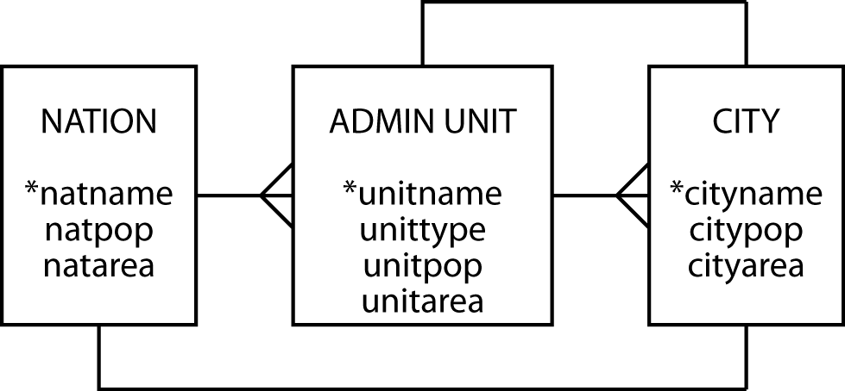
Pure geography
Can a nation have more than one capital?
Can a city be the capital of more than one state?

Slide 10
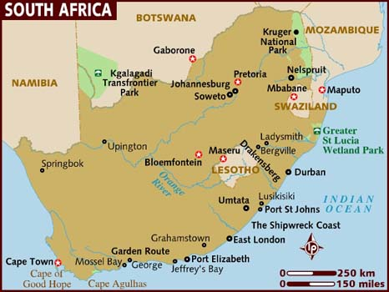
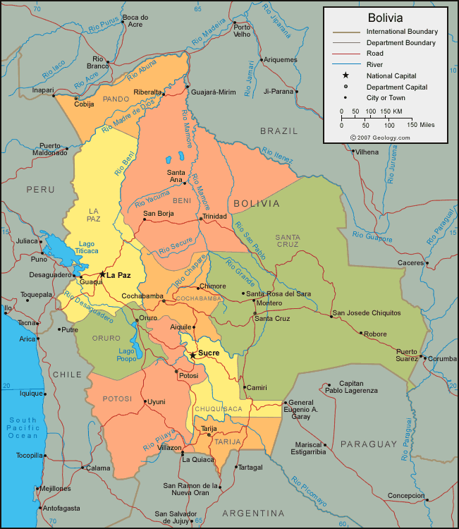
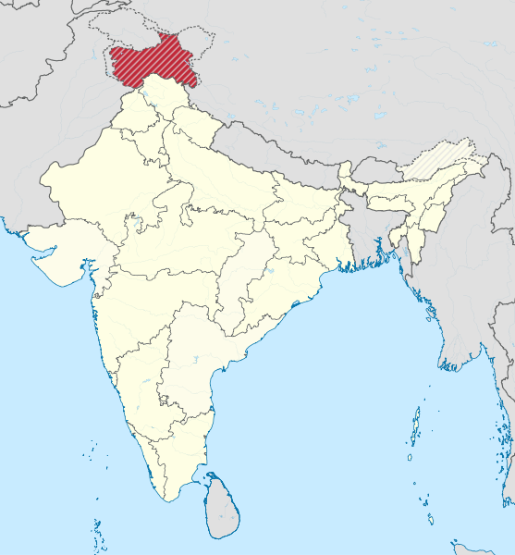
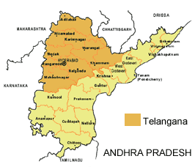
Notes:
http://www.lonelyplanet.com/maps/africa/south-africa/
http://geology.com/world/bolivia-satellite-image.shtml
http://www.chakranews.com/the-freedom-struggle-in-kashmir-a-breaking-india-tool/4763
http://www.rediff.com/news/report/formation-of-telangana-fast-becoming-a-reality/20130726.htm

Slide 11
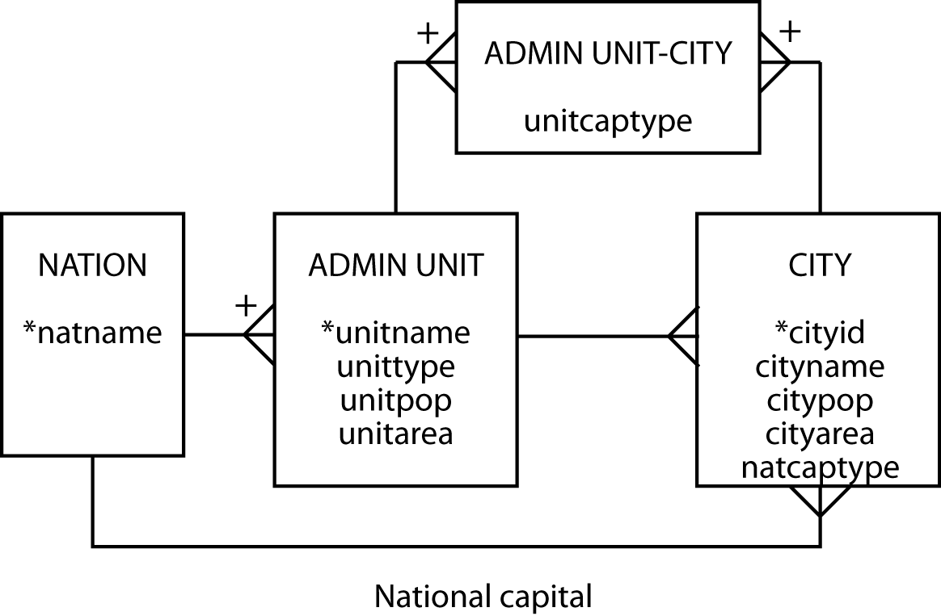
Geography revised

Slide 12
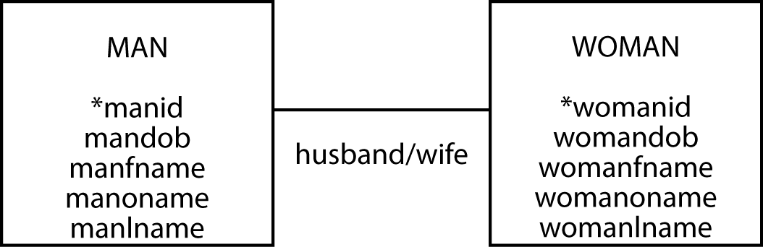
Family matters - take 1
Can we generalize?

Slide 13
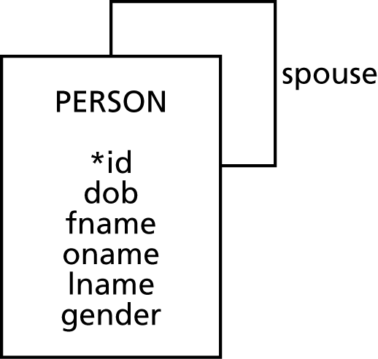
Family matters - take 2

Slide 14
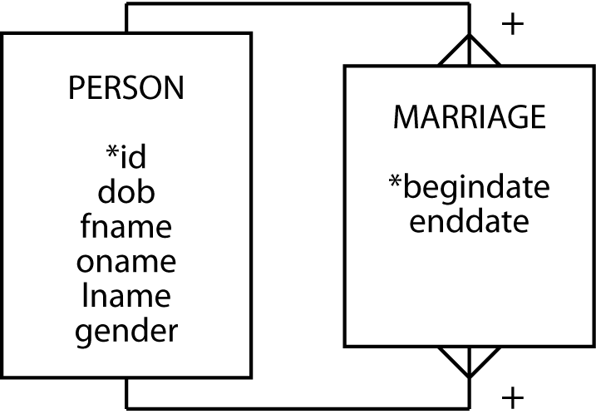
Family matters - take 3
What about couples who are not officially married but have cohabited for an extended period?

Slide 15
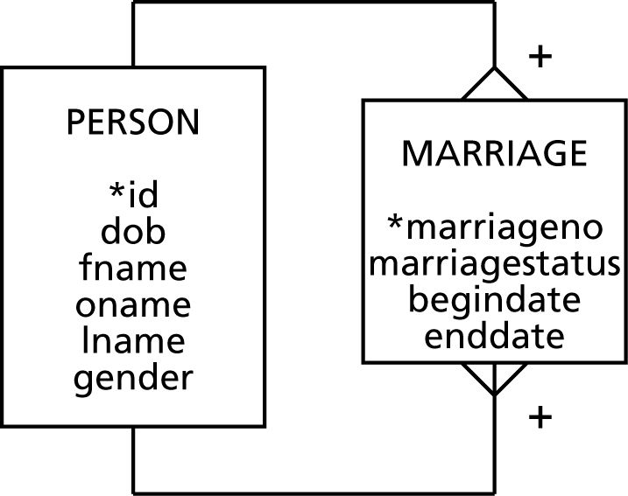
Family matters - take 4

Slide 16
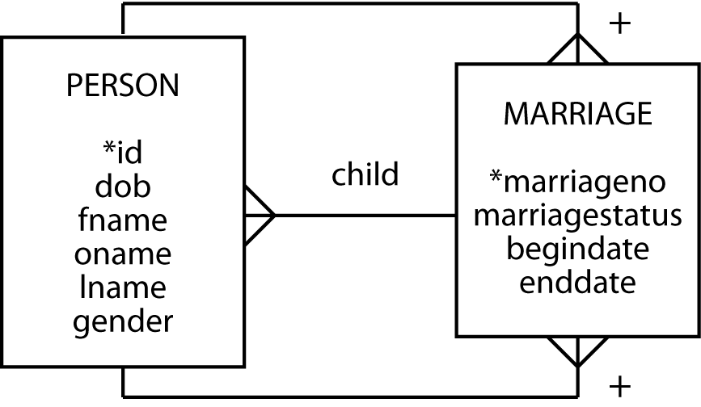
Family matters - take 5

Slide 17
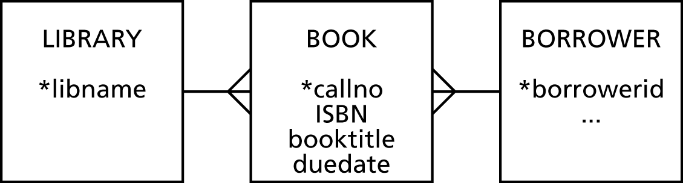
Bookish matters - take 1
Should copyno be an attribute of book?

Slide 18
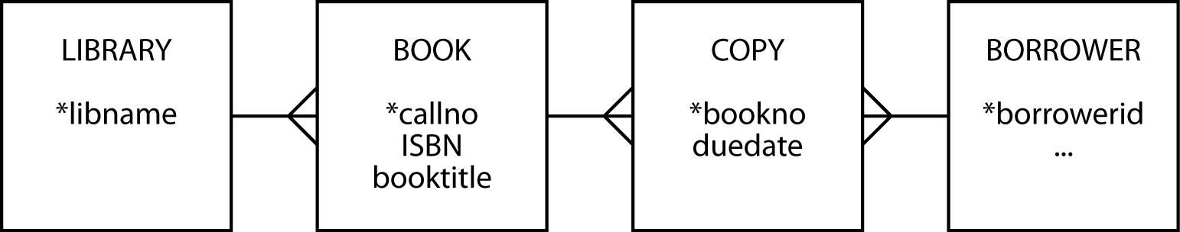
Bookish matters - take 2
This model records only the current borrower of a copy of a book

Slide 19
Identification shift
A UPC or EAN identifies a type of product
220g Vegemite
How would a data model for a retailer change if every product were uniquely identified, such as with a RFID tag?

Slide 20
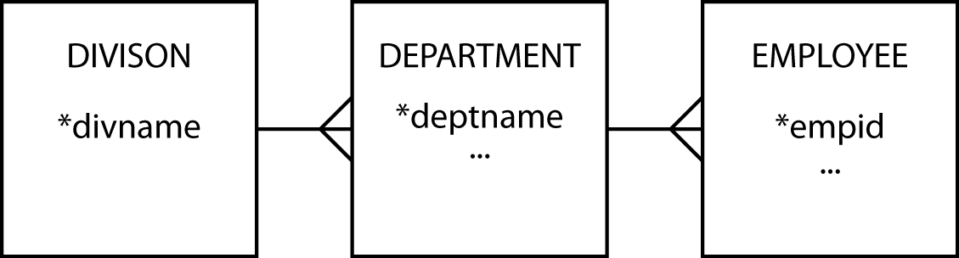
History - take 1
Can an employee work in multiple departments?

Slide 21
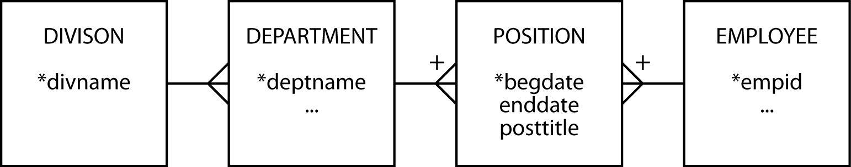
History - take 2
How do we keep track of an employee’s pay checks?

Slide 22
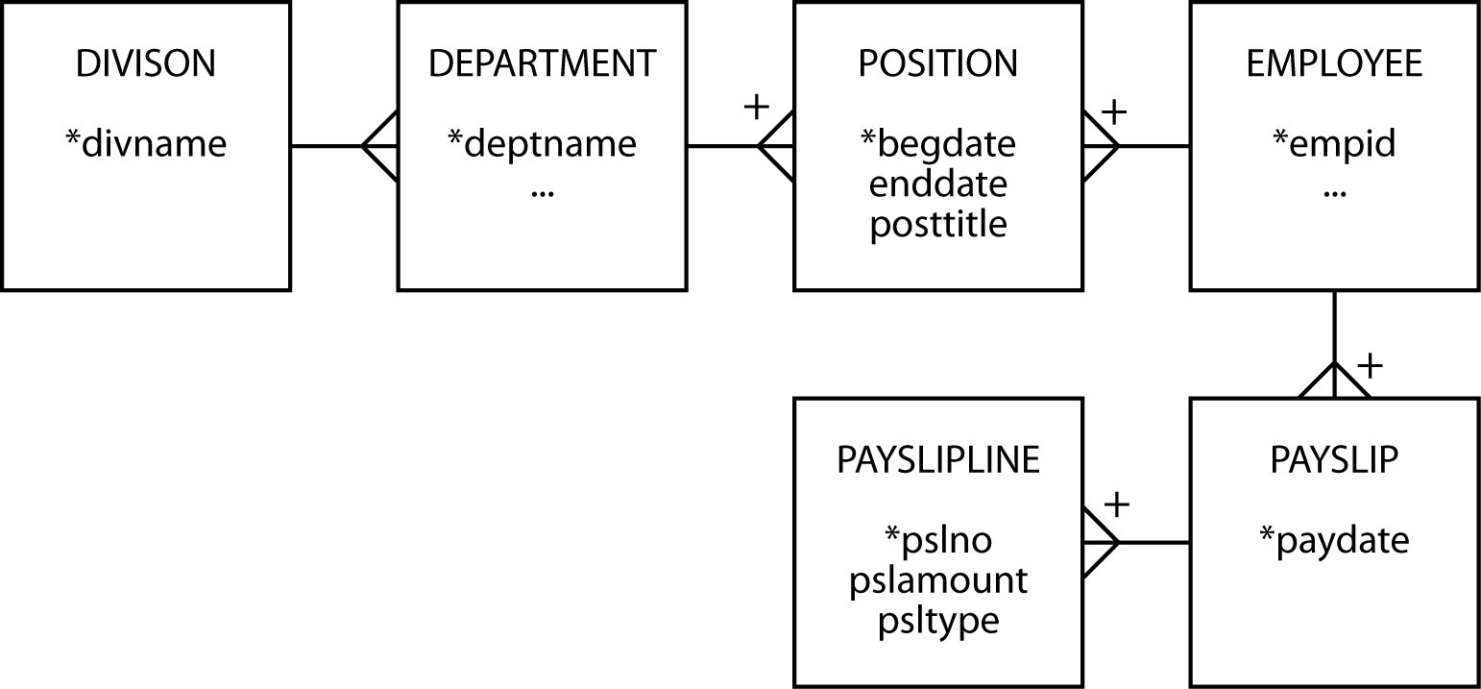
History - take 3
How is an instance of PAYSLIPLINE identified?

Slide 23
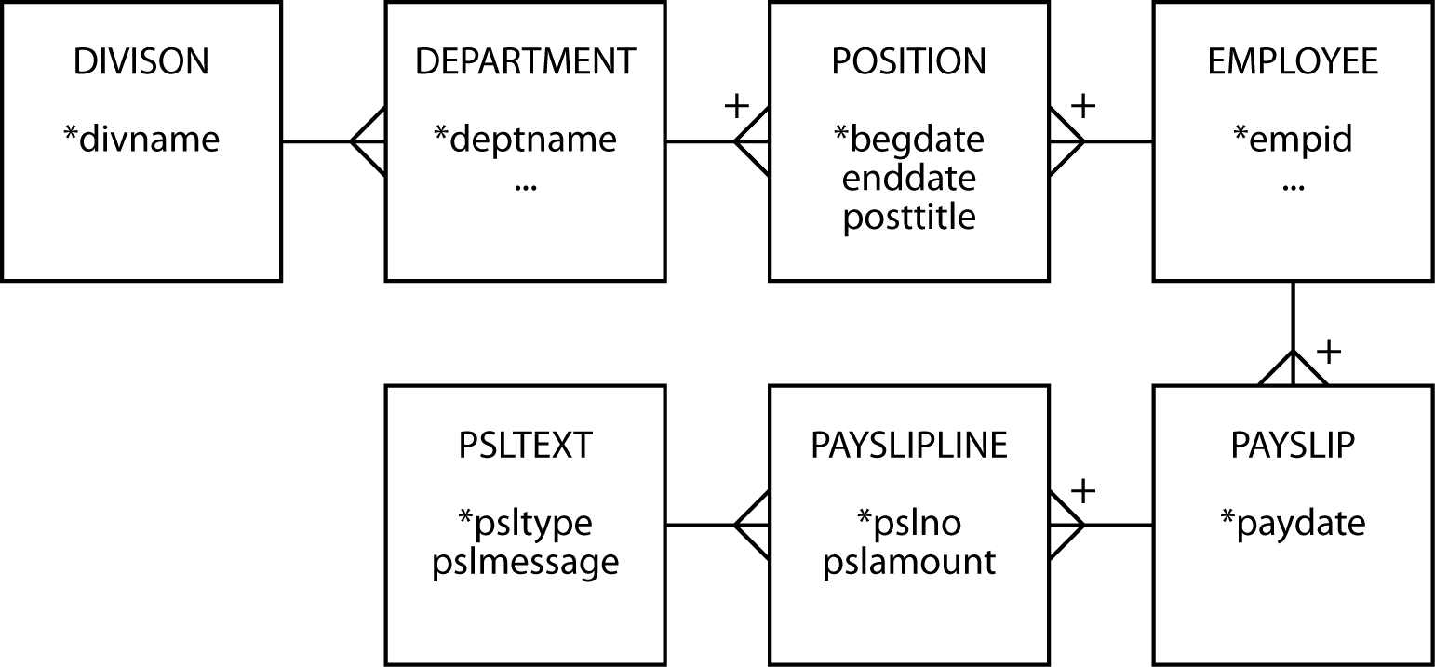
History - take 4

Slide 24
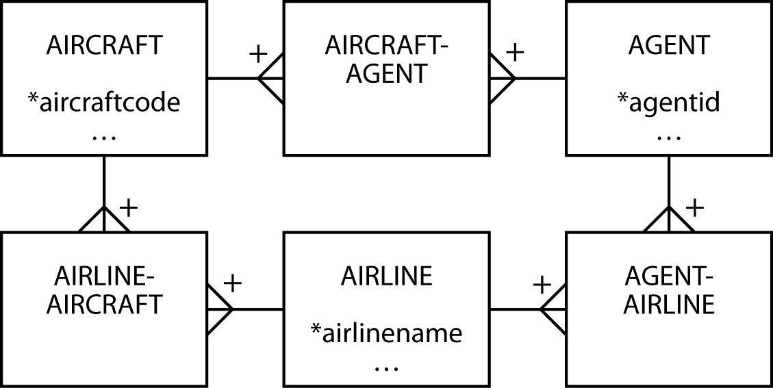
A ménage à trois for entities - take 1
Where do we store information about the lease?

Slide 25
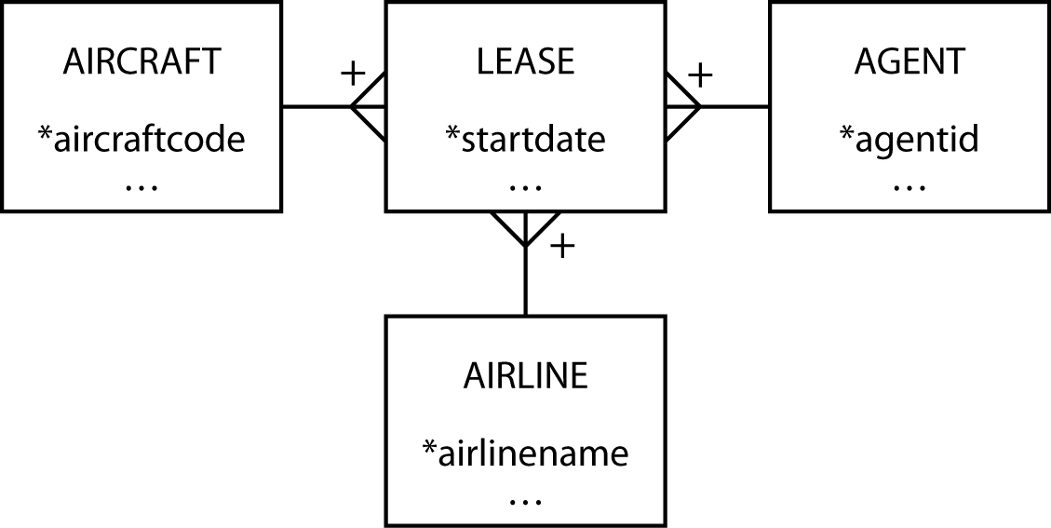
A ménage à trois for entities - take 2
Why is start date part of the composite primary key?

Slide 26
Golf statistics - take 1

Slide 27
Golf statistics – take 2

Slide 28
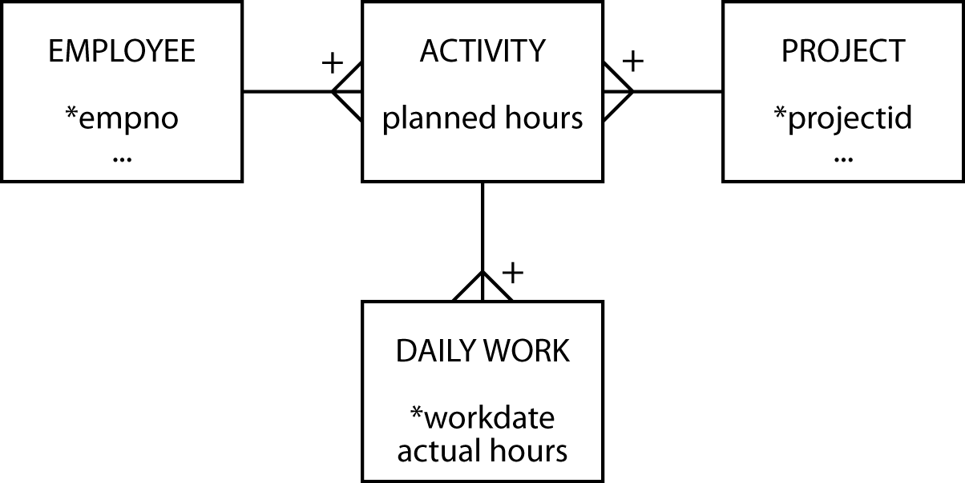
Planning and doing - take 1

Slide 29
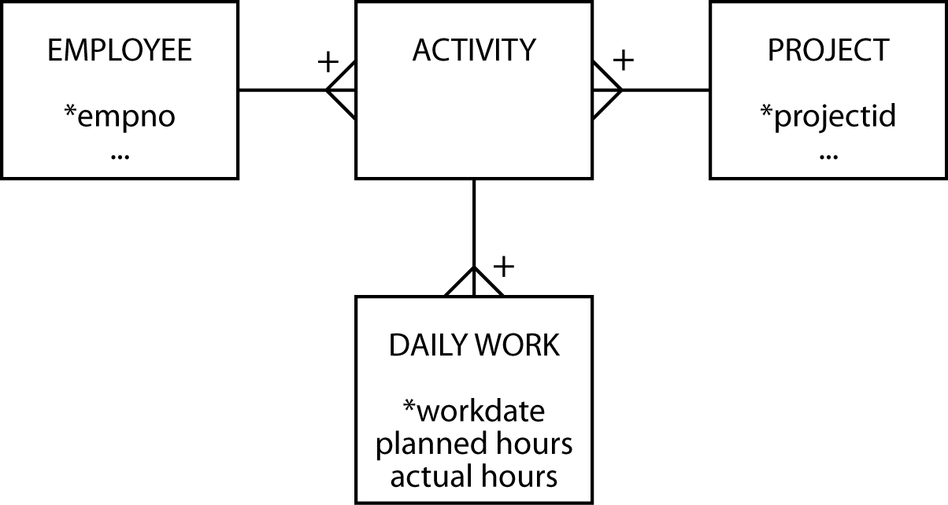
Planning and doing - take 2

Slide 30
Cardinality
Cardinality | Modality | Meaning
0,1 | Optional | There can be zero or one instances of the entity relative to the other entity
0,n |  | There can be zero or many instances of the entity relative to the other entity
1,1 | Mandatory | There is exactly one instance of the entity relative to the other entity
1,n |  | The entity must have at least one and can have many instances relative to the other entity

Slide 31
Minimalist approach
Focus has been on identifying the basic cardinality (1:m or m:m?)
Now add greater precision
There must be 1 instance
Learn the basics and then add more detail

Slide 32
Modality
Also known as optionality
Cardinality indicates the range of instances in a relationship
Modality defines the minimum number of instances
Cardinality and modality are linked

Slide 33
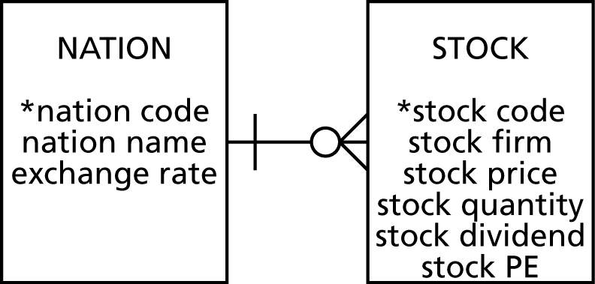
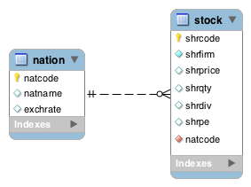
Modality and Cardinality
Optional entity
Cardinality is 0
O
Mandatory entity
Cardinality is 1
|
Cardinality
--------------
Modality
1 of 1:m
0 or n of 1:m
Mandatory
Optional

Slide 34
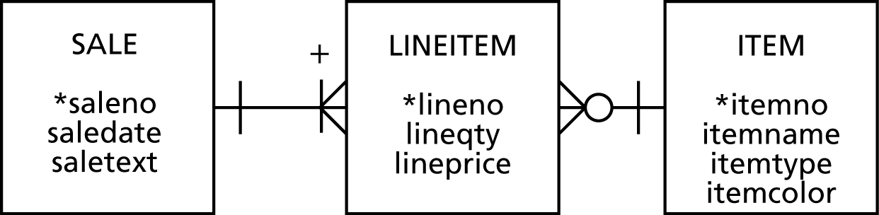
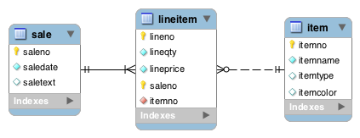
Modality
Can a lineitem exist without a sale?
Can an item exist without a lineitem?

Slide 35
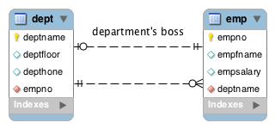
Modality
Is every employee a department boss?
Does every department have a boss?
Notes:
Optional for an employee to be a boss but mandatory for a department to have a boss
Mandatory for an employee to belong to a department (referential integrity) but option for a department to have employees

Slide 36
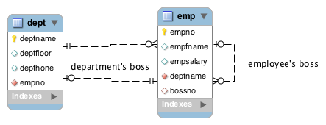
Modality

Slide 37
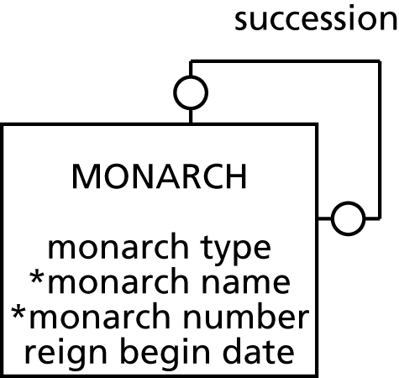
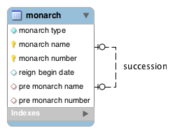
Modality
Why is it optional for a monarch to have a successor?

Slide 38
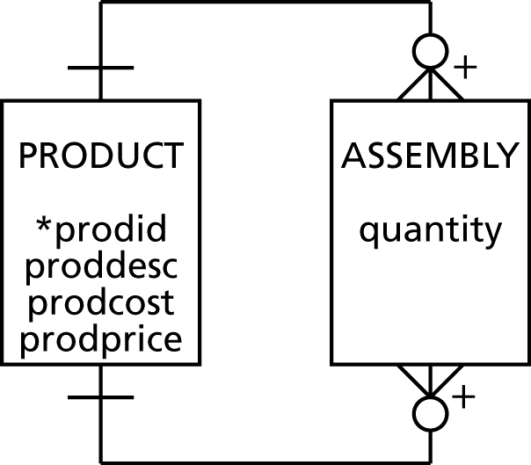
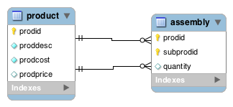
Modality
• Optional for a product to have components
• Optional for a product to be a component
• Every assembly must have products

Slide 39
Modality
Adds additional information to a data model
If a relationship is mandatory then add a constraint
Could be
Referential integrity constraint
Application logic

Slide 40
Entity types
Independent
Dependent
Associative
Aggregate
Subordinate

Slide 41
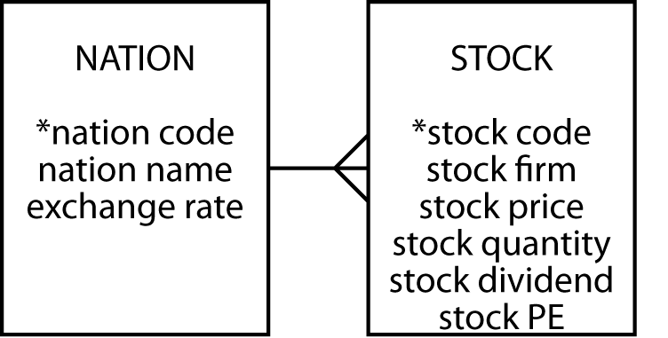
Independent
Often a starting point
Prominent in the client's mind
Often related to other independent entities

Slide 42
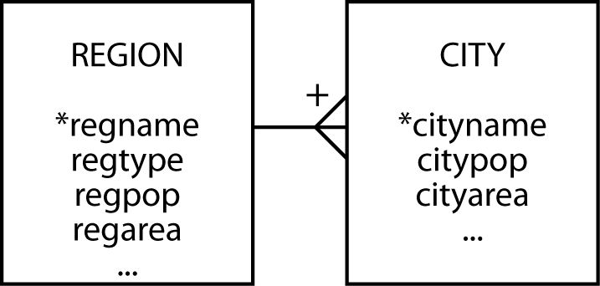
Dependent
Relies on another entity for its existence and identification
Can become independent if given an arbitrary identifier

Slide 43
Associative
A by-product of an m:m relationship
Typically between independent entities
Can store current or historical data
Can become independent if given an arbitrary identifier

Slide 44
Aggregate
Created from several different entities that have a common prefix or suffix
Commonly used with addresses or names

Slide 45
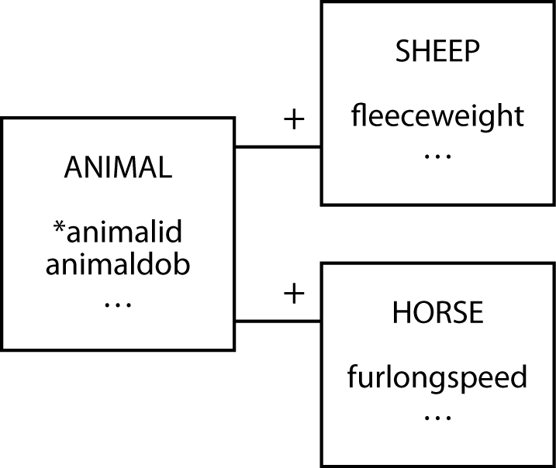
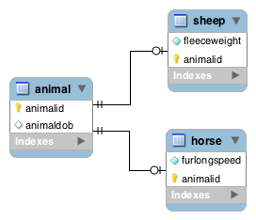
Subordinate
An entity with data that can vary among instances

Slide 46
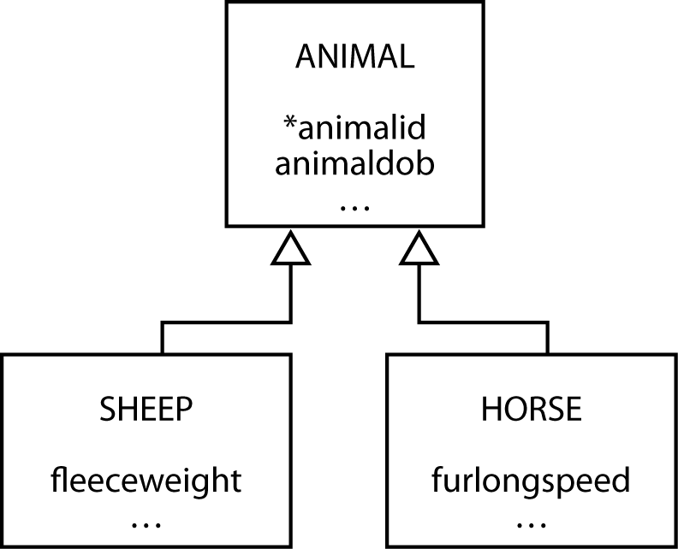
Generalization
A relationship between a more general element and a more specific element

Slide 47
Generalization
Map with one table for each entity
For each of the subtype entities the primary key is that of the supertype entity
You must also make this column a foreign key so that a subtype cannot be inserted without the presence of the matching supertype

Slide 48
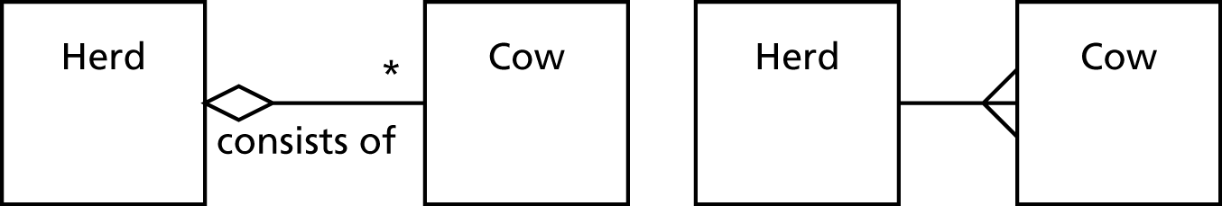
UML aggregation
Aggregation is a part-whole relationship between two entities

Slide 49

UML shared aggregation
One entity owns another entity, but other entities can own that entity as well

Slide 50
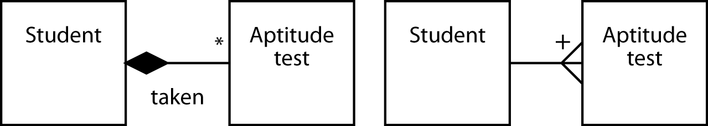
UML composite aggregation
One entity exclusively owns the other entity

Slide 51
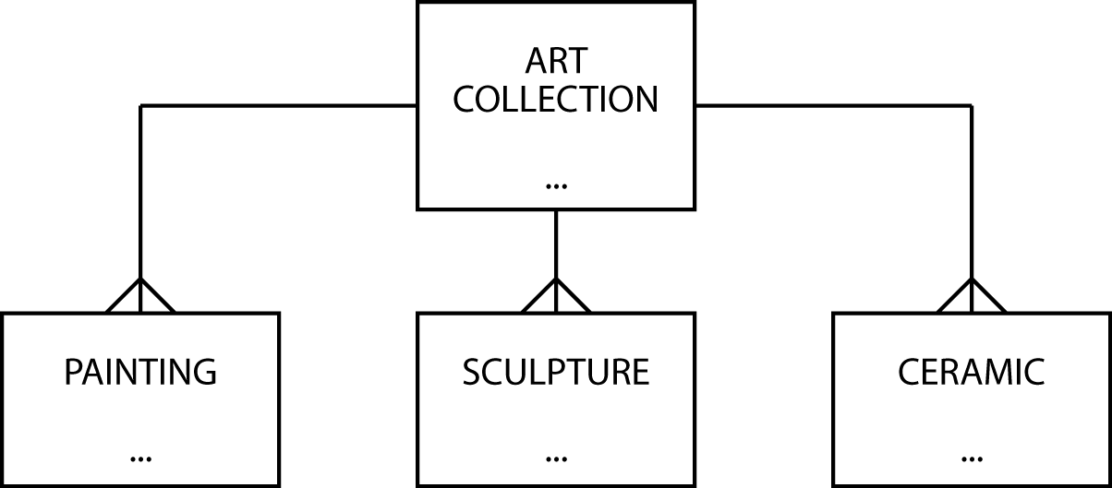
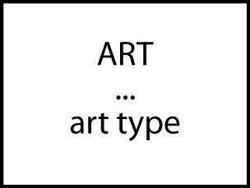
Data model contraction

Slide 52
Hints on data modeling
The model will expand and contract
Invent identifiers where necessary
Identifiers should have only one purpose – identification
A data model does not imply ordering
Create an attribute if ordering of instances is required
An attribute’s meaning must be consistent

Slide 53
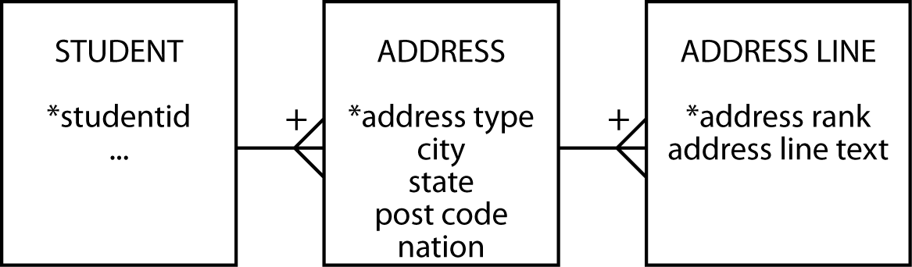
Names and addresses
The query test
If an attribute has parts, are any of the parts ever likely to appear in a query?
Have an understanding on representing names and addresses in a data model

Slide 54
Post code
A US zip code is CHAR(5) because leading zeroes are displayed
Boston MA 02201
Alternatively, use INTEGER
Format with LPAD(zipcode, 5,'0')
Full US zip is CHAR(10)
30602-6273
VARCHAR(20) probably covers all countries

Slide 55
Hints on data modeling
Single instance entities are OK
Select names carefully
Synonyms—different words have the same meaning
Get clients to settle on a common word or use views
Homonyms—same word has different meanings
Clarify to avoid confusion
Naming associative entities
Concatenate entity names if there is no obvious real world name

Slide 56
Hints on data modeling
Uncover all exceptions
Label relationships to avoid ambiguity
Keep the data model well-formed and accurate

Slide 57
Meaningful identifiers
An identifier is meaningful when some attributes of the entity can be inferred from the identifier’s value
Advantages | Disadvantages
Recognizable and rememberable | Identifier exhaustion
Administrative simplicity | Reality changes
 | Loss of meaningfulness

Slide 58
Recommendation
Nothing, however, is lost and much is gained by using non-meaningful identifiers
Non-meaningful identifiers serve their sole purpose well
To uniquely identify an entity
Attributes are used to describe the characteristics of the entity
A clear distinction between the role of identifiers and attributes creates fewer data management problems

Slide 59
The seven habits of highly effective data modelers
Immerse
Challenge
Generalize
Test
Limit
Integrate
Complete

Slide 60
Key points
A high-fidelity data model handles all exceptions
Identifiers need identify only an instance
Data modeling skills take time to develop

