Slide 1
Normalization and Other Data Modeling Methods
There are many paths to the top of the mountain but the view is always the same
Chinese proverb

Slide 2
Normalization
An alternative database design tool to data modeling
A theoretical foundation for the relational model
Application of a series of rules that gradually improve the design

Slide 3
Functional dependency
A relationship between attributes in an entity
One or more attributes determine the value of another attribute
An identifier functionally determines all the attributes of an entity
stock code → firm name, stock price, stock quantity, stock dividend
If we know stock code we know the value of firm name, etc.
Multivalued dependency
Formulae
(stock dividend, stock price) → yield

Slide 4
Full functional dependency
Yield is fully functionally dependent on stock dividend and stock price because both of these attributes are required to determine the value of yield
(stock dividend, stock price) → yield
Determinant
An attribute that fully functionally determines another attribute
e.g., stock code determines stock PE

Slide 5
Multidetermination
A given value can determine multiple values
A multidetermines B
A → → Β
e.g., Department multidetermines course
Multivalued dependency means functional dependencies are multivalued

Slide 6
Attribute relationships
One-to-one
A value of an attribute determines the value of another attribute and vice versa
A → B and B → Α
e.g.,
CH → Switzerland
Switzerland → CH

Slide 7
Attribute relationships
One-to-many
A value of one attribute determines the value of another attribute but not vice versa
country name → currency unit
currency unit not → country name

Slide 8
Attribute relationships
Many-to-many
Neither attribute determines the other
A not → B
B not → A
country name not → language
language not → country name
French and Flemish is spoken in Belgium
French is spoken in many countries

Slide 9
Normal forms
A classification of relations
Stacked like a set of Russian dolls
Innermost is first normal form

Slide 10
First normal form (1NF)
All rows must have the same number of columns
Single valued attributes only

Slide 11
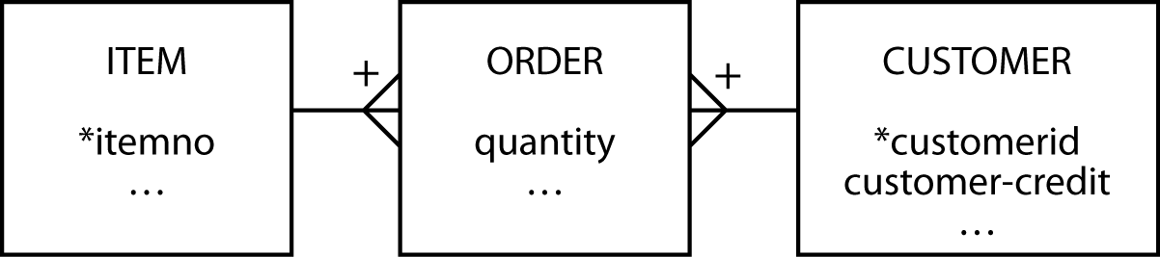
Second normal form (2NF)
Violated when a nonkey column is a fact about part of the primary key
A column is not fully functionally dependent on the primary key
customer-credit in this case
order
itemno | customerid | quantity | customer-credit
12 | 57 | 25 | OK
34 | 679 | 3 | POOR

Slide 12
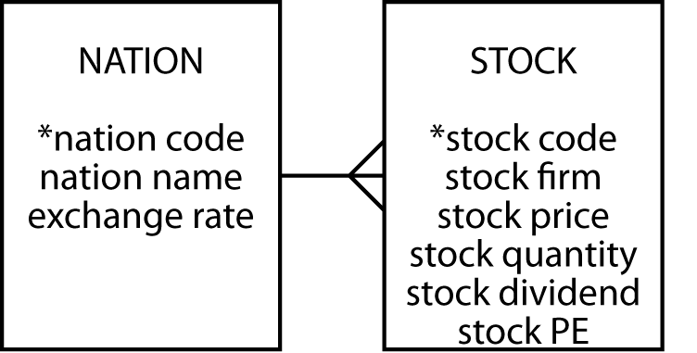
Third normal form (3NF)
Violated when a nonkey column is a fact about another nonkey column
A column is not fully functionally dependent on the primary key
exchange rate in this case
stock
stock code | nation | exchange rate
MG | USA | 0.67
IR | AUS | 0.46

Slide 13
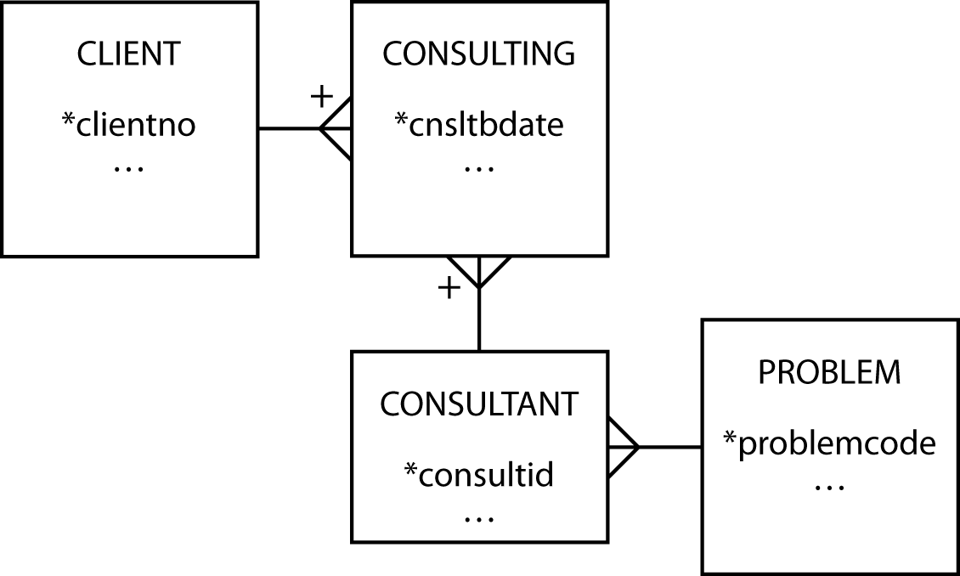
Boyce-Codd normal form (BCNF)
Arises when a table
has multiple candidate keys
the candidate keys are composite
the candidate keys overlap
advisor
client | probtype | consultant
Alpha | Marketing | Gomez
Alpha | Production | Raginiski

Slide 14
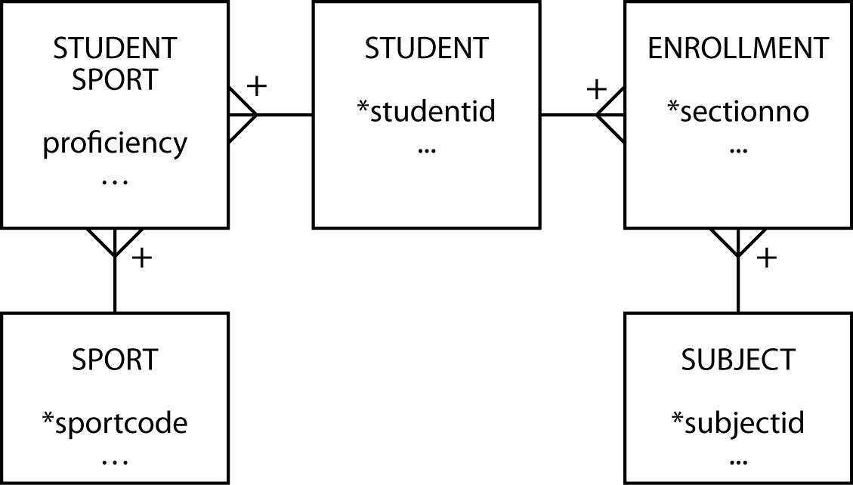
Fourth normal form (4NF)
A row should not contain two or more multivalued independent facts
student
studentid | sport | subject | …
50 | Football | English | …
50 | Football | Music | …
50 | Tennis | Botany | …
50 | Karate | Botany | …

Slide 15
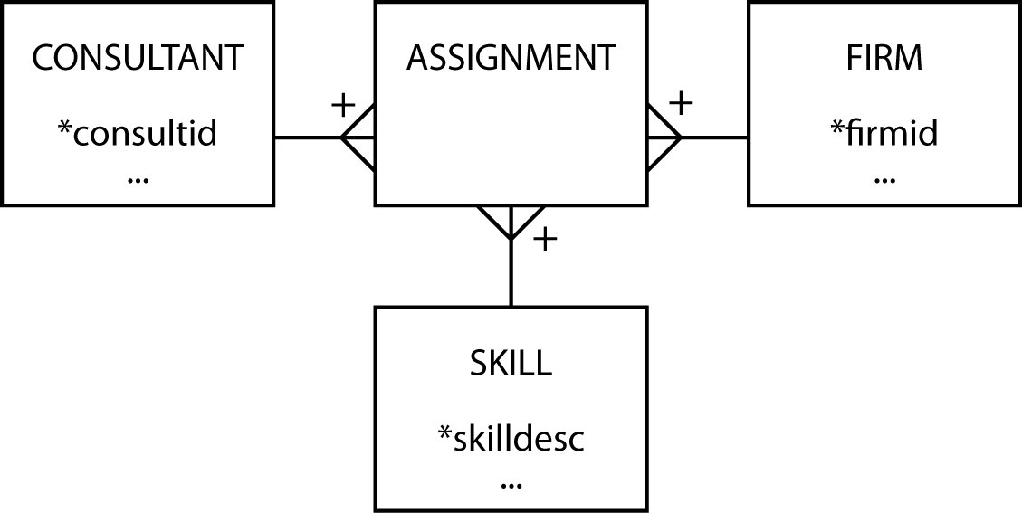
Fifth normal form (5NF)
A table can be reconstructed from other tables
There exists some rule that enables a relation to be inferred
Base case
Consultants provide skills to one or more firms and firms can use many consultants; a consultant has many skills and a skill can be used by many firms; and a firm can have a need for many skills and the same skill can be required by many firms

Slide 16
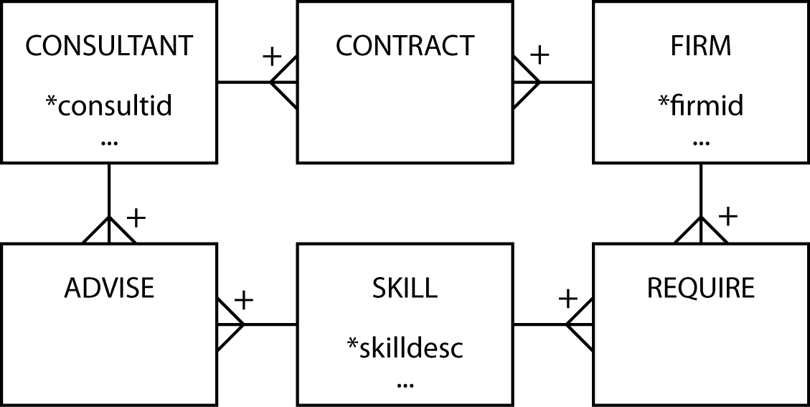
Fifth normal form (5NF)
The rule
If a consultant has a certain skill (e.g., database) and has a contract with the firm that requires that skill (e.g., IBM), then the consultant advises the firm on that skill (i.e., he advises IBM on database)

Slide 17
Domain key/ normal form (DK/NF)
Key: unique identifier
Constraint: rule governing attribute values
Domain: set of values of the same data type
Every constraint on the relation must be a logical consequence of the domain constraints and the key constraints that apply to the relation

Slide 18
Data modeling and normalization
Data modeling is often an easier path to good database design
A high-fidelity data model will be of high normal form
5NF is likely to create the most problems
Check for special rules

Slide 19
Data modeling methods
A widely known model is Chen's entity-relationship (E-R) approach
There is no standard for the E-R method
Nearly all data modeling approaches are very similar because they share common concepts
Learning is readily transferable between methods

Slide 20
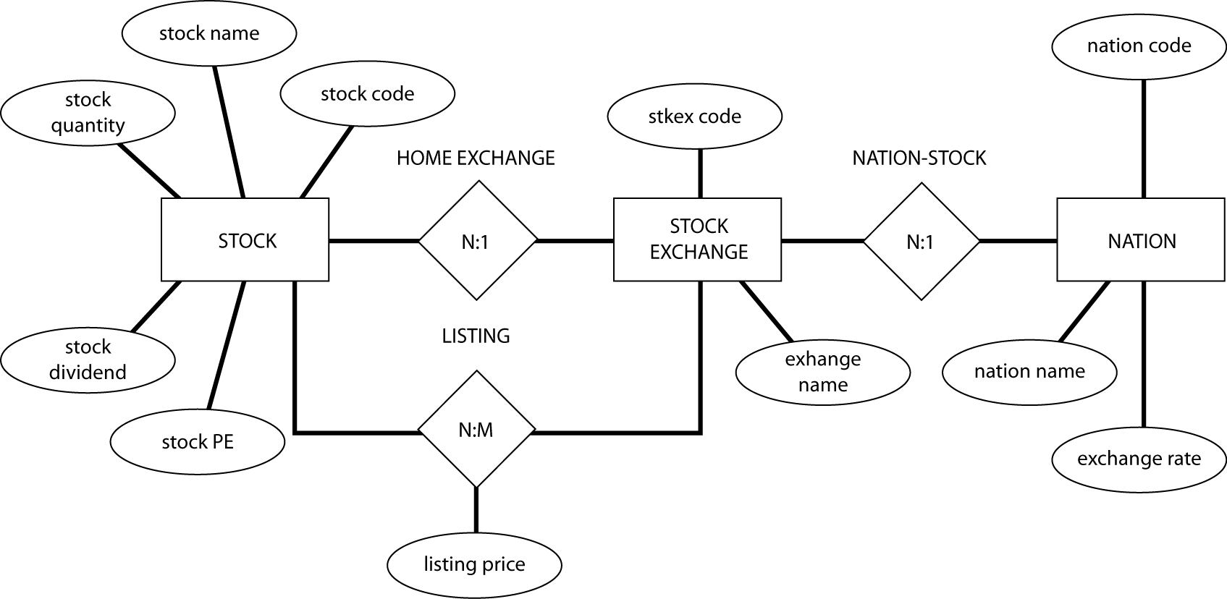
An E-R diagram

Slide 21
Representing relationships
The various dialects are most distinctive in the ways in which relationships are represented
Knowledge is very transferable between dialects

Slide 22
Goal
Learn to think like a data modeler
Different dialects and greater precision (e.g., cardinality) come easily once the basics are mastered

Slide 23
Key points
Normalization is one approach to data modeling
The are multiple representations for data model
Learning to model is difficult
Learning to represent a model is easy

