Slide 1
SQL
The questing beast
Sir Thomas Mallory

Slide 2
SQL
A standard
ANSI
ISO
SQL skills are in demand
Developed by IBM
Object-oriented extensions created

Slide 3
SQL
A complete database language
Data definition
Definition of tables and views
Data manipulation
Specifying queries
Maintaining a database
INSERT
UPDATE
DELETE

Slide 4
SQL
Not a complete programming language
Use in conjunction with a complete programming language
e.g., Java, C#, PHP, and COBOL
Embedded SQL

Slide 5
Data definition
Table, views, and indexes can be defined while the system is operational
Base table
An autonomous, named table
CREATE TABLE

Slide 6
Constraints
Primary key
CONSTRAINT pk_stock PRIMARY KEY(stkcode);
Foreign key
CONSTRAINT fk_stock_nation
FOREIGN KEY(natcode) REFERENCES nation(natcode);
Unique
CONSTRAINT unq_stock_stkname UNIQUE(stkname);

Slide 7
Check constraint Table & Column
Table
CREATE TABLE item (
itemcode INTEGER,
CONSTRAINT chk_item_itemcode CHECK(itemcode <500));
Column
CREATE TABLE item (
itemcode INTEGER
CONSTRAINT chk_item_itemcode CHECK(itemcode <500),
itemcolor VARCHAR(10));

Slide 8
Check constraint Domain
CREATE DOMAIN valid_color AS CHAR(10)
CONSTRAINT chk_qitem_color CHECK(
VALUE IN ('Bamboo',’Black',’Brown',Green', 'Khaki',’White'));
CREATE TABLE item (
itemcode INTEGER,
itemcolor VALID_COLOR);
Domain is not usually implemented

Slide 9
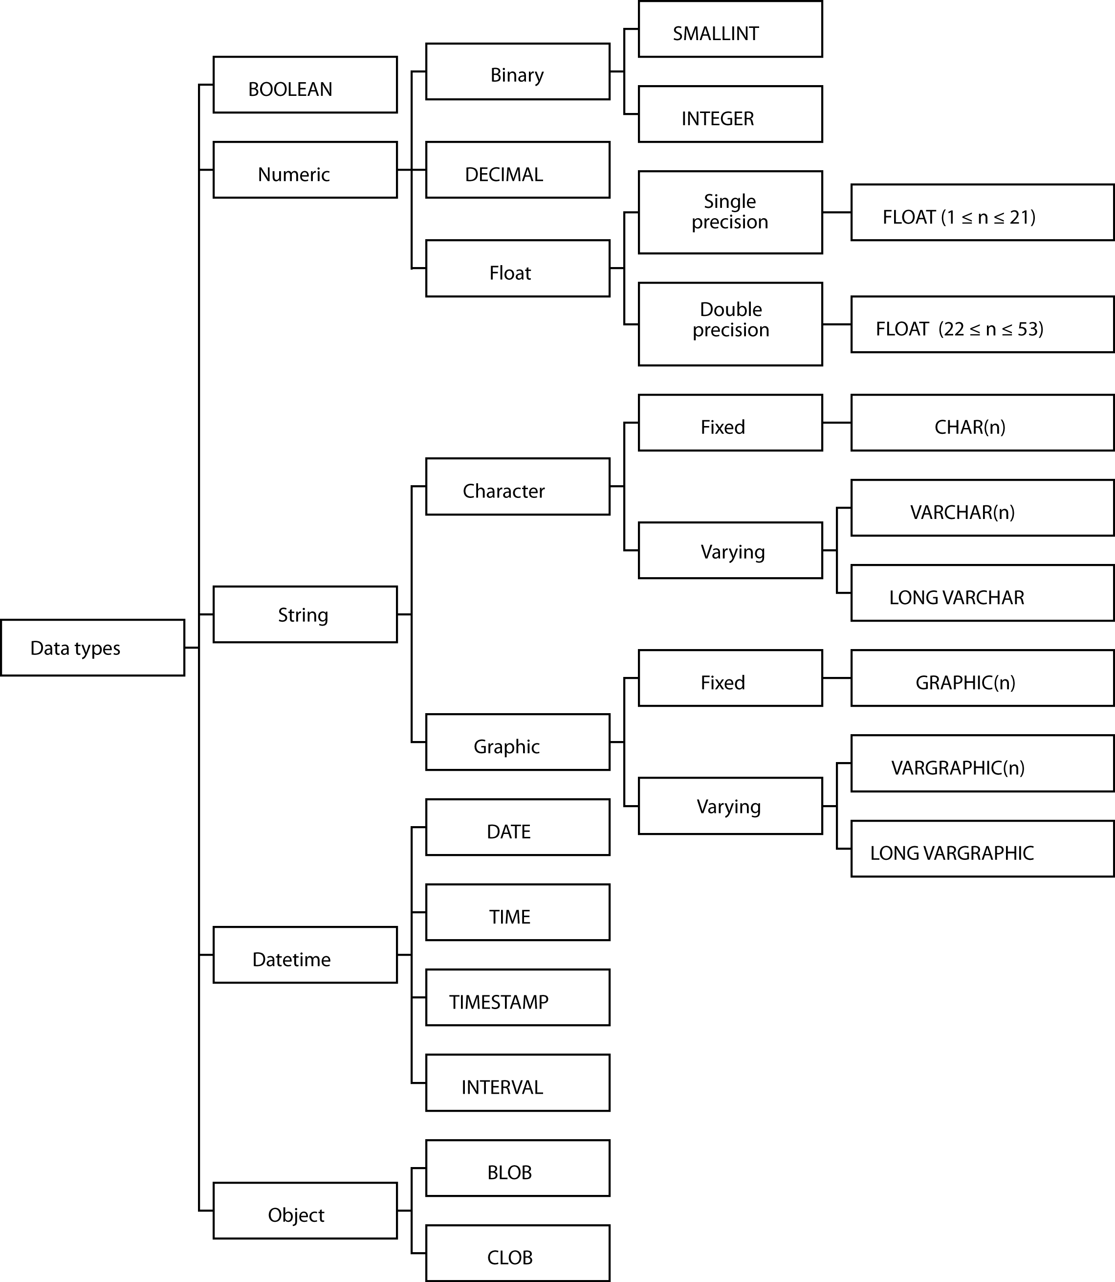
Data types

Slide 10
Data types
BOOLEAN
INTEGER
31 binary digits
SMALLINT
15 binary digits
FLOAT
Scientific work
DECIMAL
Commercial applications
CHAR and VARCHAR
Character strings
DATE, TIME, TIMESTAMP, and INTERVAL
BLOB and CLOB
Check the manual for full details

Slide 11
Formatting
Number
FORMAT(x,d) formats the number x with d decimal places with commas
SELECT FORMAT(amount,2) FROM Payments;
Date
DATE_FORMAT (date, format) provides a flexible way of reporting dates
SELECT DATE_FORMAT(orderDate, '%W, %M %Y') from Orders;
SELECT DATE_FORMAT(orderDate, '%Y-%m-%d') from Orders;
Check the manual for full details

Slide 12
Exercise
Using the ClassicModels database, report the total value of payments for each customer to the nearest dollar and list in descending value
When you use format you create a string, but you often want to sort on the numeric value of the formatted field. How do you handle this?

Slide 13
Collation sequence
Defines how to sort individual characters in a particular language
English
A B C … X Y Z
Norwegian
A B C … X Y Z Æ Ø Å

Slide 14
Collation sequence
Can specify a collation sequence at the database, table, and, column level
Good practice to specify at the database level
CREATE DATABASE ClassicModels
COLLATE latin1_general_cs;
cs indicates case sensitivity

Slide 15
Changing a table
ALTER TABLE
Adding one new column at a time
Cannot be used to
Change a column’s storage format
Delete an unwanted column
DROP TABLE
Deletes a table

Slide 16
A view
CREATE VIEW
DROP VIEW

Slide 17
An index
CREATE INDEX
DROP INDEX

Slide 18
Data manipulation statements
INSERT
UPDATE
DELETE
SELECT

Slide 19
INSERT
One row
Multiple rows
With a subquery
INSERT INTO STOCK
(stkcode, stkfirm, stkprice, stkdiv, stkpe)
SELECT code, firm, price, div, pe
FROM download WHERE code IN
('FC','PT','AR','SLG','ILZ','BE','BS','NG', 'CS','ROF');
The SQL way to copy a table

Slide 20
UPDATE
One row
Multiple rows
All rows

Slide 21
UPDATE: Copy a column
UPDATE table1
SET column1 =
(SELECT column2 FROM table2
WHERE table2.id = table1.id );

Slide 22
DELETE
One row
Multiple rows
All rows
Not the same as DROP TABLE

Slide 23
Product
All rows of the first table concatenated with all possible rows of the second table
Form the product of stock and nation
SELECT * FROM stock, nation;

Slide 24
Product
Find the percentage of Australian stocks in the portfolio.
CREATE VIEW austotal (auscount) AS
SELECT COUNT(*) FROM nation JOIN stock
ON nation.natcode = stock.natcode
WHERE natname = 'Australia'
CREATE VIEW total (totalcount) AS
SELECT COUNT(*) FROM stock;
SELECT auscount/totalcount*100
AS percentage FROM austotal, total;
Some implementations might give a result of zero due to use of integer arithmetic. Investigate use of the FLOAT function.
18.75

Slide 25
PRODUCT (alternative)
Find the percentage of Australian stocks in the portfolio.
SELECT FORMAT((SELECT COUNT(*)
FROM nation JOIN stock
ON nation.natcode = stock.natcode
WHERE natname = 'Australia')*100/(SELECT COUNT(*)
FROM stock),2) AS Percentage;
18.75

Slide 26
Join
Join creates a new table from two existing tables by matching on a column common to both tables
Equijoin
The new table contains two identical columns
SELECT * FROM stock JOIN nation
ON stock.natcode = nation.natcode;

Slide 27
Join variations

Slide 28
Inner join
SELECT * FROM stock JOIN nation ON stock.natcode = nation.natcode
SELECT * FROM stock INNER JOIN nation USING (natcode);
SELECT * FROM stock JOIN nation USING (natcode);
SELECT * FROM stock NATURAL JOIN nation;
Primary key and foreign key have the same name

Slide 29
Left outer join
An inner join plus those rows from t1 not included in the inner join
SELECT id, col1, col2 FROM t1 LEFT JOIN t2 USING (id);
t1 |  |  | t2
id | col1 |  | id | col2
1 | a |  | 1 | x
2 | b |  | 3 | y
3 | c |  | 5 | z
id | col1 | col2
1 | a | x
2 | b | null
3 | c | y

Slide 30
Right outer join
An inner join plus those rows from t2 not included in the inner join
SELECT id, col1, col2 FROM t1 RIGHT JOIN t2 USING (id);
t1 |  |  | t2
id | col1 |  | id | col2
1 | a |  | 1 | x
2 | b |  | 3 | y
3 | c |  | 5 | z
id | col1 | col2
1 | a | x
3 | c | y
5 | null | z

Slide 31
Full outer join
An inner join plus those rows from t1 and t2 not included in the inner join
SELECT id, col1, col2 FROM t1 FULL JOIN t2 USING (id);
t1 |  |  | t2
id | col1 |  | id | col2
1 | a |  | 1 | x
2 | b |  | 3 | y
3 | c |  | 5 | z
id | col1 | col2
1 | a | x
2 | b | null
3 | c | y
5 | null | z
MySQL does not support FULL JOIN.

Slide 32
MySQL: Full outer join
SELECT id, col1, col2 FROM t1 LEFT JOIN t2 USING (id)
UNION
SELECT id, col1, col2 FROM t1 RIGHT JOIN t2 USING (id);

Slide 33
Outer join
Left join example
List names of all items with details of delivery quantities if any deliveries have been made
SELECT itemname, delqty FROM qitem LEFT JOIN qdel USING (itemname);
Right join example
List item and quantity sold by department for each sale, including those departments that have not made sales.
SELECT deptname, itemname, saleqty FROM qsale RIGHT JOIN qdept USING (deptname);

Slide 34
Theta join
Join is a product with a condition clause
The condition is not restricted to equality.
A theta join is the general version
Theta is a variable that can take any value from the set [=, <>, >, ≥, <, ≤]

Slide 35
Theta join
In an alphabetical list of employees, how many appear before Clare?
SELECT count(*) FROM emp A JOIN emp B
ON A.empfname > B.empfname
WHERE A.empfname = "Clare"
This query does not match a foreign key and primary key, but it does demonstrate the principle
How many after Clare?

Slide 36
Correlated subquery
The inner query is evaluated many times rather than once
Find those stocks where the quantity is greater than the average for that country.
SELECT natname, stkfirm, stkqty FROM stock JOIN nation
ON stock.natcode = nation.natcode
WHERE stkqty >
(SELECT AVG(stkqty) FROM stock
WHERE stock.natcode = nation.natcode);

Slide 37
Correlated subquery
SELECT natname, stkfirm, stkqty FROM stock JOIN nation
ON stock.natcode = nation.natcode
WHERE stkqty >
(SELECT AVG(stkqty) FROM stock
WHERE stock.natcode = nation.natcode);
Stock |  |  |  |  |  |  | Nation
stkcode | stkfirm | stkprice | stkqty | stkdiv | stkpe | natcode | natcode | natname | exchrate
NE | Narembeen Emu | 12.34 | 45619 | 1.00 | 8 | AUS | AUS | Australia | 0.46000
IR | Indooroopilly Ruby | 15.92 | 56147 | 0.50 | 20 | AUS | AUS | Australia | 0.46000
QD | Queensland Diamond | 6.73 | 89251 | 0.50 | 7 | AUS | AUS | Australia | 0.46000
BD | Bombay Duck | 25.55 | 167382 | 1.00 | 12 | IND | IND | India | 0.02280
ROF | Royal Ostrich Farms | 33.75 | 1234923 | 3.00 | 6 | UK | UK | United Kingdom | 1.00000
CS | Canadian Sugar | 52.78 | 4716 | 2.50 | 15 | UK | UK | United Kingdom | 1.00000
FC | Freedonia Copper | 27.50 | 10529 | 1.84 | 16 | UK | UK | United Kingdom | 1.00000
BS | Bolivian Sheep | 12.75 | 231678 | 1.78 | 11 | UK | UK | United Kingdom | 1.00000
BE | Burmese Elephant | 0.07 | 154713 | 0.01 | 3 | UK | UK | United Kingdom | 1.00000
ILZ | Indian Lead & Zinc | 37.75 | 6390 | 3.00 | 12 | UK | UK | United Kingdom | 1.00000
SLG | Sri Lankan Gold | 50.37 | 32868 | 2.68 | 16 | UK | UK | United Kingdom | 1.00000
AR | Abyssinian Ruby | 31.82 | 22010 | 1.32 | 13 | UK | UK | United Kingdom | 1.00000
PT | Patagonian Tea | 55.25 | 12635 | 2.50 | 10 | UK | UK | United Kingdom | 1.00000
NG | Nigerian Geese | 35.00 | 12323 | 1.68 | 10 | UK | UK | United Kingdom | 1.00000
MG | Minnesota Gold | 53.87 | 816122 | 1.00 | 25 | US | US | United States | 0.67000
GP | Georgia Peach | 2.35 | 387333 | 0.20 | 5 | US | US | United States | 0.67000

Slide 38
Correlated subquery
Clue
The need to compare each row of a table against a function (e.g., average or count) for some rows of a column
Must be used with EXISTS and NOT EXISTS

Slide 39
Exercise
Using the ClassicModels database, write a correlated subquery to determine which employees work in the Paris office

Slide 40
Aggregate functions
COUNT
SUM
AVG
MAX
MIN

Slide 41
SQL Routines
Function
Procedure
Trigger
Improve flexibility, productivity, and enforcement of business rules

Slide 42
SQL function
Similar purpose to built-in functions
CREATE FUNCTION km_to_miles(km REAL)
RETURNS REAL
RETURN 0.6213712*km;
Use in SQL
SELECT FORMAT(km_to_miles(100),0);
SELECT km_to_miles(distance)from flight;

Slide 43
Exercise
Write an SQL function to convert Fahrenheit to Celsius.

Slide 44
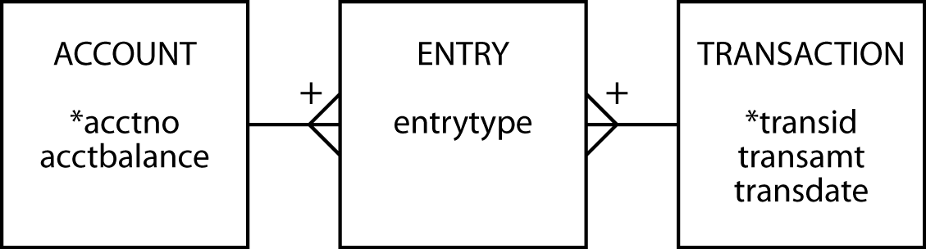
SQL procedure
A stored procedure is SQL code that is dynamically loaded and executed by a CALL statement
Accounting example

Slide 45
SQL procedure
CREATE TABLE account (
acctno INTEGER,
acctbalance DECIMAL(9,2),
primary key (acctno));
CREATE TABLE transaction (
transid INTEGER,
transamt DECIMAL(9,2),
transdate DATE,
PRIMARY KEY(transid));
CREATE TABLE entry (
transid INTEGER,
acctno INTEGER,
entrytype CHAR(2),
PRIMARY KEY(acctno, transid),
CONSTRAINT fk_account FOREIGN KEY(acctno) REFERENCES account(acctno),
CONSTRAINT fk_transaction FOREIGN KEY(transid) REFERENCES transaction(transid));
First create a schema: AccSystem

Slide 46
SQL procedure
DELIMITER //
CREATE PROCEDURE transfer (
IN `Credit account` INTEGER,
IN `Debit account` INTEGER,
IN Amount DECIMAL(9,2),
IN `Transaction ID` INTEGER)
LANGUAGE SQL
DETERMINISTIC
BEGIN
INSERT INTO transaction VALUES (`Transaction ID`, Amount, CURRENT_DATE);
UPDATE account
SET acctbalance = acctbalance + Amount
WHERE acctno = `Credit account`;
INSERT INTO entry VALUES (`Transaction ID`, `Credit account`, 'cr');
UPDATE account
SET acctbalance = acctbalance - Amount
WHERE acctno = `Debit account`;
INSERT INTO entry VALUES (`Transaction ID`, `Debit account`, 'db');
END//
Need to delimit the procedure and SQL commands

Slide 47
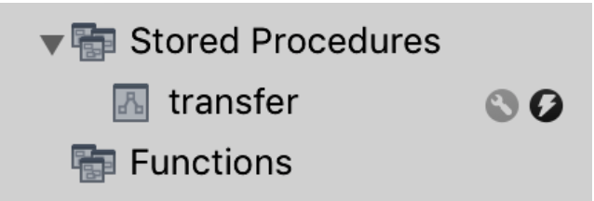
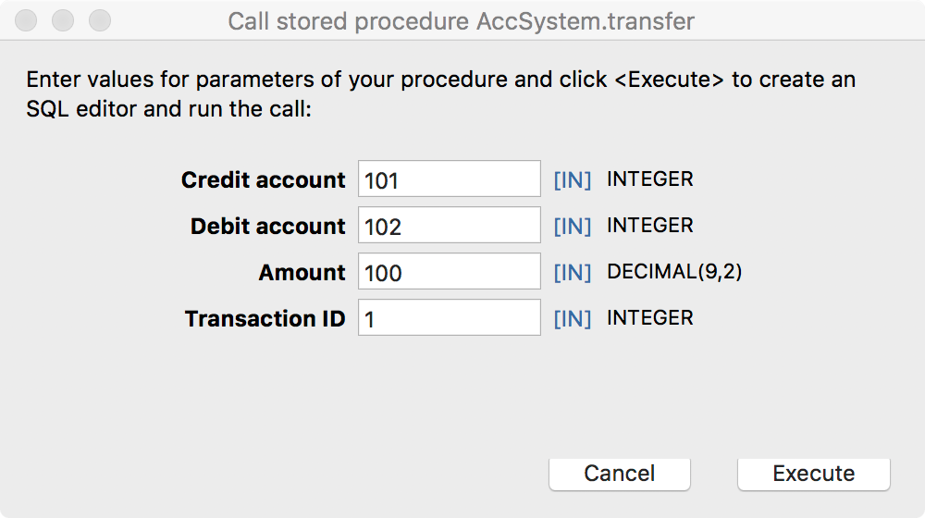
SQL procedure
Click on the stored procedure’s rightmost icon for pop-up entry window

Slide 48
SQL procedure
Example
Transaction 1 transfers $100 to account 101 (the credit account) from account 102 (the debit account)
CALL transfer(101,102,100,1);

Slide 49
Trigger
A set of actions set off by an SQL statement that changes the state of the database
UPDATE
INSERT
DELETE

Slide 50
Trigger
Automatically log all updates to a log file
Create a table for storing log rows
Create a trigger
CREATE TABLE stock_log (
stkcode CHAR(3),
old_stkprice DECIMAL(6,2),
new_stkprice DECIMAL(6,2),
old_stkqty DECIMAL(8),
new_stkqty DECIMAL(8),
update_stktime TIMESTAMP NOT NULL,
PRIMARY KEY(update_stktime));

Slide 51
Trigger
DELIMITER //
CREATE TRIGGER stock_update
AFTER UPDATE ON stock
FOR EACH ROW BEGIN
INSERT INTO stock_log VALUES
(OLD.stkcode, OLD.stkprice, NEW.stkprice, OLD.stkqty, NEW.stkqty, CURRENT_TIMESTAMP);
END//

Slide 52
Nulls
Don’t confuse with blank or zero
Multiple meanings
Unknown data
Inapplicable data
No value supplied
Value undefined
Creates confusion because the user must make an inference
One expert advises that NOT NULL be used for all columns to avoid confusion
Notes:
How might you indicate a column is NULL?
DB2 has a hidden one-character column preceding each column that is used to indicate whether a column is NULL.

Slide 53
Security
Data are a valuable resource
Access should be controlled
SQL security procedures
CREATE VIEW
Authorization commands

Slide 54
Authorization
Based on privilege concept
You cannot execute an operation without the appropriate privilege
DBA has all privileges

Slide 55
GRANT
Defines a user’s privileges
Format
GRANT privileges ON object TO users
[WITH GRANT OPTION];
An object is a base table or view
The keyword privilege can be ALL PRIVILEGES or chosen from
SELECT
UPDATE
DELETE
INSERT
Privileges can be granted to everybody using the keyword PUBLIC or to selected users by specifying their user identifier

Slide 56
GRANT
The UPDATE privilege can specify particular columns in a base table or view
Some privileges apply only to base tables
ALTER
INDEX
WITH GRANT OPTION
Permits a user to pass privileges to another user

Slide 57
Using GRANT
Give Alice all rights to the STOCK table.
GRANT ALL PRIVILEGES ON stock TO alice;
Permit the accounting staff, Todd and Nancy, to update the price of a stock.
GRANT UPDATE (stkprice) ON stock TO todd, nancy;
Give all staff the privilege to select rows from ITEM.
GRANT SELECT ON item TO PUBLIC;
Give Alice all rights to view STK.
GRANT SELECT, UPDATE, DELETE, INSERT ON stk
TO alice;
Notes:
Why wasn’t ALL PRIVILEGES used?
Since STK is a view, ALICE cannot be granted ALL PRIVILEGES since this would include ALTER and INDEX privileges for a view

Slide 58
REVOKE
Removes privileges
Format
REVOKE privileges ON object FROM users;
Cascading REVOKE
Reverses use of the WITH GRANT OPTION
When a user’s privileges are revoked, all users whose privileges were established using WITH GRANT OPTION are also revoked

Slide 59
Using REVOKE
Remove Sophie's ability to select from ITEM.
REVOKE SELECT ON item FROM sophie;
Nancy is no longer permitted to update stock prices.
REVOKE UPDATE ON stock FROM nancy;
Notes:
A revoked UPDATE is not column specific

Slide 60
Injection attack
An injection attack takes advantage of parameterized queries to make unauthorized queries
The attacker creates or alters existing SQL commands
The application takes the attacker’s input and combines it to build an unintended SQL query

Slide 61
Avoidance
Limit the authorization of the connection
SELECT only
Check the input is of the expected data type
Use parameterized queries

Slide 62
The catalog
A relational database containing definitions of base tables, view, etc.
Can be interrogated using SQL
Called systems tables rather than base tables
MySQL
Information_schema

Slide 63
Interrogating the catalog
Find the table(s) with the most rows.
SELECT TABLE_NAME, TABLE_ROWS
FROM Information_schema.TABLES
WHERE TABLE_ROWS = (SELECT MAX(TABLE_ROWS)
FROM Information_schema.TABLES);
What columns in what tables store dates?
SELECT TABLE_NAME, COLUMN_NAME
FROM Information_schema.COLUMNS
WHERE DATA_TYPE = 'date'
ORDER BY TABLE_NAME, COLUMN_NAME;
MySQL catalog queries

Slide 64
Natural language processing
English | SQL generated for MS Access
Which movies have won best foreign film sorted by year? | SELECT DISTINCT [Year], [Title] FROM [Awards] INNER JOIN [Movies] ON [Movies].[Movie ID] = [Awards].[Movie ID] WHERE [Categorie] = 'Best Foreign Film' and [Status]='Winner' ORDER BY [Year] ASC

Slide 65
Open Database Connectivity (ODBC)
Application
ODBC API
ODBC driver manager
Service provide API
Driver for DBMS server
DBMS server

Slide 66
Embedded SQL
SQL is not a stand-alone programming language
SQL statements can be embedded in application programs
The incompatibility between the table processing of SQL and record-at-time processing in procedural languages is addressed using a cursor

Slide 67
LibreOffice/MS Access
Strengths
Interface
SQL DML
Referential integrity
Fast execution
Views (queries)
Updateable views
Weaknesses
No support for GRANT and REVOKE
Domains
No support for COMMIT and ROLLBACK
Limited concurrency control

Slide 68
User-defined data types
May be used in the same way as built-in data types
A UDT is defined by
Specifying a set of declarations of the stored attributes that represent the value of the UDT
The operations that define the equality and ordering relationships of the UDT
The operations and derived attributes that represent the behavior of the UDT

Slide 69
The future of SQL
One of the most successful standardization stories
Highly portable
Across operating systems
Across applications and organizations
Mainstay of transaction processing systems for now and the immediate future

Slide 70
Key points
SQL routines
Function
Procedure
Triggers
Security
GRANT
REVOKE
Connectivity
Embedded SQL

