Slide 1
Spatial and temporal data management
Nothing puzzles me more than time and space; and yet nothing troubles me less, as I never think about them
Charles Lamb, 1810

Slide 2
Data management developments
Location-based services
Time-varying data

Slide 3
MySQL spatial extensions
Follow the specifications of the Open Geospatial Consortium
Implements a subset of the proposed extensions

Slide 4
Spatial data
Managing spatially-referenced data
Geographic information systems (GIS)
Theme
The spatial counterpart of an entity
River, road, scenic lookout
Map
A set of themes represented on paper or a screen
Geographic object
An instance of a theme

Slide 5
Generic spatial data types
Data type | Dimensions | Example
Point | 0 | Scenic lookout
Line | 1 | River
Region | 2 | County

Slide 6
Spatial Reference Support System (SRS)
A coordinate-based system for geographic locations
Projected
A projection of a globe on a flat surface
Each point is a place on the globe
A length unit rather than longitude and latitude
Geographic
Coordinates are longitude and latitude
Cartesian
An infinite flat plane with no specified units

Slide 7
Spatial Reference Identifier (SRID)
SRID identifies the coordinate space of a geometry
An integer
SRID 0 is an infinite flat plane with no units assigned to its axes
For geographic (latitude and longitude), the SRID is 4326

Slide 8
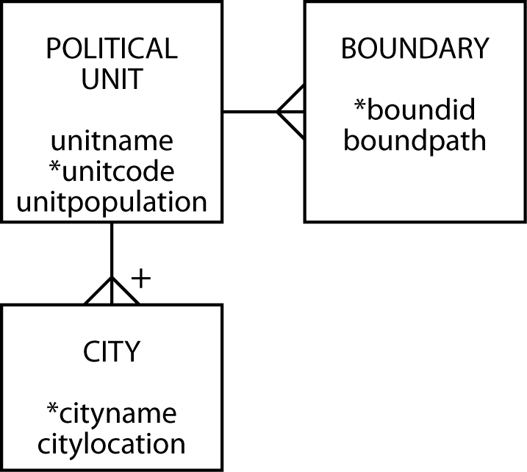
Data model for political units

Slide 9
SQL/MM Spatial
The ISO standard to manage spatial data in relational database systems
It uses the prefix ST_ for all tables, views, data types, and function names
Originally stood for Spatial and Temporal
Spatial and temporal standards development later separated
Think of ST as Spatial Type

Slide 10
MySQL geometric data types
Type | Representation | Description
Point | POINT(x y) | A point in space (e.g., a city)
LineString | LINESTRING(x1 y1,x2 y2,…) | A sequence of points with linear interpolation between points (e.g., a road)
Polygon | POLYGON((x1 y1,x2 y2,…), (x1 y1,x2 y2,…)) | A polygon (e.g., a boundary), which has a single exterior boundary and zero or more interior boundaries ( i.e., holes)

Slide 11
Create tables
CREATE TABLE political_unit (
unitname VARCHAR(30) NOT NULL,
unitcode CHAR(2),
unitpop DECIMAL(6,2),
PRIMARY KEY(unitcode));
CREATE TABLE boundary (
boundid INTEGER,
boundpath POLYGON NOT NULL SRID 0,
unitcode CHAR(2),
PRIMARY KEY(boundid),
CONSTRAINT fk_boundary_polunit FOREIGN KEY(unitcode)
REFERENCES political_unit(unitcode));
CREATE TABLE city (
cityname VARCHAR(30),
cityloc POINT NOT NULL SRID 0,
unitcode CHAR(2),
PRIMARY KEY(unitcode,cityname),
CONSTRAINT fk_city_polunit FOREIGN KEY(unitcode)
REFERENCES political_unit(unitcode));

Slide 13
Insert rows
INSERT INTO political_unit VALUES ('Republic of Ireland','ie', 3.9);
INSERT INTO political_unit VALUES ('Northern Ireland','ni', 1.7);
INSERT INTO boundary VALUES
(1,ST_GeomFROMText('POLYGON((9 8, 9 3, 4 1, 2 2, 1 3, 3 5, 3 6, 2 6,
2 9, 5 9, 5 10, 6 11, 7 11, 7 10, 6 9, 7 8, 7 9, 8 9, 8 8, 9 8))', 0),'ie');
INSERT INTO boundary VALUES
(2,ST_GeomFROMText('POLYGON((7 11, 9 11, 10 9, 10 8, 8 8, 8 9, 7 9,
7 8, 6 9, 7 10, 7 11))', 0),'ni');
INSERT INTO city VALUES ('Dublin',ST_GeomFROMText('POINT(9 6)', 0),'ie');
INSERT INTO city VALUES ('Cork',ST_GeomFROMText('POINT(5 2)', 0),'ie');
INSERT INTO city VALUES ('Limerick',ST_GeomFROMText('POINT(4 4)', 0),'ie');
INSERT INTO city VALUES ('Galway',ST_GeomFROMText('POINT(4 6)', 0),'ie');
INSERT INTO city VALUES ('Sligo',ST_GeomFROMText('POINT(5 8)', 0),'ie');
INSERT INTO city VALUES ('Tipperary',ST_GeomFROMText('POINT(5 3)', 0),'ie');
INSERT INTO city VALUES ('Belfast',ST_GeomFROMText('POINT(9 9)', 0),'ni');
INSERT INTO city VALUES ('Londonderry',ST_GeomFROMText('POINT(7 10)', 0),'ni');
SRID
SRID

Slide 14
Reviewing the boundary

Slide 15
Some MySQL geometry functions
Function | Description
ST_X(Point) | The x-coordinate of a point
ST_Y(Point) | The y-coordinate of a point
ST_Length(LineString) | The length of a linestring
ST_NumPoints(LineString) | The number of points in a linestring
ST_Area(Polygon) | The area of a polygon
ST_Distance(Point,Point) | Distance between two points
The SRID value for a column determines the formula used for calculating area or distance.

Slide 16
Area
What is the area of the Republic of Ireland?
SELECT ST_Area(boundpath)*1406
AS 'Area (km^2)' from political_unit JOIN boundary
ON political_unit.unitcode = boundary.unitcode
WHERE unitname = 'Republic of Ireland';
Area(km^2)
71706
One unit on the map is 37.5 km so the area of one grid unit is 1406 km²

Slide 17
Exercises
What is the area of Northern Ireland in square kilometers?
How close is the computed value to that reported in Wikipedia?
Notes:
Wikipedia gives 13,840 km²

Slide 18
Distance
How far, as the crow flies, is it from Sligo to Dublin?
SELECT ST_Distance(orig.cityloc,dest.cityloc)*37.5
AS "Distance (kms)"
FROM city orig, city dest
WHERE orig.cityname = 'Sligo'
AND dest.cityname = 'Dublin';
Distance (kms)
167.71

Slide 19
Closest
What is the closest city to Limerick?
SELECT dest.cityname FROM city orig, city dest
WHERE orig.cityname = 'Limerick'
AND ST_Distance(orig.cityloc,dest.cityloc)=
(SELECT MIN(ST_Distance(orig.cityloc,dest.cityloc)) FROM city orig, city dest
WHERE orig.cityname = 'Limerick' AND dest.cityname <> 'Limerick');
cityname
Tipperary

Slide 20
Westernmost
What is the westernmost city in Ireland?
SELECT west.cityname FROM city west
WHERE NOT EXISTS
(SELECT * FROM city other WHERE ST_X(other.cityloc) < ST_X(west.cityloc));
cityname
Limerick
Galway

Slide 21
Exercise
What is the eastern most city in Northern Ireland?

Slide 22
Geometry collections
A geometry collection is a data type for one more other geometries
MultiPoint
MultiLineString
MultiPolygon
geometrycollection

Slide 23
MultiPoint
A collection of points
Bus stops on a campus
Data type is MULTIPOINT
MULTIPOINT(9.0 6.1, 8.9 6.0)

Slide 24
MultiLineString
A collection of line strings
Bus routes on a campus
Data type is MULTILINESTRING
MULTILINESTRING((9 6, 4 6), (9 6, 5 2))

Slide 25
MultiPolygon
A collection of polygons
Buildings on a campus
Data type is MULTIPOLYGON
MULTIPOLYGON(((0 0,10 0,10 10,0 10,0 0)),((5 5,7 5,7 7,5 7, 5 5)))

Slide 26
GeometryCollection
A collection of geometries
Bus route and its bus stops
Data type is GEOMETRYCOLLECTION
GEOMETRYCOLLECTION(LINESTRING(15 15, 20 20), POINT(10 10), POINT(30 30))

Slide 27
Inserting data
Example
INSERT INTO table VALUES ST_GeomCollFromText('GEOMETRYCOLLECTION(POINT(1 1),LINESTRING(0 0,1 1,2 2,3 3,4 4))');

Slide 28
Exercise
Modify the example database design to include:
Historic buildings in a city
Walking paths in a city
Use of the MULTIPOLYGON data type to indicate a political region’s boundary

Slide 29
R-tree
Used to store n-dimensional data (n>=2)
Minimum bounding rectangle concept
A
D
C
B
E
X
Y
X
Y
I
n
d
e
x
s
e
t
A
B
C
D
E
S
e
q
u
e
n
c
e
s
e
t

Slide 30
R-tree searching
Search for the object covered by the shaded region
A
D
C
B
E
X
Y

Slide 31
Temporal data
Data have an associated time
When valid
When stored
Different database states recorded
Larger databases

Slide 32
Times
Transaction time
Timestamp applied when data are entered
Valid time
Time when value is valid or true

Slide 33
Times

Slide 34
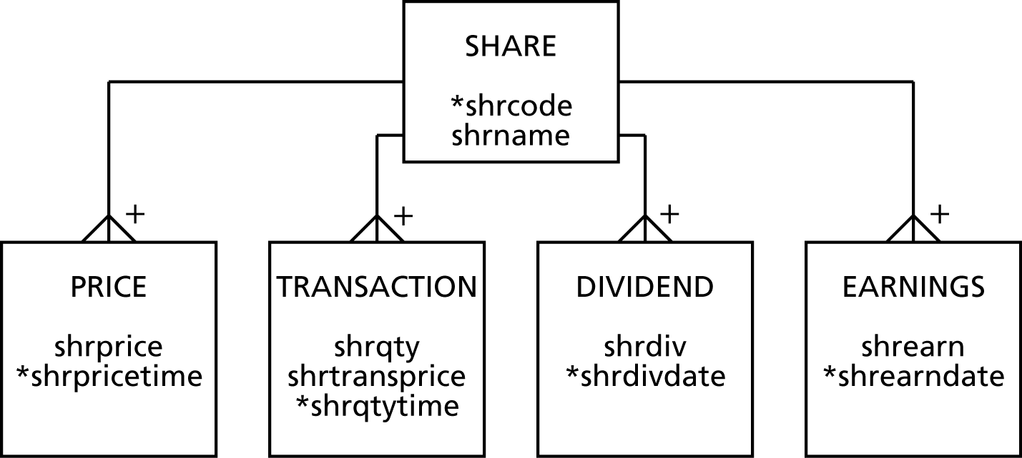
Modeling temporal data

Slide 35
TSQL
Need additional features for
Data definition
Constraint specification
Data manipulation
Querying
TSQL (temporal structured query language) is designed to provide these features

Slide 36
Conclusions
The need to maintain spatial data will increase as location-based services become more common
Temporal data management will become more common so that companies and customers have a complete historical record
New data types creates a need for new functions

