Slide 1
Rationing load Shedding
Justin Mcgowan
201613026

Slide 2
OUTLINE
Introduction
Problem
goal
Solution
implemenation
conclusion

Slide 3
Introduction
Everyone despises load shedding but have not come up with a solution to help solve this crisis
we will look at how this program can help shed the weight of load shedding through computer’s
Know where and when to load shed is the key to a successful shedding schedule

Slide 4
Problem
Load shedding Is unpredictable and ineffective. Load shedding has no basis for which areas get cut and at what times this creates inefficient load shedding at times that are unpractical which leads to annoyed customers. If we knew the areas for load shedding, this would generate a much more appreciative country.

Slide 5
Goal
The goal of the software is to help the end user decide which area’s need load shedding and at what time. based on the data provided by the software the decision will be made clear which will ease the load on eskom as well as give people a better experience through these tough times. It will show which area uses the least power which will in turn tell them where load shedding is not effective.
This will encourage area’s to become self sufficient so that they do not have to deal will load shedding anymore.

Slide 6
solution
A program that helps identify the areas of least power usage. Which requires less load shedding.
This can be achieved by applying traversals such as Dijkstra's algorithm.
The program must be simple and efficient so that any technician can understand it.
Can be achieved through a graph ADT and the UI will be done with javafx.

Slide 7
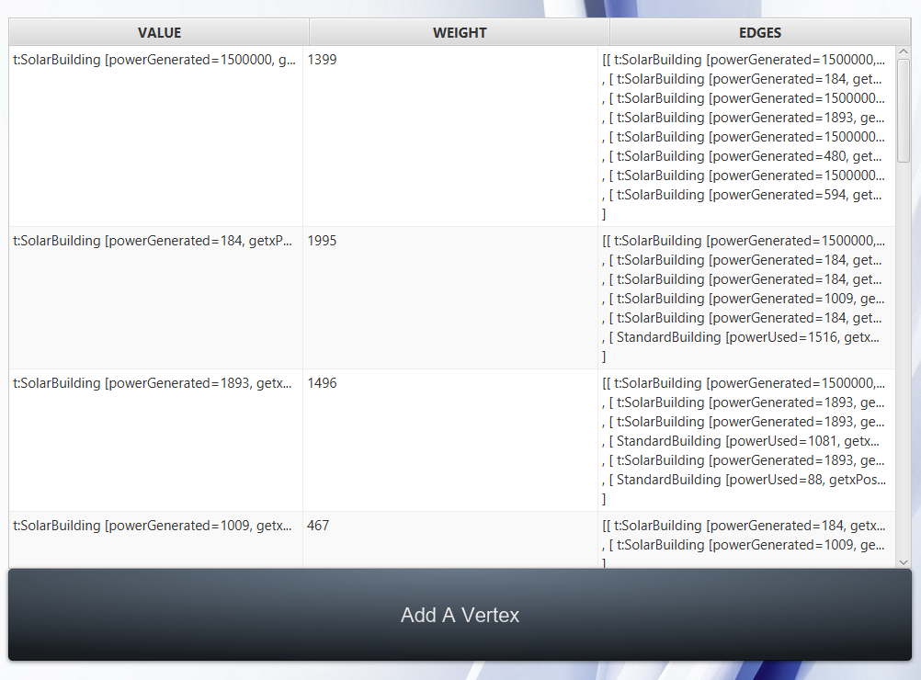
Vertices
The vertices with be a combination of powerplant’s and Buildings
The weight will be power generated and used
You can add a vertex from file.
You can add a vertex by creating a building.
You can also add a vertex through the viewPane.
A building can either use power or generate power
A building to generate power is a solar building
A building that uses power is a standard building

Slide 8
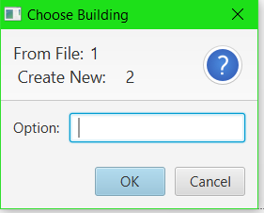
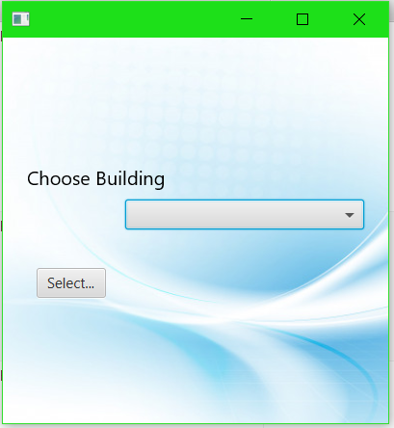
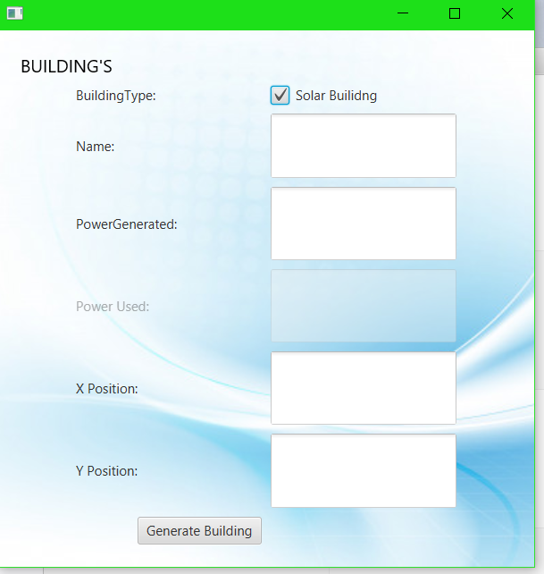
Vertices images
Option 1
Option 2

Slide 9
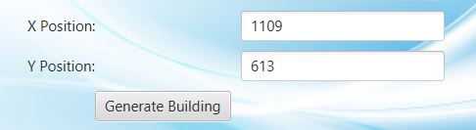
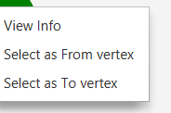
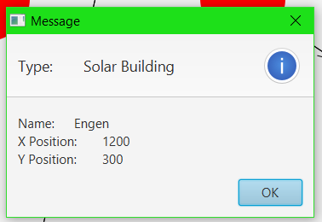
Vertices added through viewpane
Automatically detects location
Right click on vertex to view info

Slide 10
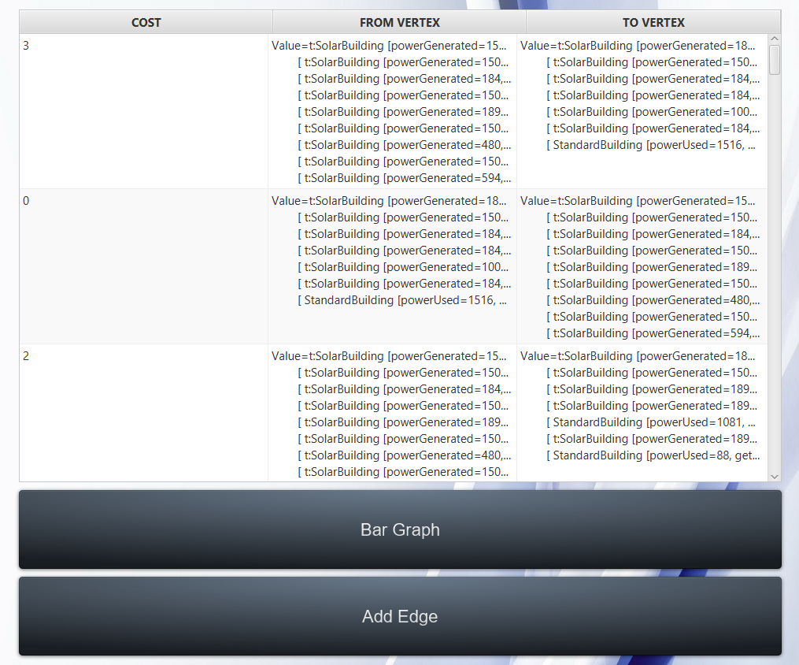
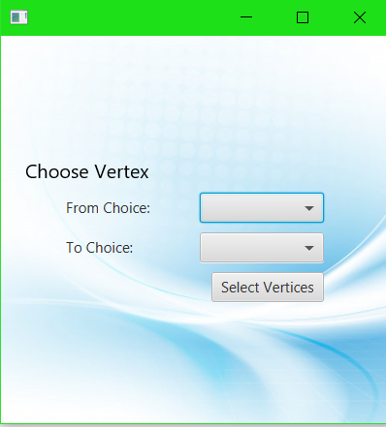
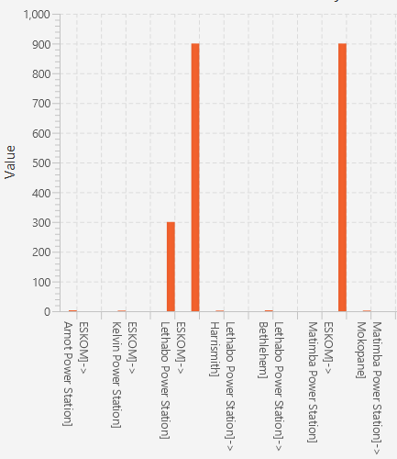
edge’s
The edges with be the power generated and the power used
You can view the edges in a bar graph which will show there costs
You can add a edge through the viewpane
When adding a edge you must select a vertex from and vertex to
The cost is automatically added

Slide 11
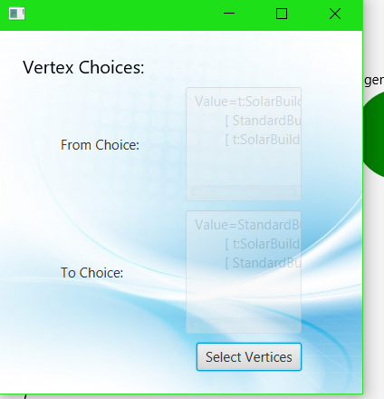
Edge’s through view pane
You select a from vertex and to vertex by right clicking on them
Then right click and select add edge to add
it then shows the vertices selected

Slide 12
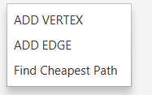
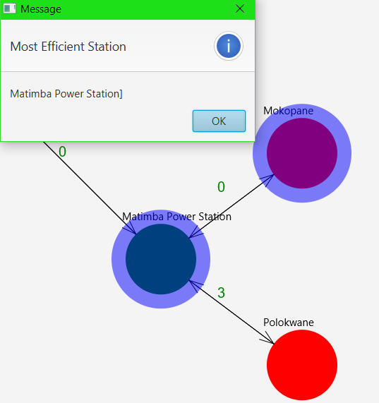
Traversal
The traversal is Dijkstra’s algorithm
And can be seen through the viewpane
Once selected it will display the most efficient power station.
It will highlight the selected route.

Slide 13


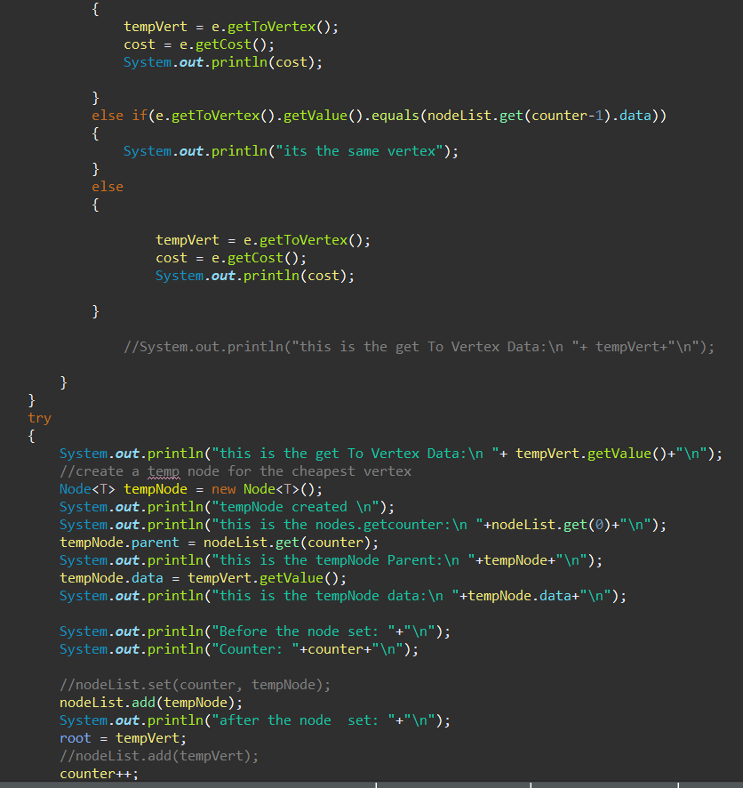
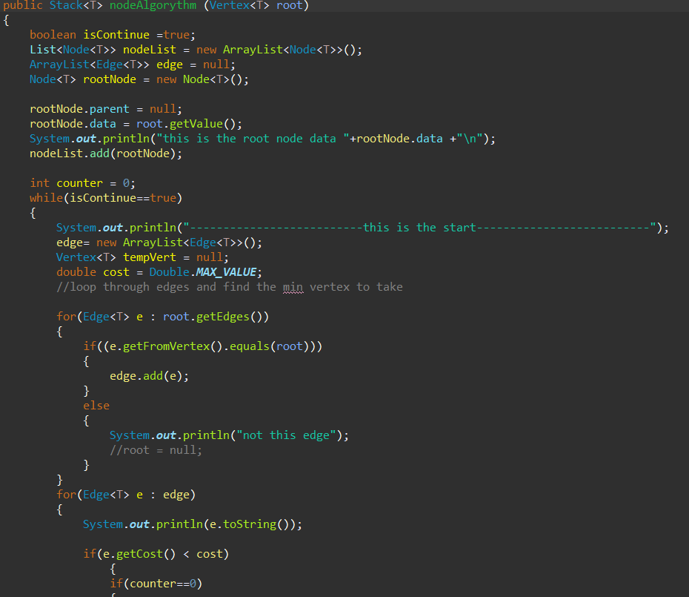
Traversal implementation

Slide 14
Implementation
User interface
Will be implemented using javafx
CSS to apply styles to javafx nodes
The program will use java as its coding language
Information for data will be stored in a .dat file which will be accessed used ObjectInputStream/objectoutputStream.

Slide 15
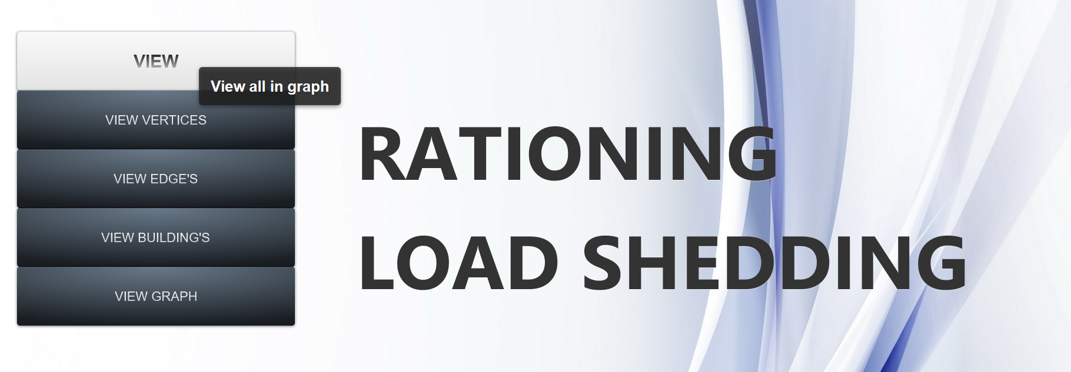
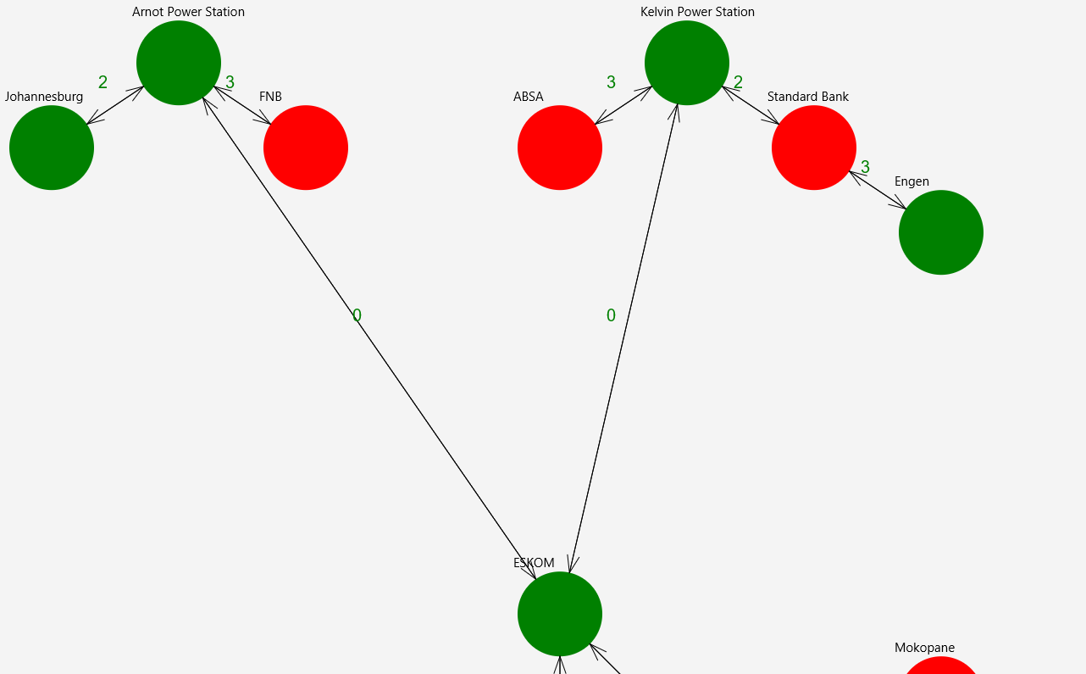
Implementation continued
The red circles are standard buildings
The green circles are solar buildings

Slide 16
conclusion
We can see that the problem identified can be addressed by implementing the program specified. More organized load shedding means less load shedding due to effectivity.

