Slide 1


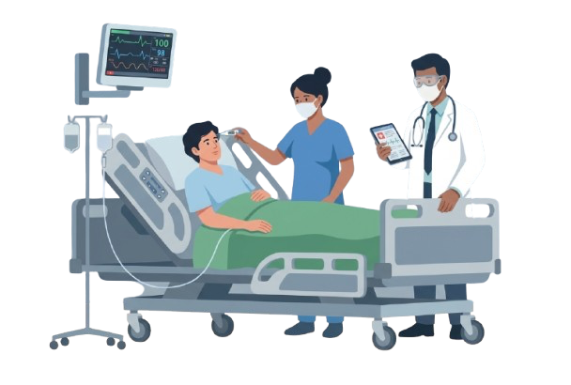
Cagayan State University
An AI-powered platform for transparent Hospital Billing and Insurance Reconciliation
Reconcile the Care. Clarify the Bill. Dignify the Discharge.
Good Governance
Transparent Billing
Tripartite Reconciliation
Notes:
Slide 1: 15s — introduce LakbayPoints and tagline.

Slide 2
Our Lived Healthcare Patient Experience
3/10
Experience-based story; cost and time are team recollection, not official averages.
LakbayPoints • MMITS Bagong Gawi, Bagong Galaw Challenge
3
Notes:
Target: 25 seconds.
Narration: “This problem is personal to us. During our internship in Metro Manila, we stayed near Ortigas and relied on walking, MRT and jeepneys. One night from España, commuting became so difficult that we first had to reach Cubao, then book a Grab to Ortigas because a direct ride was more expensive. What should have been a normal commute became hours of waiting, added transfers and a trip that cost around five times more than usual. That experience showed us that a route is only practical when the complete journey works.”

Slide 3
Problem Statement
4/10
Our experience revealed a larger journey-chain problem.
The benefits exist.
The complete bill is still difficult to decipher and trust.
Unclear Patient Financial Responsibility
1
Patients struggle to understand how hospital charges, insurance coverage, and remaining balances are calculated.
A patient’s discharge requires hospital charges, Senior/PWD discounts, PhilHealth case rates, and private HMO approvals to reconcile as one seamless ledger. One missing slip or clerical mismatch traps families in hospital rooms for hours.
₱615B/yr
Household Out-of-Pocket (OOP) healthcare expenditure (PSA, 2024)
Disconnected Insurance & Hospital Data
2
Billing information and insurance coverage are often handled across separate systems, making reconciliation slow and error-prone.
42.7% of all national health spending is shouldered directly by Filipino families.
Philippine Statistics Authority (PSA), 2024 Philippine National Health Accounts..
15%–20%
of initial claims are returned or denied by PhilHealth due to CLERICAL & XML ERRORS.
Insurance/Billing Disputes and Transparency
Concerns
3
Patients may not know exactly what their insurance covers, what they owe, and why they owe it leading to confusion, disputes, and delayed payments.
PHAPi (2023–2024); locks up ₱4B to ₱10B in trapped hospital liquidity and delays patient clear
LakbayPoints • MMITS Bagong Gawi, Bagong Galaw Challenge
4
Notes:
Target: 25 seconds.
Narration: “Our story is only one example of a larger journey-chain problem. The modes exist, but commuters need the full chain to work together. Agencies also need a practical way to understand whether the journey was completed and where access barriers disrupted it. Traditional systems can show where traffic slows; LakbayPoints tests whether alternatives can be completed, repeated and improved.”

Slide 4




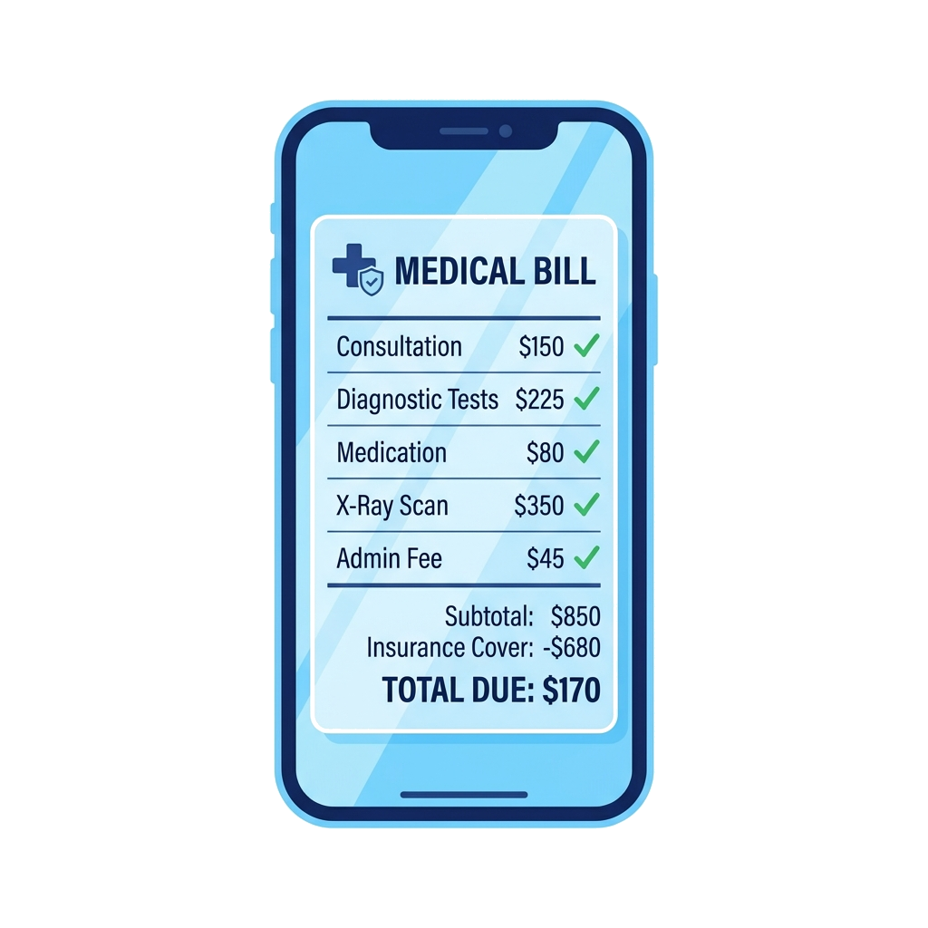
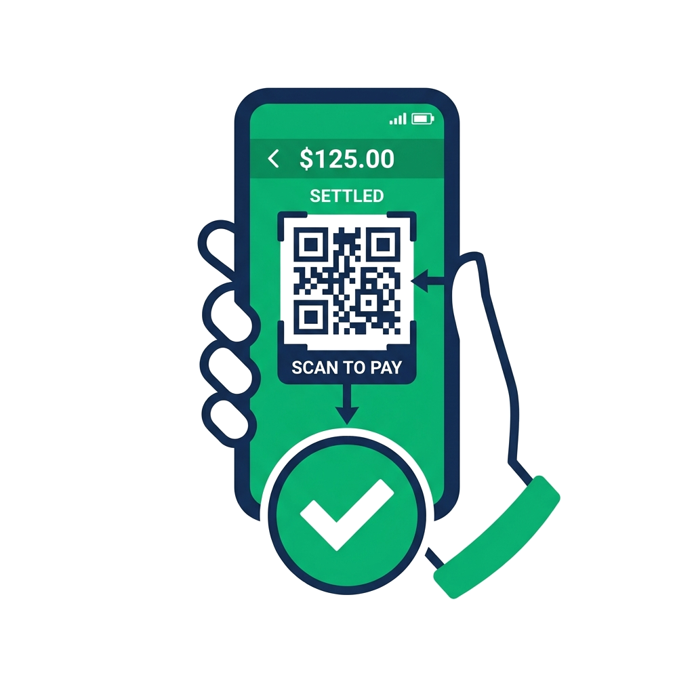
Proposed Solution
5/10
One closed loop turns a recommended journey into pilot evidence.
Ingest → Reconcile → Clarify → Settle → Accelerate
1
2
3
4
5
Ingest
Reconcile
Clarify
Settle
Accelerate
Non-invasively capture hospital charges, pharmacy requisitions, and bedside orders from legacy hospital databases in real time.
Automatically calculate the statutory deduction cascade: 12% VAT exemption, 20% SC/PWD discount, PhilHealth ACR, and HMO policy caps.
Deliver a transparent, plain-language running ledger to the patient’s smartphone via SMS magic link—explaining covered vs. excluded items.
Automatically dispatch a scannable digital discharge gate pass upon payment, freeing up hospital beds in under 45 minutes.
Enable instant digital checkout via QR Ph, GCash, Maya, cards, or structured digital promissory notes compliant with RA 9439.
Continuous intra-care reconciliation eliminates the end-of-stay administrative standoff.
Not just a billing app: one closed financial loop connecting patient transparency to hospital bed turnover.
LakbayPoints • MMITS Bagong Gawi, Bagong Galaw Challenge
5
Notes:
Target: 32 seconds.
Narration: “LakbayPoints responds with one closed loop. First, it guides the complete journey. Second, it checks whether the required chain was credibly completed. Third, it rewards only eligible trips. Fourth, it lets the commuter report the exact barrier. Finally, it aggregates journey outcomes and barriers for pilot review, so the next route and campaign can improve.”
Transition to video: “Here is how LakbayPoints works through one commuter journey.”

Slide 5
Prototype Demonstration
6/10
One commuter journey to simulated agency insight.
Prototype • simulated data
Plan route → Check journey → Reward eligible trip → Report barrier → View simulated agency insight
LakbayPoints • MMITS Bagong Gawi, Bagong Galaw Challenge
6
Notes:
Video slide. Embedded optimized MP4 duration: 75.8 seconds.
Presenter transition from Slide 5: “Here is how LakbayPoints works through one commuter journey.”
If PowerPoint does not autoplay the embedded video, click the video once. After the video: “What you just saw is the combination that makes LakbayPoints different.”
Route shown: MRT-3 Guadalupe → Walk → Ferry to Hulo → Walk → Mandaluyong Science High School.

Slide 6







8/10
Impact & Expected Benefits
PhilHealth and HMO Holders
Payers / Insurers
How much do I actually owe, what did my insurance cover, and why?
Can claims be pre-adjudicated, dispute-free, and settled without costly post-care audits?
Real-time itemized running bill, plain-language translation of cryptic medical supplies, guaranteed Senior/PWD statutory discounts, and 1-click GCash/QR Ph digital checkout.
Discharge velocity • Bill transparency • Zero bill shock
Healthcare Administrators
Where do billing bottlenecks occur, and how do we speed up bed turnover?
Centralized inpatient ledger, pre-flight eClaims 3.0 XML validation before discharge, automated doctor fee tracking via SMS, and instant digital gate-pass clearance.
Pilot value: measure what accelerates patient discharge clearance — and what causes billing delays.
Bed turnover • Clean claims (<2% RTH) • 40% less clerical overhead
Environmental impact estimates begin only after pilot baseline calibration.
LakbayPoints • MMITS Bagong Gawi, Bagong Galaw Challenge
8
Notes:
Target: 25 seconds.
Narration: “The pilot creates value because it turns the journey into measurable questions. For commuters: can the trip become clearer and easier to repeat? For MMDA: where do journeys stop and which access barriers recur? For sponsors and institutions: can participation be supported within a fixed campaign budget? We are not claiming guaranteed congestion reduction — we are proposing measurable pilot evidence.”

Slide 7
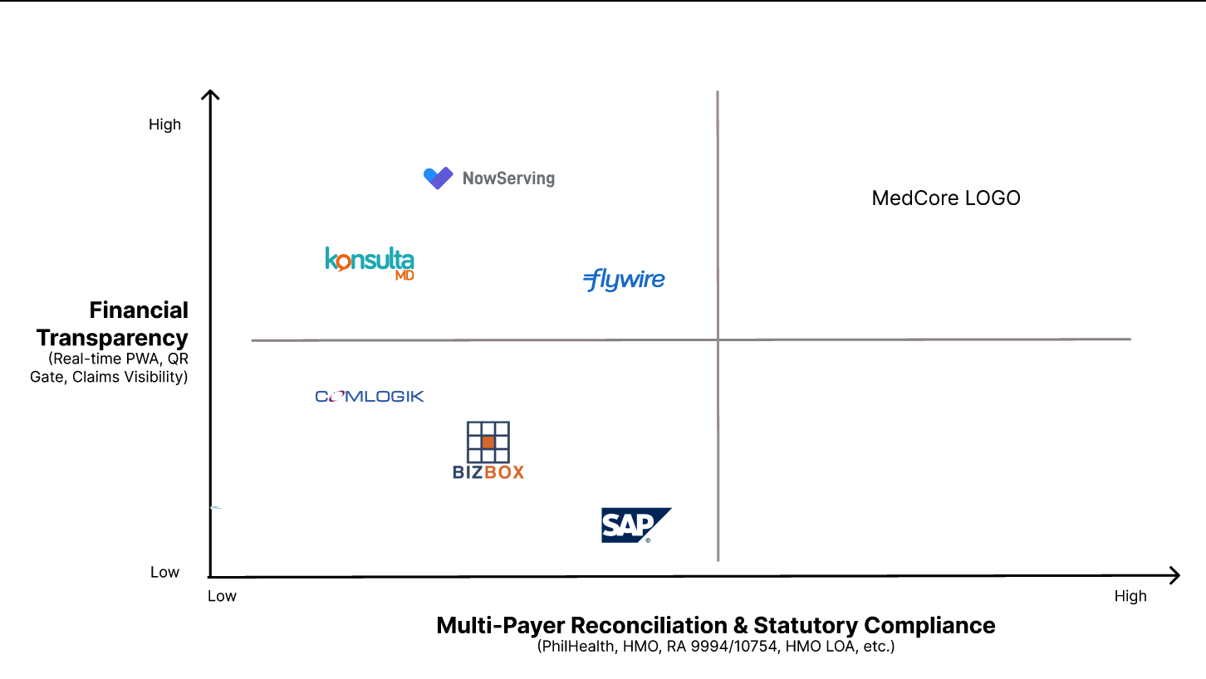
8/10
Notes:
Target: 25 seconds.
Narration: “The pilot creates value because it turns the journey into measurable questions. For commuters: can the trip become clearer and easier to repeat? For MMDA: where do journeys stop and which access barriers recur? For sponsors and institutions: can participation be supported within a fixed campaign budget? We are not claiming guaranteed congestion reduction — we are proposing measurable pilot evidence.”

Slide 8
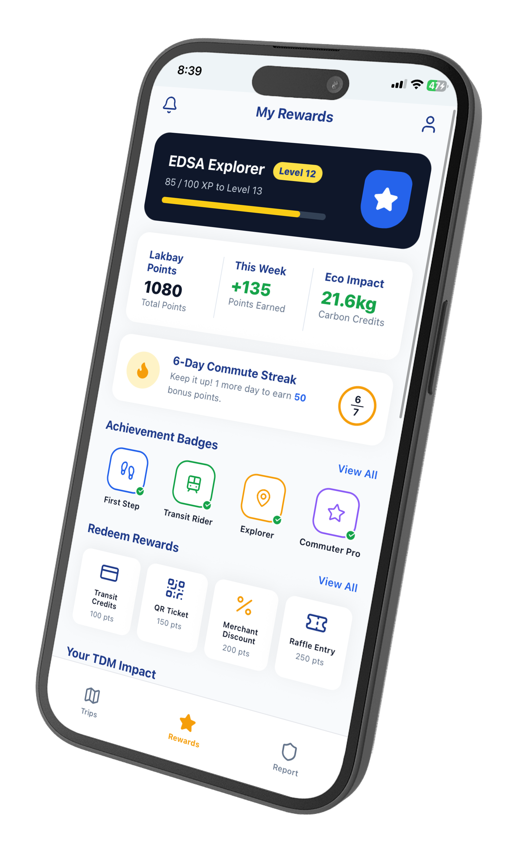
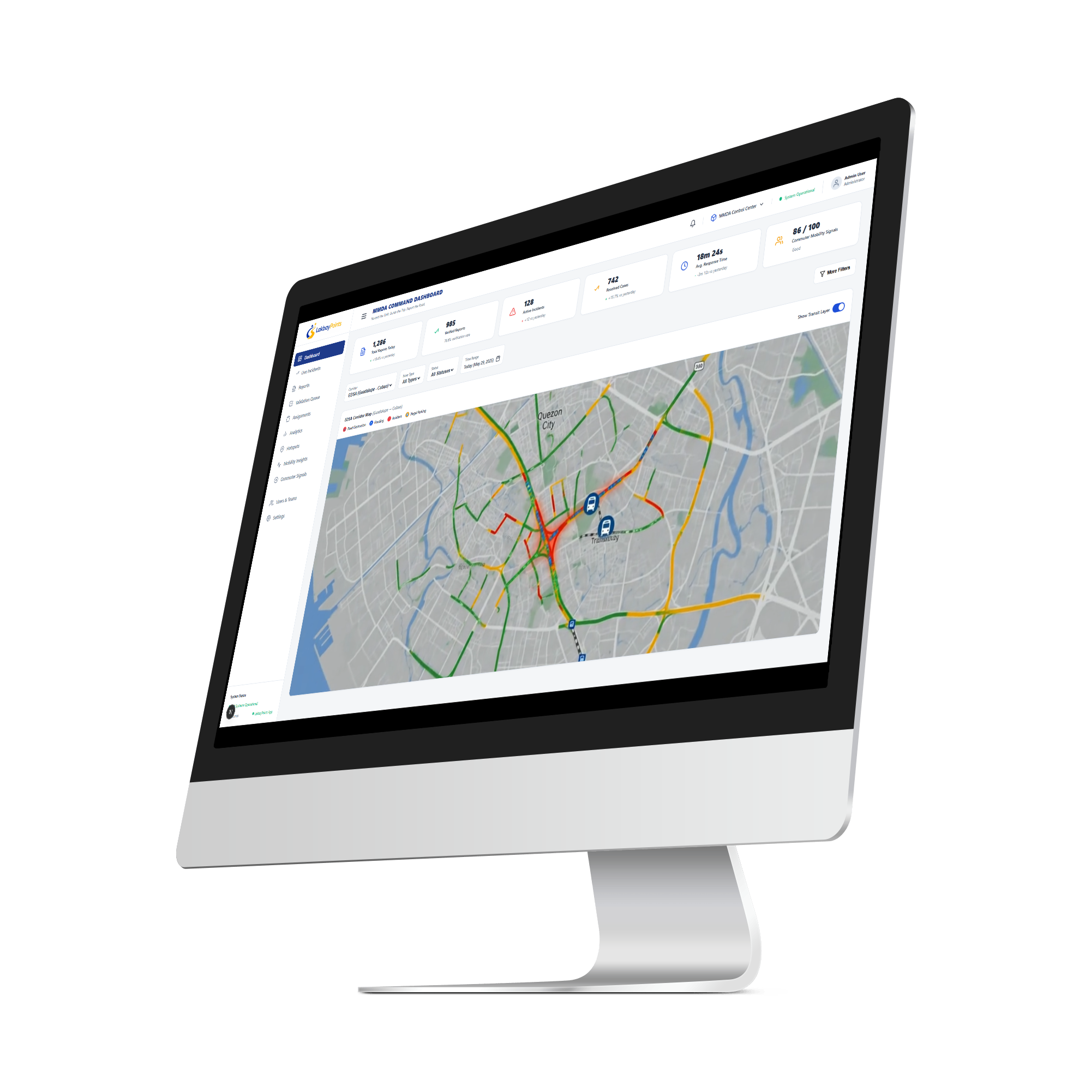
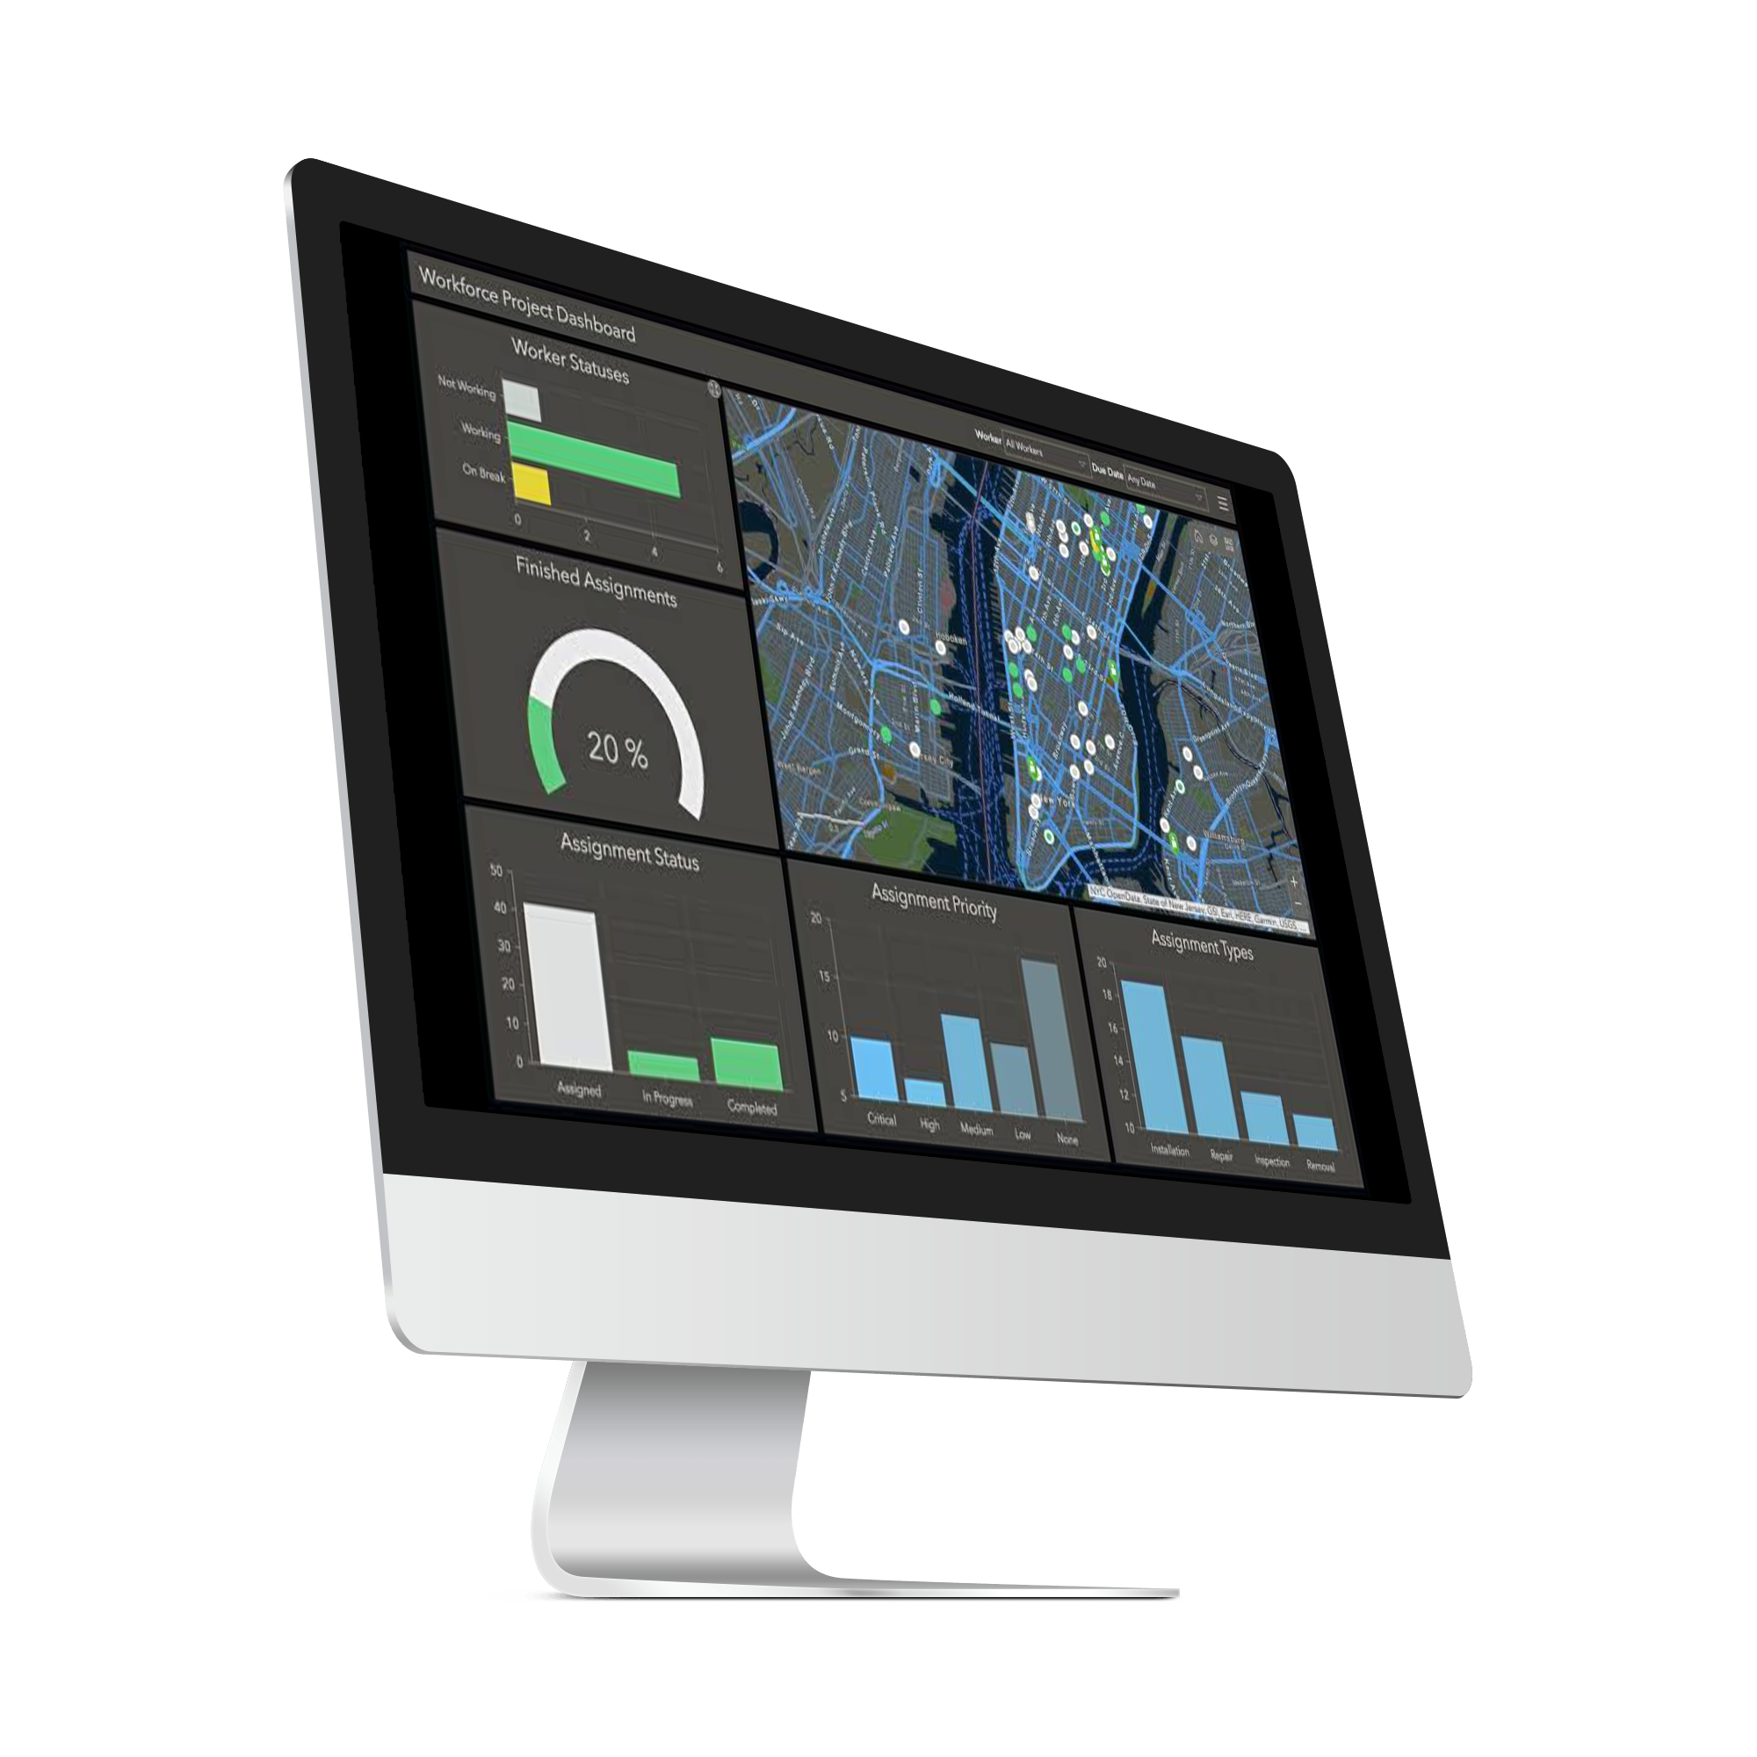
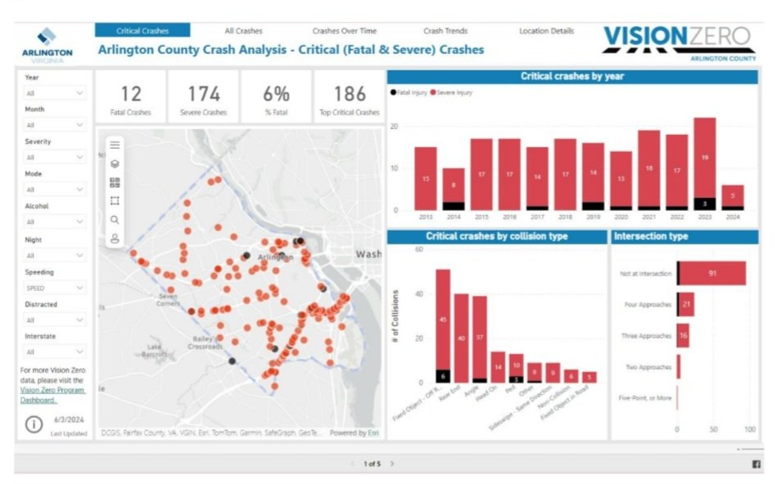
Feasibility & Scalability
9/10
Prototype demonstrated, pilot validated, then corridor-by-corridor expansion.
Prototype
demonstrated
Pilot
validation
Corridor
expansion
Feasible now
Test with real commuters
Scale after gates
Mobile journey workflow
Route, service and accessibility audit
Validated corridor profile
Additional routes after calibration
Rule-based trip-integrity checks
Verification-threshold calibration
Operator / LGU / institutional coordination
Conditional reward logic
Privacy, consent and data governance
Capped campaign budgets and governance approval
“I’m extremely interested on Lakbaypoints to track my trips to gain rewards”
Access reporting
“The feature that detects whether you walk or commute, I can use daily as route planner to ensure quality trip”
Simulated dashboard
Demo route: MRT Cubao → MRT-3 Guadalupe (Makati) → Pasig River Ferry→ Hulo Port (Mandaluyong) → Mandaluyong Science HS; subject to route, service and accessibility validation
Pilot: 8 weeks after preparation • initial cohort 100–150 • scale gate toward 300 • measures: accuracy, repeat use, report quality, workload and budget
Funding path: pre-funded mobility campaigns with capped participant and campaign rewards.
LakbayPoints • MMITS Bagong Gawi, Bagong Galaw Challenge
9
Notes:
Target: 38 seconds.
Narration: “Feasibility has three stages. First, the prototype demonstrates the workflow. Second, a pilot validates it with real commuters: route audit, threshold calibration, privacy review, usability feedback and report workload. Third, once the corridor profile is validated, it can be configured for additional corridors. We are not asking for instant citywide deployment; we are asking for one controlled pilot before scale.”

Slide 9
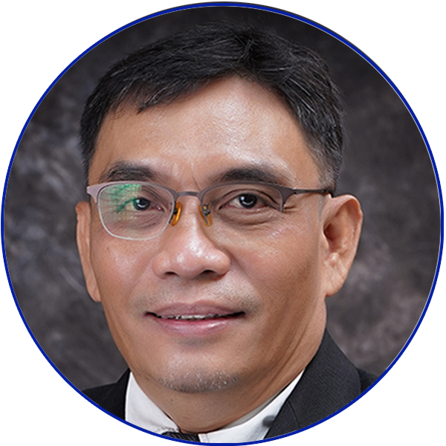
Team Profile
2/10
A multidisciplinary CSU team for transport innovation, software, multimedia and technical guidance.
Core
Capability
Prof. Fernando M. Jaminola Jr., MIT
Prof. Fernando M. Jaminola Jr., MIT
Prof. Fernando M. Jaminola Jr., MIT
Technical Consultant
Technical Consultant
Technical Consultant
Transportation Engineering
Big Data and Cloud Computing
Artificial Intelligence
Cybersecurity
Fraud Prevention
Geospatial Technology and
Geographic Information Systems eMobility R&D Center (EMRDC)
Prof. Fernando M. Jaminola Jr., MIT
Technical Consultant
LakbayPoints • MMITS Bagong Gawi, Bagong Galaw Challenge
2
Notes:
Target: 7 seconds.
Say only: “Our team combines transportation expertise, software development, multimedia communication, and technical guidance from Cagayan State University.”
Do not read every name or title.

