Slide 1

173
Reading IMF Programs
on Day One
Programmes
2002–2016
13
Machine learning on 173 IMF lending programmes
2002–2016
Predictors
Known at approval
3
Mathis Clément
Tristan Zemp
Ethan Moore
Joao Matteo Pisaturo
Ali Haidar
José Pablo Caldas
Models
One prediction task
University of St. Gallen • 7 October 2026

Slide 2
Executive summary
THE QUESTION
ROAD MAP
Can information available at approval predict permanent interruption?
1. Literature and research question
2. Study goal
A modest signal in development
The random forest reaches about 0.63 balanced accuracy out of fold.
3. Data and feature engineering
4. Three prediction models
No reliable test-set advantage
With only 28 later programmes, performance is unstable and close to chance.
5. Model comparison
6. Limitations and conclusion
Programme design is most informative
Scheduled reviews, facility type and loan access lead the forest’s importance ranking.
7. Sources
Approval-day information contains some signal, but reliable out-of-sample prediction remains difficult.
Machine Learning in Finance / Overview
1/13

Slide 3
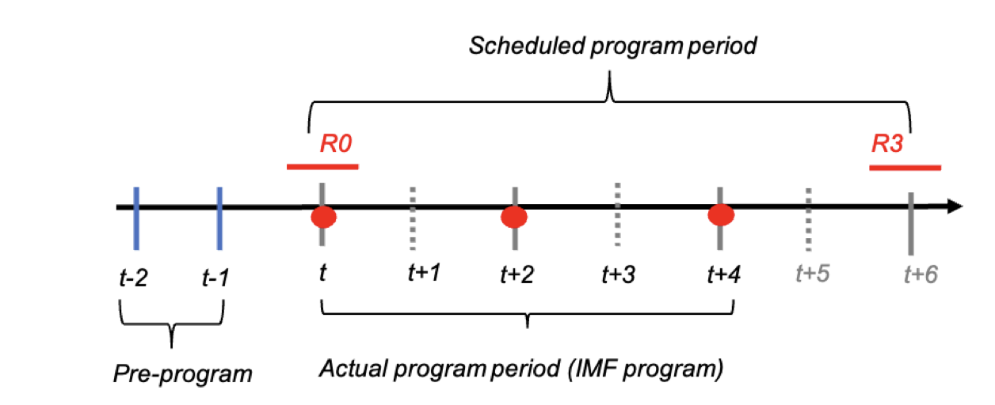
Why predict interruption at approval?
Financial relevance
Interruptions can weaken investor confidence and sovereign financing credibility.
TIMING OF IMF PROGRAMME DISBURSEMENTS
Politics and conditionality
Political incentives and institutional capacity affect implementation; evidence on structural conditions is mixed.
Ivanova et al. (2003); Joyce (2006); Reinsberg et al. (2022).
The gap in machine learning
Existing studies predict IMF participation. We ask whether approval-time information predicts permanent interruption.
Source: Aiyar and Patnam (2021), IMF Working Paper 21/146, Figure 2, p. 8.
A programme can end before its scheduled final review. The prediction must be made at Board approval.
Agbloyor et al. (2023); Batsuuri et al. (2024).
Can information available at approval predict permanent interruption?
Machine Learning in Finance / Research question
2/13

Slide 4
Study goal and sample
BINARY CLASSIFICATION
WHICH PROGRAMMES ENTER THE SAMPLE?
Outcome: programme interruption
1. Review-based facilities
SBA, EFF, ECF and SCF, including predecessors.
Y = 1
At least one scheduled review was never completed.
2. Approval in 2002–2016
MONA review records start in 2002.
Y = 0
Otherwise.
3. Money at stake
Non-precautionary arrangements with positive drawings.
Pr(Y = 1 | X) = f(X), X = (X₁, …, X₁₃).
4. Observed outcome
Matched review records.
Deal design, conditions, track record and macroeconomic information observed at approval.
5. Blends merged
Same country and approval date count as one programme.
Purpose: prediction, not causal explanation.
Earlier risk flags could help calibrate conditionality and inform sovereign-risk pricing.
Predictive framing: Shmueli (2010); James et al. (2013).
Machine Learning in Finance / Study design
3/13

Slide 5
From raw records to programme-level data
DATA SOURCES AND THEIR ROLES
CONSTRUCTION PIPELINE
Source | Information collected
IMF commitments | Dates, approved and drawn amounts, access as a share of quota, facility type.
MONA reviews | Scheduled and completed reviews; construction of the outcome.
MONA conditions and purchases | Structural conditions, prior actions and candidate front-loading measures.
MONA economic indicators | Approval-snapshot growth, inflation and current account.
WEO / WDI | WEO (Apr. 2026): debt and net lending. WDI: growth / inflation fallback considered. Final macro inputs use MONA.
1,576
Raw arrangements
Five raw files; no shared identifier
Link
By country and closest approval date within ±60 days.
Merge blends
Compare approval-day review schedules with completed reviews.
173
Programme observations
IMF (2026a–c); World Bank (2026). Revised WEO fiscal data are excluded from the prediction inputs.
82 interrupted / 91 completed
Machine Learning in Finance / Data and features
4/13

Slide 6
Thirteen inputs, all known at approval
01 / DEAL DESIGN · 5 INPUTS
03 / TRACK RECORD · 3 INPUTS
Log access (% of quota); planned duration; scheduled reviews; concessional facility; extended facility.
Prior programmes over 20 years; time since the previous programme; no previous track record.
02 / CONDITIONALITY · 2 INPUTS
04 / MACROECONOMY · 3 INPUTS
Structural conditions and prior actions at approval.
Real GDP growth; CPI inflation; current account as a share of GDP, from the approval snapshot.
TWELVE CANDIDATE ENTRIES EXCLUDED
6 look-ahead
Post-approval outcomes and revised data
4 redundant / fragile
Duplicate design or history measures
1 missing-data
Fiscal indicators with too many gaps
1 identifier group
Country and approval dates
Output: interrupted (0/1). Feature definitions and exclusion audit: Data_Prep/01_data.R.
Machine Learning in Finance / Data and features
5/13

Slide 7
Exploration: programme design stands out
INTERRUPTION RATE BY FACILITY
More reviews, larger programmes
Interrupted programmes have 7.3 scheduled reviews versus 5.9; access is larger and concessional / extended facilities are less common (p ≤ 0.004).
Weak individual correlations
Reviews: 0.31; access: 0.25; concessional: −0.22. Conditions, macro and track record show no clear outcome differences.
Selected facilities; rounded rates reported in the original presentation.
Overlap and non-linearity
Concessional–extended correlation: 0.72. Interruption across access quartiles: 31 / 52 / 41 / 67%.
Interruption rises from 38% in 2002–07 to 61% in 2014–16.
These patterns motivate testing flexible models alongside a linear log-odds benchmark.
Descriptive evidence: full sample, n = 173; these associations are not causal effects.
Machine Learning in Finance / Data and features
6/13

Slide 8
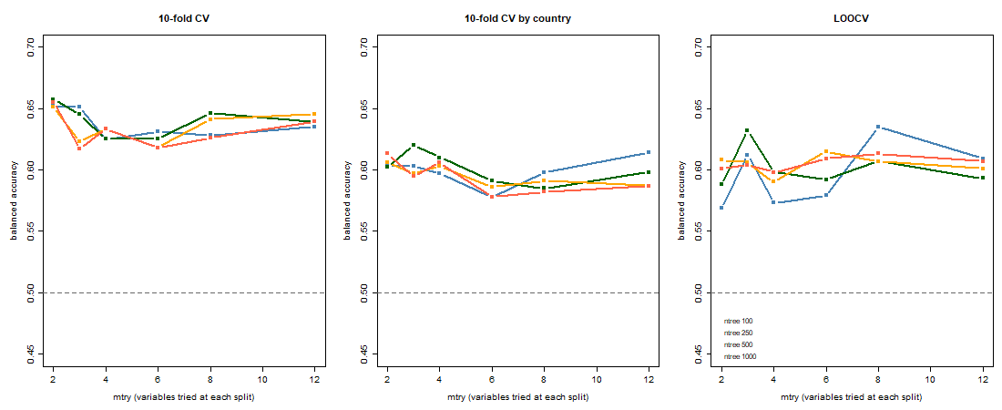
Random forest: tuning is relatively flat
24 settings: 6 mtry values × 4 tree counts; balanced accuracy under three validation schemes.
Flat grid. Curves cross; scores stay within roughly five points. No setting dominates.
Selected with country CV: 250 trees; mtry = 3; balanced accuracy 0.620.
Machine Learning in Finance / Random forest
7/13
Notes:
Country-grouped validation holds out entire countries, giving the most conservative tuning scores here. Source: original random-forest tuning figure.

Slide 9
Random forest: the test signal is weak
DEVELOPMENT AND TEST PERFORMANCE
SUBSTANTIAL UNCERTAINTY
 | Accuracy | Balanced acc.
Development, out of fold | 0.641 | 0.630
Test, final forest | 0.500 | 0.508
Test, always interrupted | 0.607 | 0.500
0.51–0.64
Balanced accuracy
Across 20 random seeds
0.38–0.75
Correctly identified on the test set
8 of 17 interrupted programmes; 6 of 11 completed programmes.
Bootstrap interval
Reported 95% interval; includes 0.50
Development scores use out-of-fold predictions; final performance is measured on later programmes.
With only 28 test observations, the result is sensitive to random variation.
The development signal does not translate into a reliable test-set edge over chance.
Machine Learning in Finance / Random forest
8/13

Slide 10
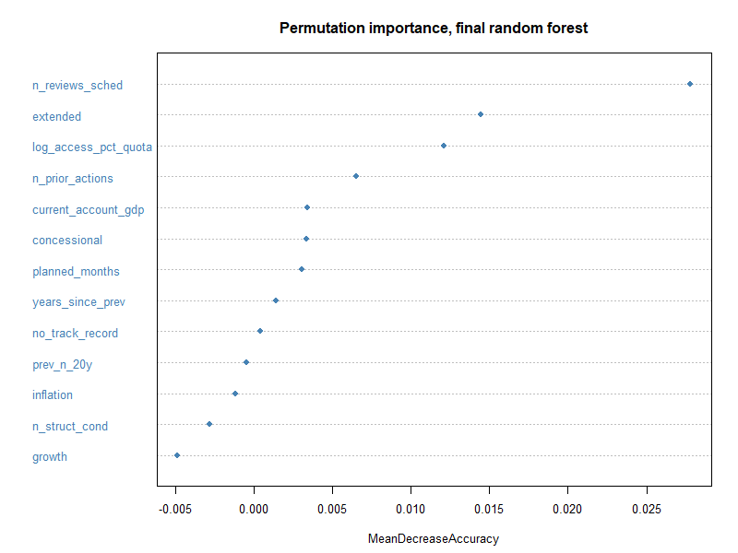
Random forest: programme design leads
THE STRONGEST PREDICTORS
1. Number of scheduled reviews
2. Extended facility indicator
3. Loan access (% of quota, log)
Macro variables have little importance here; growth and inflation are at or below zero.
Predictive importance is not a causal effect.
Permutation importance: mean decrease in accuracy after shuffling each predictor.
Machine Learning in Finance / Random forest
9/13

Slide 11
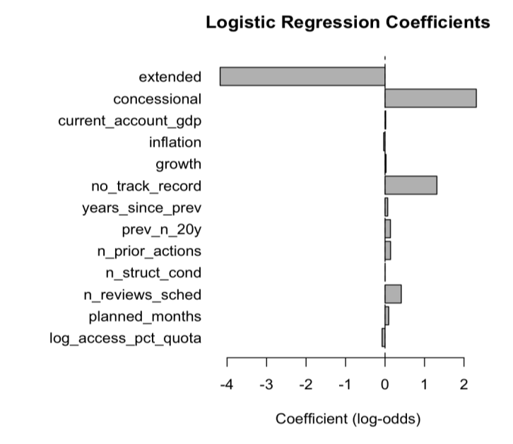
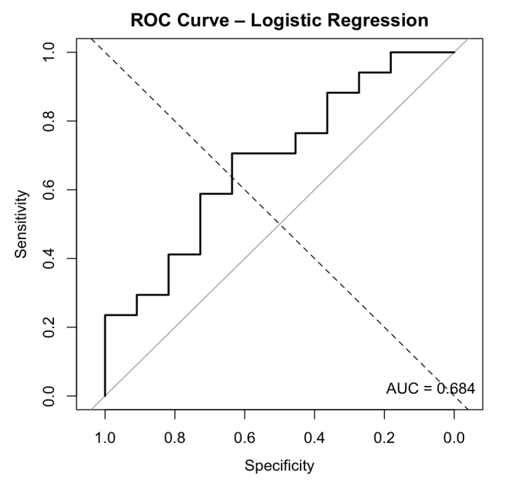
Logistic regression: a transparent benchmark
TEST-SET PERFORMANCE
INTERPRETABILITY
 | Logistic | Forest
Accuracy | 0.536 | 0.500
Balanced accuracy | 0.570 | 0.508
AUC | 0.684 | 0.586
Logistic
Interpretable coefficient direction & magnitude; less flexible.
Forest
Captures non-linearities; more flexible, harder to interpret.
Machine Learning in Finance / Logistic regression
10/13
Notes:
Coefficient magnitudes depend on the units of each predictor; they are not directly comparable measures of importance. Logistic classification uses a 0.50 threshold.

Slide 12
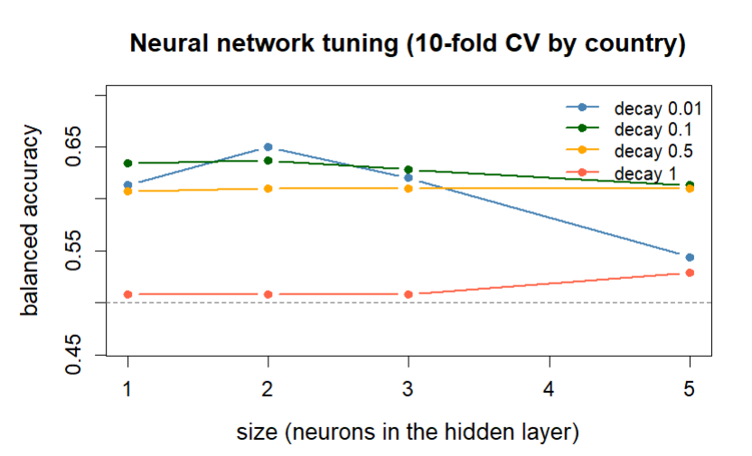
Neural network: small is enough
COUNTRY-GROUPED 10-FOLD CROSS-VALIDATION
A compact network performs best
Two neurons and a light penalty (decay 0.01) give the highest tuning score, about 0.65.
More capacity can hurt
With light regularisation, increasing from two to five neurons reduces the score to about 0.54.
Heavy regularisation underfits
With decay 1, performance stays near chance (roughly 0.51–0.53).
One hidden layer. Size: 1, 2, 3 or 5 neurons; weight decay: 0.01, 0.1, 0.5 or 1.
With 145 training programmes, added model complexity does not guarantee better predictions.
Machine Learning in Finance / Neural network
11/13

Slide 13
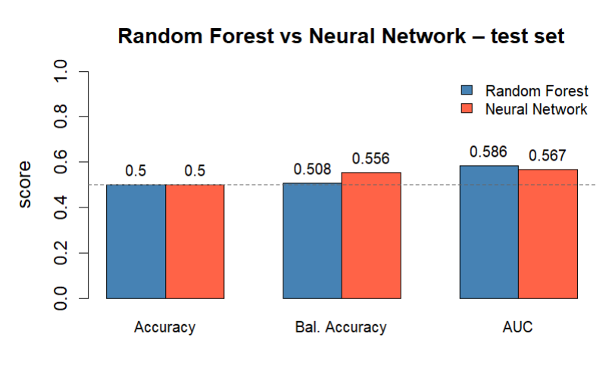
Model comparison: no reliable winner
ALL MODELS / SAME 28 TEST PROGRAMMES
Model | Acc. | BA | AUC
Logistic | 0.536 | 0.570 | 0.684
Forest | 0.500 | 0.508 | 0.586
Neural net | 0.500 | 0.556 | 0.567
Always 1 | 0.607 | 0.500 | 0.500
Neither the forest nor the neural network is reliably better than the other.
Logistic regression has the highest reported BA and AUC, but this small test sample cannot establish a reliable ranking.
Original test-set comparison. The 0.50 line is a chance reference for balanced accuracy and AUC, not the majority-class accuracy benchmark.
More flexible models do not demonstrate a dependable advantage in this sample.
Machine Learning in Finance / Model comparison
12/13

Slide 14
Limitations and conclusion
WHAT LIMITS THE EVIDENCE
WHAT WE LEARN
Small sample
145 training and 28 test programmes, with only 11 completed. One extra correct prediction changes BA by about 0.03–0.05.
The signal is weak
About 0.63 out-of-fold BA for the forest, but no reliable edge over chance on the test set.
One time split
The interruption share rises from 45% in development to 61% in the test period.
Deal design predicts best
Reviews, facility type and loan size lead. Macro variables contribute little in this forest.
Coarse approval-day inputs
Political commitment, institutional detail and post-approval shocks are not captured.
The metric matters
Plain accuracy can reward an always-interrupted rule. Balanced accuracy gives equal weight to both outcomes.
Approval-time prediction is promising as a research question, but the current evidence is too weak for a dependable risk flag.
Machine Learning in Finance / Conclusion
13/13

Slide 15
Sources / IMF programmes and implementation
Agbloyor, E. K., Pan, L., Dwumfour, R. A., & Gyeke-Dako, A. (2023). We are back again! What can artificial intelligence and machine learning models tell us about why countries knock at the door of the IMF? Finance Research Letters, 57, 104244.
Ivanova, A., Mayer, W., Mourmouras, A., & Anayiotos, G. (2003). What determines the implementation of IMF-supported programs? IMF Working Paper No. 03/8. International Monetary Fund.
Aiyar, S., & Patnam, M. (2021). IMF programs and financial flows to offshore centers. IMF Working Paper No. 21/146. International Monetary Fund.
Joyce, J. P. (2006). Promises made, promises broken: A model of IMF program implementation. Economics & Politics, 18(3), 339–365.
Batsuuri, T., He, S., Hu, R., Leslie, J., & Lutz, F. (2024). Predicting IMF-supported programs: A machine learning approach. IMF Working Paper No. 24/54. International Monetary Fund.
Reinsberg, B., Stubbs, T., & Kentikelenis, A. (2022). Compliance, defiance, and the dependency trap: International Monetary Fund program interruptions and their impact on capital markets. Regulation & Governance, 16(4), 1022–1041.
Machine Learning in Finance / Sources

Slide 16
Sources / Methods and data
METHODS
DATA SOURCES
He, H., & Garcia, E. A. (2009). Learning from imbalanced data. IEEE Transactions on Knowledge and Data Engineering, 21(9), 1263–1284.
International Monetary Fund. (2026a). IMF lending commitments [Database].
International Monetary Fund. (2026b). Monitoring of Fund Arrangements (MONA) [Database].
James, G., Witten, D., Hastie, T., & Tibshirani, R. (2013). An introduction to statistical learning: With applications in R. Springer.
International Monetary Fund. (2026c). World Economic Outlook database: April 2026 edition [Database].
Shmueli, G. (2010). To explain or to predict? Statistical Science, 25(3), 289–310.
World Bank. (2026). World Development Indicators (WDI) [Database].
The WEO and WDI references are retained from the original presentation; the final approval-time macro predictors are from MONA.
Machine Learning in Finance / Sources

