Slide 1
Penalized Regression
Ridge, Lasso, Elastic net
Joe Nese
Week 4, Class 1

Slide 2
Agenda
Introduce penalized regression
Specify a model
Fit a model
Tune a model
regular grids

Slide 3
Penalized Regression
(AKA Regularized Regression)

Slide 4
Let’s revisit linear regression
What’s good
Parsimonious
Interpretable results
Coefficients are unbiased (given standard assumptions)
Because they minimize the sum-of-squared errors (SSE)
Lowest variance (of all unbiased linear techniques)

Slide 5
Let’s revisit linear regression
What’s not so good
Sensitive to highly correlated predictors – multicollinearity
Including irrelevant predictors may hurt model performance
Model fit is influenced by “outliers” because it wants to minimize SSE
Although we can model nonlinearity by adding terms to the model (x² or log(x))
this may not capture the relationship between predictors and outcome
adds predictors to the model (problematic with many predictors fewer observations)

Slide 6
Penalized Regression
OLS regression coefficients are unbiased because the model minimizes SSE
But it turns out that adding a little bias to the coefficients can substantially decrease variance, resulting in a smaller MSE and better prediction of unseen data
How to add bias to the coefficients?
Add a penalty to the SSE if the coefficients become too large
Basically: penalize the model for coefficients as they move away from zero
As a regression coefficient grows large, the penalty must also increase to enforce the minimization of SSE
In order to have a large coefficient, a predictor will need to have a large impact on the model fit

Slide 7
Penalized Regression
How does a penalty help?
Shrinking our coefficients toward zero reduces the model's variance (think of model where all coefficients are equal to zero – no variance)
The optimal penalty will balance reduced variance with increased bias
Particularly useful for dealing with multicollinearity
As multicollinearity increases, the estimated regression coefficients are inflated and become unstable

Slide 8
Penalized Regression Models
ridge regression (Hoerl, 1970)
lasso (Tibshirani, 1996)
elastic net (Aou & Hastie, 2005)
AKA
Regularized Regression
Shrinkage methods

Slide 9

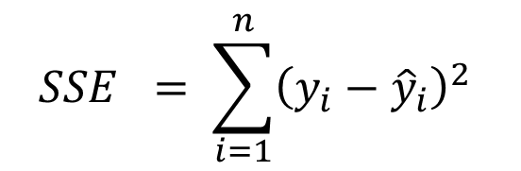

Ridge Regression
$$+ λ\sum_{j=1}^{P}{β_{j}^{2}}$$
Penalize the model for coefficients as they move away from zero unless there is a proportional reduction in the SSE
L₂ penalty = second-order penalty (squared coefficients)
λ = 0 = linear regression
As the penalty (λ) increases, the coefficients shrink toward 0 (at different rates)
A new set of coefficients is produced for each value of λ
$$SSE = \sum_{i=1}^{n}{{\left(y_{i}−{\hat{y}}_{i}\right)}^{2} }$$
$$L_{2}$$
squared coefficients
penalty

Slide 10
Penalized Regression
Scale matters
The units of the predictors can substantially affect results
The scale of predictors doesn’t affect SSE, but does affect the coefficients
Think of coefficient interpretation for meters vs. kilometers
Ridge regression will pay a larger penalty for meters
So we need to put all predictors on the same scale prior to analysis
Center and scale (standardize) all predictors
(x - mean(x)) / sd(x)

Slide 11
Ridge Regression
Ridge penalty is mostly associated with addressing collinearity between predictors
Shrinks the coefficients of correlated predictors toward each other
rather than allowing one to be wildly positive and the other wildly negative
Many less-important predictors get pushed toward zero which helps identify the important predictors in our data
Shrinks coefficients toward 0, but will never equal 0, no matter how large the penalty
A coefficient equal to 0 would, of course, be dropped from the model
That would be automatic feature selection!
That would be nice!
lasso models do this!
Least Absolute Shrinkage and Selection Operator

Slide 12
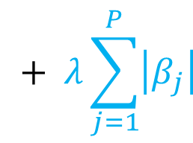

lasso - Least Absolute Shrinkage and Selection Operator
$$+ λ\sum_{j=1}^{P}{\left|β_{j}\right|}$$
Penalize the model for coefficients as they move away from zero unless there is a proportional reduction in the SSE
L₁ penalty = absolute coefficients
As the penalty (λ) increases, the coefficients shrink toward 0 (at different rates)
Allows coefficients equal to 0
$$SSE = \sum_{i=1}^{n}{{\left(y_{i}−{\hat{y}}_{i}\right)}^{2} }$$
$$L_{1}$$
absolute coefficients
penalty

Slide 13


Ridge and lasso
Both equally penalize overestimating and underestimating a coefficient
No free lunch
Ridge
Lasso
$$λ\sum_{j=1}^{P}{β_{j}^{2}}$$
$$λ\sum_{j=1}^{P}{\left|β_{j}\right|}$$
L₂ penalty
Larger errors are worse
Tends to shrinks coefficients of correlated predictors toward each other
Extreme example: for P identical predictors, each has a coefficient of 1/P the size as one modeled by itself
Helps if you want to keep all predictors in your model and reduce the noise of less influential variables (e.g., smaller data sets with severe multicollinearity)
L₁ penalty
Additional error is equally bad everywhere
Tends to just choose one predictor and not model the others
Extreme example: for P identical predictors, will model one predictor and allow coefficient of zero for the rest
Helps find the predictors with the largest (and most consistent) coefficients in data with many predictors

Slide 14
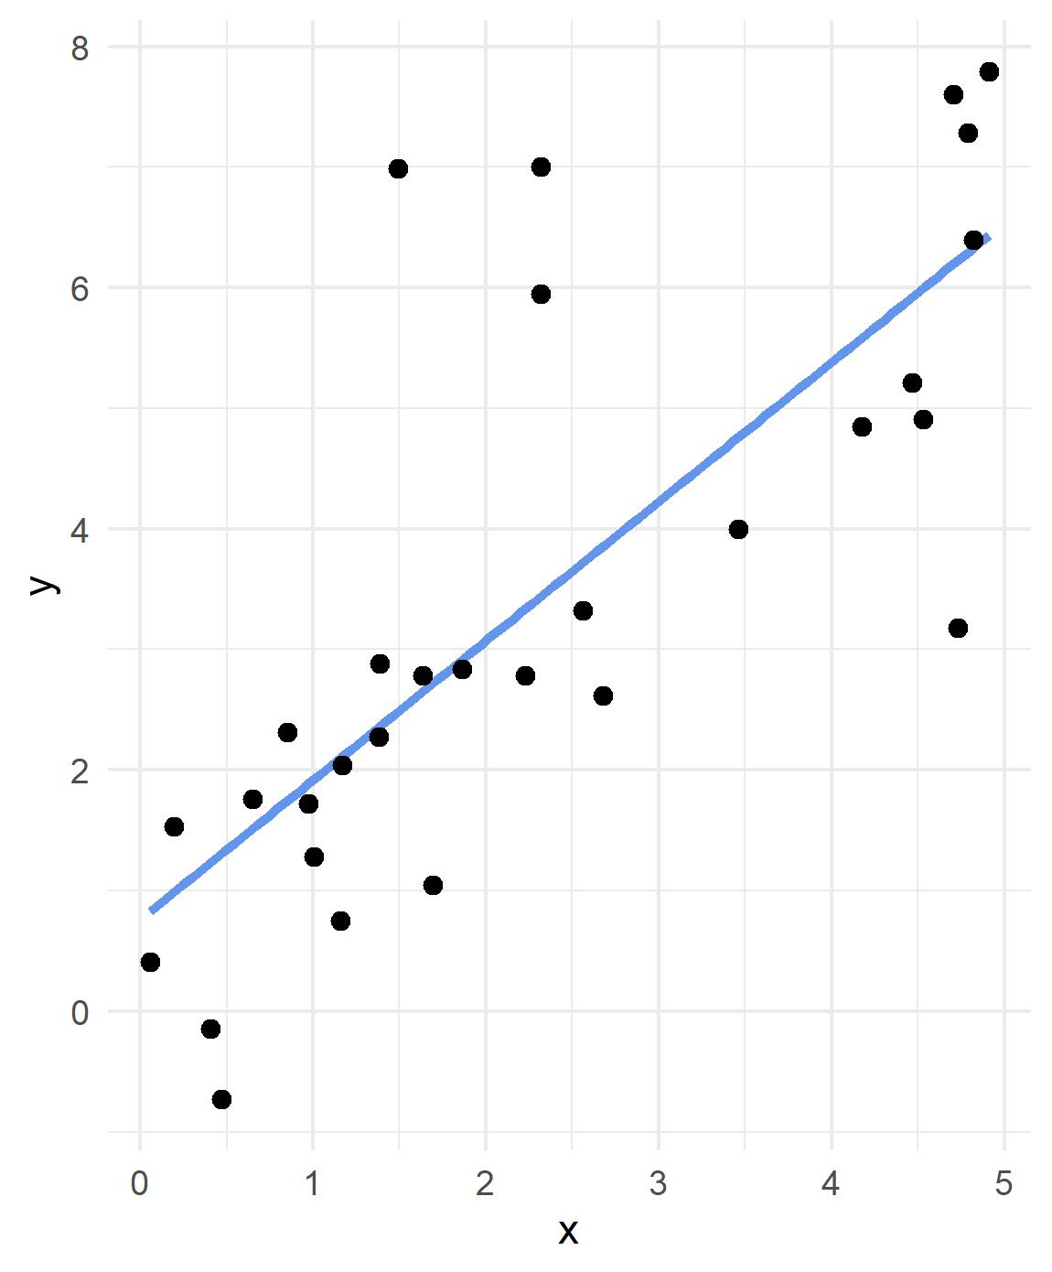
Code credit to Ed Rubin

Slide 15
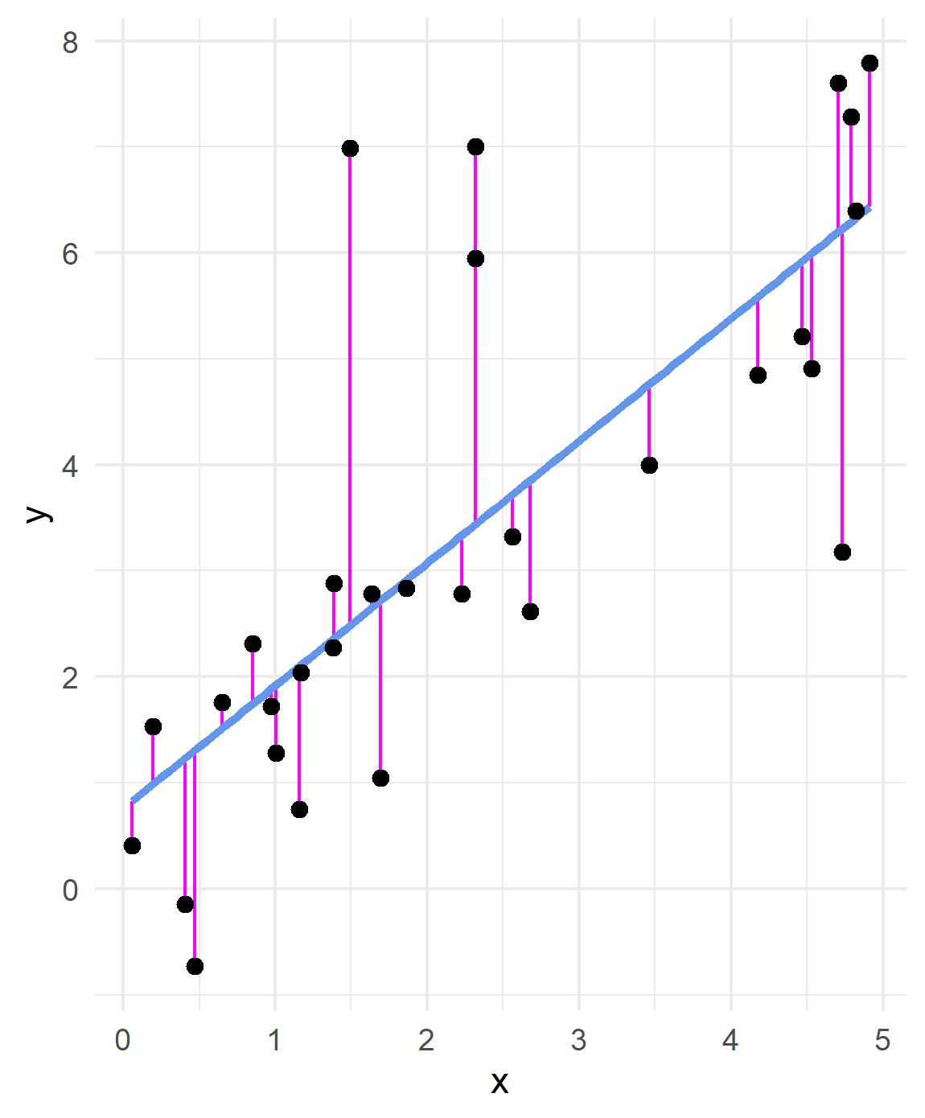
L₂ loss function

Slide 16
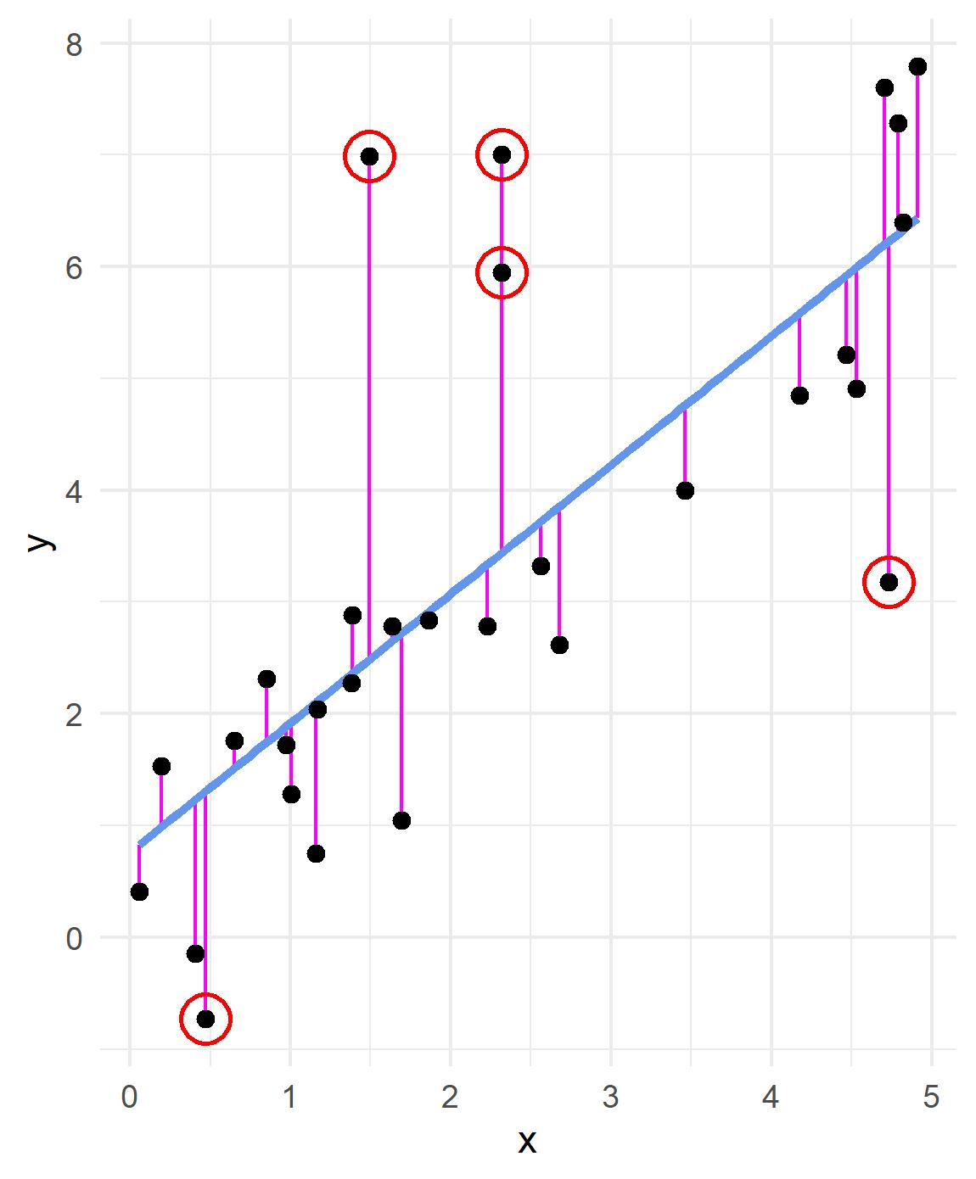


L₂ loss function
$$Σ_{i}{\left(y_{i}−{\hat{y}}_{i}\right)}^{2}$$
(4.5) ²
20.25
4.5
L₁ loss function
$$Σ_{i}\left|y_{i}−{\hat{y}}_{i}\right|$$
|4.5|
4.5

Slide 17

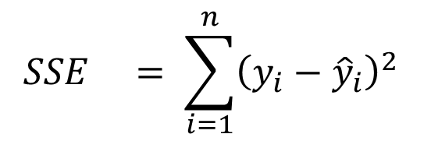

Elastic net
$$+ λ\sum_{j=1}^{P}{β_{j}^{2}}$$
$$+ λ\sum_{j=1}^{P}{\left|β_{j}\right|}$$
Combines the two types of penalties
Enables effective regularization with ridge penalty (L₂)
Offers feature selection with lasso penalty (L₁)
Better able to handle multicollinearity
$$SSE = \sum_{i=1}^{n}{{\left(y_{i}−{\hat{y}}_{i}\right)}^{2} }$$
Enet

Slide 18
Specify a model

Slide 19
Specify the model
select a model
https://www.tidymodels.org/find/parsnip/
we will be discussing many different modeling options
select the engine
the package (software) that will be used to fit the model
select the mode
regression or classification
We're just setting up the framework, we’re not estimating anything yet

Slide 20

select a model
Welcome to {parsnip}!
List of at least 30 models
https://www.tidymodels.org/find/parsnip/
We will be using the model for linear regression
which also allows for penalized regression
linear_reg()

Slide 21
set_engine()
Used to specify which package will be used to fit the model
and any arguments specific to that software
We’ll be using glmnet (default) for our penalized regression models
can also use stan, spark, keras
set_engine("glmnet")

Slide 22
set_mode()
specify whether the outcome is
set_mode(“regression”)
set_mode(“classification”)

Slide 23
Specify the model
linear_reg() %>%
set_engine("glmnet") %>%
set_mode("regression") %>% # redundant; just getting in the habit
-or-
linear_reg(mode = “regression”) %>% # only option available
set_engine("glmnet")

Slide 24
linear_reg()
mode = can only be “regression,” not “classification”
(logistic_reg is used for classification)
penalty = An non-negative number representing the total amount of regularization. This can be a combination of L1 and L2 (depending on the value of mixture)
mixture = A number between zero and one (inclusive) that represents the proportion of L1 regularization (the lasso)
ridge = mixture = 0; no L1
lasso = mixture = 1; completely L1 (and no ridge)
enet = 0 < mixture < 1; mixture of L1 (lasso) and ridge (L2)

Slide 25
math <- math <- read_csv(here::here("data", "train.csv"))
# 1 - Initial Split
set.seed(3000)
math_split <- initial_split(math)
math_train <- training(math_split)
math_test <- testing(math_split)
# 2 - Resample
set.seed(3000)
cv_splits <- vfold_cv(math_train)

Slide 26
Before we continue…
Penalized regression cannot handle missing data
Can either delete or impute
For simplicity here, we are just going to delete
We need to center and scale our continuous predictors
This is part of data preprocessing, or feature engineering
“the process of creating representations of data that increase the effectiveness of a model” (Kuhn & Johnson, 2019)
Very quick preview of next week’s topic and the {recipes} package
Center: average is subtracted from the predictor’s individual values
All predictors will have a mean of zero
Scale: divide a variable by the standard deviation
All predictors have a standard deviation of one

Slide 27

{recipes}
penreg_rec <-
recipe(
formula = score ~ enrl_grd + econ_dsvntg + lat + lon,
data = math_train
) %>%
step_naomit(all_predictors(), skip = TRUE) %>%
step_string2factor(econ_dsvntg) %>%
step_dummy(econ_dsvntg) %>%
step_normalize(lat, lon, enrl_grd)

Slide 28
{recipes}
penreg_rec <-
recipe(
formula = score ~ enrl_grd + econ_dsvntg + lat + lon,
data = math_train
) %>%
step_naomit(all_predictors(), skip = TRUE) %>%
step_string2factor(econ_dsvntg) %>%
step_dummy(econ_dsvntg) %>%
step_normalize(lat, lon, enrl_grd)
defines outcome and predictors

Slide 29
{recipes}
penreg_rec <-
recipe(
formula = score ~ enrl_grd + econ_dsvntg + lat + lon,
data = math_train
) %>%
step_naomit(all_predictors(), skip = TRUE) %>%
step_string2factor(econ_dsvntg) %>%
step_dummy(econ_dsvntg) %>%
step_normalize(lat, lon, enrl_grd)
Catalogs the names and types of each variable
Informs recipe() what is numeric and what is nominal

Slide 30
{recipes}
penreg_rec <-
recipe(
formula = score ~ enrl_grd + econ_dsvntg + lat + lon,
data = math_train
) %>%
step_naomit(all_predictors(), skip = TRUE) %>%
step_string2factor(econ_dsvntg) %>%
step_dummy(econ_dsvntg) %>%
step_normalize(lat, lon, enrl_grd)
drops missing values from all predictors

Slide 31
{recipes}
penreg_rec <-
recipe(
formula = score ~ enrl_grd + econ_dsvntg + lat + lon,
data = math_train
) %>%
step_naomit(all_predictors(), skip = TRUE) %>%
step_string2factor(econ_dsvntg) %>%
step_dummy(econ_dsvntg) %>%
step_normalize(lat, lon, enrl_grd)
converts strings (“Y”, “N”) to factors

Slide 32
{recipes}
penreg_rec <-
recipe(
formula = score ~ enrl_grd + econ_dsvntg + lat + lon,
data = math_train
) %>%
step_naomit(all_predictors(), skip = TRUE) %>%
step_string2factor(econ_dsvntg) %>%
step_dummy(econ_dsvntg) %>%
step_normalize(lat, lon, enrl_grd)
Converts nominal data into dummy variables

Slide 33
{recipes}
penreg_rec <-
recipe(
formula = score ~ enrl_grd + econ_dsvntg + lat + lon,
data = math_train
) %>%
step_naomit(all_predictors(), skip = TRUE) %>%
step_string2factor(econ_dsvntg) %>%
step_dummy(econ_dsvntg) %>%
step_normalize(lat, lon, enrl_grd)
Normalizes (centers and scales); necessary for penalized regression
Could also use:
step_center(lat, lon, enrld_grd)
step_scale(lat, lon, enrld_grd)
step_normalize(all_numeric(), -all_outcomes())

Slide 34
# 3 - Set Model
## Ridge
mod_ridge <- linear_reg() %>%
set_engine("glmnet") %>%
set_mode("regression") %>% # redundant; just setting a habit
set_args(penalty = .1, # arbitrarily set the penalty = .1
mixture = 0) # specifies a ridge regression model

Slide 35
# 3 - Set Model
## lasso
mod_lasso <- linear_reg() %>%
set_engine("glmnet") %>%
set_mode("regression") %>% # redundant; just setting a habit
set_args(penalty = .1, # arbitrarily set the penalty = .1
mixture = 1) # specifies a lasso model

Slide 36
# 3 - Set Model
## Elastic net
mod_enet <- linear_reg() %>%
set_engine("glmnet") %>%
set_mode("regression") %>% # redundant; just setting a habit
set_args(penalty = .1, # arbitrarily set the penalty = .1
mixture = .7) # specifies 70% L1 penalty (lasso) # and 30% L2 penalty (ridge)

Slide 37
Fit a model

Slide 38

fit_resamples()
Fit multiple models via resampling
fit_resamples(
object,
preprocessor,
resamples,
...,
metrics = NULL,
control = control_resamples()
)

Slide 39
fit_resamples()
mod_ridge
Fit multiple models via resampling
fit_resamples(
object,
preprocessor,
resamples,
...,
metrics = NULL,
control = control_resamples()
)
mod_lasso
mod_enet
parsnip model specification or a workflows::workflow()
we’ll get to this later

Slide 40
fit_resamples()
Fit multiple models via resampling
fit_resamples(
object,
preprocessor,
resamples,
...,
metrics = NULL,
control = control_resamples()
)
score ~ enrl_grd + econ_dsvntg + lat + lon
a traditional model formula or a
recipes::recipe()
penreg_rec

Slide 41
fit_resamples()
Fit multiple models via resampling
fit_resamples(
object,
preprocessor,
resamples,
...,
metrics = NULL,
control = control_resamples()
)
A resample rset created from an rsample function
cv_splits

Slide 42

fit_resamples()
Fit multiple models via resampling
fit_resamples(
object,
preprocessor,
resamples,
...,
metrics = NULL,
control = control_resamples()
)
A yardstick::metric_set() or NULL to compute a standard set of metrics

Slide 43
fit_resamples()
Fit multiple models via resampling
fit_resamples(
object,
preprocessor,
resamples,
...,
metrics = NULL,
control = control_resamples()
)

Slide 44
# 4 - Fit the models
## Ridge
fit_ridge <- tune::fit_resamples(
mod_ridge,
preprocessor = penreg_rec,
resamples = cv_splits,
metrics = yardstick::metric_set(rmse), # default is rmse & rsq
control = tune::control_resamples(verbose = TRUE,
save_pred = TRUE))
This will print to your console the model fitting process by Fold, so you can get an idea of progress and time

Slide 45
# 4 - Fit the models
## Ridge
fit_ridge <- tune::fit_resamples(
mod_ridge,
preprocessor = penreg_rec,
resamples = cv_splits,
metrics = yardstick::metric_set(rmse), # default is rmse & rsq
control = tune::control_resamples(verbose = TRUE,
save_pred = TRUE))
This will print to your console the model fitting process by Fold, so you can get an idea of progress and time

Slide 46
# 4 - Fit the models
## Ridge
fit_ridge <- tune::fit_resamples(
mod_ridge,
preprocessor = penreg_rec,
resamples = cv_splits,
metrics = yardstick::metric_set(rmse), # default is rmse & rsq
control = tune::control_resamples(verbose = TRUE,
save_pred = TRUE))
This will save the out-of-sample (analysis) predictions for each model evaluated

Slide 47
## Ridge
fit_ridge %>%
tune::collect_metrics()
# A tibble: 1 x 5
.metric .estimator mean n std_err
<chr> <chr> <dbl> <int> <dbl>
1 rmse standard 102. 10 0.351

Slide 48
## Ridge
fit_ridge %>%
tune::collect_metrics(summarize = FALSE)
# A tibble: 10 x 4
id .metric .estimator .estimate
<chr> <chr> <chr> <dbl>
1 Fold01 rmse standard 101.
2 Fold02 rmse standard 101.
3 Fold03 rmse standard 101.
4 Fold04 rmse standard 99.3
5 Fold05 rmse standard 103.
6 Fold06 rmse standard 103.
7 Fold07 rmse standard 102.
8 Fold08 rmse standard 103.
9 Fold09 rmse standard 101.
10 Fold10 rmse standard 102.

Slide 49
## lasso
fit_lasso <- tune::fit_resamples(
mod_lasso,
preprocessor = penreg_rec,
resamples = cv_splits,
metrics = yardstick::metric_set(rmse),
control = tune::control_resamples(verbose = TRUE,
save_pred = TRUE))
fit_lasso %>%
collect_metrics()
# A tibble: 1 x 5
.metric .estimator mean n std_err
<chr> <chr> <dbl> <int> <dbl>
1 rmse standard 101. 10 0.356

Slide 50
## Elastic net
fit_enet <- tune::fit_resamples(
mod_enet,
preprocessor = penreg_rec,
resamples = cv_splits,
metrics = yardstick::metric_set(rmse),
control = tune::control_resamples(verbose = TRUE,
save_pred = TRUE))
fit_enet %>%
collect_metrics()
# A tibble: 1 x 5
.metric .estimator mean n std_err
<chr> <chr> <dbl> <int> <dbl>
1 rmse standard 101. 10 0.356

Slide 51
collect_metrics(fit_ridge)
# A tibble: 1 x 5
.metric .estimator mean n std_err
<chr> <chr> <dbl> <int> <dbl>
1 rmse standard 102. 10 0.351
collect_metrics(fit_lasso)
# A tibble: 1 x 5
.metric .estimator mean n std_err
<chr> <chr> <dbl> <int> <dbl>
1 rmse standard 101. 10 0.356
collect_metrics(fit_enet)
# A tibble: 1 x 5
.metric .estimator mean n std_err
<chr> <chr> <dbl> <int> <dbl>
1 rmse standard 101. 10 0.356

Slide 52
Penalized regression
Thus far we have used penalty = .1 (λ)
Choosing a good value for the penalty is very important
Too small a penalty and our model is essentially OLS
Too large a penalty and we shrink all our coefficients too close to zero
So how can we find an optimal value?
Model tuning

Slide 53
Tune a model
regular grids

Slide 54
{tune}
Facilitates the tuning of hyper-parameters in tidymodels packages
Hyperparameters (tuning parameters) control the complexity of some ML models (and the bias-variance trade-off)
Hyperparameters cannot be directly estimated from the data
Some models have many tuning parameters (e.g., boosted trees)
We use cross-validation to find the optimal tuning parameter values with either:
grid search - predefined values
iterative search - where each iteration finds novel tuning parameter values to evaluate

Slide 55
tune()
A placeholder for hyper-parameters to be "tuned“
ridge_tune_mod <- linear_reg() %>%
set_engine("glmnet") %>%
set_args(penalty = tune(),
mixture = 0) # specifies a ridge regression model

Slide 56
grid search
Set a pre-defined set of tuning parameter values and evaluate their performance so that the best values can be used in the final model
For models with more than one tuning parameter, the grid is multidimensional
Using resampling to evaluate each distinct parameter value combination to get estimates of how well each performs
Calculate results and model performance, and use the “best” tuning parameter combination to fit to the entire training set

Slide 57
Regular grids
Usually a combination of vectors of tuning parameter values
The number of values don't have to be the same per parameter
The values can be regular on a transformed scale (e.g. log-10 for penalty)
Quantitative and qualitative parameters can be combined
As the number of parameters increases, so does the burden of dimensionality
Thought to be inefficient but not in all cases
Bad when performance plateaus over a range of one or more parameters
Kuhn (2019)

Slide 58
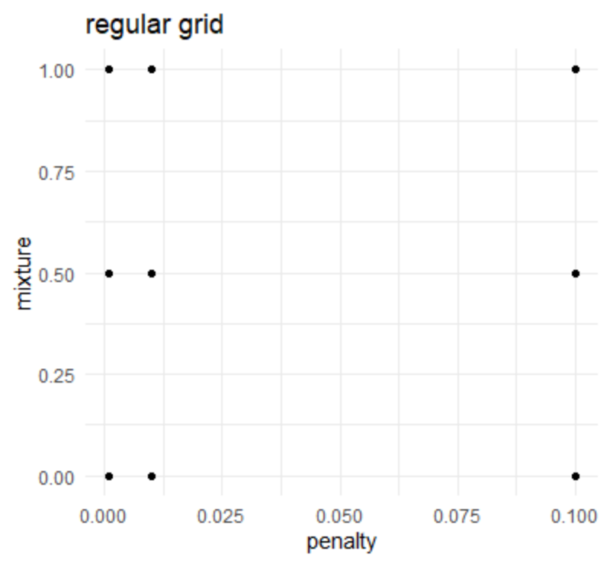
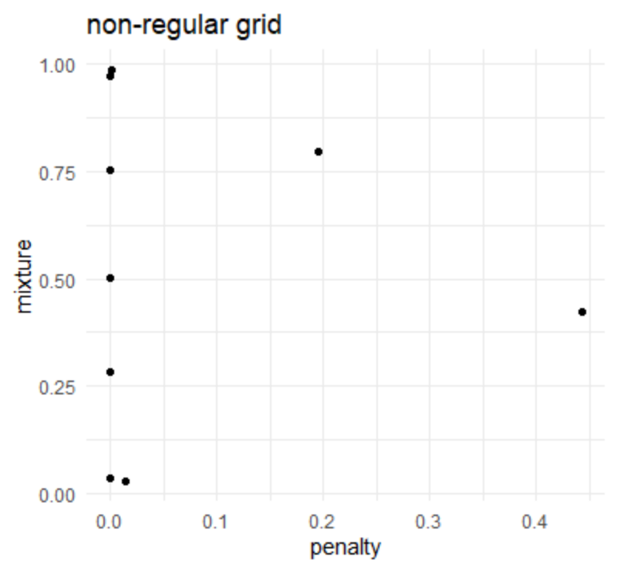

Slide 59
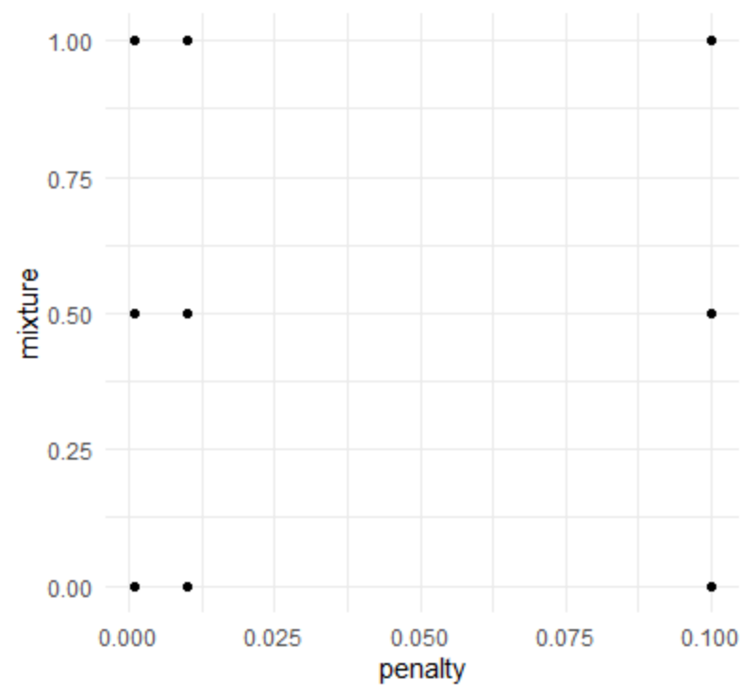
regular grid example
base::expand.grid(
penalty = c(.001, .01, .1),
mixture = c(0, .5, 1))
penalty mixture
1 0.001 0.0
2 0.010 0.0
3 0.100 0.0
4 0.001 0.5
5 0.010 0.5
6 0.100 0.5
7 0.001 1.0
8 0.010 1.0
9 0.100 1.0

Slide 60
grid_regular()
penalty() # from the {dials} package
Amount of Regularization (quantitative)
Transformer: log-10
Range (transformed scale): [-10, 0]
grid_regular(penalty())
# A tibble: 3 x 1
penalty
<dbl>
1 0.0000000001
2 0.00001
3 1
grid_regular(penalty(), levels = 10)
# A tibble: 10 x 1
penalty
<dbl>
1 0.0000000001
2 0.00000000129
3 0.0000000167
4 0.000000215
5 0.00000278
6 0.0000359
7 0.000464
8 0.00599
9 0.0774
10 1

Slide 61
tune_grid()
A version of fit_resamples() that performs a grid search for the best combination of tuned hyperparameters
tune_grid(
object,
preprocessor,
resamples,
...,
param_info = NULL,
grid = 10,
metrics = NULL,
control = control_grid()
)

Slide 62
tune_grid()
A version of fit_resamples() that performs a grid search for the best combination of tuned hyperparameters
tune_grid(
object,
preprocessor,
resamples,
...,
param_info = NULL,
grid = 10,
metrics = NULL,
control = control_grid()
)
a {parsnip} model or workflow()

Slide 63
tune_grid()
A version of fit_resamples() that performs a grid search for the best combination of tuned hyperparameters
tune_grid(
object,
preprocessor,
resamples,
...,
param_info = NULL,
grid = 10,
metrics = NULL,
control = control_grid()
)
A traditional model formula or a recipe()

Slide 64
tune_grid()
A version of fit_resamples() that performs a grid search for the best combination of tuned hyperparameters
tune_grid(
object,
preprocessor,
resamples,
...,
param_info = NULL,
grid = 10,
metrics = NULL,
control = control_grid()
)
Either:
a data frame of tuning combinations (have columns for each parameter being tuned and rows for tuning parameter candidates)
a positive integer (number of candidate parameter sets to be created automatically)

Slide 65
ridge_tune_mod <- linear_reg() %>%
set_engine("glmnet") %>%
set_args(penalty = tune(),
mixture = 0)
penreg_grid <- grid_regular(penalty(), levels = 10)
ridge_tune_mod_results <- tune::tune_grid(
ridge_tune_mod,
preprocessor = penreg_rec,
resamples = cv_splits,
grid = penreg_grid,
metrics = yardstick::metric_set(rmse),
control = tune::control_resamples(verbose = TRUE,
save_pred = TRUE)
)

Slide 66
Results: Tuned ridge regression
ridge_tune_mod_results %>%
collect_metrics()
# A tibble: 10 x 6
penalty .metric .estimator mean n std_err
<dbl> <chr> <chr> <dbl> <int> <dbl>
1 0.0000000001 rmse standard 102. 10 0.351
2 0.00000000129 rmse standard 102. 10 0.351
3 0.0000000167 rmse standard 102. 10 0.351
4 0.000000215 rmse standard 102. 10 0.351
5 0.00000278 rmse standard 102. 10 0.351
6 0.0000359 rmse standard 102. 10 0.351
7 0.000464 rmse standard 102. 10 0.351
8 0.00599 rmse standard 102. 10 0.351
9 0.0774 rmse standard 102. 10 0.351
10 1 rmse standard 102. 10 0.351

Slide 67
Results: Tuned ridge regression
ridge_tune_mod_results %>%
collect_metrics(summarize = FALSE)
# A tibble: 100 x 6
id penalty .metric .estimator .estimate .config
<chr> <dbl> <chr> <chr> <dbl> <chr>
1 Fold01 0.0000000001 rmse standard 101. Model01
2 Fold01 0.00000000129 rmse standard 101. Model02
3 Fold01 0.0000000167 rmse standard 101. Model03
4 Fold01 0.000000215 rmse standard 101. Model04
5 Fold01 0.00000278 rmse standard 101. Model05
6 Fold01 0.0000359 rmse standard 101. Model06
7 Fold01 0.000464 rmse standard 101. Model07
8 Fold01 0.00599 rmse standard 101. Model08
9 Fold01 0.0774 rmse standard 101. Model09
10 Fold01 1 rmse standard 101. Model10
# ... with 90 more rows

Slide 68
Let’s make a regular grid for our enet model
(enet_params <- parameters(penalty(), mixture()))
Collection of 2 parameters for tuning
id parameter type object class
penalty penalty nparam[+]
mixture mixture nparam[+]
enet_grid <- grid_regular(enet_params, levels = c(10, 5))
# A tibble: 50 x 2
penalty mixture
<dbl> <dbl>
1 0.0000000001 0
2 0.00000000129 0
3 0.0000000167 0
4 0.000000215 0
5 0.00000278 0
6 0.0000359 0
7 0.000464 0
8 0.00599 0
9 0.0774 0
10 1 0
# ... with 40 more rows
This is 50 models per fold = 500 models!

Slide 69
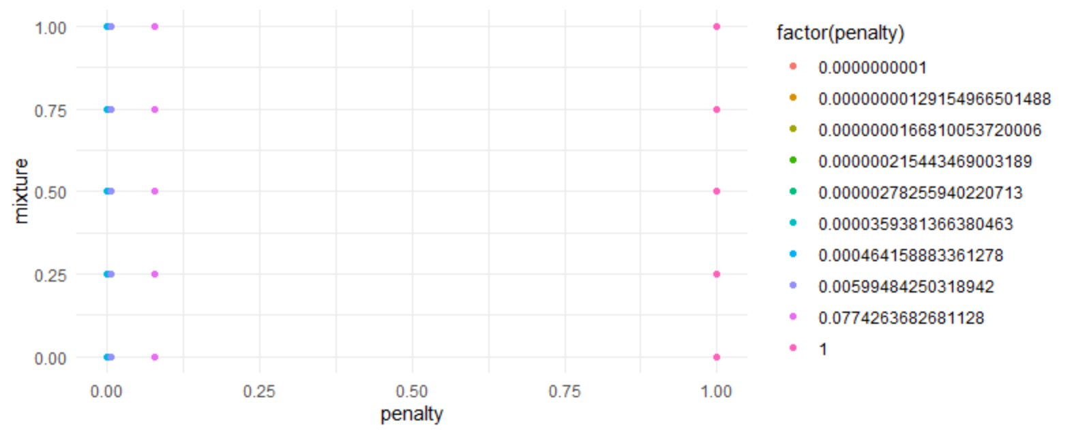
options(scipen = 999)
unique(enet_grid$penalty)
[1] 0.00000000010000 0.00000000129155 0.00000001668101 0.00000021544347
[5] 0.00000278255940 0.00003593813664 0.00046415888336 0.00599484250319
[9] 0.07742636826811 1.00000000000000
unique(enet_grid$mixture)
0.00 0.25 0.50 0.75 1.00
enet_grid %>%
ggplot(aes(penalty, mixture, color = factor(penalty))) +
geom_point()

Slide 70
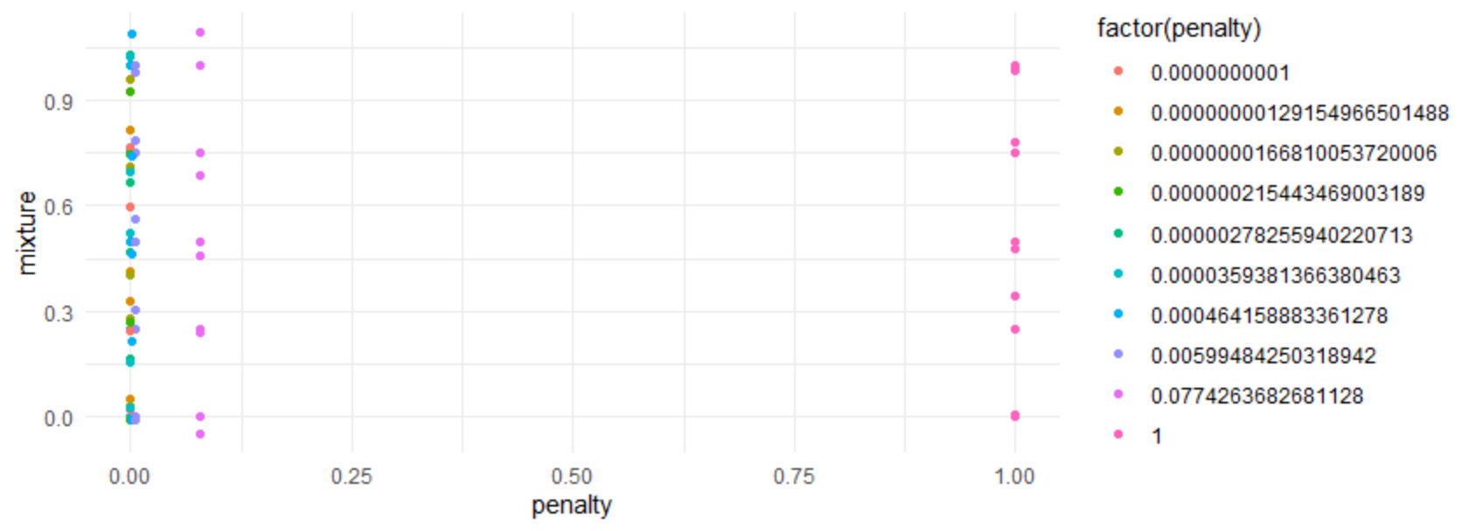
options(scipen = 999)
unique(enet_grid$penalty)
[1] 0.00000000010000 0.00000000129155 0.00000001668101 0.00000021544347
[5] 0.00000278255940 0.00003593813664 0.00046415888336 0.00599484250319
[9] 0.07742636826811 1.00000000000000
unique(enet_grid$mixture)
0.00 0.25 0.50 0.75 1.00
enet_grid %>%
ggplot(aes(penalty, mixture, color = factor(penalty))) +
geom_point() +
geom_jitter()

Slide 71
options(scipen = 999)
unique(enet_grid$penalty)
[1] 0.00000000010000 0.00000000129155 0.00000001668101 0.00000021544347
[5] 0.00000278255940 0.00003593813664 0.00046415888336 0.00599484250319
[9] 0.07742636826811 1.00000000000000
unique(enet_grid$mixture)
0.00 0.25 0.50 0.75 1.00
enet_grid %>%
ggplot(aes(penalty, mixture, color = factor(penalty))) +
geom_point()

Slide 72
Quick recap
enet_params <- parameters(penalty(), mixture())
enet_grid <- grid_regular(enet_params, levels = c(10, 5))
Make new tuned model
enet_tune_mod <- linear_reg() %>%
set_engine("glmnet") %>%
set_args(penalty = tune(),
mixture = tune())
Fit tuned model with tune_grid()
enet_tune_mod_results <- tune_grid(
enet_tune_mod,
preprocessor = penreg_rec,
resamples = cv_splits,
grid = enet_grid,
# metrics = yardstick::metric_set(rmse),
control = tune::control_resamples(verbose = TRUE,
save_pred = TRUE)
)

Slide 73
[Run the previous slide to show the verbose output]

Slide 74
Quick note
It turns out that evaluating values of penalty are cheaper than values of mixture
This is because the model simultaneously computes parameter estimates for all possible penalty values (for a fixed mixture)
So we evaluate 50 models pe fold, but only fit 5 per fold
Somehow it is able to derive all penalty values given just one (the largest). I believe it uses predict() somehow to do this. But I am unsure how, or why it works for some hyperparemeters and not others.
For example, I believe it will work with some models/packages (C5.0, earth, enet, glmboost, glmnet, lasso, rpart) and some parameters (e.g., n_trees).
Tidymodels will do this automatically (obviously I did not do this)

Slide 75
Results: Tuned elastic net regression
collect_metrics(enet_tune_mod_results)
# A tibble: 100 x 7
penalty mixture .metric .estimator mean n std_err
<dbl> <dbl> <chr> <chr> <dbl> <int> <dbl>
1 0.0000000001 0 rmse standard 102. 10 0.351
2 0.0000000001 0 rsq standard 0.229 10 0.00217
3 0.0000000001 0.25 rmse standard 101. 10 0.357
4 0.0000000001 0.25 rsq standard 0.230 10 0.00220
5 0.0000000001 0.5 rmse standard 101. 10 0.357
6 0.0000000001 0.5 rsq standard 0.230 10 0.00220
7 0.0000000001 0.75 rmse standard 101. 10 0.357
8 0.0000000001 0.75 rsq standard 0.230 10 0.00220
9 0.0000000001 1 rmse standard 101. 10 0.357
10 0.0000000001 1 rsq standard 0.230 10 0.00220
# ... with 90 more rows
50 models x 2 metrics (rmse, rsq) = 100

Slide 76
show_best()
enet_tune_mod_results %>%
show_best(metric = "rmse", n = 5)
# A tibble: 5 x 7
penalty mixture .metric .estimator mean n std_err
<dbl> <dbl> <chr> <chr> <dbl> <int> <dbl>
1 0.0000000001 0.25 rmse standard 101. 10 0.357
2 0.00000000129 0.25 rmse standard 101. 10 0.357
3 0.0000000167 0.25 rmse standard 101. 10 0.357
4 0.000000215 0.25 rmse standard 101. 10 0.357
5 0.00000278 0.25 rmse standard 101. 10 0.357

Slide 77
select_best()
tnr_enet_results %>%
select_best(metric = "rmse")
# A tibble: 1 x 2
penalty mixture
<dbl> <dbl>
1 0.0000000001 0.25

Slide 78
Final fit!
# Select best tuning parameters
enet_best <- enet_tune_mod_results %>%
select_best(metric = "rmse")
# Finalize your model using the best tuning parameters
enet_mod_final <- enet_tune_mod %>%
finalize_model(enet_best)
# Finalize your recipe using the best turning parameters
enet_rec_final <- penreg_rec %>%
finalize_recipe(enet_best)
# Run your last fit on your initial data split
enet_test_results <- last_fit(
enet_mod_final,
enet_rec_final,
split = math_split)
#Collect metrics
enet_test_results %>%
collect_metrics()
# A tibble: 2 x 3
.metric .estimator .estimate
<chr> <chr> <dbl>
1 rmse standard 101.
2 rsq standard 0.235
This will spend your test set…
SO DON’T DO THIS UNLESS YOU ARE CERTAIN
OF YOUR MODELLING PROCESS
ABSOLUTELY CERTAIN!
These are the prediction measures you can reasonably expect

Slide 79
Quick comparison
Resampled fit
show_best(enet_tune_mod_results, metric = "rmse", n = 1) %>%
bind_rows(show_best(enet_tune_mod_results, metric = "rsq", n = 1)) %>%
select(`.metric`, `.estimator`, mean)
# A tibble: 2 x 3
.metric .estimator mean
<chr> <chr> <dbl>
1 rmse standard 101.
2 rsq standard 0.230
Final fit
enet_test_results %>%
collect_metrics()
# A tibble: 2 x 3
.metric .estimator .estimate
<chr> <chr> <dbl>
1 rmse standard 101.
2 rsq standard 0.235

Slide 80

Name the package
initial_split()
set.seed(210)
math_split <- initial_split(math)

Slide 81
Name the package
training()
testing()
math_train <- training(math_split)
math_test <- testing(math_split)

Slide 82
Name the package
vfold_cv()
set.seed(210)
cv_splits <- vfold_cv(math_train)

Slide 83
Name the package
recipe()
step_*()
penreg_rec <-
recipe(
score ~ enrl_grd + econ_dsvntg + lat + lon,
data = math_train
) %>%
step_dummy(all_nominal()) %>%
step_normalize(lat, lon)

Slide 84
Name the package
linear_reg()
set_engine()
set_mode()
set_args()
mod_ridge <- linear_reg() %>%
set_engine("glmnet") %>%
set_mode("regression") %>%
set_args(penalty = .1,
mixture = 0)

Slide 85
Name the package
fit_resamples()
fit_resamples(
penreg_rec,
model = mod_ridge,
resamples = cv_splits,
metrics = yardstick::metric_set(rmse),
control = tune::control_resamples(verbose = TRUE,
save_pred = TRUE)
)

Slide 86
Name the package
tune_grid()

Slide 87
Lab 2

