Slide 1
K-nearest neighbors (KNN)
Joe Nese
Week 6, Class 1

Slide 2
Agenda
K-nearest neighbors model
regression
classification
imputation
Non-regular grids
Classification objective functions

Slide 3
K-nearest neighbors (KNN)

Slide 4
K-nearest neighbors (KNN)
To predict the outcome of a new data point:
Finds the K most similar (nearest) data points in the predictor space
Take the average (regression) or mode (classification) outcome of those K cases
A prediction is made using the training set outcomes for the neighbors (K)
KNN stores the training set data and, when predicting new samples, locates the K training set points that are in the closest proximity to the new sample

Slide 5
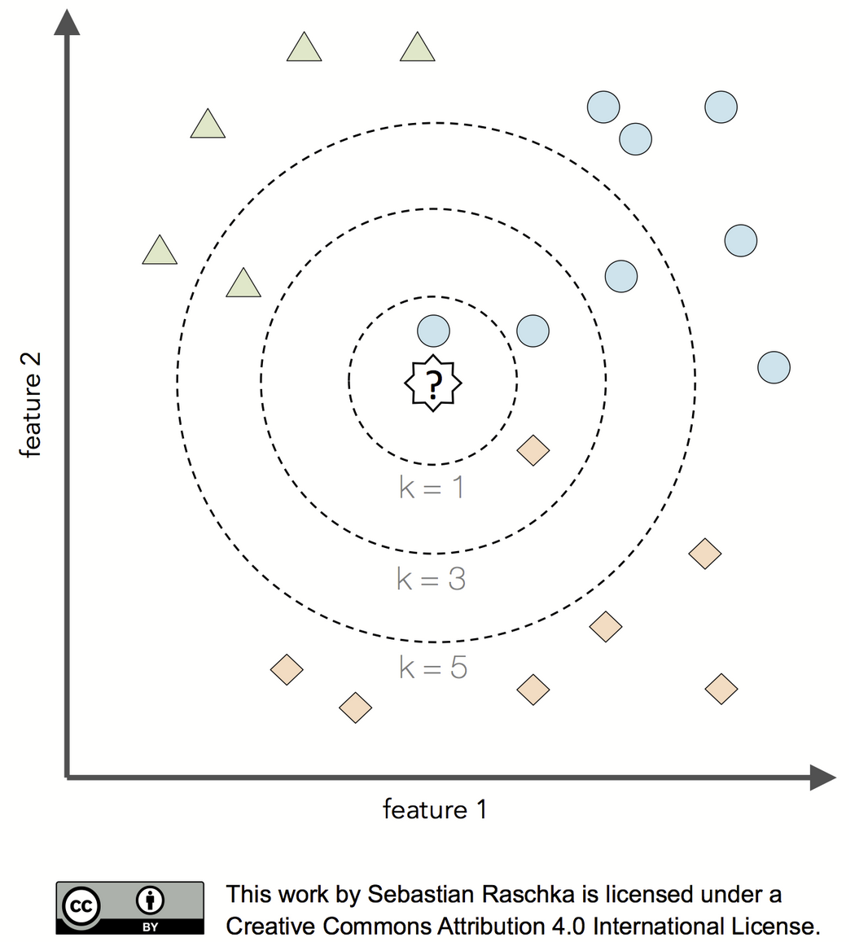

Slide 6
K-nearest neighbors (KNN)
KNN is a nonparametric method
Unlike parametric models, nonparametric models:
cannot be described by a fixed number of parameters that are being adjusted to the training set
the model structure is set a priori (and not defined by the training data)
do not assume that the data follow certain probability distributions (except Bayesian nonparametric methods)
make fewer assumptions about the data (than parametric methods)
KNN uses lazy learning (or instance-based learning)
There is no training or model fitting stage
A KNN model literally stores the training data and uses it only at prediction time
Thus, each training instance represents a parameter in KNN model
Computationally inefficient

Slide 7
K-nearest neighbors (KNN)
Feasible when the data contains more predictors than observations
Requires the predictors to be in common units because the distance between predictors are used directly
(like ridge, lasso models, elastic net, and support vector machines)

Slide 8
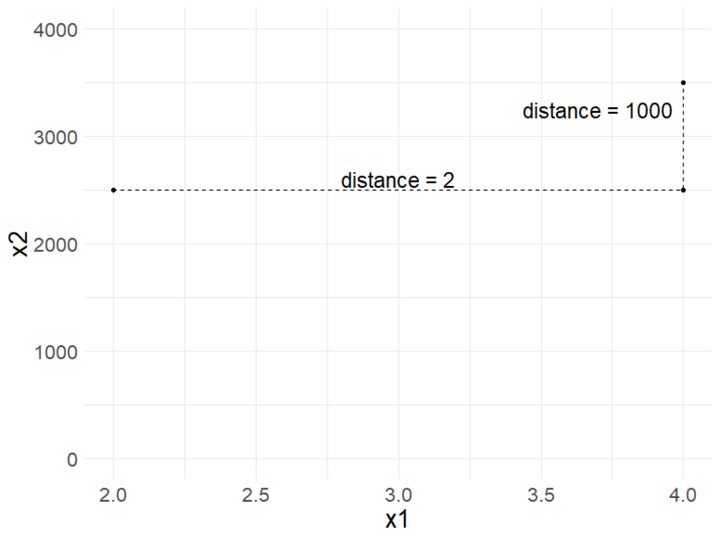
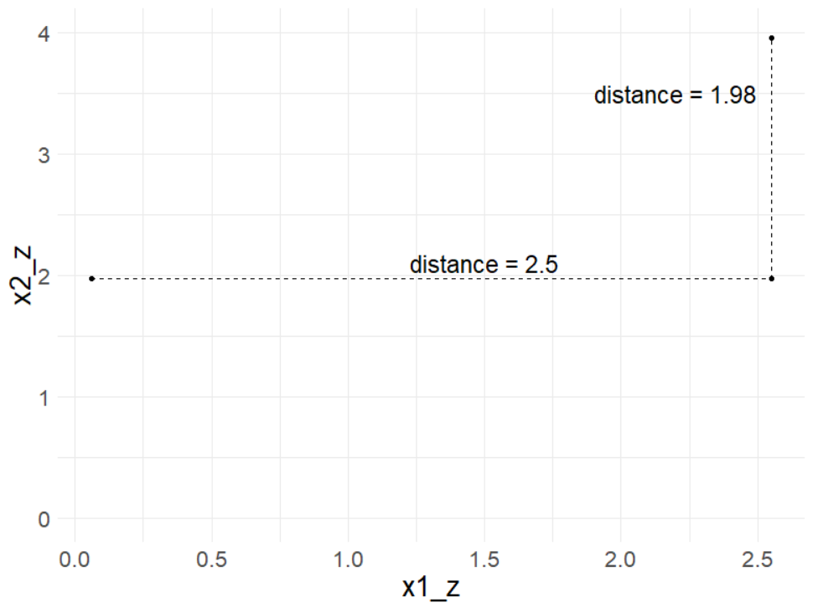
Scaling predictors

Slide 9

nearest_neighbor()
nearest_neighbor()
{parsnip} model
set_engine(“kknn”)
{kknn} is the only engine for KNN in {tidymodels}
the mode can be either regression or classification
set_mode("regression")
set_mode(“classification")
nearest_neighbor() %>%
set_engine(“kknn") %>%
set_mode(“classification")

Slide 10

nearest_neighbor() tuning parameters
?nearest_neighbor
neighbors: number of neighbors considered at each prediction
weight_func: type of kernel function that weights the distances between samples
dist_power: The parameter used when calculating the Minkowski distance
Manhattan distance with dist_power = 1
Euclidean distance with dist_power = 2

Slide 11
defaults()
“If left to their defaults here (NULL), the values are taken from the underlying model functions” from {kknn}
neighbors = 5
weight_func = “optimal”
dist_power = 2 (Euclidian)

Slide 12
neighbors
The value of K controls the bias-variance
With a small K, there is a potential for overfitting
imagine K = 1 would be very susceptible to changes in the data
low bias and high variance
smaller values of K tend to work best for high signal data with very few noisy (irrelevant) predictors
With a large K, there is a potential to underfit
too many potentially irrelevant data points are used for prediction
high bias and lower variance
larger values of K tend to work best for data with more noisy (irrelevant) predictors in order to smooth out the noise

Slide 13
How do we find the most similar (nearest) neighbors?
Two common measures of distance
Euclidian (as the crow flies)
Manhattan (city blocks)

Slide 14
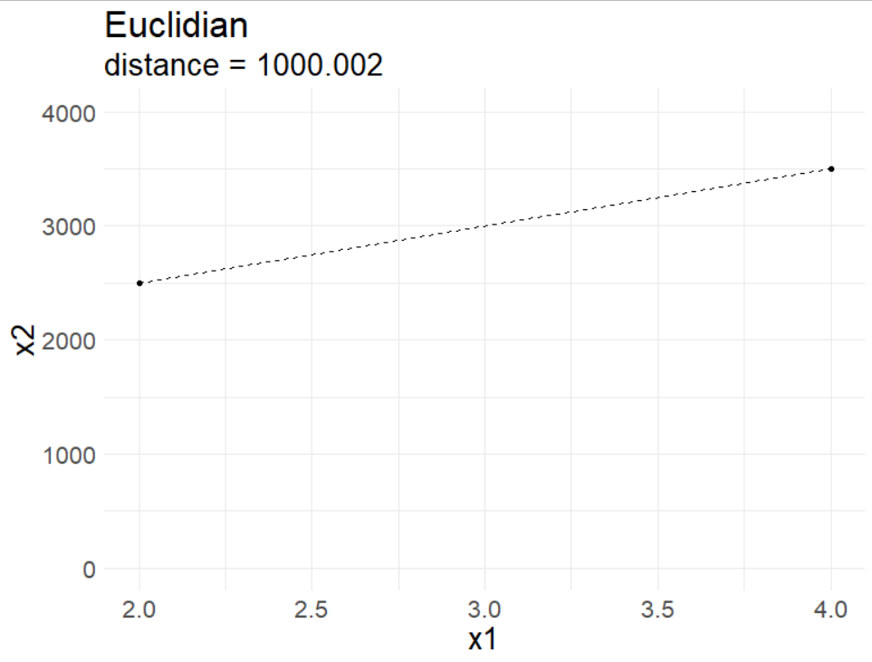
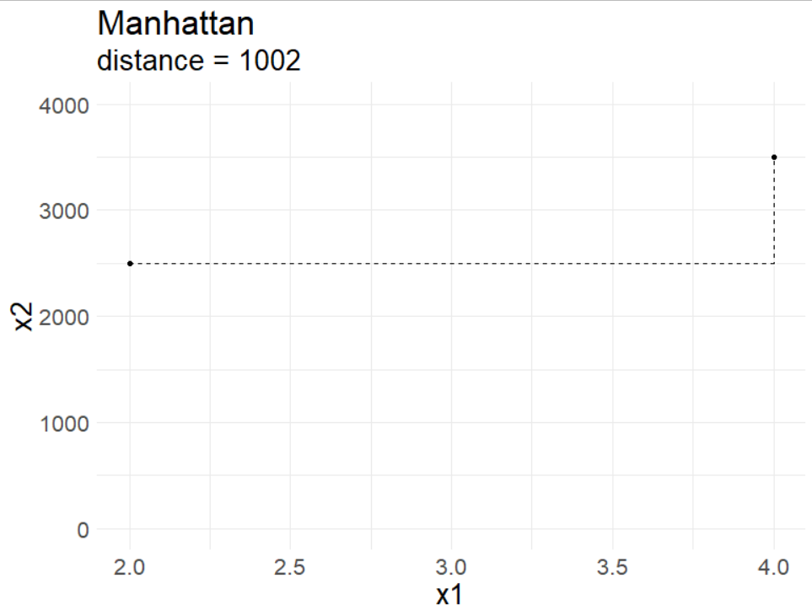
How do we find the most similar (nearest) neighbors?
Two common measures of distance:
Euclidian
Manhattan
as the crow flies
common for continuous predictors
city blocks
common for binary predictors

Slide 15

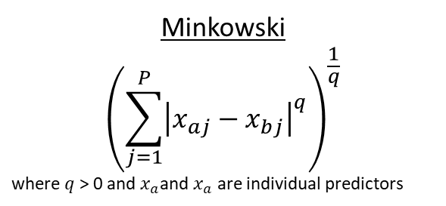



dist_power
Both Euclidian and Manhattan are special cases of Minkowski distance
Minkowski
$${\left(\sum_{j=1}^{P}{{\left|x_{aj}−x_{bj}\right|}^{q}}\right)}^{\frac{1}{q}}$$
where $q$ > 0 and $x_{a}$and $x_{a}$ are individual predictors
when $q$ = 2 we get Euclidian distance
when $q$ = 1 we get Manhattan distance
Euclidian
$${\left(\sum_{j=1}^{P}{{\left(x_{aj}−x_{bj}\right)}^{2}}\right)}^{\frac{1}{2}}$$
Manhattan
$$\left(\sum_{j=1}^{P}{\left|x_{aj}−x_{bj}\right|}\right)$$

Slide 16
weight_func
type of kernel function that weights the distances between samples
“rectangular”
“triangular”
“epanechnikov”
“biweight”
“triweight”
“cos”
“inv”
“gaussian”
“rank”
“optimal”

Slide 17
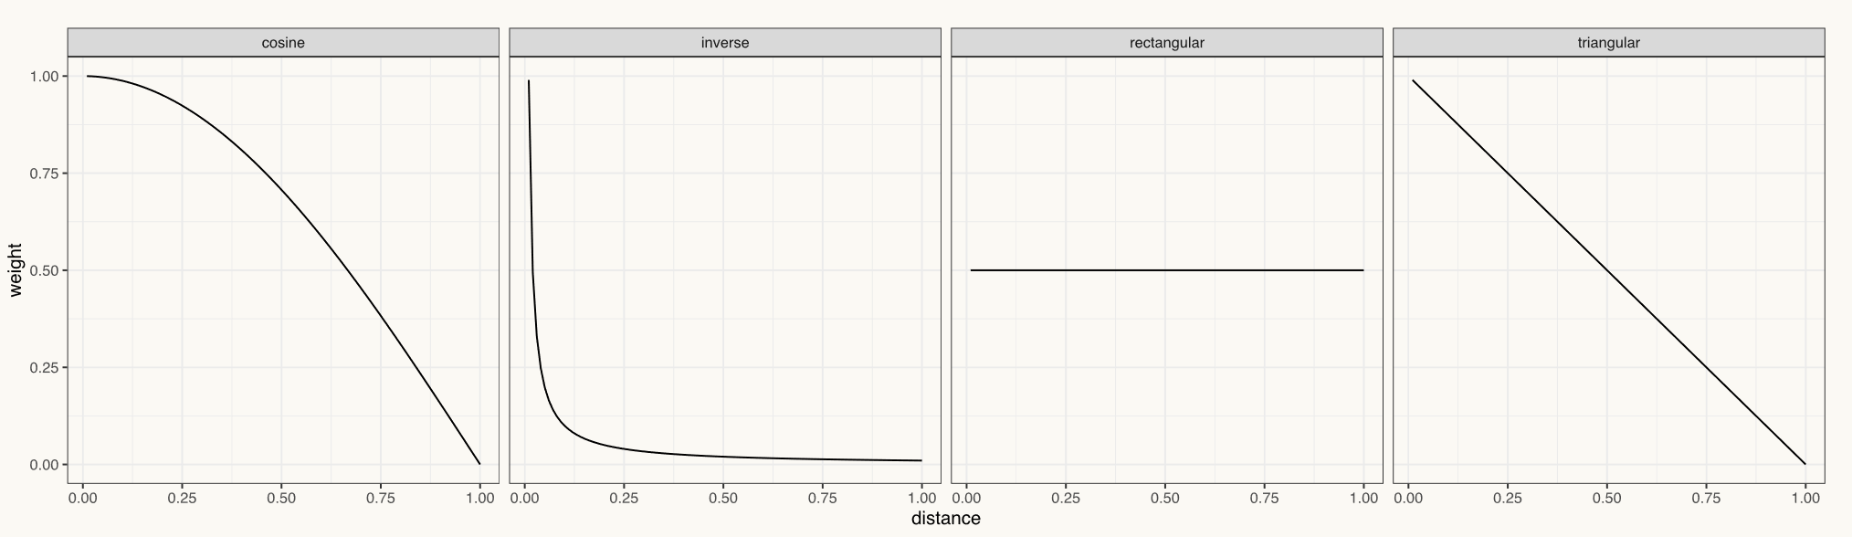
weight_func()
cosine
Slow decrease in weight as distance increases
rectangular
Uniform weight, regardless of distance
inverse
Sharp, immediate decrease in weight as distance increases, then relatively similar weight for those far away
triangular
Constant decrease in weight as distance increases

Slide 18
set.seed(3000)
math <- read_csv(here::here("data", "train.csv")) %>%
sample_frac(size = .02)
# 1 - Initial Split
set.seed(210)
math_split <- initial_split(math)
set.seed(210)
math_train <- training(math_split)
math_test <- testing(math_split)
# 2 - Resample
set.seed(210)
math_cv <- vfold_cv(math_train)

Slide 19
“Recommended preprocessing
https://www.tmwr.org/pre-proc-table.html

Slide 20
“Recommended preprocessing
https://www.tmwr.org/pre-proc-table.html
step_dummy()

Slide 21
“Recommended preprocessing
https://www.tmwr.org/pre-proc-table.html
step_zv()

Slide 22
“Recommended preprocessing
https://www.tmwr.org/pre-proc-table.html
step_bagimpute() step_modeimpute() step_impute_linear() step_lowerimpute()
step_knnimpute() step_rollimpute()
step_meanimpute() step_unknown()
step_medianimpute()

Slide 23
“Recommended preprocessing
https://www.tmwr.org/pre-proc-table.html
step_corr()

Slide 24
“Recommended preprocessing
https://www.tmwr.org/pre-proc-table.html
step_normalize()
step_center()
step_scale()

Slide 25
“Recommended preprocessing
https://www.tmwr.org/pre-proc-table.html
step_BoxCox() more…
step_YeoJohnson()
step_log()
step_sqrt()
step_inverse()

Slide 26
We’re going to fit a classification model, so let’s take a look at our outcome.
math_train %>%
tabyl(classification)
classification n percent
1 978 0.3441239
2 732 0.2575651
3 637 0.2241379
4 495 0.1741731
# Preprocess
knn1_rec <-
recipe(
classification ~ enrl_grd + lat + lon,
data = math_train
) %>%
step_mutate(classification = ifelse(classification < 3, "below", "proficient")) %>%
step_mutate(enrl_grd = factor(enrl_grd)) %>%
step_meanimpute(lat, lon) %>%
step_unknown(enrl_grd) %>%
step_dummy(enrl_grd) %>%
step_normalize(lat, lon)

Slide 27
We’re going to fit a classification model, so let’s take a look at our outcome.
math_train %>%
tabyl(classification)
classification n percent
1 973 0.3423645
2 730 0.2568614
3 631 0.2220267
4 508 0.1787474
# Preprocess
knn1_rec <-
recipe(
classification ~ enrl_grd + lat + lon,
data = math_train
) %>%
step_mutate(classification = ifelse(classification < 3, "below", "proficient")) %>%
step_mutate(enrl_grd = factor(enrl_grd)) %>%
step_meanimpute(lat, lon) %>%
step_unknown(enrl_grd) %>%
step_dummy(enrl_grd) %>%
step_normalize(lat, lon)

Slide 28
We’re going to fit a classification model, so let’s take a look at our outcome.
math_train %>%
tabyl(classification)
classification n percent
1 973 0.3423645
2 730 0.2568614
3 631 0.2220267
4 508 0.1787474
# Preprocess
knn1_rec <-
recipe(
classification ~ enrl_grd + lat + lon,
data = math_train
) %>%
step_mutate(classification = ifelse(classification < 3, "below", "proficient")) %>%
step_mutate(enrl_grd = factor(enrl_grd)) %>%
step_meanimpute(lat, lon) %>%
step_unknown(enrl_grd) %>%
step_dummy(enrl_grd) %>%
step_normalize(lat, lon)

Slide 29
We’re going to fit a classification model, so let’s take a look at our outcome.
math_train %>%
tabyl(classification)
classification n percent
1 973 0.3423645
2 730 0.2568614
3 631 0.2220267
4 508 0.1787474
# Preprocess
knn1_rec <-
recipe(
classification ~ enrl_grd + lat + lon,
data = math_train
) %>%
step_mutate(classification = ifelse(classification < 3, "below", "proficient")) %>%
step_mutate(enrl_grd = factor(enrl_grd)) %>%
step_meanimpute(lat, lon) %>%
step_unknown(enrl_grd) %>%
step_dummy(enrl_grd) %>%
step_normalize(lat, lon)

Slide 30
We’re going to fit a classification model, so let’s take a look at our outcome.
math_train %>%
tabyl(classification)
classification n percent
1 973 0.3423645
2 730 0.2568614
3 631 0.2220267
4 508 0.1787474
# Preprocess
knn1_rec <-
recipe(
classification ~ enrl_grd + lat + lon,
data = math_train
) %>%
step_mutate(classification = ifelse(classification < 3, "below", "proficient")) %>%
step_mutate(enrl_grd = factor(enrl_grd)) %>%
step_meanimpute(lat, lon) %>%
step_unknown(enrl_grd) %>%
step_dummy(enrl_grd) %>%
step_normalize(lat, lon)

Slide 31
We’re going to fit a classification model, so let’s take a look at our outcome.
math_train %>%
tabyl(classification)
classification n percent
1 973 0.3423645
2 730 0.2568614
3 631 0.2220267
4 508 0.1787474
# Preprocess
knn1_rec <-
recipe(
classification ~ enrl_grd + lat + lon,
data = math_train
) %>%
step_mutate(classification = ifelse(classification < 3, "below", "proficient")) %>%
step_mutate(enrl_grd = factor(enrl_grd)) %>%
step_meanimpute(lat, lon) %>%
step_unknown(enrl_grd) %>%
step_dummy(enrl_grd) %>%
step_normalize(lat, lon)

Slide 32
We’re going to fit a classification model, so let’s take a look at our outcome.
math_train %>%
tabyl(classification)
classification n percent
1 973 0.3423645
2 730 0.2568614
3 631 0.2220267
4 508 0.1787474
# Preprocess
knn1_rec <-
recipe(
classification ~ enrl_grd + lat + lon,
data = math_train
) %>%
step_mutate(classification = ifelse(classification < 3, "below", "proficient")) %>%
step_mutate(enrl_grd = factor(enrl_grd)) %>%
step_meanimpute(lat, lon) %>%
step_unknown(enrl_grd) %>%
step_dummy(enrl_grd) %>%
step_normalize(lat, lon)

Slide 33
We’re going to fit a classification model, so let’s take a look at our outcome.
math_train %>%
tabyl(classification)
classification n percent
1 973 0.3423645
2 730 0.2568614
3 631 0.2220267
4 508 0.1787474
# Preprocess
knn1_rec <-
recipe(
classification ~ enrl_grd + lat + lon,
data = math_train
) %>%
step_mutate(classification = ifelse(classification < 3, "below", "proficient")) %>%
step_mutate(enrl_grd = factor(enrl_grd)) %>%
step_meanimpute(lat, lon) %>%
step_unknown(enrl_grd) %>%
step_dummy(enrl_grd) %>%
step_normalize(lat, lon)

Slide 34
# 3 - Set Model
## KNN
knn1_mod <- nearest_neighbor() %>%
set_engine("kknn") %>%
set_mode(“classification")
translate(knn1_mod)
translate() will translate a model specification into a code object that is specific to a particular engine

Slide 35
# 3 - Set Model
## KNN
knn1_mod <- nearest_neighbor() %>%
set_engine("kknn") %>%
set_mode(“classification")
translate(knn1_mod)
K-Nearest Neighbor Model Specification (classification)
Computational engine: kknn
Model fit template:
kknn::train.kknn(formula = missing_arg(), data = missing_arg(),
ks = min_rows(5, data, 5))

Slide 36
min_rows()
For some tuning parameters, the range of values depend on the data dimensions. This function checks the possible range of the data and adjust them if needed (with a warning).
min_rows(num_rows, source, offset)
num_rows: set by you
data: a data frame for the data to be used in the fit
offset: number subtracted off of the number of rows available in the data

Slide 37
# 4 - Tune
## Let's run the default tuned KNN model for `neighbors`, `weight_func`, and `dist_power`
knn1_mod <- knn1_mod %>%
set_args(neighbors = tune(),
weight_func = tune(),
dist_power = tune())
translate(knn1_mod)
K-Nearest Neighbor Model Specification (classification)
Main Arguments:
neighbors = tune()
weight_func = tune()
dist_power = tune()
Computational engine: kknn
Model fit template:
kknn::train.kknn(formula = missing_arg(), data = missing_arg(),
ks = min_rows(tune(), data, 5), kernel = tune(), distance = tune())

Slide 38
Parallel Processing (quickly)
{parallel}
used for parallel processing
detectCores() will tell you how many cores you have access to
makeCluster() creates a set of copies of R running in parallel
{doParallel}
provides a parallel backend using the {parallel} package
registerDoParallel() is used to register the parallel backend with the {foreach} package
{foreach} supports parallel execution; it can execute repeated operations on multiple processors/cores on your computer, or on multiple nodes of a cluster

Slide 39
parallel::detectCores()
tic()
cl <- parallel::makeCluster(8)
doParallel::registerDoParallel(cl)
knn1_res <- tune::tune_grid(
knn1_mod,
preprocessor = knn1_rec,
resamples = math_cv,
control = tune::control_resamples(save_pred = TRUE)
)
parallel::stopCluster(cl)
toc()

Slide 40
parallel::detectCores()
tic()
cl <- parallel::makeCluster(8)
doParallel::registerDoParallel(cl)
knn1_res <- tune::tune_grid(
knn1_mod,
preprocessor = knn1_rec,
resamples = math_cv,
control = tune::control_resamples(save_pred = TRUE)
)
parallel::stopCluster(cl)
toc()

Slide 41
parallel::detectCores()
tic()
cl <- parallel::makeCluster(8)
doParallel::registerDoParallel(cl)
knn1_res <- tune::tune_grid(
knn1_mod,
preprocessor = knn1_rec,
resamples = math_cv,
control = tune::control_resamples(save_pred = TRUE)
)
parallel::stopCluster(cl)
toc()

Slide 42
parallel::detectCores()
tic()
cl <- parallel::makeCluster(8)
doParallel::registerDoParallel(cl)
knn1_res <- tune::tune_grid(
knn1_mod,
preprocessor = knn1_rec,
resamples = math_cv,
control = tune::control_resamples(save_pred = TRUE)
)
parallel::stopCluster(cl)
toc()
# without clustering: 363.86 sec elapsed
# with clustering: 63.78 sec elapsed

Slide 43
parallel::detectCores()
tic()
cl <- parallel::makeCluster(8)
doParallel::registerDoParallel(cl)
knn1_res <- tune::tune_grid(
knn1_mod,
preprocessor = knn1_rec,
resamples = math_cv,
control = tune::control_resamples(save_pred = TRUE)
)
parallel::stopCluster(cl)
toc()

Slide 44
knn1_res %>%
select(.predictions) %>%
unnest()
# A tibble: 28,420 x 9
.pred_below .pred_proficient .row neighbors weight_func dist_power .pred_class classification .config
<dbl> <dbl> <int> <int> <chr> <dbl> <fct> <fct> <chr>
1 0.634 0.366 4 10 biweight 0.805 below proficient Model01
2 0.259 0.741 5 10 biweight 0.805 proficient below Model01
3 0.677 0.323 7 10 biweight 0.805 below below Model01
4 0.726 0.274 47 10 biweight 0.805 below below Model01
5 0.740 0.260 91 10 biweight 0.805 below below Model01
6 0.663 0.337 105 10 biweight 0.805 below below Model01
7 0.527 0.473 122 10 biweight 0.805 below below Model01
8 0.739 0.261 132 10 biweight 0.805 below below Model01
9 0.280 0.720 136 10 biweight 0.805 proficient below Model01
10 0.519 0.481 138 10 biweight 0.805 below below Model01
# ... with 28,410 more rows
The first two columns represent class probabilities for our two outcome classes
The .pred_class column represents the class predicted by the model (class with highest probability)
Thus, most classification models can generate "hard" and "soft" predictions for models
The class predictions are usually created by thresholding some numeric output of the model (e.g. a class probability) or by choosing the largest value
The classification column is the observed outcome class (truth)

Slide 45
knn1_res %>%
collect_predictions()
# A tibble: 28,420 x 10
id .pred_below .pred_proficient .row neighbors weight_func dist_power .pred_class classification .config
<chr> <dbl> <dbl> <int> <int> <chr> <dbl> <fct> <fct> <chr>
1 Fold01 0.634 0.366 4 10 biweight 0.805 below proficient Model01
2 Fold01 0.259 0.741 5 10 biweight 0.805 proficient below Model01
3 Fold01 0.677 0.323 7 10 biweight 0.805 below below Model01
4 Fold01 0.726 0.274 47 10 biweight 0.805 below below Model01
5 Fold01 0.740 0.260 91 10 biweight 0.805 below below Model01
6 Fold01 0.663 0.337 105 10 biweight 0.805 below below Model01
7 Fold01 0.527 0.473 122 10 biweight 0.805 below below Model01
8 Fold01 0.739 0.261 132 10 biweight 0.805 below below Model01
9 Fold01 0.280 0.720 136 10 biweight 0.805 proficient below Model01
10 Fold01 0.519 0.481 138 10 biweight 0.805 below below Model01
# ... with 28,410 more rows

Slide 46
knn1_res %>%
collect_metrics(summarize = FALSE)
# A tibble: 200 x 8
id neighbors weight_func dist_power .metric .estimator .estimate .config
<chr> <int> <chr> <dbl> <chr> <chr> <dbl> <chr>
1 Fold01 10 biweight 0.805 accuracy binary 0.572 Model01
2 Fold01 10 biweight 0.805 roc_auc binary 0.593 Model01
3 Fold01 2 cos 1.84 accuracy binary 0.565 Model02
4 Fold01 2 cos 1.84 roc_auc binary 0.534 Model02
5 Fold01 12 epanechnikov 0.222 accuracy binary 0.565 Model03
6 Fold01 12 epanechnikov 0.222 roc_auc binary 0.568 Model03
7 Fold01 14 gaussian 0.316 accuracy binary 0.568 Model04
8 Fold01 14 gaussian 0.316 roc_auc binary 0.581 Model04
9 Fold01 5 inv 0.986 accuracy binary 0.572 Model05
10 Fold01 5 inv 0.986 roc_auc binary 0.559 Model05

Slide 47
knn1_res %>%
collect_metrics(summarize = FALSE) %>%
distinct(neighbors, weight_func, dist_power)
# A tibble: 10 x 3
neighbors weight_func dist_power
<int> <chr> <dbl>
1 10 biweight 0.805
2 2 cos 1.84
3 12 epanechnikov 0.222
4 14 gaussian 0.316
5 5 inv 0.986
6 7 optimal 1.38
7 13 rank 1.23
8 3 rectangular 1.59
9 6 triangular 1.74
10 8 triweight 0.569
There are 10 unique values because in tune_grid(), the default argument is grid = 10

Slide 48
Performance estimates
knn1_res %>%
show_best(metric = “roc_auc", n = 10)
# A tibble: 10 x 9
neighbors weight_func dist_power .metric .estimator mean n std_err .config
<int> <chr> <dbl> <chr> <chr> <dbl> <int> <dbl> <chr>
1 13 rank 1.23 roc_auc binary 0.585 10 0.0154 Model07
2 14 gaussian 0.316 roc_auc binary 0.580 10 0.0147 Model04
3 7 optimal 1.38 roc_auc binary 0.580 10 0.0111 Model06
4 10 biweight 0.805 roc_auc binary 0.579 10 0.0124 Model01
5 5 inv 0.986 roc_auc binary 0.578 10 0.0118 Model05
6 6 triangular 1.74 roc_auc binary 0.574 10 0.0119 Model09
7 12 epanechnikov 0.222 roc_auc binary 0.574 10 0.0157 Model03
8 8 triweight 0.569 roc_auc binary 0.570 10 0.00956 Model10
9 3 rectangular 1.59 roc_auc binary 0.565 10 0.0118 Model08
10 2 cos 1.84 roc_auc binary 0.559 10 0.0132 Model02

Slide 49
Performance estimates "by hand”
knn1_res$.metrics %>%
bind_rows(.id = "fold") %>%
filter(`.metric` == "roc_auc") %>%
group_by(neighbors, weight_func, dist_power) %>%
summarize(mean = mean(`.estimate`),
se = sd(`.estimate`)/sqrt(n())) %>%
arrange(desc(mean))
# A tibble: 10 x 5
# Groups: neighbors, weight_func [10]
neighbors weight_func dist_power mean se
<int> <chr> <dbl> <dbl> <dbl>
1 13 rank 1.23 0.585 0.0154
2 14 gaussian 0.316 0.580 0.0147
3 7 optimal 1.38 0.580 0.0111
4 10 biweight 0.805 0.579 0.0124
5 5 inv 0.986 0.578 0.0118
6 6 triangular 1.74 0.574 0.0119
7 12 epanechnikov 0.222 0.574 0.0157
8 8 triweight 0.569 0.570 0.00956
9 3 rectangular 1.59 0.565 0.0118
10 2 cos 1.84 0.559 0.0132

Slide 50
show_best() & select_best()
knn1_res %>%
show_best(metric = “roc_auc", n = 1)
A tibble: 1 x 9
neighbors weight_func dist_power .metric .estimator mean n std_err .config
<int> <chr> <dbl> <chr> <chr> <dbl> <int> <dbl> <chr>
1 13 rank 1.23 roc_auc binary 0.585 10 0.0154 Model07
knn1_res %>%
select_best(metric = “roc_auc")
# A tibble: 1 x 4
neighbors weight_func dist_power .config
<int> <chr> <dbl> <chr>
1 13 rank 1.23 Model07

Slide 51
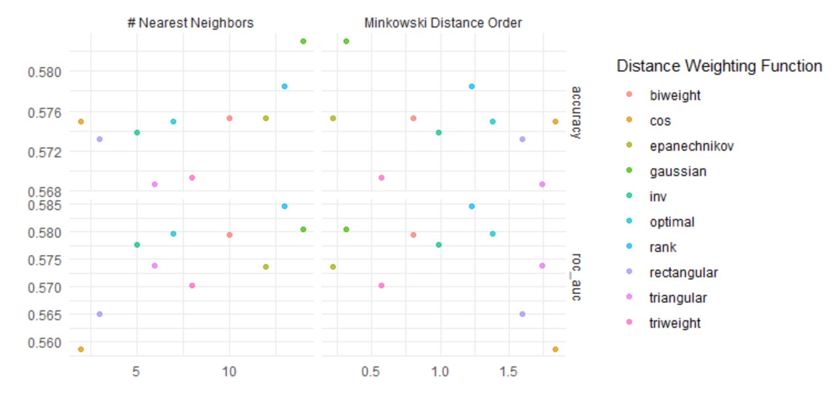
autoplot()
knn1_res %>%
autoplot()

Slide 52
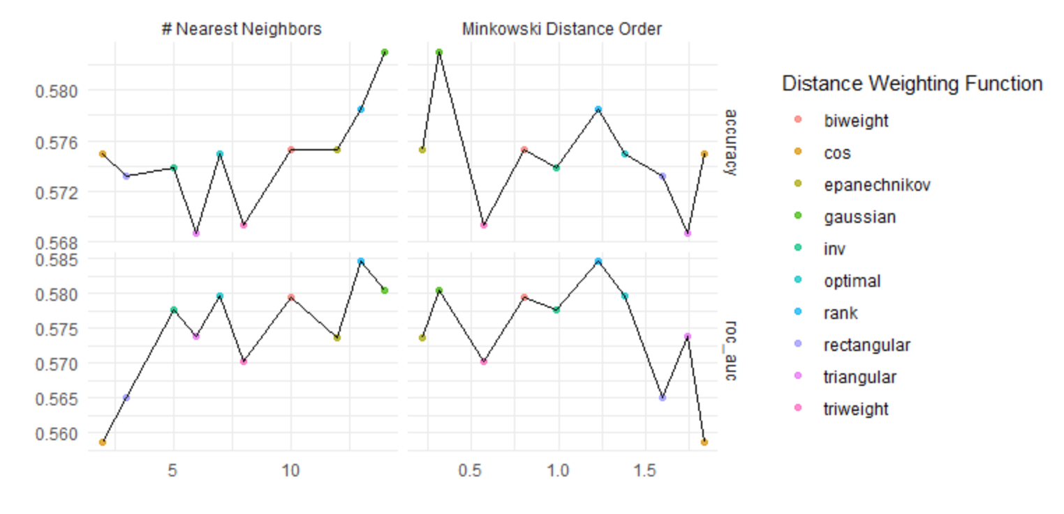
autoplot()
knn1_res %>%
autoplot() +
geom_line()

Slide 53
autoplot()
autoplot(
object,
type = c("marginals",
"parameters",
"performance"),
metric = NULL,
width = NULL,
...
)

Slide 54
autoplot()
autoplot(
object,
type = c("marginals",
"parameters",
"performance"),
metric = NULL,
width = NULL,
...
)
a tibble or results from tune_grid() or tune_bayes()

Slide 55
autoplot()
autoplot(
object,
type = c("marginals",
"parameters",
"performance"),
metric = NULL,
width = NULL,
...
)
tune_grid()
"marginals" = for a plot of each predictor versus performance "parameters“ = each parameter versus search iteration
tune_bayes()
"performance" = performance versus iteration

Slide 56
autoplot()
autoplot(
object,
type = c("marginals",
"parameters",
"performance"),
metric = NULL,
width = NULL,
...
)
which metric to plot
(default NULL is all metrics shown via facets)

Slide 57
autoplot()
autoplot(
object,
type = c("marginals",
"parameters",
"performance"),
metric = NULL,
width = NULL,
...
)
For type = "perfomance“
A number for the width of the confidence interval bars (where zero prevents them from being shown)

Slide 58
autoplot()
knn1_res %>%
autoplot()

Slide 59
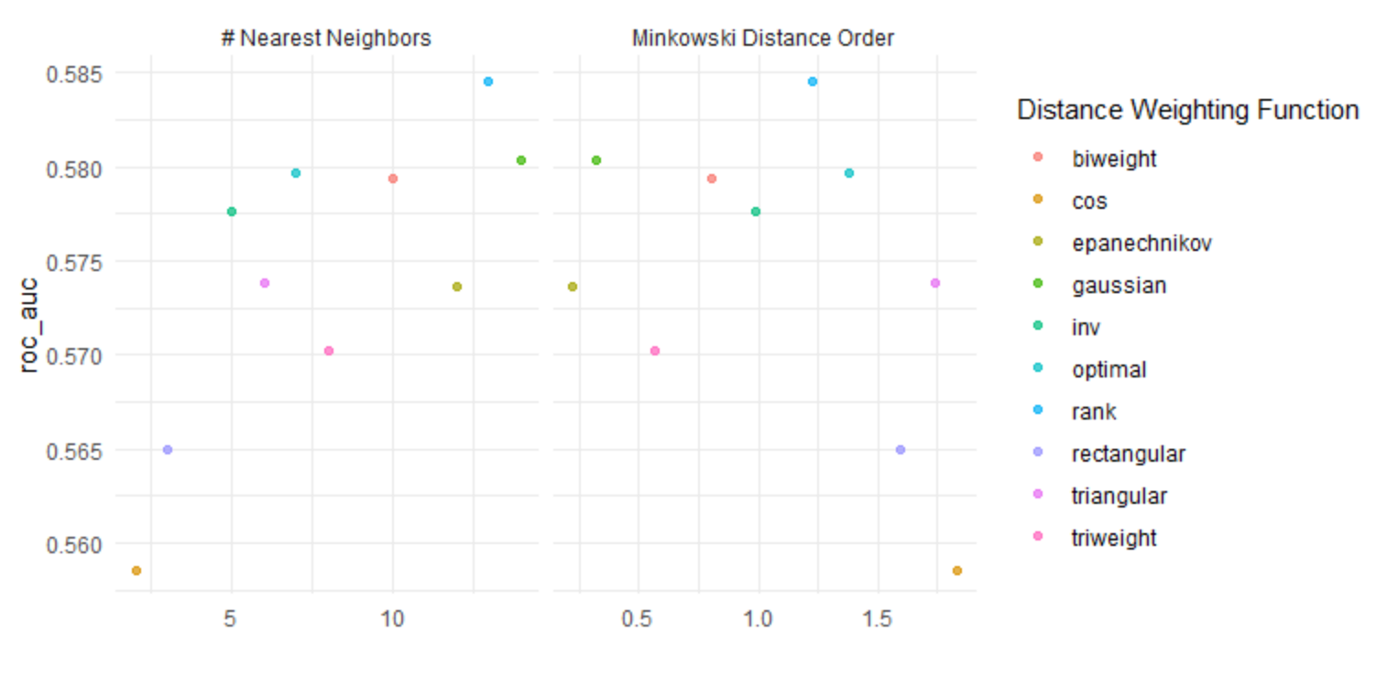
autoplot()
knn1_res %>%
autoplot(metric = “roc_auc”)

Slide 60
More grids
non-regular grids

Slide 61
Regular vs. Non-regular grids
Regular grid
a known, pre-defined set of tuning parameter values
the number of values don't have to be the same per parameter
Quantitative and qualitative parameters can be combined
As the number of parameters increases, so does the burden of dimensionality
Thought to be inefficient but not in all cases
Non-regular grids (or random grids)
define a range of possible values for each parameter and randomly sample the multidimensional space enough times to cover a reasonable amount
beneficial when there are a large number of tuning parameters and there is no a priori notion of which values should be used
A large grid may be inefficient to search, especially if the profile has a fairly stable pattern with little change over some range of the parameter
Good for neural networks and gradient boosting machines

Slide 62
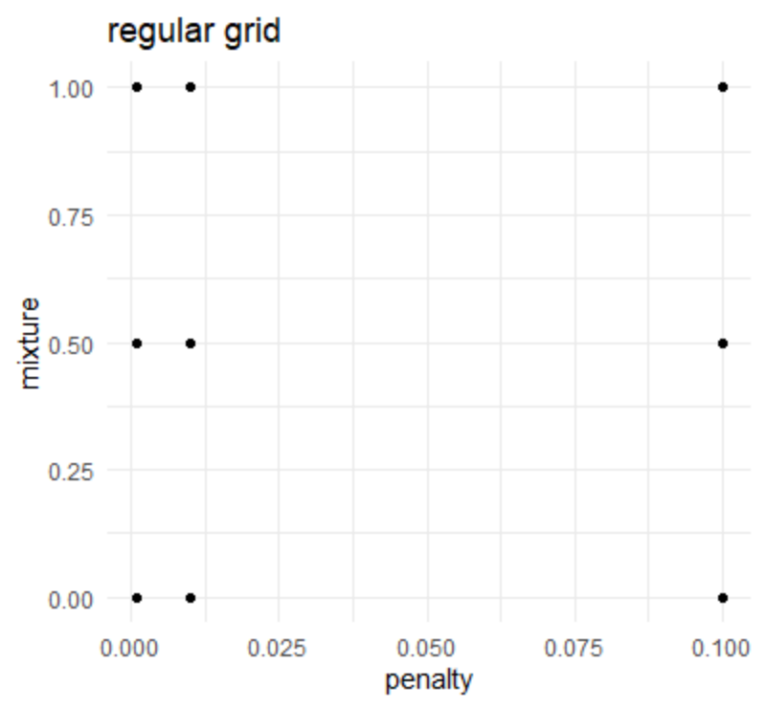
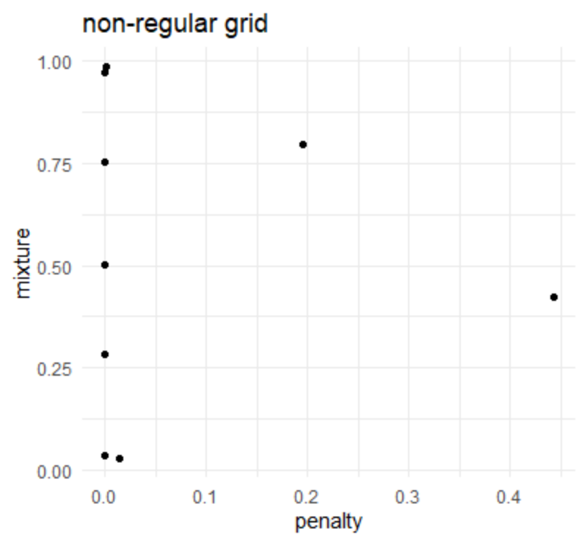

Slide 63
Regular grids

Slide 64
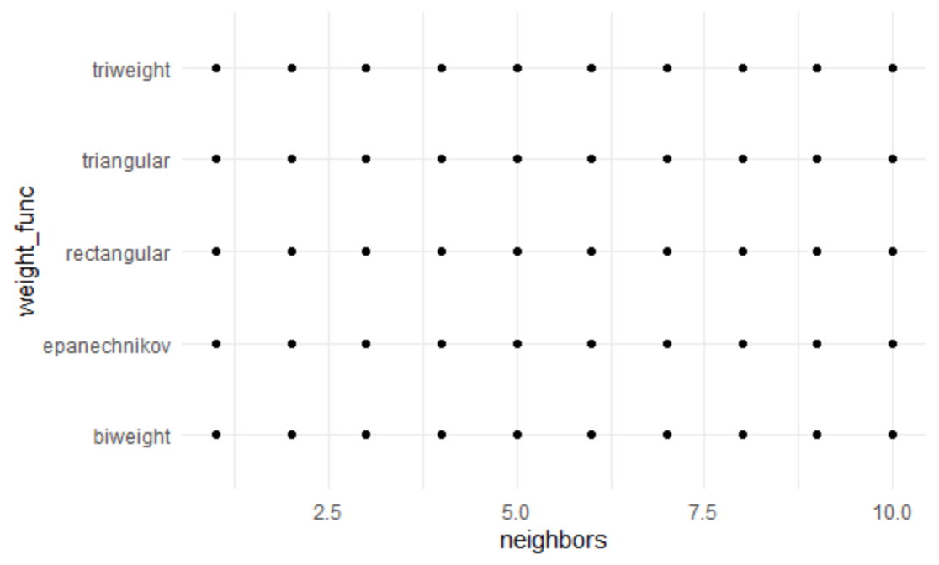
Let’s look at a regular grid
knn_params <- parameters(neighbors(), weight_func())
knn_reg_grid <- grid_regular(neighbors(), weight_func(), levels = c(15, 5))
dim(knn_reg_grid)
[1] 50 2

Slide 65
A closer look at knn_params
str(knn_params)
tibble [2 x 6] (S3: parameters/tbl_df/tbl/data.frame)
$ name : chr [1:2] "neighbors" "weight_func"
$ id : chr [1:2] "neighbors" "weight_func"
$ source : chr [1:2] "list" "list"
$ component : chr [1:2] "unknown" "unknown"
$ component_id: chr [1:2] "unknown" "unknown"
$ object :List of 2
..$ :List of 7
.. ..$ type : chr "integer"
.. ..$ range :List of 2
.. .. ..$ lower: int 1
.. .. ..$ upper: int 10
Two ways to address this

Slide 66
(1) use the arguments within the hyperparameters
?neighbors()
neighbors(range = c(1L, 10L), trans = NULL)
?weight_func()
weight_func(values = values_weight_func)
values_weight_func
"rectangular" "triangular" "epanechnikov" "biweight" "triweight" "cos" "inv" "gaussian" "rank" "optimal"
knn_params <- parameters(neighbors(range = c(1, 15)),
weight_func(values = values_weight_func[1:5]))
knn_reg_grid <- grid_regular(knn_params, levels = c(15, 5))

Slide 67
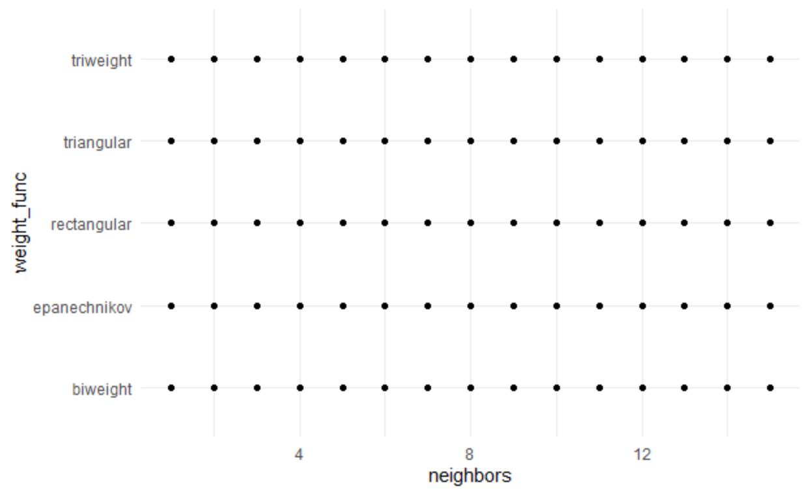
(1) use the arguments within the hyperparameters
knn_reg_grid %>%
ggplot(aes(neighbors, weight_func)) +
geom_point()

Slide 68
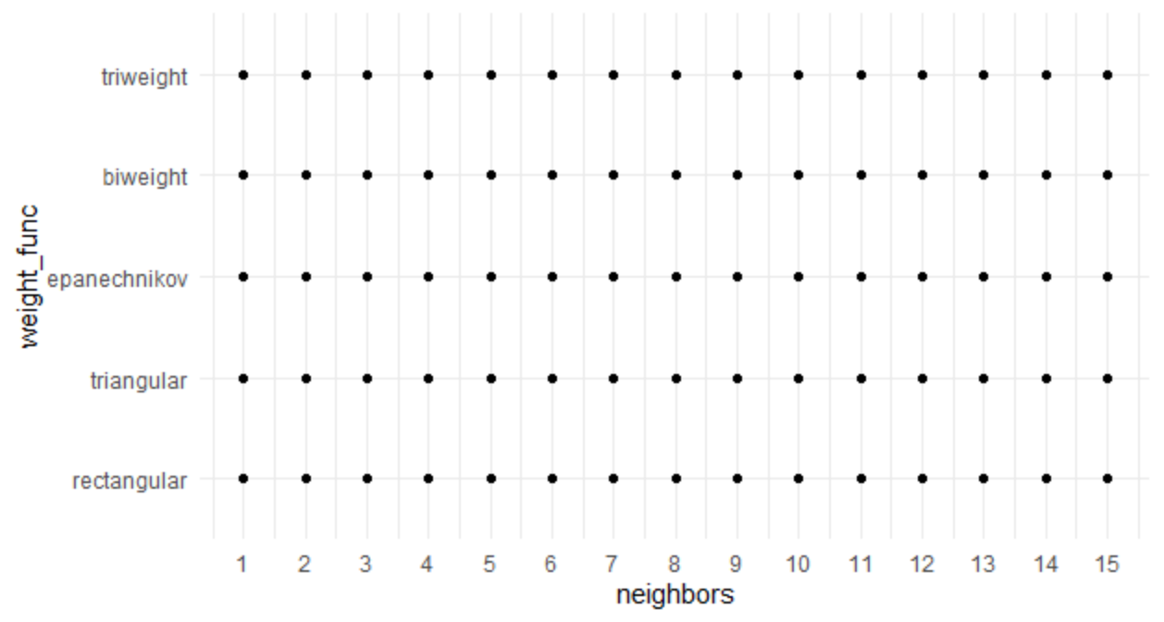
(2) Let’s make our own
Complete flexibility
knn_reg_grid_man <- expand.grid(
neighbors = c(1:15),
weight_func = values_weight_func[1:5])

Slide 69
Non-regular grids

Slide 70
Non-regular grids
There are two main methods to make non-regular grids
Random grids uniformly sample the parameter space (that might already be on a different scale)
Space-filling designs (SFD) are based on statistical experimental design principles and try to keep candidate values away from one another while encompassing the entire parameter space
There's no real downside to using SFD, so we will focus mostly on these

Slide 71

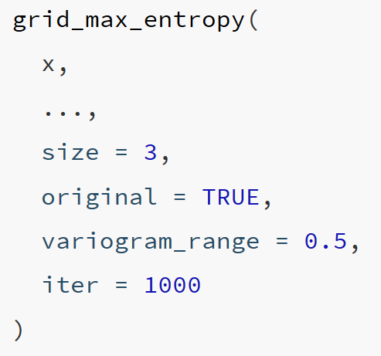
grid_max_entropy()
x : A param object, list, or parameters
... : One or more param objects (e.g., penalty()). Cannot have unknown() values in the parameter ranges or values
size: A single integer for the total number of parameter value combinations returned
original: A logical: should the parameters be in the original units or in the transformed space (if any)?
variogram_range : A numeric value greater than zero. Larger values reduce the likelihood of empty regions in the parameter space.
iter : An integer for the maximum number of iterations used to find a good design.

Slide 72
grid_max_entropy()
x : A param object, list, or parameters
... : One or more param objects (e.g., penalty()). Cannot have unknown() values in the parameter ranges or values
size: A single integer for the total number of parameter value combinations returned
original: A logical: should the parameters be in the original units or in the transformed space (if any)?
variogram_range : A numeric value greater than zero. Larger values reduce the likelihood of empty regions in the parameter space.
iter : An integer for the maximum number of iterations used to find a good design.

Slide 73
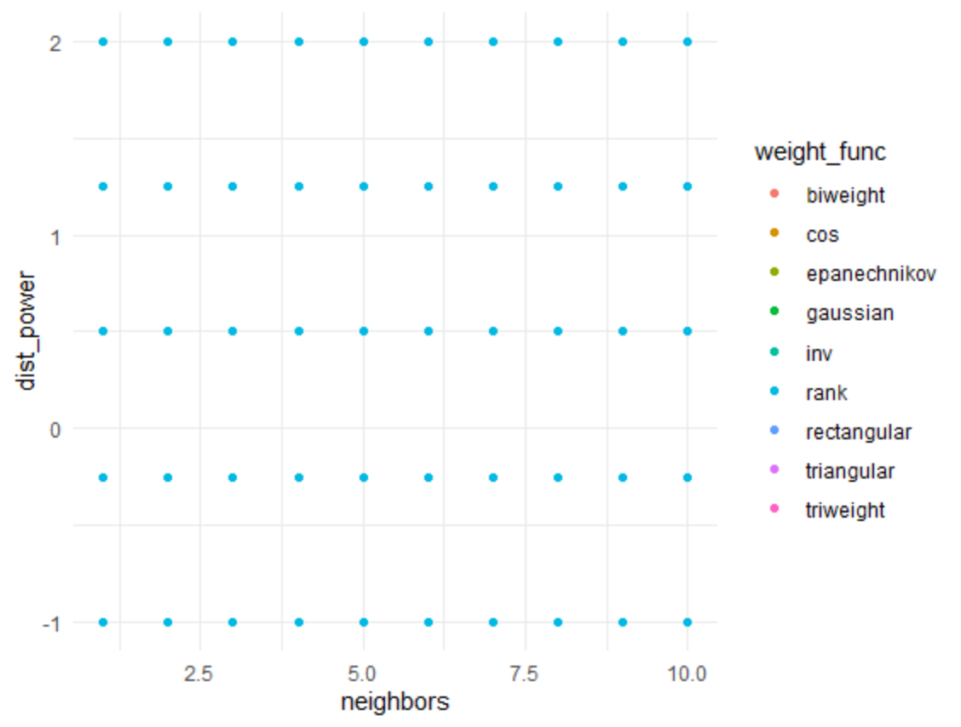
grid_regular()
knn_params <- parameters(neighbors(), weight_func(), dist_power())
knn_grid_reg <- grid_regular(knn_params, levels = c(10, 9, 5))
knn_grid_reg %>%
ggplot(aes(neighbors, dist_power)) +
geom_point(aes(color = weight_func))

Slide 74
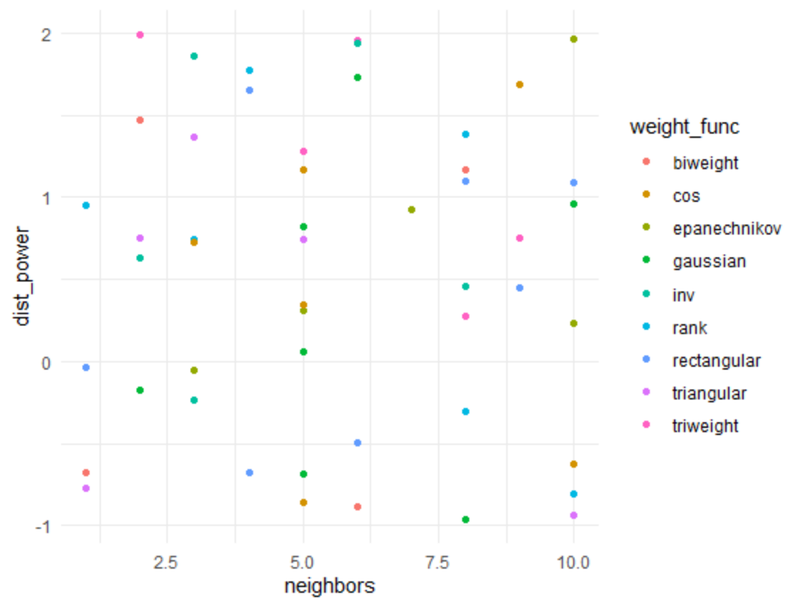
grid_max_entropy()
knn_params <- parameters(neighbors(), weight_func(), dist_power())
knn_sfd <- grid_max_entropy(knn_params, size = 50)
knn_sfd %>%
ggplot(aes(neighbors, dist_power)) +
geom_point(aes(color = weight_func))

Slide 75
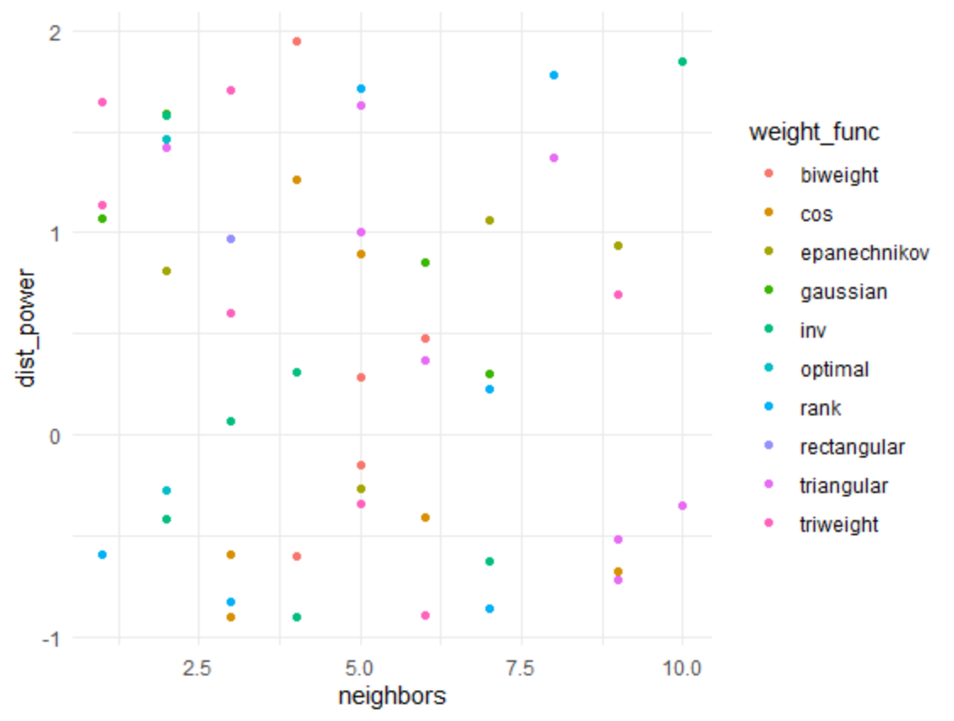
grid_random()
Uniformly samples the parameter space without taking into account the previously generated sample points
knn_grid_ran <- grid_random(knn_params, size = 50)
knn_grid_ran %>%
ggplot(aes(neighbors, dist_power)) +
geom_point(aes(color = weight_func))

Slide 76
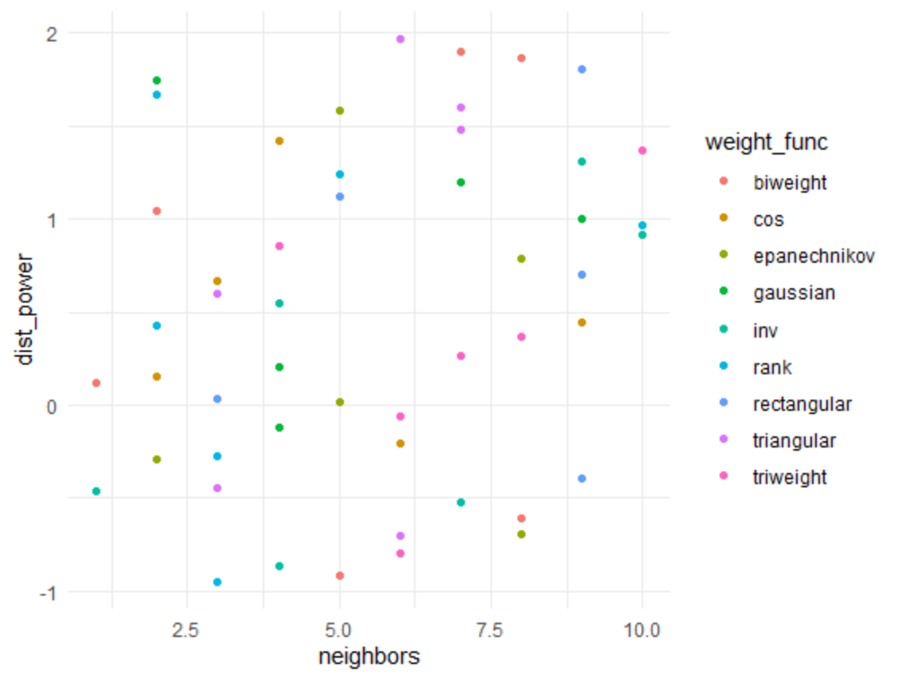
grid_latin_hypercube()
Hyperspace generalization of a Latin square (one sample in each row and each column)
knn_grid_lhs <- grid_latin_hypercube(knn_params, size = 50)
knn_grid_lhs %>%
ggplot(aes(neighbors, dist_power)) +
geom_point(aes(color = weight_func))

Slide 77
Iterative searches
grid searches
candidate values need to be pre-defined and don't learn from previous results
don't know the best values until all the computations are finished
difficult to efficiently cover the parameter space with a lot of parameters
easily optimized via parallel processing
iterative searches
builds a probability model to predict better parameters to test based on previous results
more flexible in how the parameter space is searched
less opportunities for efficiency optimizations

Slide 78
List of iterative searches
nonlinear search methods (computationally expensive)
Nelder-Mead simplex search procedure
simulated annealing
genetic algorithms
Bayesian optimization
an initial pool of samples are evaluated using grid or random search
previous parameters used as predictors and performance measure used as the outcome
Bayesian optimization process searches the grid to find the "best" new parameters to evaluate using resampling
{tune} function is tune_bayes()

Slide 79
Let’s apply to a KNN model

Slide 80
New recipe (adding predictors)
knn2_rec <-
recipe(
classification ~ enrl_grd + lat + lon + econ_dsvntg + sp_ed_fg,
data = math_train) %>%
step_mutate(classification = ifelse(classification < 3, "below", "proficient")) %>%
step_mutate(enrl_grd = factor(enrl_grd)) %>%
step_meanimpute(lat, lon) %>%
step_string2factor(econ_dsvntg, sp_ed_fg) %>%
step_unknown(enrl_grd, econ_dsvntg, sp_ed_fg) %>%
step_dummy(enrl_grd, econ_dsvntg, sp_ed_fg) %>%
step_normalize(lat, lon)
New model
knn2_mod <- nearest_neighbor() %>%
set_engine("kknn") %>%
set_mode("classification") %>%
set_args(neighbors = tune(),
dist_power = tune())

Slide 81
# Let’s make an SFD grid
knn_params <- parameters(neighbors(), dist_power())
knn_sfd <- grid_max_entropy(knn_params, size = 50)
# Tune
knn2_res <- tune::tune_grid(
knn2_mod,
preprocessor = knn1_rec,
resamples = math_cv,
grid = knn_sfd,
control = tune::control_resamples(save_pred = TRUE)
)

Slide 82
knn2_res %>%
collect_metrics()
# A tibble: 100 x 8
neighbors dist_power .metric .estimator mean n std_err .config
<int> <dbl> <chr> <chr> <dbl> <int> <dbl> <chr>
1 5 1.00 accuracy binary 0.623 10 0.0111 Model01
2 5 1.00 roc_auc binary 0.643 10 0.0134 Model01
3 2 1.02 accuracy binary 0.597 10 0.0121 Model02
4 2 1.02 roc_auc binary 0.616 10 0.0126 Model02
5 6 1.02 accuracy binary 0.622 10 0.0104 Model03
6 6 1.02 roc_auc binary 0.646 10 0.0140 Model03
7 9 1.03 accuracy binary 0.632 10 0.0115 Model04
8 9 1.03 roc_auc binary 0.658 10 0.0151 Model04
9 4 1.06 accuracy binary 0.597 10 0.0116 Model05
10 4 1.06 roc_auc binary 0.634 10 0.0127 Model05
# ... with 90 more rows

Slide 83
knn2_res %>%
show_best(metric = "roc_auc", n = 5)
# A tibble: 5 x 8
neighbors dist_power .metric .estimator mean n std_err .config
<int> <dbl> <chr> <chr> <dbl> <int> <dbl> <chr>
1 10 1.75 roc_auc binary 0.663 10 0.0154 Model39
2 10 1.07 roc_auc binary 0.662 10 0.0153 Model06
3 9 1.61 roc_auc binary 0.659 10 0.0158 Model32
4 9 1.26 roc_auc binary 0.659 10 0.0155 Model13
5 9 1.45 roc_auc binary 0.658 10 0.0157 Model22

Slide 84
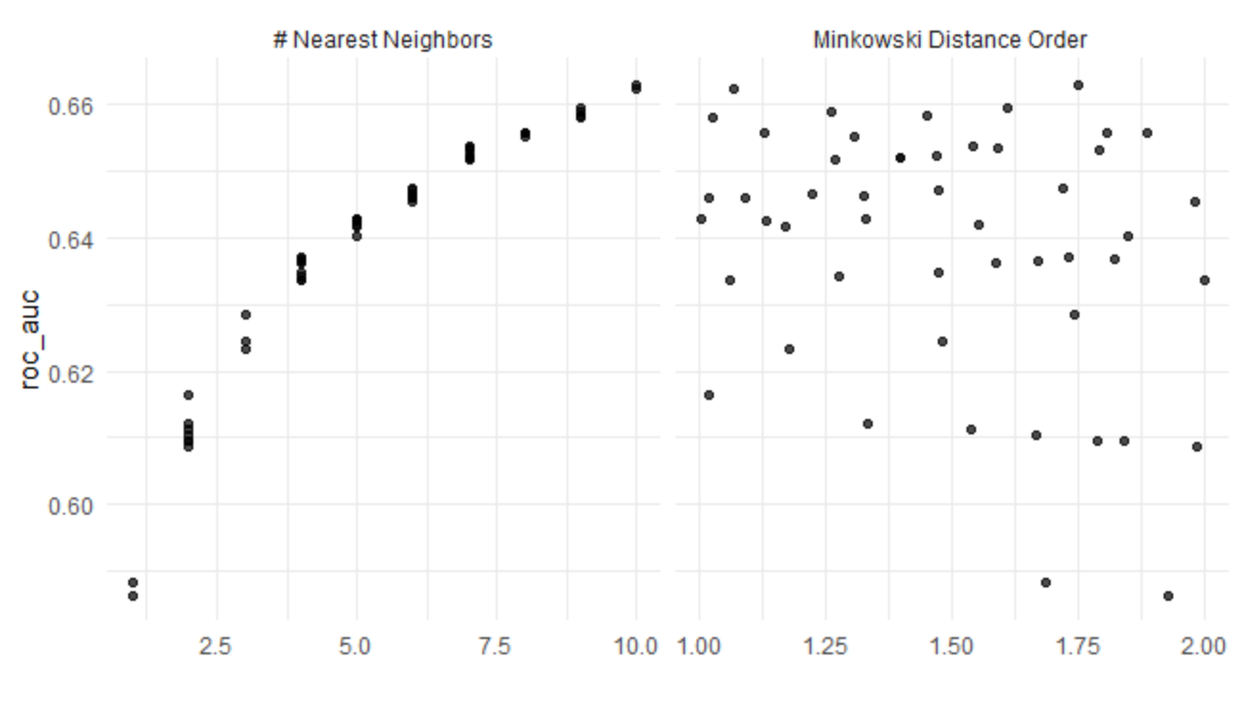
knn2_res %>%
autoplot(metric = "roc_auc")
You could argue that the fit is improving and we should add more neighbors and explore

Slide 85
compare models
knn1_res %>%
show_best(metric = "roc_auc", n = 1)
# A tibble: 1 x 9
neighbors weight_func dist_power .metric .estimator mean n std_err .config
<int> <chr> <dbl> <chr> <chr> <dbl> <int> <dbl> <chr>
1 13 rank 1.23 roc_auc binary 0.585 10 0.0154 Model07
knn2_res %>%
show_best(metric = "roc_auc", n = 1)
# A tibble: 1 x 8
neighbors dist_power .metric .estimator mean n std_err .config
<int> <dbl> <chr> <chr> <dbl> <int> <dbl> <chr>
1 10 1.75 roc_auc binary 0.663 10 0.0154 Model39

Slide 86
Final Fit
# Select best tuning parameters
knn_best <- knn2_res %>%
select_best(metric = "roc_auc")
# Finalize your model using the best tuning parameters
knn_mod_final <- knn2_mod %>%
finalize_model(knn_best)
# Finalize your recipe using the best turning parameters
knn_rec_final <- knn2_rec %>%
finalize_recipe(knn_best)

Slide 87
Final Fit
# Run your last fit on your initial data split
cl <- makeCluster(8)
registerDoParallel(cl)
knn_final_res <- last_fit(
knn_mod_final,
preprocessor = knn_rec_final,
split = math_split)
stopCluster(cl)
#Collect metrics
knn_final_res %>%
collect_metrics()
# A tibble: 2 x 3
.metric .estimator .estimate
<chr> <chr> <dbl>
1 accuracy binary 0.618
2 roc_auc binary 0.651

Slide 88
Classification objective functions

Slide 89
knn_final_res %>%
collect_predictions()
# A tibble: 947 x 6
id .pred_below .pred_proficient .row .pred_class classification
<chr> <dbl> <dbl> <int> <fct> <fct>
1 train/test split 0.223 0.777 5 proficient below
2 train/test split 0.575 0.425 6 below below
3 train/test split 1 0 7 below below
4 train/test split 0.873 0.127 8 below proficient
5 train/test split 0.244 0.756 18 proficient below
6 train/test split 0.311 0.689 19 proficient proficient
7 train/test split 0.640 0.360 27 below below
8 train/test split 0.0774 0.923 28 proficient proficient
9 train/test split 1 0 31 below below
10 train/test split 0.478 0.522 35 proficient proficient
# ... with 937 more rows
Columns 2 and 3 represent class probabilities for our two outcome classes
The .pred_class column represents the class predicted by the model (class with highest probability)
Thus, most classification models can generate "hard" and "soft" predictions for models
The class predictions are usually created by thresholding some numeric output of the model (e.g. a class probability) or by choosing the largest value
The classification column is the observed class (truth)

Slide 90
confusion matrix
knn_final_res %>%
collect_predictions() %>%
conf_mat(truth = classification, estimate = .pred_class)
Truth
Prediction below proficient
below 379 181
proficient 181 206

Slide 91
confusion matrix
knn_final_res %>%
collect_predictions() %>%
conf_mat(truth = classification, estimate = .pred_class)
Truth
Prediction below proficient
below 379 181
proficient 181 206
True Positive

Slide 92
confusion matrix
knn_final_res %>%
collect_predictions() %>%
conf_mat(truth = classification, estimate = .pred_class)
Truth
Prediction below proficient
below 379 181
proficient 181 206
True Negative

Slide 93
confusion matrix
knn_final_res %>%
collect_predictions() %>%
conf_mat(truth = classification, estimate = .pred_class)
Truth
Prediction below proficient
below 379 181
proficient 181 206
False Negative

Slide 94
confusion matrix
knn_final_res %>%
collect_predictions() %>%
conf_mat(truth = classification, estimate = .pred_class)
Truth
Prediction below proficient
below 379 181
proficient 181 206
False Positive

Slide 95
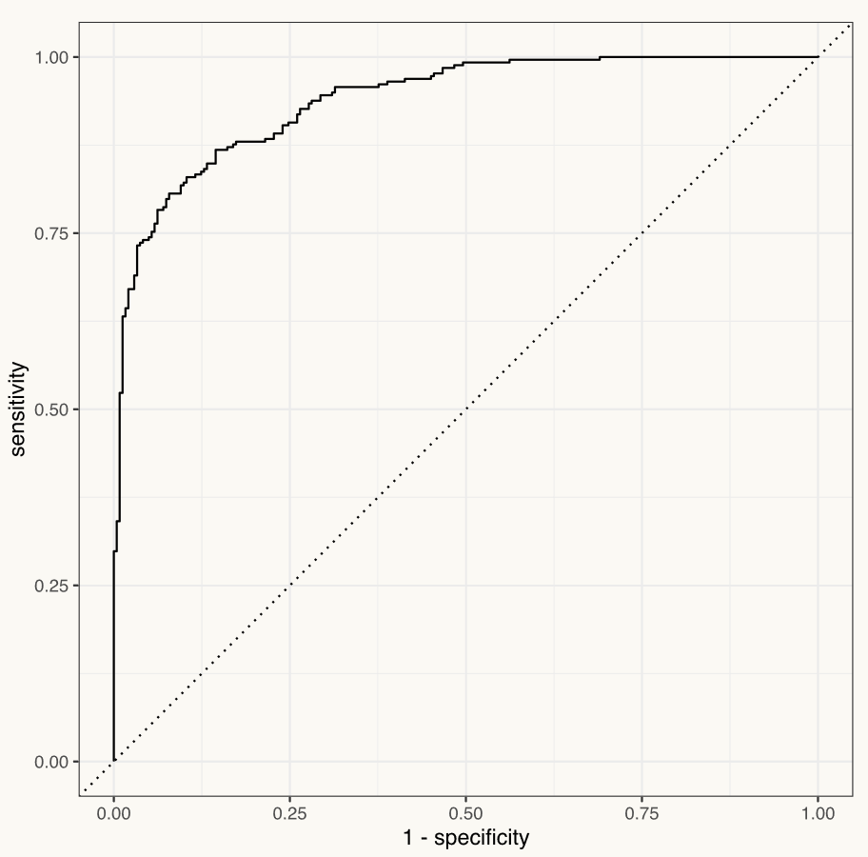
Classification objective functions
conditional measures since we need to know the true outcome
sens: true positive rate; TP / (TP + FN)
AKA: recall
1 - sensitivity = type-II error rate
spec: true negative rate: TN / (TN + FP)
1 – specificity = type-I error rate
j_index: sens + spec – 1
Youden's J statistic
roc_auc: area under the curve receiver operating characteristic curve
x-axis = 1 - spec (FPR)
y-axis = sens (TPR)

Slide 96
Classification objective functions
accuracy: percent of outcomes correctly predicted; (TP + TN)/(TP+TN+FP+FN)
suffers when there is a class imbalance
kap: Cohen’s kappa, agreement adjusted for chance
ppv: positive predictive value; TP / (TP + FP)
AKA: precision
npv: negative predictive value; TN / (FN + TN)
gain_capture: area under gain curve and above the baseline, divided by area under a perfect gain curve and above the baseline
AKA: accuracy ratio (AR), gini coefficient

Slide 97
Which to use?
Use the right criterion for your context
Are true positives more valuable than true negatives?
Sensitivity will be important
Do you want to have high confidence in predicted positives?
Precision will be important
Are all errors equal?
Accuracy will work well
There are a lot more!
f_meas combines precision and sensitivity

Slide 98
KNN for Imputation

Slide 99
Imputation
Use information and relations among non-missing predictors to provide an estimate to fill in missing values
KNN is also used in feature engineering to impute missing values
Primarily when the data is small-moderate in size
Identifies the K (complete data) samples in the training data most similar to the missing value(s)
The average value of the predictor of interest is calculated of the K closest samples and used to replace the missing value

Slide 100
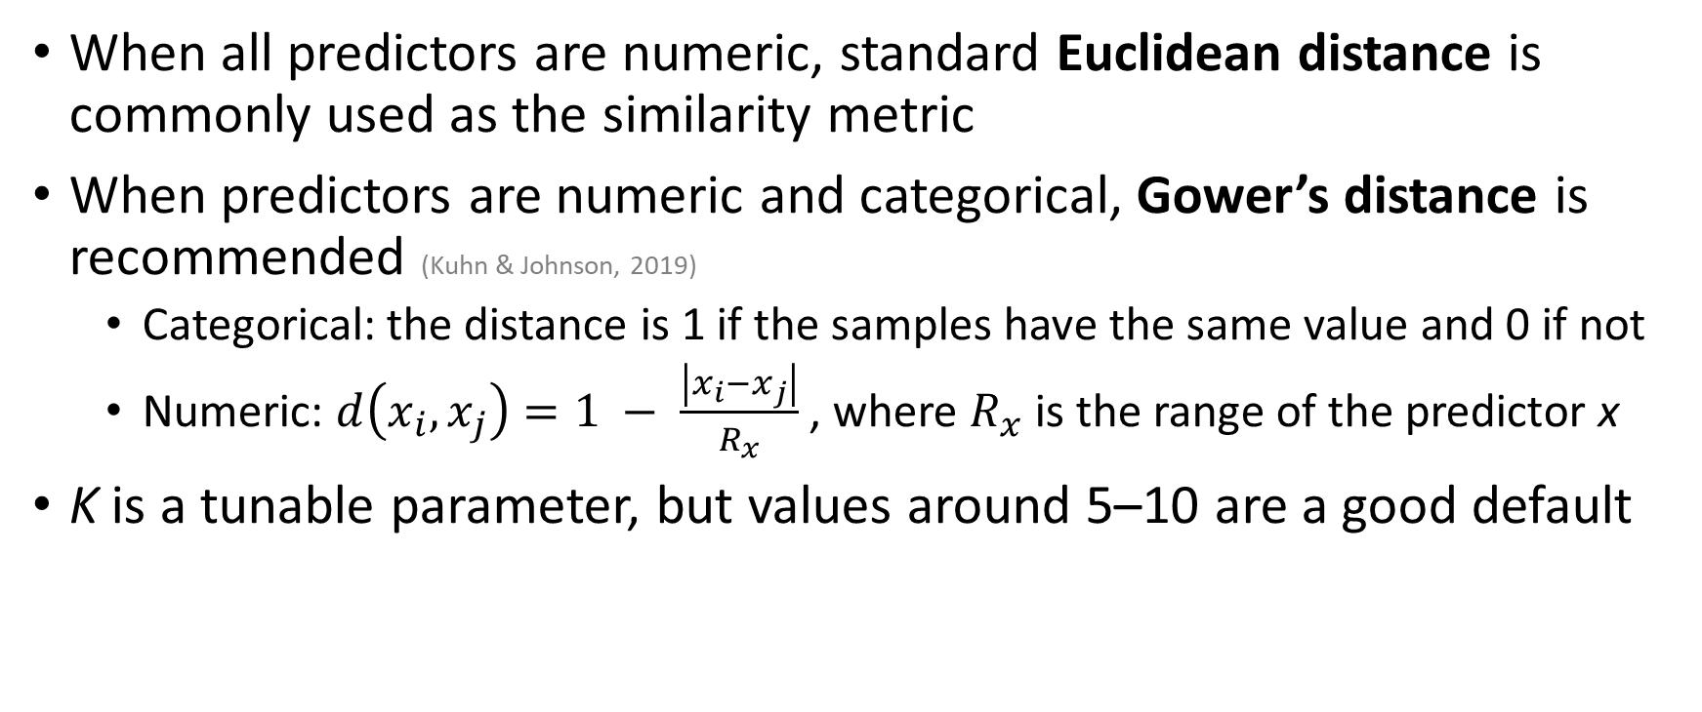
Imputation
When all predictors are numeric, standard Euclidean distance is commonly used as the similarity metric
When predictors are numeric and categorical, Gower’s distance is recommended (Kuhn & Johnson, 2019)
Categorical: the distance is 1 if the samples have the same value and 0 if not
Numeric: $d\left(x_{i},x_{j}\right)=1 − \frac{\left|x_{i}−x_{j}\right|}{R_{x}}$ , where $R_{x}$ is the range of the predictor x
K is a tunable parameter, but values around 5–10 are a good default

