Slide 1
Random Forests
Joe Nese
Week 8, Class 1

Slide 2
Agenda
Random forests
{workflows}
extract

Slide 3
Random Forests

Slide 4
Trees and Bagging
Single trees do not have great predictive accuracy
deep trees: high variance, low bias
shallow trees: high bias, low variance
Bagging trees introduces a random component by building many trees on bootstrapped copies of the training data
Bagged trees help reduce the variance compared to a single, deep tree
Bagging aggregates the predictions across all the trees
this reduces the variance of the overall procedure and results in improved predictive performance
but results in tree correlation that limits the effect of variance reduction

Slide 5
Bagging – tree correlation
Trees in a bag are not completely independent since all features are considered at every split of every tree
tree correlation: trees from different bootstrap samples generally have similar structure to each other (especially at the top of the tree) due to any underlying strong relations
prevents bagging from further reducing the variance of the base learner

Slide 6
Limited variance reduction
Suppose there is one very strong predictor in your data, along with other moderately strong predictors
In a bagged tree, most/all of the trees will use the strong predictor in the top split
all trees are quite similar
Then predictions from the bagged trees will be highly correlated
Averaging many highly correlated quantities does not lead to as large of a reduction in variance as averaging many uncorrelated quantities
This means that bagging will not lead to a substantial reduction in variance over a single tree (in this scenario)

Slide 7
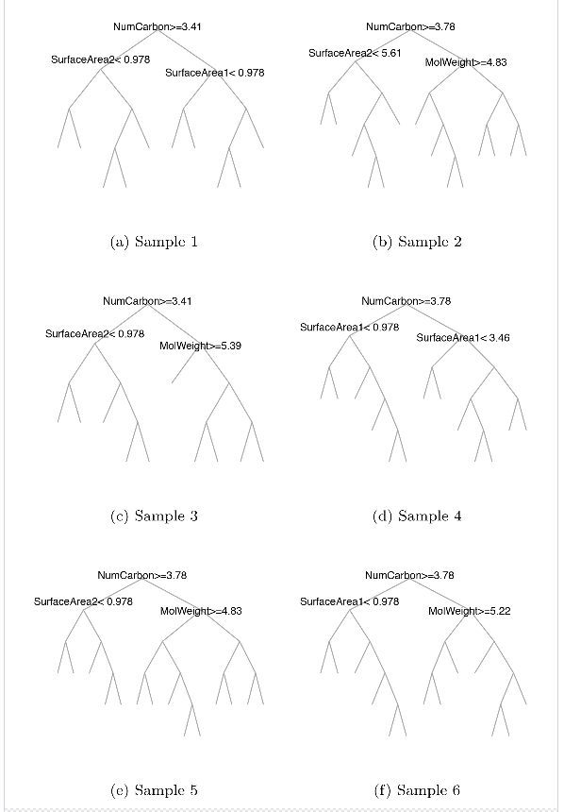
Bagged Tree
Each tree varies in structure, so predictions vary by tree
But the first splits are all very similar
Second-level splits are a bit different, but not much
So no tree is exactly the same, but they are similar and clearly correlated
So the solution is to de-correlate the trees
Kuhn & Johnson (2013)

Slide 8
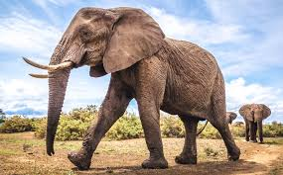
Random Forest
A random forest can reduce this variance
each tree is (more) different, and collectively their decisions will be more accurate
reduces tree correlation
Sum is greater than its parts
Credit to Allison Hill for this analogy

Slide 9
Random Forest
Bagging trees introduces a random component by building many trees on bootstrapped copies of the training data
Random forests introduce another source of randomness that helps reduce tree correlation: split-variable randomization
Each time a split is to be performed while growing a decision tree, the search for the split variable is limited to a random subset of the original p features (mtry)
Everything else about random forests works just as it did with bagging

Slide 10
Random Forest
Random Forest randomly selects a bootstrap sample to train on and a random sample of features to use at each split
a more diverse set of trees
less tree correlation (compared to bagged trees)
more predictive power
faster than bagging (smaller feature search space at each tree split)
Each tree in the ensemble is used to generate a prediction for a new sample, and these predictions are aggregated to give the forest’s prediction
Thus, Random Forests introduce two types of random variation
the bootstrapped sample
the mtry randomly selected predictors

Slide 11
Random Forest
A subset of mtry of the p features in the data is selected at random
Only these mtry features are considered for the partition at the node
Random selection of features reduces the similarity of trees grown from different bootstrap samples—even two trees grown from the same bootstrap sample will likely differ
At each split in the tree, you’re not even using a majority of the available predictors. Why?
Suppose there is one very strong predictor in your data, along with other moderately strong predictors
On average (p−mtry)/p of the splits won’t even consider the strong predictor, so other predictors will have more of a chance to appear at the root
This is “decorrelating” the trees
Which makes the average of the resulting trees more reliable

Slide 12
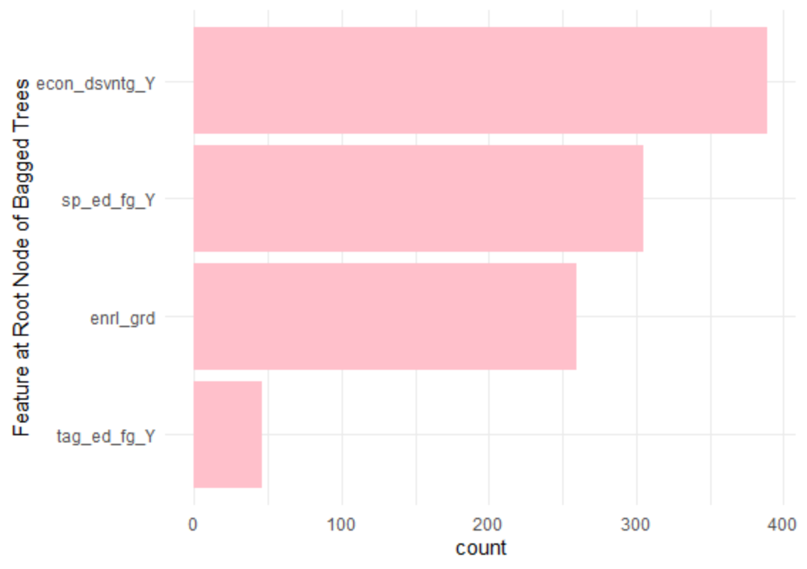
The root notes from a bagged tree with 1,000 trees (10 folds x 10 hyperparameters x 10 bootstrapped resamples)

Slide 13
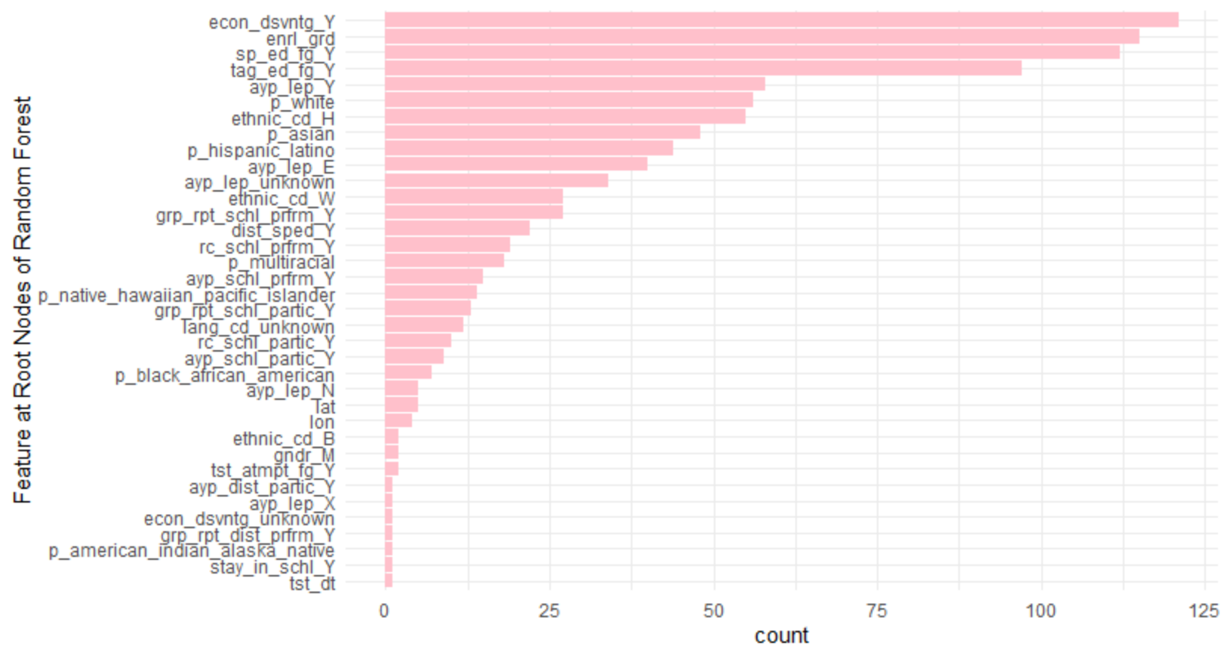
The root notes from a random forest with 1,0000 trees total (no resampling outside the forest, no tuning)

Slide 14
Random Forest algorithm
1. Given a training data set
2. Select number of trees to build (trees)
3. for i = 1 to trees do
4. | Generate a bootstrap sample of the original data
5. | Grow a regression/classification tree to the bootstrapped data
6. | for each split do
7. | | Select mtry variables at random from all p features
8. | | Pick the best variable/split-point among the mtry
9. | | Split the node into two child nodes
10. | end
11. | Use typical tree model stopping criteria min_n to determine when a tree is complete (but do not prune)
12. end
13. Output ensemble of trees
HML (Boehmke); Max & Johnson (2013)

Slide 15

rand_forest()
set_engine()
{ranger} – default
{randomForest}
set_mode()
“regression”
“classification”
default split method
regression = SSE
classification = Gini index

Slide 16
Random Forest
Tend to provide very good performance out-of-the-box
default values of tuning parameters tend to produce good result
when tuning, have the least variability in prediction accuracy among machine learning algorithms (Probst, Bischl, & Boulesteix, 2018)

Slide 17
tuning parameters
rand_forest(mtry = NULL, trees = NULL, min_n = NULL)
mtry: number of predictors that will be randomly sampled at each split when creating the tree models
trees: number of trees contained in the ensemble
min_n: minimum number of data points in a node that are required for the node to be split further

Slide 18
mtry
for data with fewer relevant predictors (e.g., noisy data) a higher mtry value tends to perform better because it is more likely to select those relevant features
for data with more relevant predictors, a lower mtry may be better
fora large number of correlated predictors, a lower mtry may be better
defaults
mtry = p/3 (regression) (Breiman, 2001)
mtry = √p (classification)
mtry = p = bagged decision trees (this is what Daniel did last class)
Suggestion: start with five evenly spaced values of mtry across the range 2–p centered at the recommended default (Boehmke, 2020; max & Johnson, 2013)

Slide 19
trees
Random forests are protected from overfitting so are not negatively affected by a large number of trees (Brieman, 2001)
trees needs to be sufficiently large to stabilize the error rate
more trees provide more robust and stable error estimates and variable importance measures
but increases computation time (linearly)
default
trees = 500
Suggestions
use at least 1,000 trees; if CV performance measures are still improving at 1,000 trees then add trees until performance levels (Max & Johnson, 2013)
start with p×10 trees and adjust as necessary (Boehmke, 2020)

Slide 20
min_n
defaults (Dı'az-Uriarte and De Andres 2006; Goldstein, Polley, and Briggs 2011)
min_n = 1 (classification)
min_n = 5 (regression)
for fewer relevant predictors (e.g., noisy data) and higher mtry values, try increasing node size (i.e., decreasing tree depth and complexity)
increasing node size will also decrease run time (and perhaps only modestly increase error estimate)
Suggestion: start with three values between 1 to 10 and adjust depending on impact to accuracy and run time (Boehmke, 2020)

Slide 21
set.seed(3000)
math <- read_csv(here::here("data", "train.csv")) %>%
select(-score) %>%
sample_frac(.04)
sheets <- readxl::excel_sheets(here::here("data", "fallmembershipreport_20192020.xlsx"))
ode_schools <- readxl::read_xlsx(here::here("data",
"fallmembershipreport_20192020.xlsx"), sheet = sheets[4])
ethnicities <- ode_schools %>%
select(attnd_schl_inst_id = `Attending School ID`,
sch_name = `School Name`,
contains("%")) %>%
janitor::clean_names()
names(ethnicities) <- gsub("x2019_20_percent", "p", names(ethnicities))
math <- left_join(math, ethnicities)

Slide 22
set.seed(3000)
math <- read_csv(here::here("data", "train.csv")) %>%
select(-score) %>%
sample_frac(.04)
sheets <- readxl::excel_sheets(here::here("data", "fallmembershipreport_20192020.xlsx"))
ode_schools <- readxl::read_xlsx(here::here("data",
"fallmembershipreport_20192020.xlsx"), sheet = sheets[4])
ethnicities <- ode_schools %>%
select(attnd_schl_inst_id = `Attending School ID`,
sch_name = `School Name`,
contains("%")) %>%
janitor::clean_names()
names(ethnicities) <- gsub("x2019_20_percent", "p", names(ethnicities))
math <- left_join(math, ethnicities)

Slide 23
set.seed(3000)
math <- read_csv(here::here("data", "train.csv")) %>%
select(-score) %>%
sample_frac(.04)
sheets <- readxl::excel_sheets(here::here("data", "fallmembershipreport_20192020.xlsx"))
ode_schools <- readxl::read_xlsx(here::here("data",
"fallmembershipreport_20192020.xlsx"), sheet = sheets[4])
ethnicities <- ode_schools %>%
select(attnd_schl_inst_id = `Attending School ID`,
sch_name = `School Name`,
contains("%")) %>%
janitor::clean_names()
names(ethnicities) <- gsub("x2019_20_percent", "p", names(ethnicities))
math <- left_join(math, ethnicities)

Slide 24
set.seed(3000)
math <- read_csv(here::here("data", "train.csv")) %>%
select(-score) %>%
sample_frac(.04)
sheets <- readxl::excel_sheets(here::here("data", "fallmembershipreport_20192020.xlsx"))
ode_schools <- readxl::read_xlsx(here::here("data",
"fallmembershipreport_20192020.xlsx"), sheet = sheets[4])
ethnicities <- ode_schools %>%
select(attnd_schl_inst_id = `Attending School ID`,
sch_name = `School Name`,
contains("%")) %>%
janitor::clean_names()
names(ethnicities) <- gsub("x2019_20_percent", "p", names(ethnicities))
math <- left_join(math, ethnicities)

Slide 25
set.seed(3000)
math <- read_csv(here::here("data", "train.csv")) %>%
select(-score) %>%
sample_frac(.04)
sheets <- readxl::excel_sheets(here::here("data", "fallmembershipreport_20192020.xlsx"))
ode_schools <- readxl::read_xlsx(here::here("data",
"fallmembershipreport_20192020.xlsx"), sheet = sheets[4])
ethnicities <- ode_schools %>%
select(attnd_schl_inst_id = `Attending School ID`,
sch_name = `School Name`,
contains("%")) %>%
janitor::clean_names()
names(ethnicities) <- gsub("x2019_20_percent", "p", names(ethnicities))
math <- left_join(math, ethnicities)

Slide 26
set.seed(3000)
math <- read_csv(here::here("data", "train.csv")) %>%
select(-score) %>%
sample_frac(.04)
sheets <- readxl::excel_sheets(here::here("data", "fallmembershipreport_20192020.xlsx"))
ode_schools <- readxl::read_xlsx(here::here("data",
"fallmembershipreport_20192020.xlsx"), sheet = sheets[4])
ethnicities <- ode_schools %>%
select(attnd_schl_inst_id = `Attending School ID`,
sch_name = `School Name`,
contains("%")) %>%
janitor::clean_names()
names(ethnicities) <- gsub("x2019_20_percent", "p", names(ethnicities))
math <- left_join(math, ethnicities)

Slide 27
# Split and Resample
set.seed(3000)
math_split <- initial_split(math, strata = "classification")
set.seed(3000)
math_train <- training(math_split)
math_test <- testing(math_split)
set.seed(3000)
math_cv <- vfold_cv(math_train, strata = "classification")

Slide 28
# Split and Resample
set.seed(3000)
math_split <- initial_split(math, strata = "classification")
set.seed(3000)
math_train <- training(math_split)
math_test <- testing(math_split)
set.seed(3000)
math_cv <- vfold_cv(math_train, strata = "classification")

Slide 29
# Split and Resample
set.seed(3000)
math_split <- initial_split(math, strata = "classification")
set.seed(3000)
math_train <- training(math_split)
math_test <- testing(math_split)
set.seed(3000)
math_cv <- vfold_cv(math_train, strata = "classification")

Slide 30
# Recipe
rf_rec <- recipe(classification ~ ., math_train) %>%
step_mutate(tst_dt = lubridate::mdy_hms(tst_dt)) %>%
step_mutate(classification = factor(recode(classification,
`1` = "wellbelow",
`2` = "below",
`3` = "above",
`4` = "wellabove"))) %>%
step_rm(contains("bnch")) %>%
update_role(contains("id"), ncessch, sch_name, new_role = "id") %>%
step_novel(all_nominal(), -all_outcomes()) %>%
step_unknown(all_nominal(), -all_outcomes()) %>%
step_medianimpute(all_numeric()) %>%
step_nzv(all_predictors(), freq_cut = 0, unique_cut = 0) %>%
step_dummy(all_nominal(), -has_role(match = "id"), -all_outcomes()) %>%
step_nzv(all_predictors())

Slide 31
prep(rf_rec)
Data Recipe
Inputs:
role #variables
id 7
outcome 1
predictor 39
Training data contained 5684 data points and 5684 incomplete rows.
Operations:
Variable mutation for tst_dt [trained]
Variable mutation for classification [trained]
Variables removed tst_bnch [trained]
Novel factor level assignment for gndr, ethnic_cd, migrant_ed_fg, ... [trained]
Unknown factor level assignment for gndr, ethnic_cd, migrant_ed_fg, ... [trained]
Median Imputation for id, attnd_dist_inst_id, ... [trained]
Sparse, unbalanced variable filter removed calc_admn_cd [trained]
Dummy variables from gndr, ethnic_cd, migrant_ed_fg, ind_ed_fg, ... [trained]
Sparse, unbalanced variable filter removed 83 items [trained]

Slide 32
# Default Model
# mtry = floor(sqrt(p))= floor(sqrt(39))= 6
# trees = 500 (num.trees)
# min_n = 1 (min.node.size)

Slide 33
# Default Model
# mtry = floor(sqrt(p))= floor(sqrt(39))= 6
# trees = 500 (num.trees)
# min_n = 1 (min.node.size)
(cores <- parallel::detectCores())
8

Slide 34
# Default Model
# mtry = floor(sqrt(p))= floor(sqrt(39))= 6
# trees = 500 (num.trees)
# min_n = 1 (min.node.size)
(cores <- parallel::detectCores())
8
rf_def_mod <-
rand_forest() %>%
set_engine("ranger",
num.threads = cores, #argument from {ranger}
importance = "permutation", #argument from {ranger}
verbose = TRUE) %>% #argument from {ranger}
set_mode("classification")

Slide 35
# Default Model
# mtry = floor(sqrt(p))= floor(sqrt(39))= 6
# trees = 500 (num.trees)
# min_n = 1 (min.node.size)
(cores <- parallel::detectCores())
8
rf_def_mod <-
rand_forest() %>%
set_engine("ranger",
num.threads = cores, #argument from {ranger}
importance = "permutation", #argument from {ranger}
verbose = TRUE) %>% #argument from {ranger}
set_mode("classification")

Slide 36
# Default Model
# mtry = floor(sqrt(p))= floor(sqrt(39))= 6
# trees = 500 (num.trees)
# min_n = 1 (min.node.size)
(cores <- parallel::detectCores())
8
rf_def_mod <-
rand_forest() %>%
set_engine("ranger",
num.threads = cores, #argument from {ranger}
importance = "permutation", #argument from {ranger}
verbose = TRUE) %>% #argument from {ranger}
set_mode("classification")

Slide 37
# Default Model
# mtry = floor(sqrt(p))= floor(sqrt(39))= 6
# trees = 500 (num.trees)
# min_n = 1 (min.node.size)
(cores <- parallel::detectCores())
8
rf_def_mod <-
rand_forest() %>%
set_engine("ranger",
num.threads = cores, #argument from {ranger}
importance = "permutation", #argument from {ranger}
verbose = TRUE) %>% #argument from {ranger}
set_mode("classification")

Slide 38
# Default Model
# mtry = floor(sqrt(p))= floor(sqrt(39))= 6
# trees = 500 (num.trees)
# min_n = 1 (min.node.size)
(cores <- parallel::detectCores())
8
rf_def_mod <-
rand_forest() %>%
set_engine("ranger",
num.threads = cores, #argument from {ranger}
importance = "permutation", #argument from {ranger}
verbose = TRUE) %>% #argument from {ranger}
set_mode("classification")

Slide 39
# Default Model
# mtry = floor(sqrt(p))= floor(sqrt(39))= 6
# trees = 500 (num.trees)
# min_n = 1 (min.node.size)
(cores <- parallel::detectCores())
8
rf_def_mod <-
rand_forest() %>%
set_engine("ranger",
num.threads = cores, #argument from {ranger}
importance = "permutation", #argument from {ranger}
verbose = TRUE) %>% #argument from {ranger}
set_mode("classification")

Slide 40
# Default Model
# mtry = floor(sqrt(p))= floor(sqrt(39))= 6
# trees = 500 (num.trees)
# min_n = 1 (min.node.size)
(cores <- parallel::detectCores())
8
rf_def_mod <-
rand_forest() %>%
set_engine("ranger",
num.threads = cores, #argument from {ranger}
importance = "permutation", #argument from {ranger}
verbose = TRUE) %>% #argument from {ranger}
set_mode("classification")

Slide 41
# Default Model
rf_def_mod <-
rand_forest() %>%
set_engine("ranger",
num.threads = cores, #argument from {ranger}
importance = "permutation", #argument from {ranger}
verbose = TRUE) %>% #argument from {ranger}
set_mode("classification")
translate(rf_def_mod)
Random Forest Model Specification (classification)
Engine-Specific Arguments:
num.threads = cores
importance = permutation
verbose = TRUE
Computational engine: ranger
Model fit template:
ranger::ranger(x = missing_arg(), y = missing_arg(), case.weights = missing_arg(),
num.threads = cores, importance = "permutation", verbose = TRUE,
seed = sample.int(10^5, 1), probability = TRUE)

Slide 42
# Tuned Model
# mtry = tune()
# trees = 1000
# min_n = tune()
rf_tune_mod <- rf_def_mod %>%
set_args(
mtry = tune(),
trees = 1000,
min_n = tune()
)

Slide 43
# Tuned Model
# mtry = tune()
# trees = 1000
# min_n = tune()
rf_tune_mod <- rf_def_mod %>%
set_args(
mtry = tune(),
trees = 1000,
min_n = tune()
)

Slide 44
# Tuned Model
rf_tune_mod <- rf_def_mod %>%
set_args(
mtry = tune(),
trees = 1000,
min_n = tune()
)
translate(rf_tune_mod)
Random Forest Model Specification (classification)
Main Arguments:
mtry = tune()
trees = 1000
min_n = tune()
Engine-Specific Arguments:
num.threads = cores
importance = permutation
verbose = TRUE
Computational engine: ranger
Model fit template:
ranger::ranger(x = missing_arg(), y = missing_arg(), case.weights = missing_arg(),
mtry = min_cols(~tune(), x), num.trees = 1000, min.node.size = min_rows(~tune(), x),
num.threads = cores, importance = "permutation",
verbose = TRUE, seed = sample.int(10^5, 1), probability = TRUE)

Slide 45
{workflows}
quick detour

Slide 46

{workflows}
Basically a bundle for your parsnip model and recipe
Advantages
You don’t have to keep track of separate objects in your workspace
The recipe prepping and model fitting can be executed using a single call to fit()
If you have custom tuning parameter settings, these can be defined using a simpler interface when combined with tune
In the future, workflows will be able to add post-processing operations, such as modifying the probability cutoff for two-class models

Slide 47
workflows
Last week we had code like this:
rec <- recipe(accuracy_group ~ ., data = train) %>%
step_mutate(accuracy_group = as.factor(accuracy_group))
mod_random1 <- decision_tree() %>%
set_mode("classification") %>%
set_engine("rpart") %>%
set_args(cost_complexity = 0.01, min_n = 5)
m01 <- fit(mod_random1, accuracy_group ~ ., prep(rec) %>% juice())

Slide 48
workflows
Last week we had code like this:
rec <- recipe(accuracy_group ~ ., data = train) %>%
step_mutate(accuracy_group = as.factor(accuracy_group))
mod_random1 <- decision_tree() %>%
set_mode("classification") %>%
set_engine("rpart") %>%
set_args(cost_complexity = 0.01, min_n = 5)
m01 <- fit(mod_random1, accuracy_group ~ ., prep(rec) %>% juice())

Slide 49
workflows
Last week we had code like this:
rec <- recipe(accuracy_group ~ ., data = train) %>%
step_mutate(accuracy_group = as.factor(accuracy_group))
mod_random1 <- decision_tree() %>%
set_mode("classification") %>%
set_engine("rpart") %>%
set_args(cost_complexity = 0.01, min_n = 5)
m01 <- fit(mod_random1, accuracy_group ~ ., prep(rec) %>% juice())

Slide 50
workflows
Last week we had code like this:
rec <- recipe(accuracy_group ~ ., data = train) %>%
step_mutate(accuracy_group = as.factor(accuracy_group))
mod_random1 <- decision_tree() %>%
set_mode("classification") %>%
set_engine("rpart") %>%
set_args(cost_complexity = 0.01, min_n = 5)
m01 <- fit(mod_random1, accuracy_group ~ ., prep(rec) %>% juice())
Alternate code is:
random1_wflow <- workflow() %>%
add_recipe(rec) %>%
add_model(mod_random1)

Slide 51
workflows
Last week we had code like this:
rec <- recipe(accuracy_group ~ ., data = train) %>%
step_mutate(accuracy_group = as.factor(accuracy_group))
mod_random1 <- decision_tree() %>%
set_mode("classification") %>%
set_engine("rpart") %>%
set_args(cost_complexity = 0.01, min_n = 5)
m01 <- fit(mod_random1, accuracy_group ~ ., prep(rec) %>% juice())
Alternate code is:
random1_wflow <- workflow() %>%
add_recipe(rec) %>%
add_model(mod_random1 )
m01 <- fit(random1_wflow, data = train)

Slide 52
workflows
You can alter existing workflows using
update_recipe() and/or update_model()
remove_recipe() and/or remove_model()

Slide 53
workflows
Other workflows functions
pull_workflow_preprocessor()
returns either the formula or recipe used for preprocessing
pull_workflow_prepped_recipe()
returns the prepped recipe
pull_workflow_spec()
returns the {parsnip} model specification
pull_workflow_fit()
returns the parsnip model fit

Slide 54
Back to our random forests

Slide 55
# Workflows
rf_def_workflow <-
workflow() %>%
add_model(rf_def_mod) %>%
add_recipe(rf_rec)
rf_tune_workflow <-
workflow() %>%
add_model(rf_tune_mod) %>%
add_recipe(rf_rec)

Slide 56
# Fit Models (without workflows)
set.seed(3000)
rf_def_res <- fit_resamples(
rf_def_mod,
rf_rec,
math_cv,
control = control_resamples(verbose = TRUE,
save_pred = TRUE,
extract = function(x) x)
)

Slide 57
# Fit Models (with workflows)
set.seed(3000)
rf_def_res <- fit_resamples(
rf_def_workflow,
math_cv,
control = control_resamples(verbose = TRUE,
save_pred = TRUE,
extract = function(x) x)
)

Slide 58
Fit Default Model
tictoc::tic()
set.seed(210)
rf_def_res <- fit_resamples(
rf_def_workflow,
math_cv,
control = control_resamples(verbose = TRUE,
save_pred = TRUE,
extract = function(x) x)
)
tictoc::toc()
66.73 sec elapsed

Slide 59
extract()
results in an additional column to be returned called .extracts
.extracts is a list column that has tibbles containing the results of the user's function for each tuning parameter combination
extract_model(x) returns the model created during resampling
extract_recipe(x) returns the recipe created during resampling
x returns the workflow created during resampling

Slide 60
rf_def_res
# 10-fold cross-validation using stratification
# A tibble: 10 x 6
splits id .metrics .notes .extracts .predictions
<list> <chr> <list> <list> <list> <list>
1 <split [5.1K/5~ Fold01 <tibble [2 x ~ <tibble [1 x~ <tibble [1 x ~ <tibble [569 x ~
2 <split [5.1K/5~ Fold02 <tibble [2 x ~ <tibble [1 x~ <tibble [1 x ~ <tibble [569 x ~
3 <split [5.1K/5~ Fold03 <tibble [2 x ~ <tibble [1 x~ <tibble [1 x ~ <tibble [569 x ~
4 <split [5.1K/5~ Fold04 <tibble [2 x ~ <tibble [1 x~ <tibble [1 x ~ <tibble [569 x ~
5 <split [5.1K/5~ Fold05 <tibble [2 x ~ <tibble [1 x~ <tibble [1 x ~ <tibble [569 x ~
6 <split [5.1K/5~ Fold06 <tibble [2 x ~ <tibble [1 x~ <tibble [1 x ~ <tibble [569 x ~
7 <split [5.1K/5~ Fold07 <tibble [2 x ~ <tibble [1 x~ <tibble [1 x ~ <tibble [569 x ~
8 <split [5.1K/5~ Fold08 <tibble [2 x ~ <tibble [1 x~ <tibble [1 x ~ <tibble [568 x ~
9 <split [5.1K/5~ Fold09 <tibble [2 x ~ <tibble [1 x~ <tibble [1 x ~ <tibble [568 x ~
10 <split [5.1K/5~ Fold10 <tibble [2 x ~ <tibble [1 x~ <tibble [1 x ~ <tibble [566 x ~

Slide 61
rf_def_res$.extracts[[1]]
# A tibble: 1 x 1
.extracts
<list>
1 <workflow>

Slide 62
pluck(rf_def_res$.extracts[[1]], 1)
== Workflow =================================================================================
Preprocessor: Recipe
Model: rand_forest()
-- Preprocessor -----------------------------------------------------------------------------
9 Recipe Steps
* step_mutate()
* step_mutate()
* step_rm()
* step_novel()
* step_unknown()
* step_medianimpute()
* step_nzv()
* step_dummy()
* step_nzv()
-- Model ------------------------------------------------------------------------------------
Ranger result
Call:
ranger::ranger(x = maybe_data_frame(x), y = y, num.threads = ~cores, importance = ~"permutation", verbose = ~TRUE, seed = sample.int(10^5, 1), probability = TRUE)
Type: Probability estimation
Number of trees: 500
Sample size: 5114
Number of independent variables: 19
Mtry: 4
Target node size: 10
Variable importance mode: permutation
Splitrule: gini
OOB prediction error (Brier s.): 0.4523303

Slide 63
pluck(rf_def_res$.extracts[[1]], 1)
== Workflow =================================================================================
Preprocessor: Recipe
Model: rand_forest()
-- Preprocessor -----------------------------------------------------------------------------
9 Recipe Steps
* step_mutate()
* step_mutate()
* step_rm()
* step_novel()
* step_unknown()
* step_medianimpute()
* step_nzv()
* step_dummy()
* step_nzv()
-- Model ------------------------------------------------------------------------------------
Ranger result
Call:
ranger::ranger(x = maybe_data_frame(x), y = y, num.threads = ~cores, importance = ~"permutation", verbose = ~TRUE, seed = sample.int(10^5, 1), probability = TRUE)
Type: Probability estimation
Number of trees: 500
Sample size: 5114
Number of independent variables: 19
Mtry: 4
Target node size: 10
Variable importance mode: permutation
Splitrule: gini
OOB prediction error (Brier s.): 0.4523303

Slide 64
pluck(rf_def_res$.extracts[[1]], 1)
== Workflow =================================================================================
Preprocessor: Recipe
Model: rand_forest()
-- Preprocessor -----------------------------------------------------------------------------
9 Recipe Steps
* step_mutate()
* step_mutate()
* step_rm()
* step_novel()
* step_unknown()
* step_medianimpute()
* step_nzv()
* step_dummy()
* step_nzv()
-- Model ------------------------------------------------------------------------------------
Ranger result
Call:
ranger::ranger(x = maybe_data_frame(x), y = y, num.threads = ~cores, importance = ~"permutation", verbose = ~TRUE, seed = sample.int(10^5, 1), probability = TRUE)
Type: Probability estimation
Number of trees: 500
Sample size: 5114
Number of independent variables: 19
Mtry: 4
Target node size: 10
Variable importance mode: permutation
Splitrule: gini
OOB prediction error (Brier s.): 0.4523303

Slide 65
rf_def_res %>%
mutate(oob = map_dbl(.extracts,
~pluck(.x$.extracts, 1)$fit$fit$fit$prediction.error)) %>%
select(id, oob)

Slide 66
rf_def_res %>%
mutate(oob = map_dbl(.extracts,
~pluck(.x$.extracts, 1)$fit$fit$fit$prediction.error)) %>%
select(id, oob)
# A tibble: 10 x 2
id oob
<chr> <dbl>
1 Fold01 0.452
2 Fold02 0.450
3 Fold03 0.453
4 Fold04 0.449
5 Fold05 0.453
6 Fold06 0.450
7 Fold07 0.454
8 Fold08 0.448
9 Fold09 0.454
10 Fold10 0.449
Brier score: measures the accuracy of probabilistic predictions; the mean squared difference between the predicted probability assigned to the possible outcomes, and the actual outcome

Slide 67
rf_def_res %>%
collect_metrics(summarize = FALSE)
# A tibble: 20 x 4
id .metric .estimator .estimate
<chr> <chr> <chr> <dbl>
1 Fold01 accuracy multiclass 0.432
2 Fold01 roc_auc hand_till 0.694
3 Fold02 accuracy multiclass 0.423
4 Fold02 roc_auc hand_till 0.677
5 Fold03 accuracy multiclass 0.456
6 Fold03 roc_auc hand_till 0.696
7 Fold04 accuracy multiclass 0.430
8 Fold04 roc_auc hand_till 0.667
9 Fold05 accuracy multiclass 0.460
10 Fold05 roc_auc hand_till 0.703
11 Fold06 accuracy multiclass 0.423
12 Fold06 roc_auc hand_till 0.682
13 Fold07 accuracy multiclass 0.467
14 Fold07 roc_auc hand_till 0.712
15 Fold08 accuracy multiclass 0.411
16 Fold08 roc_auc hand_till 0.658
17 Fold09 accuracy multiclass 0.475
18 Fold09 roc_auc hand_till 0.704
19 Fold10 accuracy multiclass 0.431
20 Fold10 roc_auc hand_till 0.664

Slide 68
pluck(rf_def_res$.extracts[[1]]$.extracts, 1) %>%
pull_workflow_fit() %>%
vip()

Slide 69
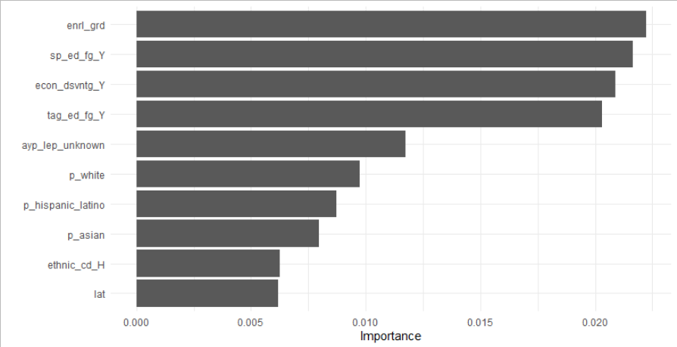
pluck(rf_def_res$.extracts[[1]]$.extracts, 1) %>%
pull_workflow_fit() %>%
vip()

Slide 70
rf_def_res %>%
mutate(vip = map(.extracts,
~pluck(.x$.extracts, 1) %>%
pull_workflow_fit() %>%
vip())) %>%
select(id, vip)
# A tibble: 10 x 2
id vip
<chr> <list>
1 Fold01 <gg>
2 Fold02 <gg>
3 Fold03 <gg>
4 Fold04 <gg>
5 Fold05 <gg>
6 Fold06 <gg>
7 Fold07 <gg>
8 Fold08 <gg>
9 Fold09 <gg>
10 Fold10 <gg>

Slide 71
pluck(rf_def_res$.extracts[[1]]$.extracts, 1) %>%
pull_workflow_preprocessor()
Data Recipe
Inputs:
role #variables
id 7
outcome 1
predictor 39
Operations:
Variable mutation for tst_dt
Variable mutation for classification
Delete terms contains("bnch")
Novel factor level assignment for all_nominal(), -all_outcomes()
Unknown factor level assignment for all_nominal(), -all_outcomes()
Median Imputation for all_numeric()
Sparse, unbalanced variable filter on all_predictors()
Dummy variables from all_nominal(), -has_role(match = "id"), -all_outcomes()
Sparse, unbalanced variable filter on all_predictors()

Slide 72
# Fit Tuned Model (without workflows)
set.seed(3000)
rf_tune_res <- tune_grid(
rf_tune_mod,
rf_rec,
math_cv,
tune = 20,
control = control_resamples(verbose = TRUE,
save_pred = TRUE,
extract = function(x) extract_model(x))
)

Slide 73
# Fit Tuned Model (with workflows)
set.seed(3000)
rf_tune_res <- tune_grid(
rf_tune_worfklow,
math_cv,
tune = 20,
control = control_resamples(verbose = TRUE,
save_pred = TRUE,
extract = function(x) extract_model(x))
)

Slide 74
# Fit Tuned Model (with workflows)
set.seed(3000)
rf_tune_res <- tune_grid(
rf_tune_worfklow,
math_cv,
tune = 20,
control = control_resamples(verbose = TRUE,
save_pred = TRUE,
extract = function(x) extract_model(x))
)

Slide 75
# Fit Tuned Model (with workflows)
set.seed(3000)
rf_tune_res <- tune_grid(
rf_tune_worfklow,
math_cv,
tune = 20,
control = control_resamples(verbose = TRUE,
save_pred = TRUE,
extract = function(x) extract_model(x))
)

Slide 76
# Fit Tuned Model (with workflows)
tictoc::tic()
set.seed(3000)
rf_tune_res <- tune_grid(
rf_tune_worfklow,
math_cv,
tune = 20,
control = control_resamples(verbose = TRUE,
save_pred = TRUE,
extract = function(x) extract_model(x))
)
tictoc::toc()
892.26 sec elapsed (about 15 mins)
compare to 66.73 sec elapsed for the default settings (no tuning)

Slide 77
rf_tune_res
# Tuning results
# 10-fold cross-validation using stratification
# A tibble: 10 x 6
splits id .metrics .notes .extracts .predictions
<list> <chr> <list> <list> <list> <list>
1 <split [5.1K/570]> Fold01 <tibble [20 x 6]> <tibble [0 x 1]> <tibble [10 x 4]> <tibble [5,700 x 10]>
2 <split [5.1K/570]> Fold02 <tibble [20 x 6]> <tibble [0 x 1]> <tibble [10 x 4]> <tibble [5,700 x 10]>
3 <split [5.1K/570]> Fold03 <tibble [20 x 6]> <tibble [0 x 1]> <tibble [10 x 4]> <tibble [5,700 x 10]>
4 <split [5.1K/570]> Fold04 <tibble [20 x 6]> <tibble [0 x 1]> <tibble [10 x 4]> <tibble [5,700 x 10]>
5 <split [5.1K/570]> Fold05 <tibble [20 x 6]> <tibble [0 x 1]> <tibble [10 x 4]> <tibble [5,700 x 10]>
6 <split [5.1K/568]> Fold06 <tibble [20 x 6]> <tibble [0 x 1]> <tibble [10 x 4]> <tibble [5,680 x 10]>
7 <split [5.1K/567]> Fold07 <tibble [20 x 6]> <tibble [0 x 1]> <tibble [10 x 4]> <tibble [5,670 x 10]>
8 <split [5.1K/567]> Fold08 <tibble [20 x 6]> <tibble [0 x 1]> <tibble [10 x 4]> <tibble [5,670 x 10]>
9 <split [5.1K/566]> Fold09 <tibble [20 x 6]> <tibble [0 x 1]> <tibble [10 x 4]> <tibble [5,660 x 10]>
10 <split [5.1K/566]> Fold10 <tibble [20 x 6]> <tibble [0 x 1]> <tibble [10 x 4]> <tibble [5,660 x 10]>

Slide 78
rf_tune_res$.extracts[[1]]
# A tibble: 10 x 4
mtry min_n .extracts .config
<int> <int> <list> <chr>
1 10 30 <ranger> Model01
2 14 33 <ranger> Model02
3 17 24 <ranger> Model03
4 8 3 <ranger> Model04
5 4 40 <ranger> Model05
6 8 13 <ranger> Model06
7 1 6 <ranger> Model07
8 16 25 <ranger> Model08
9 13 17 <ranger> Model09
10 5 20 <ranger> Model10

Slide 79
rf_tune_res$.extracts[[1]]$.extracts[[1]]
Ranger result
Call:
ranger::ranger(x = maybe_data_frame(x), y = y, mtry = min_cols(~10L, x), num.trees = ~1000, min.node.size = min_rows(~30L, x), num.threads = ~cores, importance = ~"permutation", verbose = ~TRUE, seed = sample.int(10^5, 1), probability = TRUE)
Type: Probability estimation
Number of trees: 1000
Sample size: 5114
Number of independent variables: 19
Mtry: 10
Target node size: 30
Variable importance mode: permutation
Splitrule: gini
OOB prediction error (Brier s.): 0.4436529

Slide 80
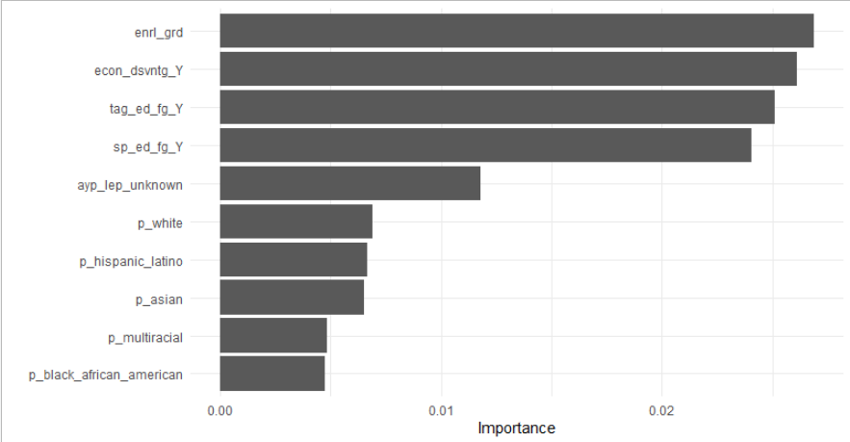
rf_tune_res$.extracts[[1]]$.extracts[[1]] %>%
vip()

Slide 81
rf_tune_res$.extracts[[1]]$.extracts[[1]] %>%
pull_workflow_preprocessor()
Error: `x` must be a workflow, not a ranger.
Run `rlang::last_error()` to see where the error occurred.

Slide 82
rf_def_res %>%
collect_metrics()
rf_tune_res %>%
collect_metrics() %>%
arrange(.metric, desc(mean)) %>%
group_by(.metric) %>%
slice(1:5)
# A tibble: 2 x 5
.metric .estimator mean n std_err
<chr> <chr> <dbl> <int> <dbl>
1 accuracy multiclass 0.441 10 0.00694
2 roc_auc hand_till 0.686 10 0.00596
# A tibble: 10 x 8
# Groups: .metric [2]
mtry min_n .metric .estimator mean n std_err .config
<int> <int> <chr> <chr> <dbl> <int> <dbl> <chr>
1 4 40 accuracy multiclass 0.460 10 0.00669 Model05
2 10 30 accuracy multiclass 0.451 10 0.00701 Model01
3 14 33 accuracy multiclass 0.449 10 0.00739 Model02
4 5 20 accuracy multiclass 0.448 10 0.00673 Model10
5 17 24 accuracy multiclass 0.446 10 0.00565 Model03
6 4 40 roc_auc hand_till 0.701 10 0.00636 Model05
7 10 30 roc_auc hand_till 0.695 10 0.00618 Model01
8 14 33 roc_auc hand_till 0.694 10 0.00609 Model02
9 5 20 roc_auc hand_till 0.693 10 0.00629 Model10
10 16 25 roc_auc hand_till 0.691 10 0.00606 Model08
We improved our predictions (based on two metrics)
But it took about 15 times as long
Worth it?

Slide 83
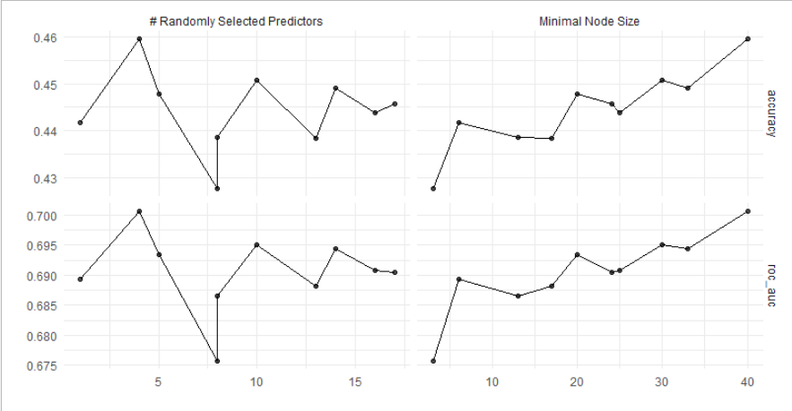
rf_tune_res %>%
autoplot() +
geom_line()
Could probably increase min_n beyond 35
Maybe lower values of mtry increased performance (between 0 and 5)?

Slide 84
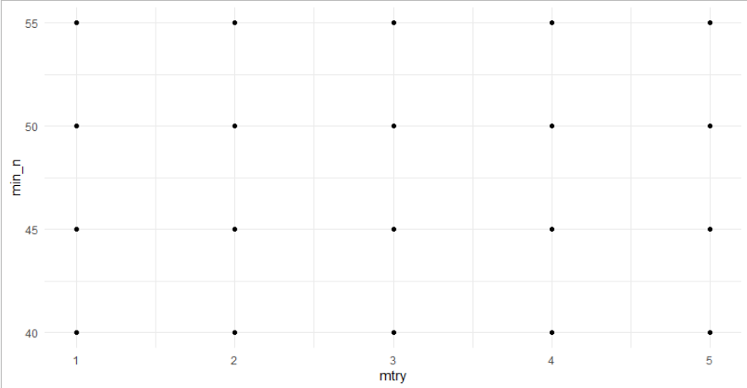
Create grid and tune model
rf_grid_reg <- grid_regular(
mtry(range = c(1, 5)),
min_n(range = c(40, 55)),
levels = c(5, 4)
)
tic()
set.seed(3000)
rf_grid_res <- tune_grid(
rf_tune_workflow,
math_cv,
grid = rf_grid_reg,
control = control_resamples(verbose = TRUE,
save_pred = TRUE)
)
toc()
1607.22 sec elapsed (about 27 min)

Slide 85
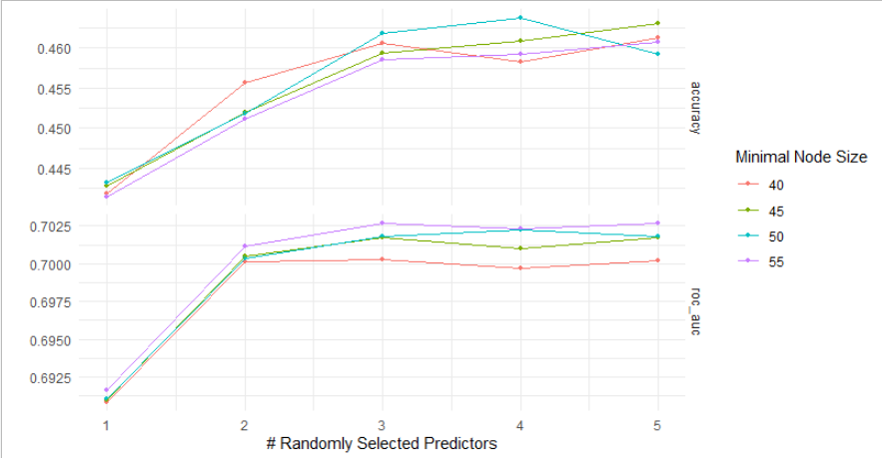
rf_grid_res %>%
autoplot() +
geom_line()

Slide 86
show_best(rf_tune_res, metric = "accuracy", n = 10) %>%
bind_rows(show_best(rf_tune_res, metric = "roc_auc", n = 10)) %>%
group_by(.metric) %>%
slice(1:5)
show_best(rf_grid_res, metric = "accuracy", n = 10) %>%
bind_rows(show_best(rf_grid_res, metric = "roc_auc", n = 10)) %>%
group_by(.metric) %>%
slice(1:5)
# A tibble: 10 x 8
# Groups: .metric [2]
mtry min_n .metric .estimator mean n std_err .config
<int> <int> <chr> <chr> <dbl> <int> <dbl> <chr>
1 4 40 accuracy multiclass 0.460 10 0.00669 Model05
2 10 30 accuracy multiclass 0.451 10 0.00701 Model01
3 14 33 accuracy multiclass 0.449 10 0.00739 Model02
4 5 20 accuracy multiclass 0.448 10 0.00673 Model10
5 17 24 accuracy multiclass 0.446 10 0.00565 Model03
6 4 40 roc_auc hand_till 0.701 10 0.00636 Model05
7 10 30 roc_auc hand_till 0.695 10 0.00618 Model01
8 14 33 roc_auc hand_till 0.694 10 0.00609 Model02
9 5 20 roc_auc hand_till 0.693 10 0.00629 Model10
10 16 25 roc_auc hand_till 0.691 10 0.00606 Model08
# A tibble: 10 x 8
# Groups: .metric [2]
mtry min_n .metric .estimator mean n std_err .config
<int> <int> <chr> <chr> <dbl> <int> <dbl> <chr>
1 4 50 accuracy multiclass 0.464 10 0.00663 Model14
2 5 45 accuracy multiclass 0.463 10 0.00652 Model10
3 3 50 accuracy multiclass 0.462 10 0.00668 Model13
4 5 40 accuracy multiclass 0.461 10 0.00738 Model05
5 4 45 accuracy multiclass 0.461 10 0.00663 Model09
6 3 55 roc_auc hand_till 0.703 10 0.00615 Model18
7 5 55 roc_auc hand_till 0.703 10 0.00641 Model20
8 4 55 roc_auc hand_till 0.702 10 0.00637 Model19
9 4 50 roc_auc hand_till 0.702 10 0.00626 Model14
10 3 50 roc_auc hand_till 0.702 10 0.00634 Model13
Worth it?

Slide 87
select_best(rf_tune_res, metric = "roc_auc")
select_best(rf_grid_res, metric = "roc_auc")
# A tibble: 1 x 3
mtry min_n .config
<int> <int> <chr>
1 4 40 Model05
# A tibble: 1 x 3
mtry min_n .config
<int> <int> <chr>
1 3 55 Model18

Slide 88
rf_best <- select_best(rf_grid_res, metric = "roc_auc")

Slide 89
rf_best <- select_best(rf_grid_res, metric = "roc_auc")
rf_wf_final <- finalize_workflow(
rf_tune_workflow,
rf_best
)

Slide 90
rf_best <- select_best(rf_grid_res, metric = "roc_auc")
rf_wf_final <- finalize_workflow(
rf_tune_workflow,
rf_best
)
rf_wf_final
== Workflow ==============================================================================
Preprocessor: Recipe
Model: rand_forest()
-- Preprocessor --------------------------------------------------------------------------
9 Recipe Steps
* step_mutate()
* step_mutate()
* step_rm()
* step_novel()
* step_unknown()
* step_medianimpute()
* step_nzv()
* step_dummy()
* step_nzv()
-- Model ---------------------------------------------------------------------------------
Random Forest Model Specification (classification)
Main Arguments:
mtry = 3
trees = 1000
min_n = 55
Engine-Specific Arguments:
num.threads = cores
importance = permutation
verbose = TRUE
Computational engine: ranger

Slide 91
tictoc::tic()
set.seed(3000)
rf_res_final <- last_fit(rf_wf_final,
split = math_split)
tictoc::toc()
# Resampling results
# Monte Carlo cross-validation (0.75/0.25) with 1 resamples
# A tibble: 1 x 6
splits id .metrics .notes .predictions .workflow
<list> <chr> <list> <list> <list> <list>
1 <split [5.7K/1.9K]> train/test split <tibble [2 x 3]> <tibble [0 x 1]> <tibble [1,893 x 7]> <workflow>

Slide 92
rf_res_final %>%
pluck(".workflow", 1)
== Workflow =====================================================================================================
Preprocessor: Recipe
Model: rand_forest()
-- Preprocessor -------------------------------------------------------------------------------------------------
9 Recipe Steps
* step_mutate()
* step_mutate()
* step_rm()
* step_novel()
* step_unknown()
* step_medianimpute()
* step_nzv()
* step_dummy()
* step_nzv()
-- Model --------------------------------------------------------------------------------------------------------
Ranger result
Call:
ranger::ranger(x = maybe_data_frame(x), y = y, mtry = min_cols(~3L, x), num.trees = ~1000, min.node.size = min_rows(~55L, x), num.threads = ~cores, importance = ~"permutation", verbose = ~TRUE, seed = sample.int(10^5, 1), probability = TRUE)
Type: Probability estimation
Number of trees: 1000
Sample size: 5684
Number of independent variables: 19
Mtry: 3
Target node size: 55
Variable importance mode: permutation
Splitrule: gini
OOB prediction error (Brier s.): 0.4487589

Slide 93
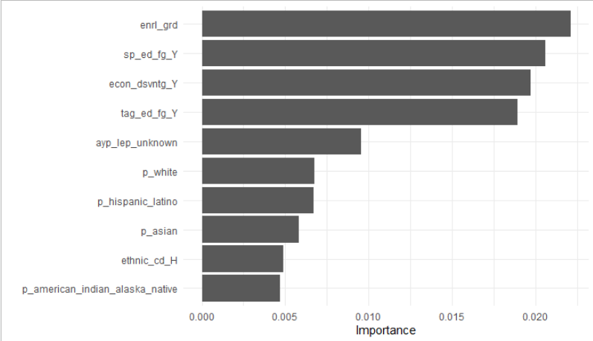
rf_res_final %>%
pluck(".workflow", 1) %>%
pull_workflow_fit() %>%
vip()

Slide 94
# Default Model
# mtry = floor(sqrt(p)) = floor(sqrt(39)) = 6
# trees = 500 (num.trees)
# min_n = 1 (min.node.size)
(cores <- parallel::detectCores())
8
rf_def_mod <-
rand_forest() %>%
set_engine("ranger",
num.threads = cores, #argument from {ranger}
importance = "permutation", #argument from {ranger}
verbose = TRUE) %>% #argument from {ranger}
set_mode("classification")
Remember this setting from 100 slides ago?

Slide 95
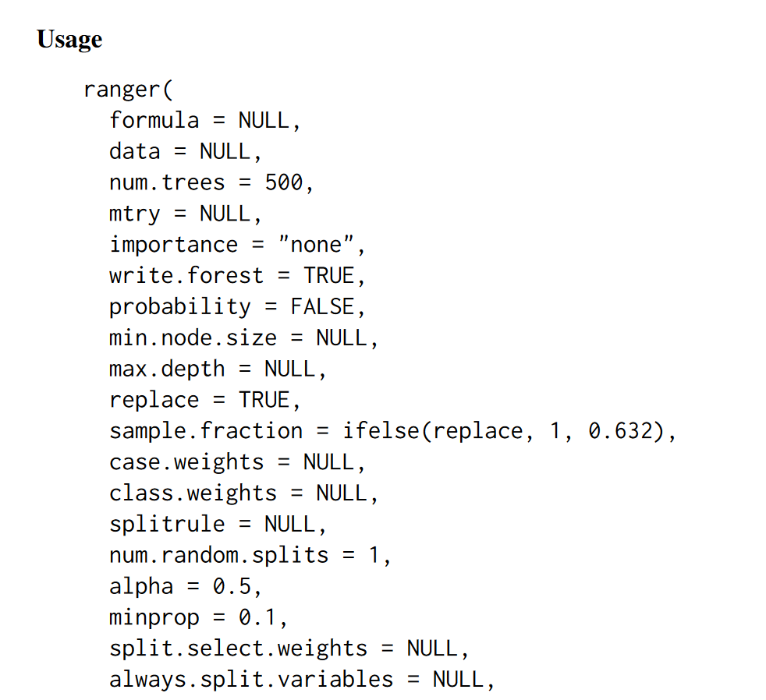
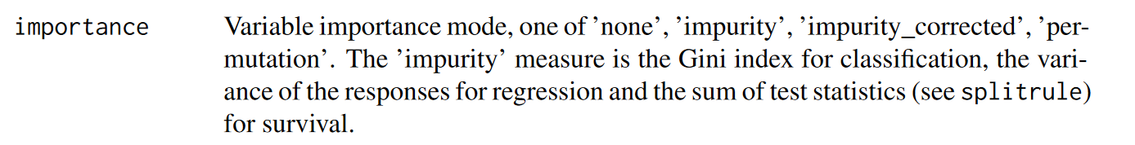
ranger::ranger

Slide 96
impurity: the probability of a variable being wrongly classified when it is randomly chosen (Gini index)
if all elements belong to a single class, then is “pure”; Gini index = 0
elements randomly distributed across classes; Gini index = 1
lowest Gini is selected for the root
impurity-based feature importance can inflate the importance of numerical features
each time a break point is selected in a variable, every level of the variable is tested to find the best break point
continuous variables will have many more split points, which results in a higher probability that by chance that variable happens to predict the outcome well, since variables where more splits are tried will appear more often in the tree
permutation: calculate the increase in the model’s prediction error after permuting the feature
a feature is “important” if shuffling its values increases the model error, because in this case the model relied on the feature for the prediction
a feature is “unimportant” if shuffling its values leaves the model error unchanged, because in this case the model ignored the feature for the prediction
permutation-based feature importance is more reliable than impurity, but:
more computationally expensive
potentially biased toward collinear predictive variables

Slide 97
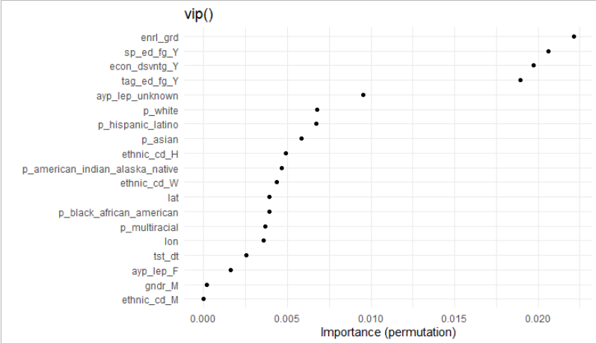
rf_res_final %>%
pluck(".workflow", 1) %>%
pull_workflow_fit() %>%
vip(geom = "point",
num_features = 20) +
labs(y = "Importance (permutation)",
title = "vip()")

Slide 99
mtry
Suggestion (Boehmke): start with five evenly spaced values of mtry across the range 2 to p centered at the recommended default
p <- 20 #length(setdiff(names(data_train), “outcome"))
grid_max_entropy(mtry(range = c(2, p)), size = 5)
# A tibble: 5 x 1
mtry
<int>
1 2
2 6
3 19
4 10
5 15

