Slide 1
PROJECT TITLE: AUTOMATED UEAB CUMPUS CAFETERIA SUPLY MANAGEMENT SYSTEM
SUPERVISOR: MR. MAYAKA KEVIN NAME: MUREMI PETER ID: SMURPE2011

Slide 2
Background Study
Managing suppliers manually in Baraton University cafeteria presents significant challenges such as inefficiency, communication problems and a lack of visibility. These difficulties frequently result in delays and mistakes during procurement, which negatively impact the cafeteria's operations. The proposed solution is an automated supplier management system, which aims to address these challenges by simplifying processes, improving communication and offering real-time insight into orders and inventory. Through automation of tasks like invoicing and payment processing, the system will cut down on administrative burdens and guarantee prompt transactions.

Slide 3
Feasibility Study
The feasibility study for implementing an automated supplier management system in UEAB campus cafeteria concludes that the project is viable. The system aims to address inefficiencies, communication issues and visibility challenges faced in manual supplier management. Technically, the required technology is readily available, and existing campus infrastructure can support implementation. Economically, initial investment costs will be offset by long-term benefits, though a comprehensive cost-benefit analysis is warranted. Operationally, staff training and change management strategies are essential for successful adoption. Legal and regulatory compliance must also be ensured. Overall, with proper planning and stakeholder engagement, the automated system promises to streamline processes and improve operational efficiency in the cafeterias.

Slide 4
PROBLEM STATEMENT.
Manual supplier management in UEAB campus cafeteria brings about inefficiencies, such as time-consuming tasks and heavy administrative workloads. Coordinating orders, deliveries, and payments with various suppliers becomes challenging due to communication problems, resulting in delays and mistakes. Additionally, the absence of real-time visibility into order status and inventory levels hampers decision-making and operational effectiveness, ultimately affecting the cafeteria's ability to operate smoothly.

Slide 5
Justification
Automating supplier management will enhance efficiency through streamlined order processing, improved communication, cost savings via optimized procurement, better inventory management with real-time visibility, and stronger supplier relationships facilitated by feedback and performance evaluations.

Slide 6
OBJECTIVES
Implement an automated supply management system to optimize procurement processes, minimize manual errors and boost operational efficiency at UEAB campus cafeteria.
Maximize cost-effectiveness by automating invoicing and payment procedures, reducing administrative overhead and leveraging cost-saving opportunities to allocate resources more efficiently.
Implement automated alerts and notifications for inventory replenishment, delivery tracking and order status updates.
Enhance supply chain transparency and accountability through real-time tracking mechanisms, enabling proactive inventory management and ensuring timely communication with suppliers.

Slide 7
Development tools
Programming Language: PHP
Framework: Laravel
Database: MySQL
Frontend: HTML, CSS, JavaScript
Other Tools: Composer for dependency management, Git for version control and WampServer.

Slide 8
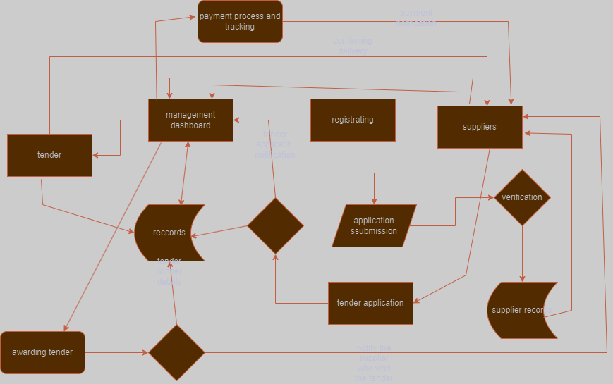
Conceptual Diagram for the Proposed system

Slide 9
References
Bowen, F. E. , Cousins, P. D. , Lamming, R. C. , & Farukt, A. C. (2020b). The role of supply management capabilities in Technology. Production and Operations Management, 10(2), 2022
Carter, C. R. , & Liane Easton, P. (2020). Sustainable supply chain management: Evolution and future directions. International Journal of Physical Distribution & Logistics Management, 41(1), 46–62.
K.T. GAV and I.J DHIM, “Information technology and e-risk of supply chain management", African Journal of Business Management, Vol 9, No.6, pp. 243-258, 2021.
Cortado, U. W. (2020). TQM for information systems management. New York, NY: McGraw-Hill.2021
Carter, C. R. , & Jennings, M. (2023). Digital Supply. Technology Research Part E, 38, 37–52.

