Slide 1
Happy Harry Hardware Store
Jonathan Birkey, Matt Cowans, Jovanny Perez, Julian Rivera

Slide 2
The Problem
Harry of Happy Harry Hardware wants a web-based application that allows customers to order items online to be picked up in the store.
He also wants his employees to be able to check and edit the inventory of the store.

Slide 3
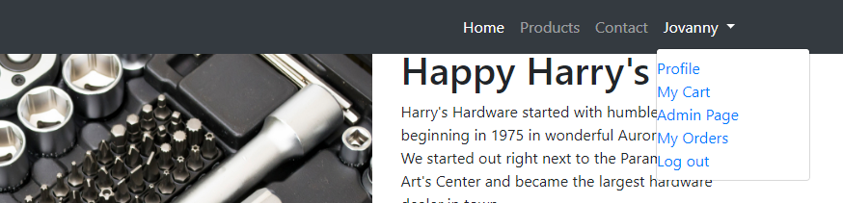
The Deliverable
Administration Page

Slide 4
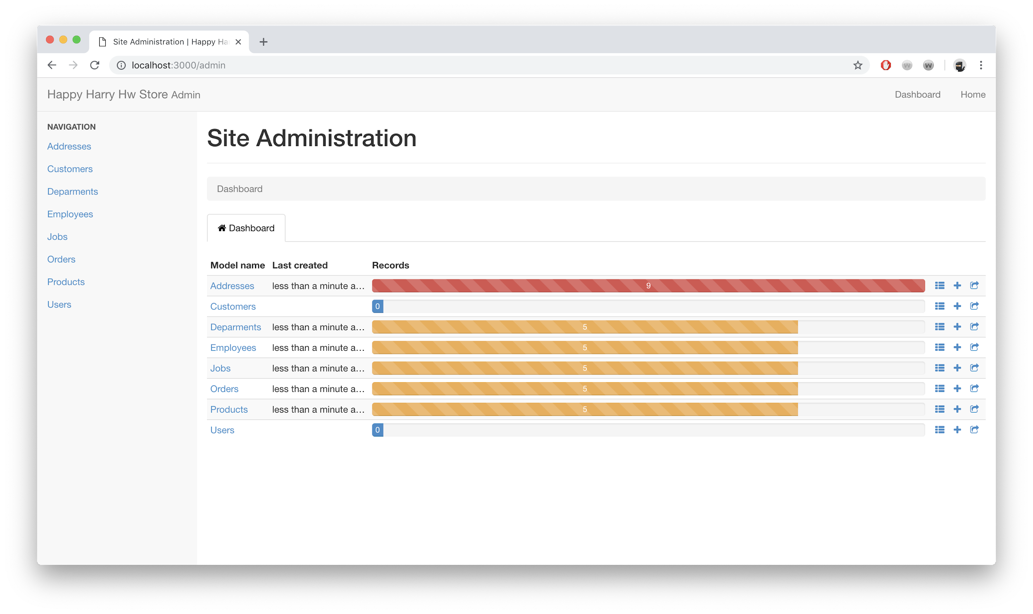
The Administration Page

Slide 5
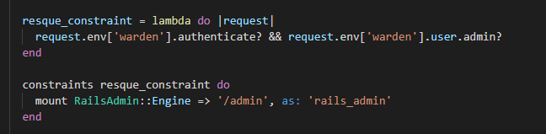

Slide 6
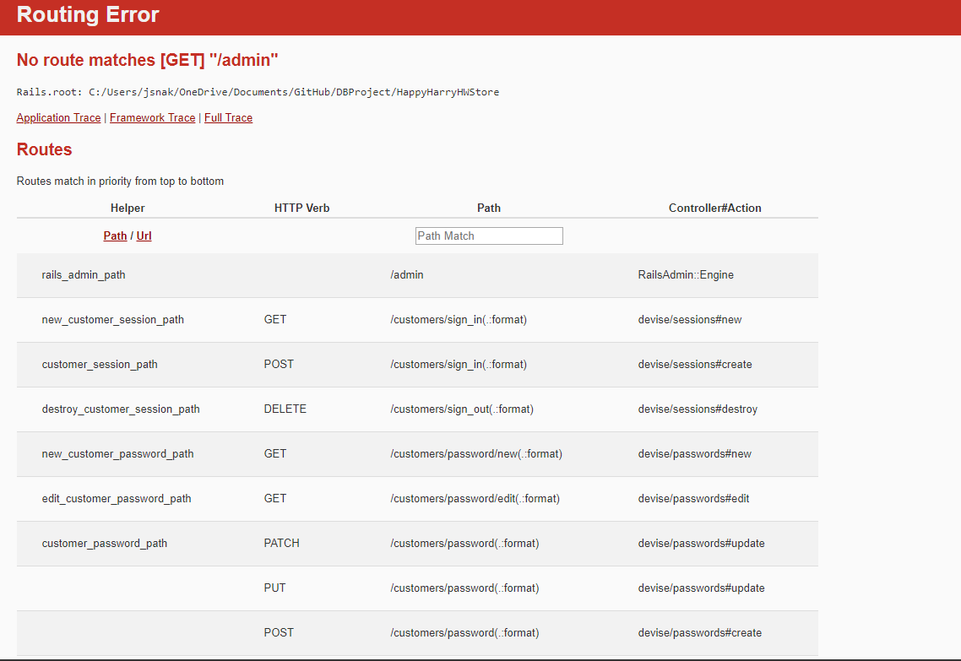

Slide 7
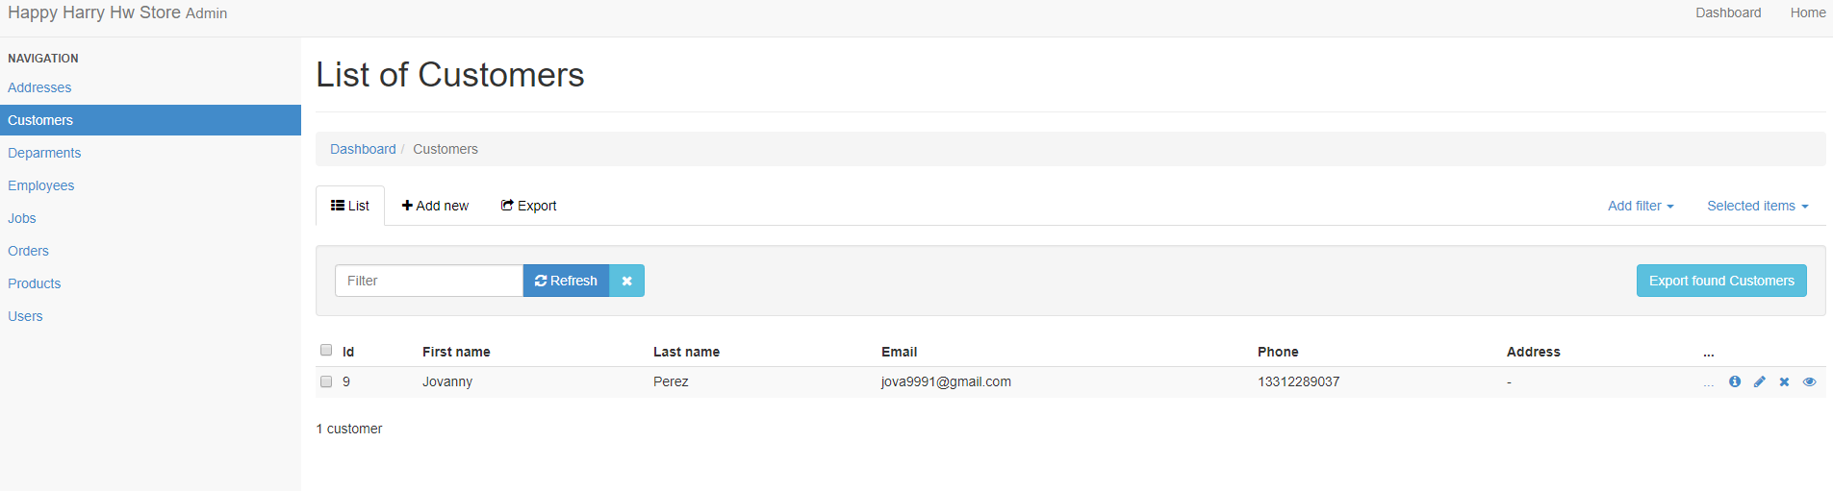

Slide 8
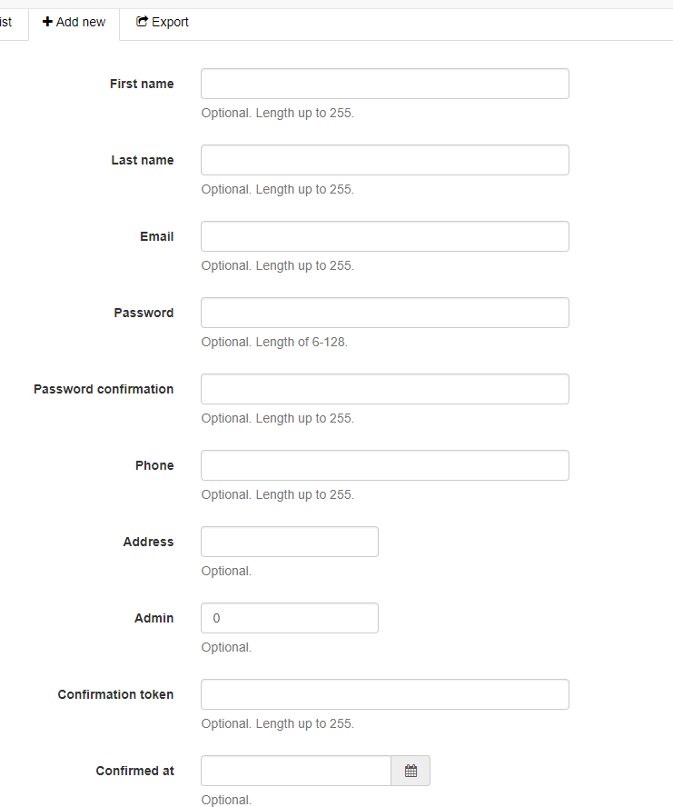

Slide 9
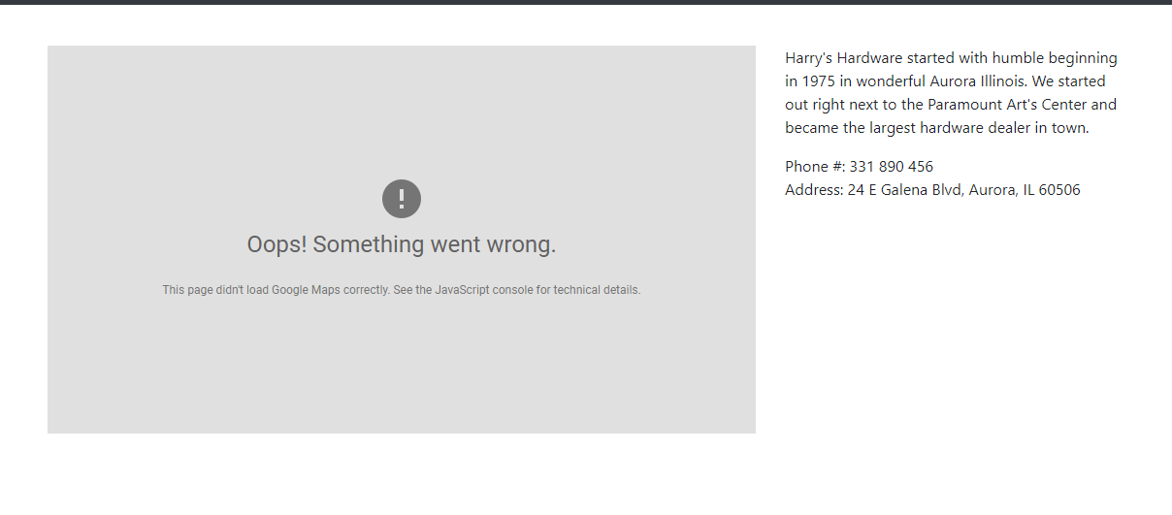
Contact Page

Slide 10
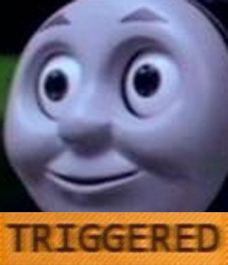
Blockers
Ruby on Rails and Triggers
HairTrigger
Active Record Callbacks

Slide 11
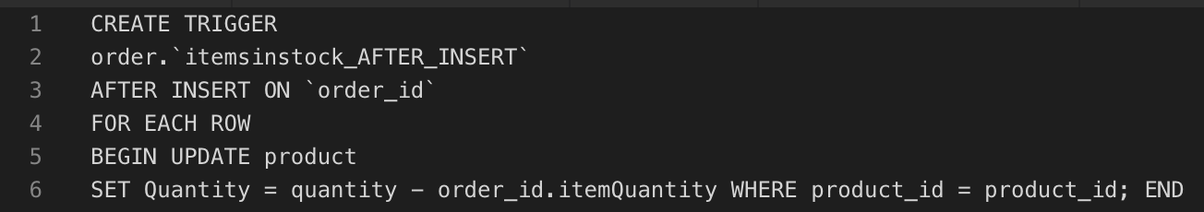
More Blockers
It gives me an error with "order_id.itemQuantity"
It worked when quantity is set to "-1" but obviously I want it to decrement based on how many "itemQuantity" is.

Slide 12

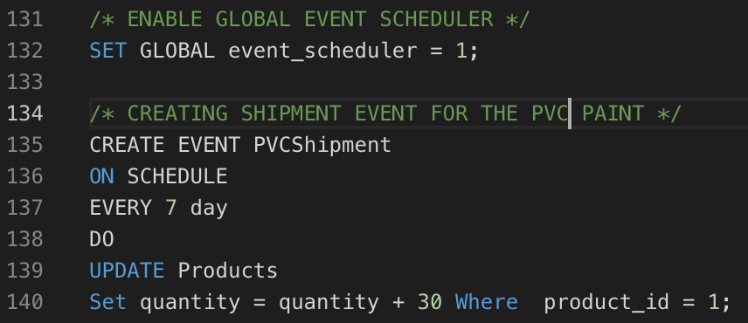
Event Scheduler/ Shipments
MySQL Events are tasks that run according to a schedule.

