Slide 1
Happy Harry Hardware Store
Jonathan Birkey, Matt Cowans, Jovanny Perez, Julian Rivera

Slide 2
The Problem
Harry of Happy Harry Hardware wants a web-based application that allows customers to order items online to be picked up in the store.
He also wants his employees to be able to check and edit the inventory of the store.

Slide 3
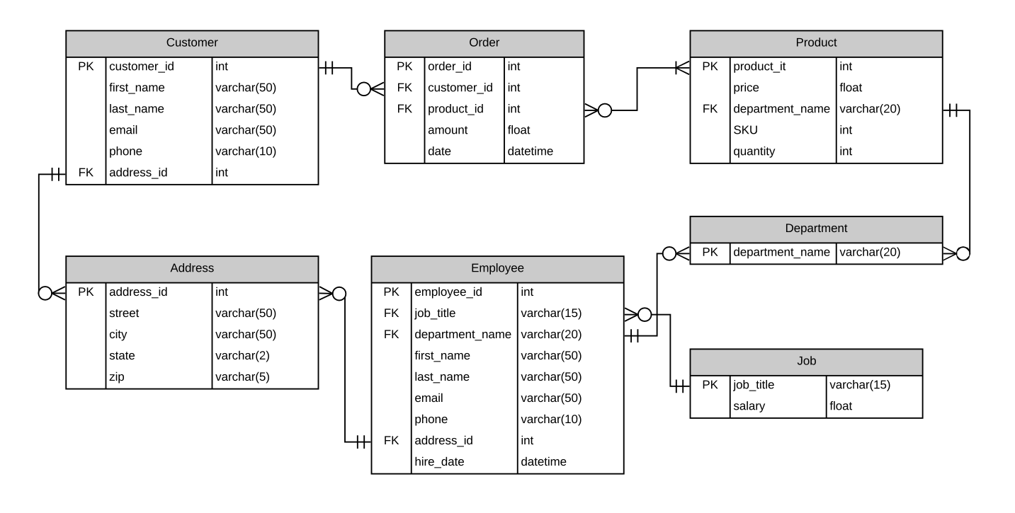
The Database

Slide 4
Constraints
Primary Keys
employee_id, customer_id, not null
Foreign Keys
customer_id in the orders table
puduct_id in orders table
department_name in employees table

Slide 5
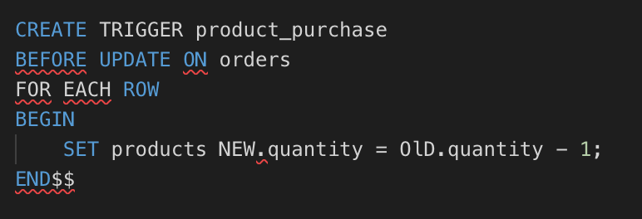
Triggers

Slide 6
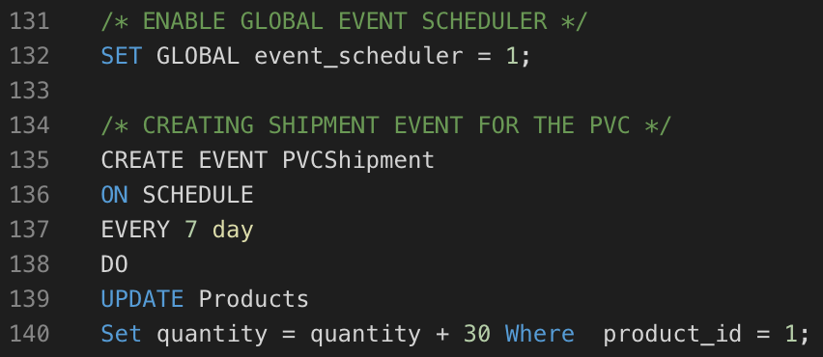
Events

Slide 7
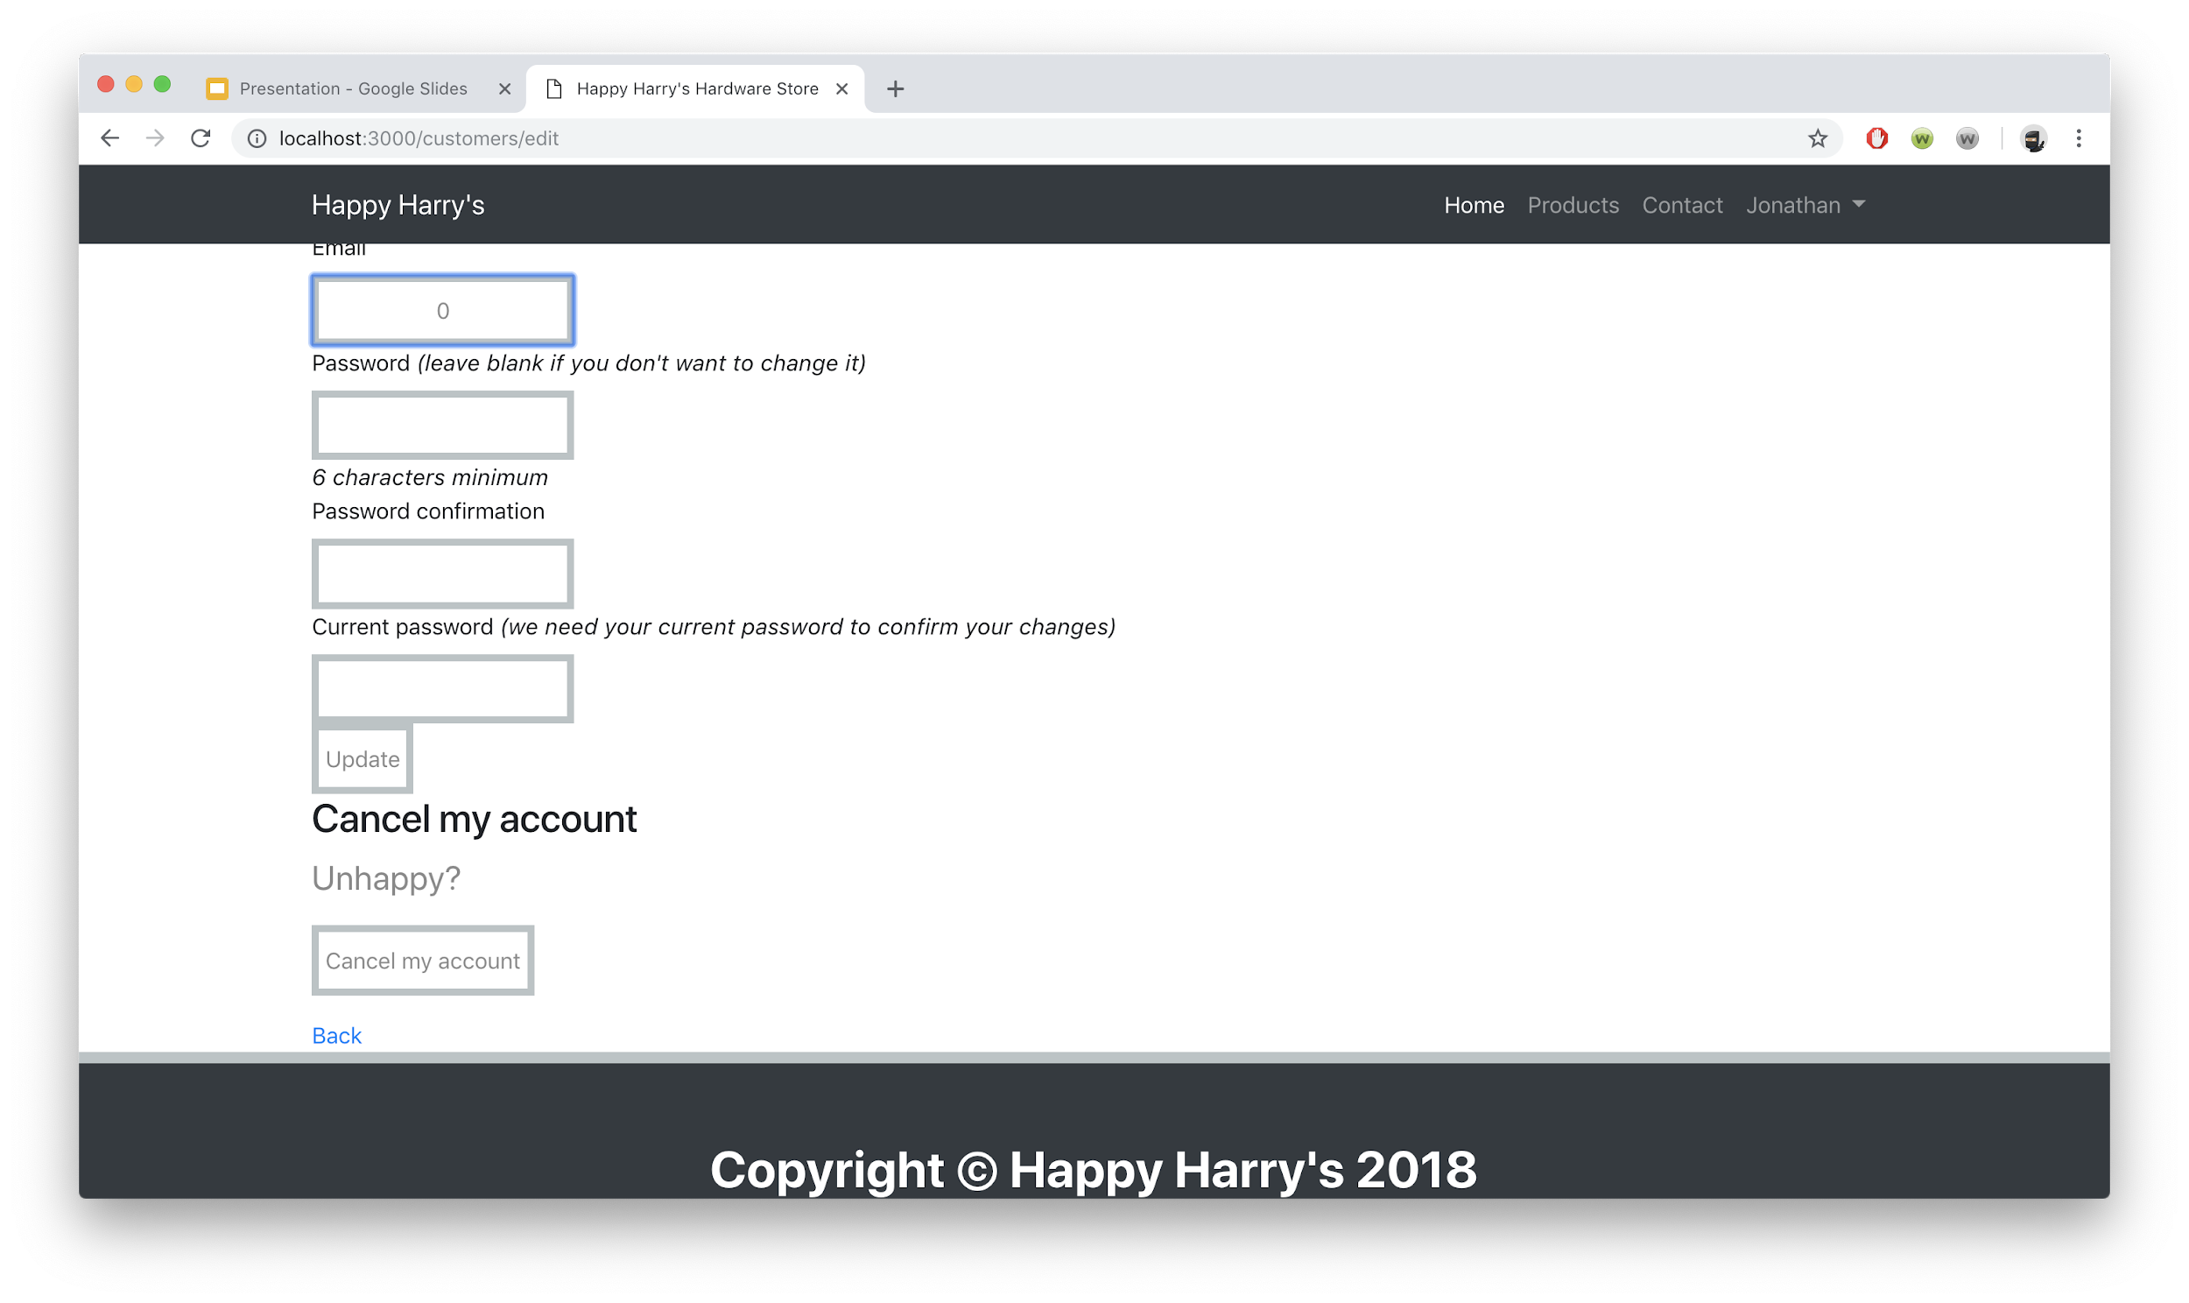
Ruby on Rails Customer Page

Slide 8
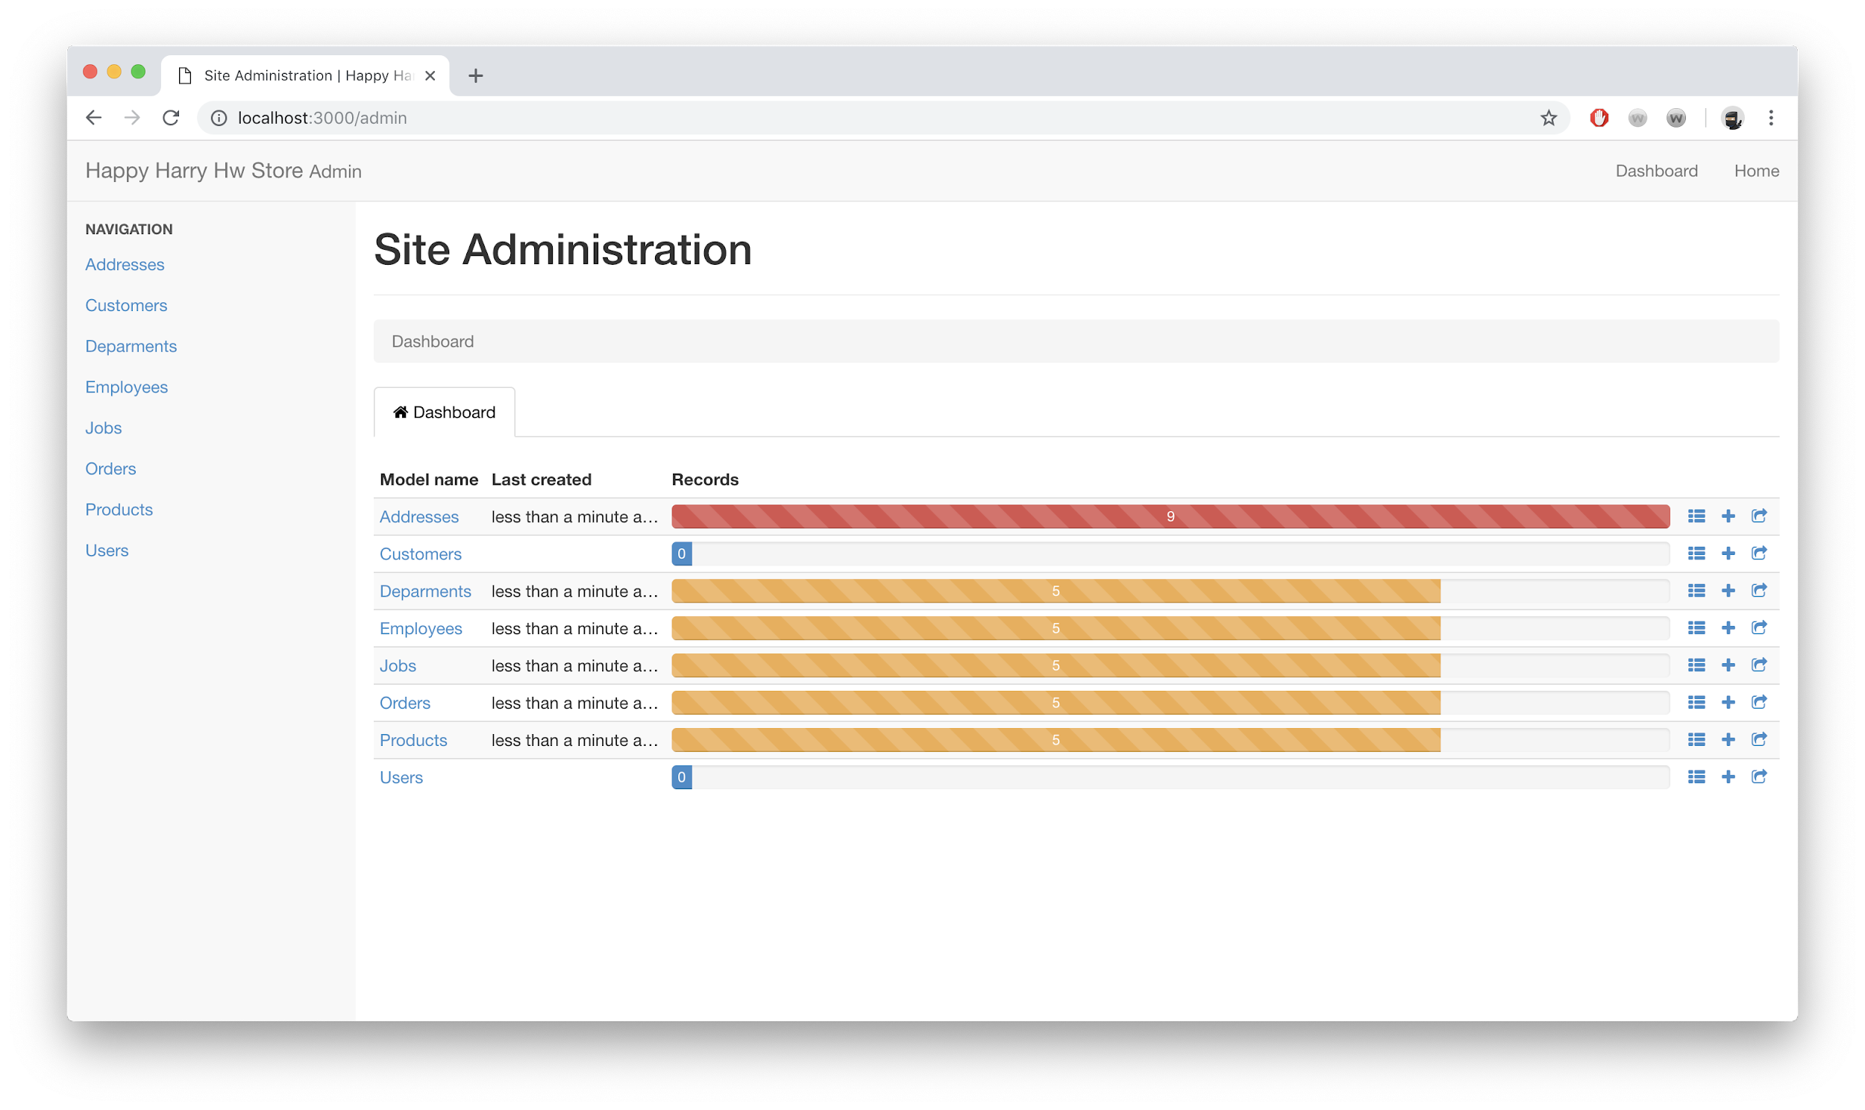
Ruby on Rails Admin Page

Slide 9
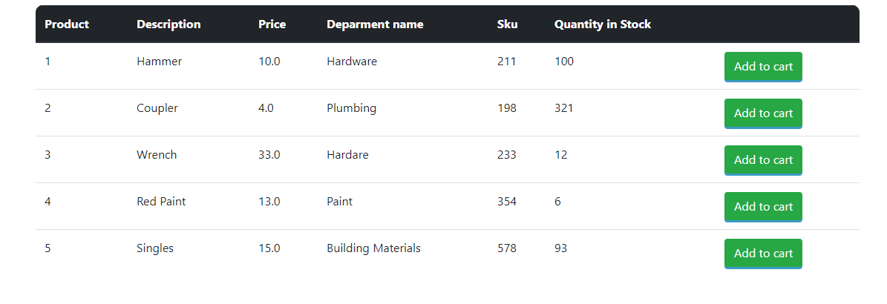
Ruby on Rails Products Page

Slide 10
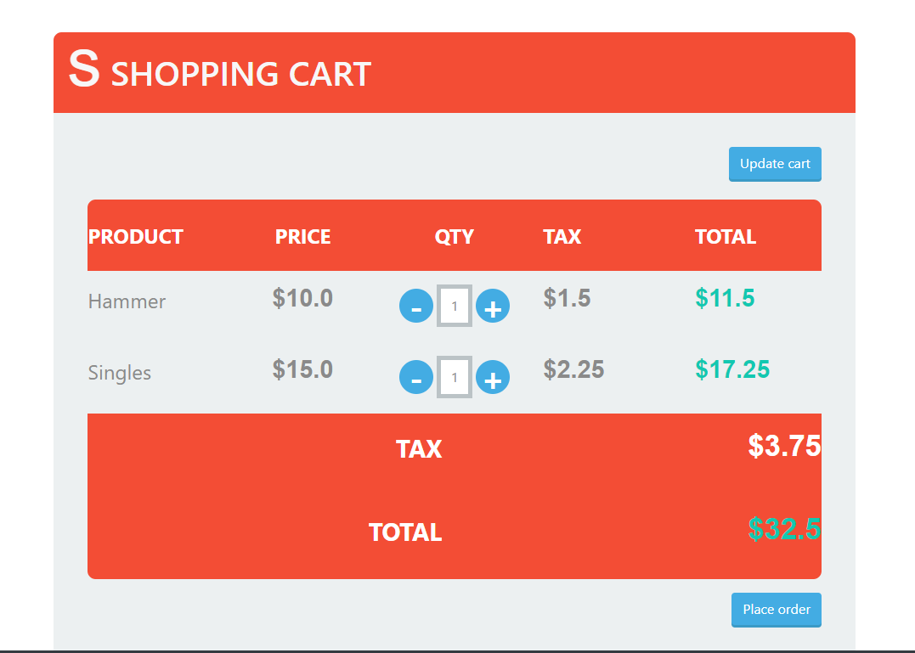
The cart
All products in cart belong to one user. Each entry has product id and a quantity.

Slide 11
The orders
Each order has an order id and it belongs to a customer. One product per entry.

Slide 12
Roadblocks
Triggers
Cart Page -> using the right data structure, displaying the right products
/admin security

Slide 13

Demo

