Slide 1

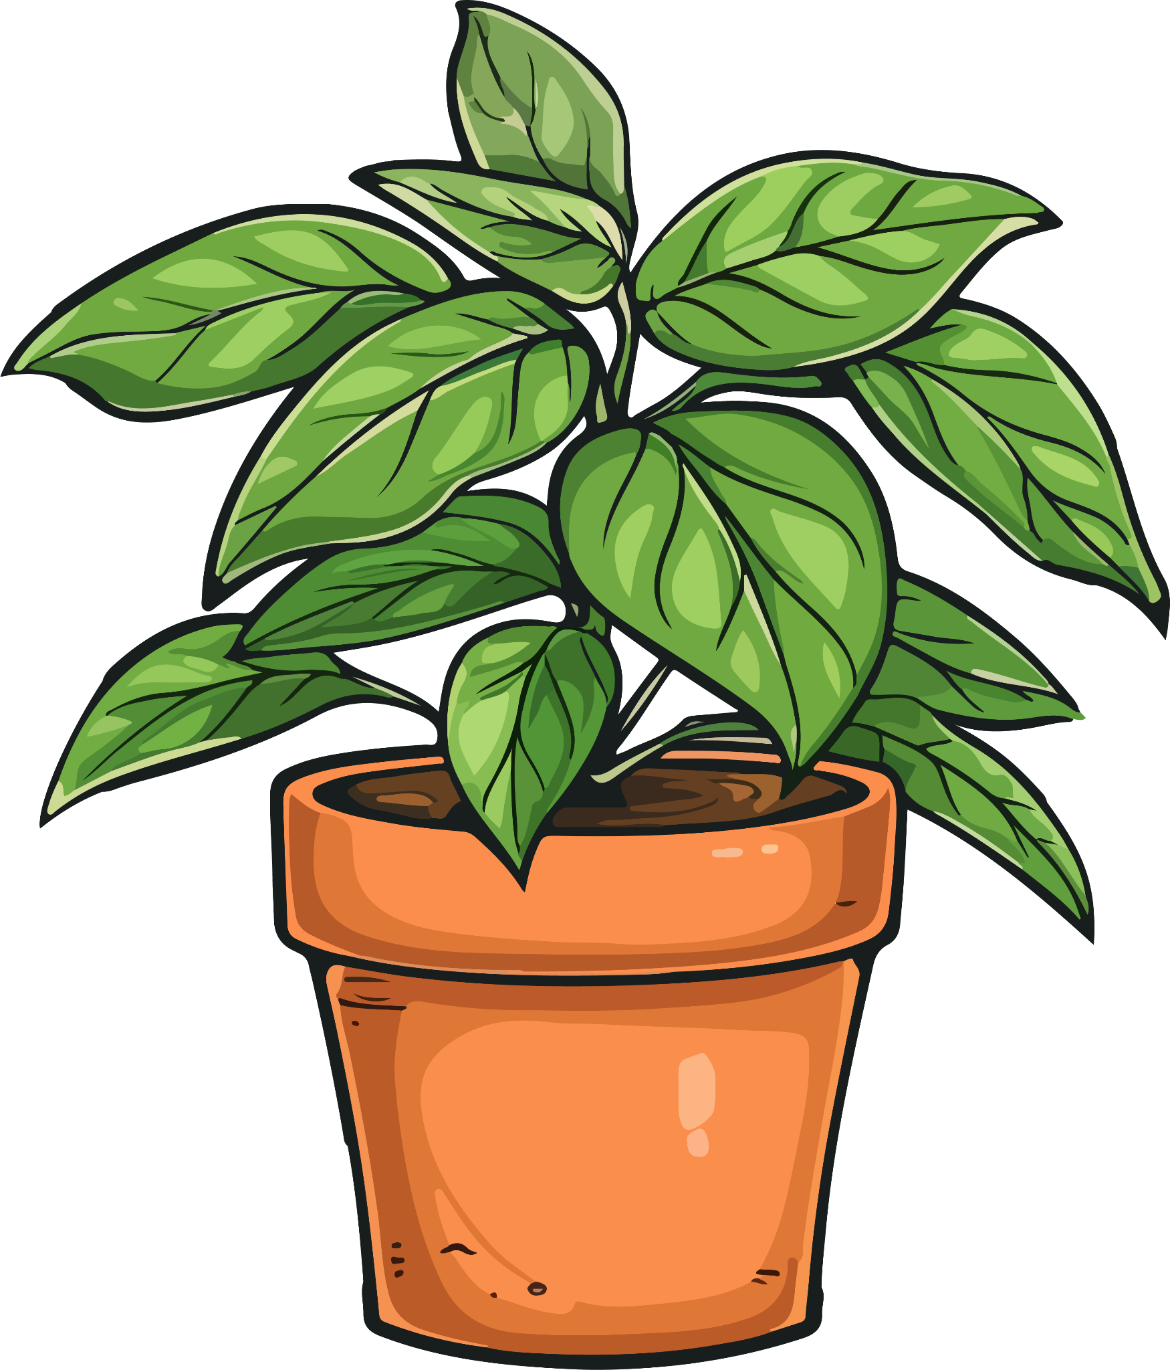
McCay's Houseplant Recommender
Data Exploration…

Slide 2

The Dataset!
Dr. Pennisi
The Indoor Plants Dataset

Slide 3
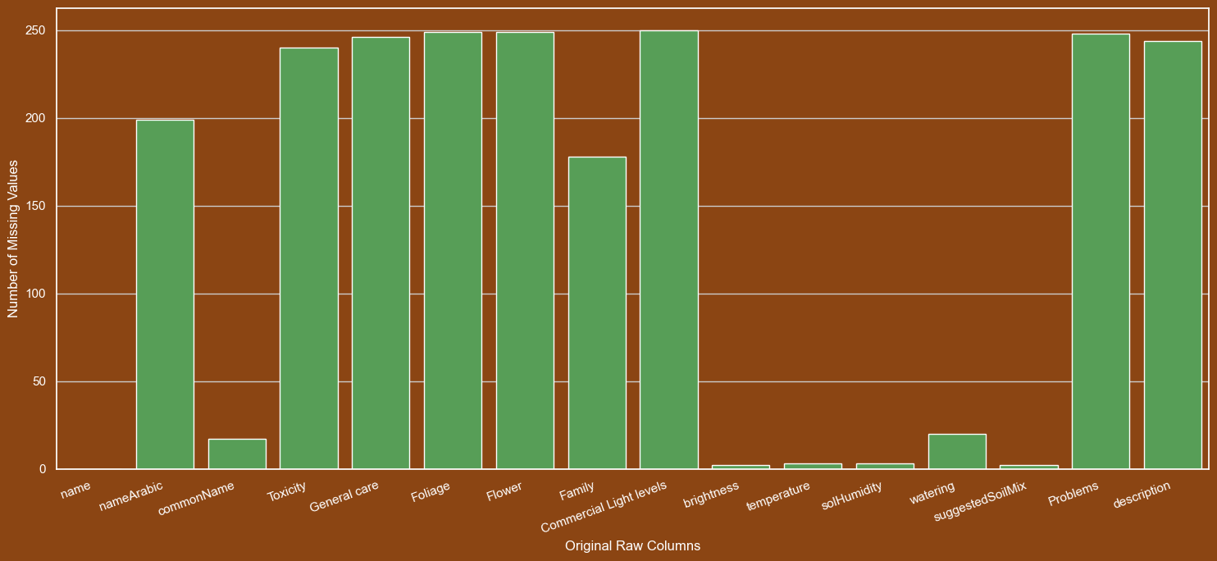
The Mess!
16 Columns
Inconsistent Values:
1,2,3
3-4
2_3
1,4
NULL
March-April
1 2
Well lit spot
Indirect light

Slide 4

The Cleanup
Final Columns
scientific_name: 🧫
common_name: 🥳
light_level ☀️
water_need 💦
humidity_need 🌫️
temp_tolerance 🌡️
is_toxic: 0|1 ☠️
has_flowers: 0|1

Slide 5
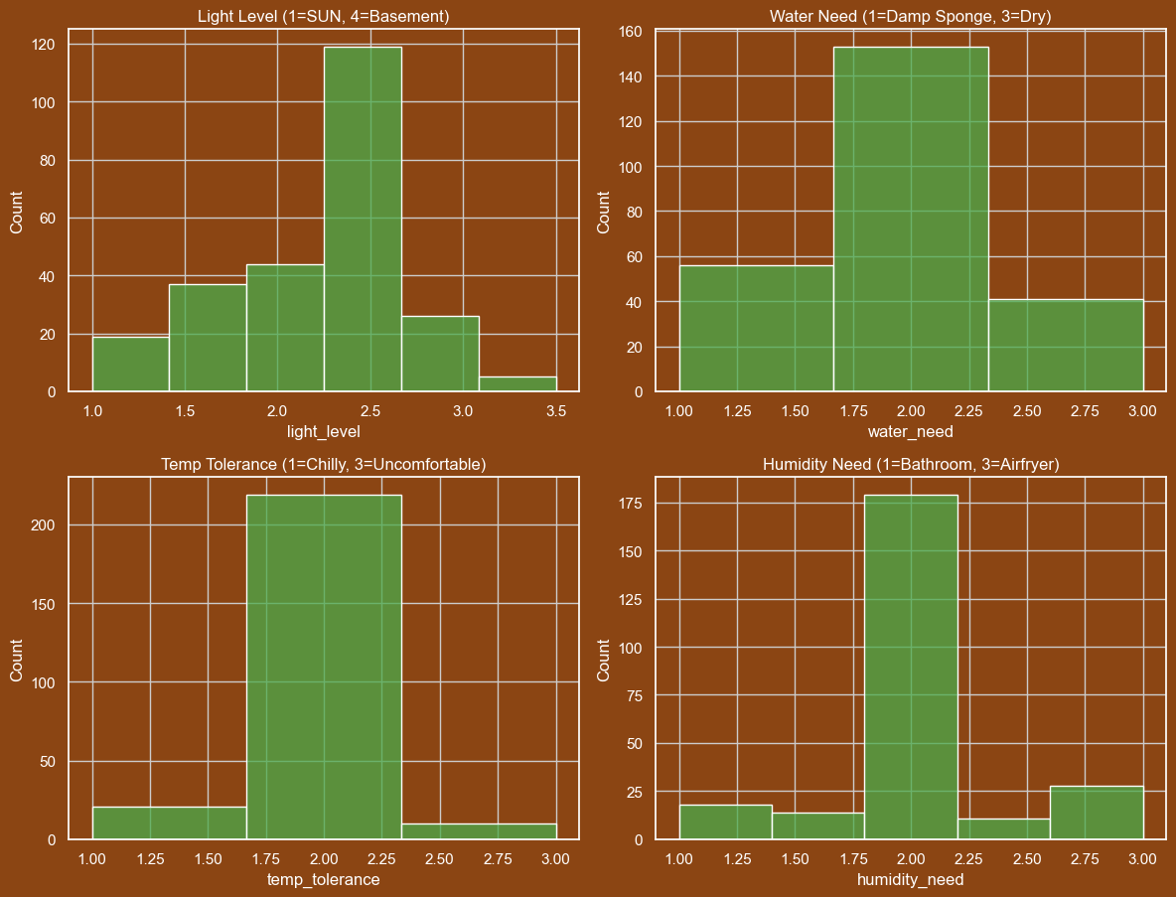
Most plants are fairly mild mannered

Slide 6
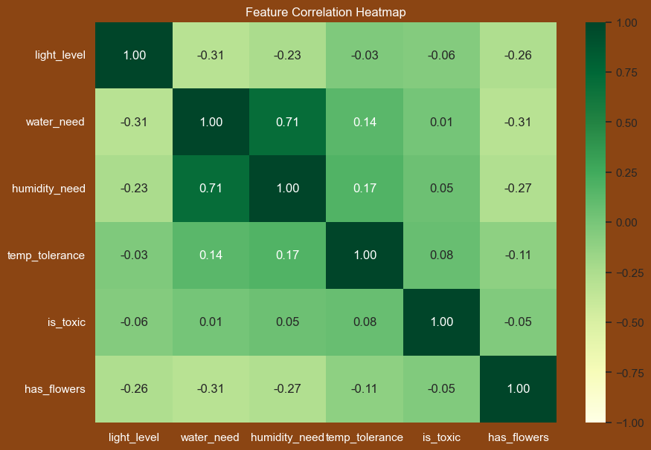


Slide 7
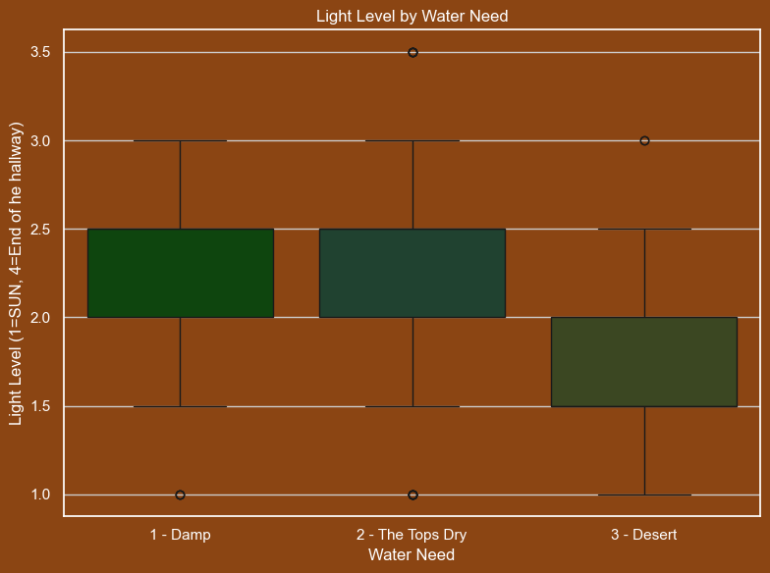



Slide 8
Next Steps
Scientific Names
Recommender
Testing

Slide 9
Sources
Plant Photos: https://www.vecteezy.com/members/timplaru-olivia23651162
Original Dataset: https://zenodo.org/records/6984514
Publication: https://fieldreport.caes.uga.edu/publications/B1318/growing-indoor-plants-with-success/

