Slide 1
AMAZON SALES ANALYSIS
By Mitesh Adelkar

Slide 2

PROBLEM STATEMENT
Sales management has gained importance to meet increasing competition and the need for improved methods of distribution to reduce cost and to increase profits. Sales management today is the most important function in a commercial and business enterprise.
Do ETL : Extract-Transform-Load on some Amazon dataset and find for me Sales-trend -> month wise, year wise, yearly-month wise.

Slide 3
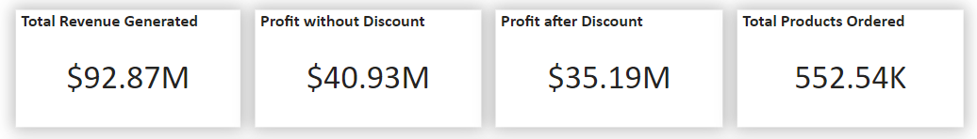
QUICK INSIGHTS
Total Revenue [2017-2019] is 92.87 Million approx.
Profit without discount is the actual profit which was expected to generate through the sales.
Profit after discount is the actual profit which we received after offering an discount to our customers for their purchases
Approximately 552k products were ordered during the 3 years time.

Slide 4
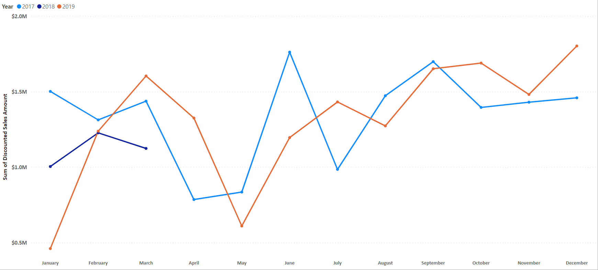

YEARLY SALES TREND
2018 Data is Incomplete in this Dataset !
Only January-March data is Available.

Slide 5
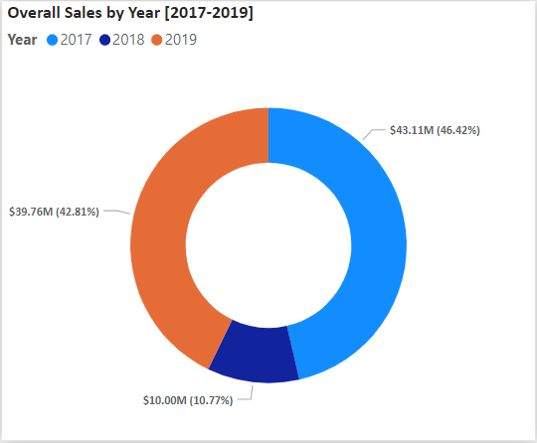
YEAR WISE REVENUE GENERATED
It was observed that:
2017: 43.11 Million
2018: 10.00 Million
2019: 39.76 Million
The data related to 2018 seems incomplete as it do not provide information of sales in months of April-December

Slide 6
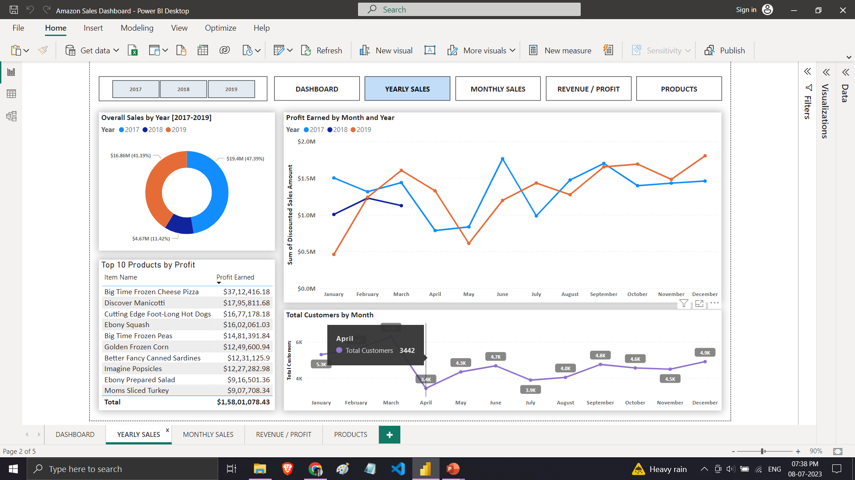
YEAR WISE PROFIT AFTER DISCOUNT
It was observed that:
2017: 19.40 Million
2018: 04.67 Million
2019: 16.86 Million
The data related to 2018 seems incomplete as it do not provide information of sales in months of April-December

Slide 7
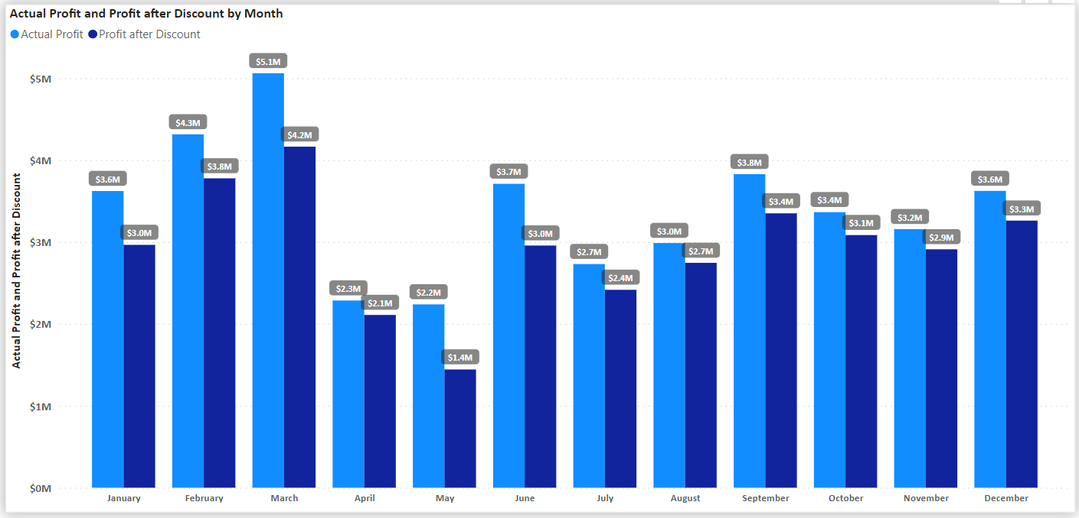
MONTH WISE SALES OBSERVATIONS
Overall in three Years the Months of February and March seems to have generated the maximum of profit.
The data for the year 2018 is incomplete which might be causing this issues.

Slide 8
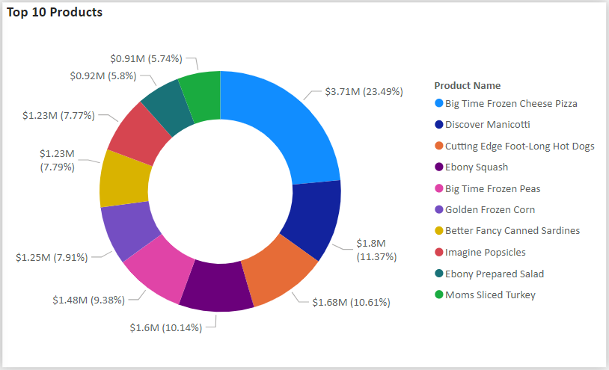
TOP 10 PRODUCTS BY PROFIT
It seems like Frozen Cheese Pizza tops the list of overall profit made contributing approx. 3.71 Million to the profits earned after giving huge discounts!
Rest top 10 products also contribute significantly to the overall sales made.
This insights can be used in order to select the products which should be considering investing in.

Slide 9
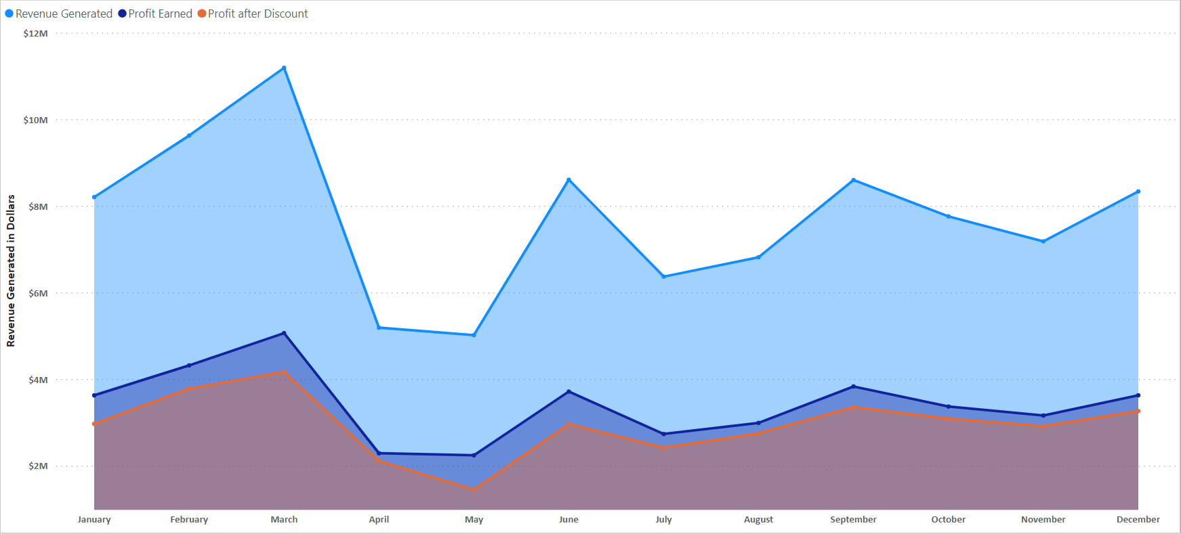
REVENUE AND PROFIT GENERATED
Overall Revenue which was Generated in these 3 Years is approx. 92.87 Million dollars.
Profit which could have been generated without giving discount is 40.93 Million dollars Approx
Actual Profits made after providing discounts to the customer sums up to be 35.19 Million dollars approx.

Slide 10

CONCLUSION
Highest Revenue was generated in the year 2017 which is 43.11 Million dollars approximately.
Highest profit after giving discount was also generated in the year 2017 which is 19.40 Million dollars approx.
It is observed that the sales and profits generated in the summer months is significantly low (April, May etc.)
According to the monthly trends we can observe that we have earned maximum profit in the months of Feb-March
Frozen Cheese Pizza is the most popular product which is ordered by a lot of people and which in turn gives us the maximum profit.

Slide 11
THANK YOU

