Slide 1
Determining Your Location Using Wi-Fi
Michael Tripp
Dr. John Bonomo, Advisor

Slide 2

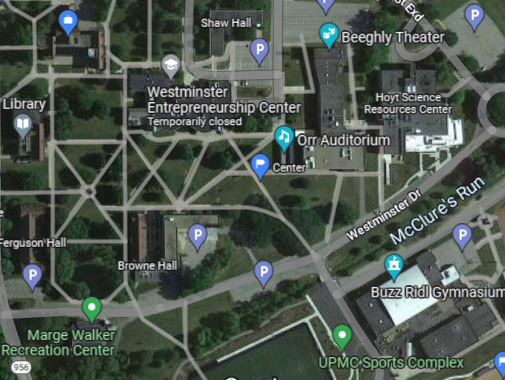

Wi-Fi Positioning
Determines location using Wi-Fi
Similar to GPS, but
Requires on-site survey
Can have much higher
accuracy!

Slide 3
How do we do this?
Collect necessary data from Wi-Fi access points
Use signal strength data to calculate relative distance
Approximate user device location using Wi-Fi trilateration

Slide 4
How do we do this?
Collect Wi-Fi data
Calculate distance
Find location (Tada!)

Slide 5
1. Collect Data

Slide 6
Necessary Data
Exact locations of access points
Collect lat/lon using Google Maps
AP Signal strength

Slide 7
Windows WLAN API
Utilize following method:
WlanGetAvailableNetworkList()
Collect specific data
BSSID (mac address)
RSSI (received signal strength indicator)
SSID (network name)

Slide 8
2. Calculating Distance

Slide 9

Free Space Path Loss (FSPL) Formula
Converts RSSI into approximate distance
Input:
RSSI (dBm)
Frequency (2400 MHz = 2.4 GHz)
Output:
Distance (m)
$$distance={10}^{\left(\frac{\left(27.55 − \left(20 ∗\log_{10}\left(frequency\right)\right) + RSSI\right.}{20}\right)}$$

Slide 10
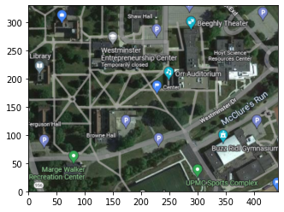
Correct Distance
Need everything in same unit
Convert lat/lon into metric units

Slide 11
3. Finding Location

Slide 12
Wi-Fi Trilateration
Produce one circle for each AP
Intersection = device location
NOTE: Need everything in same unit
Convert lat/long to metric units

Slide 13

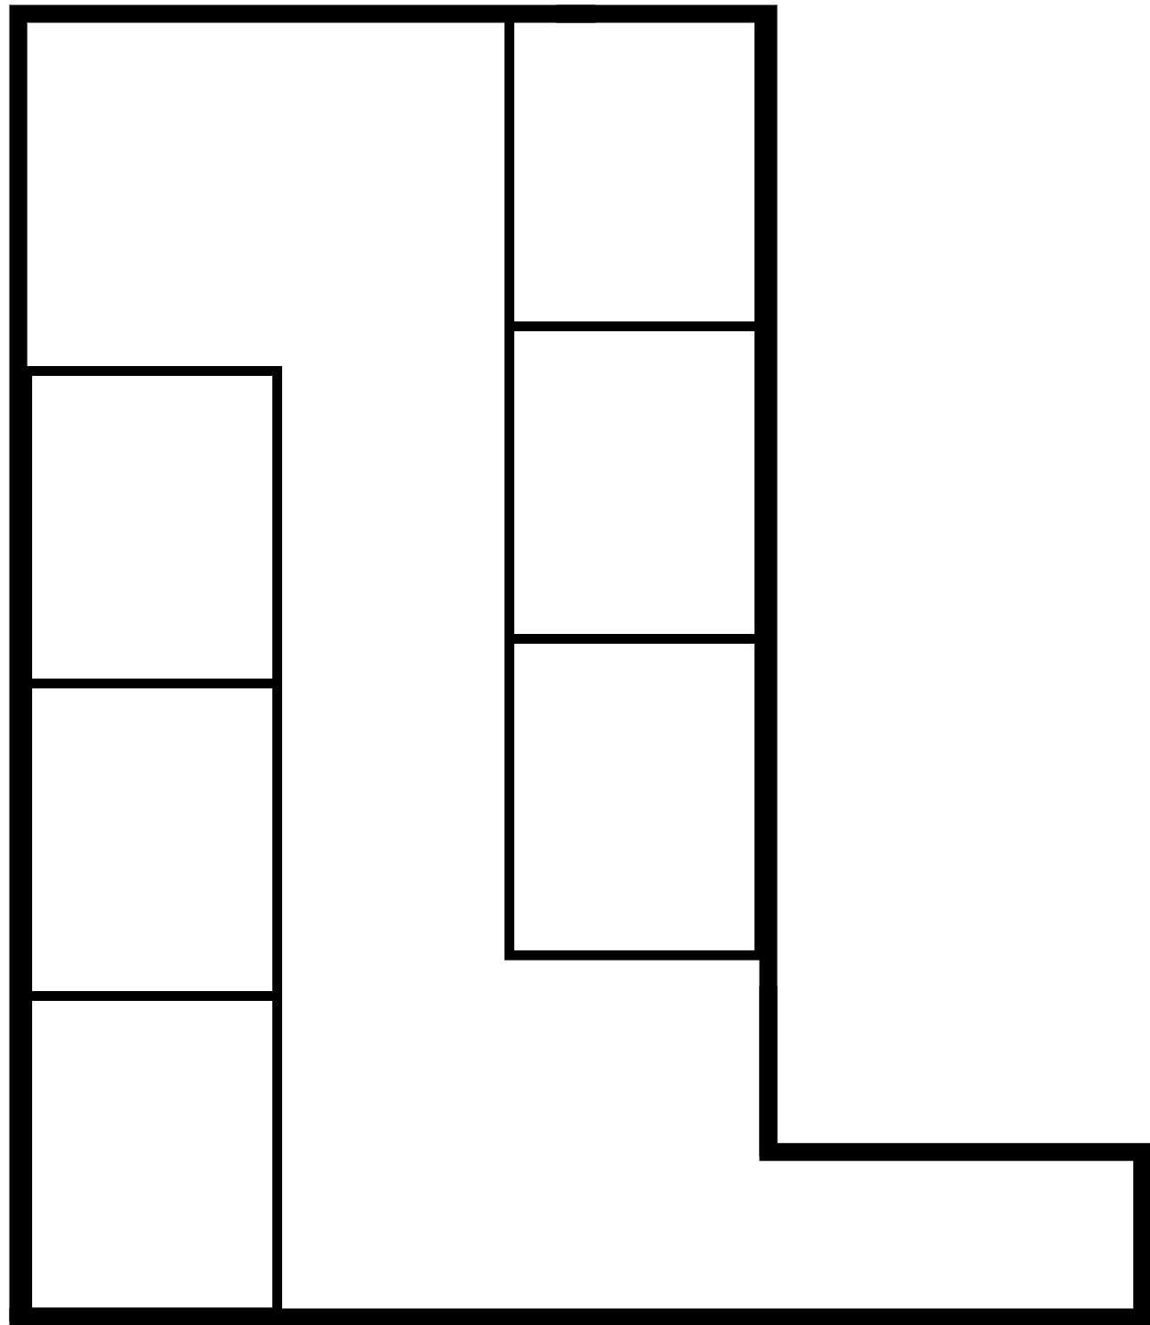


3 m
-50 dBM
(lat3, lon3)
(x3, y3)
(x, y)
5 m
(?, ?)
-55 dBM
(lat2, lon2)
(x2, y2)
7 m
-57 dBM
(lat1, lon1)
(x1, y1)
$$RSSI →Distance$$
$$\left(lat, lon\right)→\left(x,y\right) in m$$

Slide 14
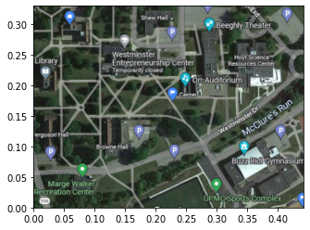
Problem!
NOTE: need exact locations of all APs!
Need everything in the same unit
Solution: convert lat/long into metric units

Slide 15
Results
Phone GPS not accurate enough

Slide 16
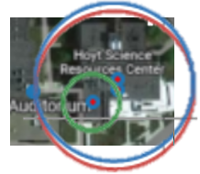
Thank You

Slide 17
