Slide 1
Case Study 7: Minimizing Losses on a Classification Problem
Matthew D. Cusack

Slide 2
Introduction:
The Problem:
The financial performance of the production process is under scrutiny due to recurrent losses incurred upon incorrect predictions by the current classification model.
Each misprediction of class 1 results in a loss of $100, while each misprediction of class 0 leads to a loss of $40.
The paramount concern is to mitigate financial hemorrhage and enhance profitability within the production system.
The Solution:
The primary objective is to develop a predictive model that optimizes financial outcomes by minimizing these losses.
The overarching goal is to construct a model that accurately predicts classes to curtail monetary losses, thereby fostering a cost-effective operational environment.

Slide 3
The Data
Initial Data: ‘final_project(5).csv’
Rows/Observations: 160000
Columns/Features: 51
‘y’: (Binary value of either 1 or 0)
x0-x49: features 0-49 with unknown description
Preprocessed Data:
Rows/Observations: 160000
Columns/Features: 68
This is increased due to one-hot encoding each of the categorical variables for each of their levels.
Cleaned Data
Rows/Observations: 158480
(-1520 or 0.0095%)
Using DropNa to remove all rows with NaN values
Columns/Features: 68

Slide 4
Preparing the Data: Preprocessing
Loading the Dataset:
Utilizing the Pandas library, the dataset is loaded into a DataFrame named "data".
The shape and data types of each column in the dataset are displayed to provide an initial overview.
Data Cleaning:
Two specific columns, 'x32' and 'x37', require cleaning.
'%' is removed from column 'x32', and the resulting values are converted to floats.
‘$' is removed from column 'x37', and the resulting values are also converted to floats.
Handling Categorical Columns:
The script identifies categorical columns based on their data type.
For each categorical column, the first 3 lines are displayed to provide a glimpse of the data.
One-Hot Encoding:
Categorical columns are one-hot encoded to transform them into a numerical format suitable for machine learning algorithms.
This step expands the dataset by creating binary columns for each category.
Handling Missing Values:
Basic information about the preprocessed dataset before and after dropping rows with missing values (NaN) is displayed.
Rows containing missing values are removed from the dataset to ensure data integrity and model performance.
Saving the Preprocessed Dataset:
The preprocessed dataset is saved as a new CSV file named "PPDataDNA.csv" for future use in machine learning tasks.

Slide 5
Untuned Models Tested: Money Lost
XGBoost Classifier: -$151,960
An optimized gradient boosting library that's highly efficient and scalable. It offers parallel and distributed computing capabilities and has been widely used in various machine learning competitions due to its exceptional performance.
Random Forest Classifier: -$153,240
An ensemble learning method that builds multiple decision trees during training and outputs the mode of the classes as the prediction. It's known for its robustness and ability to handle large datasets with high dimensionality.
Gradient Boosting Classifier: -$332,120
Another ensemble technique that builds trees sequentially, where each tree corrects the errors made by the previous one. It typically yields high predictive accuracy and is robust to overfitting.
Support Vector Machine (SVM) Classifier: -$448,240
A powerful classification algorithm that finds the hyperplane that best separates the classes in the feature space. It works well in high-dimensional spaces and is effective for cases with clear margin of separation.
Logistic Regression: -$616,740
A simple yet effective linear classification algorithm. It models the probability of the default class (class 1 in this case) as a function of the independent variables. It's easy to interpret and can provide insights into the relationships between features and the target variable.

Slide 6
Improving the Top Two Models
Fine-tuning will be done on the two models which had the lowest losses without tuning
XGBoostClassifier had the best performance by this rating.
RandomForestClassifier had the second-best performance
GridSearchCV is used to determine the best hyperparameters for these models. This should further improve their performance and therefore save more money.

Slide 7
Fine Tuning the XGBoost Classifier Model
A parameter grid was created to run a gridsearch from
'missing': [-999, np.nan]
'silent': [True, False]
'nthread': [-1, 1, 4]
The best parameter settings out of those tuned:
'missing': -999
'nthread': -1
'silent': True

Slide 8
Fine-Tuning the Random Forest Classifier Model
A parameter grid was created to run a gridsearch from
'n_estimators': ['100', '1000', '2000']
'criterion': ['gini', 'entropy', 'log_loss']
'max_depth':[None, 5, 10, 15]
'min_samples_split':[2, 5, 10]
'min_samples_leaf':[1, 5, 10]
'max_features':["auto", "sqrt", "log2"]
'max_leaf_nodes':[None, 10, 20, 30]
'min_impurity_decrease':[0.0, 0.1, 0.2]
The best parameter settings out of those tuned:
"max_depth": null,
"min_samples_leaf": 1,
"min_samples_split": 5,

Slide 9
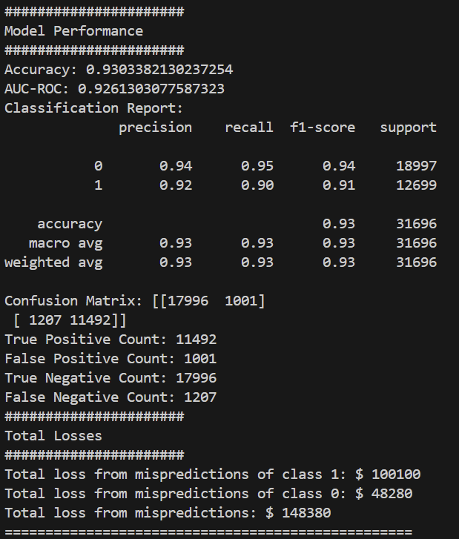
XGBoost Classifier: Training & Evaluating the Model
Training:
The data undergoes an 80/20 split to create the training and testing sets.
The data is fit on the X_train and y_train
Evaluation:
Once it is fit, it can be evaluated on the X_test and y_test data on whether the model can properly predict the value of the “y” column.
The following scores were obtained from evaluating the model:
Accuracy: 93.03%
AUC-ROC: 92.61%
Total Monetary loss: $148,380

Slide 10
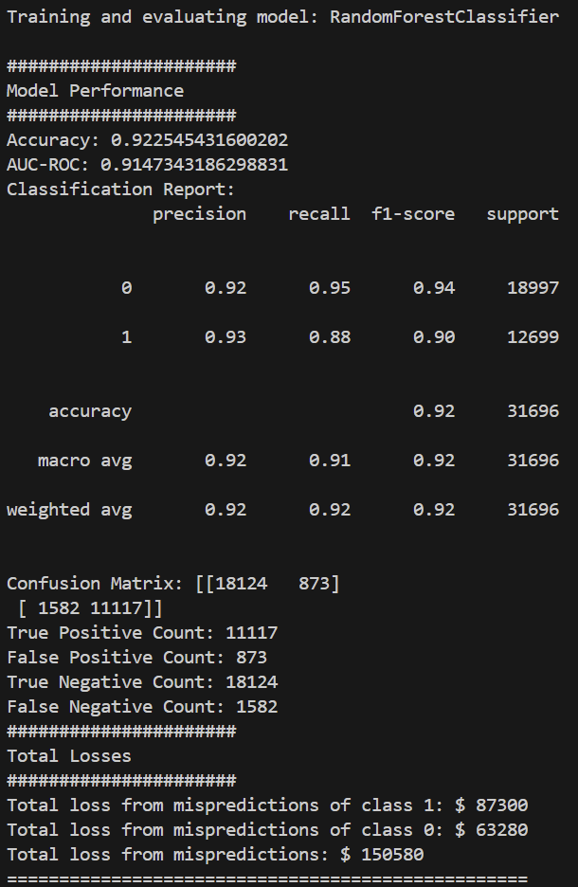
Random Forest Classifier: Training & Evaluating the Model
Training:
The data undergoes an 80/20 split to create the training and testing sets.
The data is fit on the X_train and y_train
Evaluation:
Once it is fit, it can be evaluated on the X_test and y_test data on whether the model can properly predict the value of the “y” column.
The following scores were obtained from evaluating the model:
Accuracy: 92.25%
AUC-ROC: 91.47%
Total Monetary loss: $150,580

Slide 11
XGBoost Classifier: Discussion of Metrics
Using these metrics, the following can be learned about the model:
Accuracy: 93.03%
The model achieved an accuracy of 93.03%, indicating its high level of correctness in classifying instances into their respective classes
AUC-ROC: 92.61%
With an AUC-ROC score of 92.61%, the model demonstrated a strong ability to differentiate between positive and negative classes.
Total Monetary loss: $148,380
The total monetary loss associated with mispredictions was $148,380, underscoring the significance of considering economic implications when assessing model performance
Improvement of $3,580 from being untuned

Slide 12
Random Forest Classifier: Discussion of Metrics
Using these metrics, the following can be learned about the model:
Accuracy: 92.25%
The model achieved an accuracy of 92.25%, indicating its ability to correctly classify instances into their respective classes.
AUC-ROC: 91.47%
The AUC-ROC score of 91.47% suggests the model's strong ability to distinguish between positive and negative classes.
Total Monetary loss: $150,580
The total monetary loss associated with mispredictions was $150,580, highlighting the importance of considering the economic impact of model decisions in real-world applications.
Improvement of $2,660 from being untuned

Slide 13
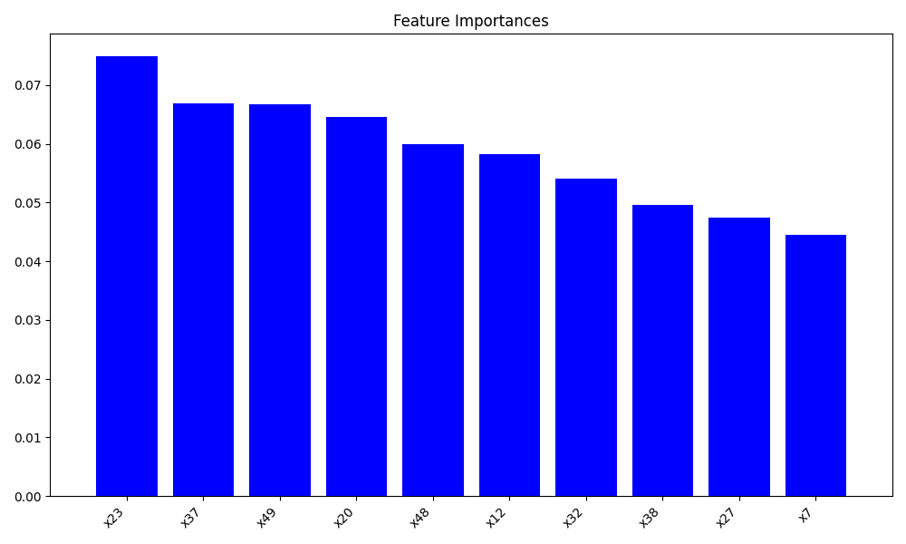
XGBoost Classifier: Important Features of the Model
After scoring the model, it is important to know which features had the most weight in obtaining these values.
The features shown were deemed most important to the model using the accuracy metric as the scoring metric.
These features are ambiguous in their meaning.
These features should be the focus of further research for understanding of this unknown topic.

Slide 14
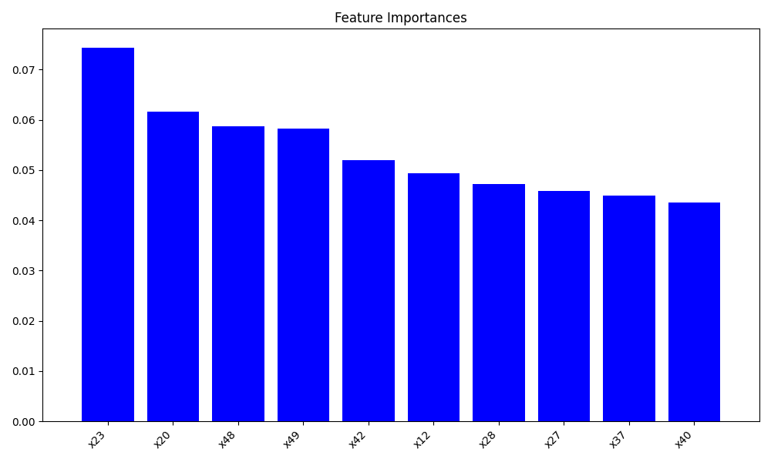
Random Forest Classifier: Important Features of the Model
After scoring the model, it is important to know which features had the most weight in obtaining these values.
The features shown were deemed most important to the model using the accuracy metric as the scoring metric.
These features are ambiguous in their meaning.
These features should be the focus of further research for understanding of this unknown topic.

Slide 15
The “Best” Model: Metrics
The “Best” model in this case was determined to be the XG Boost Classifier Model.
The XGBC model overall had better metrics when compared the Random Forest Classifier model.
Accuracy: 0.78%
AUC-ROC: 1.14%
While the XGBC model required minimal tuning and completed training and evaluation swiftly, the Random Forest Classifier had considerably longer tuning, training, and evaluation durations.

Slide 16
The “Best” Model: Money
MOST IMPORTANTLY
This model was the one that will lose less money due to mispredictions.
$148,380 total loss
$2,200 < Tuned Random Forest Classifier
Further understanding of this model could be obtained if the models were tested on holdout data or newly gathered data from the client.

Slide 17
References
Chat GPT 3.5 was used for debugging and model definitions.
Code can be found at https://github.com/Mcusac/Penny-Pincher-Case-Study.

