Slide 1

Case Study 2: Logistic Regression
Matthew D. Cusack

Slide 2
Introduction: The Problems
The Data Problem:
There is quite a bit of missing data present. This will likely cause problems in making the model.
The Data Solution:
This missing data will be imputed. This will help to retain as much data as possible.
The Ultimate Problem:
Be able to predict the readmittance status of a patient given their recorded information.
This is a classification type of problem.
The Ultimate Solution:
To build a classifier using logistic regression to predict hospital readmittance. There is missing data that must be imputed.
Discuss variable importances.

Slide 3
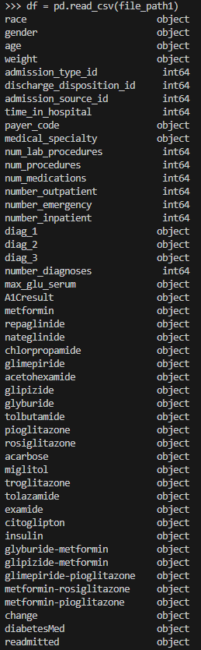
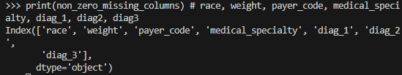
The Data
‘diabetic_data.csv’
50 features/columns
101766 inputs/rows
Quite a few missing values among 7 features:
Race (2273), weight (98569), payer_code (40256), medical_specialty (49949), diag_1 (21), diag_2 (358), diag_3 (1423)
No metadata file available so the meaning of some features will be inferred.
‘IDs_mapping.csv’
Descriptions of the following feature values: ‘admission_type_id’, ‘discharge_disposition_id’, and ‘admission_source_id’

Slide 4
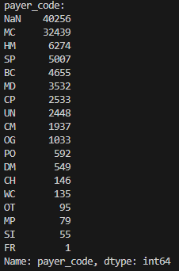
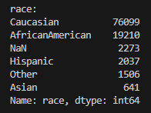
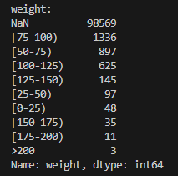
Missing Data
Each feature with missing values was explored.
‘race’ (2273): Race is known to be quite important when it comes to outcomes among patients. Diving into this could be a project of its own; as such, it will be difficult to properly impute values for this feature.
‘weight’ (98569): Weight is also known to be an important health factor. There are many more NaN values then there are recorded values which will cause difficulty imputing values as the true
‘payer_code’ (40256): This is a two-letter code signifying the payer. The importance of this feature to the model will need to be discovered. The mode maybe the appropriate imputation choice for this feature.

Slide 5
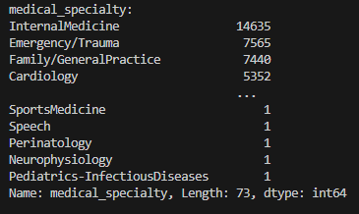
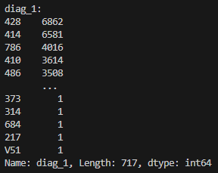
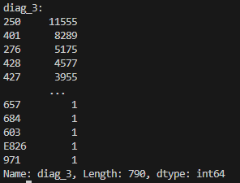
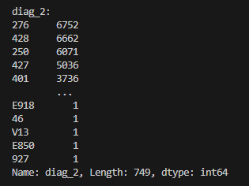
Missing Data cont.
‘medical_specialty’ (49949): Represents what kind of specialty the physician has that this patient saw. This may be able to be imputed with the mode, however, marking them as a separate level of ‘other’ may be appropriate.
Diagnosis Types 1-3: These are likely able to be imputed with the mean for each feature as there are a smaller portion of the data.
‘diag_1’ (21): Diagnosis type 1
‘diag_2’ (358): Diagnosis type 2
‘diag_3’ (1423): Diagnosis type 3

Slide 6
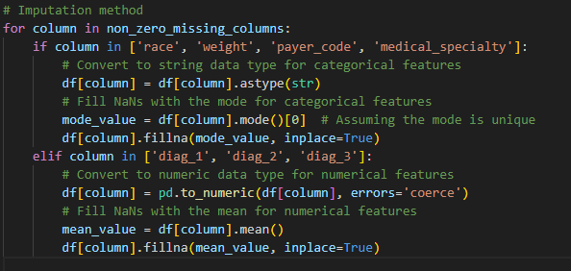
Methods: Data Imputation
The mode was used for the imputation the features of 'race', 'weight', 'payer_code’, and 'medical_specialty’. These features were better represented as strings; so, the data type of these features was changed from int64 to strings, and the mode was used to impute the missing data.
The mean was used for imputation of the features of 'diag_1', 'diag_2', 'diag_3’. These features were converted to numeric from int64 so that the mean could be calculated. This mean was then imputed into the locations of missing data in each feature.

Slide 7
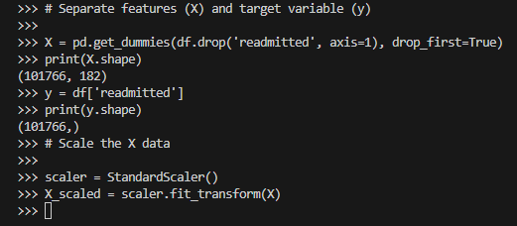
Preparation for the Model
The data is separated into X and y where X is the dataset without the target feature and y is the target feature.
When creating the X variable, .get_dummies() was used to factor each of the categorical features present.
In this case the target feature is ‘readmitted’.
After the target variable is separated, the data is scaled using StandardScalar() as Logistic Regression can often benefit from doing this.
Only X is scaled as it is not normally necessary to scale what we are predicting. This X_scaled will be used when creating the training and testing sets of data.

Slide 8
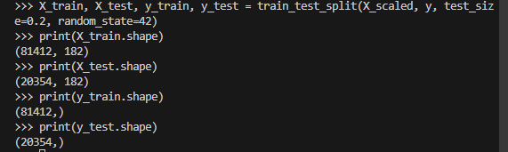
Preparation for the Model cont.
After the data is scaled, the data is split between a training set and a test set. The X_scaled and y are turned into X_train, X_test, y_train, and y_test.
These will be the X and y variables for training the model and then testing and evaluating the model.
In each of these cases, the size of the variable can be confirmed using ‘.shape’, reassuring that these variables are changing in size.
The

Slide 9
The Model
As this is a classification problem, the type of model being used is a Logistic Regression model.
The target feature that this Logistic Regression model should be able to predict is the ‘readmitted’ feature (either Yes or No) based on the remaining features.
The model is initialized using 1000 max iterations with other settings set to default.
Grid Search was then performed on the model to improve its performance.

Slide 10
Grid Search
A grid search cross-validation was done using the model to determine the best hyperparameters for this model.
A 5-fold cross was done in the grid search
The ‘penalty’, ‘C’, and ‘solver’ hyperparameters were of focus
The best hyperparameters were determined after some time. The following hyperparameter settings were deemed to be the best by the grid search.
We can now apply these best hyperparameters to the model to improve from the base logistic regression model.

Slide 11
Testing the Model
After the best Hyperparameters were determined, the model is then fit on the training data (X_train and y_train).
After fitting the model, it can now be used on the X_test data to make predictions (y_pred).
These predictions are then run alongside the y_test data that was previously set aside.
We can then evaluate how well this Logistic Regression model was able to perform with this data using the metric(s) of choice.

Slide 12
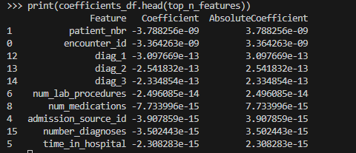
Important Features
It is also important to explore which features had the greatest importance on the model.
The coefficients represent the influence on the logistic regression model each variable has with the sign being representative of how it affects the model.
The higher the absolute value of the coefficient, the more of an influence the feature had on the model.
The top 10 most influential features of the model were narrowed down using the absolute value of the coefficient.

Slide 13
Important Features cont.
Each of the following features was found to have a negative coefficient:
patient_nbr, encounter_id, diag_1, diag_2, diag_3, num_lab_procedures, num_medications, admission_source_id, number_diagnoses, time_in_hospital
The presence of the negative coefficients indicate that an increase in any of these individual feature values will be associated with a decrease in the log-odds of the positive class.
‘patient_nbr’ has the greatest of these absolute values with ‘encounter_id’ being somewhat close behind. The exponential value begins to increase (in the negative direction) as we continue down the top 10 list.

Slide 14
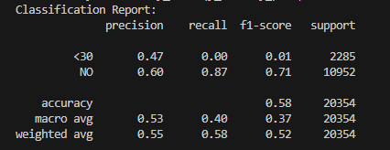
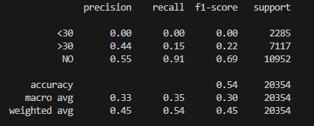
Metrics
With Grid Search
The model resulted with an overall Accuracy metric of 0.58. This is not very high and could likely be improved.
Without Grid Search
When observing the Classification report printed before the Grid Search, we see that <30 group has 0’s for the metrics of precision, recall and f1-score. This is different from the other two levels.
The >30 group has precision of 0.44, while its recall and f1-score are markedly lower.
The NO group had the highest overall of each off the three metrics when compared to the other two.
With Grid Search
Precision of the <30 increases greatly while f1-score slightly increases
Without Grid Search

Slide 15

Metrics cont.
When considering the models ability when predicting <30, a notable difference can be seen in its performance than compared to when the model is predicting values of either >30 or NO.
This means that the model is better at being able to get the answer of NO than it at getting the answer of >30 and even better still at getting the answer of <30.
Something to consider is the value counts of each of these levels within the readmitted feature. With greater values by large margins, it makes sense that the model is more easily able to get the answer of NO correct.
In the same sense the model is not as likely to come across the answer of <30. This can drive its stats down as the model is less likely to then get the prediction of <30 correct.

Slide 16
Discussion
In conclusion, a Logistic Regression model was able to be created that was able to predict which level of ‘readmitted’ a patient would fall under with BLANK success.
Without use of a grid search, the accuracy of the model was a little better than a coin flip (0.54) after the addition of a grid search it was a little better than a coin flip (0.58)
The Grid Search did not greatly improve the model.
There is likely to be a lack of external validity for this model as so many data points needed to be imputed to begin construction of the model.

