Slide 1
Case Study 5: Predicting the class of an internet connection request
Matthew D. Cusack

Slide 2
Introduction:
The Problem:
A big company is requesting a program about whether to accept or deny access to internet requests coming in.
They want this system automated as their current system is taking up a lot of manpower and a lot of resources.
The Solution:
Create a model that can filter incoming requests.
The model will be able to classify an incoming request as to either allow or not allow access.

Slide 3
The Data
Size/Shape:
65532 Rows/Observations
12 Columns/Features:
Source Port
Destination Port
NAT Source Port
NAT Destination Port
Action
Bytes
Bytes Sent
Bytes Received
Packets
Elapsed Time (sec)
pkts_sent
pkts_received

Slide 4
The Models: SVC
SVC (Support Vector Classifier)
sklearn implementation of SVM algorithms
Purpose: Classification tasks. It finds a hyperplane that best separates the data points belonging to different classes.
Strengths:
Effective for high-dimensional data.
Performs well with a small number of training samples.
Good for tasks involving interpretability, as the decision boundary can be visualized.
Weaknesses:
Can be computationally expensive for very large datasets.
Sensitive to parameter tuning, requiring careful grid search.
Not suitable for multi-class classification problems by default (requires additional steps).

Slide 5
The Models: SGDClassifier
SGDClassifier builds upon SGD specifically for classification.
Purpose: Classification tasks. It uses Stochastic Gradient Descent (SGD) for efficient learning and can handle various classification problems.
Strengths:
Efficient for large datasets due to its incremental learning approach.
Flexible with various loss functions (e.g., hinge loss for SVMs, logistic loss for logistic regression).
Can be regularized to prevent overfitting.
Offers some interpretability, especially with linear kernels.
Weaknesses:
Might not always converge to the optimal solution, requiring careful hyperparameter tuning.
Performance can vary depending on chosen loss function and hyperparameters.
Less interpretable compared to some decision tree-based models.

Slide 6
Methods: Preparing the Data
After reading in the data from the “log2.csv” file provided, the target column is separated from the rest of the columns.
The “Action” column is the target feature that the models will try to predict.
This feature is representative of the action taken of either providing or not providing internet access.
After the target is properly separated the data will be split into the training and testing sets.

Slide 7
SVM: Creating & Fine-Tuning the Model
The SVM model is initiated with its default parameters
A parameter grid dictionary is created for the different hyperparameters of SVM that will be tested.
‘kernel’:
‘linear’
‘rbf’
‘C’:
0.1
1
10

Slide 8
SVM: Running and Evaluating the Model
After determining and saving the best hyperparameters for the model a best SVM model is made with these parameters.
The best model will then be trained on the training data made previously (X_train & y_train).
After being trained, the model will use the X_test dataset to predict values for the target feature (Action).
Using the actual answers (y_test), the model can be evaluated based on accuracy, precision, and recall.

Slide 9
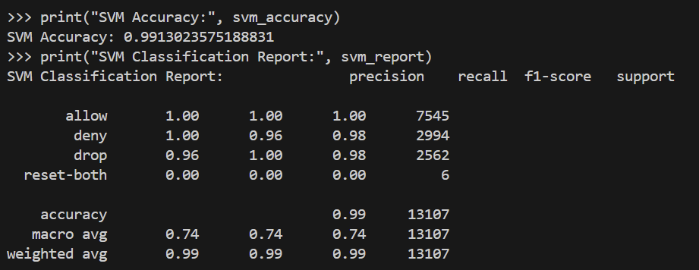
SVM: Metrics of Model
The following scores were obtained from evaluating the model:
Accuracy: 99.13%
Precision: 100%
Recall: 96%

Slide 10
SVM: Discussion of Metrics
Using these metrics, the following can be learned about the model:
Accuracy: 99.13%
This high score indicates that the model is performing well overall, making a good number of correct predictions across all classes.
Precision: 100%
Most of the negative labels the model assigns are indeed correct.
Recall: 96%
Such a high recall score shows the model is great at capturing all the actual positive cases, decreasing false negatives.

Slide 11
SGD: Fine-Tuning the Model
The SGD model is initiated with its default parameters aside from the ‘loss’ parameter which was set to ‘hinge’
A parameter grid dictionary is created for the different hyperparameters of SGD that will be tested.
‘loss’:
‘hinge’
'penalty’:
'l1’
'l2’
'alpha':
0.0001
0.001
0.01

Slide 12
SGD: Running and Evaluating the Model
After determining and saving the best hyperparameters for the model a best SGD model is made with these parameters.
The best model will then be trained on the training data made previously (X_train & y_train).
After being trained, the model will use the X_test dataset to predict values for the target feature (Action).
Using the actual answers (y_test), the model can be evaluated based on accuracy, precision, and recall.

Slide 13
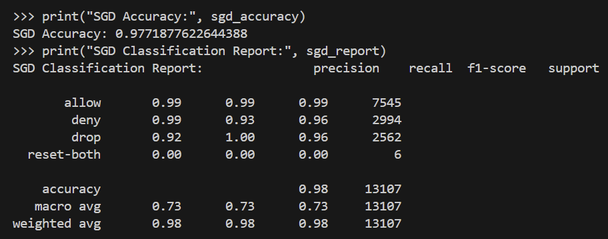
SGD: Metrics of Model
The following scores were obtained from evaluating the model:
Accuracy: 97.72%
Precision: 99%
Recall: 93%

Slide 14
SGD: Discussion of Metrics
Using these metrics, the following can be learned about the model:
Accuracy: 97.72%
This high score indicates that the model is performing well overall, making a good number of correct predictions across all classes.
Precision: 99%
Most of the negative labels the model assigns are indeed correct.
Recall: 93%
Such a high recall score shows the model is great at capturing all the actual positive cases, decreasing false negatives.

Slide 15
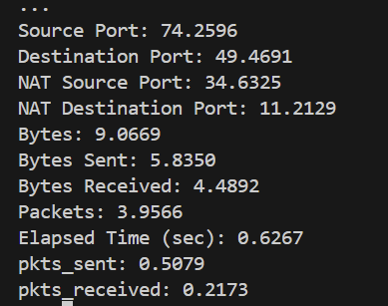
SGD: Important Features of Model
After scoring the model, it is important to know which features had the most weight in obtaining these values.
The following features were deemed most important to the model using the accuracy metric as the scoring metric:
Source Port
Destination Port
NAT Source Port
NAT Destination Port
These features should be the focus of further research for cybersecurity.

Slide 16
The “Best” Model
The “Best” model was determined to be the SGDClassifier model.
This model had somewhat lower metrics than the SVC model but not greatly.
These high metrics from the SVC model may indicate some overfitting of the model.
Further understanding of the best model could be understood if the models were tested on holdout data.
It will be advised that the Cyber Security use the SGDClassifier model as it is both faster and has great evaluation metrics.

Slide 17
References
Google Gemini was for debugging and model definitions
Code attached in .py file

