Slide 1
Case Study 3: Naïve Bayes & Clustering
Matthew D. Cusack

Slide 2
Introduction:
The Problem:
IT given the task of creating a classifier that identifies spam email messages.
Among all emails received, there are many spam messages present. Too many spam messages makes it hard to find actual emails that may be important too the individual.
The Solution:
A Naïve Bayes clustering method will be trained off the provided email messages. The accuracy of this classifier will be observed along with a confusion matrix to understand its performance better.

Slide 3
The Data
The emails are split into five folders labeled easy_ham, easy_ham_2, hard_ham, spam, and spam_2.
The files labeled with ham are files that contain non-spam emails.
There are two difficulty levels of easy (1 and 2) and hard which indicates the difficulty of identifying the email type.
The files labeled with spam are files that contain spam emails.
Each labeled file contain within it individual emails that fall into the category of either spam or ham given the file name.
The content of these emails is what will make up the ‘Content’ Column when all these emails are together.

Slide 4
Methods: Making the Data
These emails will need to be put together in a data frame so that model may be run on this data.
This new data frame containing all the emails with their labels will be what the model is trained from.
A new csv file was created based off these five folders and the emails contained within them.
This file contains all the emails separated into the columns of Content and Label.
The Content is the text within the email while the Label denotes whether the email is spam or ham

Slide 5
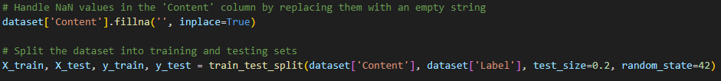
Preparing the Naïve Bayes Model
The newly created dataset loaded into python.
All NaN values for ‘Content’ column were replaced with an empty string ‘ ‘.
The dataset was then split into X_train, X_test, y_train, and y_test where ‘Content’ represents X and ‘Label’ represents y or the target variable.
The X_train and X_test data are then vectorized using ‘CountVectorizer()’ to turn the text data into numerical data.

Slide 6
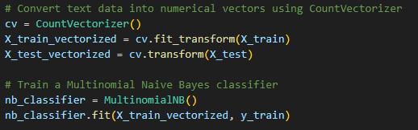
The Naïve Bayes Model
The Naïve Bayes Clustering method will be used to classify the emails as either spam or ham.
MultinomialNB is loaded in as the model.
This model is then fit on the previously vectorized X_train (X_train_vectorized) and the y_train data.

Slide 7
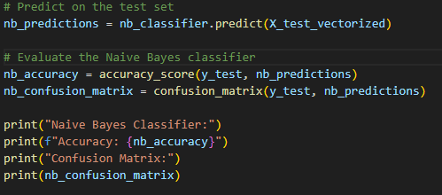
Running the Naïve Bayes Model
After having the fit model, it is then run on the X_test_vectorized data to make predictions for what it believes the y_test values would be given the ‘Content’ column.
Once these predictions are obtained, they can be run against the y_test values to obtain the accuracy metric for the model.
A confusion matrix was also created in order to give a better understanding of the ratio of false and true positives to false and true negatives.

Slide 8
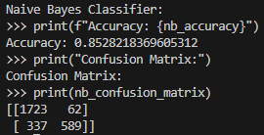
Results: Metrics from the Naïve Bayes Model
The accuracy score of the Naïve Bayes model was: 0.853
The confusion matrix allowed for greater insight on the model.
True Positives: 1723
False Positives: 62
True Negatives: 589
True Positives: 337

Slide 9
Discussion: Metrics from the Naïve Bayes Model
Out of the 2711 instances there were:
1723 instances where the model was able to correctly identify spam emails.
62 instances where the model incorrectly identified an email as spam.
589 instances where the model was able to correctly identify non-spam emails.
337 instances where the model incorrectly identified an email as non-spam.
The accuracy of our model can be calculated from the values in this matrix. We can take the number of times the model predicted correctly over all instances of the model guessing.
True Predictions / All Predictions = 2312 / 2711 = 0.853

Slide 10
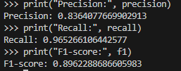
Discussion: Metrics from the Naïve Bayes Model cont.
Accuracy may not be the best metric to use in this case as the classes are quite imbalanced with ham having a much greater value than spam.
As such other metrics were found:
The precision score (0.836) denotes the model is quite good at classifying an email as ham when it is actually ham.
The recall score (0.965) shows the model is excellent at catching the ham emails.
The F1-Score (0.896) denotes the model has a great balance between precision and recall.

Slide 11
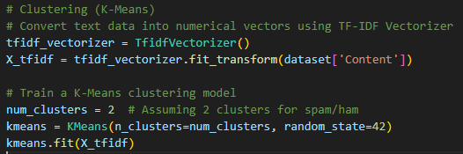
Preparing the K-Means Model
The ‘TfidfVectorizer()’ will be used in this case for vectorizing the text data.
Beginning with the created email dataset, the ‘Content’ column will be vectorized to convert the text data into numerical vectors while also using the ‘.fit_transform()’ function to prepare for fitting the K-Means model.
The K-Means model is then fit on the X_tfidf data created previously.

Slide 12
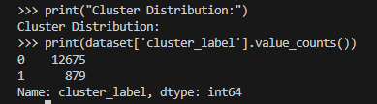
Running the K-Means Model
After fitting the K-Means model to the data, the Cluster Distribution can be printed.
When printing the Cluster Distribution, it will depict the number of clusters previously chosen and how many emails fall into those clusters.
These two clusters are likely representative of the ham (12675) and spam (879) groupings

Slide 13
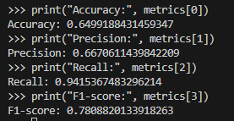
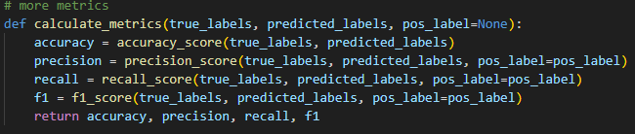
Results: Metrics from the K-Means Model
After running the model, the model is then evaluated on its performance using certain metrics to denote this performance.
The following metrics were obtained:
Accuracy: 0.650
Precision: 0.667
Recall: 0.942
F1 Score: 0.781

Slide 14
Discussion: Metrics from the K-Means Model
The scores on some of the metrics were not particularly high.
The accuracy score (0.650) denotes that the model was able to correctly identify emails as either ham or spam about 2/3 of the time.
The precision score (0.667) was nearly the same showing the model was able to classify ham correctly only about 2/3 of the time.
The recall score (0.942) was quite high denoting that the model was able to do quite well at identifying when a spam email is actually a spam email.
The F1 Score (0.781) is relatively high indicating a good balance between precision and recall scores. This makes sense as the two scores are quite close in value.

Slide 15
The ‘Best’ Model
Given the metrics as well as the topic of focus, the Naïve Bayes model was the better model for classifying the type of email that was received as either spam or ham (non-spam).
The Naïve Bayes model has an F1-Score of 0.896 while the accuracy of the K-Means model had an F1 Score of 0.781.
Increasing the number of clusters in the K-Means model or perhaps using a different initialization algorithm would possibly increase the model’s capabilities. However, with less preparation the Naïve Bayes model appears to be the better suited model for this problem.
It is important to note that there is an imbalance of ham to spam emails which can result in metrics that may not be truly representative of the models’ abilities.
This is why the F1-Score is being used in this case as it considers recall and precision scores whereas accuracy is not likely the best metric to use in this case.

