Slide 1
Case Study 6:
Matthew D. Cusack

Slide 2
Introduction:
The Problem:
The client from the superconductors is once again requesting our aid.
They've come to us with a pretty advanced data set on some complex science. What they're asking us to do is take their data, and run it, and try to predict the existence of a new particle.
The Solution:
Build a dense neural network to accurately detect the particle.
The goal is to maximize the accuracy of the model.

Slide 3
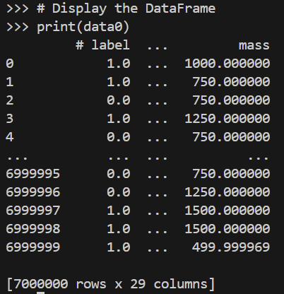
The Data
‘all_train.csv’
Rows/Observations: 7,000,000
Columns/Features: 29
# label: (1/0)
mass: mass of particle
f0-f27: features 0-27

Slide 4
The Model: Dense Neural Network
Architecture:
Dense neural networks consist of layers of neurons arranged in a sequence, with each layer fully connected to the next.
There are typically three types of layers: input layer, hidden layers, and output layer.
Input Layer:
The input layer receives the raw input data or features and passes them on to the subsequent layers.
Hidden Layers:
Hidden layers perform transformations on the input data through weighted sums and activation functions.
Each neuron in a hidden layer receives input from all neurons in the previous layer and passes its output to all neurons in the next layer.
Output Layer:
The output layer produces the final output of the network, such as class probabilities in classification tasks or numerical predictions in regression tasks.
The number of neurons in the output layer depends on the nature of the problem. For example, in binary classification, there might be one neuron for each class with a sigmoid activation function, while in multi-class classification, there could be multiple neurons with softmax activation.

Slide 5
The Model: Dense Neural Network (cont.)
Activation Function:
Each neuron typically applies an activation function to the weighted sum of its inputs to introduce non-linearity into the network.
Common activation functions include ReLU (Rectified Linear Unit), sigmoid, tanh, and softmax.
Training:
Dense neural networks are trained using optimization algorithms such as gradient descent and its variants.
During training, the network adjusts the weights and biases of the connections between neurons to minimize a chosen loss function, which measures the difference between predicted and actual outputs.
Applications:
Dense neural networks are used in a wide range of applications, including image classification, natural language processing, speech recognition, and financial forecasting.
They are effective for tasks where there are complex patterns or relationships in the data that need to be learned from examples.

Slide 6
The Model: A Sequential Model
A Sequential model in neural networks is a linear stack of layers where each layer has exactly one input tensor and one output tensor.
It is called "sequential" because the layers are added sequentially, one after the other.
It's the simplest type of model in Keras, making it easy to create and understand.
Sequential models are suitable for building feedforward neural networks where the data flows from the input layer through the hidden layers to the output layer without any feedback connections or loops.
Sequential models are often used for tasks such as classification and regression.

Slide 7
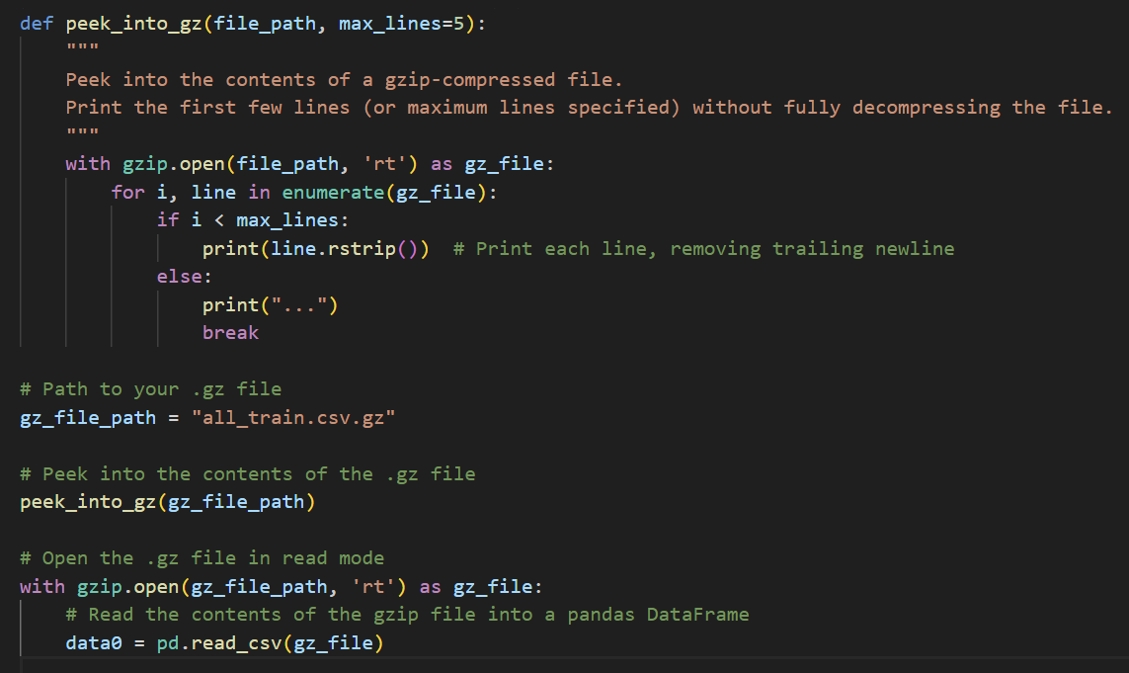
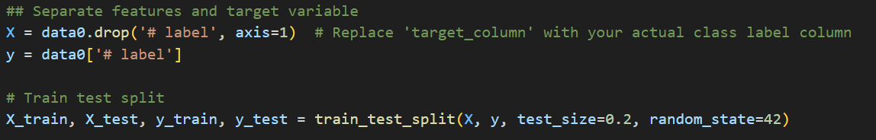
Methods: Preparing the Data
As the file is very large, the .gz file of the data is first “peeked into” to get a glimpse of what the data will be looking like.
After this .gz file is read into using gzip and the .csv contained within is then read by the read_csv function.
After reading in the data from the “.csv” file provided, the target column is separated from the rest of the columns.
The “# label” column is the target feature that the models will try to predict.
This feature is representative binary value of either 1 or 0.
After the target is properly separated the data will be split into the training and testing sets.

Slide 8
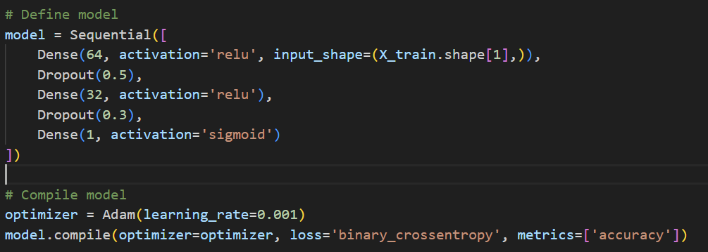
Creating the Model
Network Architecture:
The sequential model architecture consists of three dense layers with 64, 32, and 1 units, respectively.
ReLU activation functions are used for the hidden layers, and a sigmoid activation function is used for the output layer to ensure outputs are within the range [0, 1].
Dropout layers with dropout rates of 0.5 and 0.3 are added after the first and second hidden layers, respectively. This helps in regularization, reducing overfitting by randomly dropping a fraction of inputs to prevent over-reliance on specific features.
Optimization:
Adam optimizer is chosen with a learning rate of 0.001. Adam optimizer is known for its adaptive learning rate mechanism, making it suitable for training neural networks.
Binary cross-entropy loss function is used since it is commonly used for binary classification problems.

Slide 9
Fine-Tuning the Model
Further fine-tuning this model is a subject of further study.
While the metrics obtained based on this model’s performance are quite good, they could be improved.
Due to computational restraints, a proper grid search for the best parameters was not able to be completed. Therefore, manual testing was used for fine-tuning in this case.
Different dropout rates in the dropout layers were tested along with different values for the learning rate of the optimizer.
The parameters of the model were obtained from these manual tests.

Slide 10
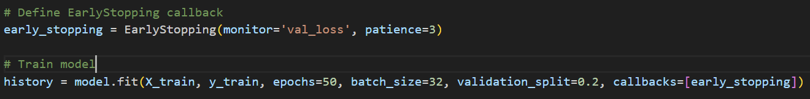
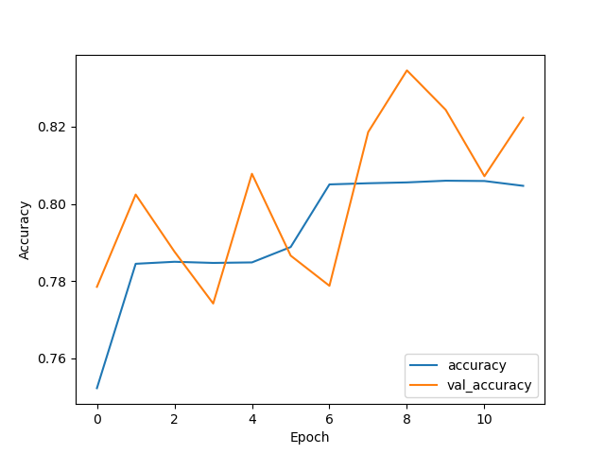
Training the Model
After compiling the model, it is then fit on the X_train and y_train data aiming for the best accuracy.
The model is trained for a maximum of 50 epochs with a batch size of 32.
Early stopping
A patience of 3 is utilized to automatically stop training when the validation loss stops improving.
This ensures that the model does not overfit and generalizes well to unseen data.
Training stops if the validation loss does not improve for 3 consecutive epochs.
It can be seen in the graph that, in this case, training ends after 11 epochs.

Slide 11
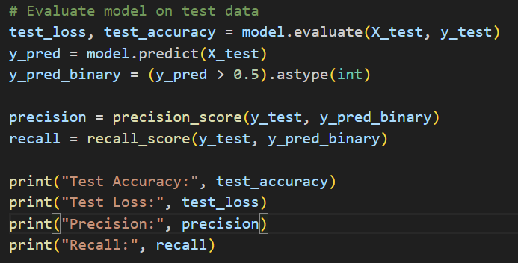
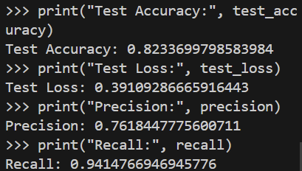
Evaluating the Model
Evaluation:
Once it is fit, it can be evaluated on the X_test and y_test data on whether the model can properly predict the value of the “# label” column.
The following scores were obtained from evaluating the model:
Accuracy: 82.34%
Test Loss: 0.3911
Precision: 76.18%
Recall: 94.15%

Slide 12
Discussion of Metrics
Using these metrics, the following can be learned about the model:
Accuracy: 82.34 %
The overall correctness of the model's predictions on the test dataset.
Calculated as the ratio of the number of correct predictions to the total number of predictions made by the model
Around 82.34% of the predictions made by the model on the test data are correct.
Test Loss: 0.3911
Indicates the average loss (or error) incurred by the model's predictions on the test dataset.
The loss is typically calculated using ‘binary_crossentropy.’
On average, the model's predictions have a loss of about 0.3911.
Precision: 76.18 %
Ratio of true positive predictions to the total number of positive predictions made by the model.
It measures the accuracy of the positive predictions made by the model, indicating how reliable the model is when it predicts an instance as positive
Approximately 76.18% of the instances predicted as positive by the model are actually positive.
Recall: 94.15 %
Measures the proportion of actual positive instances that were correctly identified by the model.
It is the ratio of true positive predictions to the total number of actual positive instances in the dataset.
Around 94.15% of the actual positive instances in the dataset were correctly identified by the model.

Slide 13
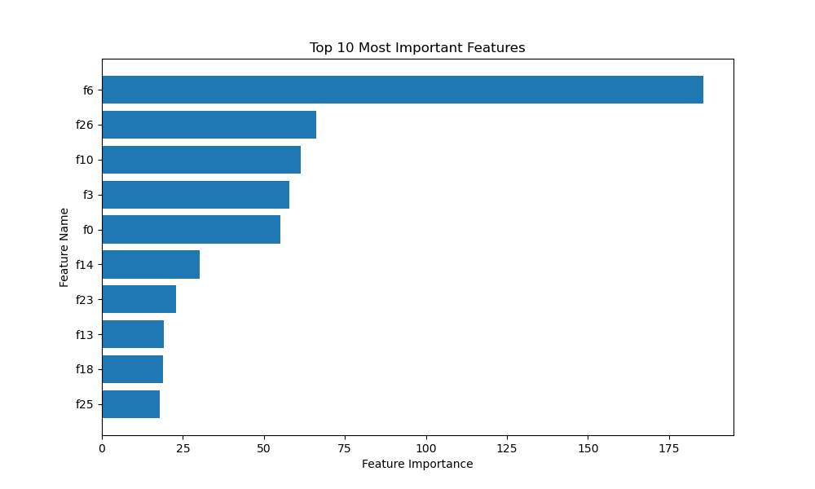
Important Features of Model
After scoring the model, it is important to know which features had the most weight in obtaining these values.
The weights will be obtained from the first layer of the model as this layer directly interacts with the input features.
The following features were deemed most important to the model using the accuracy metric as the scoring metric.
These features are among those that are ambiguous in their meaning.
These features should be the focus of further research for understanding superconductors.

Slide 14
The “Best” Model
The “Best” model in this case was determined to be carefully crafted sequential neural net model.
This model had good metrics.
These high values the model for the metrics of precision, accuracy and recall as well as the low test-loss value indicate the good competency of the model.
Further understanding of this model could be obtained if the models were tested on holdout data.

Slide 15
References
Chat GPT 3.5 was used for debugging and model definitions.
Code attached in Cusack_Matthew_CS6noGS.py file.
Alternative code with attempts at grid search across multiple parameters attached in Cusack_Matthew_CS6GS.py file.

