Slide 1
Case Study 1: Superconductors
Matthew D. Cusack

Slide 2
Introduction: The Problem
Topic: Superconductors are materials that give little or no resistance to electrical current.
Tasks:
Produce a model to predict new superconductors based on the properties and the data that they found so far
Be able to explain the relative importance of each column or variable.

Slide 3
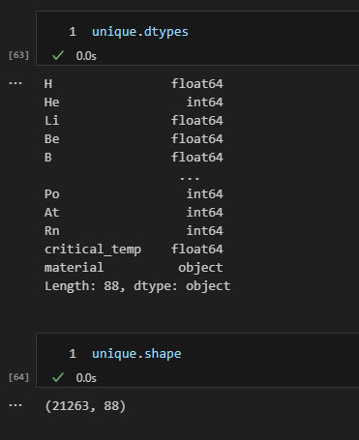
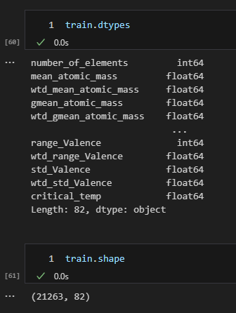
The Data
There is no missing data in this study.
‘train.csv’:
81 features some of which have prefixes in the name
21,263 superconducting materials with the superconducting critical temperature given in the 82nd column
‘unique_m.csv’:
88 features which consist of the chemical formulas for the superconductors, their critical temperature, and elements that may or may not be present in the superconductor with the proper ratios.
21,263 superconducting materials

Slide 4
The Models
Two linear regression models will be created.
The models are going to predict new superconductors and the temperature which they operate based on the experimental inputs from the data that they have already.
The models need to be interpretable so that the client can figure out at what temperature new superconductors would become superconductors, not only if they would be superconductors.

Slide 5
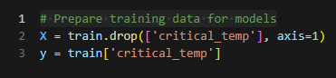
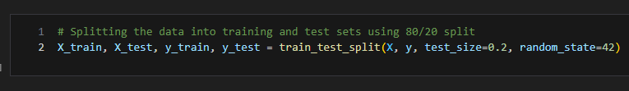
Methods: Preparing the Data
Previously cleaned data was acquired
‘train.csv’
‘unique_m.csv’
Beginning with ‘train.csv’, the target column ‘Critical Temperature’ was removed to create X and y. ‘materials’ was also removed when doing this with the .unique_m.csv’
An 80/20 training-test split using these X and y values was performed on ‘train.csv’ dataset.

Slide 6
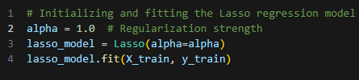
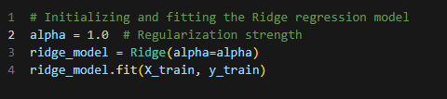
Training the Models
Two linear regression models were built with the task to predict Critical Temperature as closely as possible.
The difference between the two models was the regularization technique that is being used within the model.
One model utilized LASSO regularization
The other model utilized RIDGE regularization.
These models were fit on X_train and y_train which were made previously.

Slide 7
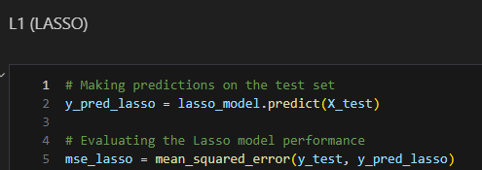
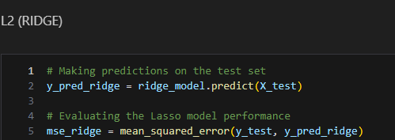
Testing the Models
The fit models are each used to make predictions on what ‘Critical Temperature’ may be given using the X_test dataset made previously.
The y_test dataset is then used to evaluate the performance on how well the model predicted the values of ‘Critical Temperature’ given other data.

Slide 8
Results: Metrics
Performance of the models was determined by calculating the MSE (Mean Squared Error) of each model
Linear Regression using L1 (LASSO) regularization resulted in an MSE value of 385.977
Linear Regression using L2 (RIDGE) regularization resulted in an MSE value of 302.817

Slide 9
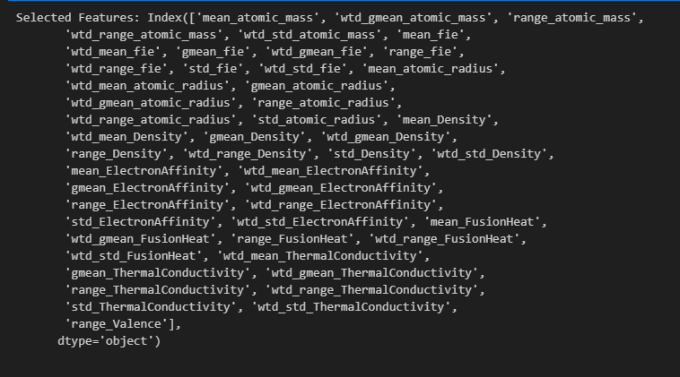
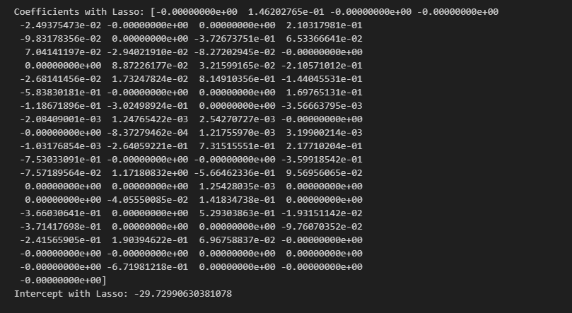
Important Features in L1 (LASSO) Model on ‘train.csv’
Intercept with Lasso: 34.53330097442681

Slide 10
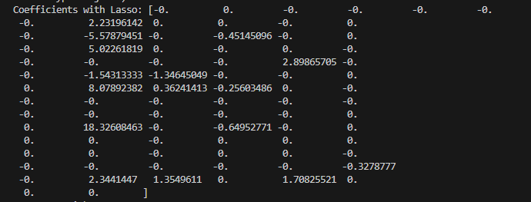
Important Features in L1 (LASSO) Model on ‘unique.csv’

Slide 11
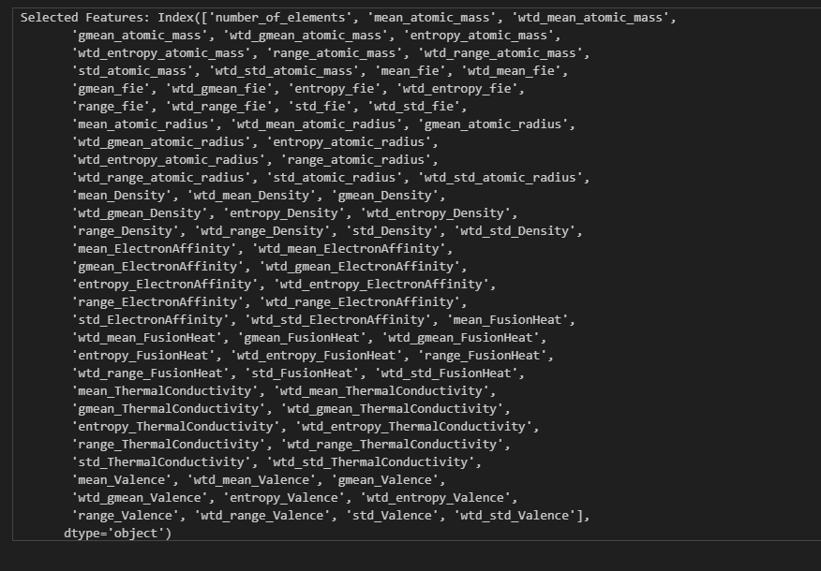
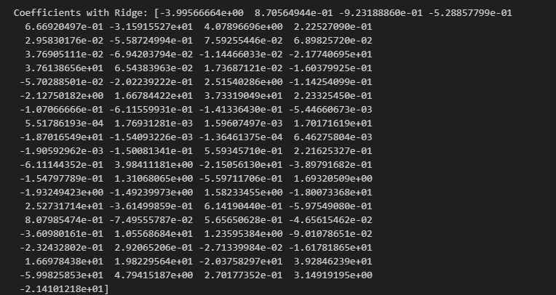
Important Features in L2 (RIDGE) Model
Intercept with Ridge: 34.533300974426794

Slide 12
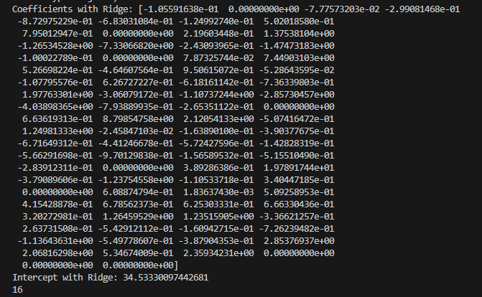
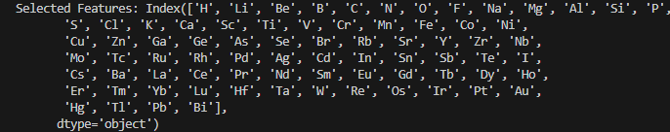
Important Features in L2 (RIDGE) Model on ‘unique.csv’

Slide 13
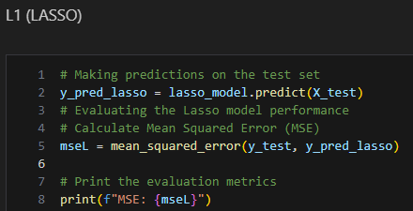
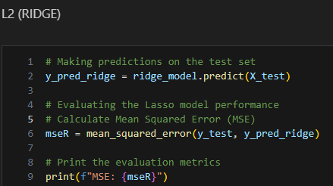
Conclusions: Metrics
Based on the chosen metric (MSE), it can be determined that L2 (RIDGE) Regularization is best for both data sets.
‘train.csv’ MSE: 385.977
‘unique_m.csv’ MSE: 430.474
‘train.csv’ MSE: 302.914
‘unique_m.csv’ MSE: 400.356

Slide 14
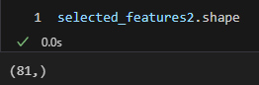


Important Features Discussion
The Linear Regression model that utilized L2 regularization shows a notably greater number of important features when compared the L1 model.
‘train.csv’: (81:49)
‘train.csv’: (77:16)
This makes sense when understanding that L1 regularization encourages sparsity and can drive many coefficients to zero.
All the features determined to be important by the L1 model were also deemed important to the L2 model.

Slide 15
Important Features ‘train.csv’
LASSO
‘wtd_std_Density’ was determined to be the most important feature
Coefficient of 5.8274935
This means that for every one unit increase of ‘wtd_std_Density’ the value of Critical Temperature increases by 5.8274935 units.
RIDGE
‘wtd_gmean_atomic_radius’ was determined to be the most important feature
Coefficient of -57.53190665
This means that for every one unit increase of ‘wtd_gmean_atomic_radius’ the value of Critical Temperature decreases by 57.53190665 units.

Slide 16
Important Features ‘unique_m.csv’
LASSO
‘Ba’ was determined to be the most important feature
Coefficient of 18.32608463
This means that for every one unit increase of ‘Ba’ the value of Critical Temperature increases by 18.32608463 units.
RIDGE
‘Nb’ was determined to be the most important feature
Coefficient of 8.79854758e+00
This means that for every one unit increase of ‘Nb’ the value of Critical Temperature in by 8.79854758e+00 units.

Slide 17
‘Best’ Model
The best model for this scenario was deemed to be the Linear Regression model that utilized L2 (RIDGE) regularization.
This model was able to determine a greater number of features that are important to the feature of Critical Temperature.
This could be useful in applying the knowledge of this model elsewhere on new data.
This could also be that the model deems the other features that LASSO reduced to zero to be somewhat more important than the remaining features.

