Slide 1
CSE343 • COMPUTER ARCHITECTURE
Design and implementation of instruction pipelining
PRESENTED BY
Md. Abdullah Al Afif
MD Mahi Hamid Ratul
Ayesha Hasib
Lamia
Md. Ajijul Hakim Sarkar
Notes:
[ALL] Good morning/afternoon everyone. We are Group [X] from Section 2, and today we'll be presenting our CSE343 Computer Architecture assignment on Single-Cycle versus Pipelined MIPS execution. Our report covers a multi-cycle pipeline diagram, a single-cycle datapath diagram, and a full cycle-by-cycle analysis of four MIPS instructions: lw, sw, sub and add. There are five of us presenting today, and each member will walk you through one part of the assignment. Let's get started.

Slide 2

Road Map
01
Pipelining Basics & Problem 1
02
Problem 2 – Pipeline Analysis
03
Problem 3 – Single-Cycle Datapath
04
Problem 4 – Single-Cycle Analysis
05
Outlook, Compliance & Fairness
02
Notes:
[ALL] Here's a quick roadmap. We'll move through the assignment in order: first the pipelined, multi-cycle view of four instructions, then a detailed analysis of that pipeline. After that we switch to single-cycle execution — its datapath diagram and control signals — followed by its own cycle analysis. We'll close with what we learned overall, and how we divided the work fairly. Each teammate's name is next to their part.

Slide 3
The 5 Pipeline Stages
IF
ID
EX
MEM
WB
Instruction Fetch
Instruction Decode
Execute
Memory Access
Write Back
Read the instruction from memory; increment PC
Decode the instruction; read source registers
ALU performs the arithmetic op or computes an address
Access data memory — only used by lw and sw
Write the result back into the register file
03
Notes:
[AFIF] Let's start with the basic idea of pipelining. A pipelined MIPS datapath breaks the execution of every instruction into five classic stages, and each stage takes exactly one clock cycle. First, IF, or Instruction Fetch: we read the instruction from instruction memory and increment the program counter. Second, ID, Instruction Decode: we decode the instruction and read the source registers from the register file. Third, EX, Execute: the ALU either performs an arithmetic operation, like add or subtract, or computes a memory address. Fourth, MEM, Memory Access: this stage is only actually used by lw and sw, since they're the only instructions that touch data memory. And fifth, WB, Write Back: we write the final result back into the register file. Because there are five stages, a new instruction can be fetched every single cycle while earlier instructions are still working through the later stages — that overlap is what makes pipelining fast.

Slide 4
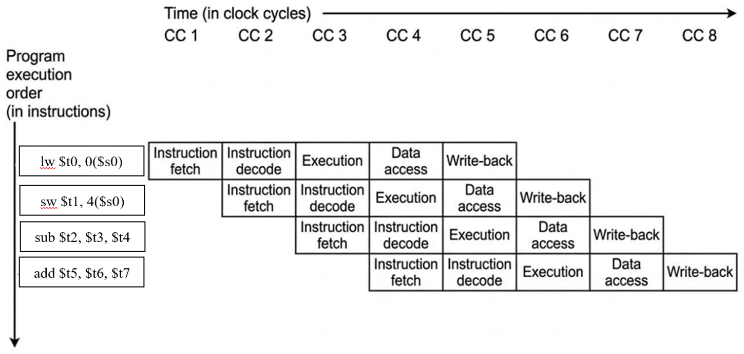
Pipeline Diagram: lw, sw, sub, add
What we drew
4 instructions: lw, sw, sub, add
Each has 5 stages
Each starts 1 cycle after the one before
They overlap, so work happens in parallel
Figure 1: Pipelined execution of lw, sw, sub, add across 8 clock cycles (CC1–CC8), using conventional pipeline-stage symbols.
04
Notes:
[AFIF] This diagram shows exactly how those five stages play out for our four instructions: lw, sw, sub and add. Time moves left to right in clock cycles, and program order moves top to bottom. Notice the staircase pattern: lw starts its Instruction Fetch in cycle 1, and one cycle later, while lw moves to Decode, sw starts its own Fetch. The same happens for sub in cycle 3 and add in cycle 4. This overlapping is exactly what pipelining is about — every cycle, one stage of the pipeline is busy with a different instruction, so the hardware is never sitting idle. We'll come back to this exact diagram in the next part, when we calculate the total number of cycles and look at what the ALU is doing partway through.

Slide 5
Problem 2(i): Total Clock Cycles
With 4 instructions running through a 5-stage pipeline:
Total cycles = Instructions + Stages − 1
8
= 4 + 5 − 1
CLOCK CYCLES
lw enters the pipeline in cycle 1 (IF).
add finishes Write Back in cycle 8 — the last instruction to complete.
05
Notes:
[RATUL] Now let's analyze that pipeline diagram. The first question is: how many clock cycles does it take to execute this code? The formula is straightforward: total cycles equal the number of instructions plus the number of pipeline stages, minus 1. We have 4 instructions — lw, sw, sub, add — and 5 pipeline stages, so that's 4 plus 5 minus 1, which equals 8 cycles. Looking back at the diagram, the first instruction, lw, enters the pipeline in cycle 1, and the very last instruction, add, finishes its Write Back stage in cycle 8. So the whole sequence completes in 8 cycles — much faster than running each instruction one after another, which would take 4 times 5, or 20 cycles. That overlap is really the whole point of pipelining.

Slide 6
Problem 2(ii): The ALU in Cycle 3
WHAT THE ALU COMPUTES
lw
EX — computing the address
Only lw has reached the EX stage in cycle 3. The ALU adds the base register value $s0 to the sign-extended 16-bit offset (0), producing the effective memory address.
sw
ID — not at the ALU yet
That address is then sent to data memory in cycle 4 (the MEM stage).
sub
IF — not at the ALU yet
sub and add haven't reached EX yet, so the ALU is not doing their arithmetic during this cycle.
add
not yet fetched
06
Notes:
[RATUL] The second question asks: what is the ALU doing during cycle 3? To answer this we look at where each instruction is in cycle 3. lw is in the EX, or Execute, stage. sw is only in ID, and sub is only in IF, so neither of them has reached the ALU yet, and add hasn't even been fetched. So the ALU is only working on lw. Specifically, it's computing the effective memory address for the load: it adds the base register, $s0, to the sign-extended 16-bit offset, which is 0 in this case. That computed address is then sent on to data memory in the next cycle, cycle 4, which is the MEM stage. The ALU is not performing the sub or the add arithmetic yet, simply because those instructions haven't reached the Execute stage during cycle 3.

Slide 7
Single-Cycle Execution: The Idea
In single-cycle execution, every instruction completes all five stages — IF, ID, EX, MEM, WB — inside one long clock cycle. There is no overlap: the next instruction cannot start until the current one is completely finished.
Instruction 1
Instruction 2
sub $t2, $t3, $t4
add $t5, $t6, $t7
$t2 ← $t3 − $t4
$t5 ← $t6 + $t7
07
Notes:
[AYESHA] Now we switch gears to single-cycle execution. Here, every instruction — no matter what type — completes all five stages, IF, ID, EX, MEM and WB, inside one single, long clock cycle. There's no overlap at all: the second instruction can't begin until the first one has entirely finished its clock cycle. For this problem, we look at two R-format instructions. The first is sub $t2, $t3, $t4, meaning $t2 gets $t3 minus $t4. The second is add $t5, $t6, $t7, meaning $t5 gets $t6 plus $t7. Since both of these are R-format instructions, neither one reads from or writes to data memory. So the Data Memory block is still physically present in the datapath, but it simply performs no operation for either instruction.

Slide 8
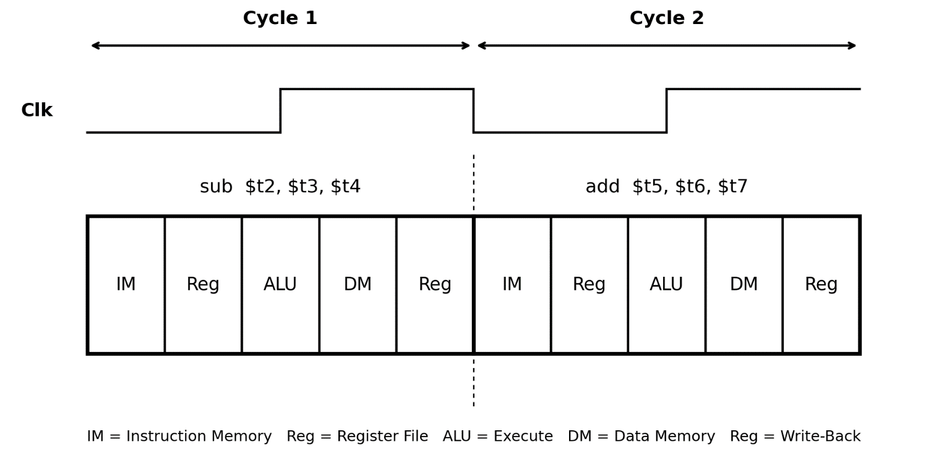
Datapath Diagram & Control Signals
CONTROL SIGNALS
RegDst
1
ALUSrc
0
MemtoReg
0
RegWrite
1
MemRead
0
MemWrite
0
Branch
0
ALUOp
10
Figure 2: Single-cycle datapath diagram (graphical symbols) for two R-format instructions
08
Notes:
[AYESHA] Here's the single-cycle datapath diagram for our two R-format instructions. Notice the clock signal at the top: it stays low, then pulses high once for cycle 1 while sub runs through IM, register read, ALU, data memory and register write-back — all in that one pulse. Then it pulses again for cycle 2, and add runs through exactly the same five blocks. On the right you can see the control signals for these R-format instructions. RegDst is 1, ALUSrc is 0, MemtoReg is 0, RegWrite is 1, MemRead is 0, MemWrite is 0, Branch is 0, and ALUOp is 10. Since sub and add don't touch memory, MemRead and MemWrite are both 0. RegWrite is 1 because both instructions do write a result back to a register. The ALU control unit itself reads the funct field of the instruction to decide whether to perform subtraction, for sub, or addition, for add.

Slide 9
Problem 4(i): Total Clock Cycles
In a single-cycle machine, every instruction — regardless of type — completes in exactly one clock cycle:
Total cycles = Instructions × 1 cycle/instruction
2
= 2 × 1
CLOCK CYCLES
Cycle 1: sub completes entirely, from IF through WB.
Cycle 2: add completes entirely, from IF through WB.
09
Notes:
[AJIJUL] Moving to the analysis of single-cycle execution. First question: how many cycles does it take to execute this code? In a single-cycle machine, every instruction, regardless of its type, completes in exactly one clock cycle. So total cycles equal the number of instructions times 1 cycle per instruction. We have 2 instructions, sub and add, so that's 2 times 1, which equals 2 cycles. Concretely, sub completes entirely — all the way from Instruction Fetch through Write Back — in cycle 1. Then add completes entirely in cycle 2. It's worth noting how different this is from the pipelined case we saw earlier: there, 4 instructions took 8 cycles because of the 5-stage overhead, but here, single-cycle timing scales directly and simply with the number of instructions.

Slide 10
Problem 4(ii): ALU in Cycles 2 & 4
CYCLE 2
CYCLE 4
The entire add instruction executes in this one clock cycle. The ALU computes $t6 + $t7, and the result is written back to $t5 by the end of the same cycle — IF, ID, EX, MEM and WB all happen together.
There is no cycle 4 in this single-cycle execution. Since each instruction takes exactly one clock cycle and there are only 2 instructions, execution finishes after cycle 2. A cycle 4 would only exist with at least 4 instructions.
10
Notes:
[AJIJUL] The second question here has two parts: what is the ALU doing during cycle 2, and what is it doing during cycle 4? For cycle 2: the entire add instruction executes within this one clock cycle. The ALU computes $t6 plus $t7, and that result is written back to $t5 by the end of the same cycle, because single-cycle execution performs IF, ID, EX, MEM and WB all within a single clock cycle. For cycle 4: there actually is no cycle 4 in this single-cycle execution. Since each instruction takes exactly one clock cycle, and we only have 2 instructions, the whole execution finishes after cycle 2. A cycle 4 would only exist if we had at least 4 instructions in the sequence.

Slide 11
Outlook: Single-Cycle vs. Pipelined
SINGLE-CYCLE
PIPELINED
Simple to design and understand
Every instruction waits for one long, slow cycle
No hazards possible — nothing overlaps
Faster overall — instructions overlap
Can face hazards when instructions depend on each other
No hazards occurred in our given sequence
11
Notes:
[LAMIA] To wrap up, let's talk about what this assignment taught us. Working through both designs helped us really understand the difference between single-cycle and pipelined execution. Single-cycle is simple: every instruction is guaranteed to finish in one shot, with no overlap and no risk of hazards. But that simplicity comes at a cost — every instruction has to wait for one long clock cycle, even simple ones, so it's slow overall. Pipelining is faster because multiple instructions overlap and move through the stages together. The trade-off is that pipelining can run into problems called hazards when instructions depend on each other's results. The good news is that in the specific instruction sequence we were given, we didn't run into any hazards.

Slide 12
Compliance, Fairness & Conclusion
COMPLIANCE
FAIRNESS
We followed every guideline: a proper cover page, member details, clearly labeled diagrams with standard symbols, and step-by-step answers backed by formulas — not just final numbers.
Workload was split so each member had a clear, separate part — diagrams, calculations and explanations. Every part was necessary, and each contribution is listed at the end of its problem.
12
Notes:
[LAMIA] Two more points before we finish. On compliance: we made sure our report followed every required guideline — a proper cover page, group member details, clearly labeled diagrams using standard symbols, and step-by-step answers backed by formulas rather than just final numbers. On fairness: the workload was divided so every group member received a clear, separate part of the assignment, covering diagrams, calculations, and explanations. Every member's part was necessary to complete the report, and each contribution is stated at the end of its problem, which keeps the overall effort fair and balanced. That brings us to the end of our presentation — thank you, and we're happy to take any questions.

Slide 13
THANK YOU
Notes:
[ALL] Thank you for listening to our presentation on Single-Cycle versus Pipelined MIPS execution. We're happy to take any questions you might have about the diagrams, the cycle calculations, or the ALU behaviour we covered.

