Slide 1
AI Based Exam Proctoring System
Batch CSE - C11
P. Gokula Kishore Reddy - 209X1A05H6
V. Pranay Kumar Reddy - 209X1A05H9
M. Obula Sai - 219X5A05L9

Slide 2
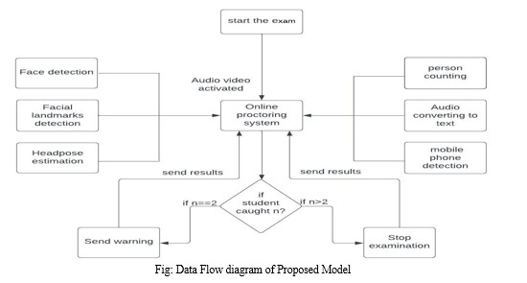
Project Flow :

Slide 3
Module Description
1. Face and Facial landmark Detection :
This is a task that considers facial landmarks and observes them throughout the test to determine if there is cheating .
We have also included face spoofing to ensure that only the specific person registered to take the exam takes the exam.
2. Malicious object detection :
Detecting Malicious object such as Cell phones, books, chairs, few people, etc.,
3. Audio Recognition :
To identify the background noises that can lead to any kind of disqualification from the
online examination .

Slide 4
Module Description
4. Head pose estimation :
we estimate the head position if he turns left or right and up or down and know if
he is cheating or not.
5. Lip Movement Detection :
The strategy we used in this detection is real-time webcam video.
6. Gaze Detection :
We can use eye tracking to identify deviant behaviour in an online exam.

Slide 5
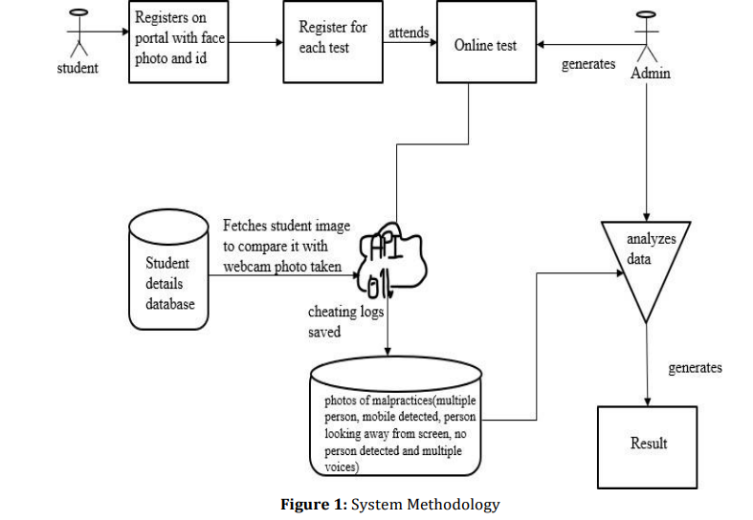
Methodology

Slide 6
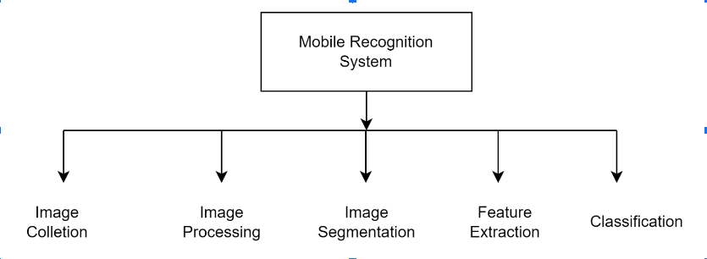
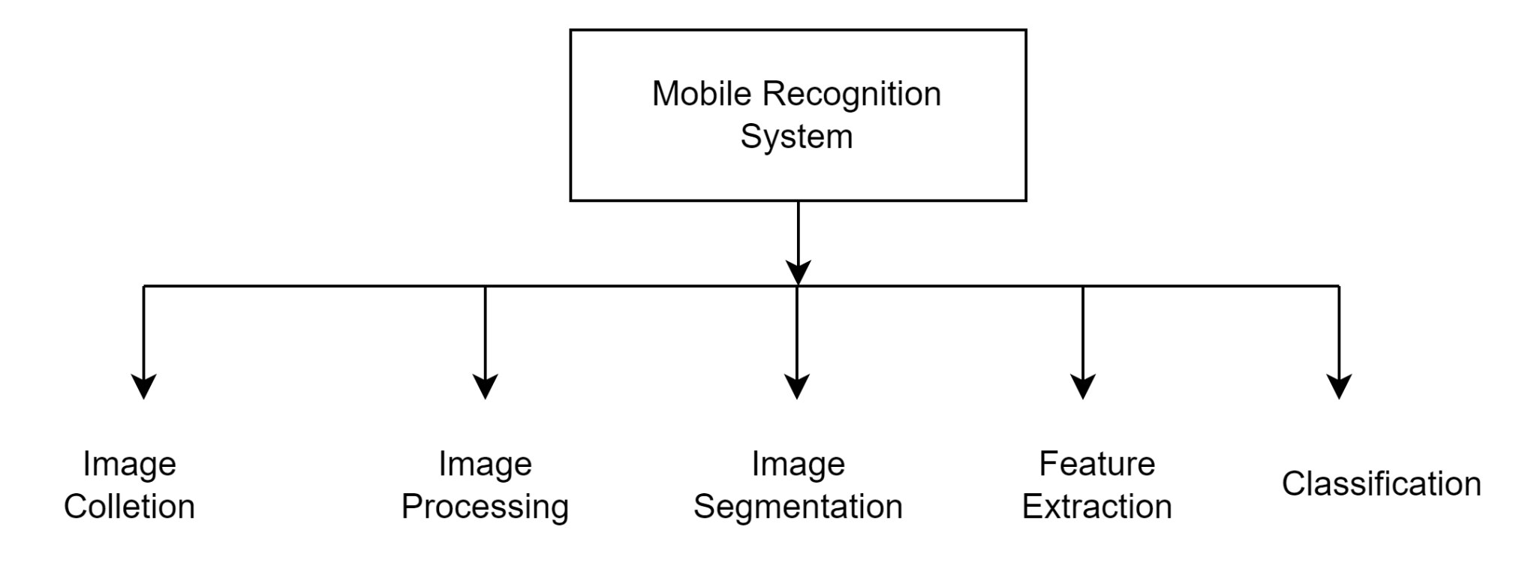
System Design

Slide 7
System Design
It is very simple phase that shows the implementation process.
The system design mainly consists of
1. Image Collection:
The real time video is captured from the webcam of the user’s pc or laptop.
2. Image Pre-processing:
Goal of pre-processing is an improvement of image data.
Image pre-processing involves three main things.
a) Gray scale conversion
b) Noise removal
c) Image enhancement

Slide 8
3. Image Segmentation:
Since a clear color distinction existed between the object and the face, thresholding was very suitable for the task. A black and white image was produced with its contrast adjusted to provide better segmentation.
4. Feature Extraction:
The purpose of feature extraction is to suppressed the original image data set by measuring certain values or features that helps to classify different images from one another.
5. Classification:
A Convolutional Neural Network (ConvNet/CNN) is a Deep Learning algorithm which can take in an input image, assign importance (learnable weights and biases) to various aspects/objects in the image and be able to differentiate one from the other.

Slide 9
System Requirements
Hardware Requirements Processor type : intel i3/i5 Processor speed : Minimum 2.4 GHz RAM : 4/8 GB HARD DISK : 500 GB | Software Requirements Operating System : Windows XP / 10 Coding Language : Python 3 Tool : Python IDLE

Slide 10
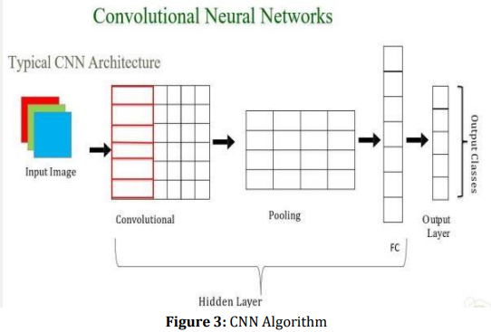
Algorithm

Slide 11
Benefits of CNN in Exam Proctoring:
Robust Feature Extraction:
CNNs excel at automatically learning hierarchical representations of visual data, enabling the system to extract meaningful features from the exam environment, including student actions and behaviors.
Real-time Processing:
Due to their parallel processing capabilities, CNNs can efficiently handle real-time video streams, allowing our proctoring system to monitor multiple students simultaneously without compromising performance.
Adaptive Learning:
CNNs can adapt and improve their understanding of the exam environment over time through training on a diverse range of data, enhancing their ability to detect irregularities and potential violations during the examination.

Slide 12
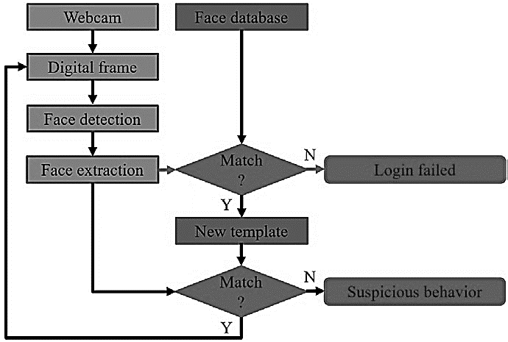
Validation Process

Slide 13
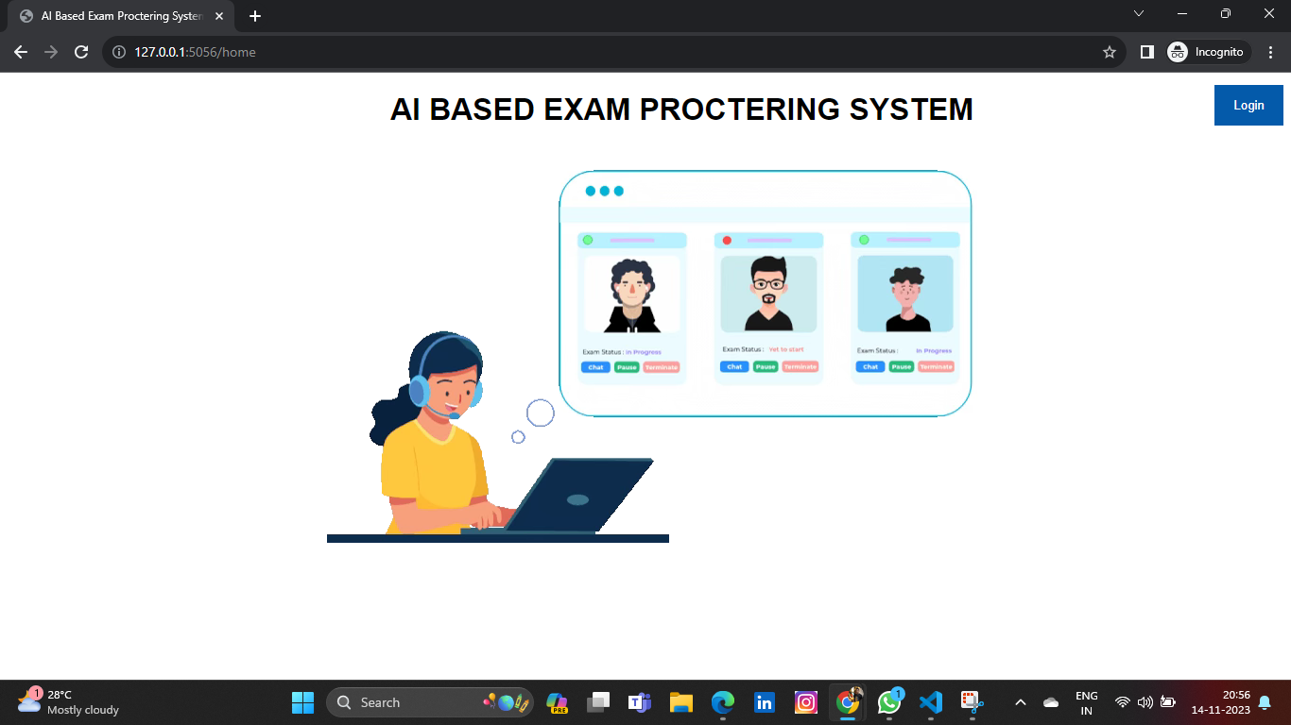
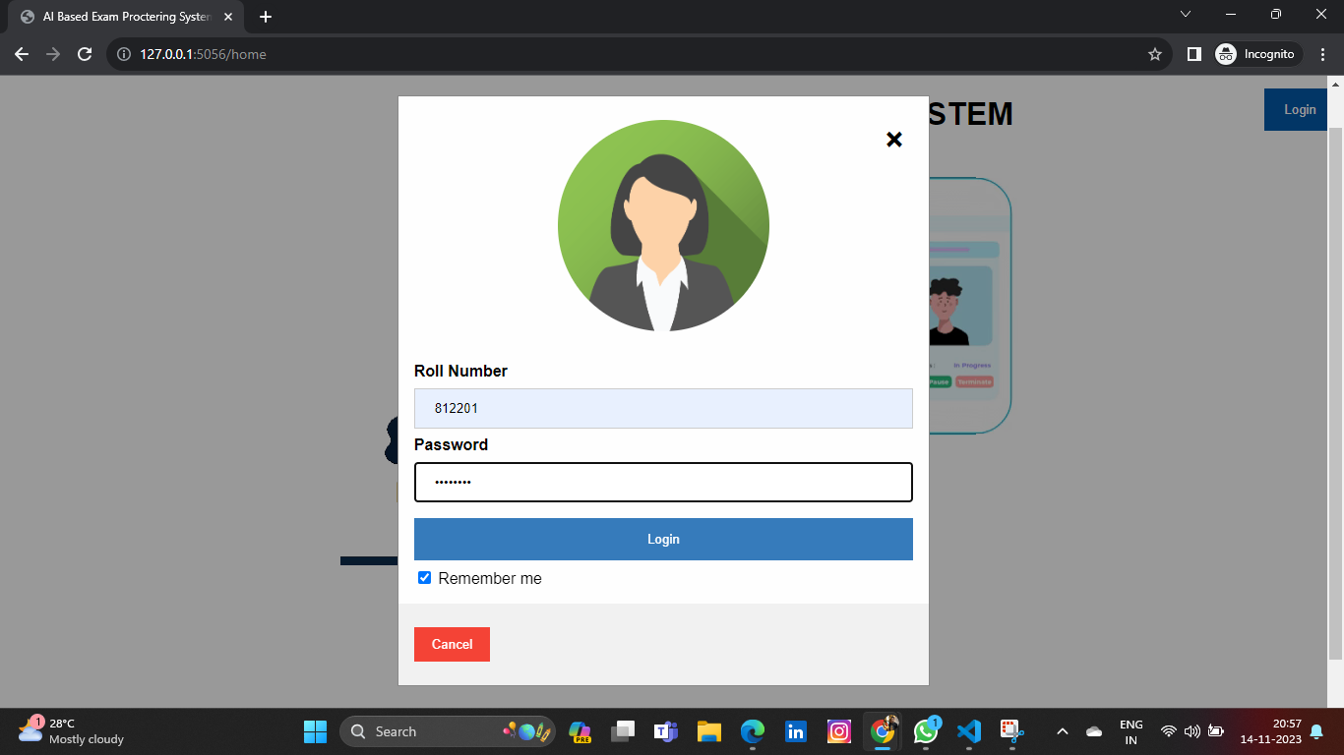
Images of the Application :

Slide 14
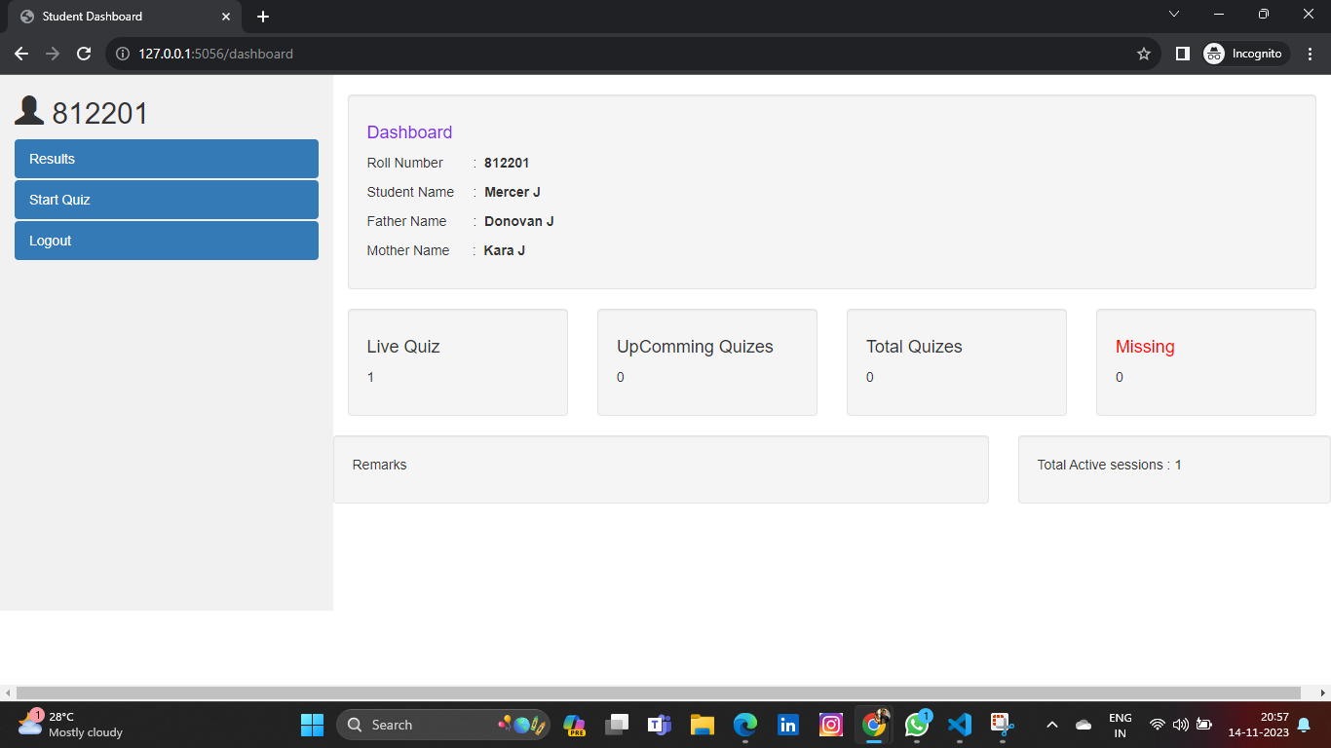
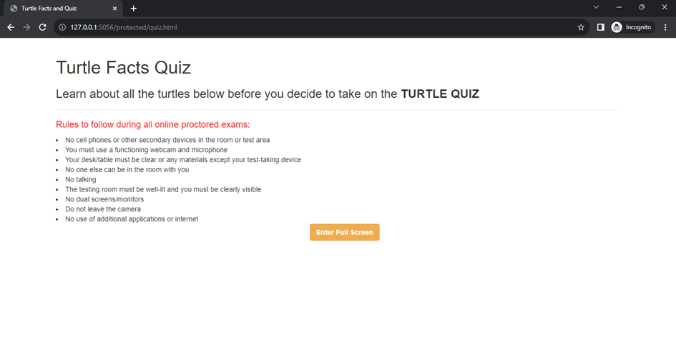
Quiz Application Interface

Slide 15
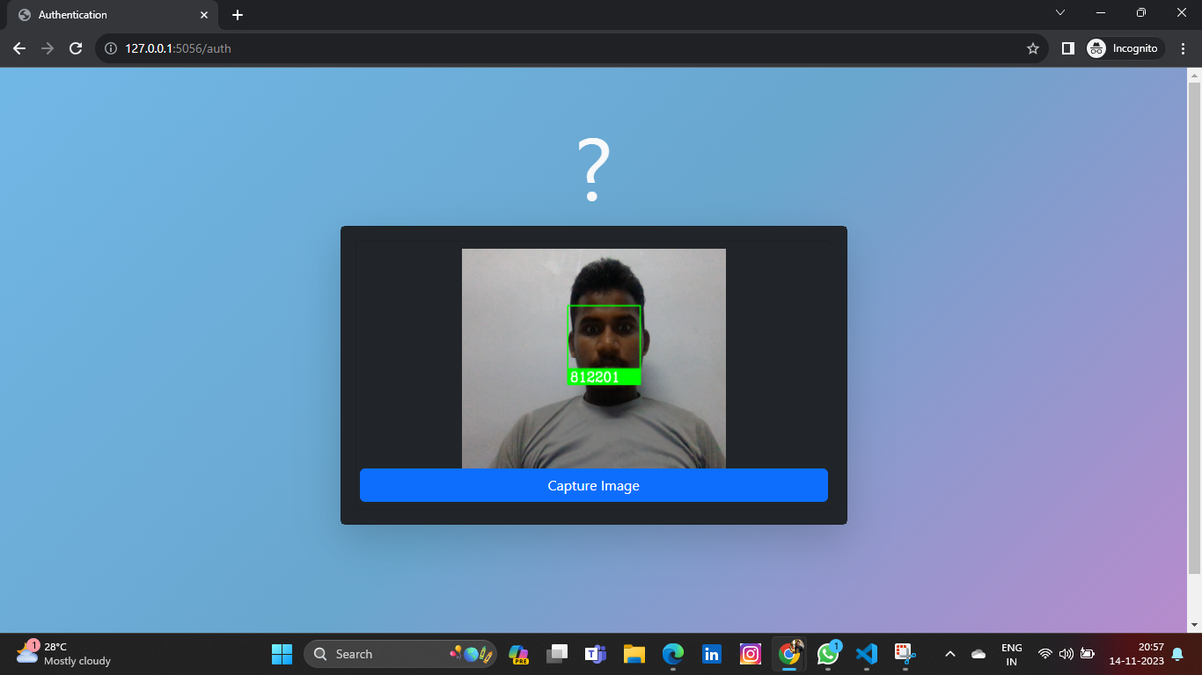
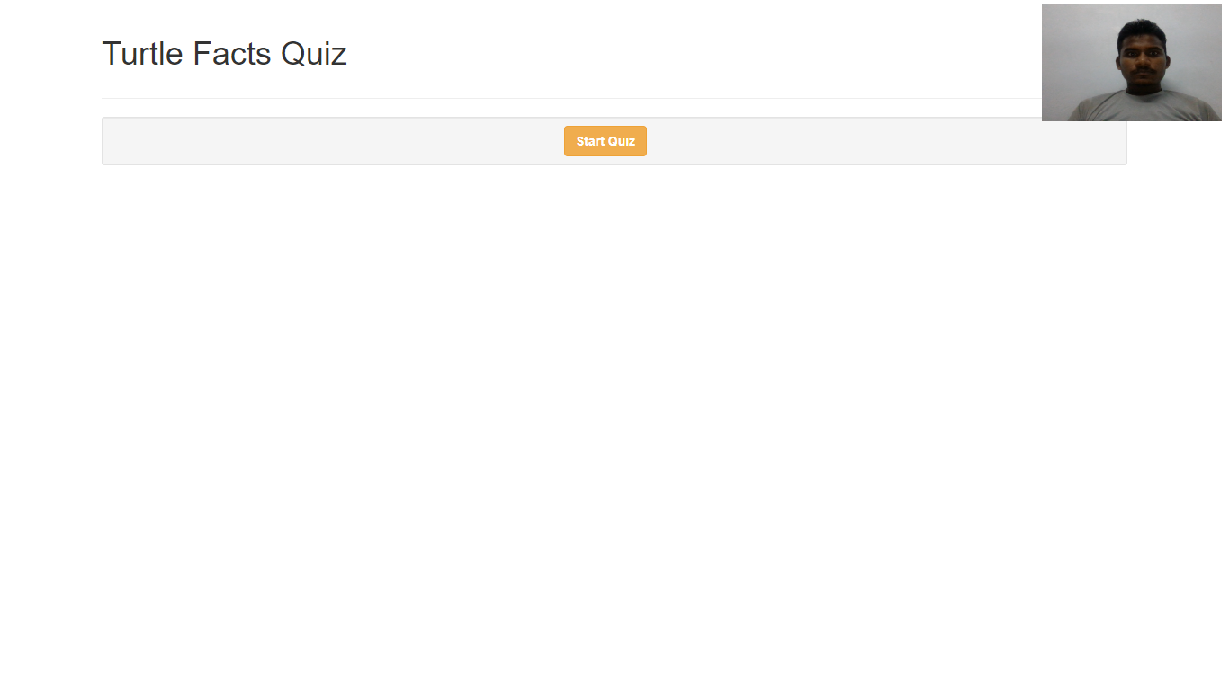
Image Capturing before starting Quiz

Slide 16
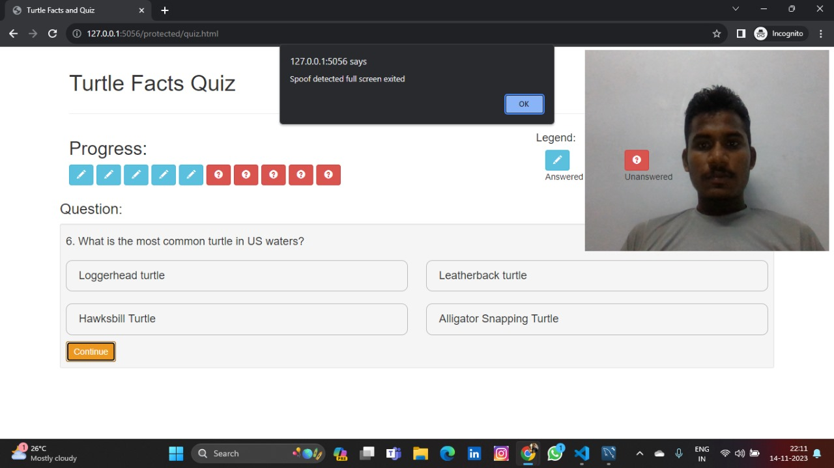
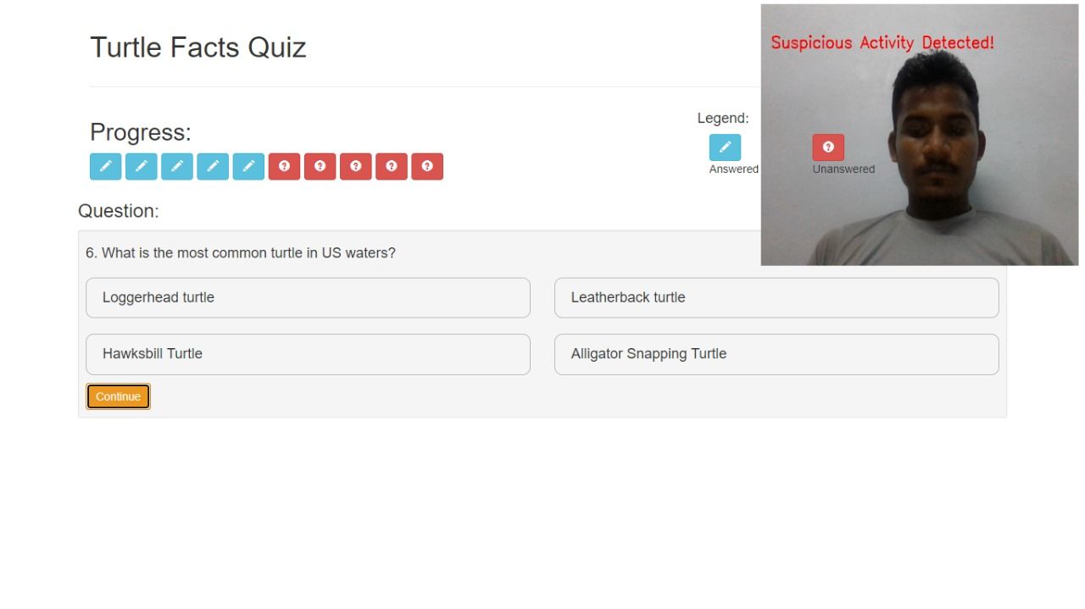
Suspicious Activity

Slide 17
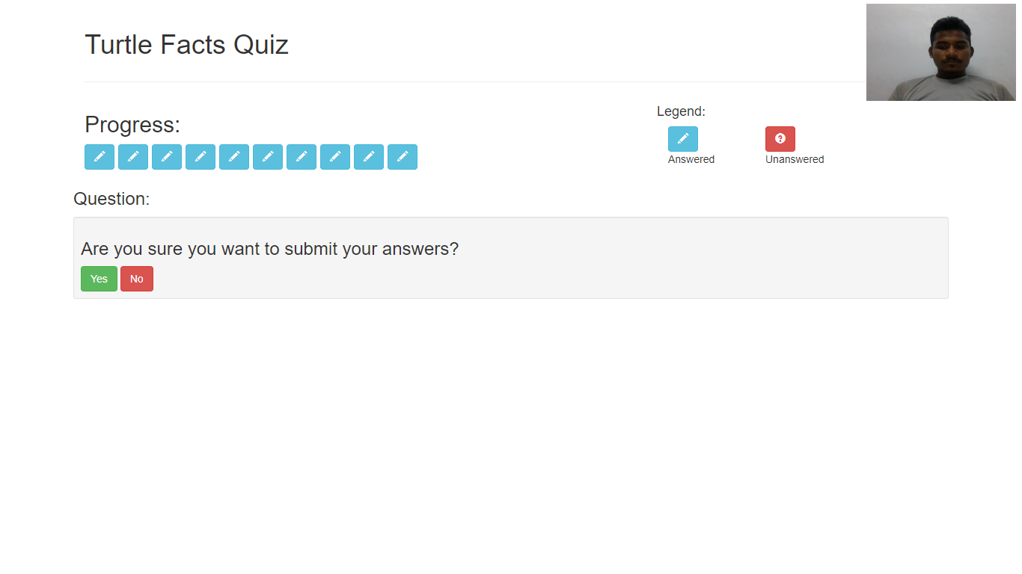
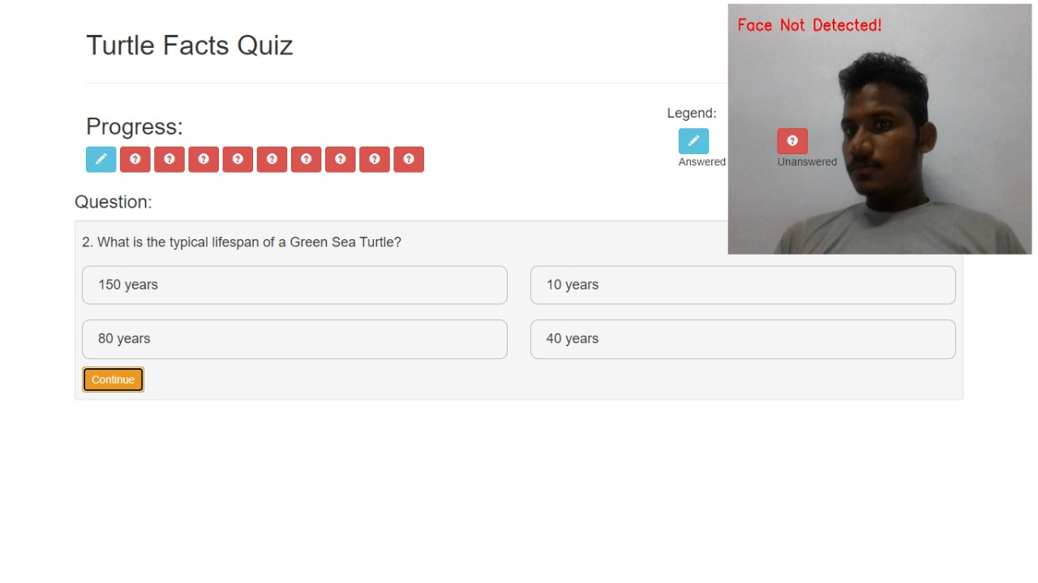
Face Not Detected
Quiz Application Page

Slide 18
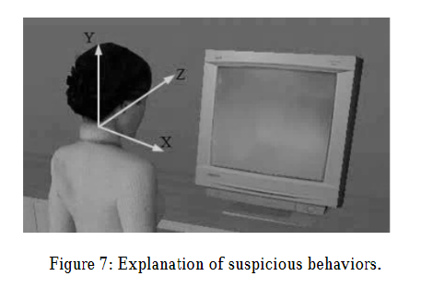
First, a student logs into the system with his/her name. Then, the webcam scans the student’s face for authentication purposes. If the authentication failed, this student is forced to exit the system. If the authentication was successful, the scanned frame is stored as the new template in the subsequent tracking and proctoring stage. Finally, the test is conducted under the supervision of the virtual proctor.

