Slide 1


IMS –Institute Management System
Presented By

Slide 2
Purpose of IMS
Institute Management System is designed to automate the management process of an institute from student admission to examination management, from course management to schedule management, from human resource employment to salary management.
Institute management need to have robust and integrated Institute Management System for their day to day operation.
It is difficult for any management to store the large number of data manually or in papers. In that case when any user wants to take information it is very difficult for management to provide information immediately. It is very time consuming process. But by using IMS it takes only few minutes/seconds.
It will store all the personal and academic information of the students. and the fee information of the students. Management will get information of any student who studied/studying in this institute till now easily.

Slide 3
Advantages from manual system to Automation
Functional Benefits
Handling Enquiries from prospective students.
Handling the admissions process.
Enrolling new students and storing teaching option choices.
Management which includes Transportation Management, Fees Management etc.
Communicating student details to parents through a parent portal.
Business Benefits
Manage multiple departments from a single computer.
Total computerized system.
Effective use of time.
Cost effective.
Anywhere, anytime Availability ? Internet or Intranet with Automatic Synchronization.
Highly customization according to your requirements

Slide 4
Advantages (Continues..)
Operational Benefits
Mobile phone access, user access and iterative system.
Highly secure data backup and comprehensive security system.
Availability & Accessibility of records 24X7 to authorized persons.
Utility to export data in multiple formats like MS Excel, PDF Files etc.
Graphical representation of report facilities analysis, planning and implementation of business activities.

Slide 5
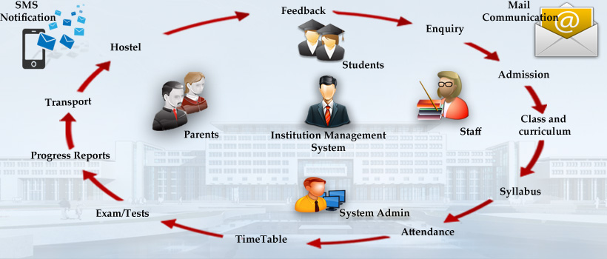
Flow Diagram

Slide 6













Modules
Admin Module Enquiry Module Student Module Staff Module Parents Module
SMS Module Certificate Module Hostel Module Transport Module
Library Module Accounts Module Attendance Reports

Slide 7

Admin Panel
This module is used by the administrator to prevent unauthorized access to the system. Any user logging into the system can access only those functions for which he/she has been granted rights for.
Features:
Transparency in Institute management
Secure in case of unauthorized access
Can reserve the rights to access
Authorized person or principal can check detail of any module on his/her system.

Slide 8
Enquiry Module
This module will help you to make the enquiry system more efficient in terms of follow up & enhance utilization of time of management as it works on self automated system. Since admission depends up on the no. of enquiry & how it is being handled & followed up on time.
Features:
Online enquiry form.
Centralized enquiry details of tables enquiry,.
Report generation of enquiry as per day, week and month.
Generate enquiry details between two date ranges.
Track each enquiry details cover up by counselor.
This System starts follow up just after enquiry submitted by students

Slide 9
Student Module
The student module helps you to store all personal, academic, professional and history data regarding a student, his/her parents, and his/her siblings..
Features:
Maintain record of all valuable information about every student
Students record can be edited as per requirement.
Change of Class & batch can be done easily.
Students record can be filtered according to course & batch wise
Student’s photograph & document can be uploaded during admission or it can upload in student edit.
Promotion of students from one class to another class can be easily handle.

Slide 10
Staff module
Institution can manage all staffs personal information & information can be updated time to time as per requirement.
Features:
Keep all staffs records at one place
Very easy to maintain & update staff records.
Relieved staff can be easily maintain by Academy Wise.

Slide 11
Parent Module
The Parent module helps to all parents to view their students personal, academic data.
Feature:
Parents can view student Daily homework, day to day activities.
Parents can view and download Calendar, Class Time table, Newsletter, Circular etc..
Parents can send feedback to staff or management by through mail.

Slide 12
Manage Attendance
This module useful to manage attendance of students of all classes & batches. Absentee remarks can be managed very easily.
Features:
Manage attendance Class& batch wise.
Summary of attendance can be viewed at one place.
Attendance report can be filtered Class & batch wise. And student wise.
Total absentee reports with remarks can be viewed.

Slide 13
SMS Module
SMS Module in very much useful to deliver the important information to students, parents, staff, etc.. And this module can be attached with some other module like attendance, examination, fee, staff, etc.
Features:
Institute management would have a right to send SMS according to their requirement.
Management can send SMS to one student to whole class.
Management can send SMS to staff Regarding meetings or any intimation.

Slide 14

Certificate Module
Certificate module useful to manage Certificate Distribution during academic year completion to students of all classes can be managed very easily. All Certificate to be printed in one click.
Features:
Conduct Certificate
Student TC
Community Certificate
Attendance Certificate

Slide 15
Hostel
This module useful to manage Hostel students of all classes & batches wise. Hostel students can be managed very easily..
Features
Hostel Students record can be filtered according to Class & batch wise
Unique Number will generate to each students in hostel
Hostel students leave and permission to be tracked and send SMS to parents.

Slide 16

Transport
This module is useful to maintain transportation facilities to student for their better security and manage the school time, tracking and maintain the transportation details. It includes vehicle name, route details, transportation fees etc.
Features:
Save Driver And Conductor Details With Identity Proof
Manage Vehicles Details like The Type Of Vehicle, Vehicle Number
Maintain Route Details Given With The Name Of Stoppage
Vehicle Maintenance And Fuel Charges Details
Management Transport expense by vehicle wise.

Slide 17

Accounts
The fee module enables you to maintain registers of fee receipts and outstanding amounts on a student/class basis. The fee module has a configurable structure for different fee head, and its calculations thereof. This module also provisions for fee waivers and optional fees.
Features :
Computerized Billing
Various modes of payment by internet banking, credit or debit cards.
Different type of fee, fine and other charges can be customized as per student and class.
You can verify fee structure of different classes.
Amount dues and amount received can be viewed as per month and year with all/specific, class/section or individual student.
Fee dues alert.
Report on the basis of fee daily/monthly.
Additional Features:
Various modes of payment by internet banking, credit or debit cards.
Online fee payment

Slide 18
Library Module
All books details can be stored at one place with management of issuing & receiving books.
Features:
Manage all books details at one place with no. of books, volume, author, etc
Issuing & receiving books can be managed.
Search books.

Slide 19
Reports
Admission Report
Student Admission Report Class wise and between dates.
General Report
Class Wise & Overall School report
Attendance Report
Student Attendance Report -Batch Class wise and between dates.
Student Fees Report
School Fees
Transport Daily report & Monthly report
Hostel

Slide 20
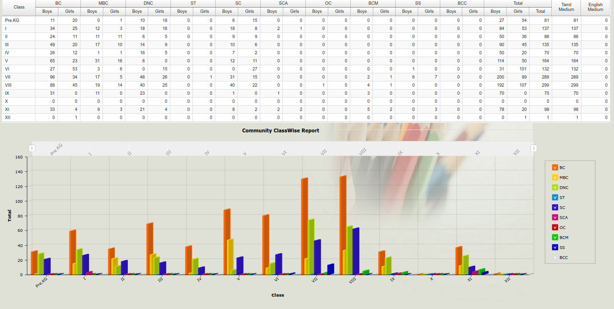
Sample Reports

Slide 21

Contact us
iNoble Infoway Pvt. Ltd.,
No :6, Velappa Gounder Nagar,
Visuvasapuram,
Saravanampatti,
Coimbatore, India-641035
Ph: +91 422-2665811
E-mail: info@inoble.in

Slide 22


