Slide 1
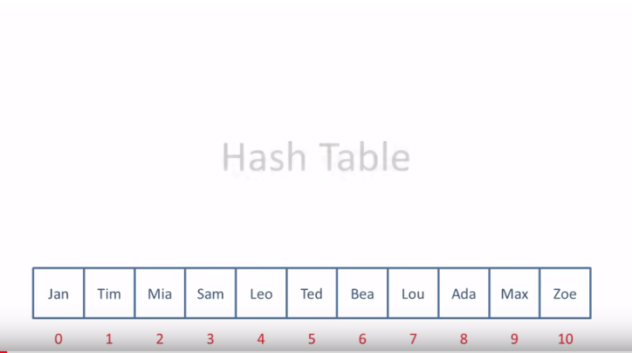

Slide 2
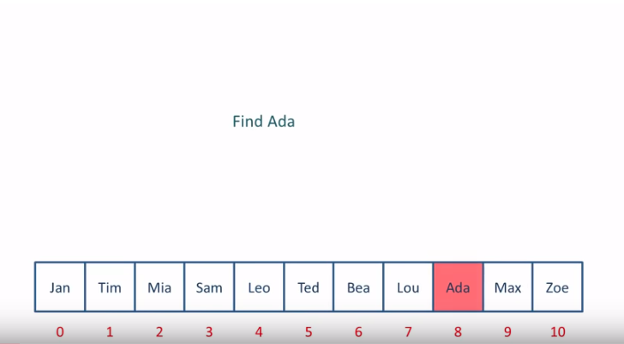
Linear Search:

Slide 3
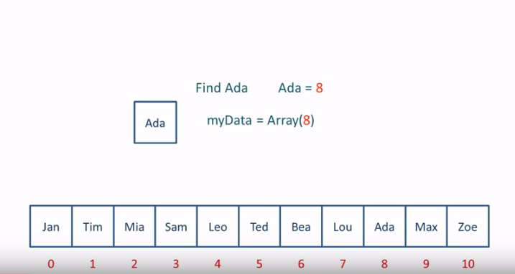
#For linear search, if array size is large then it will take long time.

Slide 4
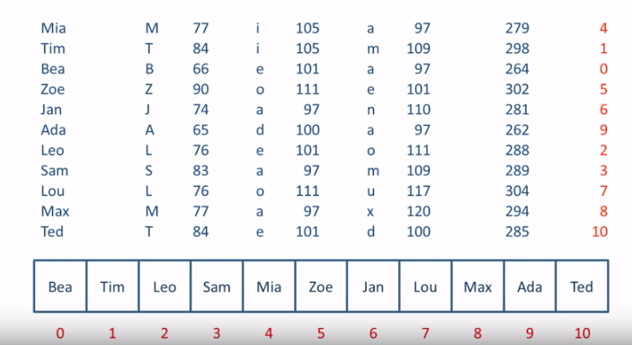
#Addressing can be calculated in another way. #You can calculate the position by calculate the data itself #Calculate the total ASCII code of data element and mod by the total data element and the remainder is the position of that element.

Slide 5
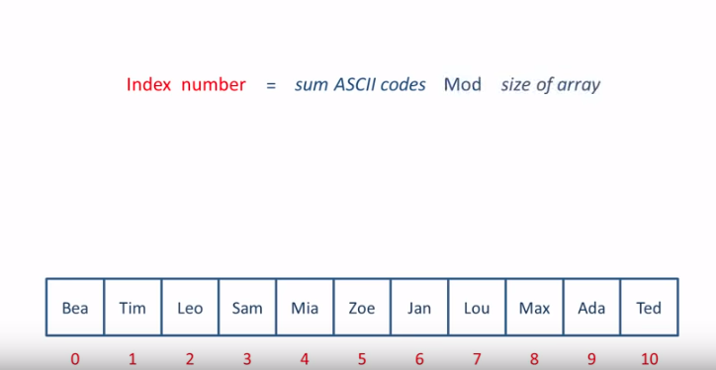

Slide 6
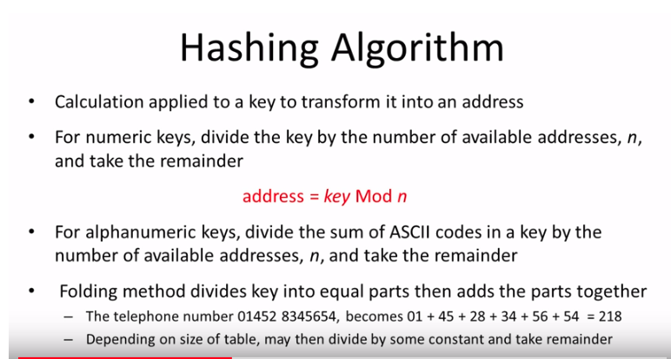

Slide 7


Slide 8
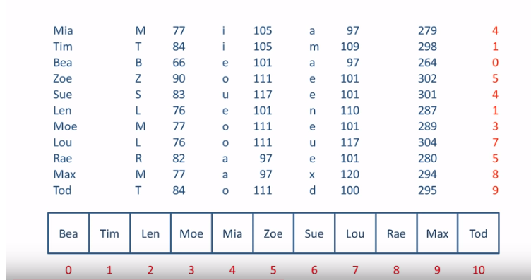

Slide 9
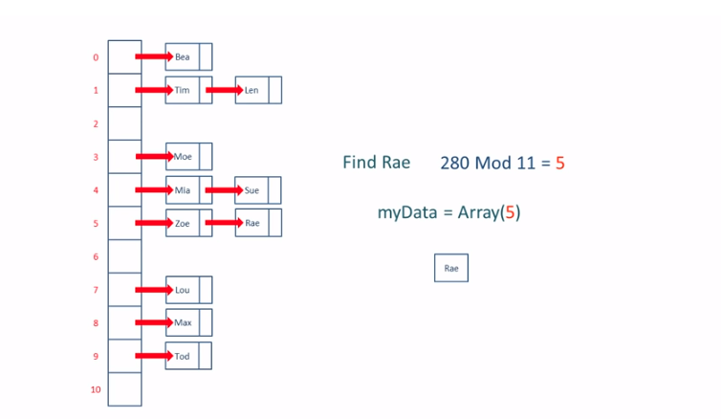

Slide 10
