Slide 1
Digital Clock with alarm feature
COURSE No: EEE304
Course Name: Digital Electronic Laboratory
Section: B2
Group: 7
Student ID:
1906114
1906117
1906118
1906130

Slide 2
Abstract
The objective of this project is to create a digital clock that displays the time using a digital format. By utilizing counters and decoders, we can construct a digital clock capable of showing the hours, minutes, and seconds. The alarm functionality of the project enables users to set alarms for specific times or recurring intervals. The project is suitable for both educational purposes and personal use .

Slide 3
Background
By utilizing digital electronics and IC technology, the digital clock with alarm project aims to offer an accurate, versatile, and user-friendly timekeeping solution that surpasses the limitations of traditional analog clocks. By combining digital display technology with an alarm system, it provides a valuable learning experience while catering to the practical needs of accurate timekeeping and efficient alarm functionality in various settings and applications.

Slide 4
Complexity Analysis
The complexity of designing a digital clock and alarm using digital logic design can vary depending on the specific features and functionalities incorporated into the system. Here are some factors that contribute to the complexity:

Slide 5
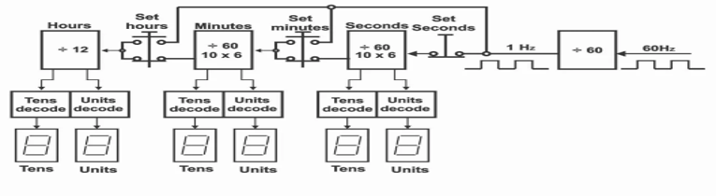
Simplifies block diagram

Slide 6
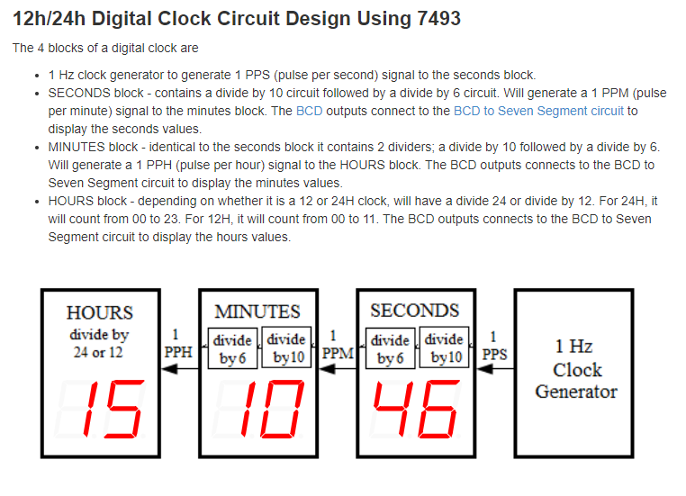
1. Timekeeping Accuracy:
Achieving precise timekeeping requires careful consideration of clock signal generation and synchronization. Designing a clock circuit with a stable and accurate frequency source, such as a quartz crystal oscillator or 555 timer , adds complexity to the overall system.

Slide 7
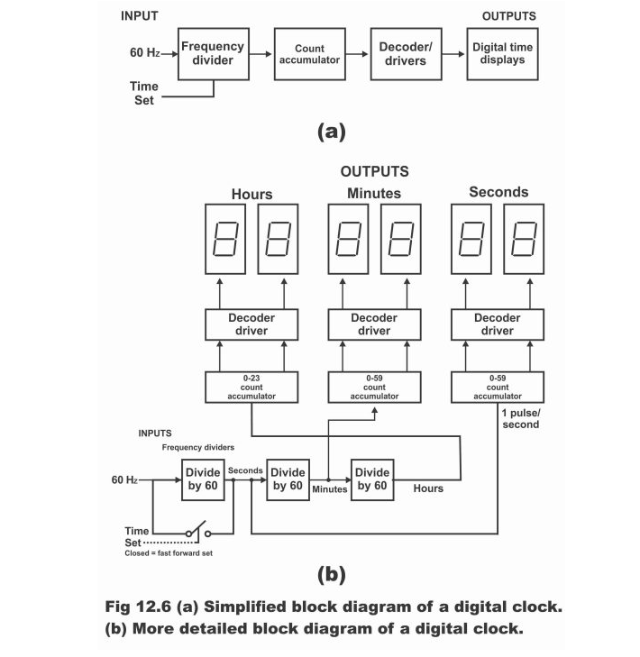
2. Digital Counter Design
Implementing counters to track hours, minutes, and seconds involves the design and integration of sequential logic circuits. The counters need to increment and reset accurately, accounting for carry and reset signals, and ensuring proper sequencing between the different time units.

Slide 8
3. Display Multiplexing
If a single display unit is used to show hours, minutes, and seconds, multiplexing techniques are typically employed. Multiplexing requires careful synchronization and time division methods to avoid flickering or distortion in the displayed values

Slide 9
4. Alarm Triggering
Designing the alarm functionality involves setting alarm parameters, comparing the current time with the set alarm time, and triggering an alarm signal accordingly. This requires additional components, such as comparators ,logic gates and timers, to monitor the time and generate appropriate alarm signals.

Slide 10
5. User Interface and Input Handling
Creating a user-friendly interface for setting the time and alarm parameters adds complexity to the design. This involves integrating input buttons or switches.

Slide 11
6. Alarm Sound Generation
Generating an audible alarm sound involves integrating a speaker or buzzer and designing a sound generation circuit .

Slide 12
7. Power Management
Battery Backup for maintaining time during power outages or low power design for energy efficiency, can add complexity to the overall system.

Slide 13
It's important to note that while designing a digital clock and alarm using digital logic can be complex, it also provides an opportunity for learning and applying various digital design principles. Careful planning, systematic approach, and understanding of digital logic concepts are key to successfully implementing a functional and reliable digital clock and alarm system

Slide 14
Reference:
1.https://www.researchgate.net/publication/350895340_Design_and_Construction_of_a_Digital_Clock_with_ Alarm_and_LED_Display
2.https://www.researchgate.net/publication/329558365_Digital_Clock_Project

